Slide 1
GWAS-by-Subtraction
Michel Nivard

Slide 2
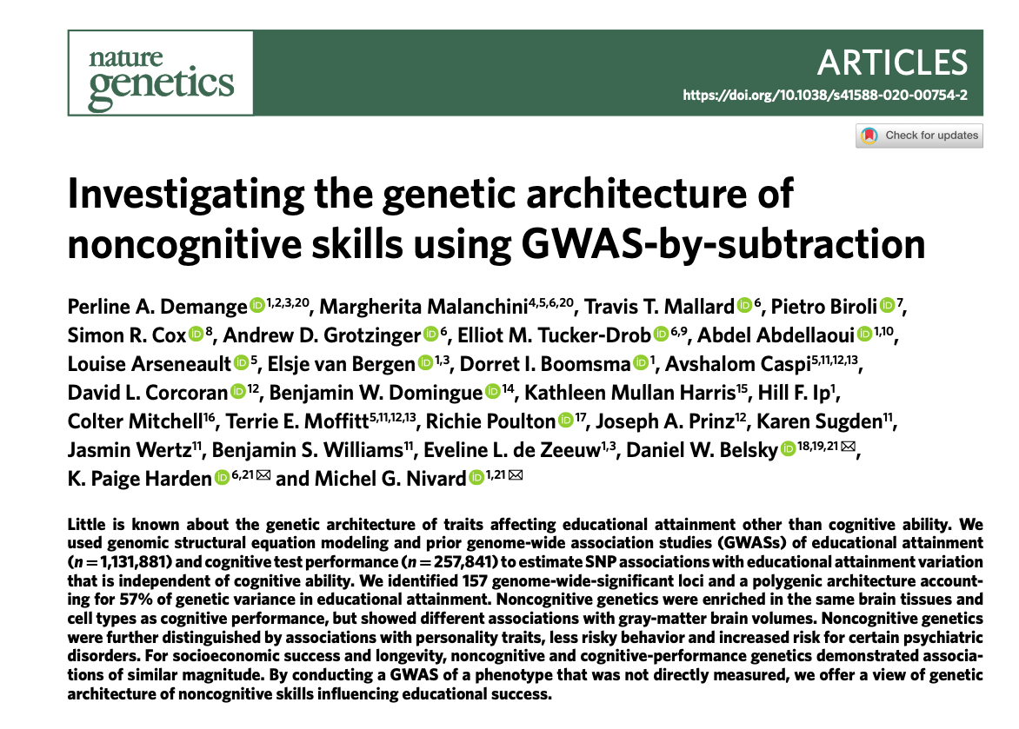
Cognitive & Non-cognitive contributions to education

Slide 3
Cognitive & Non-cognitive contributions to education
Key resources for this paper:
FAQ/motivation: https://bit.ly/3v2lSxY
Technical tutorial: https://rpubs.com/MichelNivard/565885
GitHub repo for paper: https://github.com/PerlineDemange/non-cognitive
The Paper: https://rdcu.be/cddNY

Slide 4
The goal of this GWAS
What affects educational success?
Cognitive skills: Intelligence, IQ
genetic correlation with EA: 0.70
What else?
motivation
curiosity
social skills
etc.
Non-cognitive skills

Slide 5
Wouldn’t it be nice…
… to have a GWAS of non-cognitive skills?
Unravelling the biology of non-cognitive skills
Investigating what are the important non-cognitive skills
Identify mechanisms behind the correlation between EA and other behavioural and health traits.

Slide 6
But…
What is our phenotype?
Considerable heterogeneity in association with education
Poor test-retest reliability of measures
Low heritability
Do we have enough power?
Few consistent measures in large cohorts
Smithers et al., 2018
Morris et al., 2018

Slide 7
The Solution in GenomicSEM
2pq
SNP
EA3 Lee et al. 2018 summary statistics
βCog
βNon-cog
0
1
1
Cog
Non-cog
$λ$Cog–EA
$λ$Cog–CP
$λ$Non-cog–EA
Cognitive Performance
Educational Attainment
0
0

Slide 8
The Model & Syntax in GenomicSEM
2pq
SNP
Model <- 'C =~ NA*EA + start(0.4)*CP
NC =~ NA*EA
C ~ SNP
NC ~ SNP
NC ~~ 1*NC
C ~~ 1*C
C ~~ 0*NC
CP ~~ 0*EA
CP ~~ 0*CP
EA ~~ 0*EA
SNP ~~ SNP '
βCog
βNon-cog
0
1
1
Cog
Non-cog
$λ$Cog–EA
$λ$Cog–CP
$λ$Non-cog–EA
Cognitive Performance
Educational Attainment
0
0

Slide 9
The Model & Syntax in GenomicSEM
2pq
Cog:
effects shared between EA and CP
SNP
Model <- 'C =~ NA*EA + start(0.4)*CP
NC =~ NA*EA
C ~ SNP
NC ~ SNP
NC ~~ 1*NC
C ~~ 1*C
C ~~ 0*NC
CP ~~ 0*EA
CP ~~ 0*CP
EA ~~ 0*EA
SNP ~~ SNP '
βCog
βNon-cog
0
1
1
Cog
Non-cog
$λ$Cog–EA
$λ$Cog–CP
$λ$Non-cog–EA
Cognitive Performance
Educational Attainment
0
0

Slide 10
The Model & Syntax in GenomicSEM
2pq
NonCog:
effects unique to EA after accounting for Cog
SNP
Model <- 'C =~ NA*EA + start(0.4)*CP
NC =~ NA*EA
C ~ SNP
NC ~ SNP
NC ~~ 1*NC
C ~~ 1*C
C ~~ 0*NC
CP ~~ 0*EA
CP ~~ 0*CP
EA ~~ 0*EA
SNP ~~ SNP '
βCog
βNon-cog
0
1
1
Cog
Non-cog
$λ$Cog–EA
$λ$Cog–CP
$λ$Non-cog–EA
Cognitive Performance
Educational Attainment
0
0

Slide 11
The Model & Syntax in GenomicSEM
2pq
Constrain all other variance in EA and CP
SNP
Model <- 'C =~ NA*EA + start(0.4)*CP
NC =~ NA*EA
C ~ SNP
NC ~ SNP
NC ~~ 1*NC
C ~~ 1*C
C ~~ 0*NC
CP ~~ 0*EA
CP ~~ 0*CP
EA ~~ 0*EA
SNP ~~ SNP '
βCog
βNon-cog
0
1
1
Cog
Non-cog
$λ$Cog–EA
$λ$Cog–CP
$λ$Non-cog–EA
Cognitive Performance
Educational Attainment
0
0
0
0

Slide 12
The Model & Syntax in GenomicSEM
2pq
Constrain all other variance in Cog and NonCog
SNP
Model <- 'C =~ NA*EA + start(0.4)*CP
NC =~ NA*EA
C ~ SNP
NC ~ SNP
NC ~~ 1*NC
C ~~ 1*C
C ~~ 0*NC
CP ~~ 0*EA
CP ~~ 0*CP
EA ~~ 0*EA
SNP ~~ SNP '
βCog
βNon-cog
0
1
1
Cog
Non-cog
$λ$Cog–EA
$λ$Cog–CP
$λ$Non-cog–EA
Cognitive Performance
Educational Attainment
0
0
0
0

Slide 13
The Model & Syntax in GenomicSEM
2pq
Constrain all other variance in Cog and NonCog
SNP
Model <- 'C =~ NA*EA + start(0.4)*CP
NC =~ NA*EA
C ~ SNP
NC ~ SNP
NC ~~ 1*NC
C ~~ 1*C
C ~~ 0*NC
CP ~~ 0*EA
CP ~~ 0*CP
EA ~~ 0*EA
SNP ~~ SNP '
βCog
βNon-cog
0
1
1
Cog
Non-cog
$λ$Cog–EA
$λ$Cog–CP
$λ$Non-cog–EA
Cognitive Performance
Educational Attainment
0
0
0
0

Slide 14
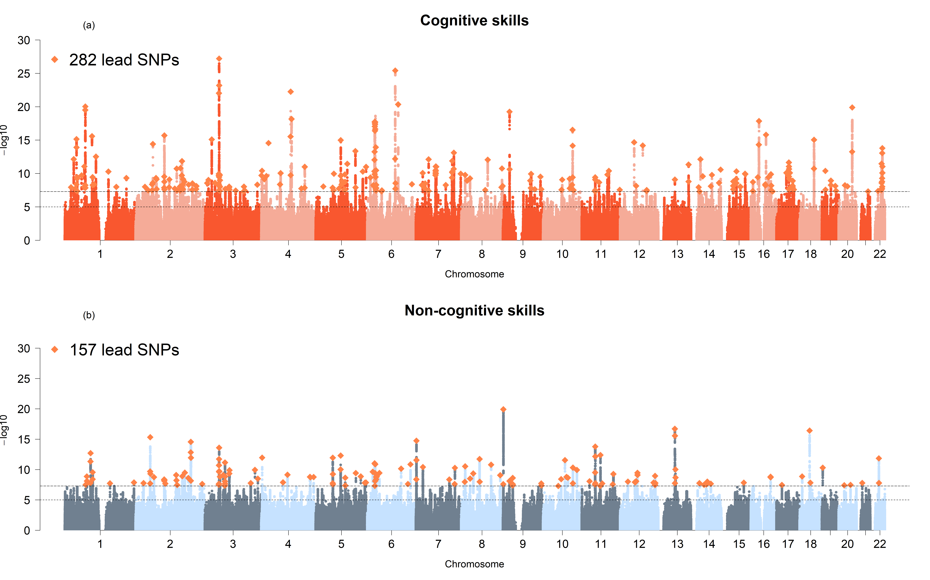
The Results:
0

Slide 15
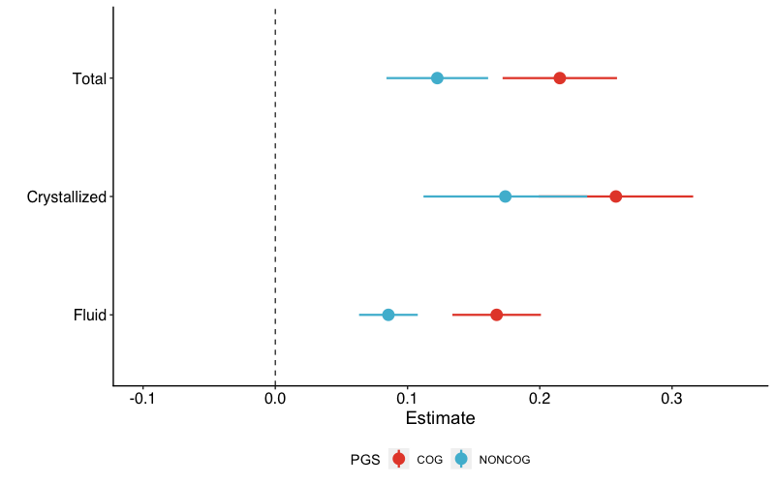
Did it work?
Genetic correlations
Childhood
IQ
Math ability
Polygenic score predictions
Meta-analysis across 4 cohorts:
Dunedin, ERisk, Texas Twins, NTR
Total IQ
Crystallized
Fluid
Non-cognitive
Cognitive
0

Slide 16
What about the assumptions we made?
2pq
SNP
βCog
βNon-cog
0
1
1
Cog
Non-cog
$λ$Cog–EA
$λ$Cog–CP
$λ$Non-cog–EA
Cognitive Performance
Educational Attainment
0
0
0
0

Slide 17
What about the assumptions we made?
2pq
Are we okay with assuming Cog and NonCog are uncorrelated?
SNP
βCog
βNon-cog
0
1
1
Cog
Non-cog
$λ$Cog–EA
$λ$Cog–CP
$λ$Non-cog–EA
Cognitive Performance
Educational Attainment
0
0
0
0

Slide 18
What about the assumptions we made?
2pq
Are we okay with assuming Cog and NonCog are uncorrelated?
SNP
Model <- 'C =~ NA*EA + start(0.4)*CP
NC =~ NA*EA
C ~ SNP
NC ~ SNP
NC ~~ 1*NC
C ~~ 1*C
C ~~ 0*NC
CP ~~ 0*EA
CP ~~ 0*CP
EA ~~ 0*EA
SNP ~~ SNP '
βCog
βNon-cog
0
1
1
Cog
Non-cog
$λ$Cog–EA
$λ$Cog–CP
$λ$Non-cog–EA
Cognitive Performance
Educational Attainment
0
0
0
0

Slide 19
What about the assumptions we made?
2pq
Are we okay with assuming Cog and NonCog are uncorrelated?
SNP
Model <- 'C =~ NA*EA + start(0.4)*CP
NC =~ NA*EA
C ~ SNP
NC ~ SNP
NC ~~ 1*NC
C ~~ 1*C
C ~~ 0.3*NC
CP ~~ 0*EA
CP ~~ 0*CP
EA ~~ 0*EA
SNP ~~ SNP '
βCog
βNon-cog
0.3
1
1
Cog
Non-cog
$λ$Cog–EA
$λ$Cog–CP
$λ$Non-cog–EA
Cognitive Performance
Educational Attainment
0
0
0
0

Slide 20
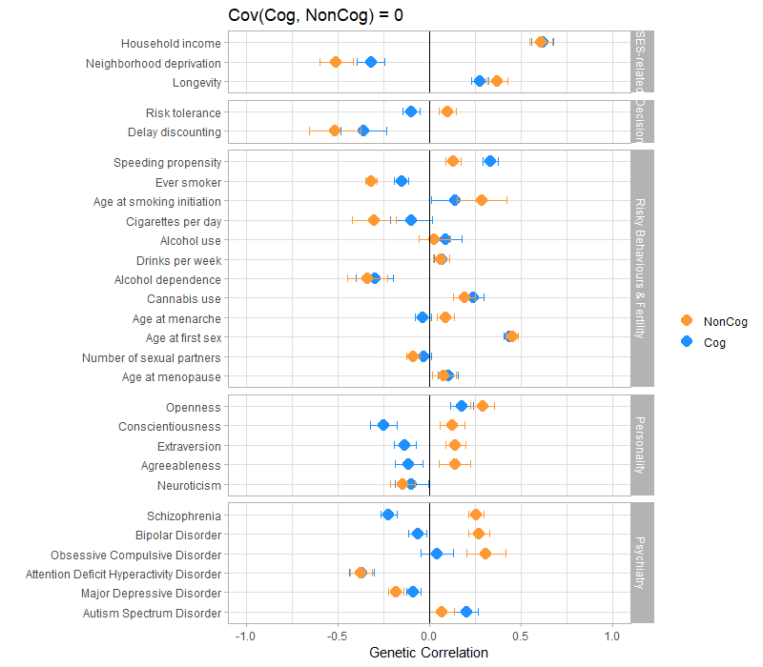
What about the assumptions we made?
2pq
Are we okay with assuming Cog and NonCog are uncorrelated?
SNP
βCog
βNon-cog
0-0.3
1
1
Cog
Non-cog
$λ$Cog–EA
$λ$Cog–CP
$λ$Non-cog–EA
Cognitive Performance
Educational Attainment
0
0
0
0

Slide 21
What about the assumptions we made?
2pq
Can we deal with evidence that education improves cognitive performance?
SNP
βCog
βNon-cog
0
1
1
Cog
Non-cog
$λ$Cog–EA
$λ$Cog–CP
$λ$Non-cog–EA
Cognitive Performance
Educational Attainment
0
0
0
0

Slide 22
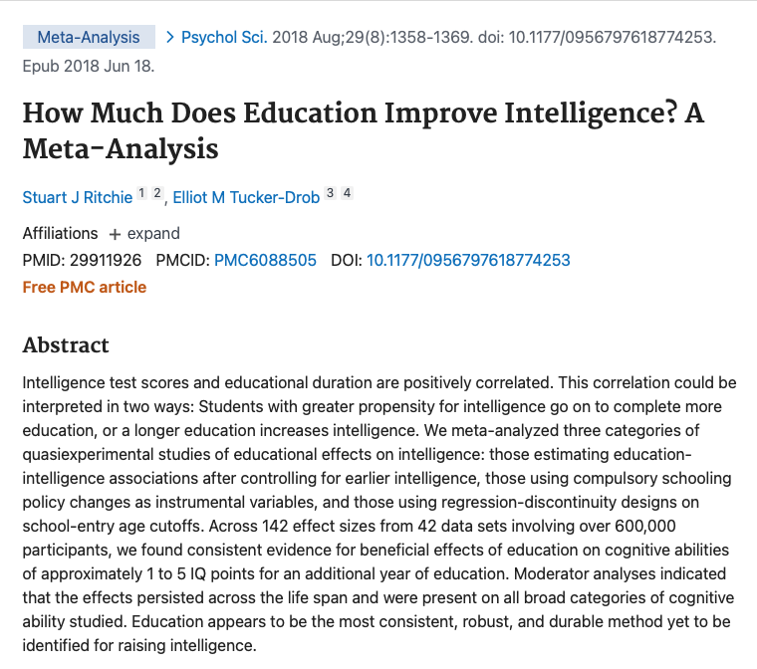
What about the assumptions we made?
2pq
Can we deal with evidence that education improves cognitive performance?
SNP
βCog
βNon-cog
0
1
1
Cog
Non-cog
$λ$Cog–EA
$λ$Cog–CP
$λ$Non-cog–EA
Cognitive Performance
Educational Attainment
0
0
0
0

Slide 23
What about the assumptions we made?
2pq
Can we deal with evidence that education improves cognitive performance?
SNP
βCog
βNon-cog
0
1
1
Cog
Non-cog
$λ$Cog–EA
$λ$Cog–CP
$λ$Non-cog–EA
Cognitive Performance
Educational Attainment
0
0
0
0

Slide 24
What about the assumptions we made?
2pq
Can we deal with evidence that education improves cognitive performance?
SNP
Model <- 'C =~ NA*EA + start(0.4)*CP
NC =~ NA*EA
C ~ SNP
NC ~ SNP
NC ~~ 1*NC
C ~~ 1*C
C ~~ 0.3*NC
CP ~~ 0*EA
CP ~~ 0*CP
EA ~~ 0*EA
SNP ~~ SNP
CP ~ 0.2*EA'
βCog
βNon-cog
0
1
1
Cog
Non-cog
$λ$Cog–EA
$λ$Cog–CP
$λ$Non-cog–EA
Cognitive Performance
0.2
Educational Attainment
0
0
0
0

Slide 25
What about the assumptions we made?
2pq
Can we deal with evidence that education improves cognitive performance?
SNP
Model <- 'C =~ NA*EA + start(0.4)*CP
NC =~ NA*EA
C ~ SNP
NC ~ SNP
NC ~~ 1*NC
C ~~ 1*C
C ~~ 0.3*NC
CP ~~ 0*EA
CP ~~ 0*CP
EA ~~ 0*EA
SNP ~~ SNP
CP ~ 0.2*EA'
βCog
βNon-cog
0
1
1
Cog
Non-cog
$λ$Cog–EA
$λ$Cog–CP
$λ$Non-cog–EA
Cognitive Performance
0.2
Educational Attainment
0
0
0
0

