Slide 1
Multivariate GWAS in Genomic SEM
Presented by:
Andrew D. Grotzinger

Slide 2
Four Primary Steps
Munge the summary statistics (munge)
Run LD-Score Regression to obtain the genetic covariance and sampling covariance matrices (ldsc)
Prepare the summary statistics for multivariate GWAS (sumstats)
Run the multivariate GWAS (commonfactorGWAS; userGWAS)
These two steps mirror that for models without SNP effects and need not be run again for the same traits

Slide 3
Github Example: P-factor
Using GWAS sumstats for:
Schizophrenia (Pardiñas et al., 2018); N = 105,318
Bipolar Disorder (Sklar et al., 2011); N = 16,731
Major Depressive Disorder (Wray et al., 2018); N = 173,005
PTSD (Duncan et al., 2017); N = 9,537
Anxiety (Otowa et al., 2016); N = 17,310

Slide 4
Step 1: munge
Munge: convert raw data from one form to another
Converts to Z-statistics
Aligns to same reference allele
Restricts to hapmap3 SNPs

Slide 5
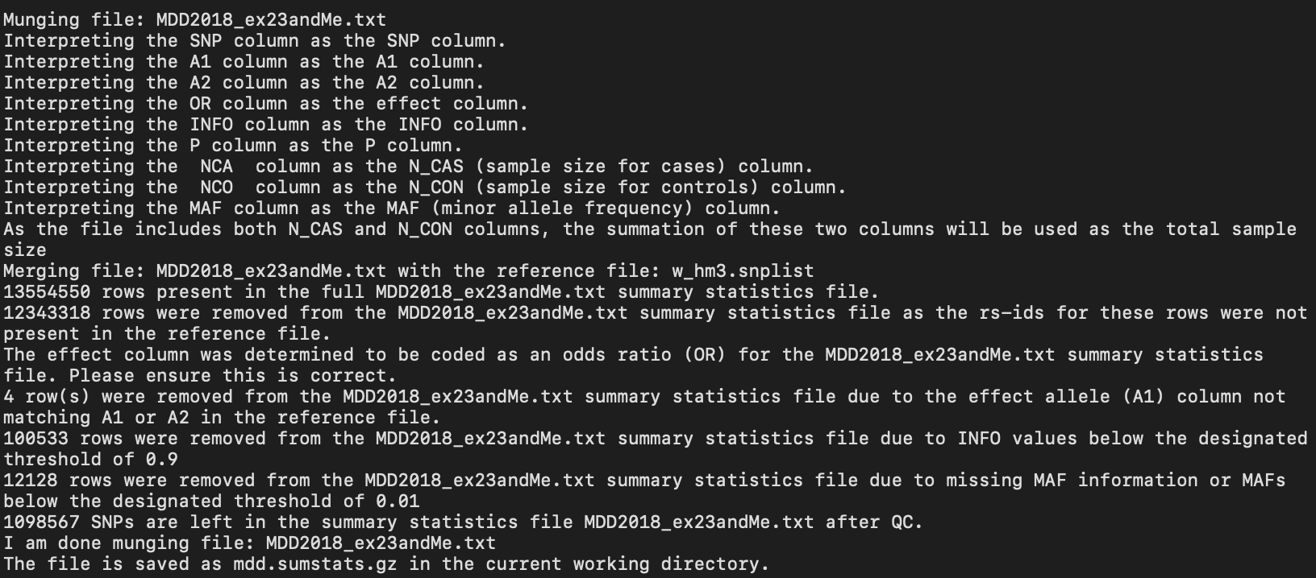
Example Munge .log file for MDD

Slide 6
Step 2: ldsc
Computes the genetic covariance (S) and sampling covariance (V) matrix discussed in Michel’s video
Note that it is best to practice to pause here and fit the “base” model using the usermodel or commonfactor functions before trying to run multivariate GWAS to make sure your model fits well and doesn’t produce warnings/errors

Slide 7
Step 3: sumstats
As with munge, makes sure that the same allele is the reference allele in all cases.
The coefficients and their SEs are then further transformed such that they are scaled relative to unit-variance scaled phenotypes.
How this rescaling occurs will depend on both the scale of the outcome and how the GWAS was run

Slide 8
sumstats arguments
files: The name of the summary statistics files. This should be the same as the name of the files used for the munge function in Step 1 and the files should be in the same listed order used for the ldsc function in step 2.
ref: The reference file used to calculate SNP variance across traits
trait.names: The names of the traits in the order that they are listed for the files.
se.logit: Whether the SEs are on a logistic scale.
OLS: Whether the phenotype was a continuous outcome analyzed using an observed least square (OLS; i.e., linear) estimator.

Slide 9
sumstats arguments
linprob: Whether the phenotype was a dichotomous outcome analyzed using an OLS estimator
prop: In order to perform the LPM conversion above from OLS betas prop takes the proportion of cases over the total sample size (range: 0 - 1).
N: A user provided N listed in the order the traits are listed for the files argument needed for LPM and OLS transformations.
info.filter: The INFO filter to use. The package default is 0.6.
maf.filter: The MAF filter to use. The package default is 0.01.
keep.indel: Whether insertion deletions (indels) should be included in the output. Default = FALSE.
parallel: Whether the function should be run in parallel. Default = FALSE.
cores: When running in parallel, whether you want the computer to use a certain number of cores.

Slide 10
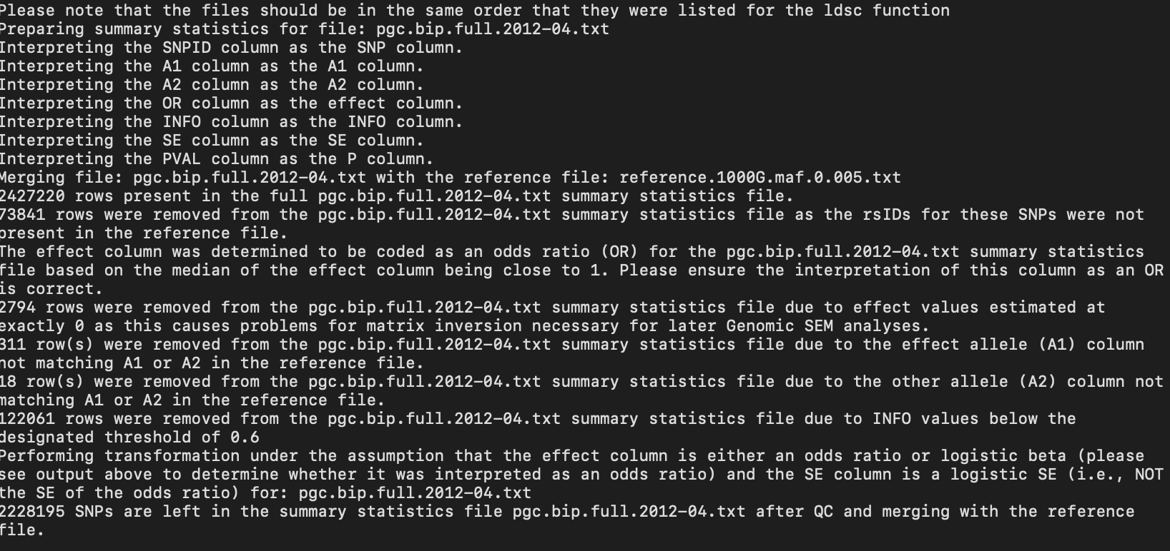
Example sumstats .log file

Slide 11
Step 4a: commonfactorGWAS
Automatically specifies a common factor model where the SNP predicts the common factor

Slide 12
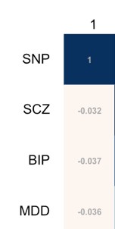
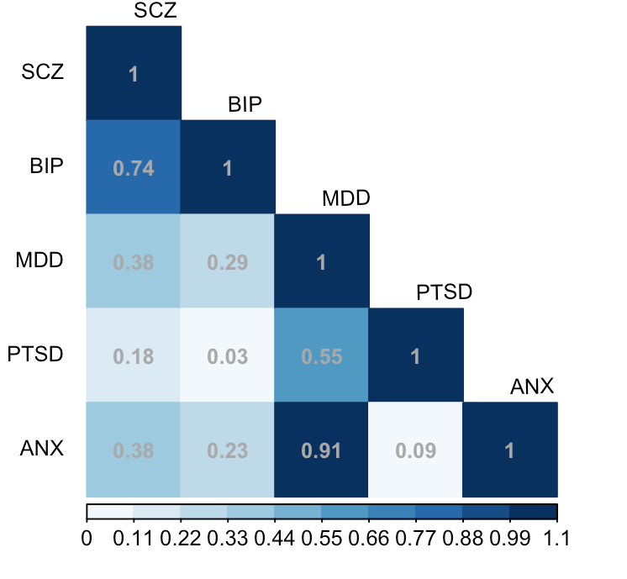
Behind the scenes
GenomicSEM GWAS functions automatically combine output from Steps 2 and 3
Creates as many covariance matrices as there are SNPs across traits
Step 3: Run sumstats
GWAS functions combine the two
Step 2: Run ldsc
+
=

Slide 13
Expanded S Matrix
u_{p}
.998 (.049)
1
rs4552973
-.045 (.008)
p_{G}
1
.86 (.06)
.53 (.08)
.81 (.06)
.29 (.09)
.46 (.04)
SCZ_{g}
BIP_{g}
MDD_{g}
PTSD_{g}
ANX_{g}
1
1
1
1
1
u_{SCZ}
u_{BIP}
u_{MDD}
u_{PTSD}
u_{ANX}
.26 (.11)
.35 (.11)
.79 (.07)
.91 (.44)
.71 (.36)
Notes:
There are two ways we can think of how latent factors fit with GWAS. Just heard about GWAS of individual indicators. Another way to think about it is, what if we have done GWAS already, is it dead or is there something we can do with it.
Just delete the twin model slide.
Other applications we want to mention?

Slide 14
commonfactorGWAS arugments
covstruc: The output from LDSC.
SNPs: The output from sumstats.
estimation: Whether the models should be estimated using "DWLS" or "ML" estimation. The package default is "DWLS".
cores: How many computer cores to use in parallel processing. The default is to use 1 less core than is available in the local environment.
toler: What tolerance level to use for matrix inversions. This is only something that needs to be of concern if warning/error messages are produced to the effect of "matrix could not be inverted".

Slide 15
commonfactorGWAS arugments
parallel: An optional argument specifying whether you want the function to be run in parallel, or to be run serially.
GC: Level of Genomic Control (GC) you want the function to use. The default is 'standard' which adjusts the univariate GWAS standard errors by multiplying them by the square root of the univariate LDSC intercept.
MPI: Whether the function should use multi-node processing (i.e., MPI).

Slide 16
Estimates of SNP level heterogeneity (Q_{SNP})
Asks to what extent the effect of the SNP operates through the common factor
$χ^{2}$distributed test statistic, indexing fit of the common pathways model against independent pathways model
1
u_{F}
$e_{F }^{2}$
F_{G}
1
SNP_{m}
$\hat{b}$_{SNPm,F}
F_{G}
$${σ\text{SNP}}_{ }^{2}$$
SNP_{m}
$${σ\text{SNP}}_{ }^{2}$$
λ_{V1}
λ_{V5}
λ_{V1}
λ_{V5}
λ_{V2}
λ_{V3}
λ_{V4}
λ_{V2}
λ_{V3}
λ_{V4}
$\hat{b}$_{SNPm,V1}
$\hat{b}$_{SNPm,V2}
$\hat{b}$_{SNPm,V3}
$\hat{b}$_{SNPm,V4}
$\hat{b}$_{SNPm,V5}
V_{2g}
V_{1g}
V_{2g}
V_{3g}
V_{4g}
V_{5g}
V_{1g}
V_{3g}
V_{4g}
V_{5g}
1
1
1
1
1
1
1
1
1
1
u_{V2}
u_{V3}
1
u_{V1}
u_{V2}
u_{V3}
u_{V4}
u_{V5}
u_{V1}
u_{V4}
u_{V5}
$${eV1}_{ }^{2}$$
$${eV3}_{ }^{2}$$
$${eV4}_{ }^{2}$$
$${eV5}_{ }^{2}$$
$${eV1}_{ }^{2}$$
$${eV2}_{ }^{2}$$
$${eV3}_{ }^{2}$$
$${eV4}_{ }^{2}$$
$${eV5}_{ }^{2}$$
$${eV2}_{ }^{2}$$
Notes:
What’s valuable about this is that it is a test of the homogeneity assumption that the genetic covariance structure applies across the genome, and obtain a heterogenetiy statistic for each SNP in the GWAS
What you can here in red are the effect of the SNP through the factor (SNP effects factor, which affects indicators). What the Q-stat indexes the extent to which the paths in black are also needed. Those paths allow for individual effects of the SNP directly on the disorders without being mediated by the factor.

Slide 17
Step 4b: userGWAS
Allows the user to specify any model including individual SNP effects (e.g., SNP predicting multiple, correlated factors)

Slide 18
userGWAS additional arguments
model: The model that is being estimated (written in lavaan syntax)
sub: An optional argument specifying whether or not the user is requesting only specific components of the model output to be saved.

Slide 19
Run times for this example
munge: 7 minutes 58 seconds
ldsc: 1 minute 17 seconds
sumstats: 6 minutes 56 seconds (run in parallel)
4a. commonfactorGWAS: 17 seconds (run in parallel for 100 SNPs)
4b. userGWAS: 10 seconds (run in parallel for 100 SNPs)

Slide 20
Run Time Notes
Parallel/MPI processing for both userGWAS and commonfactorGWAS is available
Parallel is the same as serial processing, except that it takes an additional cores argument specifying how many cores to use
MPI takes advantage of multi-node computing environments. Requires that Rmpi already be installed on the computing cluster
Ideal run-time scenario: split sumstats output across jobs on a cluster and run using MPI
All runs are independent of one another!

