Slide 1
Genomic Structural Equation Modeling: A Brief Introduction
Andrew Grotzinger
IBG Workshop 2021
Paper: Grotzinger, A. D., Rhemtulla, M., de Vlaming, R., Ritchie, S. J., Mallard, T. T., Hill, W. D, Ip, H. F., McIntosh, A. M., Deary, I. J., Koellinger, P. D., Harden, K. P., Nivard, M. G., & Tucker-Drob, E. M. (in press). Genomic SEM provides insights into the multivariate genetic architecture of complex traits. Nature Human Behaviour.
Link to paper: rdcu.be/bvn7t

Slide 2
The gradual realization that human complex traits are associated with many genes
Complex Traits
Disease Traits
Discovery Sample Size
Discovery Sample Size
Kendler et al., 2012
Notes:
Up to 22% of SNPs may cause complex traits with a non-zero effect

Slide 3
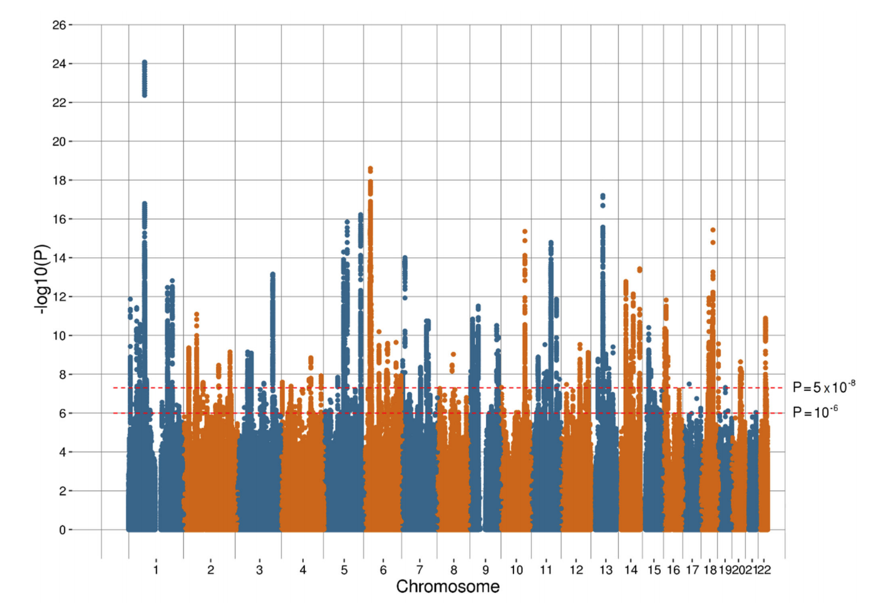
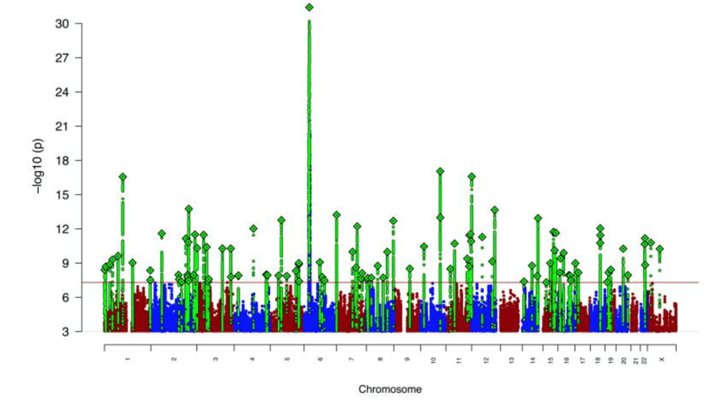
Depression
Schizophrenia
Traits are highly polygenic, so not simply a matter of identifying ~5 overlapping genes

Slide 4
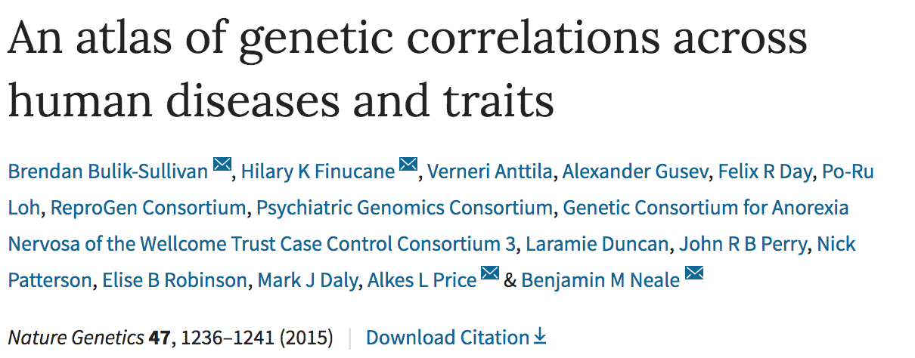
Estimates genetic correlations between samples with varying degrees of sample overlap using publicly available data

Slide 5
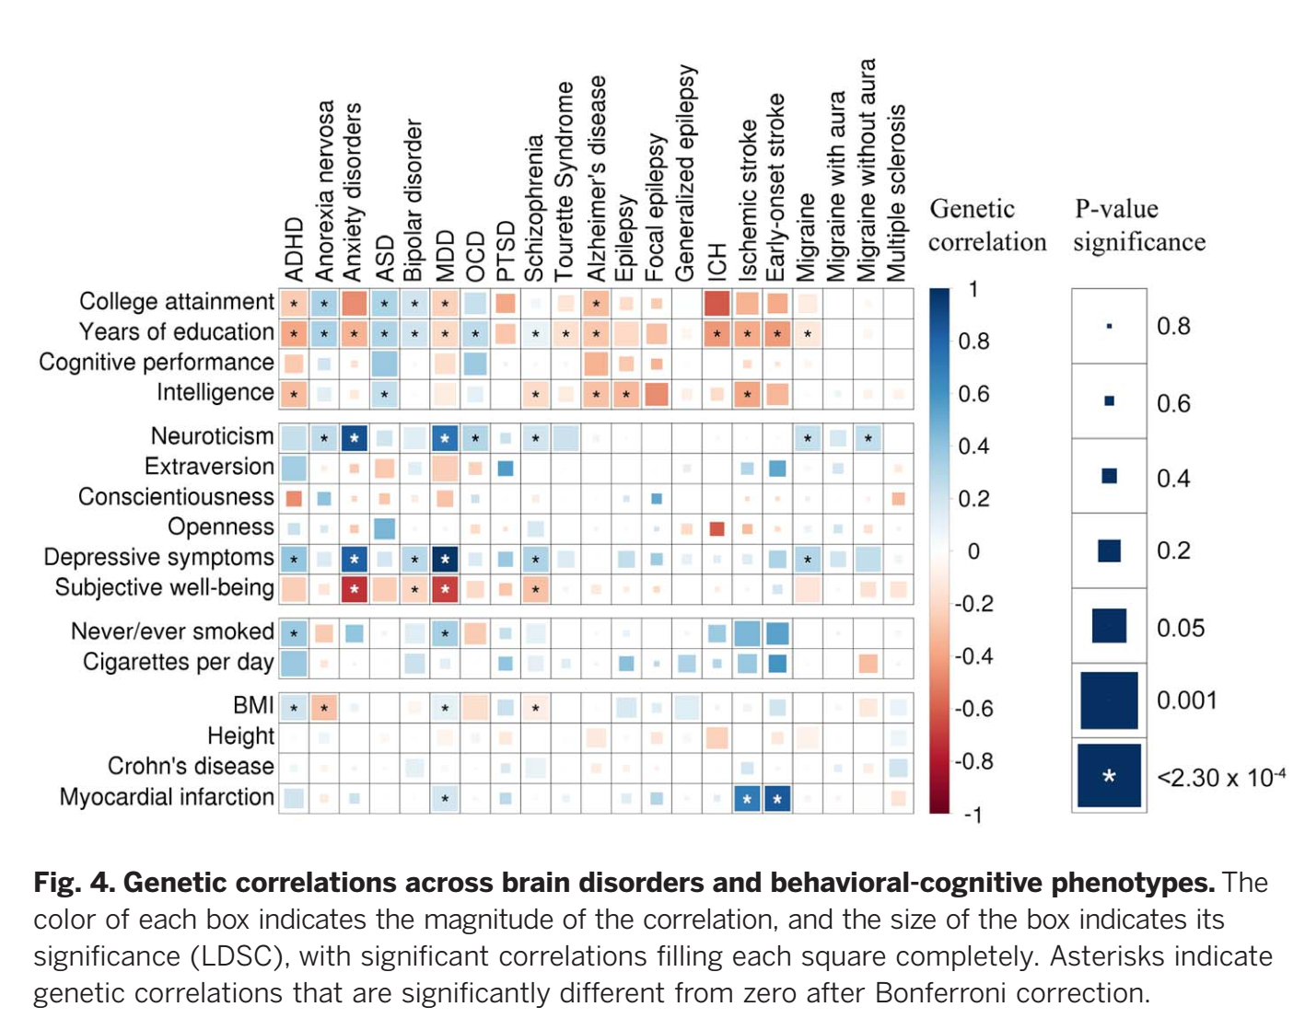
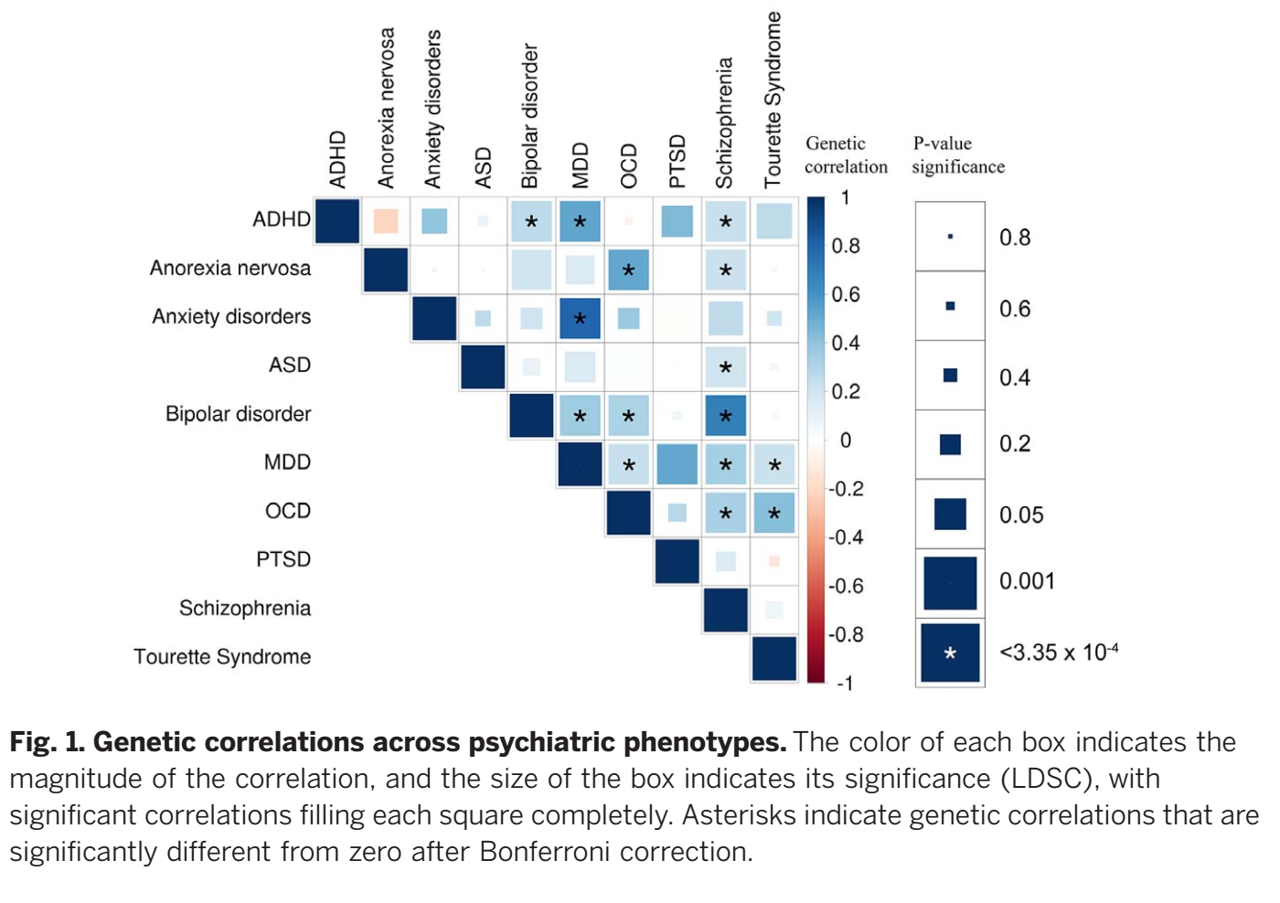
Pervasive (Statistical) Pleiotropy Necessitates Methods for Analyzing Joint Genetic Architecture

Slide 6
Background
Genome-wide methods are clearly suggestive of both high polygenicity and pervasive pleiotropy
Genetic correlations as data to be modeled, not simply results by themselves
What data-generating process gave rise to the correlations?
Notes:
There are two ways we can think of how latent factors fit with GWAS. Just heard about GWAS of individual indicators. Another way to think about it is, what if we have done GWAS already, is it dead or is there something we can do with it.
Just delete the twin model slide.

Slide 7
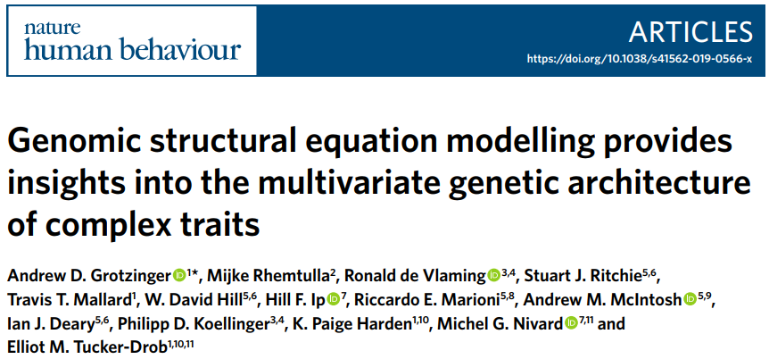
Genomic SEM
Nivard
Tucker-Drob

Slide 8
Our solution: GenomicSEM
Apply structural equation model to estimated genetic covariance matrices
Allows user to examine traits that could not be measured in the same sample
Genomic SEM provides flexible framework for estimating limitless models using GWAS summary statistics
Can be applied to GWAS “sumstats” with varying and unknown degrees of overlap

Slide 9
Genetic “heatmap” across 11 Major Psychiatric Disorders
Many of these disorders could not be measured in the same sample
Genomic SEM offers unique opportunity to model system of relationships across rare and mutually exclusive clinical presentations

Slide 10
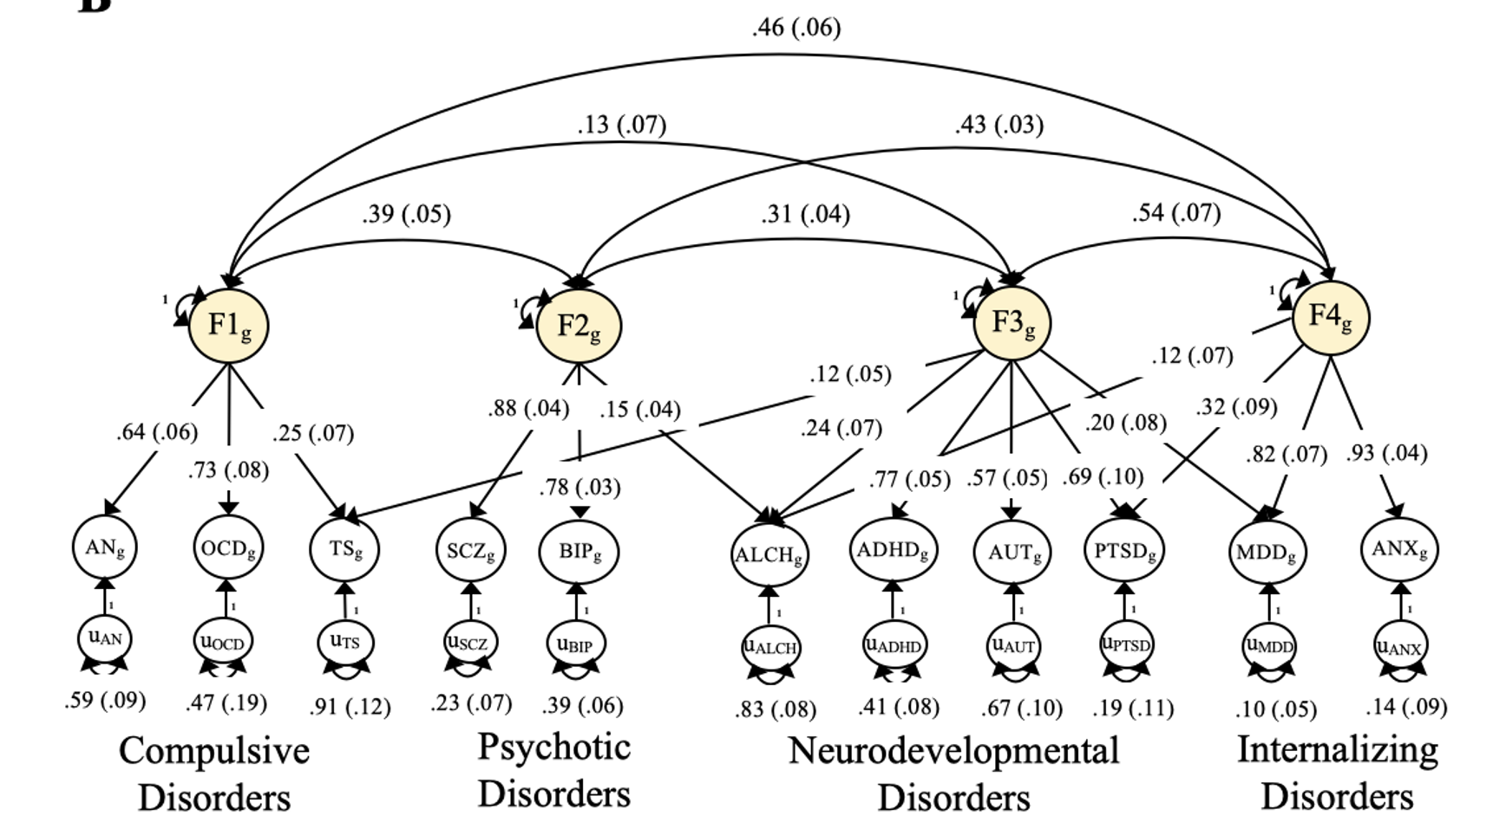
Genetic Relationships Across Eleven Major Psychiatric disorders
Notes:
Just verbalize what happens with MDD. When we expand this model to 11 disorders, most notably by include 2 other key internalizing disorders ANX and PTSD, we are able to identify a fourth factor on which major depression now loads strongly. Otherwise the three factor structure has been entirely replicated and now extended on the basis of this new data.

Slide 11
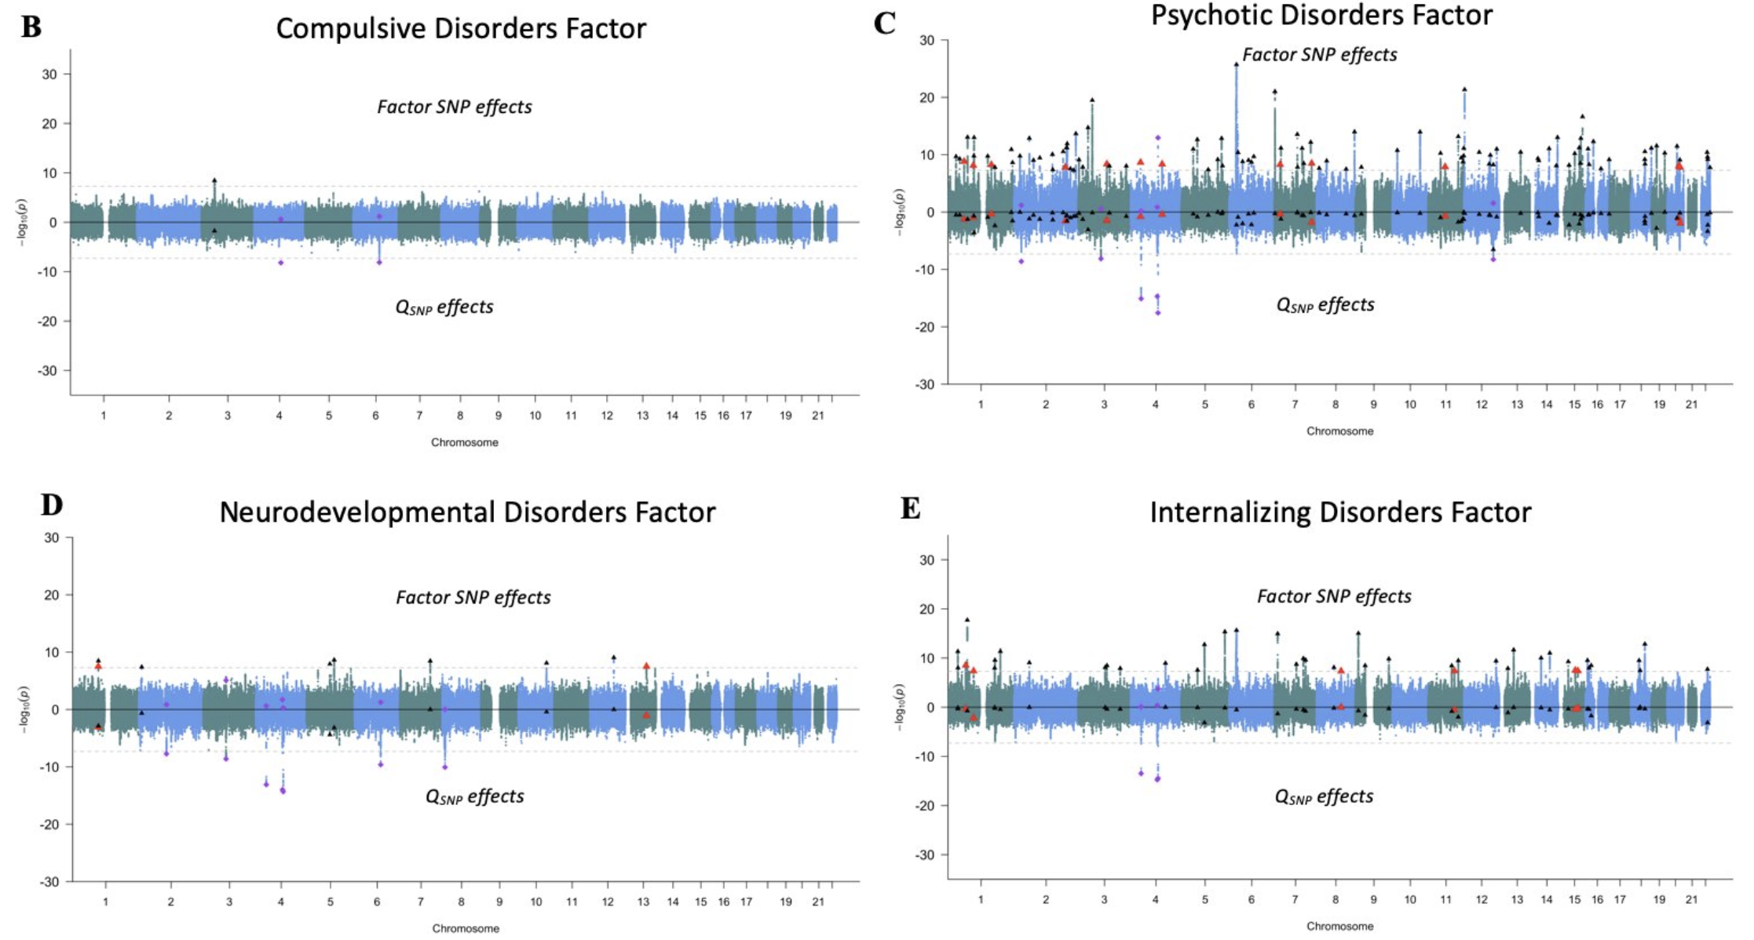
Genetic Relationships Across Eleven Major Psychiatric disorders
Notes:
Just verbalize what happens with MDD. When we expand this model to 11 disorders, most notably by include 2 other key internalizing disorders ANX and PTSD, we are able to identify a fourth factor on which major depression now loads strongly. Otherwise the three factor structure has been entirely replicated and now extended on the basis of this new data.

Slide 12
Even if you are not
interested in genetics:
Can now examine systems of relationships between a wide array of (rare) traits
that could not be measured in the
same sample

Slide 13
Genetics of Early Onset Schizophrenia
Genetics of Late Onset Schizophrenia
Genetics of Early Onset Anorexia Nervosa
Genetics of Late Onset Anorexia Nervosa
Notes:
Between person covariances requires there to be an opportunity of observing the variable
Allows you to estimate correlations never measured in the same people
Opportunities to observe those in the same sample.
Psychosis for AN

Slide 14
Genetics of Early Onset Schizophrenia
Genetics of Late Onset Schizophrenia
Genetics of Early Onset Anorexia Nervosa
Genetics of Late Onset Anorexia Nervosa
Notes:
Between person covariances requires there to be an opportunity of observing the variable
Allows you to estimate correlations never measured in the same people
Opportunities to observe those in the same sample.
Psychosis for AN

Slide 15
Genetics of Early Onset Schizophrenia
Genetics of Late Onset Schizophrenia
Genetics of Early Onset Anorexia Nervosa
Genetics of Late Onset Anorexia Nervosa
Notes:
Between person covariances requires there to be an opportunity of observing the variable
Allows you to estimate correlations never measured in the same people
Opportunities to observe those in the same sample.
Psychosis for AN

Slide 16
Genetics of Early Onset Schizophrenia
Genetics of Late Onset Schizophrenia
Genetics of Early Onset Anorexia Nervosa
Genetics of Late Onset Anorexia Nervosa
Notes:
Between person covariances requires there to be an opportunity of observing the variable
Allows you to estimate correlations never measured in the same people
Opportunities to observe those in the same sample.
Psychosis for AN

Slide 17
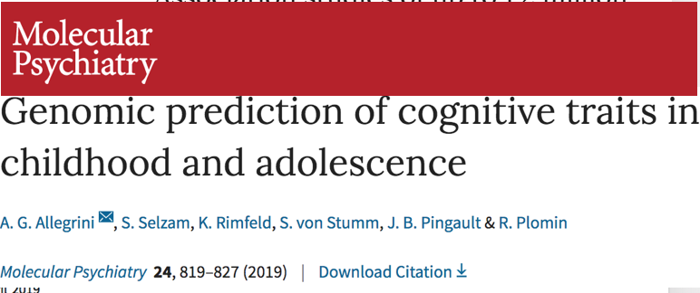
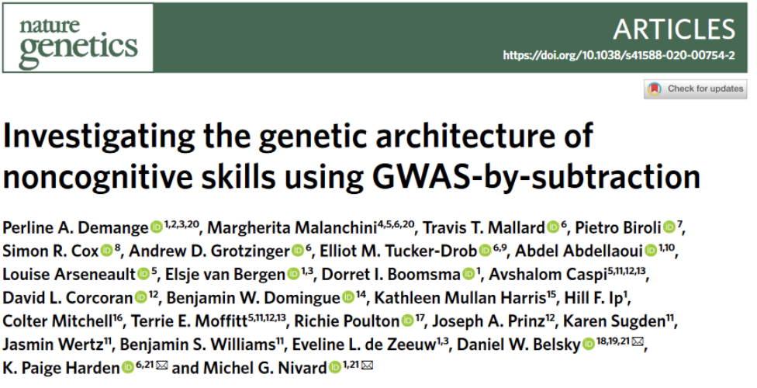
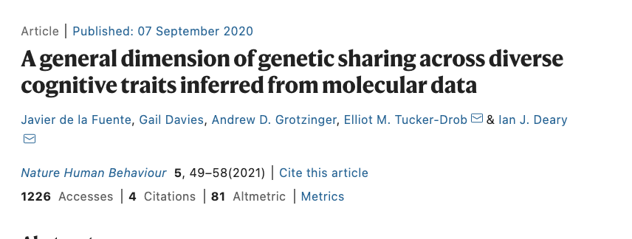
Notes:
Add journal; and allegrinir is not on biorxiv

