Slide 1
Genomic SEM Tutorial
Paper: Grotzinger, A. D., Rhemtulla, M., de Vlaming, R., Ritchie, S. J., Mallard, T. T., Hill, W. D, Ip, H. F., McIntosh, A. M., Deary, I. J., Koellinger, P. D., Harden, K. P., Nivard, M. G., & Tucker-Drob, E. M. (in press). Genomic SEM provides insights into the multivariate genetic architecture of complex traits. Nature Human Behaviour.
Link to paper: rdcu.be/bvn7t

Slide 2
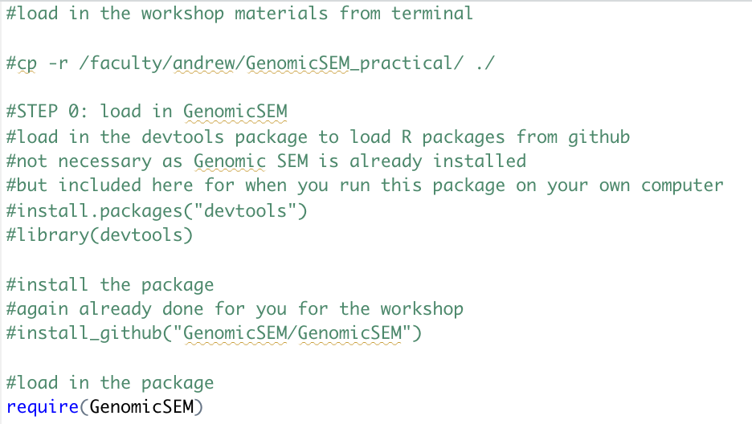
Step 0a: Load in data and package
Will likely print 24 warnings about replacing previous imports: OK TO IGNORE

Slide 3
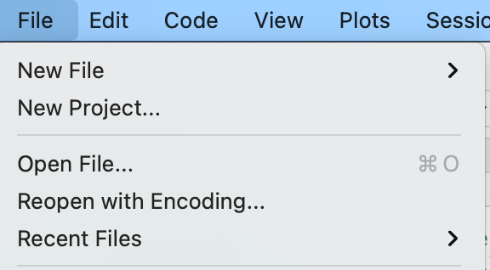
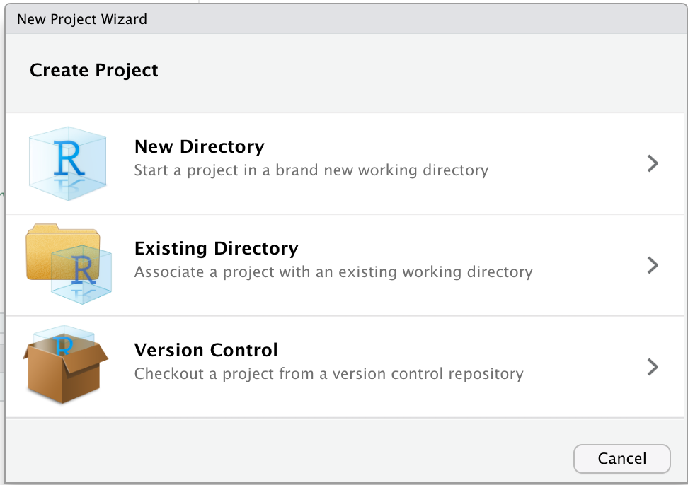
Step 0b: Create new R Project
Click “New Project” under File in Rstudio
Select Existing Directory. This will automatically put you in the directory where the Genomic SEM tutorial files are located

Slide 4
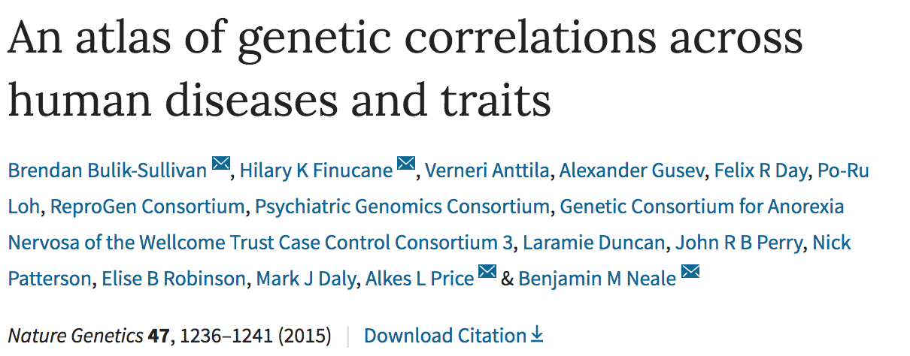
LD-score regression estimates genetic correlations between samples with varying degrees of sample overlap using publicly available GWAS data

Slide 5
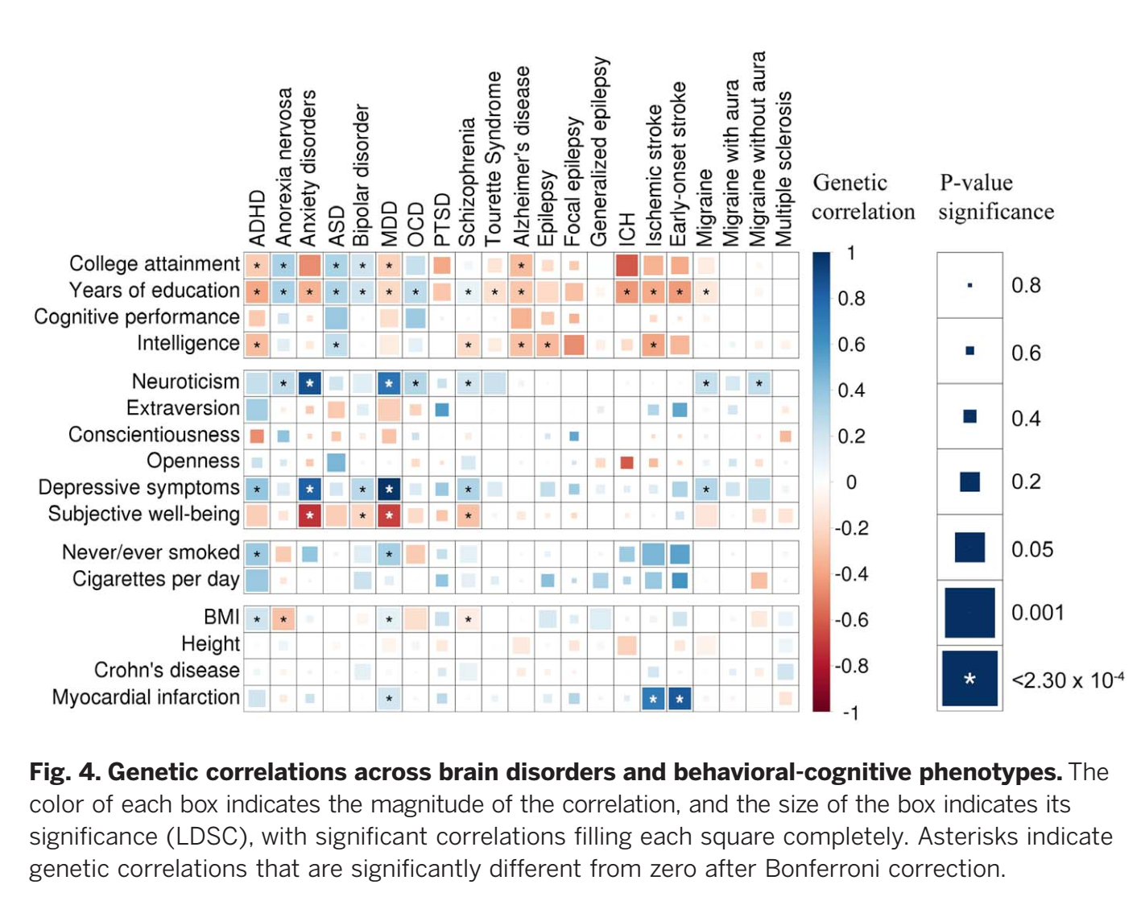
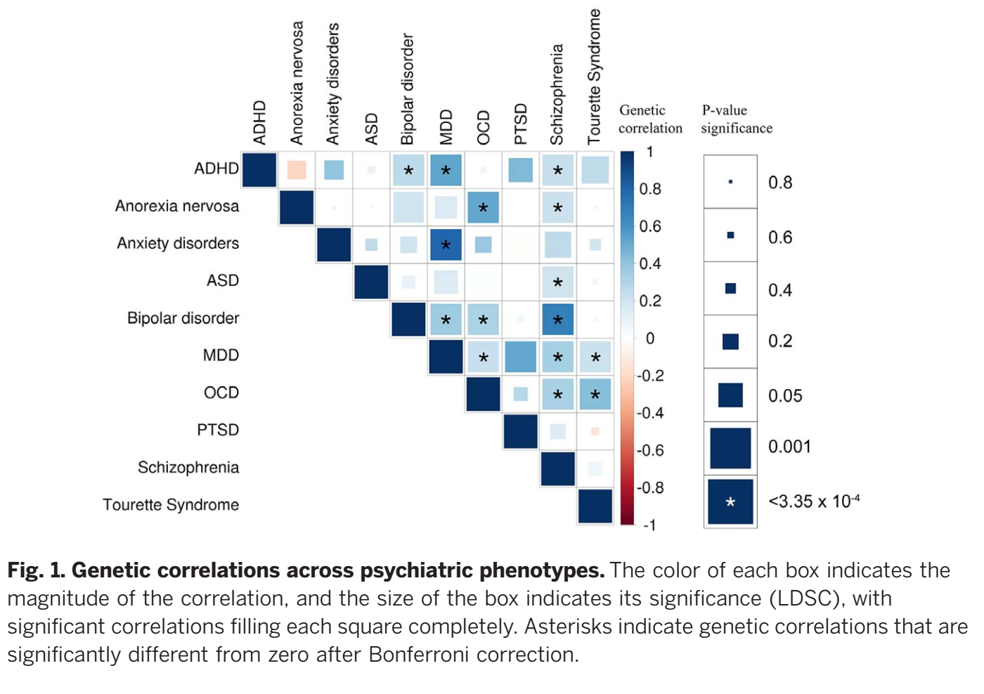
Pervasive Genetic Overlap Necessitates Methods for Analyzing Joint Genetic Architecture

Slide 6
Genomic SEM
Genomic SEM provides flexible framework for estimating limitless number of structural equation models using multivariate genetic data from GWAS summary statistics

Slide 7
Practical outline
Initial considerations
Estimating common factor models
Estimating user specified model
Estimating multivariate GWAS in Genomic SEM

Slide 8
I. Initial Considerations

Slide 9
Start with GWAS Summary Statistics for the Phenotypes of Interest
No need for raw data
No need to conduct a primary GWAS yourself: Download them online!
Example of the top of a summary statistics file

Slide 10
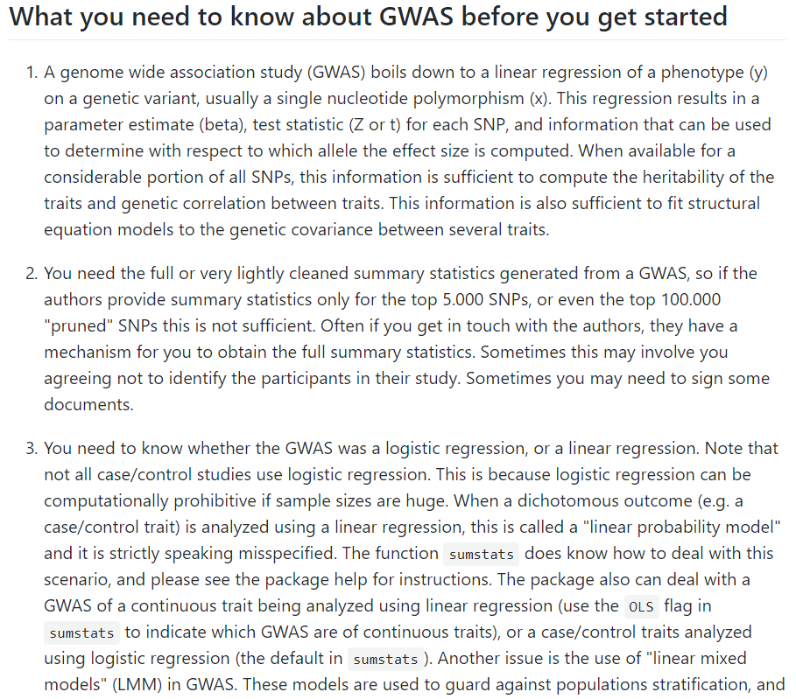
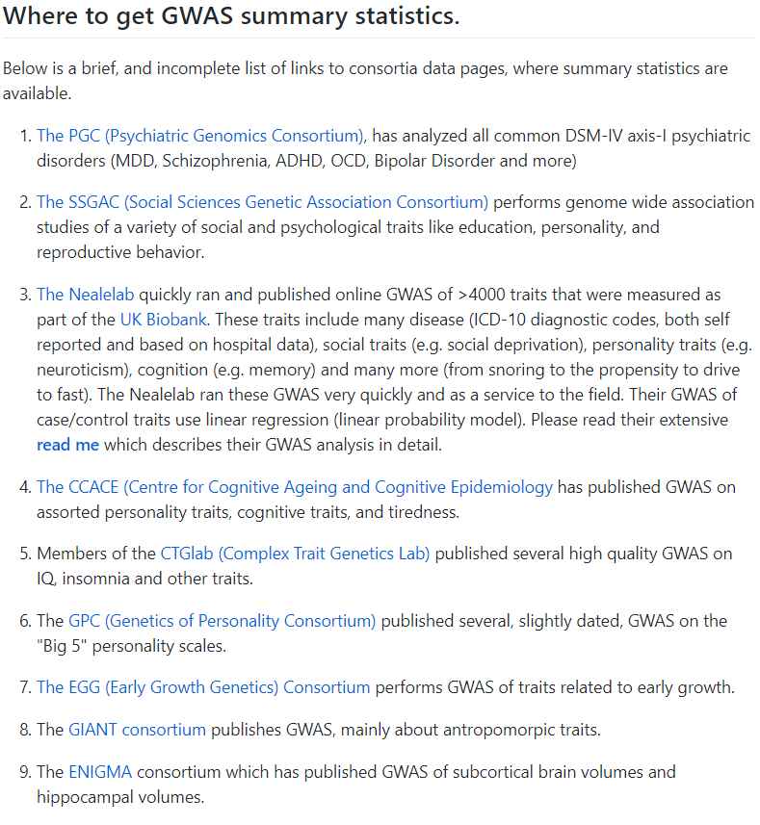
Where to get summary statistics
List lots of resources on the Genomic SEM Wiki:
https://github.com/GenomicSEM/GenomicSEM/wiki/2.-Important-resources-and-key-information

Slide 11
Things to know before getting started
1. Be sure you are using summary statistics calculated within a single ethnic population
Example: PTSD on PGC web-site
2. Be sure to use LD scores that match the ethnic population in sum stats
3. Typically advisable to only include summary statistics from a GWAS with N >= 10,000

Slide 12
Things to know before getting started
4. GenomicSEM allows for varying and unknown degrees of sample overlap
The user does not need to know the specific levels of overlap
5. Multivariate GWAS in Genomic SEM uses listwise deletion
If certain summary statistics have low genomic coverage this will affect the number of SNPs available for all included traits
6. Make sure you are not using a pruned list of summary statistics (e.g., the top 5,000 hits)

Slide 13
Things to know before getting started
7. Both the munge and sumstats functions in GenomicSEM use sample size to perform necessary conversions. Sample size from summary statistics file or provided by the user.
In order to produce accurate results, this should be the total sample size for all included traits.
Be wary of: Publicly available summary statistics that exclude certain cohorts (e.g., 23andMe).
Notes:
This can cause a mismatch between sample sizes reported in the paper and the sample size you should use for GenomicSEM.

Slide 14
Questions from videos?

Slide 15
II. Estimating Common Factor Models in Genomic SEM

Slide 16
Three Primary Steps
Munge: convert raw data from one form to another
1. Munge the summary statistics (munge)
2. Run LD-Score Regression to obtain the genetic covariance and sampling covariance matrices (ldsc)
3. Run the model (commonfactor)

Slide 17
Lab
Using GWAS sumstats for:
Schizophrenia (Pardiñas et al., 2018); N = 105,318
Bipolar Disorder (Sklar et al., 2011); N = 16,731
Major Depressive Disorder (Wray et al., 2018); N = 173,005

Slide 18
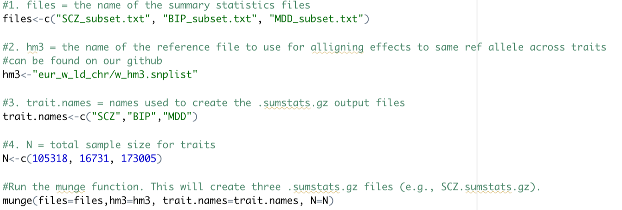
Step 1: munge example code
Note that for much of the practical we are using a subset of the summary statistics for demonstrative purposes only! In practice, you will use the full set of summary stats you download online

Slide 19
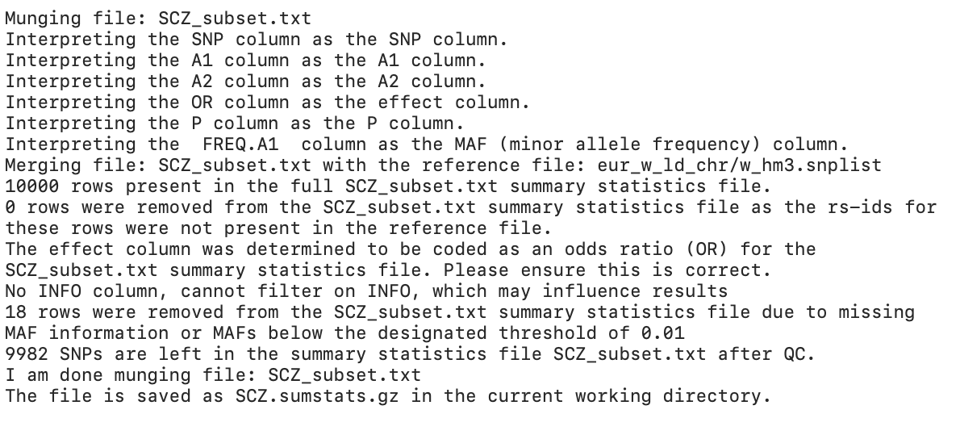
Examine SCZ_BIP_MDD_munge.log file

Slide 20
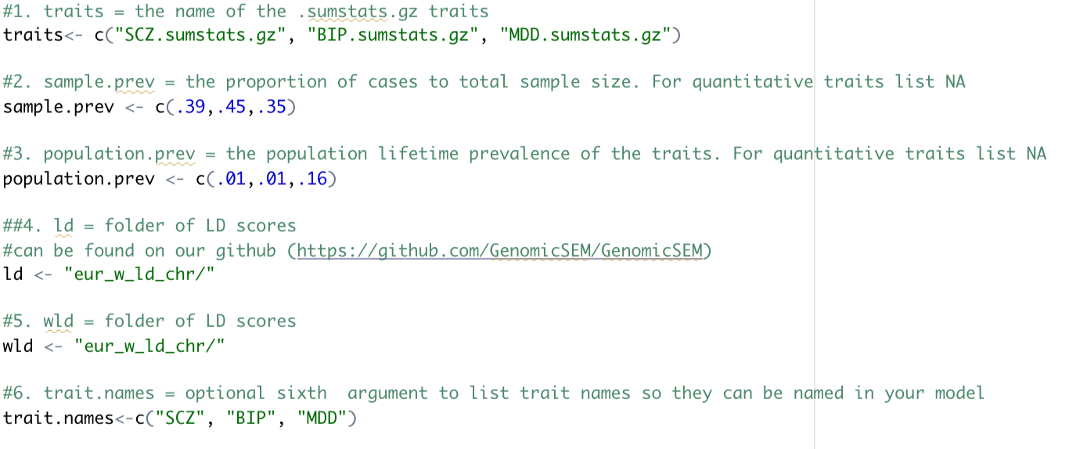
Step 2: ldsc example code
Populated with ld scores from the same ancestry

Slide 21
Load in premade ldsc data!
This was created using the full set of summary statistics. As in this real, honest to goodness (not simulated) psychiatric genetic data

Slide 22
Step 3: commonfactor example code

Slide 23
Pfactor$results
Estimates and SE for model applied to genetic covariance matrix
Estimates and SE for model applied to genetic correlation matrix
Parameter being estimated

Slide 24
Go to breakout rooms

Slide 25
III. Estimate a User-Specified Model

Slide 26
Three Primary Steps
1. Munge the summary statistics (munge)
2. Run LD-Score Regression to obtain the genetic covariance and sampling covariance matrices (ldsc)
3. Specify and run the model (usermodel)
These two steps mirror that for models without SNP effects and need not be run again for the same traits

Slide 27
How to specify a model
We use the lavaan formula language, slightly extended:
Regression:
A ~ B
(Co)variance:
A ~~ A; A ~~ B
Factor:
F1 =~ A + B + C + D
Fix a parameter:
A ~~ 1*B (the covariance between A and B is 1)
Name a parameter:
A ~~ a*B (the covariance between A and B = parameter label a)
Allows you to use model constraints for this parameter:
a > .001

Slide 28
Lets make that a bit more specific
Model1 <- “ A ~ B
B ~ C”
Model2 <- “ A ~ B
A ~ C
B ~~ C”
C
B
A
B
A
C

Slide 29
Lets make that a bit more specific
Model3 <- “ F1 =~ NA*A + B + C
F1 ~~ 1*F1”
1
F1
A
B
C

Slide 30
Lets make that a bit more specific
Model3 <- “ F1 =~ 1*A + B + C”
F1
1
A
B
C

Slide 31
Lab
Used GWAS sumstats for:
Schizophrenia (Pardiñas et al., 2018); N = 105,318
Bipolar Disorder (Sklar et al., 2011); N = 16,731
Major Depressive Disorder (Wray et al., 2018); N = 173,005
Educational Attainment (Lee et al., 2019); N = 766,035
Insomnia (Jansen et al., 2019); N = 386,533

Slide 32
My preregistration
1
F1
INSOM
EA
SCZ
BIP
MDD

Slide 33
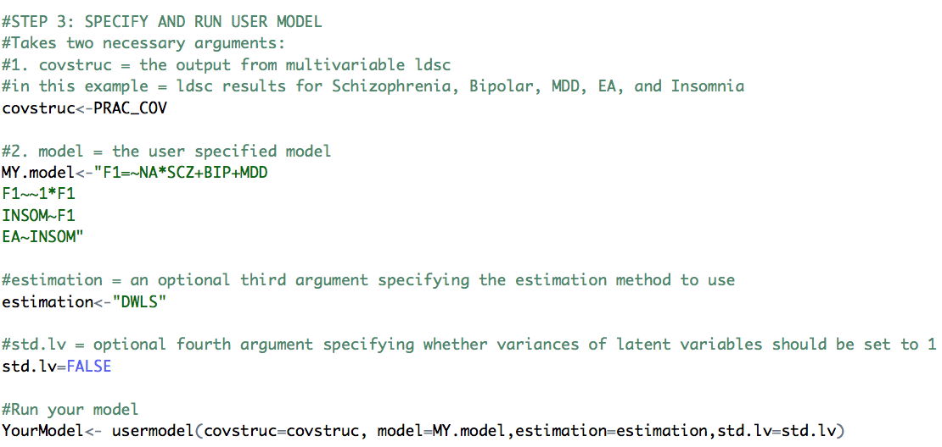
Specify Arguments

Slide 34
YourModel$results
P-values
Estimates and SE for model applied to genetic covariance matrix
Estimates and SE for model applied to genetic correlation matrix matrix
Parameter being estimated
Fully standardized estimates

Slide 35
YourModel$modelfit
chisq: The model chi-square, reflecting index of exact fit to observed data, with lower values indicating better fit.
df and p_chisq: The degrees of freedom and p-value for the model chi-square.
AIC: Akaike Information Criterion. Can be used to compare models regardless of whether they are nested.
CFI: Comparative Fit Index. Higher = better. > .90 = acceptable fit; > .95 = good model fit
SRMR: Standardized Room Mean Square Residual. Lower = better. < .10 = acceptable fit; < .05 = good fit

Slide 36
Delete Input for MY.model and run your own!

Slide 37
PRACTICAL: You Take Control
As away of preregistering them, discuss the model as a group and select someone to report the model you ran after the breakout room
Remember five variable names are:
SCZ, BIP, MDD, EA, INSOM
Also, again, this is real data. Your discoveries are REAL!

Slide 38
Go to breakout rooms

Slide 39
Models run by different breakout rooms?

Slide 40
IV. Multivariate GWAS in Genomic SEM

Slide 41
Four Primary Steps
Munge the summary statistics (munge)
Run LD-Score Regression to obtain the genetic covariance and sampling covariance matrices (ldsc)
Prepare the summary statistics for multivariate GWAS (sumstats)
Run the multivariate GWAS (commonfactorGWAS; userGWAS)
These two steps mirror that for models without SNP effects and need not be run again for the same traits

Slide 42
Lab
Using Same GWAS sumstats for:
Schizophrenia (Pardiñas et al., 2018); N = 105,318
Bipolar Disorder (Sklar et al., 2011); N = 16,731
Major Depressive Disorder (Wray et al., 2018); N = 173,005

Slide 43
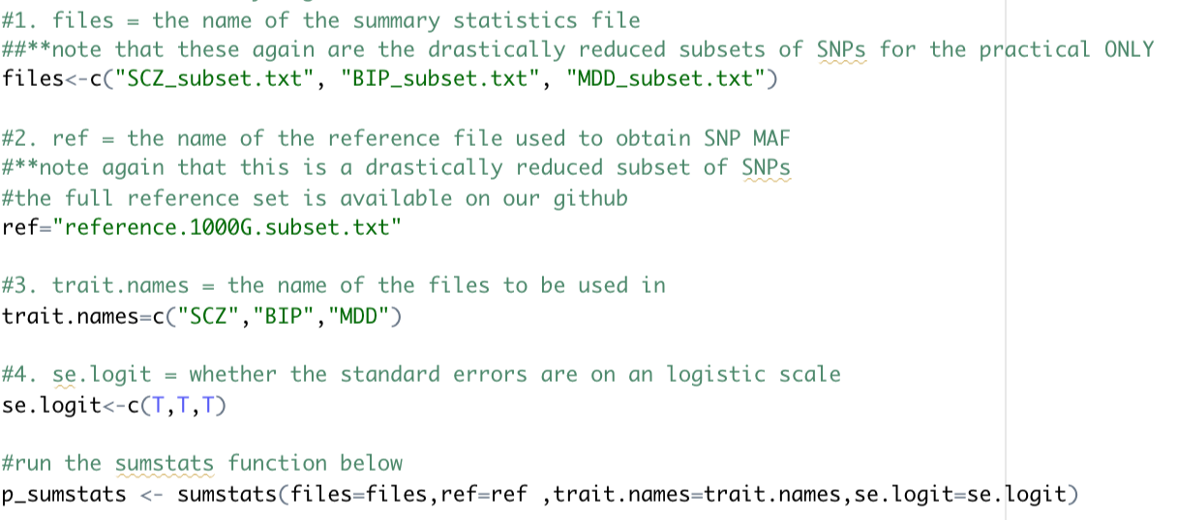
Step 3: sumstats example code
Flowchart on github to help you figure out arguments for sumstats

Slide 44
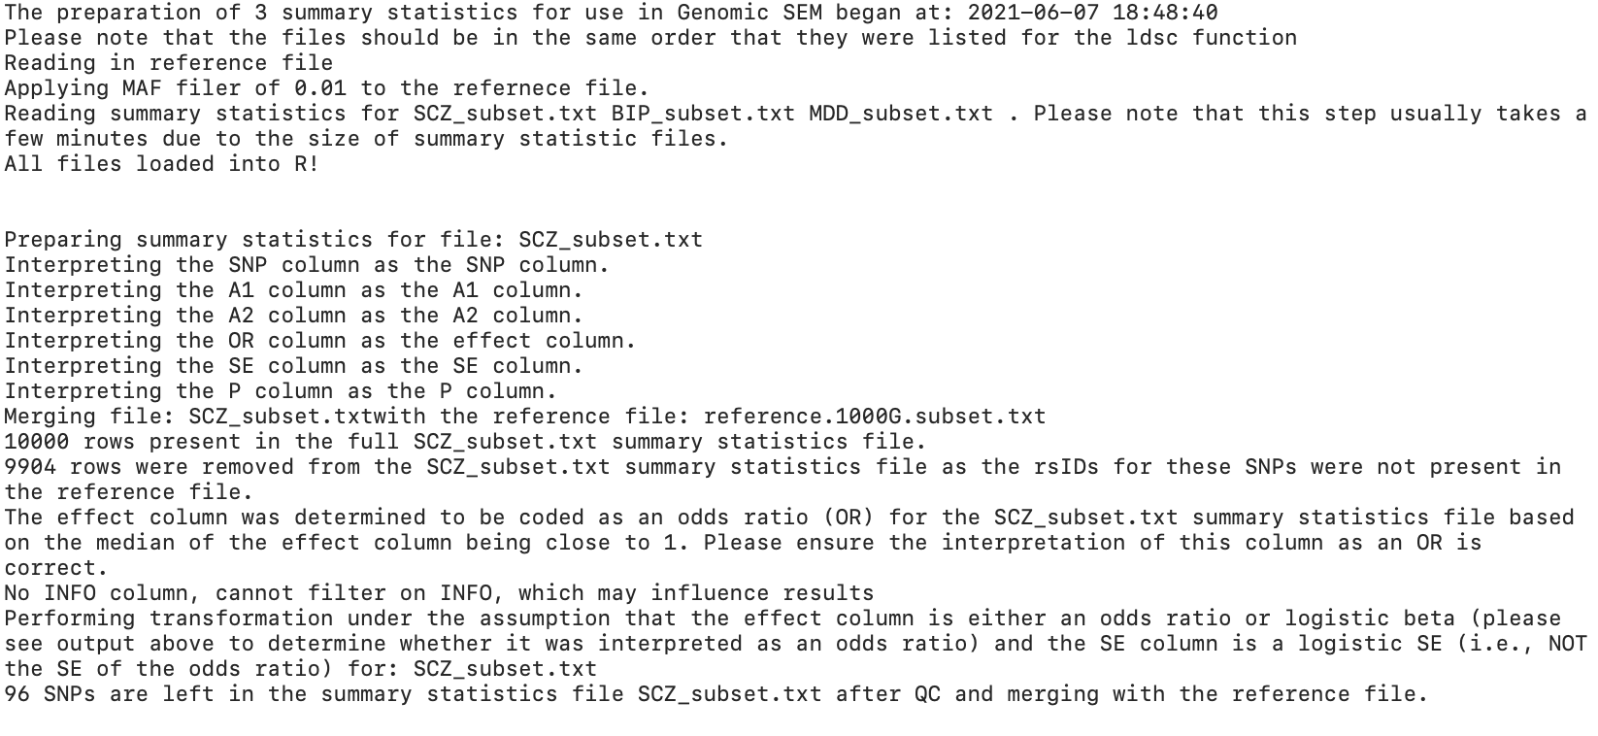
Examine SCZ_BIP_MDD_sumstats.log file

Slide 45
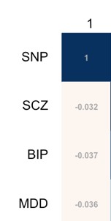
Behind the scenes
GenomicSEM GWAS functions automatically combine output from Steps 2 and 3
Creates as many covariance matrices as there are SNPs across traits
Step 3: Run sumstats
GWAS functions combine the two
Step 2: Run ldsc
+
=

Slide 46
Step 4a: commonfactorGWAS example code
To save memory, saves only the effect of the SNP on the common factor

Slide 47
First five rows of the output

Slide 48
Estimates of SNP level heterogeneity (Q_{SNP})
Asks to what extent the effect of the SNP operates through the common factor
$χ^{2}$distributed test statistic, indexing fit of the common pathways model against independent pathways model
1
u_{F}
$e_{F }^{2}$
F_{G}
1
SNP_{m}
$\hat{b}$_{SNPm,F}
F_{G}
$${σ\text{SNP}}_{ }^{2}$$
SNP_{m}
$${σ\text{SNP}}_{ }^{2}$$
λ_{V1}
λ_{V5}
λ_{V1}
λ_{V5}
λ_{V2}
λ_{V3}
λ_{V4}
λ_{V2}
λ_{V3}
λ_{V4}
$\hat{b}$_{SNPm,V1}
$\hat{b}$_{SNPm,V2}
$\hat{b}$_{SNPm,V3}
$\hat{b}$_{SNPm,V4}
$\hat{b}$_{SNPm,V5}
V_{2g}
V_{1g}
V_{2g}
V_{3g}
V_{4g}
V_{5g}
V_{1g}
V_{3g}
V_{4g}
V_{5g}
1
1
1
1
1
1
1
1
1
1
u_{V2}
u_{V3}
1
u_{V1}
u_{V2}
u_{V3}
u_{V4}
u_{V5}
u_{V1}
u_{V4}
u_{V5}
$${eV1}_{ }^{2}$$
$${eV3}_{ }^{2}$$
$${eV4}_{ }^{2}$$
$${eV5}_{ }^{2}$$
$${eV1}_{ }^{2}$$
$${eV2}_{ }^{2}$$
$${eV3}_{ }^{2}$$
$${eV4}_{ }^{2}$$
$${eV5}_{ }^{2}$$
$${eV2}_{ }^{2}$$
Notes:
What’s valuable about this is that it is a test of the homogeneity assumption that the genetic covariance structure applies across the genome, and obtain a heterogenetiy statistic for each SNP in the GWAS
What you can here in red are the effect of the SNP through the factor (SNP effects factor, which affects indicators). What the Q-stat indexes the extent to which the paths in black are also needed. Those paths allow for individual effects of the SNP directly on the disorders without being mediated by the factor.

Slide 49
Troubleshooting

Slide 50
Step 4b: userGWAS example code

Slide 51
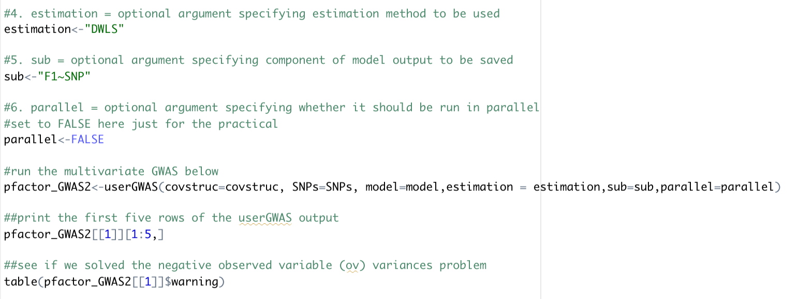
Step 4b: userGWAS example code

Slide 52
If you finish early feel free to go onto next slides/section of code to play around more with specifying your own model

Slide 53
Go to breakout rooms

Slide 54
If there’s time… play around with some anthropometric traits
Note that you do not need to include all variables in the model

Slide 55
Variable Names
BMI = Body Mass Index
WHR = Waist Hip Ratio
Waist = Waist Circumference
Hip = Hip circumference
CO = childhood obesity
Height = Height
BL = Birth Length
BW = Birth Weight
IHC = Infant Head Circumference

Slide 56
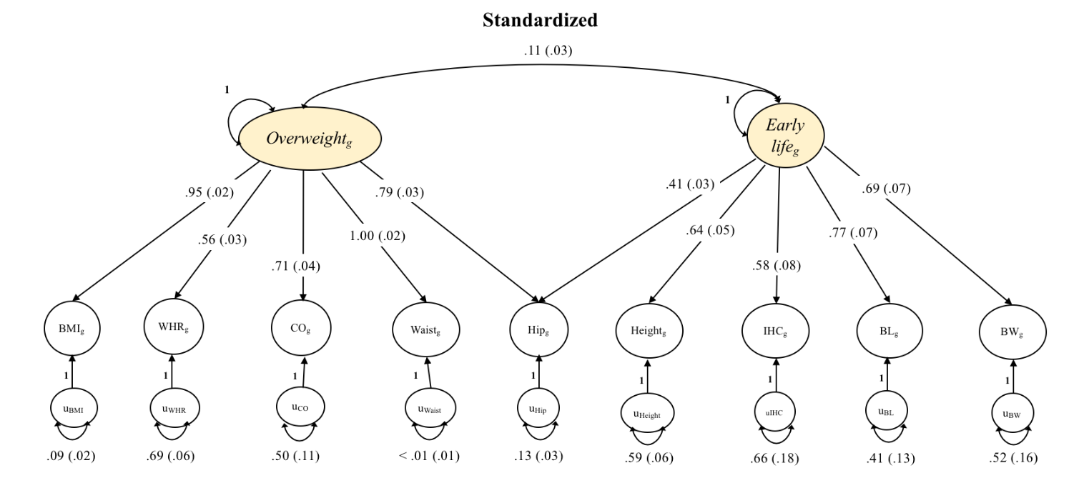
Example model that could be fit to the data

Slide 57
Final Notes
Parallel processing for both userGWAS and commonfactorGWAS is available
Parallel is the same as serial processing, except that it takes an additional cores argument specifying how many cores to use
Ideal run-time scenario: split jobs across computing nodes on a cluster and run in-parallel
All runs are independent of one another!

Slide 58
Overview
Genomic SEM is ready for use today!
Ask questions on our google forum
https://groups.google.com/forum/#!forum/genomic-sem-users
Lots can be done using existing, openly available GWAS summary statistics
Models are flexible and up to the user
Use Genomic SEM to derive sumstats for novel phenotypes for use in PGS analyses

Slide 59
Resources
See paper at: rdcu.be/bvn7t
See github at: https://github.com/GenomicSEM/GenomicSEM
See tutorials at: https://github.com/GenomicSEM/GenomicSEM/wiki

