Slide 1
Imputation
Sarah Medland
The 2021 Virtual Workshop on Statistical Genetic Methods for Human Complex Traits

Slide 2
3 main reasons for imputation
Meta-analysis
Fine Mapping
Combining data from different chips
Other less common uses
sporadic missing data imputation
correction of genotyping errors
imputation of non-SNP variation

Slide 3
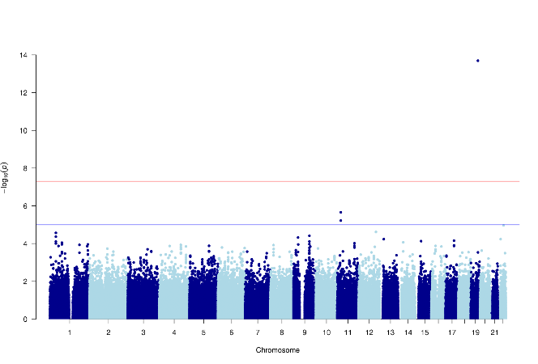
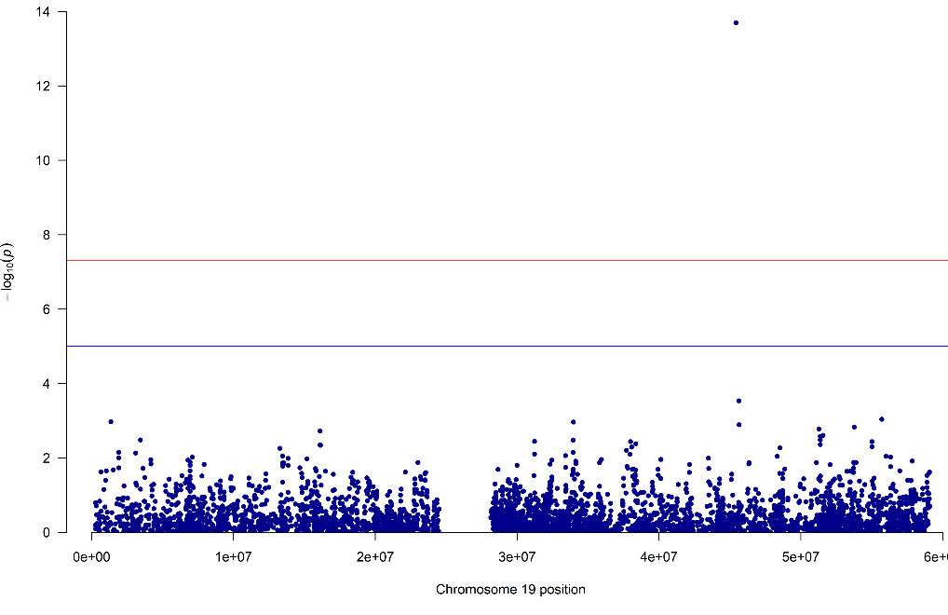
Fine Mapping
GWAS using only
genotyped SNPs

Slide 4
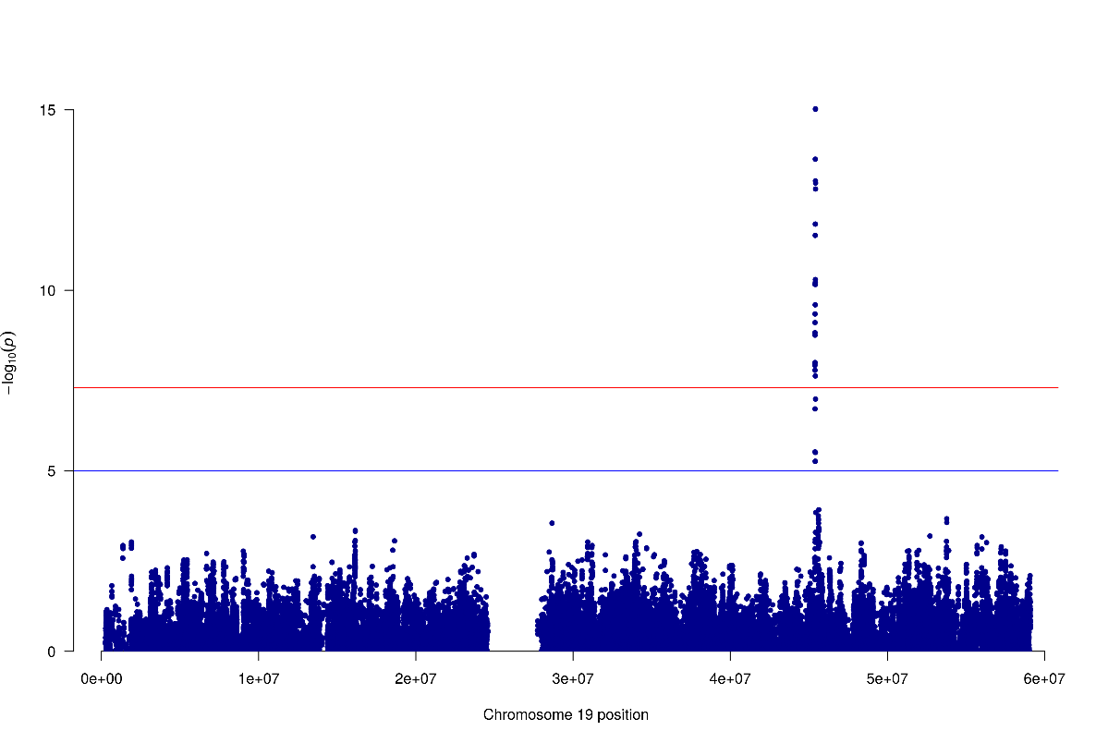
Fine Mapping
Genotyped only Post-Imputation

Slide 5
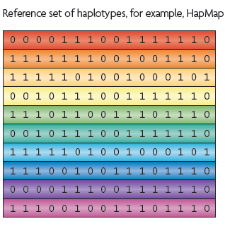
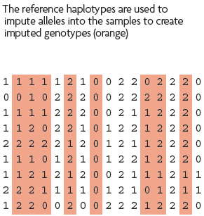
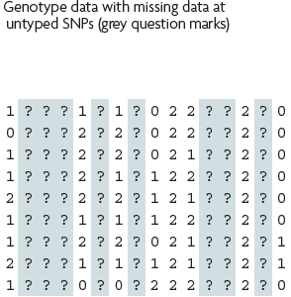
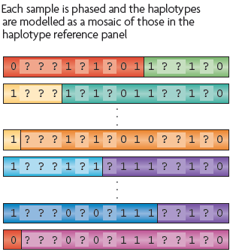
What is imputation? (Marchini & Howie 2010)

Slide 6
1. Starting Data
Genotyped sample
. | . | C | . | . | G | . | C | .
Reference haplotypes
A | G | A | T | C | T | C | C | T
A | G | C | T | C | T | C | A | T
A | G | A | T | C | G | C | C | T
A | G | A | T | C | T | A | C | T

Slide 7
2. Identify shared regions of chromosome
Genotyped sample
. | . | C | . | . | G | . | C | .
Reference haplotypes
A | G | A | T | C | T | C | C | T
A | G | C | T | C | T | C | A | T
A | G | A | T | C | G | C | C | T
A | G | A | T | C | T | A | C | T

Slide 8
3. Fill in missing genotypes
Genotyped sample
A | G | C | T | C | G | C | C | T
Reference haplotypes
A | G | A | T | C | T | C | C | T
A | G | C | T | C | T | C | A | T
A | G | A | T | C | G | C | C | T
A | G | A | T | C | T | A | C | T

Slide 9
Step 1 – QC & references
Current Publically Available References
HapMapII (no phased X data officially released)
1KGP – phase 3 version v5
References only available via custom imputation servers
HRC - 64,976 haplotypes 39,235,157 SNPs
CAPPA – African American/Carabbean
Multi-ethnic HLA
Genome Asia Pilot - GAsP
TopMed - 97,256 haplotypes 308,107,085 SNPs (b38)

Slide 10
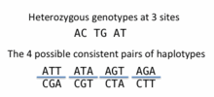
Step 2 – Phase your data
In this context it is really Haplotype Estimation
We take genotype data and try to reconstruct the haplotypes
Can use reference data to improve this estimation

Slide 11
Phasing in Eagle2 or Shapeit2
Hidden Markov Models are used to reconstruct haplotypes in the genotyped data
These are used to provide scaffolds for the imputation

Slide 12
Step 3: Impute
Minimac4
Impute5
Positional Burrows Wheeler Transform (PBWT)
Beagle
never use plink for imputation!

Slide 13
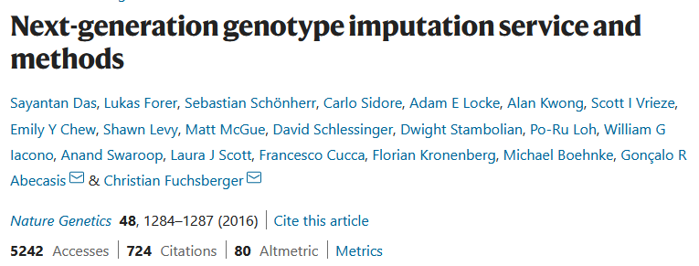
Minimac4
https://github.com/statgen/Minimac4
Building on the work from Gonçalo Abecasis, Christian Fuchsberger and colleagues
Analysis options
SAIGE
BoltLMM
plink2

Slide 14
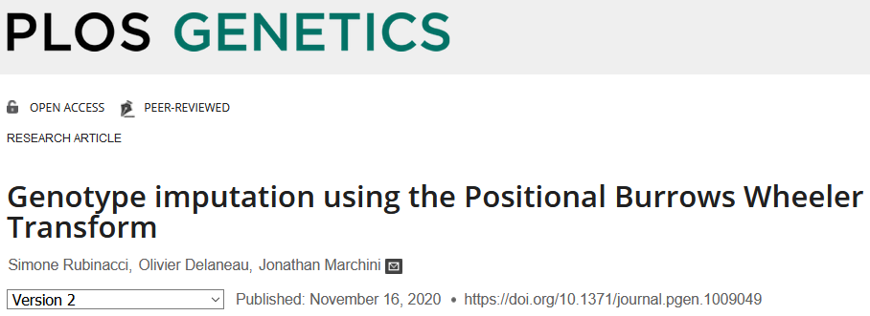
Impute5
https://jmarchini.org/software/#impute-5
Built by Jonathan Marchini and colleges
Incorporating Positional Burrows Wheeler Transform (PBWT)
Downstream analysis options
BGENIE
SNPtest
Quicktest

Slide 15
Options for imputation
DIY – Use a cookbook!
http://genome.sph.umich.edu/wiki/Minimac3_Imputation_Cookbook OR http://genome.sph.umich.edu/wiki/IMPUTE2:_1000_Genomes_Imputation_Cookbook
UMich Imputation Server
https://imputationserver.sph.umich.edu/
Sanger Imputation Server
https://imputation.sanger.ac.uk/
TOPMed Imputation Server
https://imputation.biodatacatalyst.nhlbi.nih.gov/

Slide 16
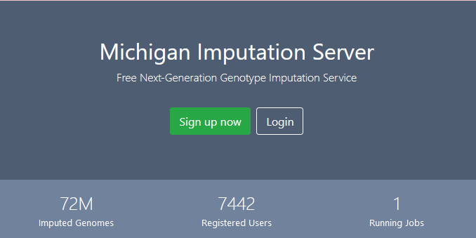
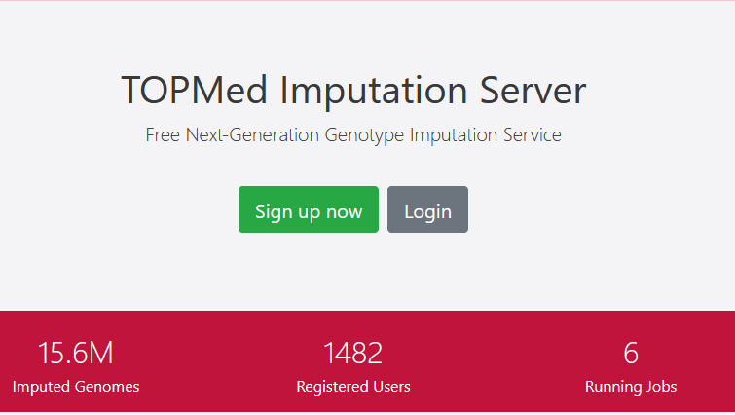

Slide 17
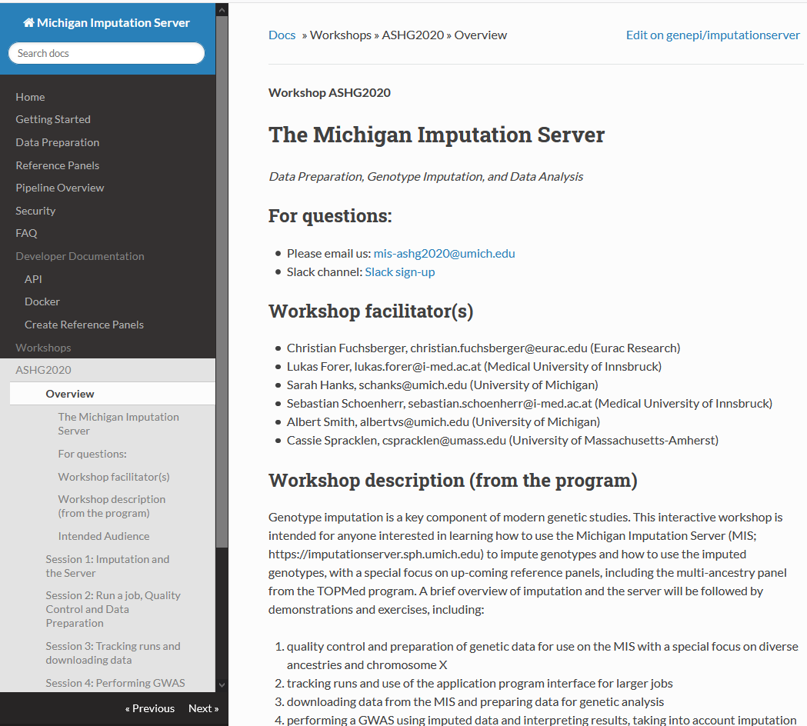
On the Michigan Imputation Server Site - Great practical workshop sessions from ASHG 2020
https://imputationserver.readthedocs.io/en/latest/workshops/ASHG2020/

Slide 18
Preparing your data
Exclude snps with excessive missingness (>5%), low MAF (<1%), HWE violations (~P<10⁻⁶), Mendelian errors
Drop strand ambiguous (palindromic) SNPs – ie A/T or C/G snps
Update build and alignment (b37 vs b38)
Output your data in the expected format for the phasing program you will use
Check the naming convention for the program and reference you want to use
rs278405739 OR 22:395704

Slide 19
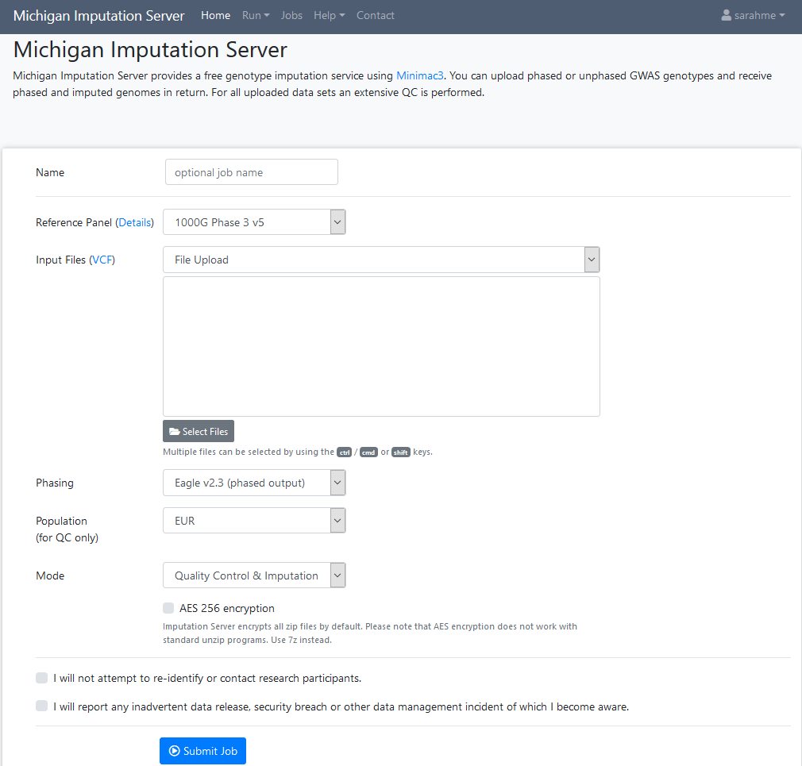

Slide 20
Output
3 main genotype output formats
Hard call or best guess
Dosage data (most common – 1 number per SNP, 1-2)
Probs format (probability of AA AB and BB genotypes for each SNP)

Slide 21
Output
Info files

Slide 22
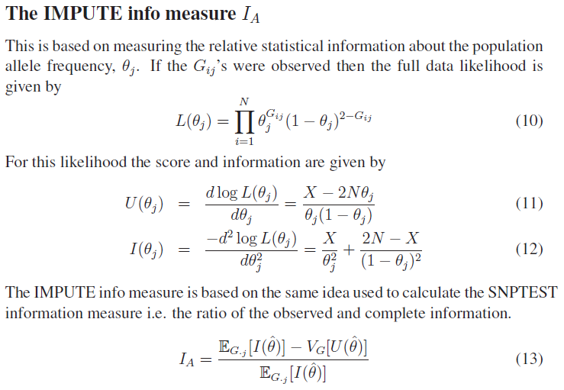
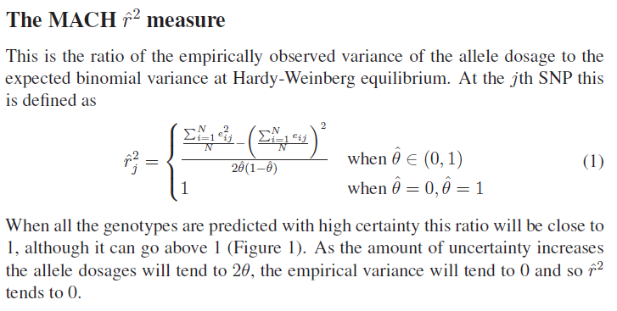
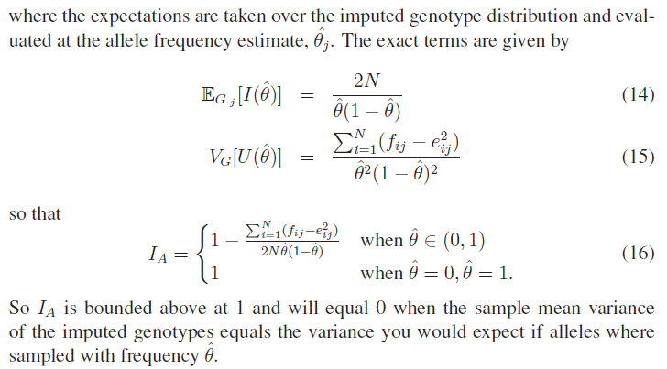
The r² metrics differ between imputation programs

Slide 23
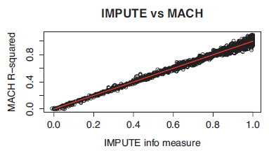
In general fairly close correlation
rsq/ ProperInfo/ allelic Rsq
1 = no uncertainty
0 = complete uncertainty
.8 on 1000 individuals = amount of data at the SNP is equivalent to a set of perfectly observed genotype data in a sample size of 800 individuals

Slide 24
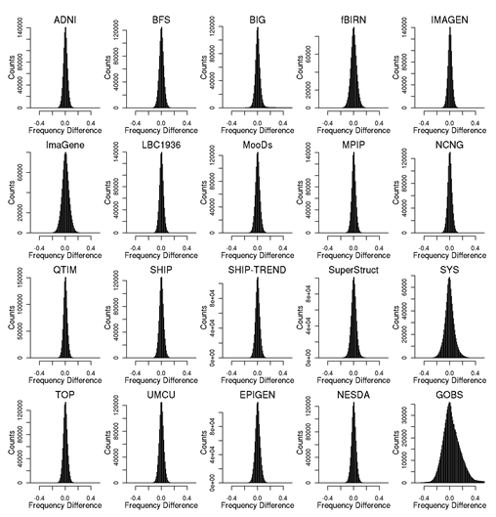
Post imputation QC
After imputation you need to check that it worked and the data look ok
Things to check
Plot r² across each chromosome look to see where it drops off
Plot MAF-reference MAF

Slide 25
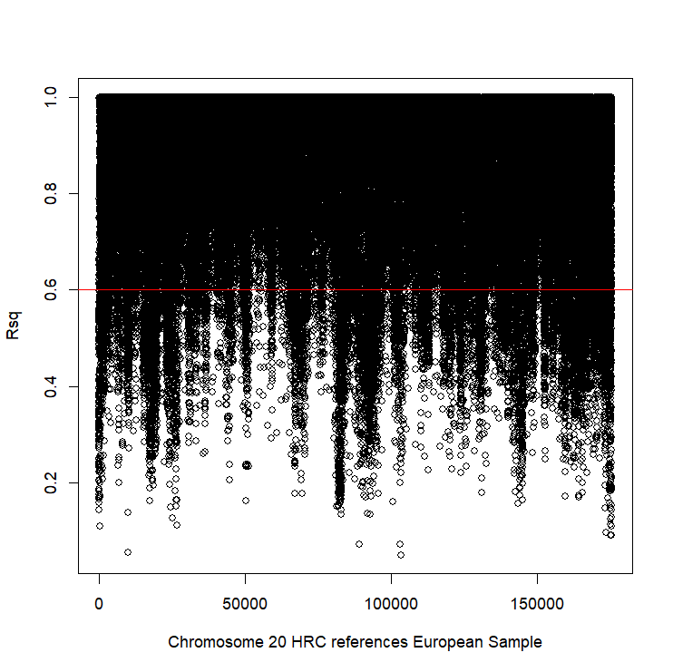
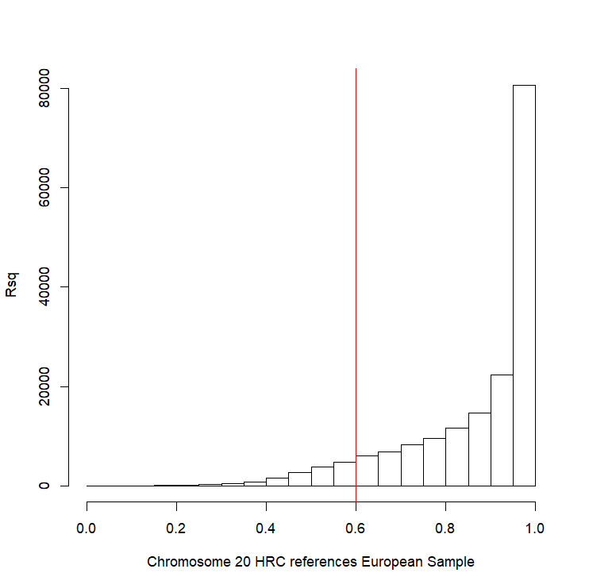
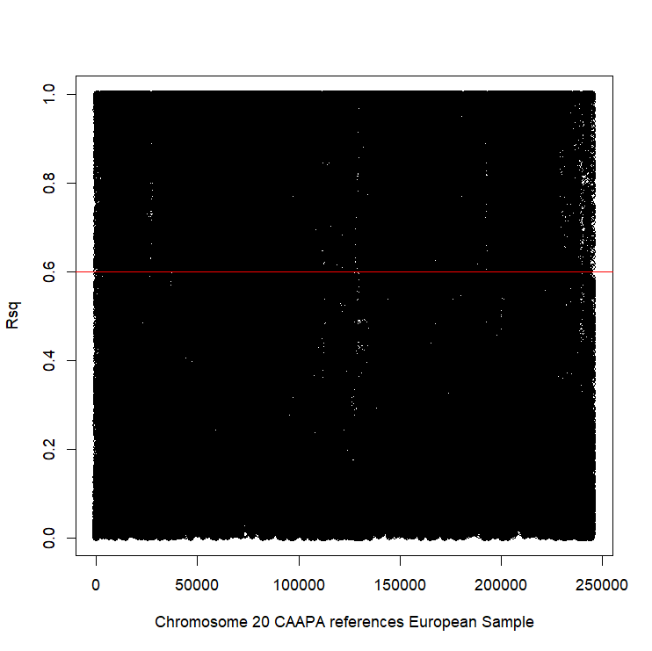
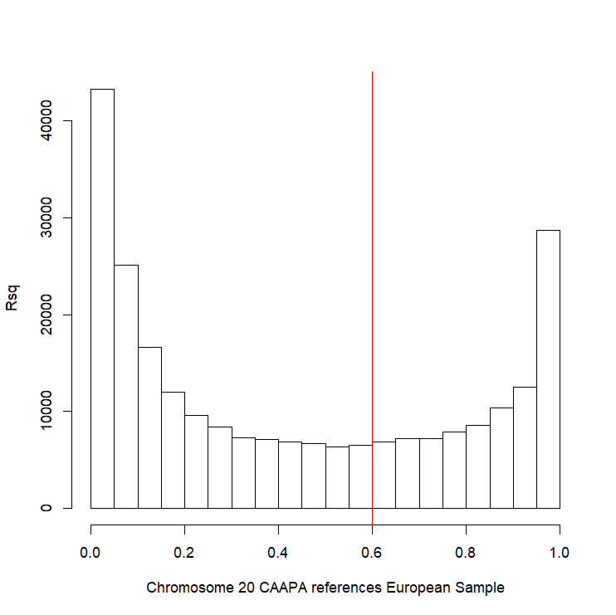
Good imputation
Bad imputation

Slide 26
Post imputation QC
Next run GWAS for a trait – ideally continuous, calculate lambda and plot:
QQ
Manhattan
SE vs N
P vs Z
Run the same trait on the observed genotypes – plot imputed vs observed

Slide 27
Last points
If you are running analyses for a consortium they will probably ask you to analyse all variants regardless of whether they pass QC or not…
(If you are setting up a meta-analysis consider allowing cohorts to ignore variants with MAF <.5% and low r2 – it will save you a lot of time)

Slide 28
Questions?

