Slide 1
Polygenic risk scores
Adrian Campos
Adrian.Campos@qimrberghofer.edu.au
Thanks to
Sarah Medland, Lucia Colodro Conde & Baptiste Couvy Douchesne

Slide 2
Layout
Introduction – recapitulating GWAS and allele effect sizes
PRS overview – graphical summary of what a PRS is
Which variants to include and accounting for LD
Traditional ‘clumping and thresholding’
Applications for PRS
Other methods for PRS
Summary

Slide 3
Layout
Introduction – recapitulating GWAS and allele effect sizes
PRS overview – graphical summary of what a PRS is
Which variants to include and accounting for LD
Traditional ‘clumping and thresholding’
Applications for PRS
Other methods for PRS
Summary

Slide 4
Notes:
Genome-wide association studies have reached the point where the effect of genetic variants on traits of interest is identified with a relatively small margin of error.

Slide 5
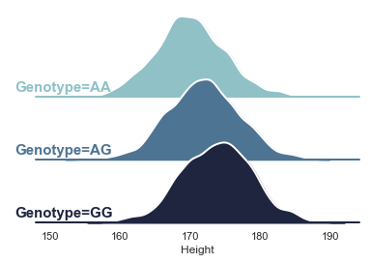
A regression would show an average increase of 2cm per copy of the G allele. So the effect size of this variant would be approximately 2.

Slide 6
In a new sample we would expect AG individuals to be on average 2cm taller than AA and 2cm shorter than GG

Slide 7
Complex traits are highly polygenic!
From above we can see there are many more genetic variants that contribute to the phenotype
Common variants typically have a small effect size (our example is an exaggeration for a common variant!). This would cause single-loci based prediction useless
We can combine the information we gain from several genetic variants to estimate an overall score and gain a better estimate of the trait. This is essentially what a PRS does

Slide 8
Layout
Introduction – recapitulating GWAS and allele effect sizes
PRS overview – graphical summary of what a PRS is
Which variants to include and accounting for LD
Traditional ‘clumping and thresholding’
Applications for PRS
Other methods for PRS
Summary

Slide 9
PRS overview

Slide 10
PRS overview
Effect size of 2cm per G allele
+2
+4
+4
+0
+0
+0
+2
+2
+2

Slide 11
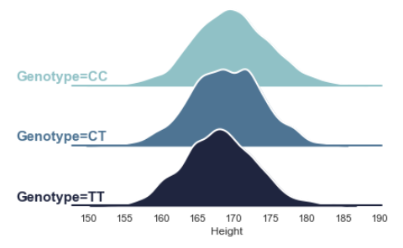
Effect size of -1 per T allele

Slide 12
Effect size of -1 per T allele
+0
+0
-1
-1
+0
-2
-2
-1
-2
+4
+4
+0
+0
+0
+2
+2
+2
+2

Slide 13
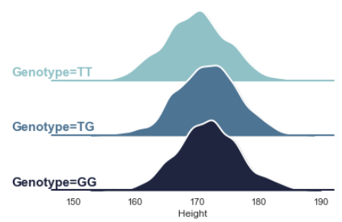
Effect size of +0.5 per G allele

Slide 14
Effect size of +0.5 per G allele
+0.5
+0
-0.5
+0
+0.5
+0
+0.5
+0.5
+1
+0
+0
-1
-1
+0
-2
-2
-1
-2
+4
+4
+0
+0
+0
+2
+2
+2
+2

Slide 15
Note on ambiguous variants
A/C
+
rsxxy A C MAF
rsxxy T G MAF
This variant is not ambiguous
-
T/G
A/T
+
rsxxx A T MAF
rsxxx T A 1-MAF
This variant is ambiguous
-
T/A
Note that one can usually solve ambiguity with information on allele frequency, but it gets tricky if its close to 0.5
(it is easy to drop them; as non-ambiguous SNPs will still tag variance thanks to LD)

Slide 16
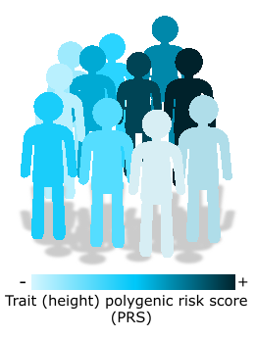
Repeat including the other variants and sum across all loci
Will give you an estimate of their polygenic risk for the trait of interest
Polygenic risk score – Weighted sum of alleles which quantify the effect of several genetic variants on an individual’s phenotype.

Slide 17
Repeat including the other variants and sum across all loci
Caution! The sample for which PRS will be calculated should be independent from that of the discovery GWAS. Sample overlap will bias your results.
GWAS
PRS

Slide 18
Layout
Introduction – recapitulating GWAS and allele effect sizes
PRS overview – graphical summary of what a PRS is
Which variants to include and accounting for LD
Traditional ‘clumping and thresholding’
Applications for PRS
Other methods for PRS
Summary

Slide 19
Repeat including the other variants and sum across all loci
Things to consider:
We know many GWAS are underpowered (there’s many more true associations than those discovered)
Linkage-disequilibrium creates a correlation structure within the variants. Its important to use independent SNPs (or account for their correlation somehow)

Slide 20
Clumping
Select all SNPs that are significant at a certain p-value threshold (p1 parameter, set to 1 for traditional approach)
Form clumps of SNPs within a certain distance (kb param) to the index SNP if they are in LD with the index SNP (r2 param)

Slide 21
Clumping and thresholding approach
The variants left are approximately independent, but there is still the question of how significant the association needs to be for inclusion in the PRS calculation

Slide 22
Clumping and thresholding approach
Solution: Calculate many PRS including more and more variants (reducing the p-value threshold used to filter them)
Example 8 p-value thresholds:
Number of independent variants included in PRS calculation
p<5e-8 | p<1e-5 | p<0.001 | p<0.01 | p<0.05 | p<0.1 | p<0.5 | p<1
723 | 2310 | 10473 | 30201 | 73120 | 110168 | 285410 | 393492

Slide 23
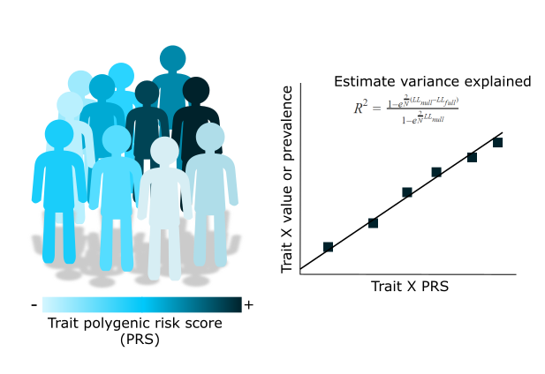
PRS – trait association
Notes:
PRS are a tool that allow us to test hypotheses regarding the genetic liability to a trait.
We will eventually need to perform associations between our PRS and a trait of interest.
The trait of interest will depend on what our question is and what the PRS is being used for, but regardless of it there are important considerations:

Slide 24
PRS – trait association
Think about your sample:
> Is it a family based sample? ! Adjust for relatedness e.g. LMM
> Is it homogeneous in terms of ancestry?
-Always a good idea to adjust for genetic PCs
>Does it match the GWAS ancestry?
Think about your trait:
> Is it continuous – linear regression
> Binary – logistic or probit regression
> Ordinal – cumulative linked mixed models
> Always remember potential confounders of the trait and of the discovery GWAS
Notes:
PRS are a tool that allow us to test hypotheses regarding the genetic liability to a trait.
We will eventually need to perform associations between our PRS and a trait of interest.
The trait of interest will depend on what our question is and what the PRS is being used for, but regardless of it there are important considerations:

Slide 25
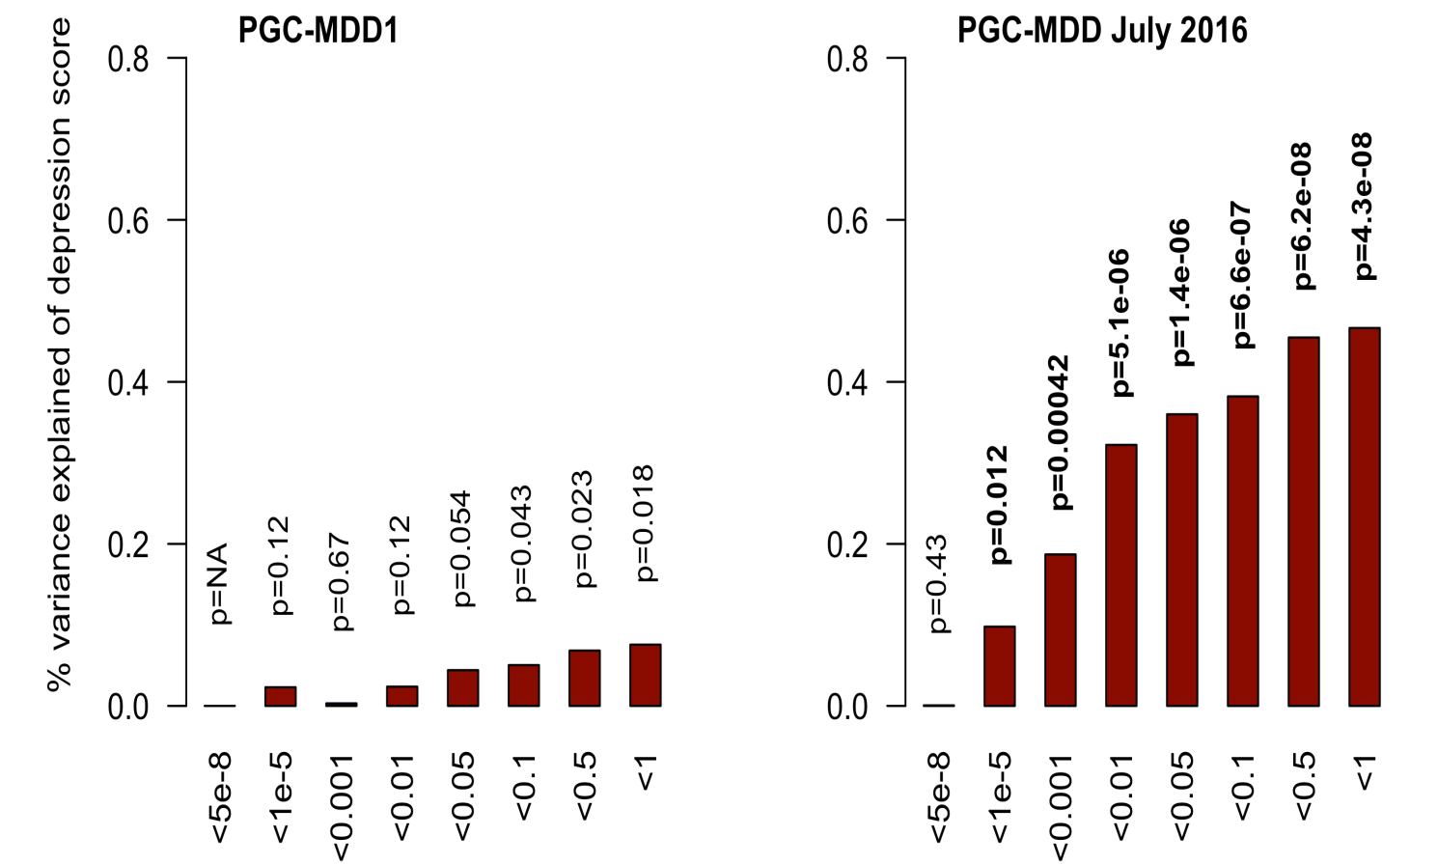
Power of PRS analysis increases with GWAS sample size
PGC-MDD1: N=18k
max variance explained = 0.08%, p=0.018
PGC-MDD2: N=163k
max variance explained =0.46%,
p= 5.01e-08
Colodro-Conde L, Couvy-Duchesne B, et al, (2017) Molecular Psychiatry

Slide 26
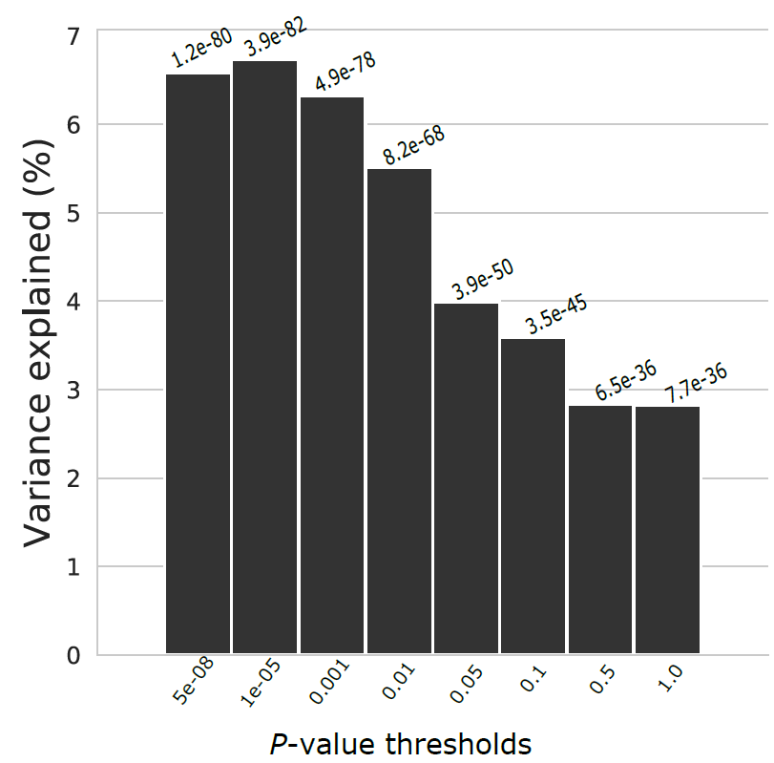
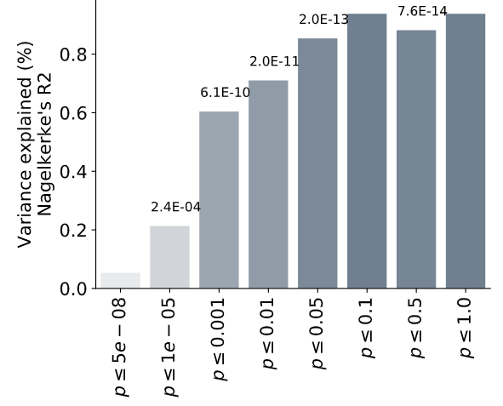
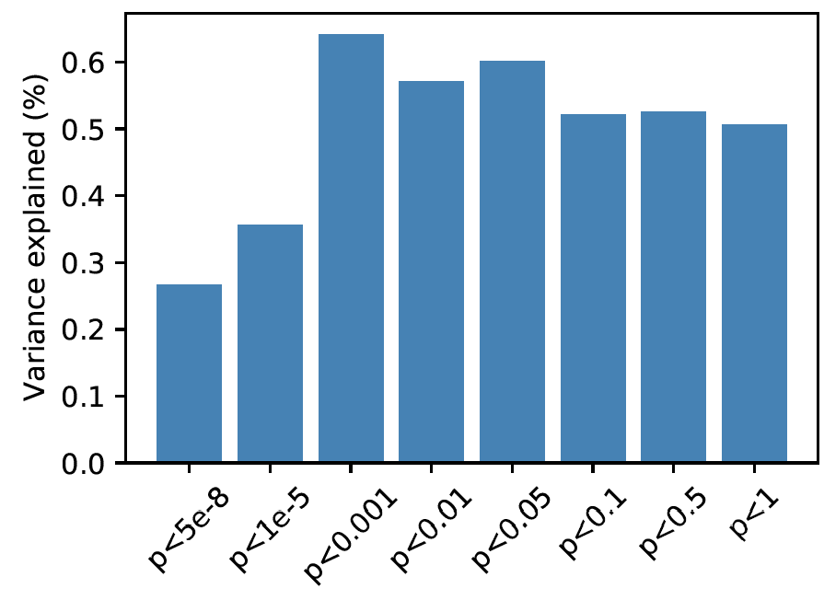
C+T also allows us to explore the pattern of variance explained
Variance explained = partial R² for quantitative traits. Different ways of estimating it for binary traits

Slide 27
Layout
Introduction – recapitulating GWAS and allele effect sizes
PRS overview – graphical summary of what a PRS is
Which variants to include and accounting for LD
Traditional ‘clumping and thresholding’
Applications for PRS
Other methods for PRS
Summary

Slide 28
Test for GWAS association and quantify variance explained
Risk stratification (i.e. identifying people to later test for specific disease)
Aid in clinical diagnosis
Test for genetic overlap between traits (e.g. does a Depression PRS predict cardiovascular disease?)
Trait imputation when not measured (obviously imperfect and dependent on heritability)
Personalized treatment (GWAS on treatment response are gaining power)
Any hypothesis where you rely on a risk or liability (e.g. GxE interactions)

Slide 29
Layout
Introduction – recapitulating GWAS and allele effect sizes
PRS overview – graphical summary of what a PRS is
Which variants to include and accounting for LD
Traditional ‘clumping and thresholding’
Applications for PRS
Other methods for PRS
Summary

Slide 30
Beyond clumping and thresholding
C+T (your options):
PLINK
PRSice2
bigsnpR (R library)
Other types of PRS:
LDpred2 – Implemented in bigsnpR
SBayesR – Implemented in GCTB
Lassosum (and lassosum2) – Implemented in bigsnpR
PRS-CS
JAMPred

Slide 31
Commonality across these approaches
If our sample size and computational power was big enough we could run a multiple linear regression model, and use the joint effect sizes (also called sometimes conditional) for PRS
Because we can’t, what we do is to run m regressions (one for each SNP) thus obtaining their marginal effect sizes. The lack of adjustment for correlation is obvious from the Manhattan plot “skyscrapers”
To solve this problem we need to find a method to approximate the multiple linear regression results based on the GWAS summary statistics
Notes:
All of these approaches are used to deal with the fact that a GWAS identifies the effect of each SNP one at a time without accounting for LD or correlation between them.
Nonetheless for polygenic risk scoring what we want is the joint effects of the variants. That is the effect of variant i after adjusting for all other variants.

Slide 32
Beyond clumping and thresholding
Approaches for fancier PRS:
LDpred2 – Implemented in bigsnpR
Gibbs sampler to estimate joint SNP effects (replacing clumping)
SBayesR – Implemented in GCTB
Estimates joint SNP effects using Bayesian multiple regression
Lassosum (and lassosum2) – Implemented in bigsnpR
Penalized (LASSO) regression (complementary to LDpred2 for MHC)
PRS-CS
Joint SNP effects using Bayesian regression with continuous shrinkage priors
JAMPred
Two step Bayesian regression framework

Slide 33
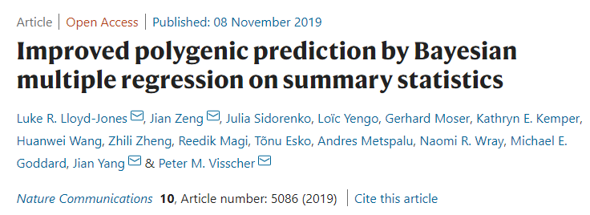
SBayesR
Combines a likelihood connecting the joint effects with GWAS summary statistics and a finite mixture of normal distribution priors for marker effects.
Models the SNP effect sizes as a mixture of normal distributions with mean zero and different variances.
Requires GWAS summary statistics with FREQ, BETA, SE and N; and an LD reference matrix
Typically uses four normal distributions with mean zero and variances =
Then performs a Markov chain Monte Carlo Gibbs sampling for the model parameters:

Slide 34
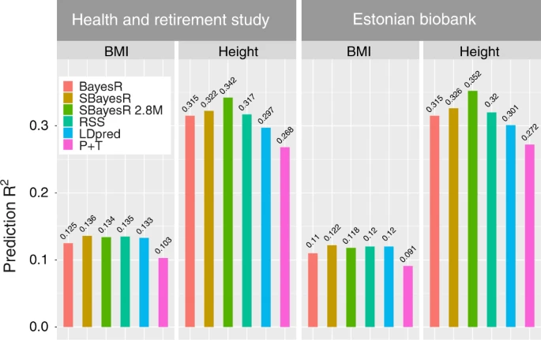
SBayesR
Combines a likelihood connecting the joint effects with GWAS summary statistics and a finite mixture of normal distribution priors for marker effects.
Models the SNP effect sizes as a mixture of normal distributions with mean zero and different variances.
Requires GWAS summary statistics with FREQ, BETA, SE and N; and an LD reference matrix
Lloyd-Jones, Jian Zeng, et al (2019)

Slide 35
LDpred2
Addressed instability issues in LDpred providing a more stable workflow. Models long range LD such as that found near the HLA region.
Also derives an expectation of joint effects given marginal effects and correlation between SNPs
Assumes:
With p= proportion of causal variants and h2 estimated using Ldscore regression. Grid for p:
Estimated effect sizes from a Gibbs sampler (also MCMC)
It also adds two new models to the traditional LDpred:
Estimate p and h2 from the model instead of testing several values and LD-score regression (LDpred2-auto). Thus no intermediate validation dataset is needed to tune these parameters.
LDpred2-sparse allows for effect sizes to be exactly 0 (similar to the first mixture component of SBayesR)

Slide 36
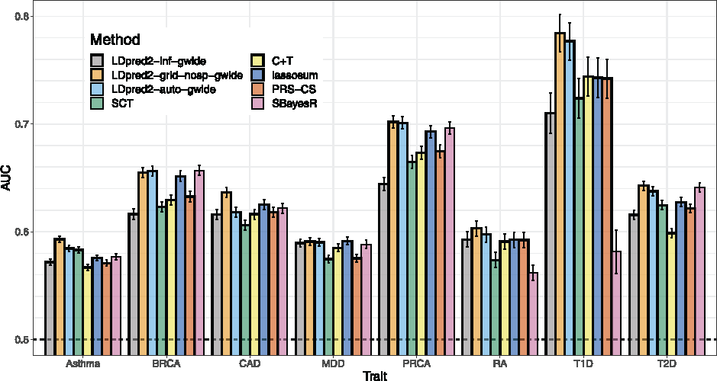
LDpred2
Addressed instability issues in LDpred providing a more stable workflow. Models long range LD such as that found near the HLA region.
Also derives an expectation of joint effects given marginal effects and correlation between SNPs
Assumes:
With p= proportion of causal variants and h2 estimated using Ldscore regression. Grid for p:
Bioinformatics, Volume 36, Issue 22-23, 1 December 2020, Pages 5424–5431

Slide 37
Beyond clumping and thresholding
These approaches usually perform better than (or at least as well as) C+T
When they don’t, maybe raise an eyebrow (sometimes the models don’t converge and they might fail silently)
Still an area of active research and a clear battle between complexity and power vs scalability and ease of use
There’s many publications comparing them, read them and pick the one that better fits your needs

Slide 38
Layout
Introduction – recapitulating GWAS and allele effect sizes
PRS overview – graphical summary of what a PRS is
Which variants to include and accounting for LD
Traditional ‘clumping and thresholding’
Applications for PRS
Other methods for PRS
Summary

Slide 39
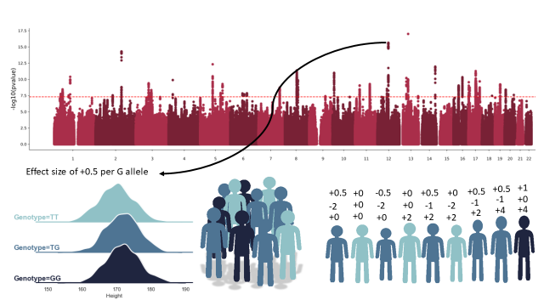
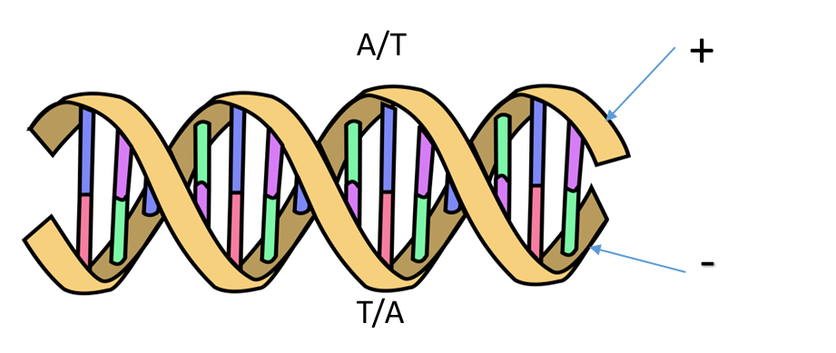
PRS- Weighted sum of alleles. A tool for estimating the genetic liability or risk to traits
Essential:
QC GWAS data (discovery)
QC Genotype data (target)
SNP identifiers need to be matched
Independent discovery and target samples
Consider statistical power
When using PRS:
Beware of related individuals in the sample
Adjust for population stratification
Ancestry consideration (portability issues)
Be wary of jumping too fast to conclusions consider potential biases in the discovery GWAS and the target sample.

Slide 40
References for PRS
Wray NR, Goddard, ME, Visscher PM. Prediction of individual genetic risk to disease from genome-wide association studies. Genome Research. 2007; 7(10):1520-28.
Evans DM, Visscher PM., Wray NR. Harnessing the information contained within genome-wide association studies to improve individual prediction of complex disease risk. Human Molecular Genetics. 2009; 18(18): 3525-3531.
International Schizophrenia Consortium, Purcell SM, Wray NR, Stone JL, Visscher PM, O'Donovan MC, Sullivan PF, Sklar P . Common polygenic variation contributes to risk of schizophrenia and bipolar disorder. Nature. 2009; 460(7256):748-52
Evans DM, Brion MJ, Paternoster L, Kemp JP, McMahon G, Munafò M, Whitfield JB, Medland SE, Montgomery GW; GIANT Consortium; CRP Consortium; TAG Consortium, Timpson NJ, St Pourcain B, Lawlor DA, Martin NG, Dehghan A, Hirschhorn J, Smith GD. Mining the human phenome using allelic scores that index biological intermediates. PLoS Genet. 2013,9(10):e1003919.
Dudbridge F. Power and predictive accuracy of polygenic risk scores. PLoS Genet. 2013 Mar;9(3):e1003348. Epub 2013 Mar 21. Erratum in: PLoS Genet. 2013;9(4). (Important discussion of power)
Wray NR, Lee SH, Mehta D, Vinkhuyzen AA, Dudbridge F, Middeldorp CM. Research review: Polygenic methods and their application to psychiatric traits. J Child Psychol Psychiatry. 2014;55(10):1068-87. (Very good concrete description of the traditional methods).
Wray NR, Yang J, Hayes BJ, Price AL, Goddard ME, Visscher PM. Pitfalls of predicting complex traits from SNPs. Nat Rev Genet. 2013;14(7):507-15. (Very good discussion of the complexities of interpretation).
Witte JS, Visscher PM, Wray NR. The contribution of genetic variants to disease depends on the ruler. Nat Rev Genet. 2014;15(11):765-76. (Important in the understanding of the effects of ascertainment on PRS work).
Shah S, Bonder MJ, Marioni RE, Zhu Z, McRae AF, Zhernakova A, Harris SE, Liewald D, Henders AK, Mendelson MM, Liu C, Joehanes R, Liang L; BIOS Consortium, Levy D, Martin NG, Starr JM, Wijmenga C, Wray NR, Yang J, Montgomery GW, Franke L, Deary IJ, Visscher PM. Improving Phenotypic Prediction by Combining Genetic and Epigenetic Associations. Am J Hum Genet. 2015; 97(1):75-85. (Important for the conceptualization of polygenicity)

