Slide 1
Meta-analysis and PRS
Sarah Medland, Adrian Campos, Jose Morosoli,
Katrina Grasby, Liz Prom-Wormley, Lucia Colodro Conde,
Brad Verhulst, Jodie Painter, Gunn-Helen Moen

Slide 2
Acknowledgement of Country I’d like to acknowledge the Turrbal and Yuggerah People as the traditional owners of the land where I live and work. I pay my respects to the Elders past, present and emerging.

Slide 3
Copy the files for today’s tutorial
In this session we will be using terminal.
To get started ssh into the workshop server.
mkdir day5 cp –r /faculty/sarah/2021/MA_PRS/ .
The practical will involve some R analyses, the tutorial assumes you will run these using the terminal window but you can use R studio is you prefer to.

Slide 4
Today we will be using an online worksheet for the tutorial
The link to the workbook will be shared in the zoom chat window and in the slack channel

Slide 5
RECAP

Slide 6
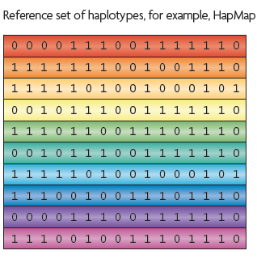
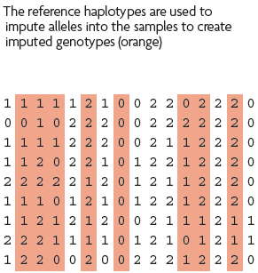
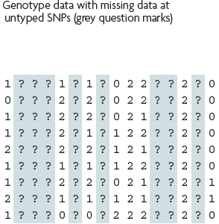
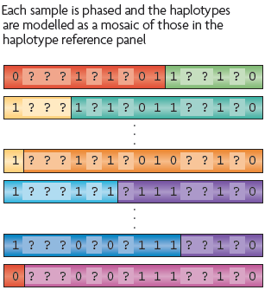
What is imputation? (Marchini & Howie 2010)

Slide 7
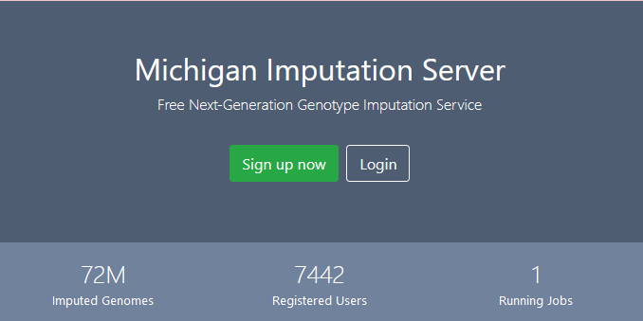
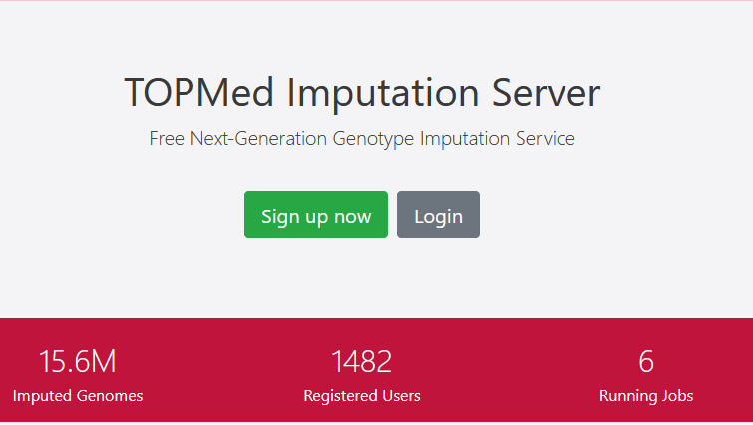

Slide 8
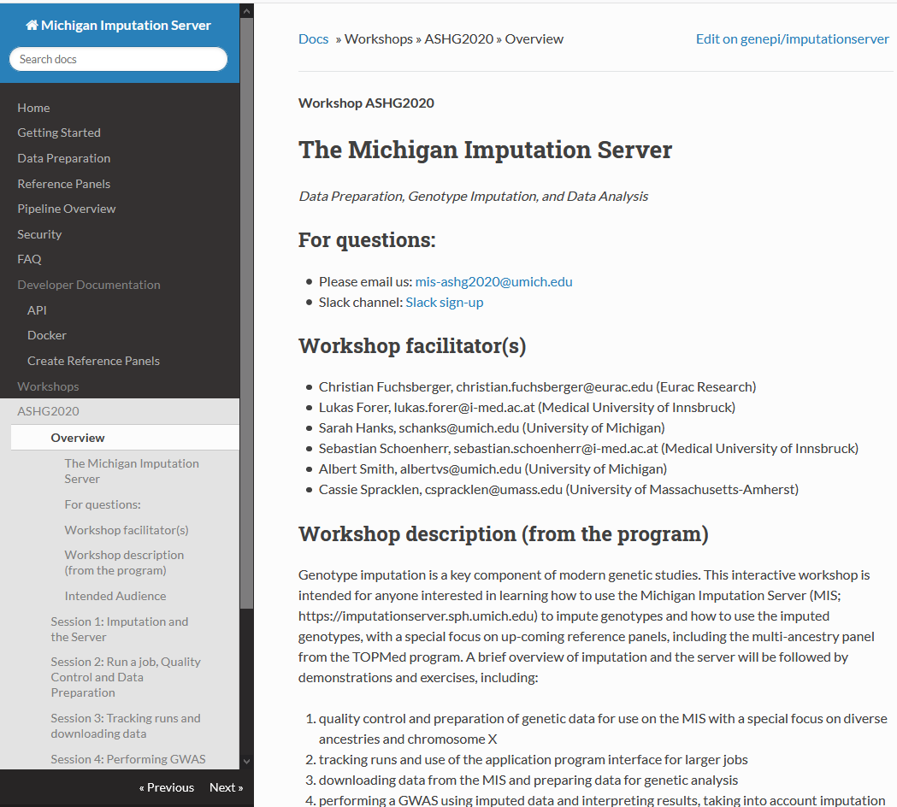
On the Michigan Imputation Server Site - Great practical workshop sessions from ASHG 2020
https://imputationserver.readthedocs.io/en/latest/workshops/ASHG2020/

Slide 9
QUESTIONS?

Slide 10
How we use meta-analysis in GWAS
Commissioned analyses rather than MA of previously published findings
Analysis protocol
Imputation reference
Phenotypic definition
Covariates to be included
Population stratification
Analyses to be run
Output format
Study 1
Study 2
…
Study n

Slide 11
Setting up a meta-analysis
Start with an analysis plan
Decide on QC of input and analytic approach
Define your primary analyses
Define any secondary analyses – sensitivity, populations
Map out intended follow-ups
Define replication
Preregistration or public posting is strongly encouraged
Allow a lot more time than you think you will need

Slide 12
Choosing an analytic approach
Metal
Fixed effect analysis – Inverse variance weighted
Requires: beta, SE, alleles
Outputs: beta, SE, p, N, heterogeneity, MAF

Slide 13
Choosing an analytic approach
Metal
Fixed effect analysis – Sample size weighted
Requires: direction, P, N , alleles
Outputs: Z, p, N, heterogeneity, MAF
Sample overlap correction

Slide 14
QUESTIONS?

Slide 15
PRS Overview
Discovery GWAS
Independent Target sample with genotypes and phenotypes

Slide 16
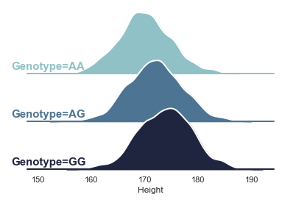
Effect size of 2cm per G allele
+2
+4
+4
+0
+0
+0
+2
+2
+2

Slide 17
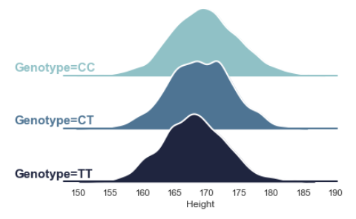
Effect size of -1 per T allele
+0
+0
-1
-1
+0
-2
-2
-1
-2
+4
+4
+0
+0
+0
+2
+2
+2
+2

Slide 18
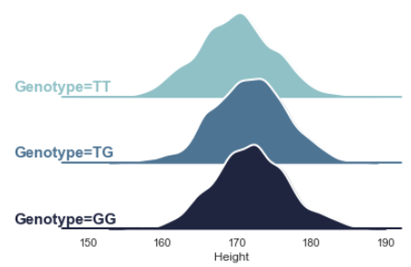
Effect size of +0.5 per G allele
+0.5
+0
-0.5
+0
+0.5
+0
+0.5
+0.5
+1
+0
+0
-1
-1
+0
-2
-2
-1
-2
+4
+4
+0
+0
+0
+2
+2
+2
+2

Slide 19
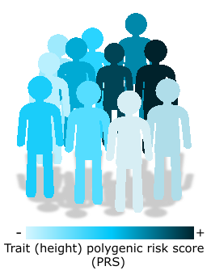
Repeat including the other variants and sum across all loci
Caution! The sample for which PRS will be calculated should be independent from that of the discovery GWAS. Sample overlap will bias your results.

Slide 20
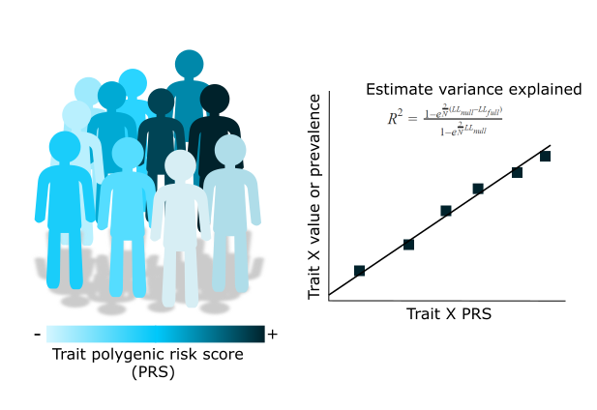
PRS – trait association
Notes:
PRS are a tool that allow us to test hypotheses regarding the genetic liability to a trait.
We will eventually need to perform associations between our PRS and a trait of interest.
The trait of interest will depend on what our question is and what the PRS is being used for, but regardless of it there are important considerations:

Slide 21
Types of PRS
Clumping+Thresholding:
PLINK
PRSice2
bigsnpR (R library)
Other types of PRS:
LDpred2 – Implemented in bigsnpR
SBayesR – Implemented in GCTB
Lassosum (and lassosum2) – Implemented in bigsnpR
PRS-CS
JAMPred

Slide 22
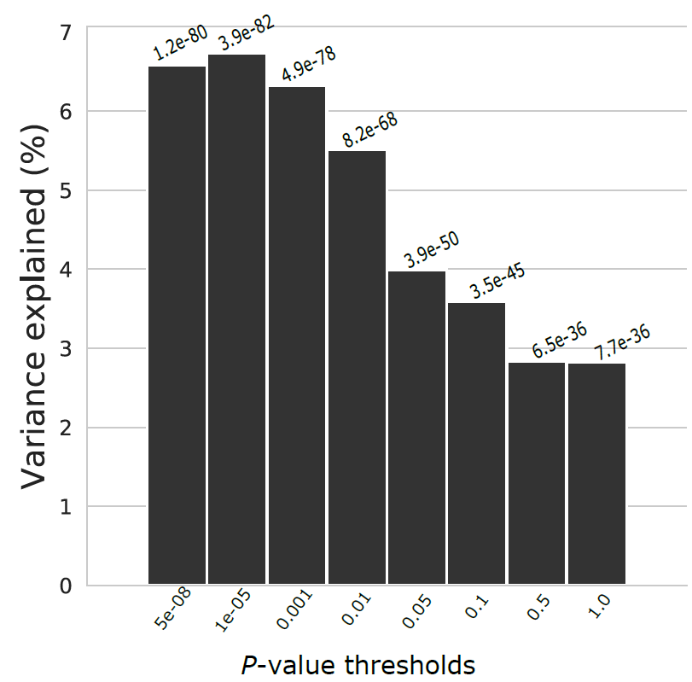
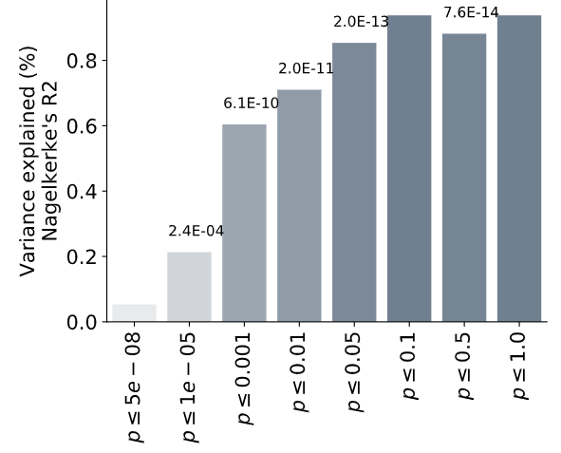
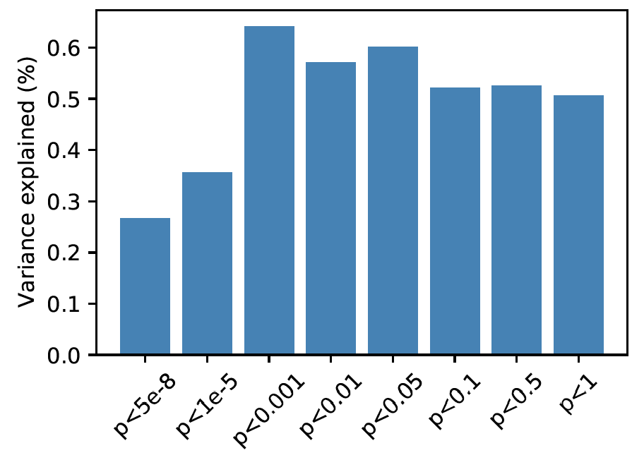
C+T allows us to explore the pattern of variance explained across the distribution of effect sizes/significance
Variance explained = partial R² for quantitative traits. Different ways of estimating it for binary traits

Slide 23
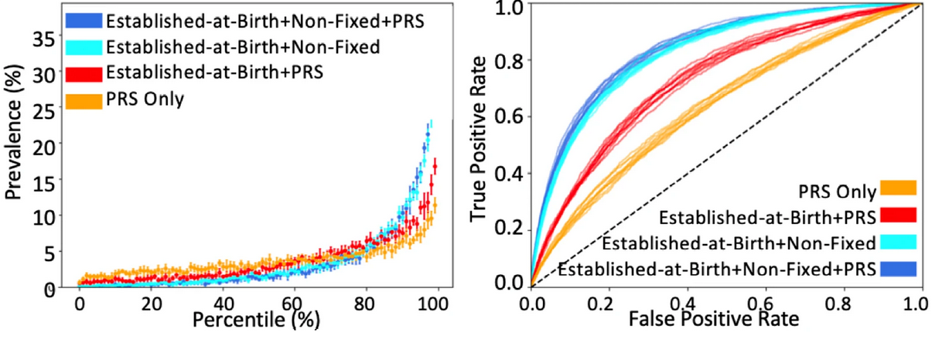
Other methods may be better if your goal is to find the best predictor

Slide 24
Questions?

Slide 25
Breakout room time…
Please share screen and work together!!
The link to the workbook is now being shared in the zoom chat window and in the slack channel
Ask for help if you need it!

Slide 26
Workbook
https://qimr.az1.qualtrics.com/jfe/form/SV_57iJKVtD3y0fQns

