Slide 1
Introduction to PLINK
Lucía Colodro Conde and Katrina Grasby

Slide 2
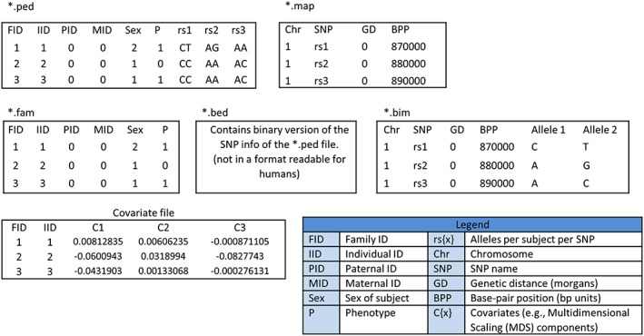
Marees et al. Int J Methods Psychiatr Res. 2018 Jun; 27(2): e1608.

Slide 3
Example:
plink --file {your_file} --assoc --out {your_output_file}
Note default Plink coding
Male = 1, Female = 2
Control = 1, Case = 2
Missing = -9, 0, non numeric
Note the code for cases, controls, and missing data can be changed using different flags.

Slide 4
PLINK
PLINK 1: http://zzz.bwh.harvard.edu/plink
PLINK 1.9: https://www.cog-genomics.org/plink/1.9/
PLINK 2.0: https://www.cog-genomics.org/plink/2.0/

