Slide 1
Introduction to GWAS (part II)
Katrina Grasby and Lucia Colodro Conde

Slide 2
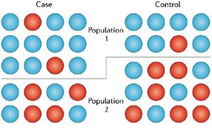
Confounders
Population Stratification
Mean trait or case frequency
differences between populations
Alleles with frequency differences
between populations
False positive / negative associations
Balding. Nat Rev Genet (2006)
Notes:
e.g., Blue = risk allele (simplified)
Disproportionate representation of cases in one population group (i.e.. more cases in Population 1) and greater frequency of allele in that population.
If the total sample is a combination of populations, then the allele might be associated with the disease OR there might be something else in Population 1 that is leading to the disease frequency and the allele frequency is co-incidental.
Same for continuous traits but looking at the mean scores are different across populations.

Slide 3
Multiple Testing Burden
p < 5 x 10⁻⁸
Consider ancestry
~ 1 million independent tests in Caucasians (CEU)
~ 2 million in African (YRI)
Notes:
Millions of loci = millions of tests, so some will be positive by chance. Need to control the type 1 error rate.
Estimated 1 million independent tests, common SNPs in HapMap CEU population.
P < 5 x10-8 for 5% alpha, based on genome-wide testing burden of common sequence variation
LD differs across different populations e.g., higher LD (alleles more correlated) in European than in African populations.

Slide 4
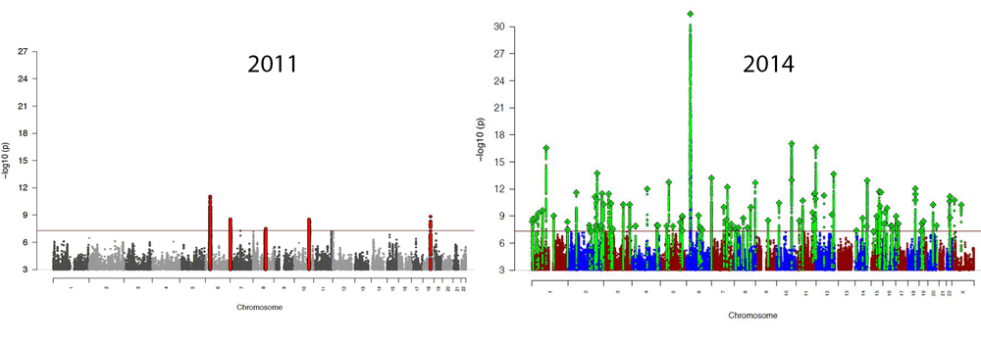
Sample Size & Power
Schizophrenia Working Group of the Psychiatric Genomics Consortium.
9,394 cases
12,462 controls
36,989 cases
113,075 controls
Notes:
Small effects = need large sample for power to detect effects reliably.

Slide 5
Power Calculation Tools
Consider: Effect size, Sample size, Prevalence, MAF
Purcell, Cherny, & Sham. Bioinformatics, 2003
http://zzz.bwh.harvard.edu/gpc/
Johnson & Abecasis. bioRxiv, 2017
https://csg.sph.umich.edu/abecasis/gas_power_calculator/index.html

Slide 6
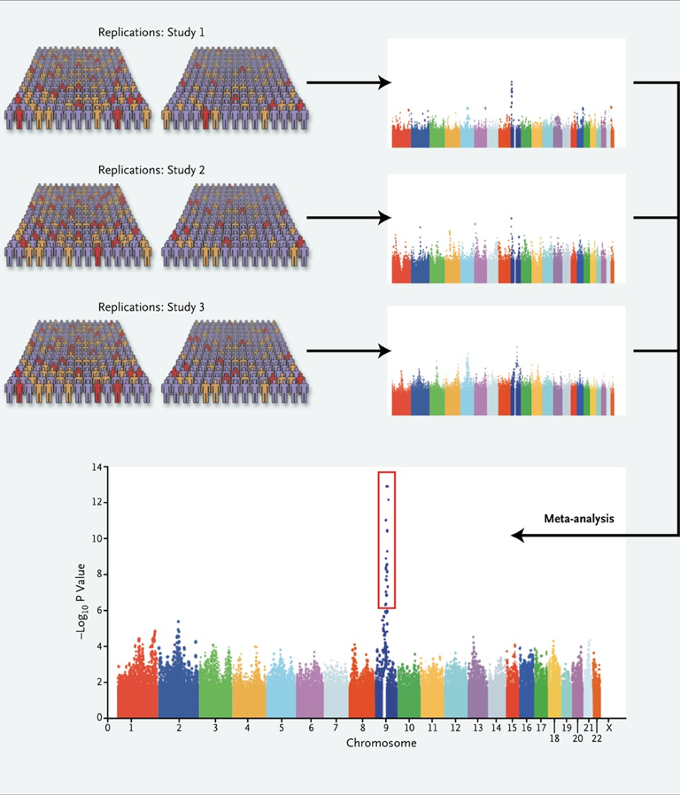
Replication
Significance
Size
Direction
If the lead SNP changes, check LD and direction of effect
https://ldlink.nci.nih.gov/?tab=ldmatrix
Manolio. N Engl J Med, 2010
Notes:
Replication through magnitude and direction.
Meta-analysis, sometime just top hits are shared.
Indirect association, all SNPs in high LD are potential replicates, but need to check direction of the allele effects (LD link very useful)

Slide 7
Key GWAS Findings (so far)
Thousands of genetic variants
Each has a very small effect
Large samples required
Can look at the cumulative effect…
Khera et al. Nat Gen, 2018

Slide 8
GWAS check list
Quality Control
Genotyping Call Rate, HWE, MAF, Sample Call Rate
Confounders
Population stratification, any systematic difference between cases & controls
Appropriate methods for individuals are related
mixed models
Sample size large
Replication
Indirect association
be wary of over-interpreting biology, follow-up work is essential!

