Slide 1
Introduction to GWAS (part I)
Katrina Grasby and Lucia Colodro Conde

Slide 2
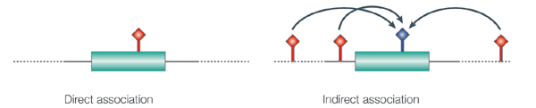
What is it?
A hypothesis free study of genetic variation across the entire human genome
Tests for genetic associations with continuous traits or with the presence / absence of disease
With a focus on low penetrance & high frequency loci
Tests indirect association
Hirschhorn & Daly. Nat Rev Genet (2014)
Notes:
Indirect association
SNPs are not completely independent. This correlation among SNPs = linkage disequilibrium.
We might have an association with a measured SNP, but the causal variant might be in LD with that measured SNPs

Slide 3
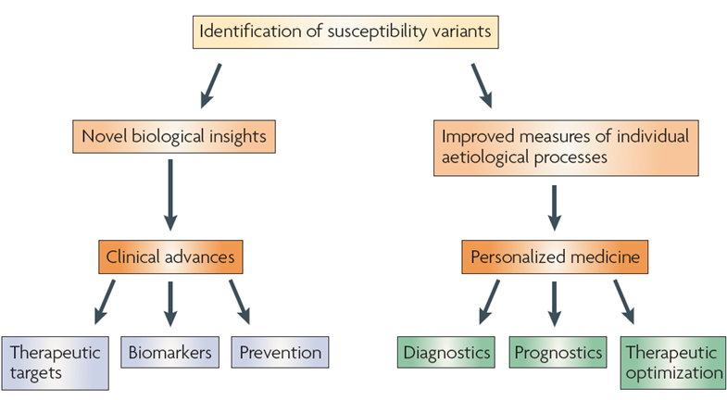
Why do it?
McCarthy et al. Nat Rev Genet (2008)

Slide 4
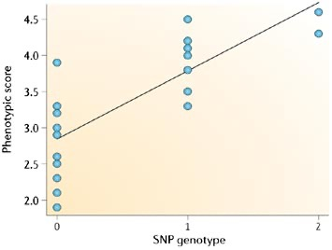
Quantitative Trait
Linear Regression
Ŷ = α + βX + ε
Ŷ = score on phenotype
X = 0, 1 or 2 copies of allele (“G”)
β = 0 no association
β > 0 G allele associated with higher score on trait
β < 0 G allele associated with lower score on trait
Balding. Nat Rev Genet (2006)
Notes:
At each locus each individual has two alleles, one from their biological mother and one from their biological father.
e.g., a SNP with either an A or G allele.
At that locus, each individual will be either AA, AG, or GG.
If G is coded as the effect allele, then each individual is coded as 0, 1, or 2 for that SNP, which is the predictor in the regression.
The beta of the SNP will indicate is the G allele is associated with a higher or lower score on the trait.

Slide 5
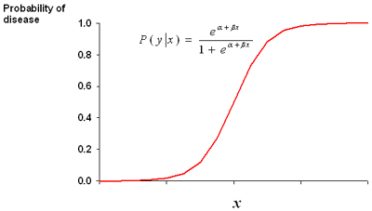
Case-Control
Logistic Regression
Controls
Cases
A/A
A/A
G/A
ln(P/1-P) = α + βX + ε
G/G
G/A
A/A
G/A
G/G
G/A
β = difference in log odds for cases vs. controls
e^{(β)} = difference in odds
= Odd Ratio (OR)
Allelic effect is an OR:
OR > 1 increased risk
OR < 1 decreased risk
A/A
A/A
A/A
G/A
G/G
A/A
A/A
G/A
G/G
G/G
A/A
The G allele is associated with disease
Notes:
e.g., same locus but binary disease outcome
Estimate the odds of being a case given that a person has the ‘G’ allele and is this is different to the odds of being a control.
If you use the logistic/logit function, taking the logarithm will give terms that resemble a linear regression model.
α = log odds for control; α + β = log odds for cases; β = difference in log odds for cases compared to controls.
Taking the exponent of the logistic β will give us the difference in odds or the odds ratio.

Slide 6
Relatedness
Only a few in the total sample = drop
Random Effects Model
Ŷ = α + βX + G + ε
β = fixed effect of the allele
G = genetic relationship random effect
Genetic Relationship Matrix (GRM)
Sub-sample of SNPs
Leave One Chromosome Out (LOCO)
Notes:
Non-independence among the individuals, use a mixed model.
A genetic relationship matrix can model the relationship structure.
Full GRM is covariance among sample calculated on all SNPs
Computational and memory constraints on full genetic relationship matrix, can use a subsample of SNPs to calculate covariation.
Proximal contamination when SNP is both in fixed and random effect of equation.
LOCO calculates the GRM on the chromosomes that do not include the fixed effect at that locus.

