Slide 1
Quality Control
Katrina Grasby and Lucia Colodro Conde
Notes:
Quality control steps on genetic data.
Before impute data.
Before statistical analyses.
Other quality control steps are also applied after statistical analysis.

Slide 2
Why Do Quality Control?
Poor quality data false positives / negatives
To remove genotyping errors
Low quality or quantity of DNA
Contaminated DNA
Chemical or machinery failure
Human error
To ensure data suitable for the analyses
Relatedness

Slide 3
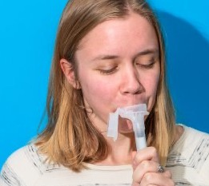
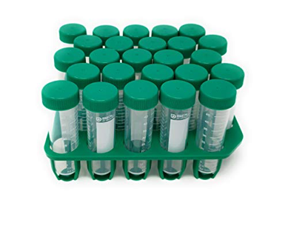
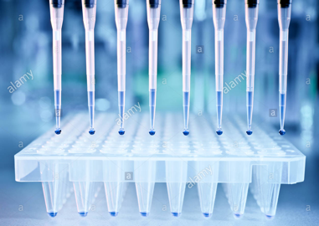
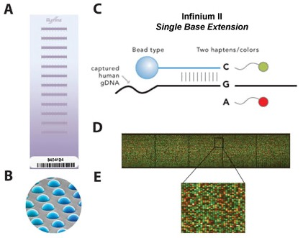
From DNA to data
Notes:
Spit kit can be posted.
In the lab: fragment, amplify, extract DNA.
Plate some onto SNP array. Randomize males & females, cases and controls.
Lots of SNP-chip platforms, ongoing improvements in technology e.g., bead-based microarrays.
SNP chip with 1-2 dozen individuals; hundreds of thousands of allele-specific probes, each well has multiple probes per SNP to allow for mismatches; probes target a specific locus, bind fragmented, complementary sequences of DNA and fluoresce if next nucleotide binds to the probe.
The color or intensity indicates genotype at a locus: homozygous for one allele or the other, or heterozygous.

Slide 4
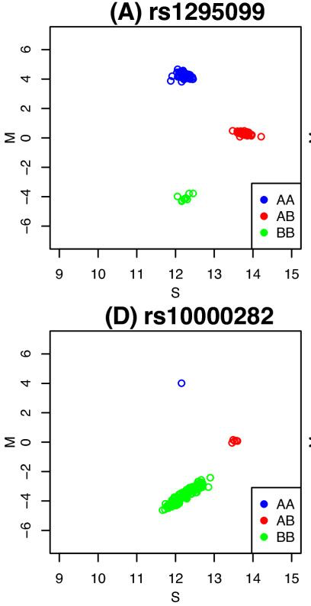
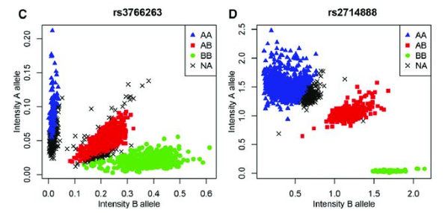
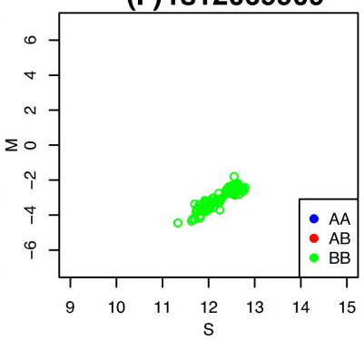
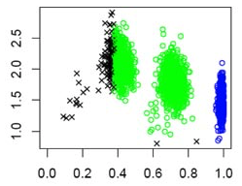
Genotyping Intensities
Notes:
Color/intensity is “read” into genotype.
Top row: Ideally 3 clusters e.g., CC CA TT; Overlap between clusters leads to missing genotype calls;
If failed genotypes are biased to one allele/genotype it will bias estimates of frequencies.
Bottom row: Rare alleles; Monomorphic locus; Error in calling.
While image files are provided by genotyping company, the first genotyping quality steps are done by the genotyping company and a report returned with the genotyped data.

Slide 5
Key Steps in QC
Check Data (file format, data coding, missing, build)
Sex (chr X heterozygosity)
Genotyping Call Rate (SNPs missing individuals)
Hardy-Weinberg Equilibrium
Minor Allele Frequency
Sample Call Rate (individuals missing genotypes)
Proportion of Heterozygosity
Relatedness
Population Stratification
Notes:
These QC steps will be checking for genetic variants or individuals that we should exclude from our analyses.
Order of QC will affect how many people or SNPs are kept/dropped.

Slide 6
Check the build
https://genome.ucsc.edu
Notes:
Useful website

Slide 7
Key Steps in QC
Check Data (file format, data coding, missing, build)
Sex (chr X heterozygosity)
Genotyping Call Rate (SNPs missing individuals)
Hardy-Weinberg Equilibrium
Minor Allele Frequency
Sample Call Rate (individuals missing genotypes)
Proportion of Heterozygosity
Relatedness
Population Stratification
Notes:
Checking sex compares the sex in the ped file (reported by individual) with sex from genotype.
This can flag if there has been a problem with the matching individuals to samples.
This comparison it is about biological sex, not gender.

Slide 8
Key Steps in QC
Check Data (file format, data coding, missing, build)
Sex (chr X heterozygosity)
Genotyping Call Rate (SNPs missing individuals)
Hardy-Weinberg Equilibrium
Minor Allele Frequency
Sample Call Rate (individuals missing genotypes)
Proportion of Heterozygosity
Relatedness
Population Stratification
Notes:
SNPs that are missing too much data

Slide 9
Key Steps in QC
Check Data (file format, data coding, missing, build)
Sex (chr X heterozygosity)
Genotyping Call Rate (SNPs missing individuals)
Hardy-Weinberg Equilibrium
Minor Allele Frequency
Sample Call Rate (individuals missing genotypes)
Proportion of Heterozygosity
Relatedness
Population Stratification
Notes:
Hardy-Weinberg Equilibrium: expected allele frequency

Slide 10
Key Steps in QC
Check Data (file format, data coding, missing, build)
Sex (chr X heterozygosity)
Genotyping Call Rate (SNPs missing individuals)
Hardy-Weinberg Equilibrium
Minor Allele Frequency
Sample Call Rate (individuals missing genotypes)
Proportion of Heterozygosity
Relatedness
Population Stratification
Notes:
If too rare, won’t have power to analyse.

Slide 11
Key Steps in QC
Check Data (file format, data coding, missing, build)
Sex (chr X heterozygosity)
Genotyping Call Rate (SNPs missing individuals)
Hardy-Weinberg Equilibrium
Minor Allele Frequency
Sample Call Rate (individuals missing genotypes)
Proportion of Heterozygosity
Relatedness
Population Stratification
Notes:
Individuals missing too much data

Slide 12
Key Steps in QC
Check Data (file format, data coding, missing, build)
Sex (chr X heterozygosity)
Genotyping Call Rate (SNPs missing individuals)
Hardy-Weinberg Equilibrium
Minor Allele Frequency
Sample Call Rate (individuals missing genotypes)
Proportion of Heterozygosity
Relatedness
Population Stratification
Notes:
Heterozygosity: excessive might be DNA contamination, reduced might be inbreeding or individuals missing SNPs.
Order of QC will affect how many people or SNPs are kept/dropped

Slide 13
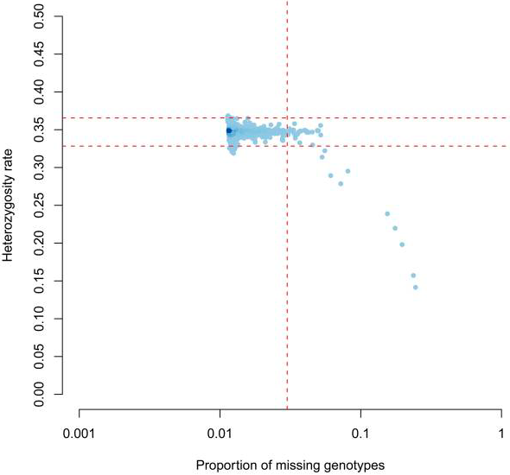
Heterozygosity vs. Missing
Anderson et al. Nat Proc. 2010
Notes:
Inappropriate inferences can be concluded about a sample based on QC,
Another reason why order of QC might matter.
This example shows that high rates of homozygosity can correlate with poor sample call rate.

Slide 14
Key Steps in QC
Check Data (file format, data coding, missing, build)
Sex (chr X heterozygosity)
Genotyping Call Rate (SNPs missing individuals)
Hardy-Weinberg Equilibrium
Minor Allele Frequency
Sample Call Rate (individuals missing genotypes)
Proportion of Heterozygosity
Relatedness
Population Structure / Stratification
Notes:
Check if individuals in sample are related. This will guide choice of statistical methods.

Slide 15
Key Steps in QC
Check Data (file format, data coding, missing, build)
Sex-check (chr X heterozygosity)
Genotyping Call Rate (SNPs missing individuals)
Hardy-Weinberg Equilibrium
Minor Allele Frequency
Sample Call Rate (individuals missing genotypes)
Proportion of Heterozygosity
Relatedness
Population Structure / Stratification
Notes:
Allele frequencies differ across populations. Phenotypes also differ across populations.
This can be a problematic confound.
Can get false associations if this is not addressed in analyses.

Slide 16
Key Steps in QC
Check Data (file format, data coding, missing, build)
Sex-check (chr X heterozygosity)
Genotyping Call Rate (SNPs missing individuals)
Hardy-Weinberg Equilibrium
Minor Allele Frequency
Sample Call Rate (individuals missing genotypes)
Proportion of Heterozygosity
Relatedness
Population Structure / Stratification

