Slide 1

Introduction to common variation (II)
Lucía Colodro Conde and Katrina Grasby

Slide 2
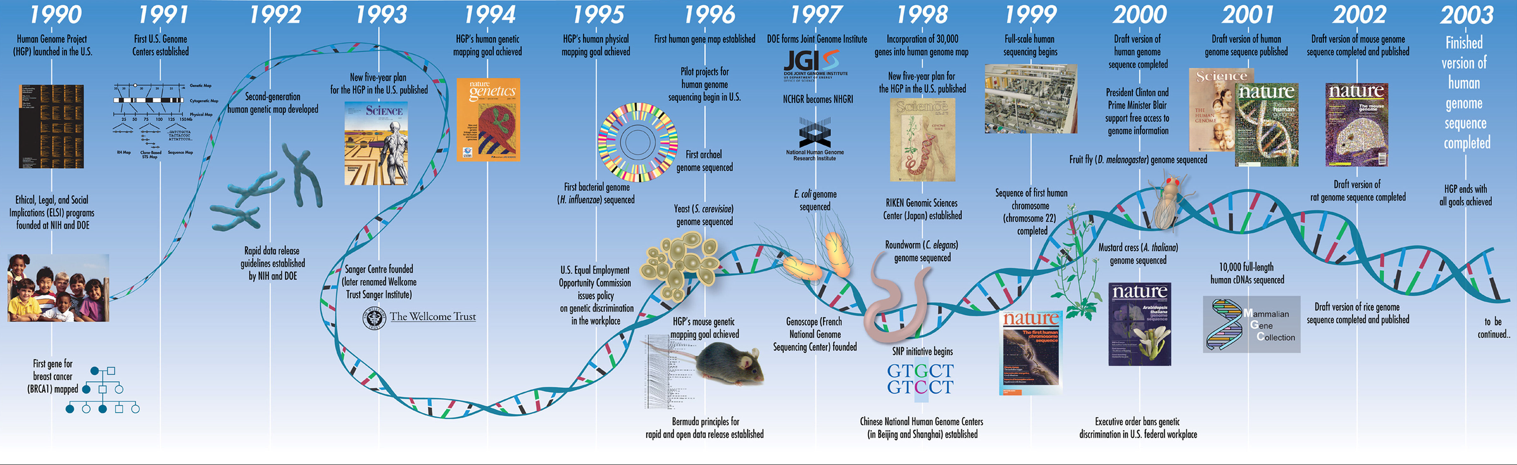
Collins et al 2003, A vision for the future of genomics research, Nature

Slide 3
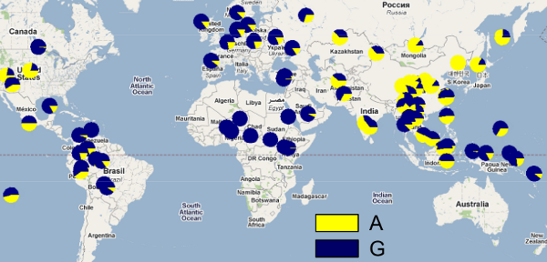
Projects to create reference panels have provided information on:
Patterns of human common genetic variation
Linkage disequilibrium (LD) and allele frequencies differences in populations
Tag SNPs for the design of SNP arrays to facilitate imputation and GWAS
YRI
CEU
CHB _ JPG

Slide 4

HapMap (haplotype map) Project
270 individuals:
30 parent-offspring trios of the Yoruba from Ibadan, Nigeria (YRI)
30 trios of Utah residents with European ancestry (CEU)
45 individuals from Beijing, China (CHB)
45 individuals from Tokyo, Japan (JPT)
The International HapMap Consortium (2005). A haplotype map of the human genome. Nature.

Slide 5
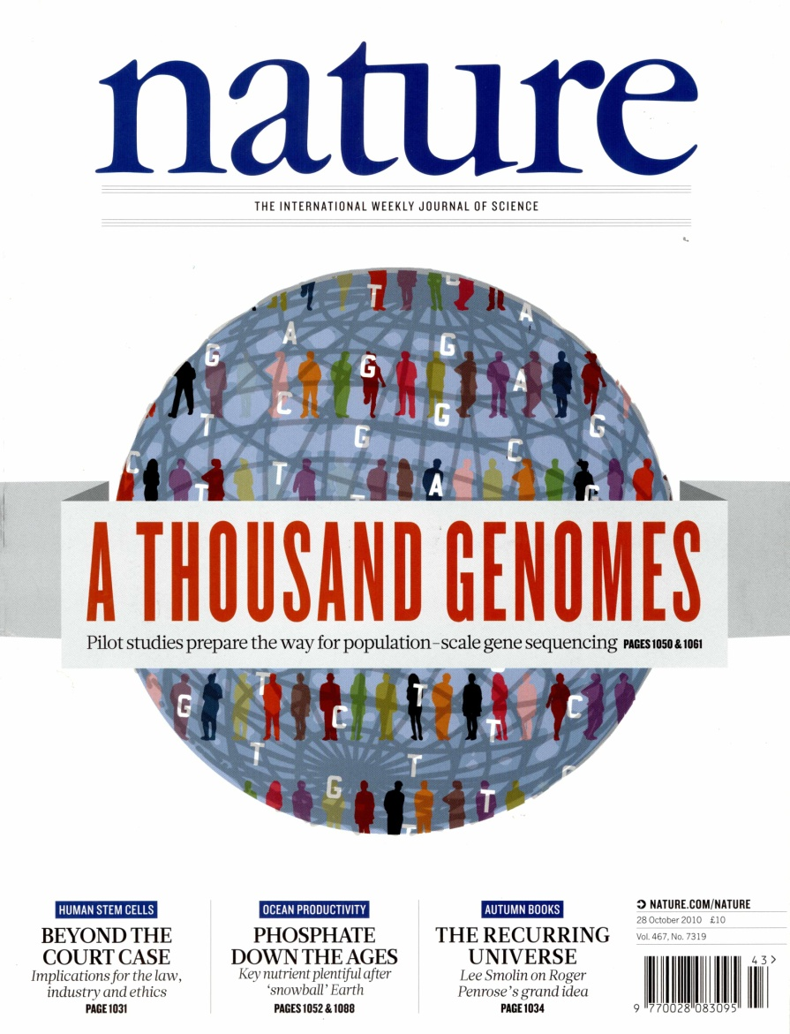
1000 Genomes Project
Phase 1: 1,092 individuals from 14 populations..
Phase 3: 2,504 individuals from 26 populations (~500 samples form each 5 continental ancestry groups, with ~5 populations for each group)
The 1000 Genomes Project Consortium (2012). An integrated map of genetic variation from 1,092 human genomes. Nature.
The 1000 Genomes Project Consortium (2015). A global reference for human genetic variation. Nature.

Slide 6
The Haplotype Reference Consortium (HRC)
The Haplotype Reference Consortium (2016). A reference panel of 64,976 haplotypes for genotype imputation. Nature Genetics.

Slide 7

Trans-Omics for Precision Medicine (TOPMed)
Taliun, D., Harris, D.N., Kessler, M.D. et al. (2021). Sequencing of 53,831 diverse genomes from the NHLBI TOPMed Program. Nature

Slide 8
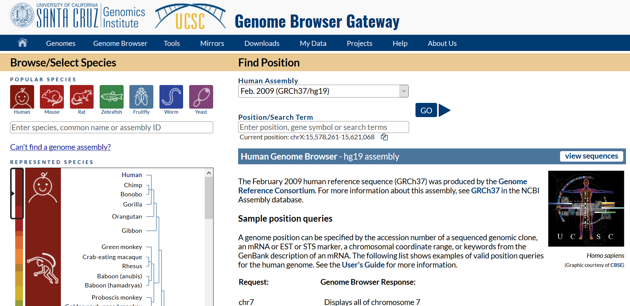

Slide 9
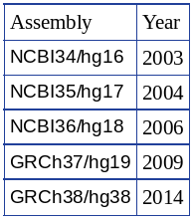
NCBI / GRCh

Slide 10
Introduction to common variation (II)
Lucía Colodro Conde and Katrina Grasby

