Slide 1
Introduction to common variation (I)
Lucía Colodro Conde and Katrina Grasby

Slide 2
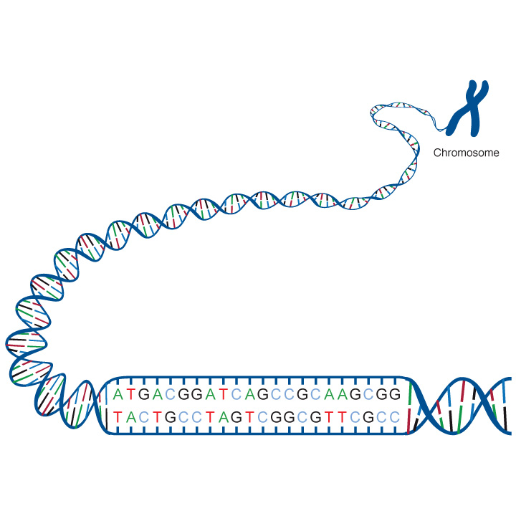
person 1
person 2
adenine (A), thymine (T), cytosine (C), guanine (G)
Genetic variation: differences in the sequence of DNA among individuals.
Mutation: a newly arisen variant

Slide 3
Genetic variant: any specific region of the genome which differs between two genomes.
Allele: version of a variant
Allele frequency: incidence of an allele in a population.
Minor allele frequency (MAF): frequency at which the less common allele occurs in a given population.
Minor allele count (MAC): number of times that allele appears over all individuals

Slide 4
Rare variant: a genetic variant present in < 1% of the alleles in the population
Common variant: a genetic variant present in >= 1% of the alleles in the population
Note 1% is arbitrary

Slide 5
Effect
High
Rare variants
causing
Mendelian traits
Very unlikely
Intermediate
Low frequency variants
with intermediate effects
Modest
Common variants implicated in complex traits
Difficult to detect
Low
0.001 0.01 0.1 0.3
Allele frequency
Based on McCarthy et al (2008) Nature Reviews Genetics 9, 356-369

Slide 6
Structural variation
Examples of genetic variation
Sequence variation
GWAS
Knight JC (2009). Genetics and the general physician: insights, applications and future challenge. QJM..

Slide 7
SNP (single nucleotide polymorphism):
variation at a single base pair in a DNA sequence among individuals.
Chrom.
DNA sequence
Genotype
Mat
GTAACTTGGGATCTAGACCAATAGAT
GTAACTTGGGATCTAGACCAATAGAT
GTAACTTGGGATCTAGACCAATAGAT
GTAACTTGGGATCTCGACCAATAGAT
GTAACTTGGGATCTCGACCAATAGAT
GTAACTTGGGATCTCGACCAATAGAT
Person 1
A A
Pat
Mat
Person 2
A C
Pat
Person 3
Mat
C C
Pat
Slide based on Manuel Ferreira’s

Slide 8
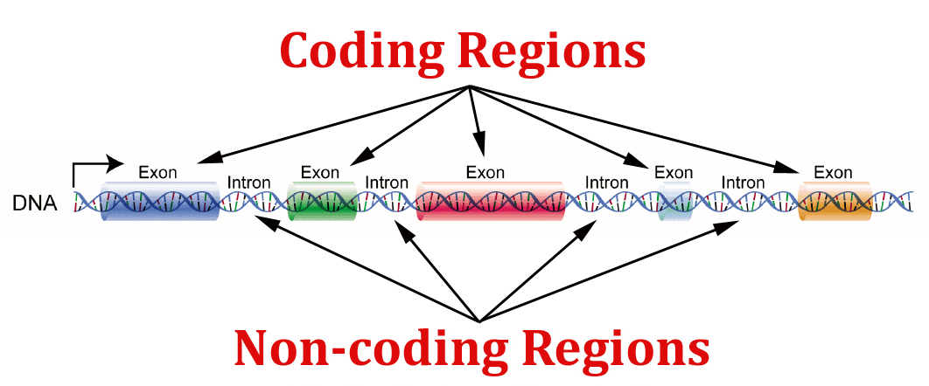
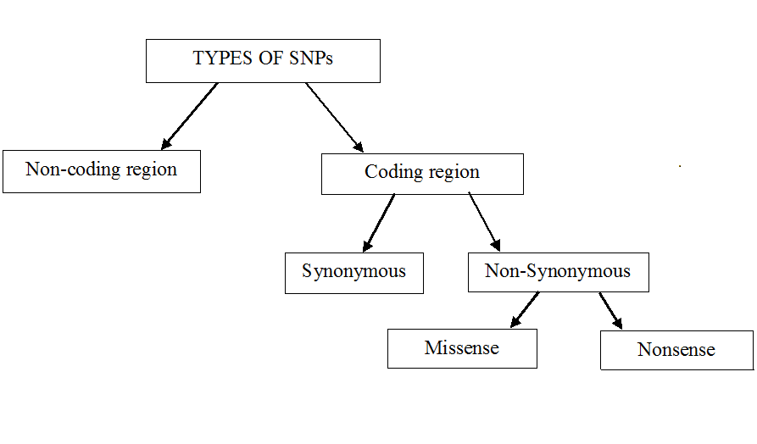
They may affect regulation of genes in coding regions
They change the amino acid sequence
They do not change the amino acid sequence
They change one amino acid in a protein (which may have an effect in the protein)
They produce a premature stop codon, that results in an incomplete and usually non-functional protein product

Slide 9
Insertion–deletion variants (indels):
one or more base pairs are present in some genomes but absent in others in relation to the reference
Chrom.
DNA sequence
Genotype
Mat
GTAACTTGGGATCTGATGACCAGATAG
GTAACTTGGGATCT---GACCAGATAG
GTAACTTGGGATCTGATGACCAGATAG
GTAACTTGGGATCTGATGACCAGATAG
GTAACTTGGGATCT---GACCAGATAG
GTAACTTGGGATCT---GACCAGATAG
Person 1
R D
Pat
Mat
Person 2
R R
Pat
Mat
Person 3
D D
Pat

Slide 10
Introduction to common variation (I)
Lucía Colodro Conde and Katrina Grasby

