Slide 1
Genetically informative designs & Genetic covariance structure analysis: A brief introduction based on the classical twin design
Conor V. Dolan & Michael C. Neale
PPT presentation in 4 parts
PART 1 (11 slides)
Linear regression
A covariance structure (based on linear regression)
The problem: how to infer genetic effects if you have not measured any genes (SNPs)?
PART 2 (19 slides):
Genetic covariance structure analysis
Genetically informative design - MZ twins raised together
The observed covariance matrix vs. the hypothesized covariance matrix (model)
Representation in path diagram
Genetically informative design - MZ and DZ twins raised together ... the classical twin design (CTD)
CTD Illustration height
PART 3 (8 slides):
CTD multivariate ACE models from 1 to p (p>1) phenotypes - limited to ACE (ADE models also possible)
Illustration Height and Weight
PART 4 (14 slides):
The classical twin design (CTD) assumptions
Other GIDs
Notes:
This is about estimating genetic and environmental effects in genetically informative designs.
In GWAS genetic effects are estimated by regressing the measured phenotype on the measured genetic variants ("genes", "SNPs")
In GID genetic and environmental effects are estimated as variance components. These are estimated on the basis of the phenotypic covariance (correlation) among family members.
So a GID generally involves analysing the phenotypic covariances among individuals who are characterized by known genetic and environmental relations.
A big difference with GWAS is that a GWAS will identify individual SNPs (in genes) that are associated with the phenotype of interest.
GID give use estimates of genetic variance, which represents the effect of ALL genes relevant to the phenotype studies (but does not identifiy the actual relevant genes.
Part 1 12 slides
Part 2 19 slides
Part 3 6 slides
Part 4 9+3 slides

Slide 2
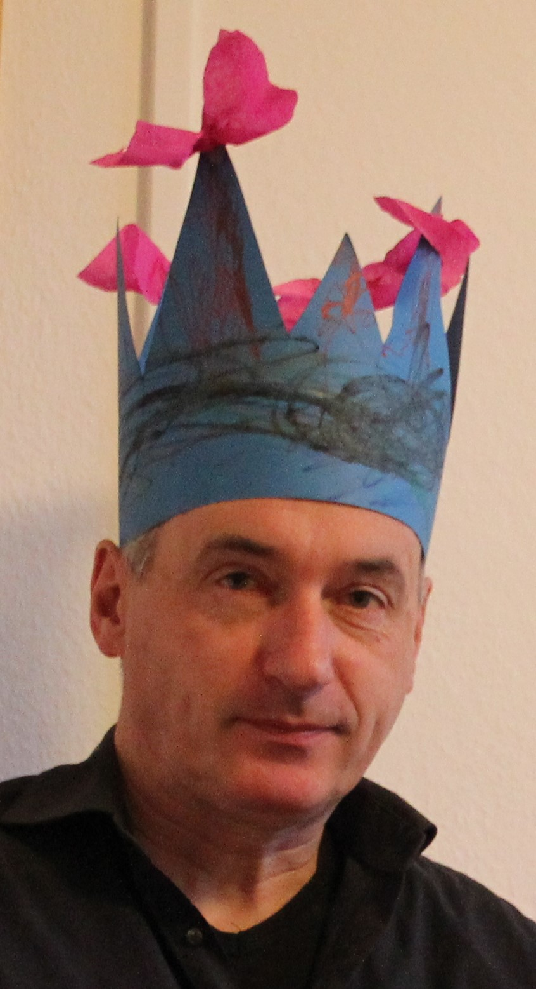

Genetically informative design & Genetic covariance structure analysis:
A brief introduction based on the classical twin design
Conor V. Dolan & Michael C. Neale
PPT presentation in 4 parts .... PART 1 (12 slides)
Linear regression
A covariance structure (based on linear regression)
The problem: how to infer genetic effects if you have not measured any genes (SNPs)?
Notes:
This is about estimating genetic and environmental effects in genetically informative designs.
In GWAS genetic effects are estimated by regressing the measured phenotype on the measured genetic variants ("genes", "SNPs")
In GID genetic and environmental effects are estimated as variance components. These are estimated on the basis of the phenotypic covariance (correlation) among family members.
So a GID generally involves analysing the phenotypic covariances among individuals who are characterized by known genetic and environmental relations.
A big difference with GWAS is that a GWAS will identify individual SNPs (in genes) that are associated with the phenotype of interest.
GID give use estimates of genetic variance, which represents the effect of ALL genes relevant to the phenotype studies (but does not identifiy the actual relevant genes.
Part 1 12 slides
Part 2 19 slides
Part 3 6 slides
Part 4 9+3 slides

Slide 3
Fitting models to phenotypic data in genetically informative designs (GID)
using genetic covariance structure modeling (GCSM)
Aim: infer genetic and environmental contributions to phenotypic variance from the phenotypic covariances (correlations) among family members (no measured genotypes, no measured environmental variables)
Contributions are expressed as “variance components”, so the
the phenotypic variance is decomposed into variance components.
Start with something familiar: the linear regression model
(e.g., as used in GWAS)

Slide 4
Linear regression model: predict Y from X ....
equation: Y_{i} = b₀ + b₁*X_{i} + e_{i} ... e.g. GWAS: Height_{i} = b₀ + b₁*SNP_{i} + e_{i}
variables: Y_{i} dependent (predicted) in participant i (EA, Height, Depression)
X_{i} predictor in participant i (genetic variant: a SNP)
e_{i} residual in participant i
parameters: b₀ intercept
b₁ slope or regression coefficient
Y, X and e are variables because their value vary over persons
b₀ and b₁ are (fixed) parameters, with unknown values (in the well defined population)
Are X and Y linearly related? Null hypothesis (H-null): b₁=0
Notes:
The linear regression model. It is useful to know the distinction between a parameter and a variable.
Perhaps you think: " this is about linear association, so what about correlation?"
That is a good thing to think. I am focusing on regression because it used in GWAS in genetically informative designs.
However, so can indeed also test a linear relationship using correlation.
rs1042725 (chr 12)

Slide 5
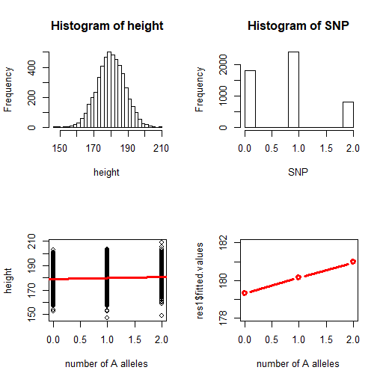
N = 20000
Descriptives
height: mean = 180.03 var= 64.01
SNP: mean = 0.80 var = 0.48
Covariance matrix
height SNP
height 64.01 0.212
SNP 0.212 0.480
Correlation matrix
height SNP
height 1.000 0.038
SNP 0.038 1.000
Alleles A-a, genotypes aa, Aa/aA and AA, coded 0, 1, 2 (Note this is additive coding)
Notes:
rs1042725 (chr 12)
Standard deviations sqrt(64.01) = ~8.00 and sqrt(.480) = ~.692
These results are based on simulated data .... here is the R code
# R script 6: regression of height on a bi-allelic genetic variant.
rm(list=ls(all=TRUE)) # empty memory
pA1=.4 # allele frequency of A
pA2=1-pA1 # allele frequency of a
a=.4 # a and d as featured in Figure 2.5
d=.0 # Figure 2.5
exact=F # F means draw a random sample
if (!exact) { randomseed=1243; set.seed(randomseed) }
# genotype effects
eff_A1A1=a # this is really a big effect
eff_A2A1=eff_A1A2=d
eff_A2A2=-a
m_height=180 # mean in genotype AA
sd_height=8 # population standard deviation
m_GV_A1A1 = m_height+eff_A1A1 # mean in genotype A1A1
m_GV_A1A2 = m_height+eff_A1A2 # mean in genotype A1A2
m_GV_A2A2 = m_height+eff_A2A2 # mean in genotype A2A2
N=20000 # sample size
Ns1=round(N*pA1^2) # number of people with genotype A1A1
Ns2=round(N*2*pA1*pA2) # number of people with genotype A1A2
Ns3=round(N*pA2^2) # number of people with genotype A2A2
#
N=sum(Ns1,Ns1,Ns3)
if (exact) {
h3=sd_height*scale(rnorm(Ns1))+m_GV_A1A1 # simulate the data in the three genotype groups
h2=sd_height*scale(rnorm(Ns2))+m_GV_A1A2
h1=sd_height*scale(rnorm(Ns3))+m_GV_A2A2
}
if (!exact) {
h3=rnorm(Ns1,m_GV_A1A1,sd_height) # simulate the data in the three genotype groups
h2=rnorm(Ns2,m_GV_A1A2,sd_height)
h1=rnorm(Ns3,m_GV_A2A2,sd_height)
}
height=c(h1,h2,h3) # put the height data together
SNP=c(rep(0,Ns3),rep(1,Ns2),rep(2,Ns1)) # put the genotype data together
res1=lm(height~SNP) # regress height on the genotype
summary(res1) # show the results
layo=matrix(c(1,3,2,4),2,2)
layout(layo)
#x11()
hist(height,30)
#x11()
hist(SNP)
plot(SNP,height,xlab="number of A alleles") # plot the data
abline(res1,col=2,lwd=3)
#x11();
plot(SNP,res1$fitted.values,
xlab="number of A alleles",ylim=c(178,182),type='b',lwd=3,col=2) #
descr_h=round(c(mean(height), var(height), sd(height)),2)
descr_SNP=round(c(mean(SNP),var(SNP),sd(SNP)),2)
S1=round(cov(cbind(height, SNP)),3)
R1=round(cor(cbind(height, SNP)),3)
#
# MZ twins
library(MASS)
varPh=65
h2=.8
varA=h2*varPh
varE=(1-h2)*varPh
SMZ=matrix(c(varPh, varA, varA, varPh),2,2)
mu=c(180,180)
mzdat=mvrnorm(250, mu, Sigma=SMZ, emp=F)
Smz=round(cov(mzdat),3)
Rmz=round(cor(mzdat),3)

Slide 6
Results of linear regression analysis (in R).
Estimate Std. Error t value Pr(>|t|)
b₀ (Intercept) 179.67245 0.08635 2080.67 < 2e-16 ***
b₁ SNP 0.44226 0.08160 5.42 6.02e-08 ***
Linear association? H-null b1=0, H-alt b1≠0, α=0.01
Conclusion: p< α(p= 6.02e-08) so we reject H-null
Conclusion: individual differences in height are linearly related to Individual differences in SNP; or SNP explains variance of height or the SNP is associated with height.
Linear additive model: the effect of alleles A on height is additive
go from aa (0) to Aa (1) is associated with difference .44226 (b₁)
go from aa (0) to AA (2) is associated with difference .44226 + .44226 (additive: b₁+ b₁)
Notes:
Simulated data results ... regression analysis conducted in R.
# R script 6: regression of height on a bi-allelic genetic variant.
rm(list=ls(all=TRUE)) # empty memory
pA1=.4 # allele frequency of A
pA2=1-pA1 # allele frequency of a
a=.4 # a and d as featured in Figure 2.5
d=.0 # Figure 2.5
exact=F # F means draw a random sample
if (!exact) { randomseed=1243; set.seed(randomseed) }
# genotype effects
eff_A1A1=a # this is really a big effect
eff_A2A1=eff_A1A2=d
eff_A2A2=-a
m_height=180 # mean in genotype AA
sd_height=8 # population standard deviation
m_GV_A1A1 = m_height+eff_A1A1 # mean in genotype A1A1
m_GV_A1A2 = m_height+eff_A1A2 # mean in genotype A1A2
m_GV_A2A2 = m_height+eff_A2A2 # mean in genotype A2A2
N=20000 # sample size
Ns1=round(N*pA1^2) # number of people with genotype A1A1
Ns2=round(N*2*pA1*pA2) # number of people with genotype A1A2
Ns3=round(N*pA2^2) # number of people with genotype A2A2
#
N=sum(Ns1,Ns1,Ns3)
if (exact) {
h3=sd_height*scale(rnorm(Ns1))+m_GV_A1A1 # simulate the data in the three genotype groups
h2=sd_height*scale(rnorm(Ns2))+m_GV_A1A2
h1=sd_height*scale(rnorm(Ns3))+m_GV_A2A2
}
if (!exact) {
h3=rnorm(Ns1,m_GV_A1A1,sd_height) # simulate the data in the three genotype groups
h2=rnorm(Ns2,m_GV_A1A2,sd_height)
h1=rnorm(Ns3,m_GV_A2A2,sd_height)
}
height=c(h1,h2,h3) # put the height data together
SNP=c(rep(0,Ns3),rep(1,Ns2),rep(2,Ns1)) # put the genotype data together
res1=lm(height~SNP) # regress height on the genotype
summary(res1) # show the results
layo=matrix(c(1,3,2,4),2,2)
layout(layo)
#x11()
hist(height,30)
#x11()
hist(SNP)
plot(SNP,height,xlab="number of A alleles") # plot the data
abline(res1,col=2,lwd=3)
#x11();
plot(SNP,res1$fitted.values,
xlab="number of A alleles",ylim=c(178,182),type='b',lwd=3,col=2) #
descr_h=round(c(mean(height), var(height), sd(height)),2)
descr_SNP=round(c(mean(SNP),var(SNP),sd(SNP)),2)
S1=round(cov(cbind(height, SNP)),3)
R1=round(cor(cbind(height, SNP)),3)
#
# MZ twins
library(MASS)
varPh=65
h2=.8
varA=h2*varPh
varE=(1-h2)*varPh
SMZ=matrix(c(varPh, varA, varA, varPh),2,2)
mu=c(180,180)
mzdat=mvrnorm(250, mu, Sigma=SMZ, emp=F)
Smz=round(cov(mzdat),3)
Rmz=round(cor(mzdat),3)

Slide 7
Height_{i} = b₀ + b₁*SNP_{i} + e_{i} = 197.67 + .442*SNP_{i} + e_{i}
Increase in the number of A alleles (from aa to Aa and from Aa to AA) is associated
with increase in height of b₁ = 0.442 cm. Because the SNP is coded 0 (aa) / 1 (Aa, aA) / 2 (AA) and the model is linear, the explained variance is called additive genetic variance.
R²: 0.001467 proportion of variance explained or 0.1467%
Covariance structure model:
The linear regression model
provides an account of the covariance (correlation) of Height and SNP
  (remember correlation expression linear association)
provide a decomposition of variance of Height
  (remember: variance is a measure of the magnitude of individual differences)
Notes:
The regression model is associated with a covariance structure.

Slide 8
covariance matrix
observed numerical cov S
 | Height | SNP
Height | 64.01 | 0.212
SNP | 0.212 | 0.480
in symbols
 | Height | SNP
Height | s²_{H} | s_{H,SNP}
SNP | s_{H,SNP} | s²_{SNP}
based on linear regression model
 | Height | SNP
Height | b₁²*s²_{SNP}+ s²_{e} | b₁*s²_{SNP}
SNP | b₁*s²_{SNP} | s²_{SNP}
Height_{i} = b₀ + b₁*SNP_{i} + e_{i} .... Height_{i} = 197.67 + .442*SNP_{i} + e_{i}
Notes:
Top left: Numerical, based on simulated data.
Top right: The variances and covariances in symbols
Bottom: the covariance matrix as implied by the linear regression model.
The point is that a linear model implies a covariance structure.

Slide 9
Observed numerical
 | Height | SNP
Height | 64.01 | 0.212
SNP | 0.212 | 0.480
linear regression model
 | Height | SNP
Height | b₁²*s²_{SNP} + s²_{e} | b₁*s²_{SNP}
SNP | b₁*s²_{SNP} | s²_{SNP}
Decomposition: s²_{H} = b₁²*s²_{SNP} + s²_{e} =
.442²*0.480 = 0.0938 (i.e. explained additive genetic variance)
Covariance: b₁*s²_{SNP} = .442*0.480 = .212
Effect size R²: {b₁²*s²_{SNP} } / { b₁²*s²_{SNP} + s²_{e} } =
0.0938 / 64.01 = .00146, or .146%
Notes:
Top left: numerical results based on simulated data
Top right: the covariance matrix (structure) implied by the model
The model includes parameters. If we have estimates of these parameters, we can express the covariance structure numerically.
Also we calculate the R-sqr statistic, which is also based on he parameter estimates

Slide 10
Height_{i} = b₀ + b₁*SNP_{i} + e_{i}
model: linear regression model
linear regression model - implied covariance structure
 | Height | SNP
Height | b₁²*s²_{SNP} + s²_{e} 64.01 | b₁*s²_{SNP} 0.212
SNP | b₁*s²_{SNP} 0.212 | s²_{SNP} 0.480
model implied
covariance structure
SNP
b₁
Height
e
1
path diagram
s²_{e}
s²_{SNP}
Notes:
Ok so we have 1) the regression model as an equation (b0 and b1 estimates on the right)
2) the regression model represented as a path diagram
3) The numecal covariance matrix, and 4) the model implies covariance matrix.

Slide 11
Height
an observed variable, a measured variable (phenotype, locus)
A
a latent variable, unobservable variable (additive genetic factor)
neuro-ticism
a latent variable, unobservable variable (the neuroticism as a latent construct)
conventions
neuro-
ticism
neuroticism as measured using a psychometric test, a test score
(the test score approximates the latent construct)
regression relationship - linear association
(asymmetric)
X
Y
e
covariance or correlation - linear association
(symmetric)
X
Y
variance
X

Slide 12
Suppose we measured all SNPs relevant to height, suppose there are just 2
Height_{i} = b₀ + b₁*SNP1_{i} + b₂*SNP2_{i} + e_{i}
s²_{SNP1}
A_{i} = b₁*SNP1_{i} + b₂*SNP2_{i}
SNP1
s²_{E}
s²_{A}
s²_{E}
b₁
1
E
A
1
H
1
E
s₁₂
H
s²_{SNP2}
SNP2
b₂
s²_{Height} = s²_{A} + s²_{e}
s²_{Height} = b₁²*s²_{SNP1} + b₂²*s²_{SNP2} + 2*b₁*b₂*s₁₂ + s²_{E}
Additive genetic variance: s²_{A}
(Environmental) variance: s²_{E}
Notes:
Note the small change in notation from s²e to s²E. Why ? because A represents all genes relevant to height, the the residual is due to the environment. So I used e (lower case) to denote residual in regression
(prediction error), but I used E here (slide 12) to denote Environment.
Height, like many psychological and medical traits, is a polygenic trait. It is subject to the effects of many genes, which implies many SNPs.
Here we generalize the regression model from 1 to 2 SNPs.
Why just 2? MERELY to ease presentation. There are hundreds (if not thousands) of SNPs (in genes) relevant to height.
Given M SNPs, we can consider the total variance explained by the SNPs (whether M=2 or m=100 or M=1000).
We call the variance of Height explained by the SNPs, the additive genetic variance (A).
Why do we call it additive genetic variance? Because it is the variance explained by the additive coded SNPs.
The SNPs are diallelic. Gives alleles A and a, the genotypes are aa, Aa (=aA), and AA, and are coded 0 (aa), 1 (Aa or aA) and 2 (AA).
You can see from the predicted values that an increase of one A alleles (0 to 1 and 1 to 2) is associated with the same increase in the predicted value of the phenotype.
(the increase is equal to the regression coefficient .4422 - see slide 8)
height|genotype aa (0): 179.67 + .4422*0 = 179.67
Aa (1): 179.67 + .4422*1 = 180.11
AA(2): 179.67 + .4422*2 = 180.55
So increasing the number of A alleles has an additive effect, hence additive genetic variance
.

Slide 13
Suppose the following, where s²_{A} is attributable to M SNPs (M>1000, say).
Eq 1: Height = b₀ + b₁*Gene₁ + b₂*Gene₂ + ....b_{M}*Gene_{M} + E
Eq 2: Height = b₀ + A + E
s²_{A}
s²_{E}
A
1
H
1
E
s²_{Height} = s²_{A} + s²_{E}
s²_{A} attributable to Gene₁ to Gene_{M}.
How to estimate the variance components, if we have not measured the SNPs?
Solution: Genetically Informative Design (GID)
+ Genetic covariance structure modelling (GCSM)
Notes:
Ok now consider the hypothesis that M SNPs contribute to individual differences in Height.
GIDs are designs that allow us to estimate genetic and environmental variances ("variance components") without having measured the relevant (associated) genetic variants (e.g. SNPs)

Slide 14
Genetically informative design & Genetic covariance structure analysis:
A brief introduction based on the classical twin design
Conor V. Dolan & Michael C. Neale
PPT presentation in 4 parts .... PART 2 (18 slides):
Genetic covariance structure analysis
Genetically informative design - MZ twins raised together
The observed covariance matrix vs. the hypothesized covariance matrix (model)
Representation in path diagram
Genetically informative design - MZ and DZ twins raised together ... the classical twin design (CTD)
CTD Illustration height

Slide 15
Genetic covariance structure model (GCSM)
A model for the linear relationships among phenotype
Phenotypes collected in a genetically informative design (GID)
Phenotypes measured in individuals in known genetic / environmental relationships
GID aim: estimate genetic and environmental variance components based only
on the phenotype measures, no measured genes (SNPs), no measured environment
Most used GID: MZ and DZ twins raised together: the classical twin design (CTD
Polderman et al 2015 - see slide notes for the ref)
Start with a simpler GID: MZ twins raised together (MZT)
Design: collect height in a representative sample of MZ twins
(i.e., representative of the well defined population)
Notes:
Polderman, T., Benyamin, B., de Leeuw, C. et al. Meta-analysis of the heritability of human traits based on fifty years of twin studies. Nat Genet 47, 702–709 (2015). https://doi.org/10.1038/ng.3285

Slide 16
s²_{E}
s²_{A}
Our hypothesis
A represents genetic effects s²_{A}
E represents unshared environmental effects s²_{E}
A
1
H
1
E
Data: Height measured in 250 twin pairs (500 twins),
Unit of sampling: twin pair
Key to the GID: MZ twins are genetically identical, 100% genetic variance is shared by MZ twins ... implies a covariance structure model

Slide 17
MZ tw1 variance s²_{Height} = s²_{A} + s²_{E}
MZ tw2 variance s²_{Height} = s²_{A} + s²_{E}
Genes that contribute to height variance, necessarily contribute to MZ covariance, because MZ twins are genetically identical.
MZ tw1-tw2 covariance s_{H1,H2} = s²_{A}
Hypothesis (variance)
Hypothesis (covariance)
Observed N=250 MZ pairs (S) |  |  | GCSM (Model) (Σ)
 | MZ1 | MZ2 |  | MZ1 | MZ2
MZ1 | 63.891 | 50.782 | MZ1 | s²_{A} + s²_{E} | s²_{A}
MZ2 | 50.782 | 64.150 | MZ2 | s²_{A} | s²_{A} + s²_{E}
Notes:
Simulated data

Slide 18
Observed N=250 MZ pairs (S) |  |  | GCSM (Model) (Σ)
 | MZ1 | MZ2 |  | MZ1 | MZ2
MZ1 | 63.891 | 50.782 | MZ1 | s²_{A} + s²_{E} | s²_{A}
MZ2 | 50.782 | 64.150 | MZ2 | s²_{A} | s²_{A} + s²_{E}
s²_{A}
s²_{A}
s²_{E}
A
A
1
H
1
E
1
1
s²_{Height} = s²_{A} + s²_{E}
H1
H2
s²_{E}
1
1
s²_{E}
The hypothesis of interest
Estimate s²_{A} and s²_{E}
E
E
The GID: the means to the end of
estimating s²_{A} and s²_{E}
Notes:
We use the GID as a means to estimate the variance components.

Slide 19
Observed N=250 MZ pairs (S) |  |  | GCSM (Model) (Σ)
 | MZ1 | MZ2 |  | MZ1 | MZ2
MZ1 | 63.891 | 50.782 | MZ1 | s²_{A} + s²_{E} | s²_{A}
MZ2 | 50.782 | 64.150 | MZ2 | s²_{A} | s²_{A} + s²_{E}
s²_{A} = 50.782 (estimate of A variance component)
s²_{E} = s²_{Ph} - s²_{A} = 63.891 – 50.782 =13.11 and 64.150 – 50.782 = 13.37
s²_{E} = (13.11 + 13.37) /2 = 13.24 (estimate of E variance component)
Notes:
The manner of estimation is simple to do and simple to understand. In practice however things are often a lot more complicated - in practice we use maximum likelihood estimation.
What is important here is not the actual estimation method, but rather that the GID (MZT) is associated with an expected phenotypic hypothetical covariance matrix, which we can equate with the observed phenotype covariance matrix.
The implied equations allow us to identify and estimate the hypothetical variance components

Slide 20
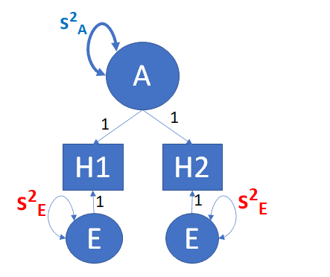
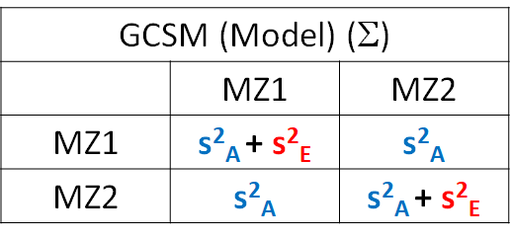
GID (MZ)
Graphically: pathmodel
GID (MZ)
Regression Equations
GID (MZ)
Covariance structure
(variances and covariance)
H₁ = m + A₁ + E₁
H₂ = m + A₂ + E₁
or (A₁=A₂)
H₁ = m + A + E₁
H₂ = m + A + E₂
This a weak GID... what have we assumed concerning the environment?
(see the MZ1-MZ2 covariance!)
Notes:
GID MZ together summarized.
This a weak GID... what have we assumed concerning the environment?
We have assumed that the environment does NOT contribute to the phenotypic resemblance of the MZ twins, i.e., there are no shared environmental influences.
The phenotype is not subject to shared environmental effects. Is this a save assumption? In the case of height, perhaps, but we still want to rule this out.
What about the case of IQ? Suppose we study MZ twins of age 12. Would you be willing to assume that there are no shared environmental effects on IQ?

Slide 21
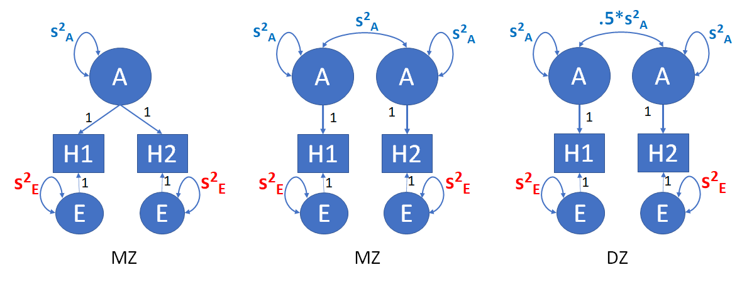
Classical twin design: MZ twins and DZ twins (raised / growing up together in the same household) .... AE model
=
GCSM (Model) (Σ_{MZ})
 | MZ1 | MZ2
MZ1 | s²_{A} + s²_{E} | s²_{A}
MZ2 | s²_{A} | s²_{A} + s²_{E}
GCSM (Model) (Σ_{DZ})
 | DZ1 | DZ2
DZ1 | s²_{A} + s²_{E} | .5*s²_{A}
DZ2 | .5*s²_{A} | s²_{A} + s²_{E}
Why add DZ twins? To extend the model (add variance component): ACE model or ADE model
Notes:
The classical twi design: MZ and DZ twins raised together.

Slide 22
ACE model
A = additive genetic
C= common (shared) environmental
E = unshared environmental
(+ measurement error)
r_{A}*s²_{A}
s²_{C}
0
s²_{A}
s²_{C}
s²_{E}
s²_{A}
s²_{C}
s²_{E}
A
C
E
A
C
E
1
1
1
1
1
1
H1
H2
GCSM (Model) (Σ_{MZ}) r_{A} = 1
 | MZ1 | MZ2
MZ1 | s²_{A} + s²_{C}+ s²_{E} | 1*s²_{A}+ s²_{C}
MZ2 | 1*s²_{A}+ s²_{C} | s²_{A} + s²_{C}+ s²_{E}
GCSM (Model) (Σ_{DZ}) r_{A} = ½
 | DZ1 | DZ2
DZ1 | s²_{A} + s²_{C}+s²_{E} | ½*s²_{A}+s²_{C}
DZ2 | ½*s²_{A}+s²_{C} | s²_{A} + s²_{C}+ s²_{E}
Notes:
Note that measurement error can be relatively large.
For instance, suppose you are studying neuroticism and you measure this in twins with a psychometric instrument (a neuroticism questionnaire).
Suppose that the established reliability of the test scores is .85. This means that 15% of the phenotypic variance is due to error, i.e., the variance of E will include 15% of the phenotypic variance

Slide 23
ADE model
A = additive genetic
D= dominance genetic
E = unshared environmental
(+ measurement error)
r_{A}*s²_{A}
r_{D}* s²_{D}
s²_{A}
s²_{D}
s²_{E}
s²_{A}
s²_{D}
s²_{E}
A
D
E
A
D
E
1
1
1
1
1
1
H1
H2
GCSM (Model) (Σ_{MZ}) r_{A} = 1 r_{D} = 1
 | MZ1 | MZ2
MZ1 | s²_{A} + s²_{D}+ s²_{E} | s²_{A}+ s²_{D}
MZ2 | s²_{A}+ s²_{D} | s²_{A} + s²_{D}+ s²_{E}
GCSM (Model) (Σ_{DZ}) r_{A} =½ r_{D} = ¼
 | DZ1 | DZ2
DZ1 | s²_{A} + s²_{D}+s²_{E} | ½*s²_{A}+¼*s²_{D}
DZ2 | ½*s²_{A}+¼*s²_{D} | s²_{A} + s²_{D}+ s²_{E}
Notes:
The CTD allows us to fit an ACE or and ADE model. The ACDE model cannot be fitted by cause we cannot estimate the C and the D variance simultaneously,
that is: these variance components are not identified.

Slide 24
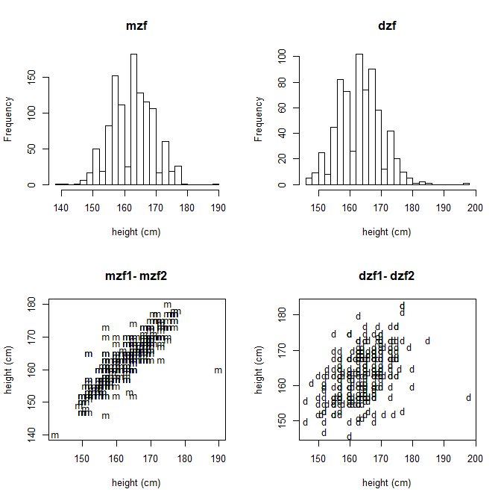
Illustration - height in females twins (mean age 23; std age 3.6)
(twinData in OpenMx R library ... R code in slide notes)
MZF Data descriptives
vars N* mean sd min max
ht1 1 556 162.97 6.64 141.99 189.99
ht2 2 560 162.93 6.65 139.99 179.98
mzf correlation r_{MZ} = .878
DZF Data descriptives
vars N* mean sd min max
ht1 1 348 164.09 6.94 146 198.00
ht2 2 343 163.28 6.73 146 182.98
dzf correlation r_{DZ} = .439
*note: variation in N is due to missing data
Notes:
Results obtained using the R code given below.
#
rm(list=ls())
library(OpenMx)
library(psych)
#
# ----------------------------------------------------------------------------------------------------------------------
# Load Data
#
data(twinData) # read data / load data
dim(twinData) # check dimensions
#
twinData=twinData[twinData$zyg<=5,] # younger group ... cohort
describe(twinData[,1:12], skew=F) # get the desciptives, I don't want the skewness
#
# (twinData)
# [1] "fam" "age" "zyg" "part" "wt1" "wt2"
# [7] "ht1" "ht2" "htwt1" "htwt2" "bmi1" "bmi2"
#[13] "cohort" "zygosity" "age1" "age2"
#
# Select Variables for Analysis
#
nv <- 1 # number of variables in the analysis: just bmi
ntv <- nv*2 # number of total variables
#
#
# Annotation: we have sex info in terms of the variable zyg. Use the zyg info to create the sex variable, and define the MZ and DZ dataframes, mzData and dzData.
# MZFF, MZMM, DZFF, DZMM, DZOS. DZOS are in Female/Male wide order.
#
N=dim(twinData)[1]
sex=matrix(NA,N,2)
sex[twinData$zyg==1,1:2]=1
sex[twinData$zyg==2,1:2]=0
sex[twinData$zyg==3,1:2]=1
sex[twinData$zyg==4,1:2]=0
sex[twinData$zyg==5,1]=c(1)
sex[twinData$zyg==5,2]=c(0)
colnames(sex)=c('sex1','sex2')
twinData=cbind(twinData, sex)
#
sel1=(twinData$zyg==1 | twinData$zyg==2) # mzf, mzm
sel2=(twinData$zyg==3 | twinData$zyg==4 | twinData$zyg==5) # dzf dzm dzfm
#
#
selVars1 = c("ht1","wt1","bmi1","sex1","ht2","wt2","bmi2","sex2") # the array with the variable names
#
mzData <- subset(twinData, sel1, selVars1)
dzData <- subset(twinData, sel2, selVars1)
#
# Descriptive Statistics for MZ and DZ
#
describe(mzData, skew=F)
describe(dzData, skew=F)
# use height
selv=c('ht1','ht2')
sel1=mzData$sex1 == 0 & mzData$sex2 == 0
mzmData=mzData[sel1,selv]
sel1=dzData$sex1 == 0 & dzData$sex2 == 0
dzmData=dzData[sel1,selv]
#
# use female data (larger samples)
sel1=mzData$sex1 == 1 & mzData$sex2 == 1
mzfData=mzData[sel1,selv]
sel1=dzData$sex1 == 1 & dzData$sex2 == 1
dzfData=dzData[sel1,selv]
#
#
# meter to centimeters
mzfData=mzfData*100
dzfData=dzfData*100
#
describe(mzfData, skew=F)
describe(dzfData, skew=F)
smzf=cov(mzfData, use="pairwise.complete.obs")
sdzf=cov(dzfData, use="pairwise.complete.obs")
rmzf=cov2cor(smzf)
rdzf=cov2cor(sdzf)
#
layout(matrix(c(1,3,2,4),2,2))
hist(c(mzfData$ht1, mzfData$ht2),20, main='mzf',xlab='height (cm)')
hist(c(dzfData$ht1, dzfData$ht2),20, main='dzf',xlab='height (cm)')
plot(mzfData$ht1, mzfData$ht2, type='p', pch='m', main='mzf1- mzf2',xlab='height (cm)',ylab='height (cm)')
plot(dzfData$ht1, dzfData$ht2, type='p', pch='d', main='dzf1- dzf2',xlab='height (cm)',ylab='height (cm)')
#
round(smzf,3)
round(sdzf,3)
round(rmzf,3)
round(rdzf,3)
# PREPARE MODEL
library(OpenMx)
#
svVA=30
svVC=.0
svVE=10
svMe=160
selVars=c('ht1','ht2')
# Create Algebra for expected Mean Matrices
meanH <- mxMatrix( type="Full", nrow=1, ncol=ntv, free=TRUE, values=svMe, labels=c("mean","mean"), name="meanH" )
#ACE model
# Create Matrices for Variance Components
covA <- mxMatrix( type="Symm", nrow=nv, ncol=nv, free=TRUE, values=svVA, label="VA11", name="VA" )
covC <- mxMatrix( type="Symm", nrow=nv, ncol=nv, free=TRUE, values=svVC, label="VC11", name="VC" )
covE <- mxMatrix( type="Symm", nrow=nv, ncol=nv, free=TRUE, values=svVE, label="VE11", name="VE" )
#ACE model
# Create Algebra for expected Variance/Covariance Matrices in MZ & DZ twins
covP <- mxAlgebra( expression= VA+VC+VE, name="V" )
covMZ <- mxAlgebra( expression= VA+VC, name="cMZ" )
covDZ <- mxAlgebra( expression= 0.5%x%VA+ VC, name="cDZ" )
expCovMZ <- mxAlgebra( expression= rbind( cbind(V, cMZ), cbind(t(cMZ), V)), name="expCovMZ" )
expCovDZ <- mxAlgebra( expression= rbind( cbind(V, cDZ), cbind(t(cDZ), V)), name="expCovDZ" )
#ACE model
# Create Data Objects for Multiple Groups
#ACE model
dataMZ <- mxData( observed=mzfData, type="raw" )
dataDZ <- mxData( observed=dzfData, type="raw" )
#ACE model
# Create Expectation Objects for Multiple Groups
expMZ <- mxExpectationNormal( covariance="expCovMZ", means="meanH", dimnames=selVars )
expDZ <- mxExpectationNormal( covariance="expCovDZ", means="meanH", dimnames=selVars )
funML <- mxFitFunctionML()
#ACE model
# Create Model Objects for Multiple Groups
pars <- list( meanH, covA, covC, covE, covP )
modelMZ <- mxModel( pars, covMZ, expCovMZ, dataMZ, expMZ, funML, name="MZ" )
modelDZ <- mxModel( pars, covDZ, expCovDZ, dataDZ, expDZ, funML, name="DZ" )
multi <- mxFitFunctionMultigroup( c("MZ","DZ") )
#ACE model
# Create Algebra for Variance Components
rowVC <- rep('VarComp',nv)
colVC <- rep(c('StA','StC','StE'),each=nv)
estVC <- mxAlgebra( expression=cbind(VA/V,VC/V,VE/V), name="VarComp", dimnames=list(rowVC,colVC) )
#ACE model
# Create Confidence Interval Objects
ciACE <- mxCI( "VarComp[1,1:3]" )
#ACE model
# Build Model with Confidence Intervals
modelACE <- mxModel( "oneACEvc", pars, modelMZ, modelDZ, multi, estVC, ciACE )
#ACE model
# ----------------------------------------------------------------------------------------------------------------------
# RUN MODEL
#
# Run ACE Model
fitACE <- mxRun( modelACE, intervals=F )
sumACE <- summary( fitACE )
#
# Compare with Saturated Model
# mxCompare( fitSAT, fitACE )
#
# ----------------------------------------------------------------------------------------------------------------------
# RUN SUBMODELS AE model, CE model, E model
# Run AE model
modelAE <- mxModel( fitACE, name="oneAEvc" )
modelAE <- omxSetParameters( modelAE, labels="VC11", free=FALSE, values=0 )
fitAE <- mxRun( modelAE, intervals=T )
sumAE = summary(fitAE)

Slide 25
GID: the classical twin design.
Decomposing phenotypic variance based on ACE Model: s²_{Height} = s²_{A} + s²_{C}+ s²_{E}
GCSM (Model) (Σ_{MZ})
 | MZ1 | MZ2
MZ1 | s²_{A} + s²_{C}+ s²_{E} | s²_{A}+ s²_{C}
MZ2 | s²_{A}+ s²_{C} | s²_{A} + s²_{C}+ s²_{E}
GCSM (Model) (Σ_{DZ})
 | DZ1 | DZ2
DZ1 | s²_{A} + s²_{C}+s²_{E} | ½*s²_{A}+s²_{C}
DZ2 | ½*s²_{A}+s²_{C} | s²_{A} + s²_{C}+ s²_{E}
Observed data (variances, covariances, correlations)
Observed S_{MZ} (R_{MZ}) (N=569)
 | MZ1 | MZ2
MZ1 | 44.068 (1) | 38.721 (.878)
MZ2 | 38.721 (.878) | 44.177 (1)
GCSM (Model) S_{DZ} (R_{DZ}) (N=351)
 | DZ1 | DZ2
DZ1 | 48.175 (1) | 20.519 (.439)
DZ2 | 20.519 (.439) | 45.319 (1)
Notes:
Again the GID gives us the expected, hypothetical covariance matrices in MZs and DZs, which we can compare to the observed phenotypic covariance matrices
We can estimate the variances in the hypothetical covariance matrices on the basis of the information in the phenotypic covariance matrices.

Slide 26
Quick method based on standardized phenotypes .... Falconer's equations
s²_{A} + s²_{C}+ s²_{E} = variance = 1
s²_{A} + s²_{C} = r_{MZ} = .878
½*s²_{A} + s²_{C} = r_{DZ} = .439
three equations,
three unknowns, three knowns
solve for the unknowns....
ACE model, if (2*r_{DZ})≥r_{MZ}
s²_{A} = 2*(r_{MZ}-r_{DZ}) = 2*(.878 - .439) = .878
s²_{C} = 2*r_{DZ}-r_{MZ} = 2*.439-.878 = 0.0
s²_{E} = 1- s²_{A} - s²_{C} = 1-.0-.878 = .122
Conclusion given s²_{A} + s²_{C}+ s²_{E} =.878 + 0 + .122 = 1. In young females adults, #1) 87.8% of variance is genetic (87.8% of phenotypic differences due to genetic differences); #2) No contribution of shared environment; #3) 12.2% of variance is environmental (+ measurement error).
Solution
Note: ADE model equations in slide notes (used if (2*r_{DZ})<r_{MZ})
Notes:
A simple estimation method based on standardized phenotypes. .... Falconer's equations
ACE model
parameter a² c² e²
calculation 2*(r_{MZ}-r_{DZ}) 2*r_{DZ}-r_{MZ} 1-a²-c²
ADE model, if (2*r_{DZ})<r_{MZ}
parameter a² d² e²
calculation 4*r_{DZ}-r_{MZ} 2*r_{MZ}-4*r_{DZ} 1-a²-d²
#
#
#
# try this in R. Because the AE model fits perfectly (var(C) = 0), we'll get the same results as when we use the equations of the ACE model
rmz=.878
rdz=.439
va=4*rdz-rmz
vd=2*rmz - 4*rdz
ve=1-va-vd
print(c(va,vd,ve))

Slide 27
In practice, we use genetic covariance structure modeling to fit models to data collected in genetically informative design.
1) Optimal estimates of parameters + information about precision of estimates (95% CIs)
2) Overall goodness of fit testing: does the specified model fit the observed covariance matrices?
3) Statistical testing of individual parameters (ACE vs AE; ACE vs CE; ADE vs AE).
and
4) Generalizes from 1 phenotype to P phenotypes (multivariate phenotype / repeated measures)
5) Accommodates missing data
6) Can handle binary / dichotomous phenotypic data
7) Can handle any (multivariate) Genetically Informative Design
(e.g. twins + parents; twins + siblings; children of twin design; extended pedigree design)

Slide 28
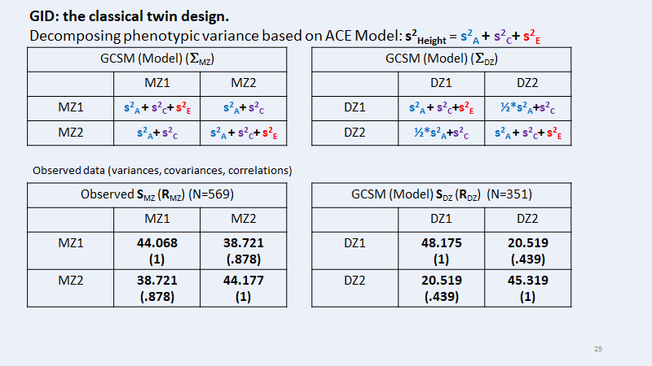
GCSM
We have the data (MZ and DZ twin phenotypic data)
The data summary (linear relationship): two covariance matrices and the 4 means
We have a linear model for the data (pathmodel), which implies covariance structure(s)
The covariance structure(s) are covariance matrices expressed in terms of unknown (to be estimated) and
known parameters (GID!).
The classical twin design: unknown parameters (s²_{A} , s²_{C}, s²_{e}) and known parameters (1, ½, ¼)
How to obtain estimates? Maximum likelihood estimation

Slide 29
Illustration of ML estimation in GCSM with MZ and DZ twin design (phenotype height)
Observed S_{MZ} (R_{MZ}) (N=569)
 | MZ1 | MZ2
MZ1 | 44.068 (1) | 38.721 (.878)
MZ2 | 38.721 (.878) | 44.177 (1)
GCSM (Model) S_{DZ} (R_{DZ}) (N=351)
 | DZ1 | DZ2
DZ1 | 48.175 (1) | 20.519 (.439)
DZ2 | 20.519 (.439) | 45.319 (1)
μ the phenotypic mean
s²_{A} genetic variance
s²_{C} shared env variance
s²_{E} unshared env variance
Parameters associated with the
hypothesis ACE model

Slide 30
OpenMx ML estimates ACE model ... Hypothesis ACE model
free parameters:
name matrix row col Estimate Std.Error 4 Parameters
1 mean meanH 1 1 163.296892 0.2045165 μ the phenotypic mean
2 VA11 VA 1 1 41.162844 4.1639267 s²_{A} genetic variance
3 VC11 VC 1 1 -1.093649 4.1465672 s²_{C} shared env variance
4 VE11 VE 1 1 5.419555 0.3276949 s²_{E} unshared env variance
Model Statistics:
| Parameters | Degrees of Freedom | Fit (-2lnL units)
Model: 4 1803 11135.91 .... -2*f_{ML}(θ)
OpenMx ML estimates AE model i.e., s²_{C} = 0 (fixed to zero) ... Hypothesis AE model
free parameters:
name matrix row col Estimate Std.Error 3 Parameters
1 mean meanH 1 1 163.29555 0.2051183 μ the phenotypic mean
2 VA11 VA 1 1 40.18631 1.8228455 s²_{A} genetic variance
3 VE11 VE 1 1 5.42909 0.3269049 s²_{E} unshared env variance
Model Statistics:
| Parameters | Degrees of Freedom | Fit (-2lnL units)
Model: 3 1804 11135.99 .... -2*f_{ML}(θ)
Notes:
# PREPARE MODEL
library(OpenMx)
#
svVA=30
svVC=.0
svVE=10
svMe=160
selVars=c('ht1','ht2')
# Create Algebra for expected Mean Matrices
meanH <- mxMatrix( type="Full", nrow=1, ncol=ntv, free=TRUE, values=svMe, labels=c("mean","mean"), name="meanH" )
#ACE model
# Create Matrices for Variance Components
covA <- mxMatrix( type="Symm", nrow=nv, ncol=nv, free=TRUE, values=svVA, label="VA11", name="VA" )
covC <- mxMatrix( type="Symm", nrow=nv, ncol=nv, free=TRUE, values=svVC, label="VC11", name="VC" )
covE <- mxMatrix( type="Symm", nrow=nv, ncol=nv, free=TRUE, values=svVE, label="VE11", name="VE" )
#ACE model
# Create Algebra for expected Variance/Covariance Matrices in MZ & DZ twins
covP <- mxAlgebra( expression= VA+VC+VE, name="V" )
covMZ <- mxAlgebra( expression= VA+VC, name="cMZ" )
covDZ <- mxAlgebra( expression= 0.5%x%VA+ VC, name="cDZ" )
expCovMZ <- mxAlgebra( expression= rbind( cbind(V, cMZ), cbind(t(cMZ), V)), name="expCovMZ" )
expCovDZ <- mxAlgebra( expression= rbind( cbind(V, cDZ), cbind(t(cDZ), V)), name="expCovDZ" )
#ACE model
# Create Data Objects for Multiple Groups
#ACE model
dataMZ <- mxData( observed=mzfData, type="raw" )
dataDZ <- mxData( observed=dzfData, type="raw" )
#ACE model
# Create Expectation Objects for Multiple Groups
expMZ <- mxExpectationNormal( covariance="expCovMZ", means="meanH", dimnames=selVars )
expDZ <- mxExpectationNormal( covariance="expCovDZ", means="meanH", dimnames=selVars )
funML <- mxFitFunctionML()
#ACE model
# Create Model Objects for Multiple Groups
pars <- list( meanH, covA, covC, covE, covP )
modelMZ <- mxModel( pars, covMZ, expCovMZ, dataMZ, expMZ, funML, name="MZ" )
modelDZ <- mxModel( pars, covDZ, expCovDZ, dataDZ, expDZ, funML, name="DZ" )
multi <- mxFitFunctionMultigroup( c("MZ","DZ") )
#ACE model
# Create Algebra for Variance Components
rowVC <- rep('VarComp',nv)
colVC <- rep(c('StA','StC','StE'),each=nv)
estVC <- mxAlgebra( expression=cbind(VA/V,VC/V,VE/V), name="VarComp", dimnames=list(rowVC,colVC) )
#ACE model
# Create Confidence Interval Objects
ciACE <- mxCI( "VarComp[1,1:3]" )
#ACE model
# Build Model with Confidence Intervals
modelACE <- mxModel( "oneACEvc", pars, modelMZ, modelDZ, multi, estVC, ciACE )
#ACE model
# ----------------------------------------------------------------------------------------------------------------------
# RUN MODEL
#
# Run ACE Model
fitACE <- mxRun( modelACE, intervals=F )
sumACE <- summary( fitACE )
#
# Compare with Saturated Model
# mxCompare( fitSAT, fitACE )
#
# ----------------------------------------------------------------------------------------------------------------------
# RUN SUBMODELS AE model, CE model, E model
# Run AE model
modelAE <- mxModel( fitACE, name="oneAEvc" )
modelAE <- omxSetParameters( modelAE, labels="VC11", free=FALSE, values=0 )
fitAE <- mxRun( modelAE, intervals=T )
sumAE = summary(fitAE)

Slide 31
Likelihood ratio test. ACE vs AE .... can we "drop" C (i.e., set s²_{C} = 0)?
A statistical test of the hypothesis s²_{C} = 0 based on the values of the likelihood functions
Model Statistics:
| Parameters | Degrees of Freedom | Fit (-2lnL units)
Model: 4 1803 11135.91
Model Statistics:
| Parameters | Degrees of Freedom | Fit (-2lnL units)
Model: 3 1804 11135.99
Test statistic called the (log-)Likelihood Ratio test (LRT):
11135.99 - 11135.91 = .08
If H-null: s²_{C} = 0 is true, the LRT is distributed chi2(1), where 1 (df) = 4-3, difference in the number of parameters
.08, df=1, p-value = .777 (in R pchisq(.08,1,lower=F)
If p-value < alpha (e.g. .01), we would reject s²_{C} = 0.
Here we conclude s²_{C} = 0 ... So there is no shared environmental variance
no shared environmental contributions to the phenotype variance in height
s²_{Height} = s²_{A} + s²_{C} + s²_{E}

Slide 32
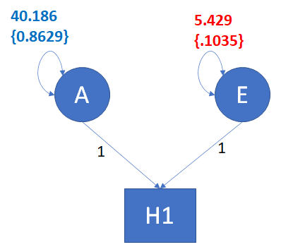
s²_{Height} = s²_{A} + s²_{E} = 40.186 + 5.429 = 45.615
standardized variance components
s²_{A} / {s²_{A} + s²_{E}} = 40.186 / 45.615 = .881 (a.k.a "narrow-sense" heritability, a proportion like R²)
s²_{E} / {s²_{A} + s²_{E}} = 5.429 / 45.615 = .119
95% confidence intervals of the standardized variance components:
lbound estimate ubound
s²_{A} / {s²_{A} + s²_{E}} 0.8629 0.881 0.8964
s²_{E} / {s²_{A} + s²_{E}} 0.1035 0.119 0.1370
95% CI tell us how precise
the estimate are ...
Notes:
s²_{A} + s²_{C}+ s²_{e} =.878 + 0 + .122 = 1 ... based on Falconer's equations ... .note the error: i include the lwer bounds in the path diagram.... should be the estimates of .881 and .119

Slide 33
Genetically informative design & Genetic covariance structure analysis:
A brief introduction based on the classical twin design
Conor V. Dolan & Micheal C. Neale
PPT presentation in 4 parts .... PART 3 (8 slides):
CTD multivariate ACE models from 1 to p (p>1) phenotypes - limited to ACE (ADE models also possible)
Illustration Height and Weight
Notes:
Part 1 12 slides
Part 2 19 slides
Part 3 6 slides
Part 4 9+3 slides

Slide 34
Univariate ACE model (one phenotype: s²_{A} and s²_{C} and s²_{E} are variances)
GCSM (Model) (Σ_{MZ})
 | MZ1 | MZ2
MZ1 | s²_{A} + s²_{C}+ s²_{E} | s²_{A}+ s²_{C}
MZ2 | s²_{A}+ s²_{C} | s²_{A} + s²_{C}+ s²_{E}
GCSM (Model) (Σ_{DZ})
 | DZ1 | DZ2
DZ1 | s²_{A} + s²_{C}+s²_{E} | ½*s²_{A}+s²_{C}
DZ2 | ½*s²_{A}+s²_{C} | s²_{A} + s²_{C}+ s²_{E}
Classical twin model generalizes readily to the multivariate case.
p-phenotypes: S_{A} and S_{C} and S_{E} are pxp covariance matrices in the ACE model
GCSM (Model) (Σ_{MZ}) r_{A} = 1
 | MZ1 | MZ2
MZ1 | S_{A} + S_{C}+ S_{E} | S_{A}+ S_{C}
MZ2 | S_{A}+ S_{C} | S_{A} + S_{C}+ S²_{E}
GCSM (Model) (Σ_{DZ}) r_{A} = ½
 | DZ1 | DZ2
DZ1 | S_{A} + S_{C}+S_{E} | ½*S_{A}+S_{C}
DZ2 | ½*S_{A}+S_{C} | S_{A} + S_{C}+ S_{E}
Notes:
lower case s = a 1x1 covariance matrix = variance
upper case S = a pxp covariance matrices, containing p*(p+1)/2 values, of which p are variances and p*(p-1)/2 are covariances

Slide 35
Path diagram of 2 phenotypes: height and weight. Hypothesis / aim: S_{PH} = S_{A} + S_{D} + S_{E}
s_{AH,AW}
s_{DH,DW}
s_{EH,EW}
s²_{AH}
s²_{DH}
s²_{EH}
s²_{AW}
s²_{DW}
s²_{EW}
A_{H}
D_{H}
E_{H}
A_{W}
D_{W}
E_{W}
1
1
1
1
1
1
Height
Weight
S_{PH} = S_{A} + S_{D} + S_{E}
S_{PH} | H | W
H | s²_{H} | s_{H,W}
W | s_{H,W} | s²_{W}
S_{A} | H | W
H | s²_{AH} | s_{AH,AW}
W | s_{AH,AW} | s²_{AW}
S_{D} | H | W
H | s²_{DH} | s_{DH,DW}
W | s_{DH,DW} | s²_{DW}
S_{E} | H | W
H | s²_{EH} | s_{EH,EW}
W | s_{EH,EW} | s²_{EW}
=
+
+
Notes:
Note that this is a diagram of the two phenotypes H and W. NOT a diagram of the twin model, which would involve 2x2 variables: height and weight in twinmembers 1 and twin members 2.
The bivariate model allows us to address the question: what is the contribution of genetic effect to the phenotypic covariance of height and weight (is s_{AH,AW} unequal zero?).

Slide 36
Covariance matrices (correlations)
Covariance matrices (m)
MZ | H1 | W1 | H2 | W2
H1 | 44.068 (1) | 28.066 | 38.721 | 24.283
W1 | 28.066 (.493) | 73.441 (1) | 27.702 | 63.359
H2 | 38.721 (.878) | 27.702 (.486) | 44.177 (1) | 26.909
W2 | 24.283 (.415) | 63.359 (.839) | 26.909 (.459) | 77.662 (1)
S_{A} + S_{D} + S_{E} | S_{A} + D
S_{A} + S_{D} | S_{A} + S_{D} + S_{E}
DZ | H1 | W1 | H2 | W2
H1 | 48.175 (1) | 26.426 | 20.519 | 14.952
W1 | 26.426 (.441) | 74.632 (1) | 10.158 | 26.773
H2 | 20.519 (.439) | 10.158 (.175) | 45.319 (1) | 28.205
W2 | 14.952 (.234) | 26.773 (.337) | 28.205 (.456) | 84.564 (1)
S_{A} + S_{D} + S_{E} | .5*S_{A} + .25*S_{D}
.5*S_{A}+ .25*S_{D} | S_{A} + S_{D} + S_{E}
S_{A ,} S_{D ,} and S_{E} are 2x2 matrices (2 phenotypes)

Slide 37
Path diagram of 2 phenotypes: height and weight. Hypothesis / aim: S_{PH} = S_{A} + S_{D} + S_{E}
s_{AH,AW}
s_{DH,DW}
s_{EH,EW}
s²_{AH}
s²_{DH}
s²_{EH}
s²_{AW}
s²_{DW}
s²_{EW}
A_{H}
D_{H}
E_{H}
A_{W}
D_{W}
E_{W}
LRT results
ADE model vs AE model:
LRT stat = 6.62, df=3, p=0.085
Drop D, reduce model to AE
1
1
1
1
1
1
Height
Weight
S_{PH} = S_{A} + S_{D} + S_{E}
S_{PH} | H | W
H | s²_{H} | s_{H,W}
W | s_{H,W} | s²_{W}
S_{A} | H | W
H | s²_{AH} | s_{AH,AW}
W | s_{AH,AW} | s²_{AW}
S_{C} | H | W
H | s²_{DH} | s_{DH,DW}
W | s_{DH,DW} | s²_{DW}
S_{E} | H | W
H | s²_{EH} | s_{EH,EW}
W | s_{EH,EW} | s²_{EW}
=
+
+

Slide 38
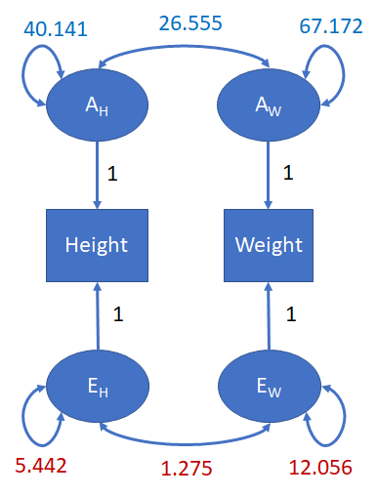
S_{PH} = S_{A} + S_{E}
S_{PH} | H | W
H | s²_{H} | s_{H,W}
W | s_{H,W} | s²_{W}
S_{A} | H | W
H | s²_{AH} | s_{AH,AW}
W | s_{AH,AW} | s²_{AW}
S_{E} | H | W
H | s²_{EH} | s_{EH,EW}
W | s_{EH,EW} | s²_{EW}
=
+
S_{PH} | H | W
H | 45.584 | 27.829
W | 27.829 | 79.228
S_{A} | H | W
H | 40.141 | 26.555
W | 26.555 | 67.172
S_{E} | H | W
H | 5.442 | 1.275
W | 1.275 | 12.056
=
+
Bivariate AE model reveals:
1) Contribution of A and E to phenotypic height variance (s²_{AH} s²_{EH})
(40.141 / 45.484 = .881; 5.442 / 45.484 = .119)
2) Contribution of A and E to phenotypic weight variance (s²_{AW} s²_{EW})
(67.172 / 79.228 = .848; 12.056 / 79.228 = .152)
3) Contribution of A and E to phenotypic height - weight covariance (s_{AH,AW} s_{EH,EW} )
(26.555 / 27.829 = .954; 1.275/27.829 = .046)
.... Pleiotropy is used to denote genetic effects common to 2 or more phenotypes.
R script in slide notes
Notes:
#
rm(list=ls())
library(OpenMx)
library(psych)
#
# ----------------------------------------------------------------------------------------------------------------------
# Load Data
#
data(twinData) # read data / load data
dim(twinData) # check dimensions
#
twinData=twinData[twinData$zyg<=5,] # younger group ... cohort
describe(twinData[,1:12], skew=F) # get the desciptives, I don't want the skewness
#
# (twinData)
# [1] "fam" "age" "zyg" "part" "wt1" "wt2"
# [7] "ht1" "ht2" "htwt1" "htwt2" "bmi1" "bmi2"
#[13] "cohort" "zygosity" "age1" "age2"
#
# Select Variables for Analysis
#
nv <- 1 # number of variables in the analysis: just bmi
ntv <- nv*2 # number of total variables
#
#
# Annotation: we have sex info in terms of the variable zyg. Use the zyg info to create the sex variable, and define the MZ and DZ dataframes, mzData and dzData.
# MZFF, MZMM, DZFF, DZMM, DZOS. DZOS are in Female/Male wide order.
#
N=dim(twinData)[1]
sex=matrix(NA,N,2)
sex[twinData$zyg==1,1:2]=1
sex[twinData$zyg==2,1:2]=0
sex[twinData$zyg==3,1:2]=1
sex[twinData$zyg==4,1:2]=0
sex[twinData$zyg==5,1]=c(1)
sex[twinData$zyg==5,2]=c(0)
colnames(sex)=c('sex1','sex2')
twinData=cbind(twinData, sex)
#
sel1=(twinData$zyg==1 | twinData$zyg==2) # mzf, mzm
sel2=(twinData$zyg==3 | twinData$zyg==4 | twinData$zyg==5) # dzf dzm dzfm
#
#
selVars1 = c("ht1","wt1","bmi1","sex1","ht2","wt2","bmi2","sex2") # the array with the variable names
#
mzData <- subset(twinData, sel1, selVars1)
dzData <- subset(twinData, sel2, selVars1)
#
# Descriptive Statistics for MZ and DZ
#
describe(mzData, skew=F)
describe(dzData, skew=F)
# use height
selv=c('ht1','wt1','ht2','wt2')
sel1=mzData$sex1 == 0 & mzData$sex2 == 0
mzmData=mzData[sel1,selv]
sel1=dzData$sex1 == 0 & dzData$sex2 == 0
dzmData=dzData[sel1,selv]
#
# use female data (larger samples)
sel1=mzData$sex1 == 1 & mzData$sex2 == 1
mzfData=mzData[sel1,selv]
sel1=dzData$sex1 == 1 & dzData$sex2 == 1
dzfData=dzData[sel1,selv]
#
#
# meter to centimeters
mzfData$ht1=mzfData$ht1*100
dzfData$ht1=dzfData$ht1*100
mzfData$ht2=mzfData$ht2*100
dzfData$ht2=dzfData$ht2*100
#
describe(mzfData, skew=F)
describe(dzfData, skew=F)
#
#
smzf=cov(mzfData, use="pairwise.complete.obs")
sdzf=cov(dzfData, use="pairwise.complete.obs")
rmzf=cov2cor(smzf)
rdzf=cov2cor(sdzf)
#
layout(matrix(c(1,3,2,4),2,2))
hist(c(mzfData$ht1, mzfData$ht2),20, main='mzf',xlab='height (cm)')
hist(c(dzfData$ht1, dzfData$ht2),20, main='dzf',xlab='height (cm)')
plot(mzfData$ht1, mzfData$ht2, type='p', pch='m', main='mzf1- mzf2',xlab='height (cm)',ylab='height (cm)')
plot(dzfData$ht1, dzfData$ht2, type='p', pch='d', main='dzf1- dzf2',xlab='height (cm)',ylab='height (cm)')
#
round(smzf,3)
round(sdzf,3)
round(rmzf,3)
round(rdzf,3)
# PREPARE MODEL
library(OpenMx)
#
nv=2
ntv=nv*2
#
sPH=matrix(c(44,26,26,77),2,2,byrow=T)
svVA=.8*sPH
svVC=.0*sPH
svVE=.2*sPH
svVD=.0*sPH
svMe=c(160,56,160,56)
#
selVars=c('ht1','wt1','ht2','wt2')
# Create Algebra for expected Mean Matrices
meanHW <- mxMatrix( type="Full", nrow=1, ncol=ntv, free=TRUE, values=svMe, labels=c("mh","mw","mh","mw"), name="meanHW" )
#ACE model
# Create Matrices for Variance Components
covA <- mxMatrix( type="Symm", nrow=nv, ncol=nv, free=TRUE, values=svVA,
label=c("VA11","VA21","VA22"),name="VA" )
covC <- mxMatrix( type="Symm", nrow=nv, ncol=nv, free=FALSE, values=svVC,
label=c("VC11","VC21","VC22"),name="VC" )
covD <- mxMatrix( type="Symm", nrow=nv, ncol=nv, free=TRUE, values=svVD,
label=c("VD11","VD21","VD22"),name="VD" )
covE <- mxMatrix( type="Symm", nrow=nv, ncol=nv, free=TRUE, values=svVE,
label=c("VE11","VE21","VE22"),name="VE" )
#ACE model
# Create Algebra for expected Variance/Covariance Matrices in MZ & DZ twins
covP <- mxAlgebra( expression= VA+VC+VD+VE, name="V" )
covMZ <- mxAlgebra( expression= VA+VC+VD, name="cMZ" )
covDZ <- mxAlgebra( expression= 0.5%x%VA+0.25%x%VD+VC, name="cDZ" )
expCovMZ <- mxAlgebra( expression= rbind( cbind(V, cMZ), cbind(t(cMZ), V)), name="expCovMZ" )
expCovDZ <- mxAlgebra( expression= rbind( cbind(V, cDZ), cbind(t(cDZ), V)), name="expCovDZ" )
#ACE model
# Create Data Objects for Multiple Groups
#ACE model
dataMZ <- mxData( observed=mzfData, type="raw" )
dataDZ <- mxData( observed=dzfData, type="raw" )
#ACE model
# Create Expectation Objects for Multiple Groups
expMZ <- mxExpectationNormal( covariance="expCovMZ", means="meanHW", dimnames=selVars )
expDZ <- mxExpectationNormal( covariance="expCovDZ", means="meanHW", dimnames=selVars )
funML <- mxFitFunctionML()
#ACE model
# Create Model Objects for Multiple Groups
pars <- list( meanHW, covA, covC, covD, covE, covP )
modelMZ <- mxModel( pars, covMZ, expCovMZ, dataMZ, expMZ, funML, name="MZ" )
modelDZ <- mxModel( pars, covDZ, expCovDZ, dataDZ, expDZ, funML, name="DZ" )
multi <- mxFitFunctionMultigroup( c("MZ","DZ") )
#ACDE model
# Create Algebra for Variance Components
#ACDE model
# Build Model with Confidence Intervals
modelACDE <- mxModel( "oneACDEvc", pars, modelMZ, modelDZ, multi )
#ACDE model
# ----------------------------------------------------------------------------------------------------------------------
# RUN MODEL
#
# Run Model
fitACDE <- mxRun( modelACDE, intervals=F )
sumACDE <- summary( fitACDE )
#
# -----------------------------------------------------------------------------------
# RUN SUBMODELS AE model, CE model, E model
# Run AE model
modelAE <- mxModel( fitACDE, name="oneAEvc" )
modelAE <- omxSetParameters( modelAE, labels=c("VD11", "VD21","VD22"), free=FALSE, values=0 )
fitAE <- mxRun( modelAE, intervals=T)
sumAE = summary(fitAE)
mxCompare( fitACDE, fitAE )
#modelAdE <- mxModel( fitAE, name="oneAdEvc" )
#modelAdE <- omxSetParameters( modelAdE, labels=c("VE21"), free=FALSE, values=0 )
#fitAdE <- mxRun( modelAdE, intervals=T)
#sumAdE = summary(fitAdE)
#mxCompare( fitAE, fitAdE )
SA=fitAE$VA$values
SE=fitAE$VE$values
SPH=SA+SE
round(SPH,3)
round(SA,3)
round(SE,3)
round(cov2cor(SA),3)
round(cov2cor(SE),3)
round(SA/SPH,3)
round(SE/SPH,3)

Slide 39
The p-variate twin model based on the CTD represents the following hypothesis
S_{PH} = S_{A} + S_{C} + S_{E} (or S_{PH} = S_{A} + S_{D} + S_{E})
where S_{A}, S_{C} and S_{E} are pxp covariance matrices
In genetic covariance structure pxp covariance matrices S_{A}, S_{C} and S_{E} may themselves be subject to a covariance structure model. Well known models in standard phenotypic covariance structure modeling, can be applied to S_{A}, S_{C} and S_{E.}
Example: common factor model

Slide 40
Suppose S_{PH} = S_{A} + S_{E} where S_{PH} is the phenotypic covariance of p=4 phenotypes: anxiety, depression, introversion, withdrawnness
Common set
(source of pleiotropy)
source of variance and
covariance
A_{c}
A_{A}
A_{D}
A_{I}
A_{W}
A
D
I
W
A
D
I
W
Unique set
source of variance,
not covariance
A_{A}
A_{D}
A_{I}
A_{W}
S_{A} as a 4x4 covariance matrix with 10 parameters
(estimated not modeled)
S_{A} as a 4x4 covariance matrix with 8 parameters (estimated subject to specified structure: 1 common factor model)
We know that these phenotypes are phenotypically correlated (correlations between .4 and .6).
Hypothesis: The phenotypic correlations are due to a set of genes common to the four phenotypes (A_{c}).
In addition each phenotype has its own unique set of genes.... (A _{A} A _{D}A_{I} A_{W})

Slide 41
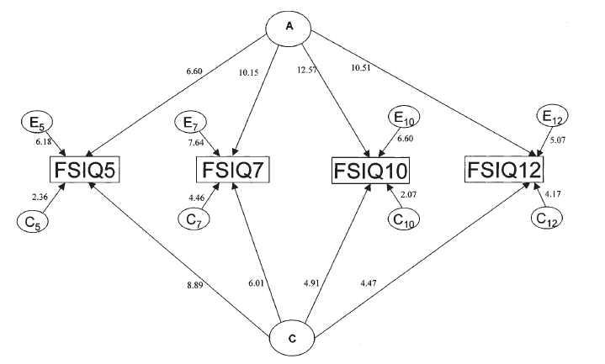
S_{C} 4x4 covariance matrix ... a 1 common factor model
S_{A} 4x4 covariance matrix ... a 1 common factor model without phenotype specific genetic residuals
S_{E} 4x4 covariance matrix ... a diagonal matrix (E does not contribute to the phenotypic covariance)
Bartels M, Rietveld MJH, Baal van GCM, Boomsma DI. (2002) Behavior Genetics, 32, 237-249.
Notes:
Another twin study. This time "Full Scale IQ". A and C are sources of stability. However A is waxing, C is waning. Ultimately, C influences disappear (as the children enter early adulthood). The contribution of A increases. The numbers shown are unstandardized path coefficients. As these increase for A but descrease for C, this tell us that the increase in heritability is actually due to the increase of A and decrease of C.

Slide 42
Genetically informative design & Genetic covariance structure analysis:
brief introduction based on the classical twin design
Conor V. Dolan & Michael C. Neale
PPT presentation in 4 parts .... PART 4 (13 slides):
The classical twin design (CTD) assumptions
Other GIDs
Notes:
Part 1 12 slides
Part 2 19 slides
Part 3 6 slides
Part 4 9+3 slides

Slide 43
Assumptions of the CTD: generalizability.
The CTD is a means to an end .... S_{PH} = S_{A} + S_{C}+S_{E} , cognitive abilities in 12 year olds
The MZ and DZ twins are representative of the “target” population (i.e., 12 year olds).
12 year old Dutch urban MZ twins are representative of 12 year old Dutch urban children.
12 year old Dutch urban DZ twins are representative of 12 year old Dutch urban children.
In a study of IQ (say), this means statistically ...
phenotypically: same mean, same variance,
genetically: same genetic influences / genetic variants
environmentally: same environmental influences

Slide 44
Assumption: random mating (testable if you have parental data .... r_{spouse} = 0).
The .5 in .5*s_{A}² is based on the assumption of random mating
.5*s_{A}²
s_{C}²
s_{A}²
s_{C}²
s_{E}²
s_{A}²
s_{C}²
s_{E}²
A1
C1
E1
A2
C2
E2
1
1
1
1
1
1
Y1
Y2
Positive non-random mating (a.k.a. assortative mating) may result in r_{A}*s_{A}² , where r_{A}>.5.
Simple test: what is the phenotypic spousal correlation r_{spouse}?
If r_{spouse} > 0, then we acknowledge assortative mating ..... This raises the question: what process underlies
assortative mating?
Is mating random? Height r_{spouse} = ~ .2 ... IQ r_{spouse} = ~ .3 to ~.4

Slide 45
no A-E (r_{AE}) and A-C (r_{AC}) correlation
A-E (s_{AE}≠0) and A-C (s_{AC} ≠0) covariance
0
s²_{A}
s_{AC}
s²_{C}
s²_{A}
A
s²_{C}
A
C
C
1
1
1
1
0
IQ
s_{AE}
IQ
1
1
E
E
s²_{E}
s²_{E}
Crucial: What process gives rise to rAC, rAE?

Slide 46
r_{AC} process
r_{AC} consequence
s_{AC} ≠0
s²_{A}
IQ_p
s²_{C}
A
A_p
SES_p
C
EA_p
1
source
of
s_{AC}
1
s_{AE}
transmission of alleles
IQ_c
IQ_c
A_c
environment
(C)
1
E
s²_{E}
Intelligence (IQ) and Educational attainment (EA)

Slide 47
Moderation / interaction
The effect of A is expressed as s_{A}² and quantified as s_{A}² /(s_{A}² + s_{E}²). The effect of A does not depend on E: E does not moderate the effect of A. There is no AxE interaction.
The effect of E is expressed as s_{E}² and quantified as s_{E}² /(s_{A}² + s_{E}²). The effect of E does not depend on A: A does not moderate the effect of E. There is no AxE interaction.
s_{A}²
s_{E}²
s_{A}²
s_{E}²
A
E
A
E
1
1
1
1
pheno
pheno
Notes:
Basic AE model (leave C out for now). m is the mean and this is represented as a regression coefficient in regression of pheno type on unit vector (hence “1”)

Slide 48
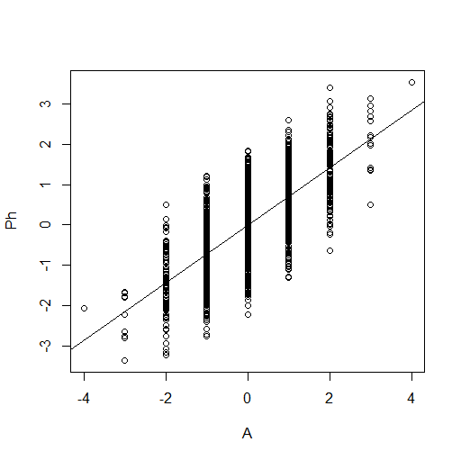
NO AxE interaction
Environmental
Dispersion / variance
Variance of
E given A score ...
does not depend on A
a.k.a.
homoskedasticity
Phenotypic
scores
Genetic level (score on A only 9 levels for clarity)
s_{E}² is constant over levels of A:
environmental effects (s_{E}²) are the same given any value of A
Notes:
Suppose we measured A and regressed Ph on A. The regression model is linear and homoskedastic: the variance of the residuals are contant over the levels of the the predictor (A). Here we regrees Ph on A, so the residuals are actually E.

Slide 49
AxE interaction
Conditional
variance of E
given A
a.k.a.
heteroskedasticity
Phenotypic
scores
Genetic level (score on A)
G x E as “genetic control” of E effects: The effect of E, expressed as s_{E}² is a function of A: s_{E}² =f(A)
Notes:
We can apply the same reasoning if we encounter heteroscedasticity in the regression of Ph on E. The magnitude of genetic effects depends on the level of E.

Slide 50
any one
or more
s²_{Ai}
s²_{Ci}
s²_{Ei}
Interaction AxE
Moderation
phenotypic score
s²_{Ei}
Genetic level (A)
Moderator level (M)
Environmental effects (variance)
depend on A-level
Environmental effects and /or genetic effects (variances) depend on M-level (linear increase)
s²_{E} = f(M)
s²_{A} = f(M)
s²_{C} = f(M)
S. Purcell (2002). Variance Components Models for Gene–Environment Interaction in Twin Analysis Twin Research Volume 5 Number 6 pp. 554-571
Notes:
Heteroskedastic residuals E: the variance of E is NOT the same for different values of A. E variance is the manifestation of environmental contributions to Phenotypic individual differences: So the contributions of E dependent in magnitude on the value of A. Heteroskedasticity here is the manifestation of GxE.

Slide 51
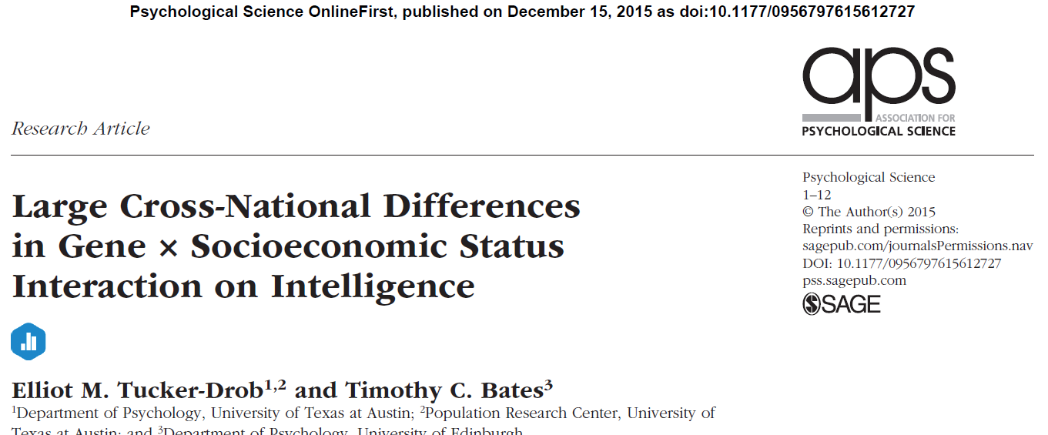
Age a continuous moderator
of genetic and environmental effects
on IQ
Tucker-Drob & Bates (2015): Variance components. Moderation model with measured moderator (age) .... A increase and C decreases with age
Notes:
Age as the moderator of the effects of A,C,E (on IQ) here expressed in standardized variance components

Slide 52
Suppose that there is GxE interaction or G-E covariance, but you fit the standard ACE twin model...
how are the variance components biased?
 |  | consequence in the CTD
Assumption | violation | Bias
AxE | AxE>0 mimics E | E overestimated
AxC | AxC>0 mimics A | A overestimated
cov(A,C) | cov(A,C) >0 mimics C | C overestimated
cov(A,E) | cov(A,E) >0 mimics A | A overestimated

Slide 53
 |  | consequence in the CTD
Assumption | violation | Bias
cov(A,C) | cov(A,C) >0 mimics C | C overestimated
cov(A,E) | cov(A,E) >0 mimics A | A overestimated
C variance declines with age .... Effect of C declines with age ....
However, cov(AC) results in C overestimation in the twin model....
So the large C variance in early years could be due in part to cov(AC).
So the apparent C variance may - in part - be cov(AC) and the decline in C effects, may be due - in part - to a change in process that gives rise to the cov(AC)
.... just sayin' interpret your variance components carefully .... bearing in mind possible violations of model assumptions

Slide 54
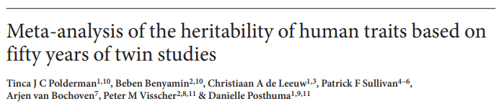

CTD is ONE genetically informative design (GID) that has proven to be highly productive and
very influential... (changed the view of genetics in psychology!)
It is generally recognized to be a useful design that includes strong assumptions.
However the CTD is not the only GID ... more extended designs are less dependent on assumptions
or allow one to test assumptions. Examples of extended GIDs:
Nuclear Twin Family Design (e.g., Keller et al 2009 Twin Research and Human Genetics)
Children of Twin Designs (e.g., McAdams et al 2018 Behavior Genetics)
Twins and spouses Designs (e.g. Reynolds et al 2006 Behavior Genetics)

Slide 55
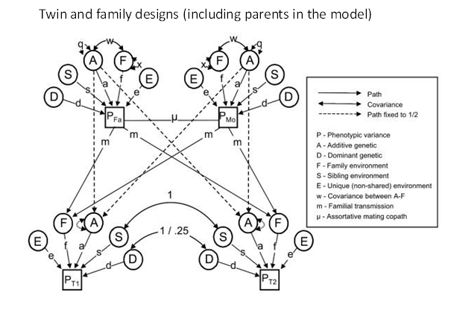
Includes assortative mating (μ), s_{AC} (A-C covariance) stemming from cultural transmission (m)
Keller et al (2009) Twin Res Hum Genet. 2009 Feb;12(1):8-18. doi: 10.1375/twin.12.1.8.

Slide 56
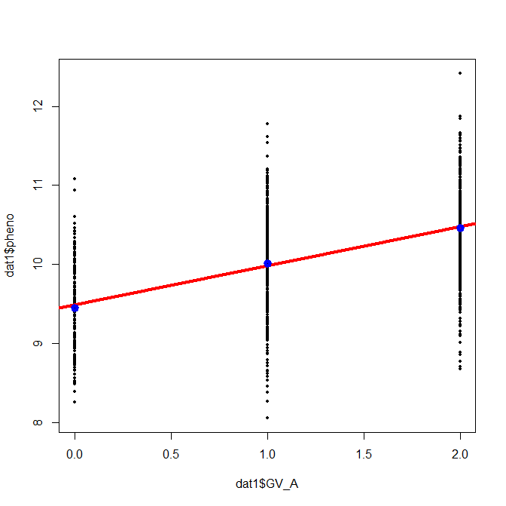
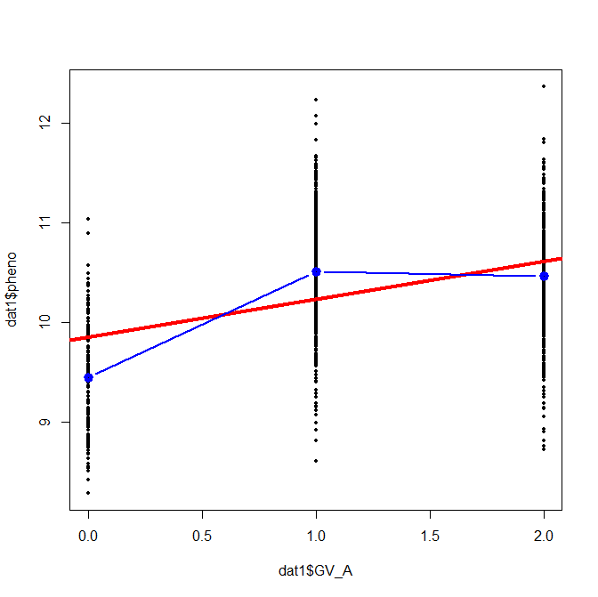
blue dots are the conditional mean
read line is the linear regression line
data are consistent with linear regression
blue dots are the conditional mean
read line is the linear regression line
data are not consistent with linear regression
see difference between conditional means and the regression
.... that is dominance

