Slide 1
International Statistical Genetics Workshop
Benjamin Neale, PhD
June 2021
Content warning: eugenics

Slide 2
Virtual format!

Slide 3
Few words on the curriculum

Slide 4
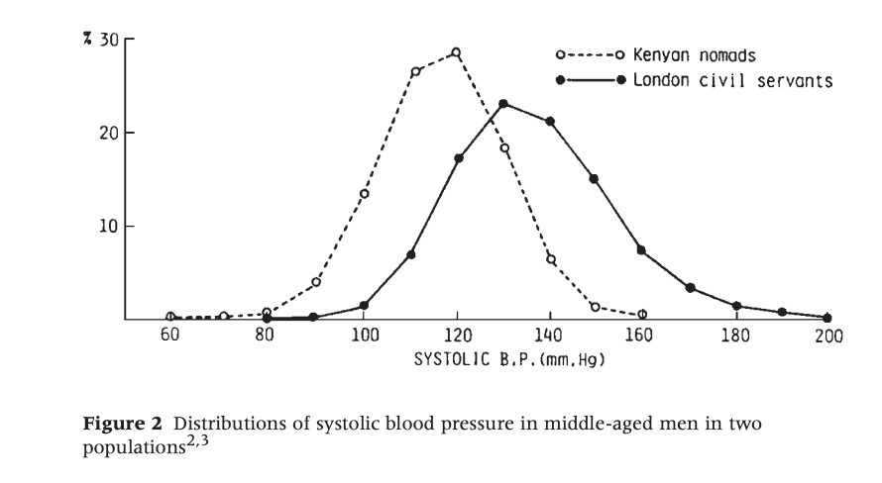


Slide 5
Introduction to genetics

Slide 6
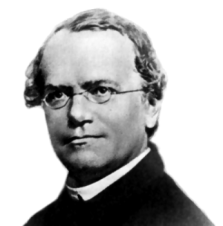
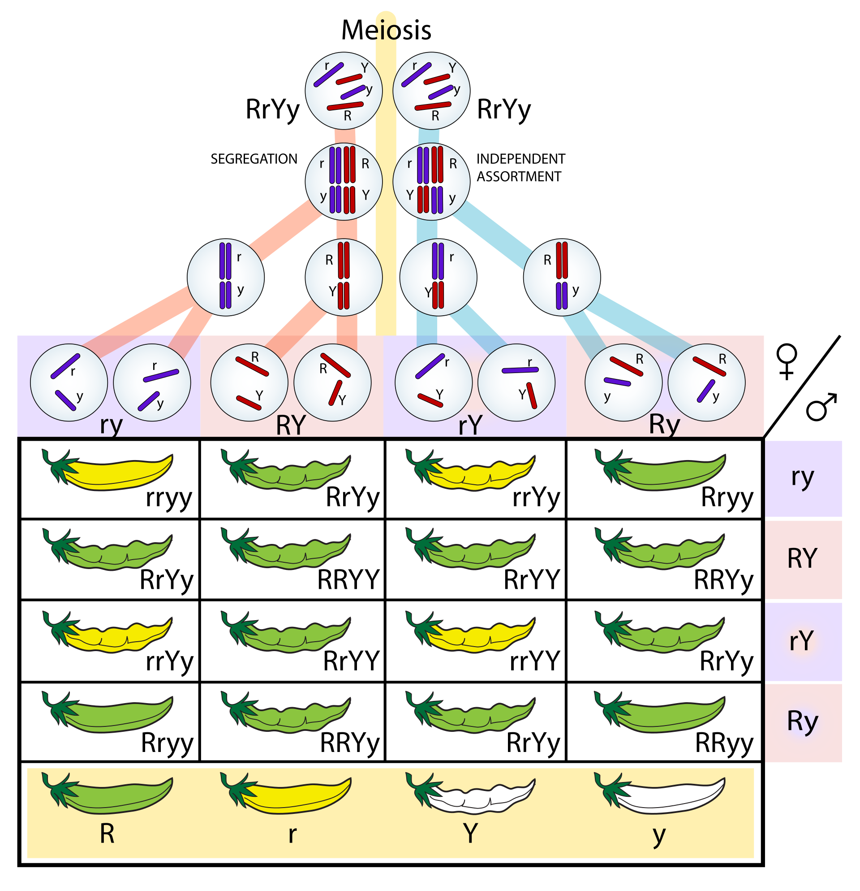
Mendelian Genetics
https://en.wikipedia.org/wiki/Mendelian_inheritance#/media/File:Independent_assortment_&_segregation.svg

Slide 7
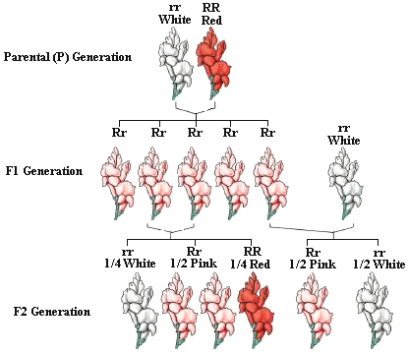
Co-dominance

Slide 8
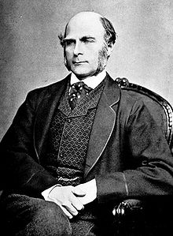
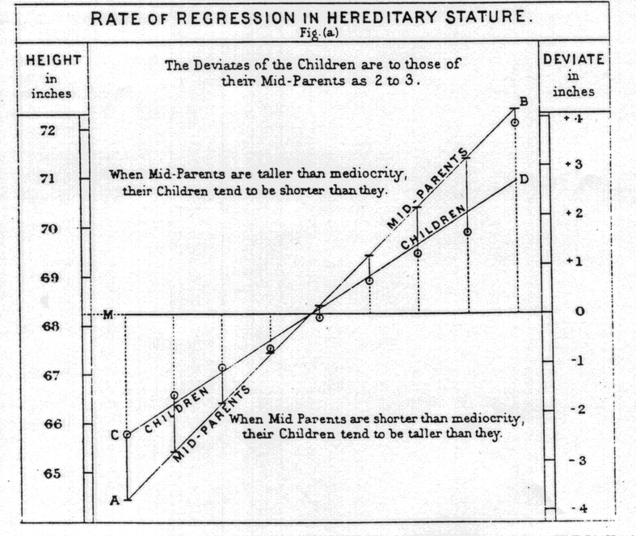

Slide 9
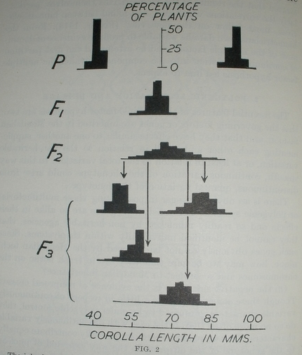
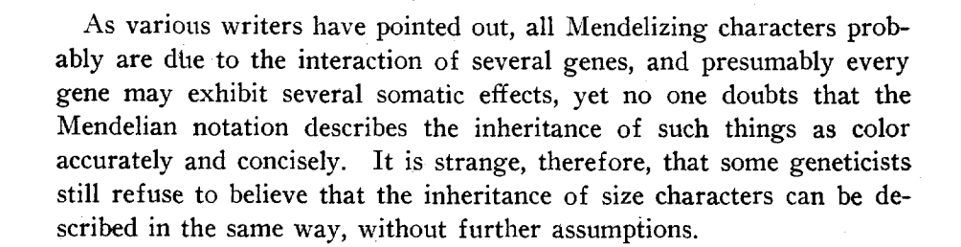
East 1916: Inheritance of Corolla Length in Nicotiana longiflora

Slide 10
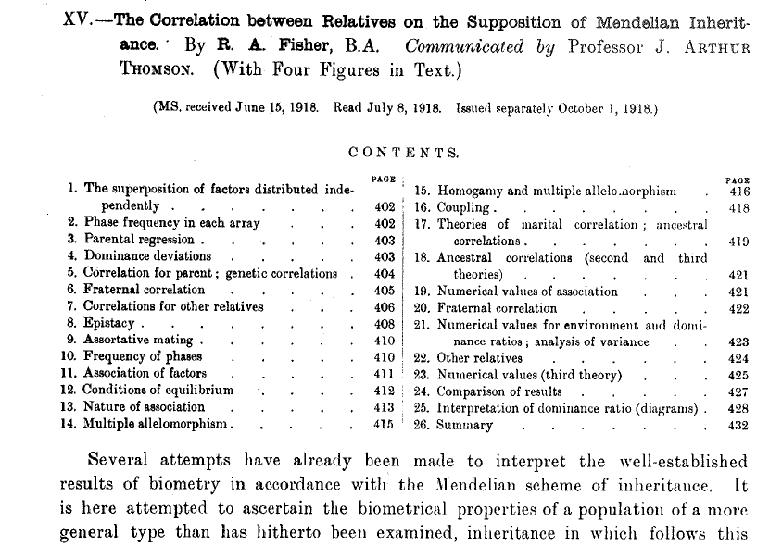
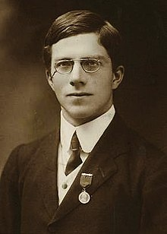
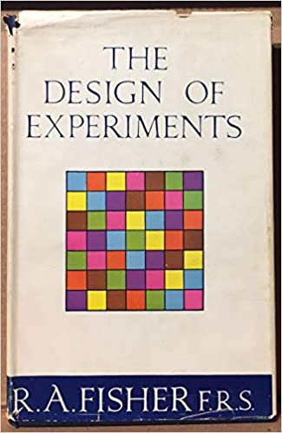
Neo-Darwinist Reconciliation
Ronald Fisher picture from 1913

Slide 11
One Coin toss
2 outcomes
Probability
0.6
0.5
0.4
0.3
0.2
0.1
0
Heads
Tails
Outcome

Slide 12
Two Coin toss
3 outcomes
Probability
0.6
0.5
0.4
0.3
0.2
0.1
0
HH
HT/TH
TT
Outcome

Slide 13
Four Coin toss
5 outcomes
Probability
0.4
0.3
0.2
0.1
0
HHHH
HHHT
HHTT
HTTT
TTTT
Outcome

Slide 14
Ten Coin toss
11 outcomes
Probability
0.3
0.25
0.2
0.15
0.1
0.05
0
Outcome

Slide 15
Infinite Outcomes
Gauss 1827; de Moivre 1738

Slide 16
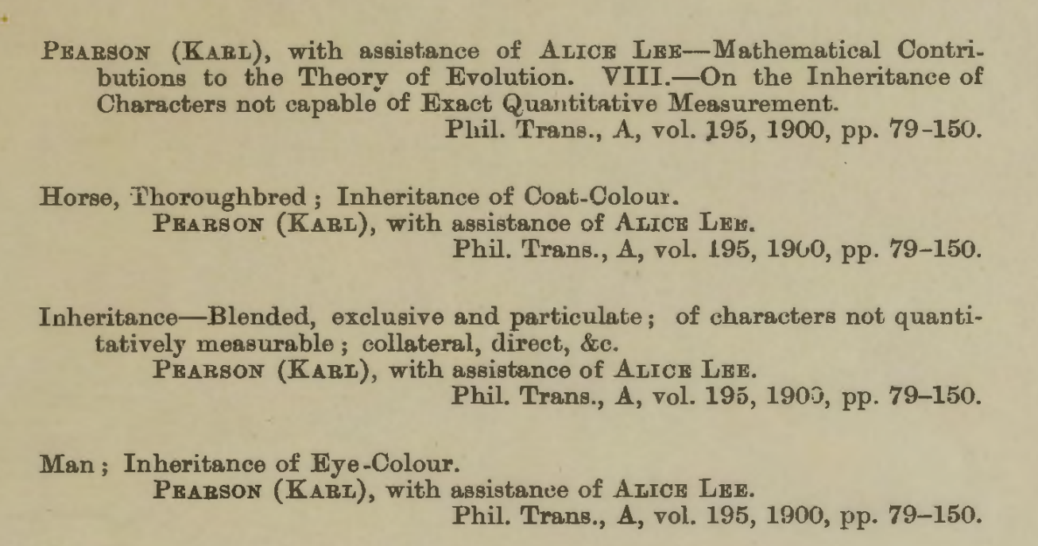
Liability threshold model. Pearson and Lee (1900)

Slide 17
Genotype with an additive effect
d = 0 (no dominance)
– a
d
+a
+a
+a
m = 0
aa
Aa
AA
Additive model
Manuel Ferreira

Slide 18
Source of variance
Aa
aa
AA

Slide 19
Genotype with an additive and dominance effects
d > 0 (dominance)
– a
d
+a
+a+d
+a-d
m = 0
aa
Aa
AA
Dominant model

Slide 20
Means, variances, covariances
1. Mean (X)

Slide 21
Means, variances, covariances
2. Variance (X)

Slide 22
Means, variances, covariances
3. Covariance (X,Y)

Slide 23
How much mean and variance?
1. Contribution of the QTL to the Mean (X)
e.g. cholesterol levels in the population
Genotypes
AA
Aa
aa
Effect, x
a
d
-a
Frequencies, f(x)
p²
2pq
q²
Mean (X)
= a(p²) + d(2pq) – a(q²)
= a(p-q) + 2pqd

Slide 24
How much mean and variance?
2. Contribution of the QTL to the Variance (X)
Genotypes
AA
Aa
aa
Effect, x
a
d
-a
Frequencies, f(x)
p²
2pq
q²
Var (X)
= (a-m)²p² + (d-m)²2pq + (-a-m)²q²
= V_{QTL}
Heritability of X at this locus = V_{QTL} / V _{Total}

Slide 25
How much mean and variance?
Var (X)
= (a-m)²p² + (d-m)²2pq + (-a-m)²q²
m = a(p-q) + 2pqd
= 2pq[a+(q-p)d]² + (2pqd)²
= V_{AQTL} + V_{DQTL}
Additive effects: the main effects of individual alleles
Dominance effects: represent the deviation from additive effects

Slide 26
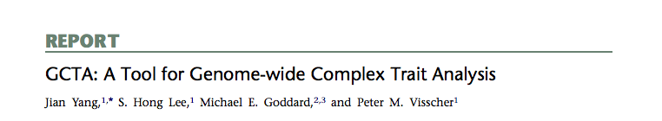
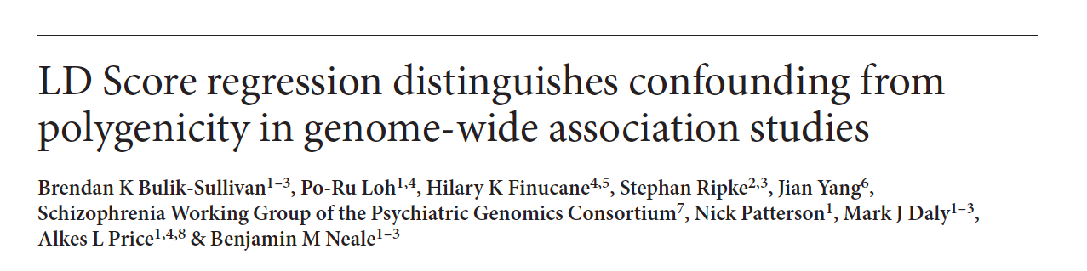
Polygenes!
Many small genetic effects
Can we develop a little further?
We can assume a distribution of SNP effects and now generate estimates of heritability
β

Slide 27
Many many further considerations!

Slide 28
What about the genome?

Slide 29
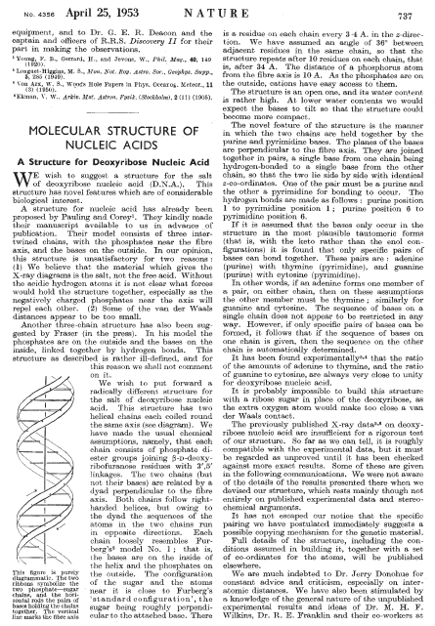
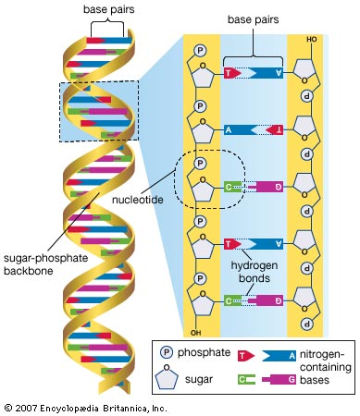
Structure of DNA
1953 Watson & Crick
Bases: A, C, G, T
Notes:
W & C were the first to propose the correct structure of DNA in a short paper in 1953.
A DNA molecule contains two helical chains, held together side-by-side through hydrogen bonds.
The building block of each chain is a nucleotide, which contains a sugar residue, a phosphate group and a nitrogen-containing base.
The first two elements do not change between nucleotides. However, nucleotides can differ with respect to the base that they carry: Adenosine, cytosine, guanine and thymine.
It is the sequence of these 4 letters throughout our DNA that encodes all the necessary information to make all the proteins in our body.

Slide 30
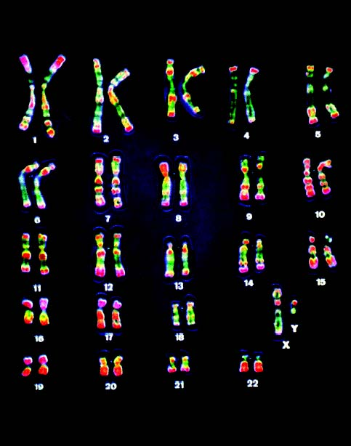
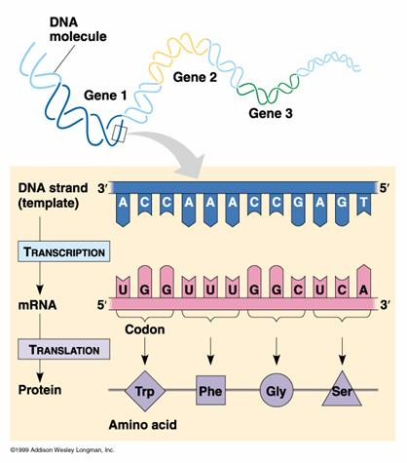
Genome
23 pairs of chromosomes
“pairs”: one copy from father, one mother
~20,000 genes

Slide 31
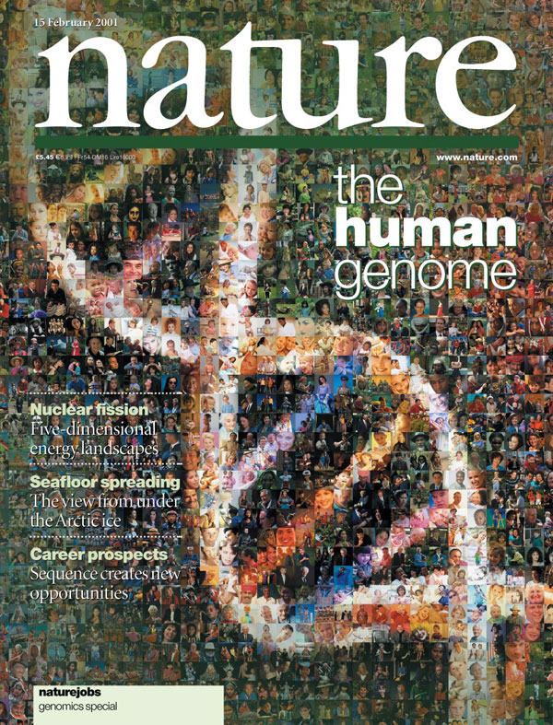

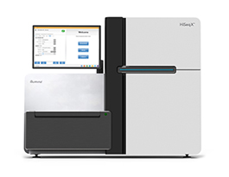
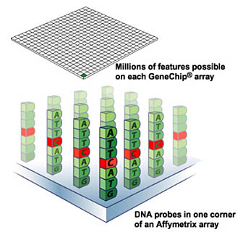

Twenty years of technological progress
Characterizing common variation
2003 - 2007
Next generation sequencing
2009 - present
Mapping the human genome
2001
Genome-wide association (GWAS)
2005 - present

Slide 32

Technologies
Arrays
Exomes
Genomes
Upside Hits + epidemiology Gene identification Comprehensive capture
Downside Hit interpretation Limited Scope Cost (small N)

Slide 33
Single Nucleotide Polymorphisms (SNPs)
DNA sequence
Genotype
Chrom.
SNP 2
SNP 1
Mat
GTAACTTGGGATCTAGACCAGATAGAT
GTAACTTGGGATCTAGACCAGATAGAT
GTAACTTGGGATCTAGACCAGATAGAT
GTAACTTGGGATCTCGACCAGATAGAT
GTAACTTGGGATCTCGACCAGATAGAT
GTAACTTGGGATCTCGACCATATAGAT
Person 1
A A
G G
Pat
Mat
Person 2
A C
G G
Pat
Mat
Person 3
C C
G T
Pat
SNP 1
SNP 2
  Mutation that arose at some point in demographic history
  Typically, each SNP has two alleles (bases)
  Each SNP is eventually given an “rs” number rs214621

Slide 34
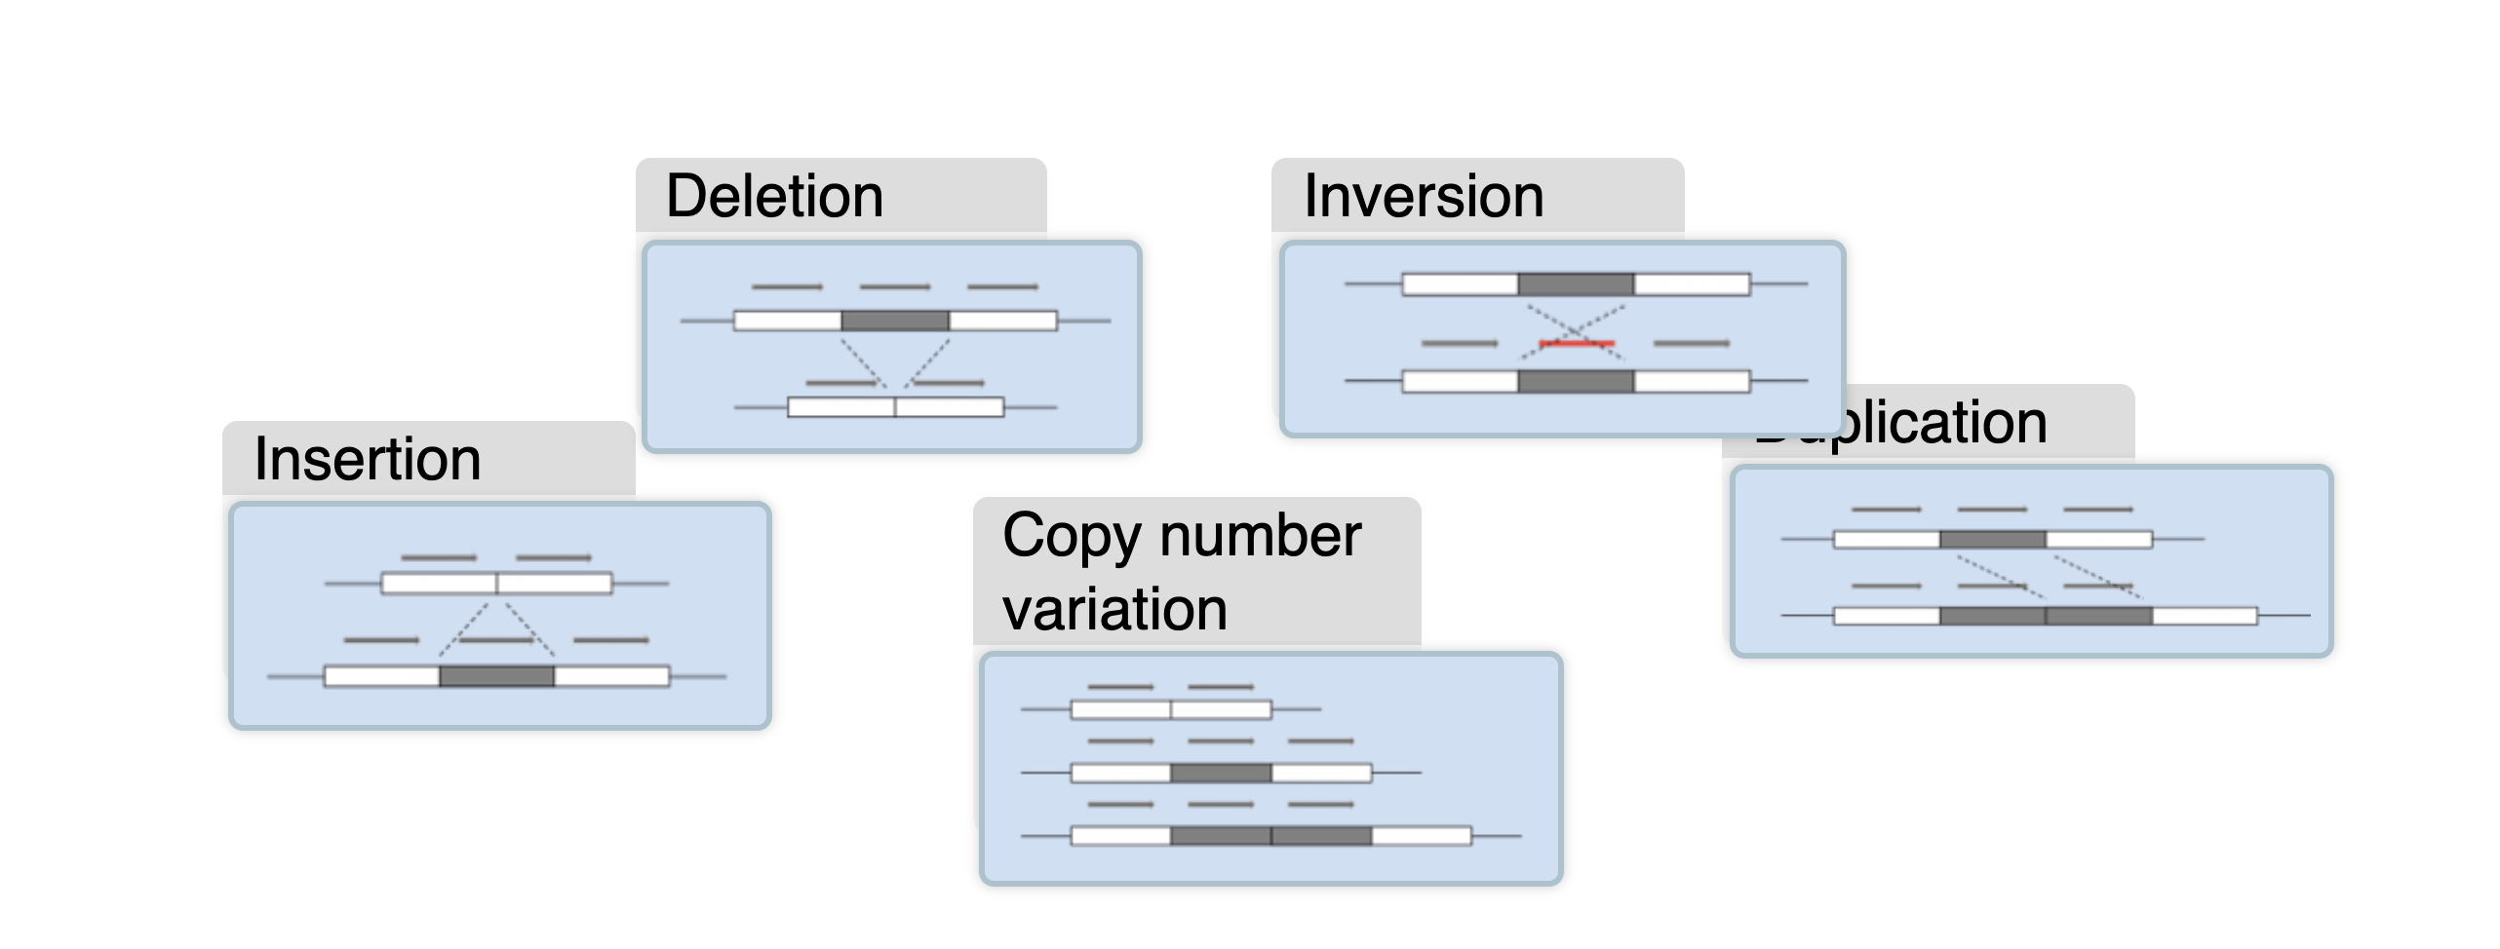
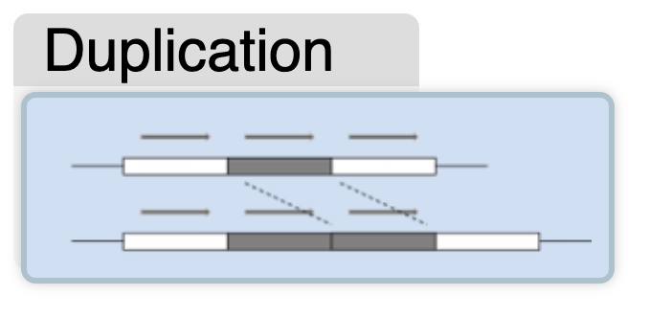
Structural variation
https://www.ebi.ac.uk/training/online/courses/human-genetic-variation-introduction/what-is-genetic-variation/types-of-genetic-variation/

Slide 35
Definitions
SNPs
trait variant
chromosome
Population Data
Affection Trait₁…Trait_{n}
haplotypes
A 10.3 75.66
A 9.9 -99
U 15.8 101.22
genotypes
alleles
Lon Cardon

Slide 36
Allelic Association
SNPs
trait variant
chromosome
Genetic variation
yields phenotypic variation
More copies of ‘B’ allele
More copies of ‘b’ allele
Lon Cardon

Slide 37
Simplest Regression Model of Association
Y_{i} = α + βX_{i} + e_{i}
where
Y_{i} = trait value for individual i
X_{i} = 1 if allele individual i has allele ‘A’
0 otherwise
i.e., test of mean differences between ‘A’ and ‘not-A’ individuals
Lon Cardon
0
1

