Slide 1


Using GW-SEM to analyze latent variables in a multivariate GWAS framework
Brad Verhulst & Joshua Pritikin
March 4th, 2020

Slide 2
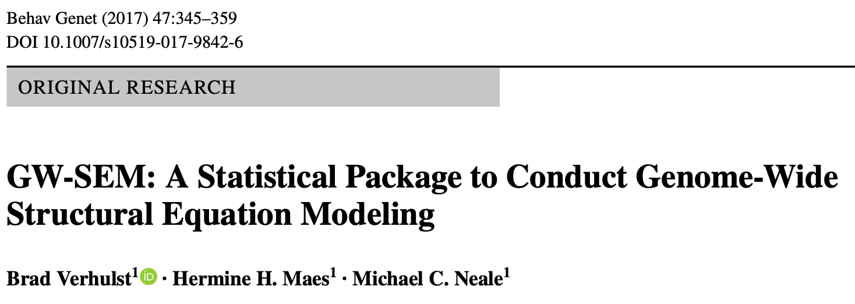
The Long Road to Boulder

Slide 3
Goals of the Presentation
Showcase how alternative phenotypic model specifications provide can unique insights into genetic mechanisms
  Present a latent variable model depicting substance use frequency
In the practical we are going to conduct an analysis

Slide 4
Strengths of GW-SEM
More appropriate modeling of the items
  Ordinal vs Continuous
Incorporating more environmental and situational variables into the model.
Move beyond latent variable models into networks, mixture distributions, and multiple group models

Slide 5
Utility of Structural Equation Modeling
Structural Equation Modeling (SEM):
Incredibly broad framework to estimate a wide variety of statistical models:
  Factor Analysis
  Path Analysis (mediation, feedback loops)
  Mixture modeling
  Regression (linear, logistic, ordinal)

Slide 6
Utility of Factor Analysis
Psychometric or Measurement Model:
The implicit or explicit relationship between the latent variable and its indicators.
Understanding the measurement of the latent variable will provide valuable insights into the meaning of the factor and interpretation of subsequent associations

Slide 7
Factor Analysis & GWAS
By merging factor analysis with GWAS we can integrate measurement aspects of the phenotype (i.e. the measurement model) into a GWAS.
This allows us to test an enormous range of hypotheses that cannot be tested within a strict linear modeling framework
This can also be used to:
Assess the fit of the correlations
assess phenotypic heterogeneity across samples (or subsamples) with measurement invariance

Slide 8
The Benefits of using Raw Data
Raw data gives users more control over the specification of the model components compared with summary statistics from disparate GWAS
Takes a longer to run because we are fitting a separate structural equation model for each SNP

Slide 9


Unparalleled Access to Raw GWAS Data

Slide 10
Standard GWAS Model
SNP
DV

Slide 11
Novel Hypothesis Tests
DV₁
SNP
DV₂
DV₃

Slide 12
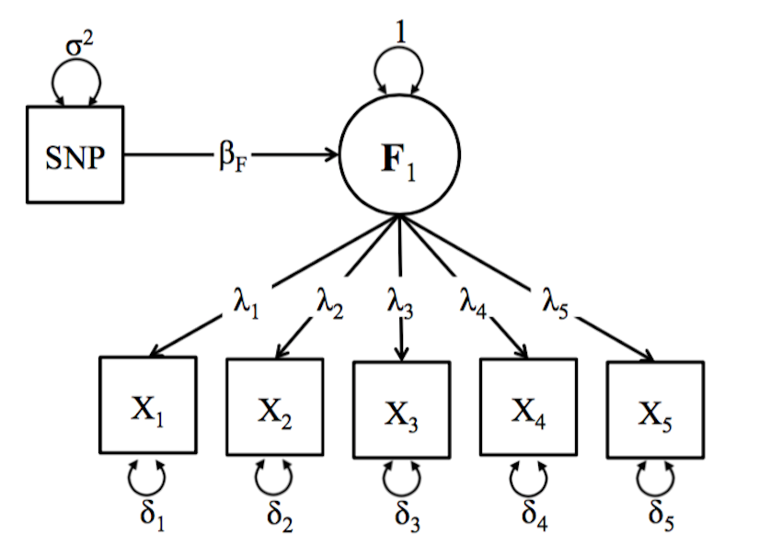
Novel Hypothesis Tests

Slide 13
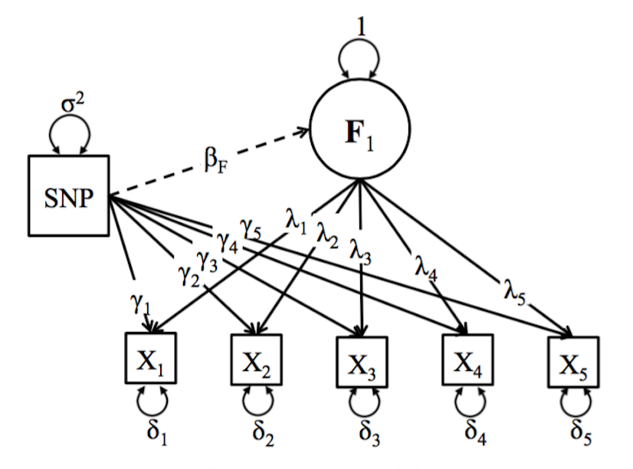
Novel Hypothesis Tests

Slide 14
FTND Example

Slide 15
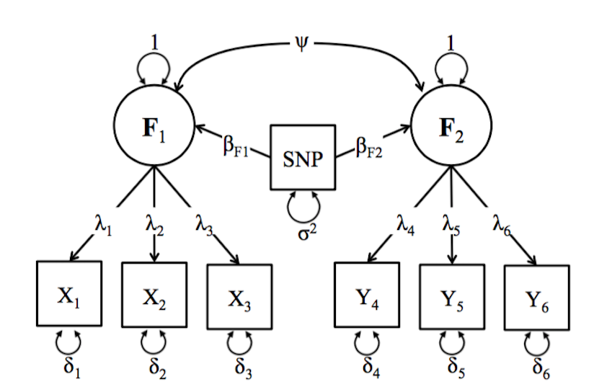
Novel Hypothesis Tests

Slide 16
Real Data Example

Slide 17
Method
Data were obtained from the UK Biobank
(Application 40967)
  Individuals included in the analysis if they were :
    of European ancestry
    unrelated to other individuals (one person selected from families)
    had sufficient genotyping quality
Total Sample Size for the analysis was 379, 153
  a subsample was asked about cannabis use (N=112, 109)
Fit a single factor confirmatory factor model to frequency of use for tobacco, cannabis and alcohol (not quantity)
  SNP predicted the latent factor
  SNP predicted the individual item residuals

Slide 18
Question Wording and Response Options
Tobacco
Cannabis
Alcohol
In the past, how often have you smoked tobacco?
Smoked on most or all days
Smoked occasionally
Just tried once or twice
I have never smoked
Have you taken CANNABIS (marijuana, grass, hash, ganja, blow, draw, skunk, weed, spliff, dope), even if it was a long time ago?
Yes, more than 100 times
Yes, 11-100 times
Yes, 3-10 times
Yes, 1-2 times
No
About how often do you drink alcohol?
Daily or almost daily
Three or four times a week
Once or twice a week
One to three times a month
Special occasions only
Never
N = 348, 032
N = 112, 109
N = 379, 153

Slide 19
Single Factor Model of Substance Use Frequency
1
SU
Freq
The latent SU Freq variable is disproportionately driven by tobacco frequency.
This means the regression of the latent factor on the SNP will resemble the tobacco frequency residual regression more than the other variables
While model fit is excellent, this is not a very good model from a psychometric perspective
SNP_{i}
.68
.20
.18
Tob
Can
Alc
δ₁
δ₂
δ₃
Δ
Δ
Δ
1
1
1
Not Shown: All models controlled for Age, Sex, and the top 10 ancestry PCs

Slide 20
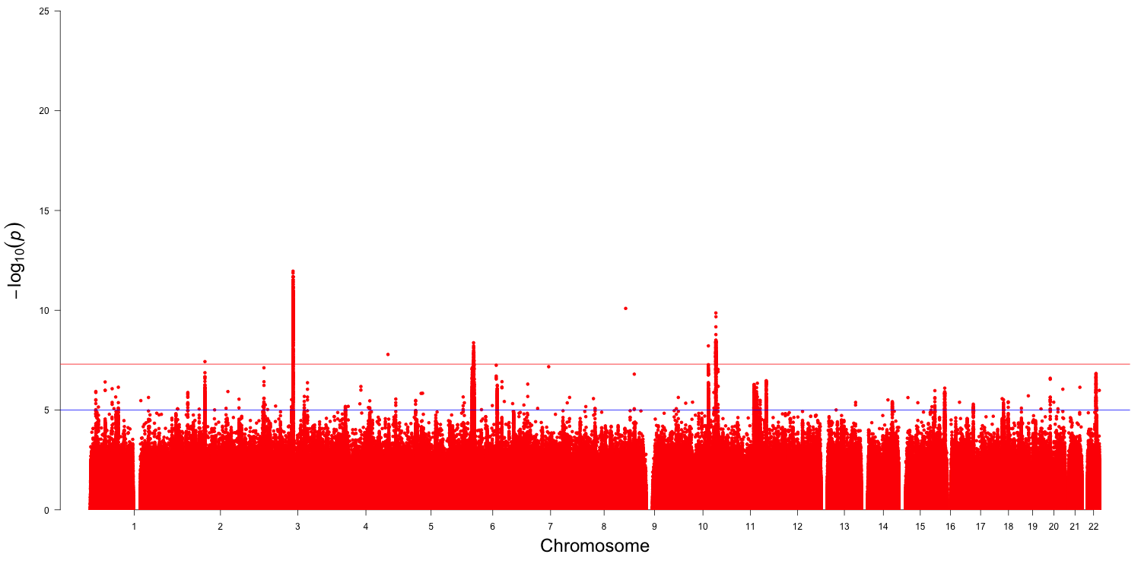
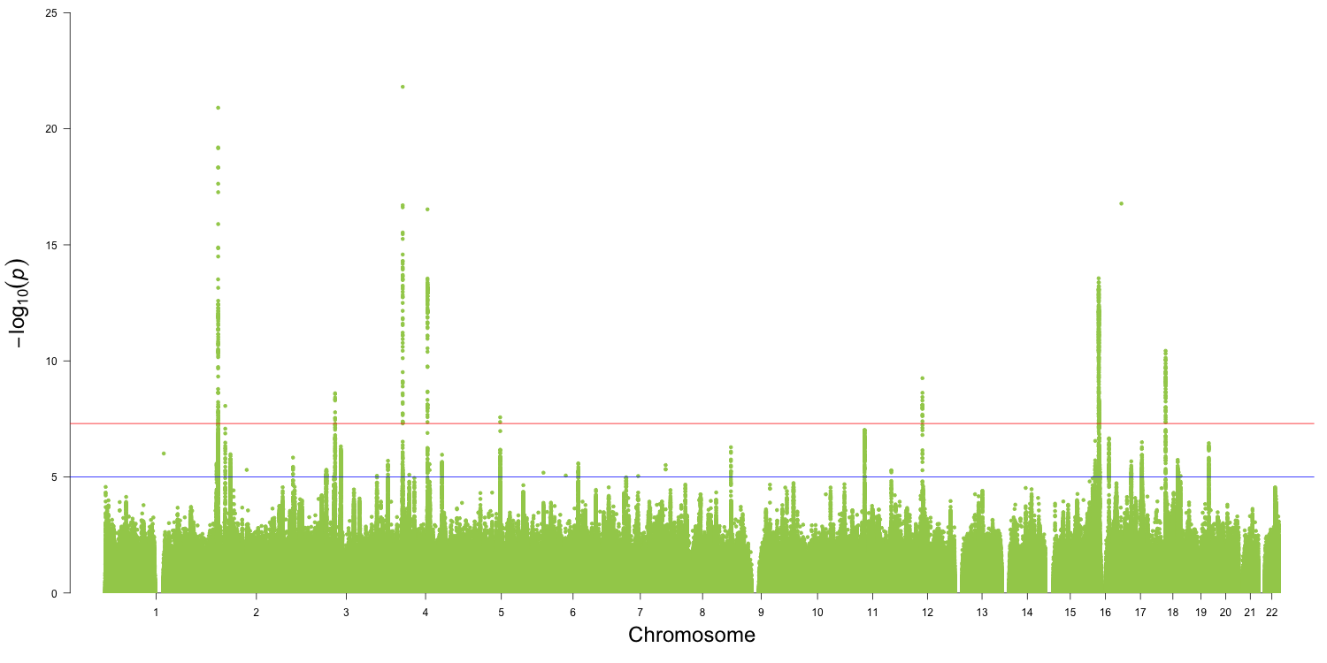
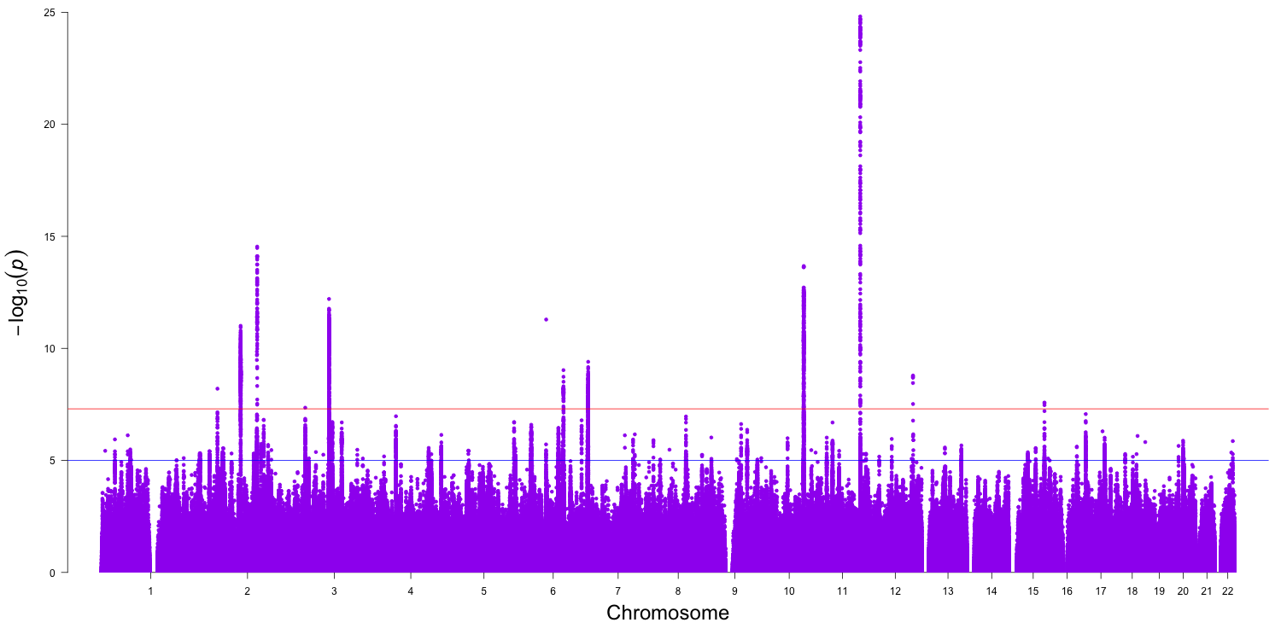
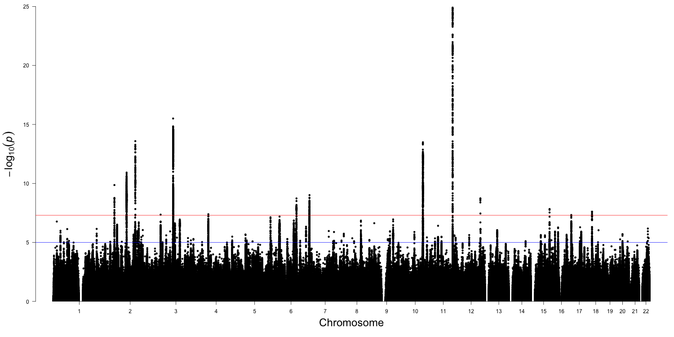
Layered Manhattan Plot of the Associations with the Latent Factor and Items Residuals
NACM1
Order Plotted
1 Alcohol Residuals
2 Cannabis Residuals
3 Tobacco Residuals
4 Latent Factor
CADM2
ADH1C

Slide 21
Layered Manhattan Plot of the Associations with the Latent Factor and Items Residuals
NACM1
Order Plotted
1 Latent Factor
2 Tobacco Residuals
3 Cannabis Residuals
4 Alcohol Residuals
CADM2
ADH1C

Slide 22
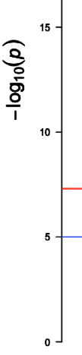

Locus Zoom Plot of CADM2
The combination of multiple frequency items increases the signal for the latent variable
Notes:
Cell Adhesion Molecule
Risk Taking Behavior
Expression in the brain (particularly the cerebral cortex and the cerebellum)
This gene encodes a member of the synaptic cell adhesion molecule 1 (SynCAM) family which belongs to the immunoglobulin (Ig) superfamily. The encoded protein has three Ig-like domains and a cytosolic protein 4.1 binding site near the C-terminus. Proteins belonging to the protein 4.1 family crosslink spectrin and interact with other cytoskeletal proteins. Multiple transcript variants encoding different isoforms have been found for this gene.

Slide 23
Locus Zoom Plot of NCAM1
The latent variable signal is coming almost exclusively from tobacco
Notes:
Neural Cell Adhesion Molecule
Smoking Status: Ever / Never
Primary expression in the Brain
This gene encodes a cell adhesion protein which is a member of the immunoglobulin superfamily. The encoded protein is involved in cell-to-cell interactions as well as cell-matrix interactions during development and differentiation. The encoded protein has been shown to be involved in development of the nervous system, and for cells involved in the expansion of T cells and dendritic cells which play an important role in immune surveillance. Alternative splicing results in multiple transcript variants. [provided by RefSeq, Jun 2011]

Slide 24
Locus Zoom Plot of ADH1C
There is not genomic signal for the latent variable, but a strong signal from drinking frequency
Notes:
Alcohol Dehydrogenase 1C
Alcohol Consumption
ADH1C gene is active in intestine and kidney in fetal and early postnatal life, and persists in the stomach and liver in adult life.
The ADH1C gene encodes the gamma subunit of class I alcohol dehydrogenase (ADH; EC 1.1.1.1), an enzyme that catalyzes the rate-limiting step for ethanol metabolism: the oxidation of alcohol to acetaldehyde. Class 1 ADH is a homo- or heterodimeric molecule, formed by the association of 3 types of class I ADH subunits, alpha (ADH1A; 103700), beta (ADH1B; 103720), and gamma (Edenberg, 2007).
This gene encodes class I alcohol dehydrogenase, gamma subunit, which is a member of the alcohol dehydrogenase family. Members of this enzyme family metabolize a wide variety of substrates, including ethanol, retinol, other aliphatic alcohols, hydroxysteroids, and lipid peroxidation products. Class I alcohol dehydrogenase, consisting of several homo- and heterodimers of alpha, beta, and gamma subunits, exhibits high activity for ethanol oxidation and plays a major role in ethanol catabolism. Three genes encoding alpha, beta and gamma subunits are tandemly organized in a genomic segment as a gene cluster

Slide 25
Three Types of Associations
More signal from the latent factor than the items
  Ideal use of a factor model to enhance our GWAS of the latent trait
  CADM2 has previously been associated with risk taking behaviors
Association with a single item that dominates that factor
  NCAM1 seemed less like a SU frequency association and more like a smoking related association
Association with a residual item but not the latent factor
  This indicates substance specificity
  ADH1C is not really a SU related gene, but instead is an alcohol related gene

Slide 26
Leveraging Latent Variable Models
SEM allows us to integrate the phenotypic measurement of constructs into the genomic
  Let the genes “revise” the interpretation of the constructs
Integrating rarely used substances into factor models
  Potential to infer loci that are associated with general use even if:
    sample sizes are small
    specific substance use behavior is not measured at all (potentially)
  Proxy GWAS for rarely used substances
We can analyze competitive responses that can teach us more about tradeoffs between substances than would could understand by any other type of modeling framework.

Slide 27
Post GWAS Software Integration
Easy integration with:
  LD Score Regression Software
    LDhub
    genomicSEM
  LocusZoom
  qqman
Working on integrating with:
MAGMA, FUMA and other Post-analysis software

Slide 28
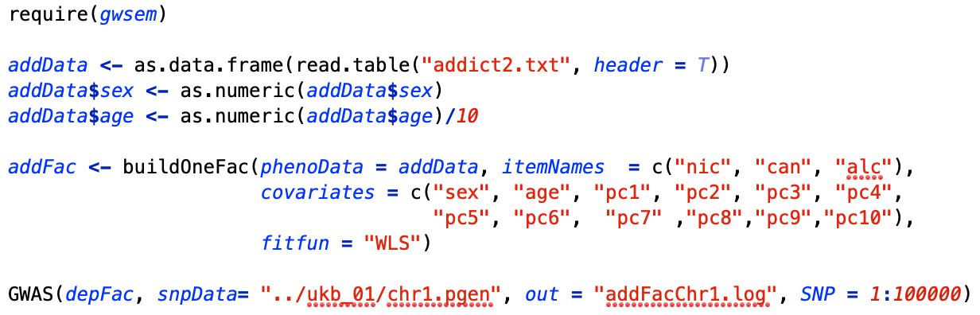
Example Syntax

Slide 29
Acknowledgements
Texas A&M Collaborator
Shaunna Clark
VCU Collaborators
Elizabeth Prom-Wormley
Michael Neale
This project used data from the UK Biobank that was accessed under application number 40967

