Slide 1
Introduction to R Focusing on Twin Data
Elizabeth Prom-Wormley

Slide 2
Housekeeping / Overview
A little prior experience is assumed and we hope we have something for everyone
Instructors are really here to help- no question is too silly!
Don’t forget about the Electronic Question Box
Classmates are your new community and R/OpenMx network

Slide 3
Session Objectives
By the end of the morning, you will be able to:
Review the basic functionality of R and Rstudio
Apply basic R functions for twin-focused data management and graphics

Slide 4
Using R and R Studio
R is the engine
People build things around the engine
R Studio is a user interface to make it easier to communicate and work with R
So…let’s take a look at R and R Studio!

Slide 5
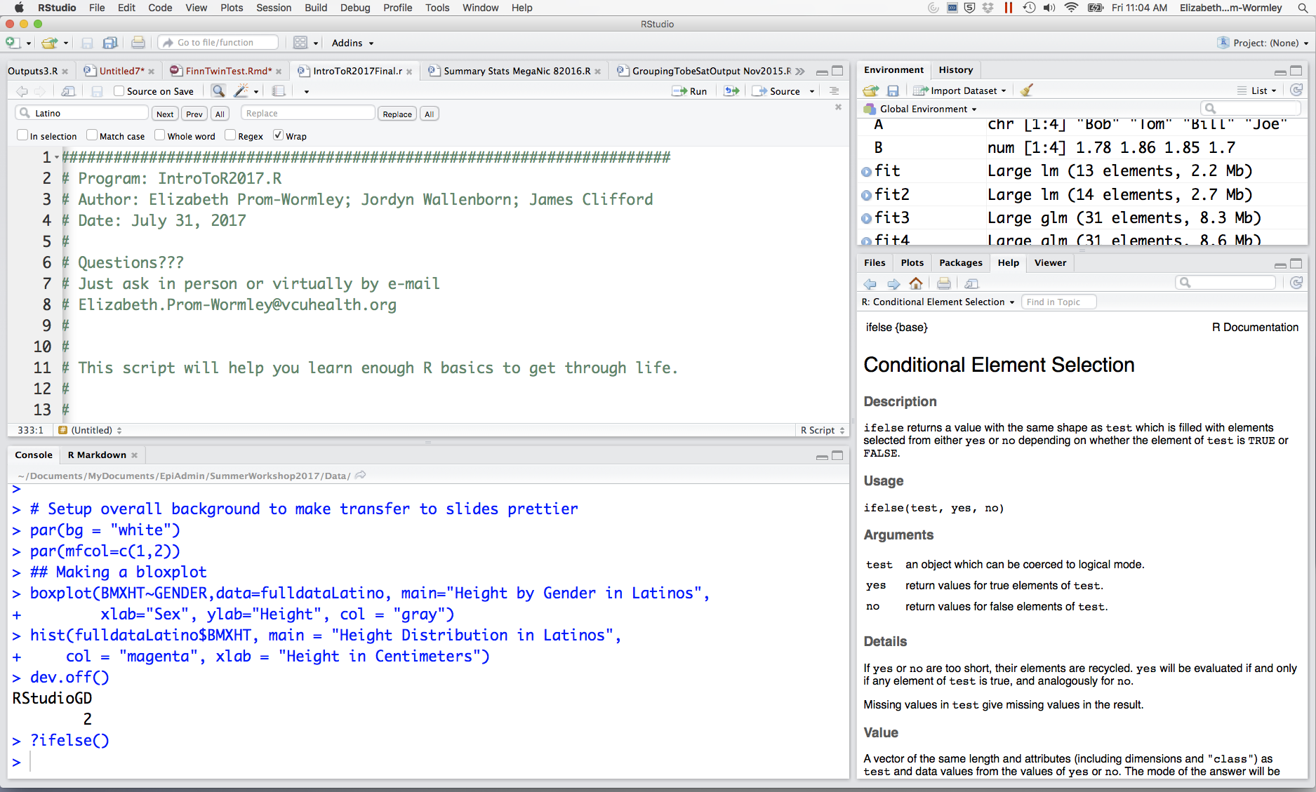
R Studio Console
Important Tabs:
Reminds you of prior code
You wrote
Identifies objects you have
In your working directory
Text Editor
Where you write and save your work
Open your files here.
Important Tabs:
Help files
Packages you have stores
Graphs you produce
File explorer
Console- Similar to
SAS log

Slide 6
Let’s Play!
Open
IntroToR.R

