Slide 1
Plink and GRM practical
In this practical, we will:
Learn about genetic relatedness / relationship matrices by estimating one.
Learn about some concepts and methods from molecular genetic methods.

Slide 2
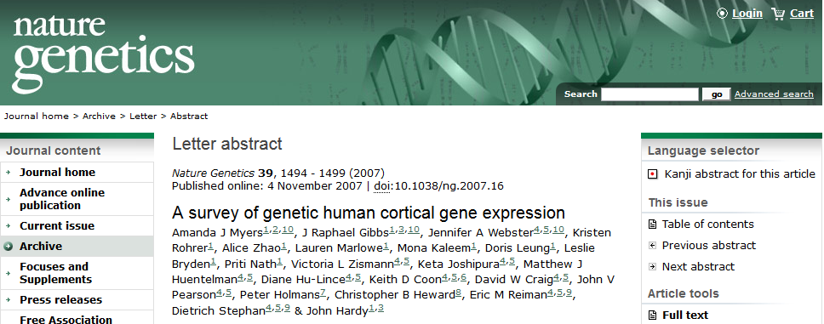
Our data
Simulated dataset based on real data.

Slide 3
gwas_plinkdata.ped
150 individuals
23 MZ pairs, 21 DZ pairs, 62 unrelated individuals
Notes:
We go from this…

Slide 4
1) Change working directory
First, open Unix terminal. Copy the files to a folder of your preference.
Then, we need to make sure we are working in the right folder:
cd C:/Users/joseMor/Documents

Slide 5
2) Check file format
PLINK-friendly formats (.bed and .ped):
PED: pedigree information standard
BED: compressed (binary) version of PED
plink --file gwas_plinkdata --make-bed --out gwas_plinkdata

Slide 6
3) Clean the data (quality control)
PLINK includes several options to clean genetic data.
This means filtering out low quality data or outliers.
We are going to run a very basic quality control (to learn more: next year at the IBG GWAS workshop!)
plink --bfile gwas_plinkdata --geno 0.05 --mind 0.05 --hwe 1e-6 --maf 0.1 --make-bed --out gwas_plinkdata_clean

Slide 7
4) Estimate the genetic relatedness matrix
Output style (A) -- matrix
Take a look to the results in Unix…
plink --bfile gwas_plinkdata_clean --make-rel triangle
zless -S plink.rel

Slide 8
4) Estimate the genetic relatedness matrix
Open the file ‘GRM_highlighted.pdf’ to see how it looks.
Zoom in to find which individuals are likely to be MZ twins (in green), DZ twins (in red), and genetically unrelated (not highlighted).

Slide 9
4) Estimate the genetic relatedness matrix

Slide 10
4) Estimate the genetic relatedness matrix
Output style (B) – relatedness pair by pair
Take a look to the results in Unix…
plink --bfile gwas_plinkdata_clean -make-grm-gz no-gz
zless -S plink.grm

Slide 11
4) Estimate the genetic relatedness matrix
Open the file ‘grel_highlighted.xls’ to see how it looks.
You can sort the data by gen. relatedness and find which pairs are likely to be MZ twins (in green), DZ twins (in red), or unrelated individuals (not highlighted).

Slide 12
4) Estimate the genetic relatedness matrix
ID1 | ID2 | common SNPs | gen relatedness
2 | 1 | 247262 | -0.0233
3 | 1 | 250987 | -0.0227
3 | 2 | 247011 | -0.0209
4 | 1 | 247683 | -0.0195
26 | 3 | 251499 | 0.9960
73 | 51 | 247061 | 0.5048

Slide 13
Thank you!

