Slide 1
2020 International Statistical Genetics Workshop
Challenges and solutions
Jose Morosoli and Sarah Medland
With thanks to Katrina Grasby, Lucía Colodro-Conde and Elizabeth Prom-Wormley
\workshop\Faculty\jose\Friday

Slide 2
In this practical…
We don’t cover ANY theory.
We will learn about common coding and analytical problems we find when we work with OpenMx and twin data in real life.
Hopefully we will make OpenMx less scary.

Slide 3
Finding starting values
Most of them can be estimated outside.
Good for checking if results makes sense.
For saturated models (assumptions), different starting values for each twin and zygosity. In genetic models, they are equated.
Closest starting values come from last assumption testing model. Some are exactly the same (means, thresholds, covariate effect).
Don’t use exact value for starting values, a bit smaller to give space to the optimizer.

Slide 4
Finding starting values
Parameter | For saturated model
Means and Covariates ꞵ | lm(vD1con_1~AGE_1*SEX_1, data = mzData)*
Thresholds (without covariates) | qnorm(cumsum(table(mzData$var_T1))/sum(table(mzData$var_T1)))[1:nthresholds]
Vars and covars | var(mzData[,selVars])
Cors (categorical) | cor(mzData[,selVars], method = "kendall")
* For a continuous phenotype, a linear mixed model would be closest to what OpenMx does, but a standard linear regression can do the job for starting values.

Slide 5
Finding starting values
Parameter | Unstandardized components*
VA | 2ꞏ(covarianceMZ – covarianceDZ)
VC | 2ꞏcovarianceDZ – covarianceMZ
VD | covMZ – [2ꞏ(covMZ – covDZ)]
VE | varMZ – covMZ
COVA | 2ꞏ(cross.covMZ – cross.covDZ)
COVC | 2ꞏcross.covDZ – cross.covMZ
COVE | covPh –cross.covMZ
*Based on Holzinger (1929) and Falconer (1960,) formulas.

Slide 6
Fantastic error codes and where to find them
Most common errors: misspelling, mismatched variable names, or forget to add an object to the model…
Take a deep breath and relax, everything is gonna be fine.
Run code line by line – Read the error message and locate the objects they are referring to.
Personal experience: only 1/10 scripts I run for the first time don’t give an error.

Slide 7
Fantastic error codes and where to find them
Check variable names (mzData/dzData) and ‘names’ and ‘labels’ of mxAlgebra/mxMatrix objects.
Check that you have included all objects in the final model.
E.g., lower case instead of upper case (vV, cC, uU), a classic!
E.g., wrong variable/object names
Especial mention to non-conformable arrays: usually you’re multiplying matrices with incompatible dimensions (revise your matrix algebra!).

Slide 8
Fantastic error codes and where to find them
All mxRun(s) have a status code. They tell you if a solution has been found and its reliability.
✓
The Good
Code 0 – All good! No probs
Code 1 – Probably okay but good to re-run
ACTION: MxRun(fit) or MxTryHard
https://openmx.ssri.psu.edu/wiki/errors

Slide 9
Fantastic error codes and where to find them
All mxRun(s) have a status code. They tell you if a solution has been found and its reliability.
✘
The Bad
Code 5: Optimizer is stuck
Code 10: Infeasible starting values
Action: check starting values and model specification. Something is quite wrong
The Ugly
Code 6: Almost there, OMX needs your help.
Action: MxTryHard(), improve starting values, rescale variables.
✘
https://openmx.ssri.psu.edu/wiki/errors

Slide 10
Fantastic error codes and where to find them
Always check status codes
Also status code of CIs
summary(myRun)$CIcodes
It’s OK to use MxTryHard() but ideally mxRun() should be enough.
Use mxRun first, more informative error messages.
Inspect summary() even if you get error codes: could direct you to the problem (name of the object / matrix with issues).

Slide 11
Missing data
How to avoid losing the complete family when there is one twin / family member missing but not the others?
OpenMx DON’T accept missing values in a definition variable covariate. It’s okay in the phenotype.
Full-information maximum likelihood (FIML) allows analyzing the non-missing member of the family / cluster.
Only possible when using raw data (not cov or cor matrices).
When only the covariate (not the phenotype) is missing, standard techniques apply (multiple imputation, substitution, elimination).

Slide 12
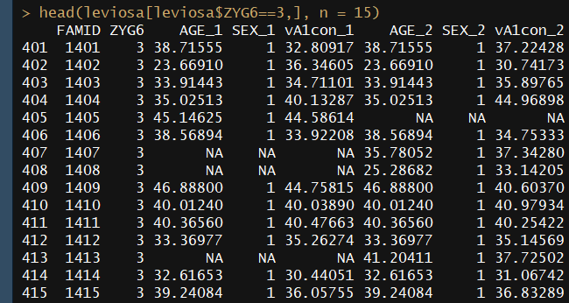
Missing data

Slide 13
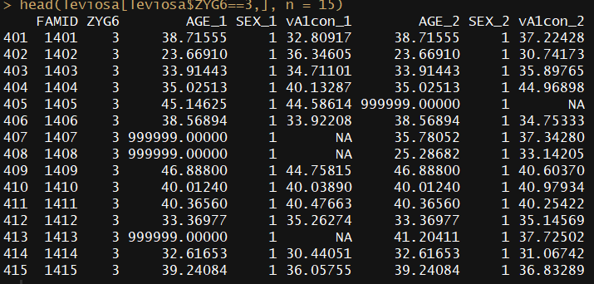
Missing data

Slide 14
About optimizers
Optimizer: algorithm programmed to find a numerical solution to an specific mathematical problem.
In our case, free parameters in expected means, thresholds, and variances.
OpenMx has three optimizers: SQSLP, CSOLNP and NPSOL (only available when you download OpenMx from https://openmx.ssri.psu.edu/installing-openmx)

Slide 15
About optimizers
Different optimizers work better with different datasets. It’s worth trying a different one if your model is struggling to converge.
Even if you get a solution, you may struggle to estimate confidence intervals. Different optimizers in different datasets may succeed where others fail.
To change optimizers run:
mxOption(NULL, “Default optimizer”, “CSOLNP”)

Slide 16
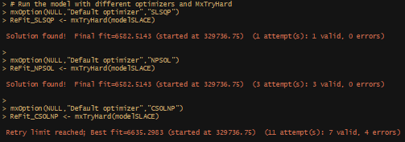
About optimizers

Slide 17
About optimizers

Slide 18
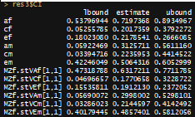
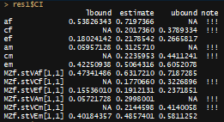
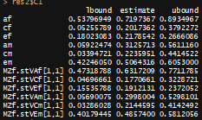
About optimizers
CSOLNP
SLSQP
NPSOL

Slide 19
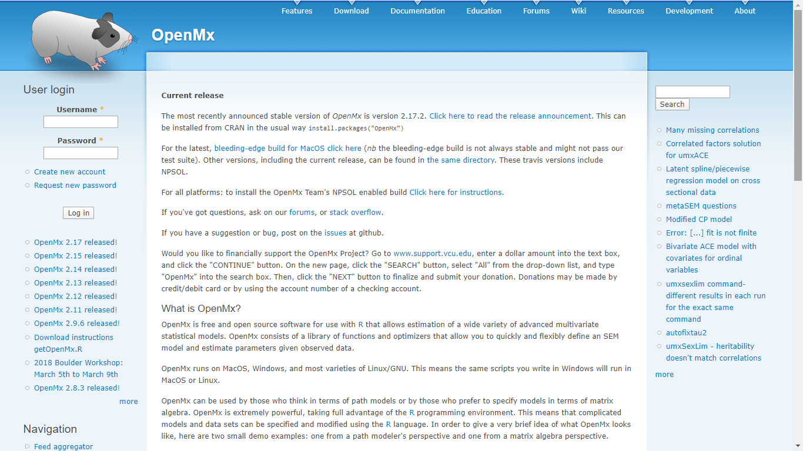
OpenMx Forum
https://openmx.ssri.psu.edu/

Slide 20
Practical: The Good Samaritan
Setting the scene
A master’s student at your lab is struggling with a bivariate twin model. You just came back from Boulder and they ask you if you could take a look to their script and help them getting it to run. They adapted someone else’s script but they keep getting errors.
They want to analyze the relationship between internalizing anger (variable anger) and blood pressure (variable mmHg).
They send you their script (angry2ACEc.R) and their data (goodsamaritan.txt) and promise to buy you a drink or chocolates if you fix it.

Slide 21
Practical: The Good Samaritan
Assumptions were already tested and have been met.
Final estimates for vars, covars, and means after equating across twin and zygosity from saturated model are in next slide.
NOW OPEN score-sheet_Fri8am.docx AND angry2ACEc.R

Slide 22
Practical: The Good Samaritan
MZ | mmHg_1 | anger_1 | mmHg_2 | anger_2
mmHg_1 | 8.14
anger_1 | 1.50 | 3.94
mmHg_2 | 4.80 | 0.94 | 8.14
anger_2 | 0.94 | 1.47 | 1.50 | 3.94
means | Interc. | age | sex | a*s
anger | 6.35 | 0.02 | 1.36 | -0.3
mmHg | 123.83 | 0.03 | 1.07 | -0.2
MZ | mmHg_1 | anger_1 | mmHg_2 | anger_2
mmHg_1 | 8.14
anger_1 | 1.50 | 3.94
mmHg_2 | 2.01 | 0.42 | 8.14
anger_2 | 0.42 | 1.38 | 1.50 | 3.94

Slide 23
Coding hygiene and positive thinking
First, write down an analysis plan and follow it: write down the research question, decide the models you need to run, don’t go down rabbit holes.
Triangulate results: descriptives and basic tests outside OpenMx, saturated models, univariate before multivariate.
Don’t be afraid of warning or error messages, they want to help you. Breath. Read them.
Relax, take another deep breath, go for a walk if stuck (coder’s block is real, google it).
Say only nice things to OpenMx, it remembers and can strike back.

Slide 24
Speeding up confidence intervals
Only for confidence intervals, not the base model.
Try changing optimizer if confident intervals don’t converge.
# Computing CIs in parallel
library(snowfall)
library(parallel)
(ncores <- detectCores()) # How many cores
sfInit(parallel=TRUE, cpus = ncores)
sfLibrary(OpenMx)
EqZygFit_Ci <- omxParallelCI( EqZygFit )

