Slide 1
Univariate 5 ways
Sarah Medland and Lucía Colodro Conde
2020

Slide 2
Today - sarah/2020/tuesday2
We start with the univariate from yesterday
We will look at:
some extensions of the model
some different parameterisations
Pay particular attention to the variance covariance model!

Slide 3
Important structural stuff
openMx has a very fluid and flexible stucture
Each code snippet is being saved as an object
We tend to reuse the object names in our scripts
There are very few ‘reserved’ names
Naming a matrix “mean” does not make it a mean.
Remember the project also contains the data so these files can become very large.

Slide 4
Matrices are the building blocks
Many types eg. type="Lower"
Denoted by names eg. name="a“
Size eg. nrow=nv, ncol=nv
All estimated parameters must be placed in a matrix & Mx must be told what type of matrix it is
mxMatrix( type="Lower", nrow=nv, ncol=nv, free=TRUE, values=.6, label="a11", name="a" ), #X

Slide 5
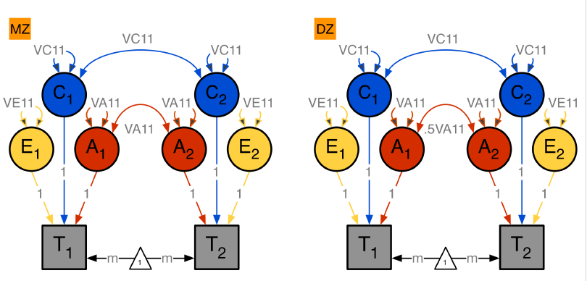
Yesterday’s model
MZ and DZ pairs – estimating A, C and E

Slide 6
Yesterday’s model
MZ and DZ pairs – estimating A, C and E
MZ DZ
A+C+E | A+C
A+C | A+C+E
A+C+E | .5⊗A+C
.5⊗A+C | A+C+E

Slide 7
MZ
A+C+E | A+C
A+C | A+C+E
covP <- mxAlgebra( expression= VA+VC+VE, name="V" )
covMZ <- mxAlgebra( expression= VA+VC, name="cMZ" )
expCovMZ <- mxAlgebra( expression= rbind( cbind(V, cMZ),
cbind(t(cMZ), V)),
name="expCovMZ" )
V | cMZ
cMZ | V

Slide 8
DZ
A+C+E | .5⊗A+C
.5⊗A+C | A+C+E
covP <- mxAlgebra( expression= VA+VC+VE, name="V" )
covDZ <- mxAlgebra( expression= 0.5%x%VA+VC, name="cDZ" )
expCovDZ <- mxAlgebra( expression= rbind( cbind(V, cDZ),
cbind(t(cDZ), V)),
name="expCovDZ" )
V | cDZ
cDZ | V

Slide 9
00_ACEvc.R
Run the ACE model
Look at the output
(type “sumACE”)
Record the output in Tuesday2.xls
Any questions about this model or script?

Slide 10
Next step – add a sibling
Let’s include 1 extra sibling in the analysis
Assume that this is a non-twin full sibling
What would the variance of the sibling be in the ACE model we just ran? (trick question)
What would the covariance be between the sibling and twin1? (trick question)
Is this the same for MZ and DZ families? (trick question)

Slide 11
Next step – add a sibling
MZ
A+C+E | A+C | .5⊗A+C
A+C | A+C+E | .5⊗A+C
.5⊗A+C | .5⊗A+C | A+C+E

Slide 12
Next step – add a sibling
expCovMZ <- mxAlgebra( expression=
rbind(cbind(V, cMZ, cDZ),
cbind(t(cMZ), V, cDZ),
cbind(t(cDZ), t(cDZ), V)), name="expCovMZ" )
A+C+E | A+C | .5⊗A+C
A+C | A+C+E | .5⊗A+C
.5⊗A+C | .5⊗A+C | A+C+E

Slide 13
Next step – add a sibling
DZ
A+C+E | .5⊗A+C | .5⊗A+C
.5⊗A+C | A+C+E | .5⊗A+C
.5⊗A+C | .5⊗A+C | A+C+E

Slide 14
Next step – add a sibling
expCovDZ <- mxAlgebra( expression=
rbind(cbind(V, cDZ, cDZ),
cbind(t(cDZ), V, cDZ),
cbind(t(cDZ), t(cDZ), V)), name="expCovDZ" )
A+C+E | .5⊗A+C | .5⊗A+C
.5⊗A+C | A+C+E | .5⊗A+C
.5⊗A+C | .5⊗A+C | A+C+E

Slide 15
Next step – add a sibling
Q: What about if some families have siblings and others don’t?
A: That is fine because we use full information maximum likelihood (FIML) methods
model your biggest family size
missing phenotypes for the non-exsistent sibs BUT you do need to give them covariates
assumes missing at random

Slide 16
01_extrasib.R
Two versions – if you have some mx experience try challenge_01_extrasib.R
Run the ACE model
Look at the output
(type “sumACE”)
Record the output in Tuesday2.xls
Any questions about this model or script?

Slide 17
Variation on this theme
Although it can be helpful to write out the full variance/covariance matrix it quickly becomes unwieldy
imagine doing this if you largest family = 10 sibs…
expCovMZ <- mxAlgebra( expression=
rbind(cbind(V, cMZ, cDZ),
cbind(t(cMZ), V, cDZ),
cbind(t(cDZ), t(cDZ), V)), name="expCovMZ" )

Slide 18
Alternate parameterisation
Lets think about A for an MZ family
A+C+E | A+C | .5⊗A+C
A+C | A+C+E | .5⊗A+C
.5⊗A+C | .5⊗A+C | A+C+E
A | A | .5⊗A
A | A | .5⊗A
.5⊗A | .5⊗A | A
1 | 1 | .5
1 | 1 | .5
.5 | .5 | 1
= A ⊗

Slide 19
Alternate parameterisation
Lets think about A for an DZ family
A+C+E | .5⊗A+C | .5⊗A+C
.5⊗A+C | A+C+E | .5⊗A+C
.5⊗A+C | .5⊗A+C | A+C+E
A | .5⊗A | .5⊗A
.5⊗A | A | .5⊗A
.5⊗A | .5⊗A | A
1 | .5 | .5
.5 | 1 | .5
.5 | .5 | 1
= A ⊗

Slide 20
Alternate parameterisation
What about C?
A+C+E | .5⊗A+C | .5⊗A+C
.5⊗A+C | A+C+E | .5⊗A+C
.5⊗A+C | .5⊗A+C | A+C+E
C | C | C
C | C | C
C | C | C
1 | 1 | 1
1 | 1 | 1
1 | 1 | 1
= c ⊗

Slide 21
Alternate parameterisation
What about E?
A+C+E | .5⊗A+C | .5⊗A+C
.5⊗A+C | A+C+E | .5⊗A+C
.5⊗A+C | .5⊗A+C | A+C+E
E | E | E
E | E | E
E | E | E
1 | 0 | 0
0 | 1 | 0
0 | 0 | 1
= E ⊗

Slide 22
How do we do this in the script?
relMZ <- mxMatrix( type="Symm", nrow=ntv, ncol=ntv, free=FALSE, values=c(1,1,.5,1,.5,1), name="rAmz" )
relDZ <- mxMatrix( type="Symm", nrow=ntv, ncol=ntv, free=FALSE, values=c(1,.5,.5,1,.5,1), name="rAdz" )
relMZ (rAmz) relDZ (rAdz)
1 | 1 | .5
1 | 1 | .5
.5 | .5 | 1
1 | .5 | .5
.5 | 1 | .5
.5 | .5 | 1

Slide 23
How do we do this in the script?
relMZ <- mxMatrix( type="Symm", nrow=ntv, ncol=ntv, free=FALSE, values=c(1,1,.5,1,.5,1), name="rAmz" )
relDZ <- mxMatrix( type="Symm", nrow=ntv, ncol=ntv, free=FALSE, values=c(1,.5,.5,1,.5,1), name="rAdz" )
relMZ (rAmz) relDZ (rAdz)
r here is the coefficient of relatedness
1 | 1 | .5
1 | 1 | .5
.5 | .5 | 1
1 | .5 | .5
.5 | 1 | .5
.5 | .5 | 1

Slide 24
How do we do this in the script?
relC <- mxMatrix( type="Unit", nrow=ntv, ncol=ntv, free=FALSE, name="rC" )
relE <- mxMatrix( type="Iden", nrow=ntv, ncol=ntv, free=FALSE, name="rE" )
relC (rC) relE (rE)
1 | 1 | 1
1 | 1 | 1
1 | 1 | 1
1 | 0 | 0
0 | 1 | 0
0 | 0 | 1

Slide 25
How do we do this in the script?
expCovMZ <- mxAlgebra( expression=
VA%x%rAmz + VC%x%rC + VE%x%rE,
name="expCovMZ" )
expCovDZ <- mxAlgebra( expression=
VA%x%rAdz + VC%x%rC + VE%x%rE,
name="expCovDZ" )

Slide 26
02_extrasib2.R
Run the ACE model
Look at the output
(type “sumACE”)
Record the output in Tuesday2.xls
Any questions about this model or script?

Slide 27
Can we make this even more efficient?
What are the differences between the MZ and DZ groups?
relMZ <- mxMatrix( type="Symm", nrow=ntv, ncol=ntv, free=FALSE, values=c(1,1,.5,1,.5,1), name="rAmz" )
relDZ <- mxMatrix( type="Symm", nrow=ntv, ncol=ntv, free=FALSE, values=c(1,.5,.5,1,.5,1), name="rAdz" )
relMZ (rAmz) relDZ (rAdz)
1 | 1 | .5
1 | 1 | .5
.5 | .5 | 1
1 | .5 | .5
.5 | 1 | .5
.5 | .5 | 1

Slide 28
Is there another way we could do this?
How about we read this coefficient from the data and only have one group?
relA <- mxMatrix( type="Stand", nrow=ntv, ncol=ntv, free=FALSE, labels=c("data.zyg","data.zyg2","data.zyg2"), name="rA" )
relA (rA)
Putting data. in the label tells openMx that this is a definition variable and should be updated dynamically for each case in the data
1 | zyg | zyg2
zyg | 1 | zyg2
zyg2 | zyg2 | 1

Slide 29
Is there another way we could do this?
How about we read this coefficient from the data and only have one group?
relA <- mxMatrix( type="Stand", nrow=ntv, ncol=ntv, free=FALSE, labels=c("data.zyg","data.zyg2","data.zyg2"), name="rA" )
zyg = 1 for MZs
zyg = .5 for DZs
zyg2 =.5 for everyone
zyg = 1 for MZs
zyg = .5 for DZs
1 | zyg | zyg2
zyg | 1 | zyg2
zyg2 | zyg2 | 1

Slide 30
03_zygdef.R
Run the ACE model
Look at the output
(type “sumACE”)
Record the output in Tuesday2.xls
Any questions about this model or script?

Slide 31
Is this more efficient?
01_extrasib.R
With CIs: Wall clock time: 49.40628 secs
Without CIs: Wall clock time: 1.26036 secs
02_extrasib2.R
With CIs: Wall clock time: 29.92903 secs
Without CIs: Wall clock time: 1.300223 secs
03_zygdef.R
With CIs: Wall clock time: 39.61322 secs
Without CIs: Wall clock time: 1.577673 secs

Slide 32
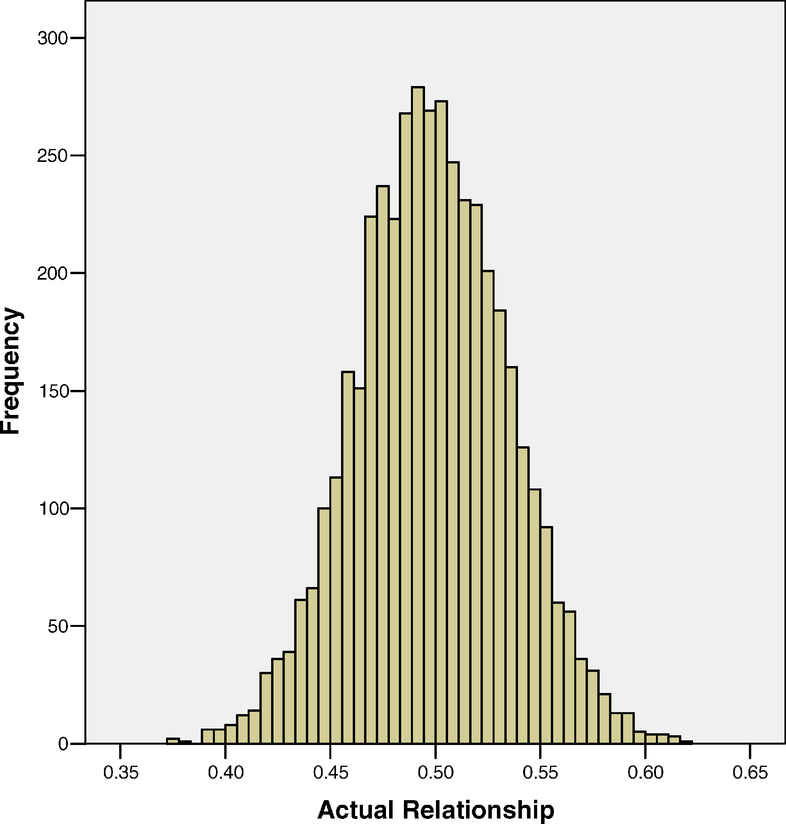
Variations on this theme
How about including actual genetic relatedness instead of the .5 or 1?
Estimate genetic relatedness by computing a GRM in PLINK or GCTA

Slide 33
Variations on this theme
How about including actual genetic relatedness instead of the .5 or 1?
Estimate genetic relatedness by computing a GRM in PLINK or GCTA
relA <- mxMatrix( type="Stand", nrow=ntv, ncol=ntv, free=FALSE, labels=c("data.s1","data.s2","data.s3"), name="rA" )
1 | S1 | S2
S1 | 1 | S3
S2 | S3 | 1

Slide 34
04_relatedness.R
Run the ACE model
Look at the output
(type “sumACE”)
Record the output in Tuesday2.xls
Any questions about this model or script?
How do the answers compare to the previous scripts?

Slide 35
Final variation…
Once we include measured relationships the model we don’t technically need MZs to make the model identified

Slide 36
Final variation…
When would we do this?
If the equal environments assumption was problematic for your trait
If we only had sibling pairs
(If we want to show we’re super clever…)

Slide 37
05_relatednessDZonly.R
Run the ACE model
Look at the output
(type “sumACE”)
Record the output in Tuesday2.xls
Any questions about this model or script?
How do the answers compare to the previous scripts?
If you have MZ twins is this a good use of your data?

Slide 38
In summary
This is a different simulation run so pay more attention to the width of the CIs than the point estimates

Slide 39
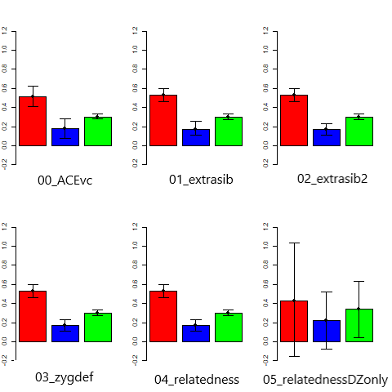
A
C
E

Slide 40
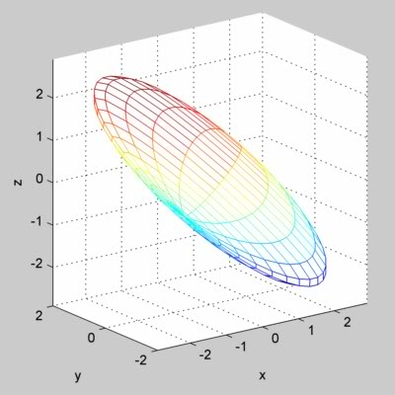
Thinking out side the box…
Rather than thinking about estimates as fixed points I like to think about parameter space…
Imagine an ACE model as a solution space bounded by CIs

Slide 41
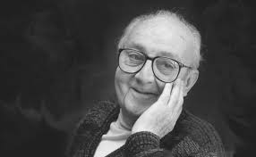
“Remember that all models are wrong; the practical question is how wrong do they have to be to not be useful”
George E P Box and Norman R Draper. 1986. Empirical Model-Building and Response Surface. John Wiley & Sons, Inc., New York, NY, USA.

Slide 42
Questions?

