Slide 1
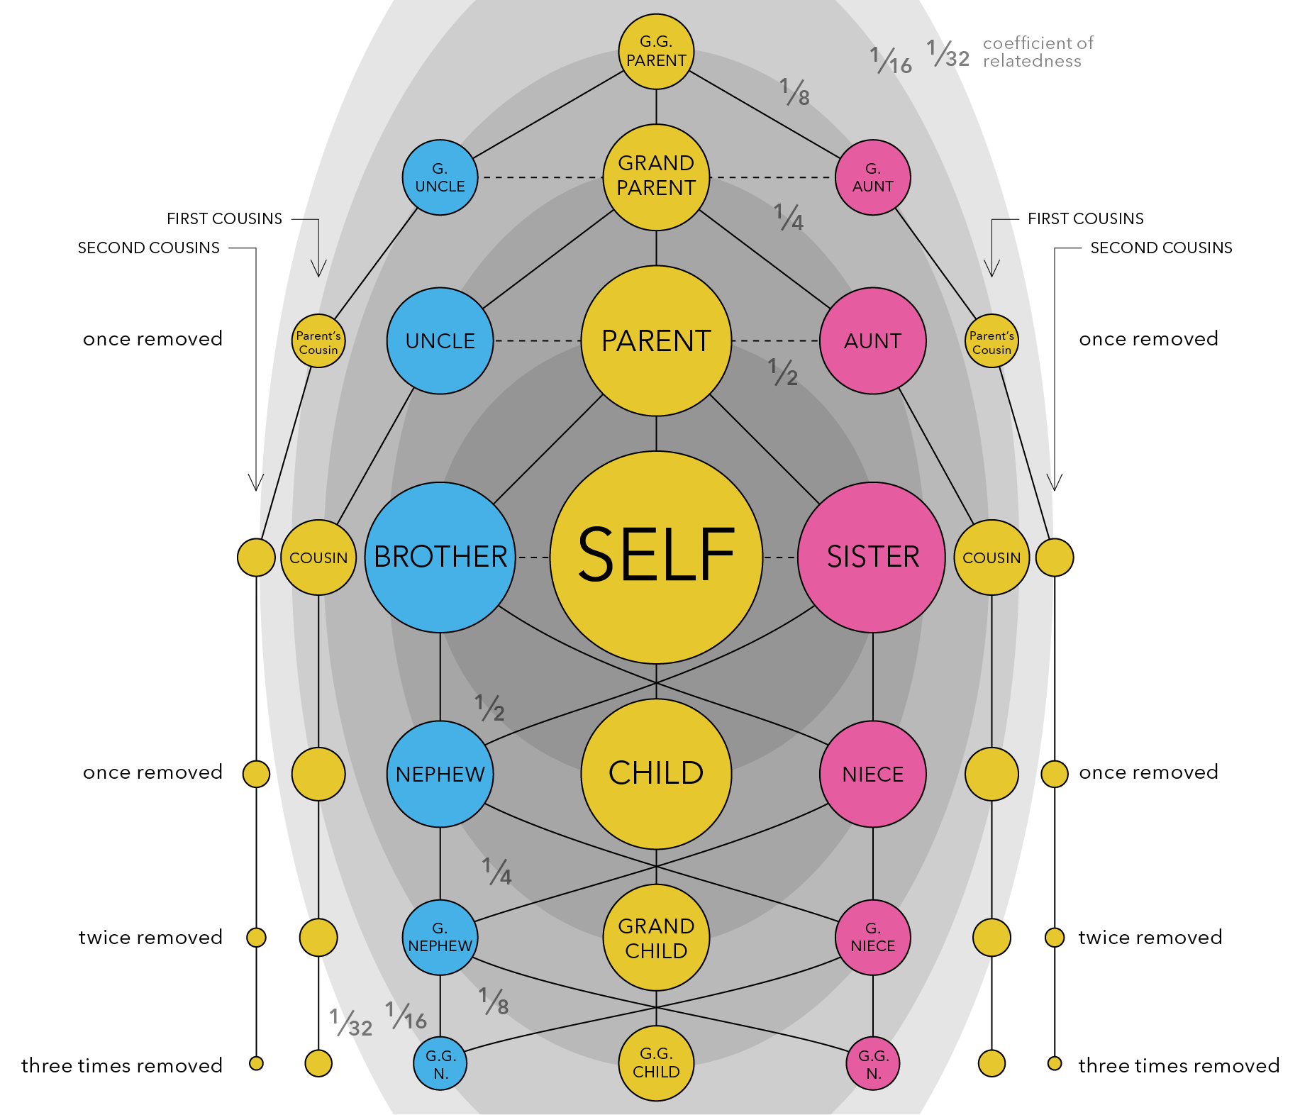
(superfast) Overview of PLINK and Genetic Relatedness
Sarah Medland and José Morosoli

Slide 2
Today
Quick play with some QC functions in PLINK
Calculate genetic relatedness

Slide 3
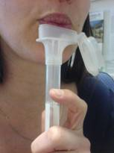
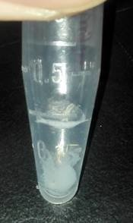
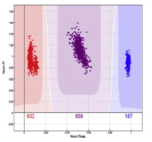
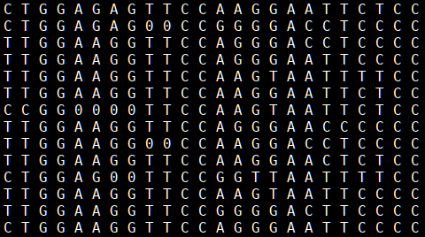
Common variant genotyping

Slide 4
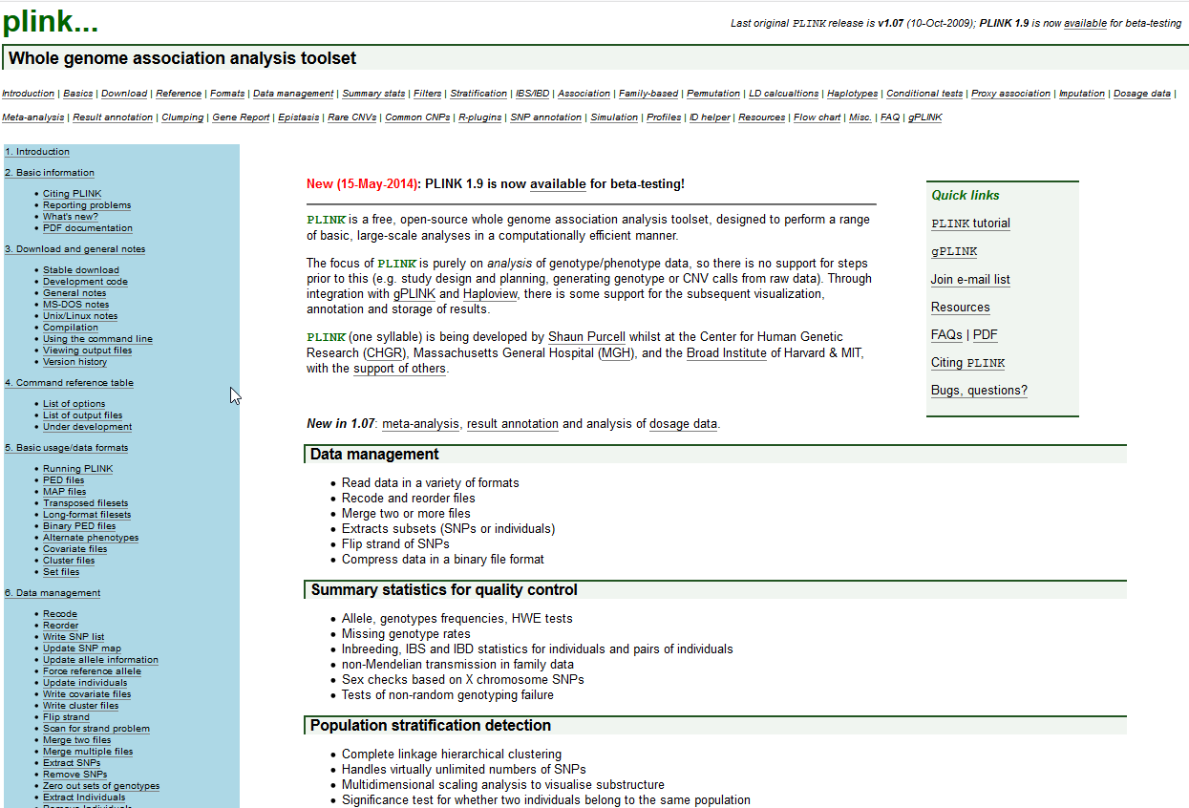
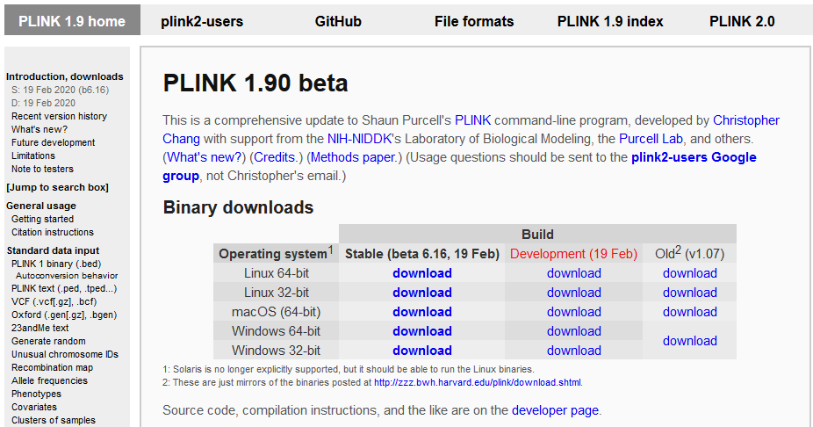
PLINK…
Designed to be a one stop shop for GWAS data handling and analysis
Limitations: families or dosage data

Slide 5
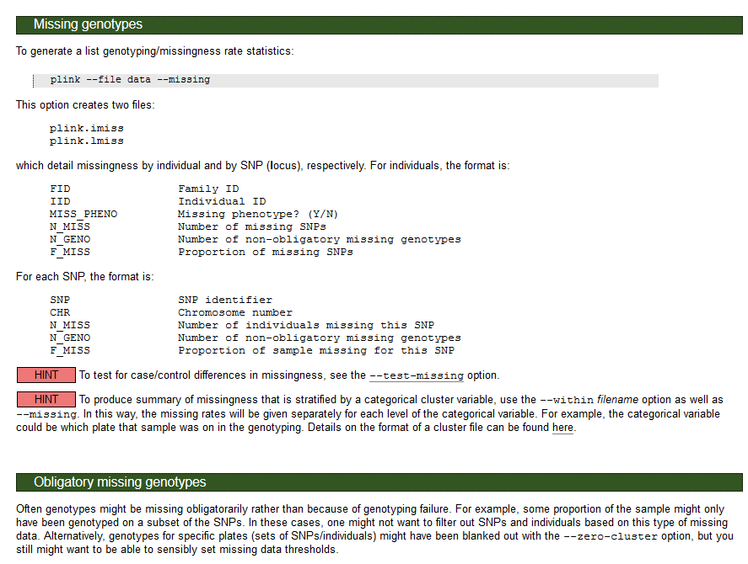
Plink…
Brilliant well explained online manual

Slide 6
Calculating genetic relatedness
Estimate relatedness from genomic data
Typically common variant GWAS data
Doesn’t need to be very dense genotyping but you do want whole genome coverage
Two main approaches
Identity by state
Identity by descent

Slide 7
Calculating genetic relatedness
Identity by state
Do individuals share the same genetic variants at a given locus?
Identity by descent
Do individuals share the same genetic variants at a given locus AND was it inherited from the same ancestor?

Slide 8
Calculating genetic relatedness
Identity by state
Does not require pedigree information or data from other relatives
Identity by descent
Does

Slide 9
Calculating genetic relatedness
Identity by state
Information is limited to the observed locus (and variants that are very, very close by)
Identity by descent
Provides more information about surrounding loci

Slide 10
Calculating genetic relatedness
Identity by state
Produces a coefficient of relatedness known as r
Implementation in GRMs is typically calculated as the average correlation between individuals across genotyped snps

Slide 11
Calculating genetic relatedness
Identity by descent
Estimation typically requires Monte Carlo Markov Chain methods
Estimate is known as $π$ (pi-hat)
^

Slide 12
Plink and GRM practical
In this practical, we will:
Learn about genetic relatedness / relationship matrices by estimating one.
Learn about some concepts and methods from molecular genetic methods.

Slide 13
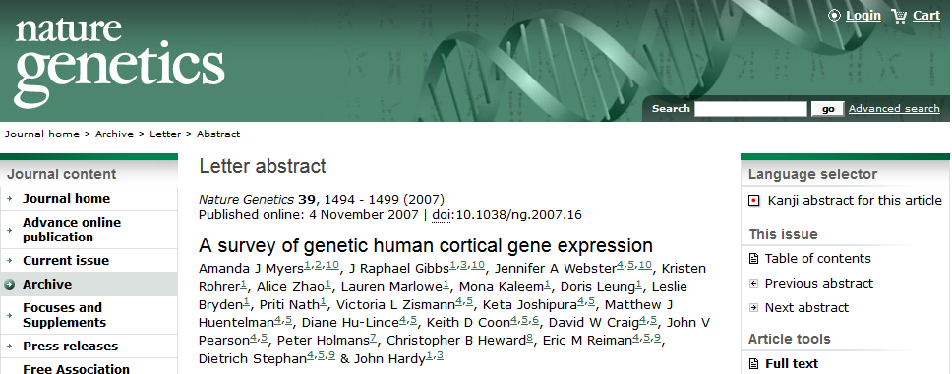
Our data
Simulated dataset based on real data.
23 MZ pairs, 21 DZ pairs, 62 unrelated individuals

Slide 14
gwas_plinkdata.ped
150 individuals
23 MZ pairs, 21 DZ pairs, 62 unrelated individuals
Notes:
We go from this…

Slide 15
1) Change working directory
First, open Unix terminal. Copy the files to a folder of your preference.
Then, we need to make sure we are working in the right folder
For example:
cd /home/jose/2020

Slide 16
2) Check file format
PLINK-friendly formats (.bed and .ped):
PED: pedigree information standard
BED: compressed (binary) version of PED
plink --file gwas_plinkdata --make-bed --out gwas_plinkdata

Slide 17
3) Clean the data (quality control)
PLINK includes several options to clean genetic data.
This means filtering out low quality data or outliers.
We are going to run a very basic quality control (to learn more: next year at the IBG GWAS workshop!)
plink --bfile gwas_plinkdata --geno 0.05 --mind 0.05 --hwe 1e-6 --maf 0.1 --make-bed --out gwas_plinkdata_clean

Slide 18
4) Estimate the genetic relatedness matrix
Output style (A) -- matrix
Take a look to the results in Unix…
plink --bfile gwas_plinkdata_clean --make-rel triangle
zless -S plink.rel

Slide 19
4) Estimate the genetic relatedness matrix
Open the file ‘GRM_highlighted.pdf’ to see how it looks.
Zoom in to find which individuals are likely to be MZ twins (in green), DZ twins (in red), and genetically unrelated (not highlighted).

Slide 20
4) Estimate the genetic relatedness matrix

Slide 21
4) Estimate the genetic relatedness matrix
Output style (B) – relatedness pair by pair
Take a look to the results in Unix…
plink --bfile gwas_plinkdata_clean -make-grm-gz no-gz
zless -S plink.grm

Slide 22
4) Estimate the genetic relatedness matrix
Open the file ‘grel_highlighted.xls’ to see how it looks.
You can sort the data by gen. relatedness and find which pairs are likely to be MZ twins (in green), DZ twins (in red), or unrelated individuals (not highlighted).

Slide 23
4) Estimate the genetic relatedness matrix
ID1 | ID2 | common SNPs | gen relatedness
2 | 1 | 247262 | -0.0233
3 | 1 | 250987 | -0.0227
3 | 2 | 247011 | -0.0209
4 | 1 | 247683 | -0.0195
26 | 3 | 251499 | 0.9960
73 | 51 | 247061 | 0.5048

Slide 24
USING these estimates in our models
Today – within family ‘ACE’ models
Sarah and Lucia
Friday – across family ‘REML’ models
Rob
Next year – across family ‘GCTA’ analysis ☺

Slide 25
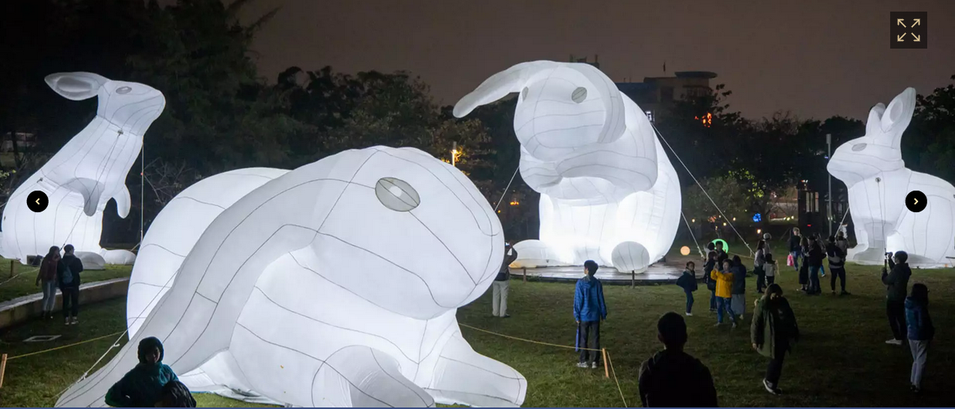
Questions?

