Slide 1
Polygenic risk scores
Sarah Medland and Lucía Colodro Conde
sarah/2020/thursday

Slide 2
What are Polygenic risk scores (PRS)?
PRS are a quantitative measure of the cumulative genetic risk or vulnerability that an individual possesses for a trait.
The traditional approach to calculating PRS is to construct a weighted sum of the betas (or other effect size measure) for a set of independent loci thresholded at different significance levels.
  Typically the independence is LD based (LD r2 <=.2) via clumping.

Slide 3





The classics
Wray NR, Goddard, ME, Visscher PM. Prediction of individual genetic risk to disease from genome-wide association studies. Genome Research. 2007; 7(10):1520-28.
Evans DM, Visscher PM., Wray NR. Harnessing the information contained within genome-wide association studies to improve individual prediction of complex disease risk. Human Molecular Genetics. 2009; 18(18): 3525-3531.
International Schizophrenia Consortium, Purcell SM, Wray NR, Stone JL, Visscher PM, O'Donovan MC, Sullivan PF, Sklar P . Common polygenic variation contributes to risk of schizophrenia and bipolar disorder. Nature. 2009; 460(7256):748-52
Evans DM, Brion MJ, Paternoster L, Kemp JP, McMahon G, Munafò M, Whitfield JB, Medland SE, Montgomery GW; GIANT Consortium; CRP Consortium; TAG Consortium, Timpson NJ, St Pourcain B, Lawlor DA, Martin NG, Dehghan A, Hirschhorn J, Smith GD. Mining the human phenome using allelic scores that index biological intermediates. PLoS Genet. 2013,9(10):e1003919.

Slide 4
Further reading
Dudbridge F. Power and predictive accuracy of polygenic risk scores. PLoS Genet. 2013 Mar;9(3):e1003348. Epub 2013 Mar 21. Erratum in: PLoS Genet. 2013;9(4). (Important discussion of power)
Wray NR, Lee SH, Mehta D, Vinkhuyzen AA, Dudbridge F, Middeldorp CM. Research review: Polygenic methods and their application to psychiatric traits. J Child Psychol Psychiatry. 2014;55(10):1068-87. (Very good concrete description of the traditional methods).
Wray NR, Yang J, Hayes BJ, Price AL, Goddard ME, Visscher PM. Pitfalls of predicting complex traits from SNPs. Nat Rev Genet. 2013;14(7):507-15. (Very good discussion of the complexities of interpretation).
Witte JS, Visscher PM, Wray NR. The contribution of genetic variants to disease depends on the ruler. Nat Rev Genet. 2014;15(11):765-76. (Important in the understanding of the effects of ascertainment on PRS work).
Shah S, Bonder MJ, Marioni RE, Zhu Z, McRae AF, Zhernakova A, Harris SE, Liewald D, Henders AK, Mendelson MM, Liu C, Joehanes R, Liang L; BIOS Consortium, Levy D, Martin NG, Starr JM, Wijmenga C, Wray NR, Yang J, Montgomery GW, Franke L, Deary IJ, Visscher PM. Improving Phenotypic Prediction by Combining Genetic and Epigenetic Associations. Am J Hum Genet. 2015; 97(1):75-85. (Important for the conceptualization of polygenicity)

Slide 5
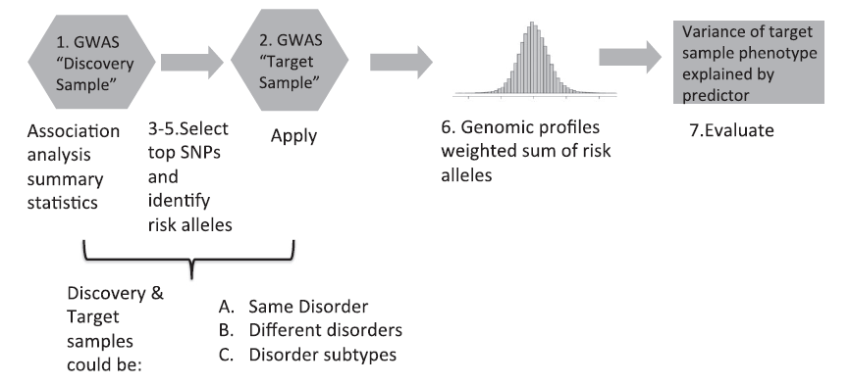
Traditional approach
Wray et al (2014) J Child Psychol Psychiatry
Notes:
Any overlapping individuals (or relatives) between the discovery and target samples will result in overfitting. (Even selecting SNPs from a meta-analysis that includes target samples but taking the weights from a meta-analysis excluding the overlap will result in substantial overfitting).

Slide 6
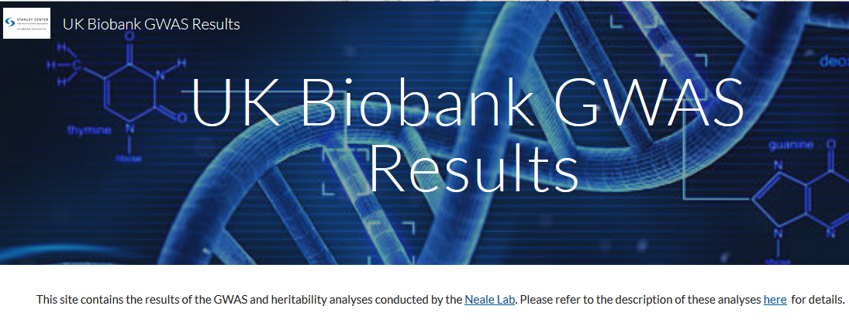
https://sites.google.com/broadinstitute.org/ukbbgwasresults/

Slide 7
Traditional approach
MUST BE INDEPENDENT
Wray et al (2014) J Child Psychol Psychiatry
Notes:
Any overlapping individuals (or relatives) between the discovery and target samples will result in overfitting. (Even selecting SNPs from a meta-analysis that includes target samples but taking the weights from a meta-analysis excluding the overlap will result in substantial overfitting).

Slide 8
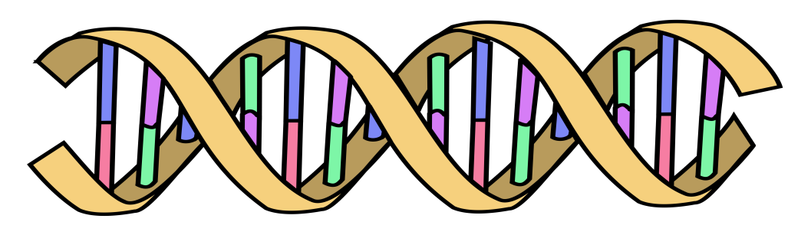
1×-.02 + 2×.01 + 1×.002 + 0×.03 + 2×.025
Polygenic
score:
AC
CC
TT
.052
GG
AT
Effect size
from GWAS
β_{C}=-.02
β_{G}=.01
β_{A}=.002
β_{G}=.03
β_{T}=.025
Wray et al (2014) J Child Psychol Psychiatry

Slide 9
Main uses of PRS
Single disorder analyses
Cross-disorder analysis
Sub-type analysis

Slide 10
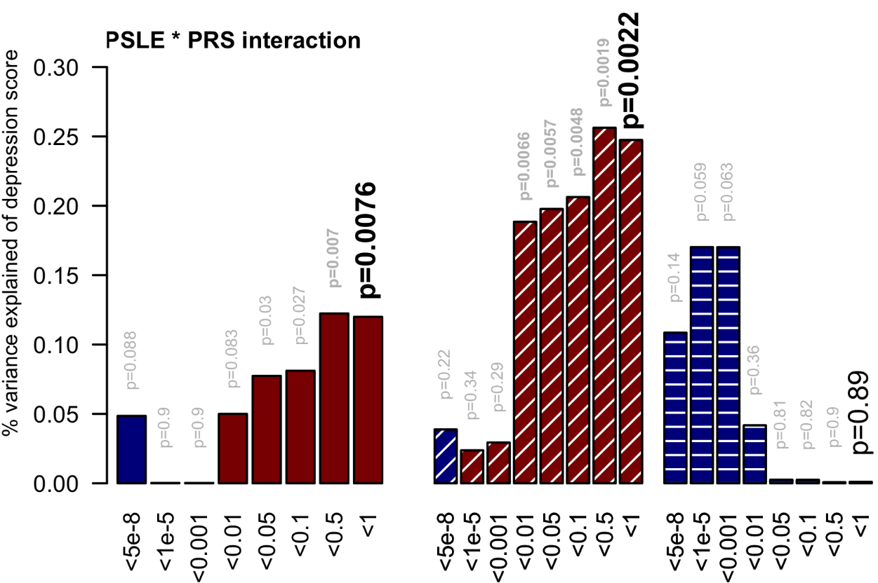
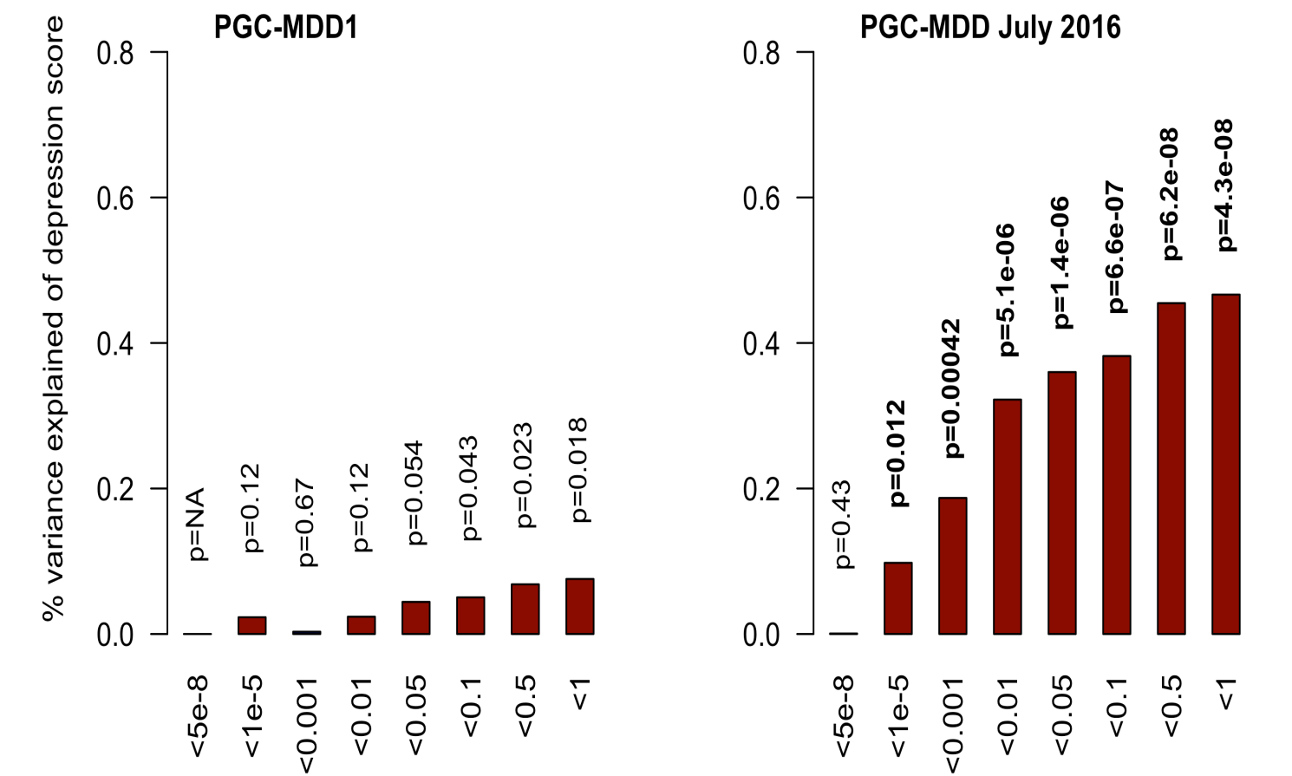
Single trait analyses

Slide 11
Moderated single trait analyses

Slide 12
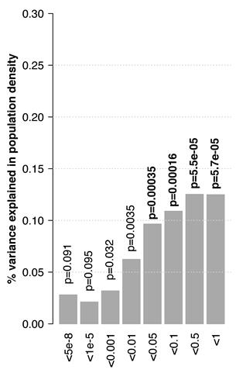
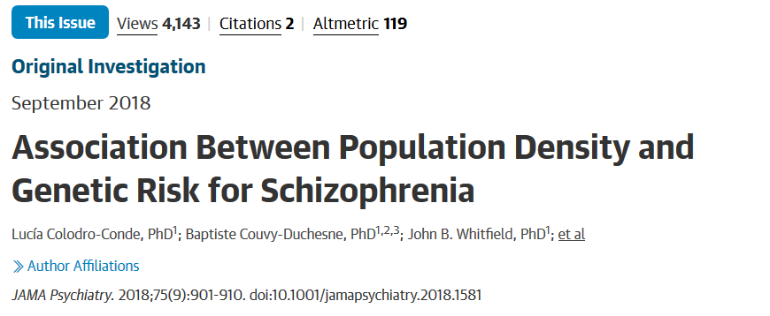
Cross-trait analysis
PRS-SCZ

Slide 13
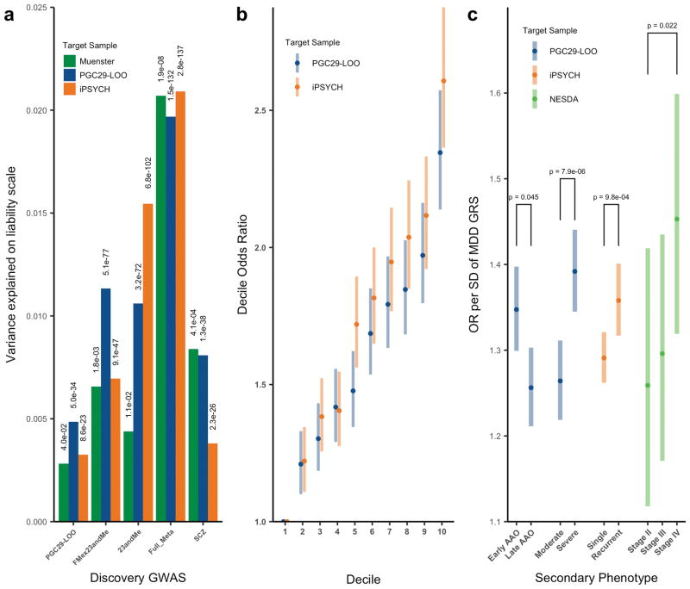
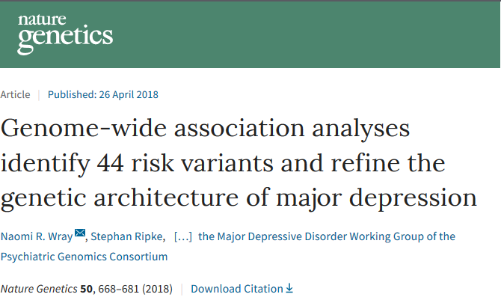
Sub-type analysis

Slide 14
PRS and power
The power of the predictor is a function of the power of the GWAS in the discovery sample (due to its impact on the accuracy of the estimation of the betas).
“I show that discouraging results in some previous studies were due to the low number of subjects studied, but a modest increase in study size would allow more successful analysis. However, I also show that, for genetics to become useful for predicting individual risk of disease, hundreds of thousands of subjects may be needed to estimate the gene effects.”
(Dudbridge, 2013)

Slide 15
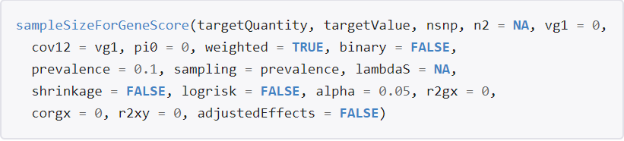
PRS and power
For simple power calculations you can use a regression power calculator (for r² of up to 0.5%).
As a general rule of thumb you usually want 2,000+ people in the target dataset.
R AVENGEME (https://github.com/DudbridgeLab/avengeme)
Power calculator for discovery (GWAS) sample needed to achieve prediction of r² in target sample

Slide 16
Power of PRS analysis increases with GWAS sample size
PGC-MDD1: N=18k
max variance explained = 0.08%, p=0.018
PGC-MDD2: N=163k
max variance explained =0.46%,
p= 5.01e-08
Colodro-Conde L,
Couvy-Duchesne B, et al, (2017) Molecular Psychiatry

Slide 17
Making a PRS

Slide 18
(1) GWAS summary statistics
→From PGC results, other public domain GWAS, unpublished GWAS
SNP identifier (rs number, Chr:BP )
Both Alleles (effect/reference, A1/A2)
Effect
Beta from association with continuous trait
OR from an ordinal trait - convert to log(OR)
Z-score, MAF and N (from an N weighted meta-analysis)
p-value
(frequency of A1)
Notes:
If you have an N weighted meta-analysis:
Calculate SE (of an allele) = sqrt((1/N)*2pq) where N= number of chromosomes available for that snp, for an autosome this is 2*sample size for that snp, p =MAF and q=1-MAF
The calculate Beta (on the allelic scale) = Z* sqrt((1/N)*2pq).

Slide 19
(1) GWAS summary statistics
→From PGC results, other public domain GWAS, unpublished GWAS
SNP identifier (rs number, Chr:BP )
Both Alleles (effect/reference, A1/A2)
Effect
Beta from association with continuous trait
OR from an ordinal trait - convert to log(OR)
Z-score, MAF and N (from an N weighted meta-analysis)
p-value
(frequency of A1)
Make sure that your target genotypes are named the same way as your discovery data!
→ imputation reference and genomic build
Notes:
many SNPs have more than one rs number and the same variant may be named differently in the target and replication especially if the discovery analysis did not use the same imputation reference.
If switching to Chr:bp: CHR and BP positions come from the same genomic builds.
The build should be stated in the result annotations but it is worth re-checking: search the rs number or position in the genome browser under multiple builds (https://genome.ucsc.edu/cgi-bin/hgGateway).
If you only have CHR:BP make sure you check that the alleles and frequencies fit with what is in the discovery results set. If your discovery data are on a different build you will have to lift over.
Also watch out for the naming of non-SNPs in the CHR:BP format as there are many ways to go about this (ie 2:2450:AAA_T, 2:2450:INDEL etc).

Slide 20
(2) Find SNPs in common with your local sample and QC
Imputed data
QC
  R² >=0.6
  MAF>=0.01
  No indels
  No ambiguous strands (*) - A/T or T/A or G/C or C/G
for ((i=1;i<=22;i++))
do
awk '{ if ($5<=.01 & $5<=.99 & $6>=.6) print $1}’ file"$i".info >> available.snps
done

Slide 21
(*) On ambiguous strands
GWAS chip results are expressed relative to the + or – strand of the genome reference
A/C
+
rsxxx A C MAF
rsxxx T G MAF
-
T/G
A/T
+
rsxxx A T MAF
rsxxx T A 1-MAF
-
T/A
Notes:
The discovery and target data need to be strand aligned. However, as strand information can come from many sources and differs between databases and builds using cohort supplied strand information is very problematic. The major issue with strand is the difficulty in determining which allele is the effect allele in the case of strand ambigious SNPs
We delete them.
If not, To include this snp in our PRS you would need to reconcile this strand flip by EITHER flipping the alleles in the discovery result set OR flip the sign on the beta in the discovery set (multiply by -1).

Slide 22
(3) Clumping
Select most associated SNP per LD region (pruning)
Plink1.9 --bfile ReferencePanelForLD
--extract QCedListofSNPs
--clump gwasFileWithPvalue
--clump-p1 (#Significance threshold for index SNPs)
--clump-p2 (#Secondary significance threshold for clumped SNPs)
--clump-r2 (#LD threshold for clumping)
--clump-kb (#Physical distance threshold for clumping)
--out OutputName
Notes:
Although PRS can be calculated without pruning it has become conventional to prune prior to calculation.
You will need some a reference data set in plink format (bed, bim, fam) .
Ideally discovery data set alternatively, you can use public reference or genotypes from the target sample.

Slide 23
(4) Calculate risk scores
The traitX"$i".selected files will contain the lists of top independent snps. Merge the alleles, effect & P values from the discovery data onto these files.
To do a final strand check merge the alleles of the target set onto these files. If any SNPs are flagged as mismatched you will have to manual update the merged file - flip the strands (ie an A/G snp would become a T/C snp) but leave the effect as is.
Create Score files (SNP EffectAllele Effect) and P files contain (SNP Pvalue).
for ((i=1;i<=22;i++))
do
awk '{ if ($6==$8 || $6==$9 ) print $0, "match" ; if ($6!=$8 && $6!=$9 ) print $0, "mismatch"}' traitX."$j".merged > strandcheck.traitX."$i"
grep mismatch strandcheck.traitX*
done

Slide 24
(4) Calculate risk scores
for ((i=1;i<=22;i++))
do
plink --noweb --dosage Your_chr"$i".plink.dosage.gz format=1 Z --fam Your_chr"$i".plink.fam --score traitX."$i".score --q-score-file traitX."$i".P --q-score-range p.ranges --out Your_chr"$i".PRS
done
p.ranges
S1 0.00 0.000001
S2 0.00 0.01
S3 0.00 0.10
S4 0.00 0.50
S5 0.00 1.00

Slide 25
(5) Run PRS analysis –unrelated individuals
base <- lm (ICV ~ age + sex + PC1 + PC2 +PC3 +PC4 + other-covariates, data =mydata)
score1 <- lm (ICV ~ S1 + age + sex + PC1 + PC2 +PC3 +PC4 + other-covariates, data =mydata)
score2 <- lm (ICV ~ S2 + age + sex + PC1 + PC2 +PC3 +PC4 + other-covariates, data =mydata)
model_base <- summary(base)
model_score1 <- summary(score1)
model_score2 <- summary(score2)
model_base$r.squared
model_score1$r.squared
model_score2$r.squared
anova(base,score1)
anova(base,score2)

Slide 26
(5) Run PRS analysis, controlling for relatedness – twin pairs or small families
You can add the PRS as a covariate on the means model in an open Mx script
Allows you to do multivariate PRS analyses
Or look at variance explained over time in longitudinal data
  Test if the betas are equal across time points

Slide 27
(5) Run PRS analysis, controlling for relatedness in large/complex cohorts
gcta --reml
--mgrm-bin GRM
--pheno phenotypeToPredict.txt
--covar discreteCovariates.txt
--qcovar quantitativeCovariates.txt
--out Output
--reml-est-fix
--reml-no-constrain
Could run this analysis in a multilevel OpenMx model

Slide 28
Other Methods

Slide 29
Classic / Clump and Threshold | BLUP (LDpred) | PRSice
Dosage or best guess | Best guess | Dosage or best guess
clumping | BLUP effects summed over all SNPs | clumping
Multiple PRS by p-value thresholds | Unique PRS | All p-value thresholds tested
Bonferroni correction |  | Unclear significance threshold for association
 | Hypothesis: effect sizes of SNPs normally distributed
Fast (can be parallelized) | Matrix inversion, can be long for large N | Slower and harder to parallelize (R package)
PLINK | GCTA, PLINK | R (PLINK)

Slide 30
Overlap and Overfitting

Slide 31
Q: How important is independence with Biobank size samples?
Perceptions that this may not matter with biobank type discovery samples when the overlap is very small
Impact of relatedness across the discovery and target samples is usually ignored

Slide 32
Q: How important is independence with Biobank size samples?
To examine this
  GWAS were conducted for a continuous (height)
  ~340,000 individuals were extracted from the UK Biobank (app. 25331)
    European Ancestry & Unrelated (less than 3rd degree relatedness)
    Age, Sex and 10 PCs included as covariates
    A set of 35,000 individuals held out to ensure independence of the target sample

Slide 33
Q: How important is independence with Biobank size samples?
  Discovery GWAS were clumped and PRS were calculated
  PRS analyses were conducted using target samples
    of 2,000, 5,000 or 10,000 individuals randomly drawn from the hold-out sample (of 35,000)
    1,000 replicates
    4 PRS thresholds:
      0.00 0.0001
    Age, Sex and 10 PCs included as covariates
  To examine overfitting the target samples were spiked with
    5, 10, 50, 100 or 200 overlapping individuals
    5, 10, 50, 100 or 200 1st degree relatives

Slide 34
A: Variance explained
  PRS analyses in independent samples explained a median of 11.6% of variance

Slide 35
A: Impact of non-independent samples
  Yes – as expected there is bias in the estimate of variance explained and the p values
  Pattern of results the same across all Ns

Slide 36
A: Impact of non-independent samples
  Inflation present
    Extent is a function of the % overlap in the target sample
      Confirms the cautions of Wray et al 2013 apply to biobank sized discovery samples
    With 5 overlapping people in a target sample of 10k there was significant inflation
      Median CIs did not include 1

Slide 37
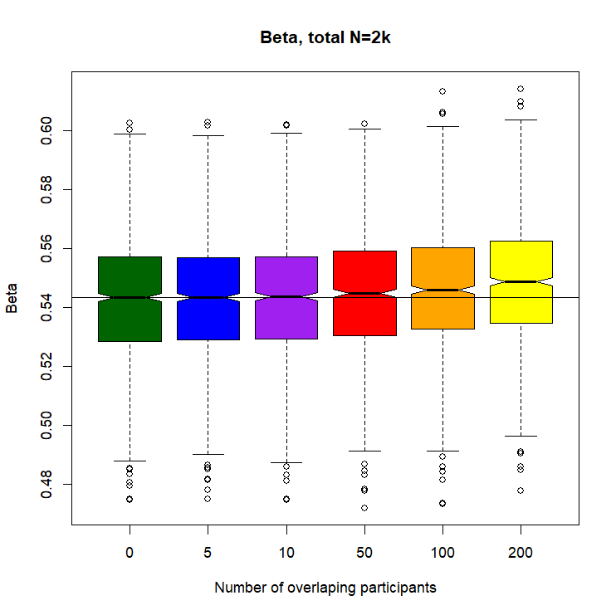
A: Impact of non-independent samples

Slide 38
A: Impact of non-independent samples
  Inflation also present
    In binary phenotypes
      Even if the overlap is limited to only controls or only cases
  Expect that inflation will be worse for quantitative traits if overlap is restricted to the tails of the distribution
    (Not tested)

Slide 39
A: Impact of First Degree Relatives
  Inflation present
    Proportional to the h² and the extent of overlap in the target sample (% of N)

Slide 40
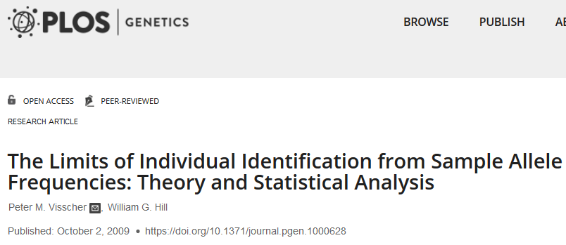
Q: How to Identify non-independence?
  Homer et al method
    Visscher and Hill 2009 more powerful
    However, many cohorts do not provide true MAF, violates data access, not clear how well this really works with a realistic meta-analysis

Slide 41
Q: How to Identify non-independence?
  LDScore – (Maybe, more work needed…)
    Using the Height data from the PRS analyses ran GWAS for 20 permutations
    Sample1 340,000 individuals
    Sample 2 30,000 individuals
    Overlap of 200 individuals
      Covariance “Intercept” ranged from .067 (.017) to .075 (.017) indicating non-independence
    Overlap of 5 individuals
      Covariance “Intercept” ranged from .062 (.016) to .072 (.017) indicating non-independence

Slide 42
WHAT Are the Solutions if you find non-independence
  Homer et al method
    Visscher and Hill 2009 more powerful
    However, many cohorts do not provide true MAF, violates data access, not clear how well this really works with a realistic meta-analysis

Slide 43
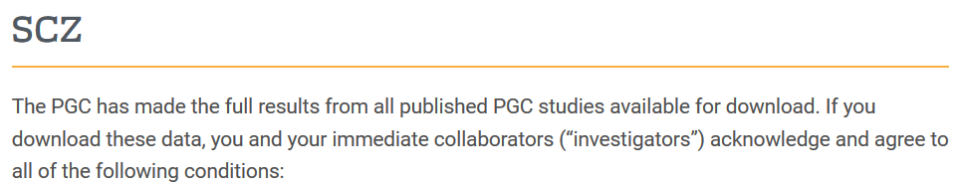
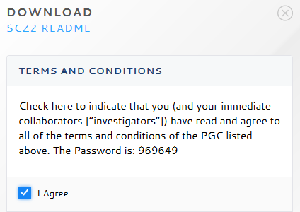
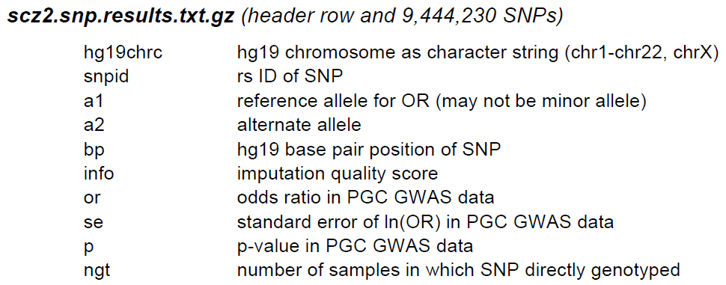
WHAT Are the Solutions if you find non-independence
  Homer et al method
    Visscher and Hill 2009 more powerful
    However, many cohorts do not provide true MAF, violates data access, not clear how well this really works with a realistic meta-analysis

Slide 44
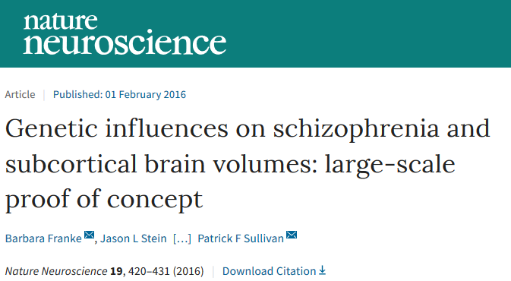
WHAT Are the Solutions if you find non-independence
  Leave-one-out…
  If both groups have raw data access collaborate & exchange checksums
    Make list of common non-ambiguous SNPs passing QC in discovery and target
    Make n SNP set lists each with m SNPs
    Export hardcall data from each SNP set (1 line per person but no IDs)
    Parse the data obtaining a checksum for each line of data
    Exchange and look at % of identical checksums
Google: checksum ripke
https://personal.broadinstitute.org/sripke/share_links/checksums_download/

Slide 45
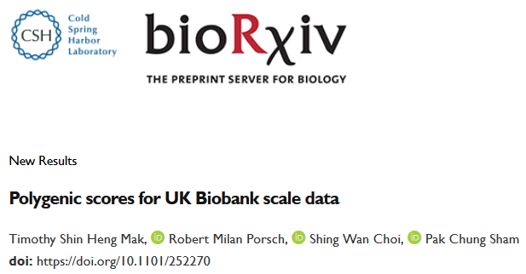
WHAT Are the Solutions if you find non-independence
  Mak et al (2018) proposed using all available data in the discovery and use of cross-prediction with split-validation to reduce inflation
    Focus is on situations where you have raw data for both discovery and target
    They do not consider the more typical situation where you have discovery sum-stats and raw target data

Slide 46
WHAT Are the Solutions if you find non-independence
  Do you really need prediction
    Are you trying to show polygenicity?
    If not can you answer your question with LDSC, GWAS-SEM, MR, SECA or another approach?

Slide 47
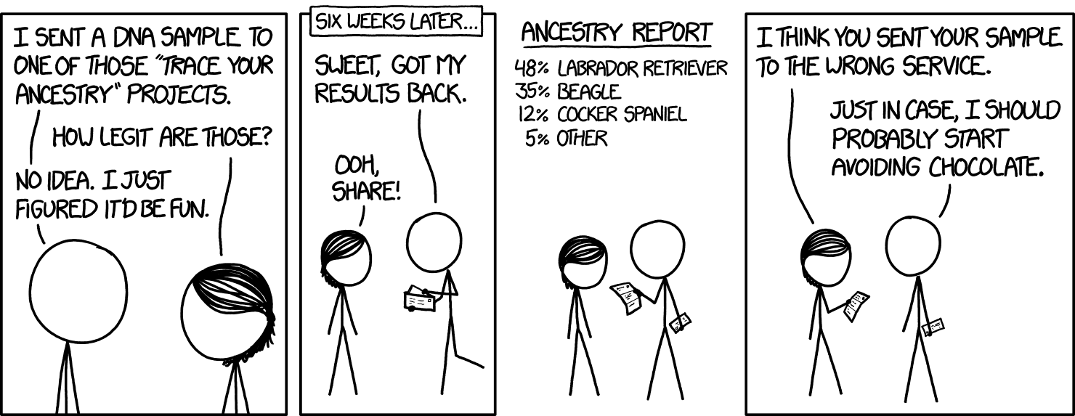
Questions?

