Slide 1












34th International Workshop on Statistical Genetic Methods for Human Complex Traits - 2020
Mike Neale (director)
Sarah Medland(co)
David Evans
Ben Neale
Hermine Maes
Conor Dolan
Lucia Colodro Conde
Nathan Gillespie
Brad Verhulst
Tim Bates
John Hewitt (host)
Jeff Lessem
Matt Keller
Stacey Cherny
Elizabeth Prom-Wormley
Nick Martin
Dorret Boomsma
Eveline de Zeeuw
Michel Nivard
Rob Kirkpatrick
Pete Hatemi
Mike Hunter

Slide 2
The Causes of Variation
2020 International Workshop on Statistical Genetic Methods for Human Complex Traits
Boulder, CO.
Nick Martin
Queensland Institute of Medical Research
Brisbane, Australia
March 2, 2020

Slide 3
GOALS
To outline some of the basic issues that we shall address this week
To set some of the issues in their historical context in the story of genetics and its application to human variation.

Slide 4
Genetics
The Study of
Variation and Heredity

Slide 5
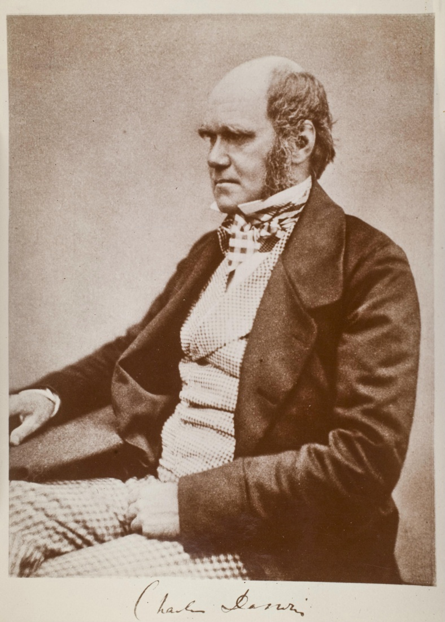
Charles Darwin (1809-1882)
1859: On the Origin of Species

Slide 6
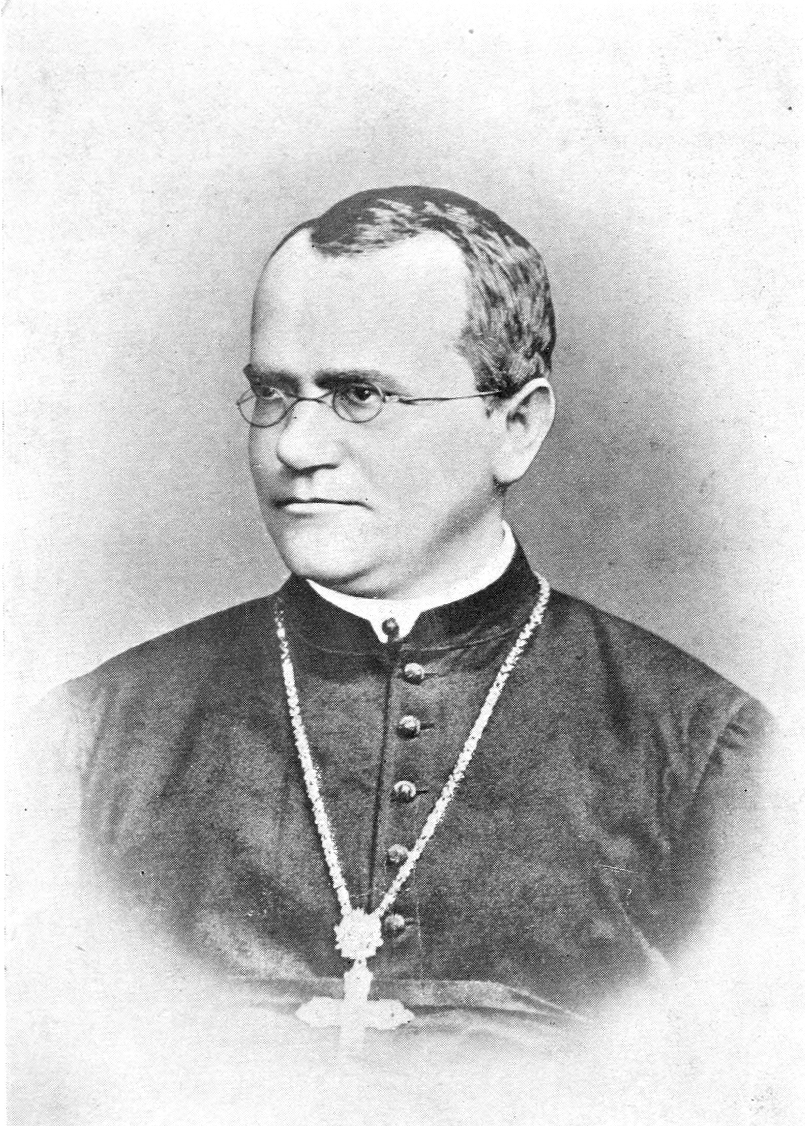
Gregor Mendel (1822-1885)
1865: Experiments in Plant Hybridisation

Slide 7
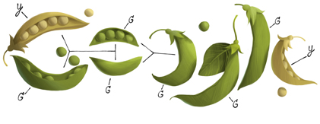
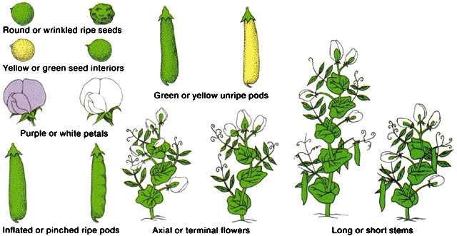
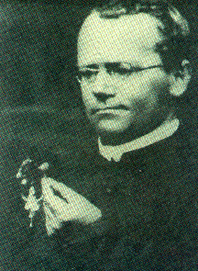
Mendel 1865 – genetics of discrete traits

Slide 8
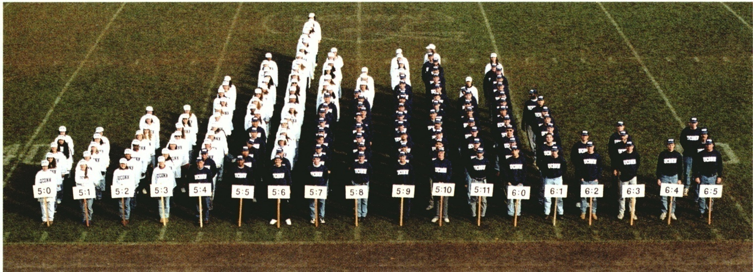
….the distribution of height

Slide 9
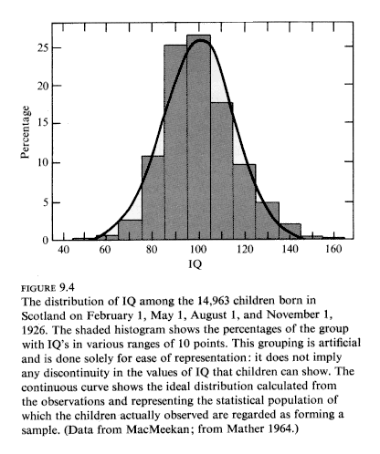

Slide 10
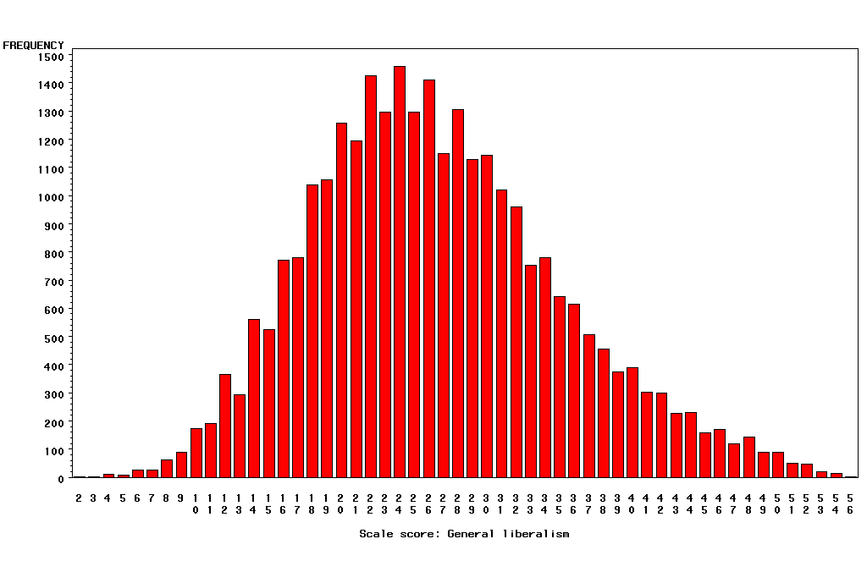
“Liberalism”

Slide 11
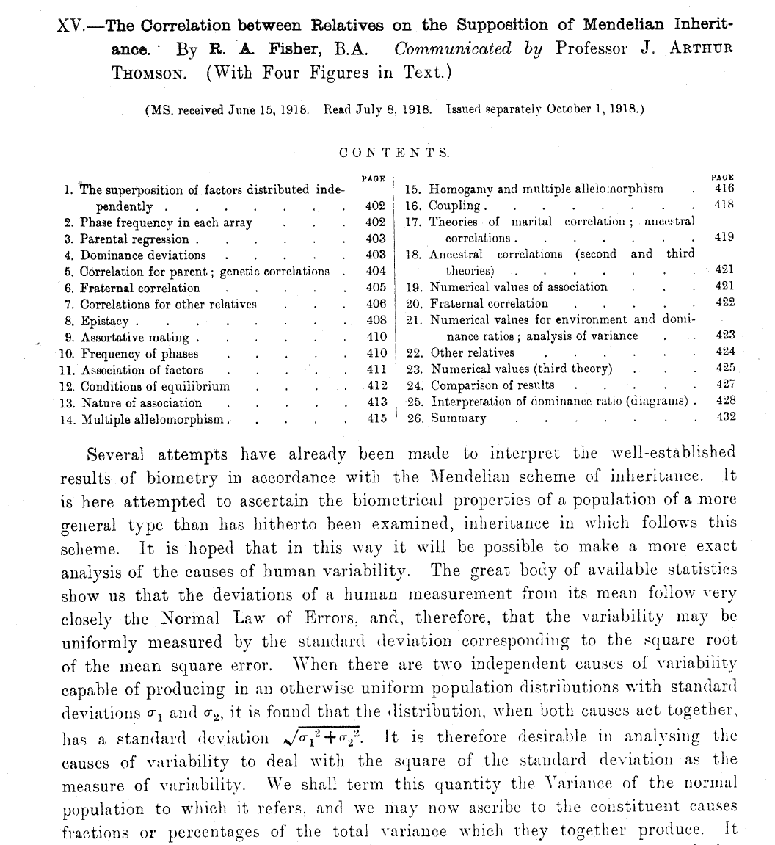
RA Fisher (1918). Transactions of the Royal Society
of Edinburgh
52: 399-433.

Slide 12
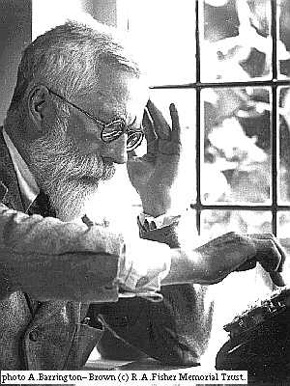
R.A. Fisher, 1918
The explanation of quantitative inheritance in Mendelian terms
1 Gene
→ 3 Genotypes
→ 3 Phenotypes
2 Genes
→ 9 Genotypes
→ 5 Phenotypes
3 Genes
→ 27 Genotypes
→ 7 Phenotypes
4 Genes
→ 81 Genotypes
→ 9 Phenotypes

Slide 13
Fisher (1918): Basic Ideas
Continuous variation caused by lots of genes (“polygenic inheritance”)
Each gene followed Mendel’s laws
Environment smoothed out genetic differences
Genes may show different degrees of “dominance”
Genes may have many forms (“multiple alleles”)
Mating may not be random (“assortative mating”)
Showed that correlations obtained by e.g. Pearson and Lee were explained well by polygenic inheritance
Led to “Biometrical Genetics” (Mather, Jinks etc.)

Slide 14
Multifactorial Threshold Model
of Disease – normally distributed “liability”
Multiple thresholds
Single threshold
unaffected affected
normal
mild
mod
severe
Disease liability
Disease liability

Slide 15
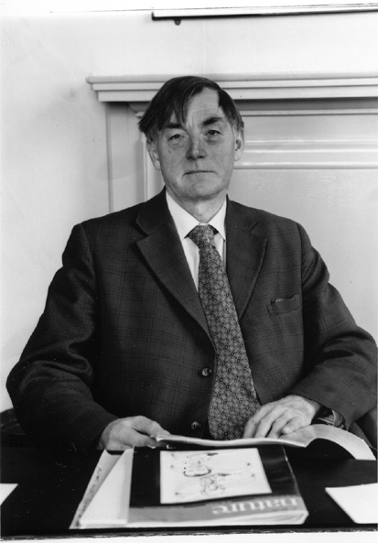
Douglas Scott Falconer, FRS, FRSE (1913-2004)
1965 Inheritance of liability to certain diseases estimated from
incidence among relatives., Ann. Hum. Genet.29:51ff.
1960 Introduction to Quantitative Genetics. Edinburgh: Oliver and Boyd.

Slide 16
The (Really!) BIG Problem
Families are a mixture of genetic and social factors

Slide 17
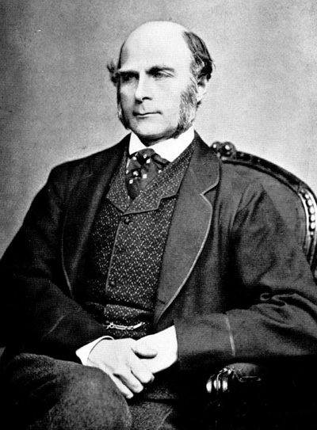
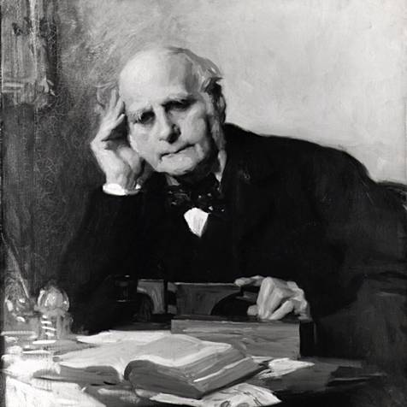
Francis Galton (1822-1911)
1869: Hereditary Genius
1883: Inquiries into Human Faculty and its Development
1884-5: Anthropometic Laboratory at “National Health Exhibition”
Notes:
Astonishing intellectual curiosity: 3-volume biography by his graduate student (Karl Pearson). Self-styled “gentleman”
i.e. didn’t need to earn his living. Could afford to do research. Many interests: numbers (devised vest with grid of pockets to accumulate contingency table from observations); finger-prints; composite photographs; family history (pedigree methods); statistics (devised correlation coefficient);
Measured family resemblance; collected first “twin” data (though Augustine hit on the method in the 4th Cent. Ch. 5 of Civitas Dei.)

Slide 18
Galton’s Solution:
      Twins
      (Though Augustine may have got there first – 5th cent.)

Slide 19
One (?ideal) solution
Twins separated at birth

Slide 20
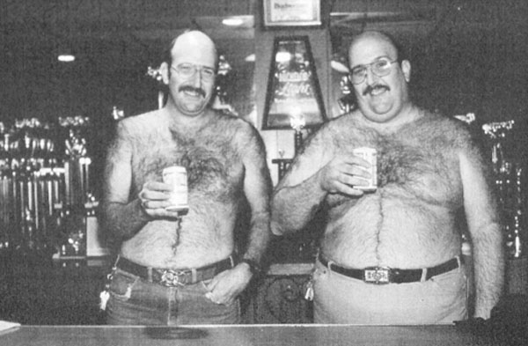
MZ twins reared apart - note the same way of supporting their cans of beer

Slide 21
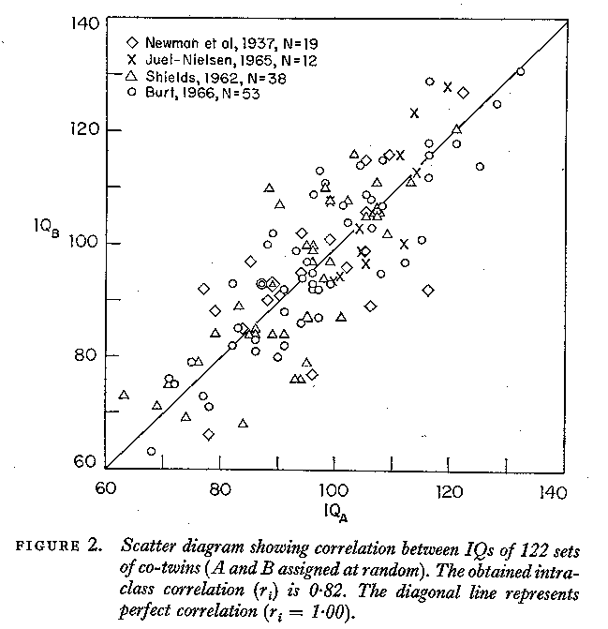

Slide 22
But separated MZs are rare

Slide 23
An easier alternative:
Identical and non-identical twins reared together
Galton (again!)……Or was it ?
Twin Research and Human Genetics 12: 237–245, 2009
Poll, H. (1914). Über Zwillingsforschung als Hilfsmittel
menschlicher Erbkunde. Zeitschrift für Ethnologie 46, 87–105.

Slide 24
Identity at marker loci - except for rare mutation
MZ and DZ twins: determining zygosity using ABI Profiler™ genotyping
(9 STR markers + sex)
MZ
DZ
DZ

Slide 25
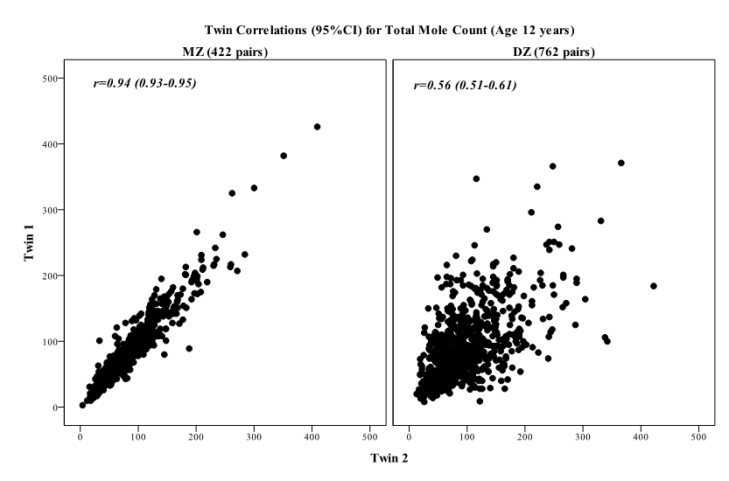
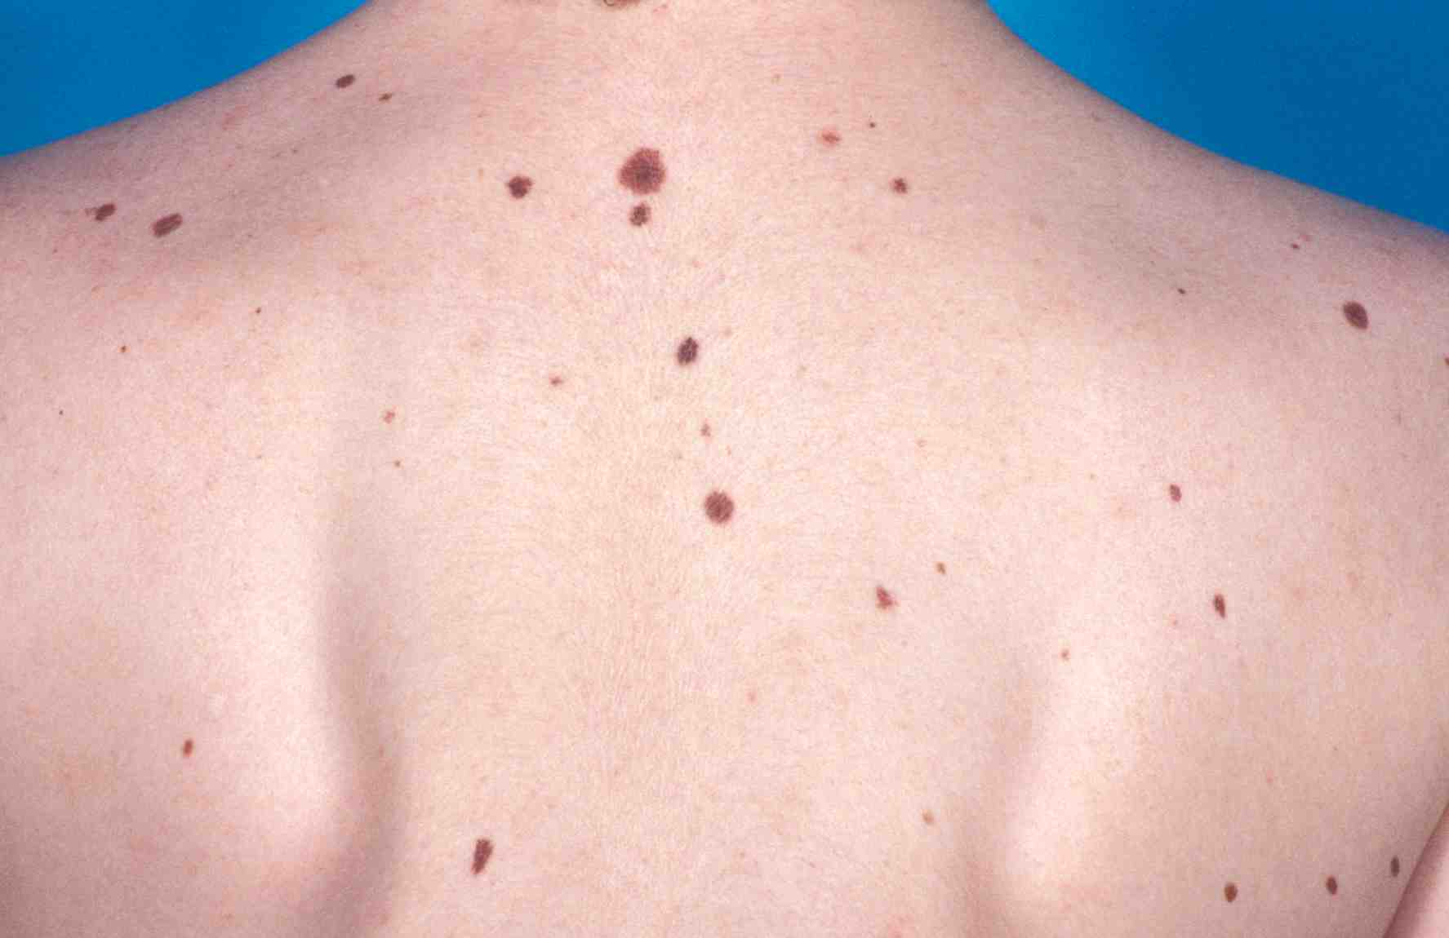
Twin correlations for total mole count

Slide 26
Three scenarios
Twin Correlation
Causes of Variation

Slide 27
Twin Correlations for Adult Stature
(Virginia 30,000 and Australia 22,000)

Slide 28
Structural equation modeling
Both continuous and categorical variables
Systematic approach to hypothesis testing
Tests of significance
Can be extended to:
  More complex questions
  Multiple variables
  Other relatives

Slide 29
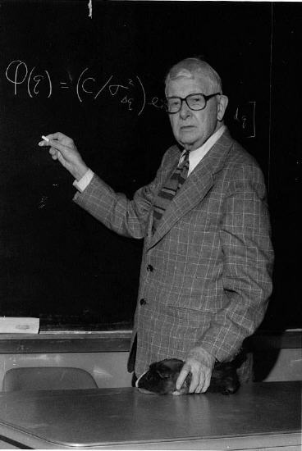
Sewall Wright (1889-1988)
1984. Evolution and the Genetics of Populations:
Genetics and Biometric Foundations (4 vols.)
1934. The method of path coefficients. Ann. Math. Staiist. 5: 161-215

Slide 30
Variance components
Additive
Genetic
Effects
Dominance
Genetic
Effects
Unique
Environment
Shared
Environment
E
C
A
D
c
a
e
d
Phenotype
P = eE + aA + cC + dD

Slide 31
ACE Model for twin data
1
MZ=1.0 / DZ=0.5
E
C
A
A
C
E
e
c
a
a
c
e
P_{T1}
P_{T2}

Slide 32
Sources of variation in exam (QCST) results
Additive
genetic
Shared
environment
Non-shared
environment

Slide 33
Problems with the ACE model (in the classical twin design)
C and D are negatively confounded and a model with ACDE is not identified – can only fit one or the other of C/D-
  If rmz = rdz > pure C : CE model fits best
  If rmz = 2rdz > pure A : AE model fits best
  If rmz < 2rdz > A plus C : ACE model fits best
  If rmz > 2rdz > A plus D : ADE model fits best
  If rmz = rdz=0 > all E : no familial resemblance

Slide 34
Other problems (2)
C can be inflated by age, sex differences; also batch effects; correct for these using Means model in Mx
Low power to detect D
D subsumes epistasis and other non-additive genetic effects
E includes measurement error – value of test-retest data

Slide 35
Other problems (3)
C can be inflated by phenotypic assortative mating (like marrying like)
  Important to collect spouse data to estimate marital correlation
    Height ~0.2
    Education, smoking, drinking, politics ~0.6
    CAN ACCOUNT FOR SOME/MOST/ALL OF “C” ESTIMATED FROM ACE MODEL IN TWIN DATA

Slide 36
How twin studies changed research agendas
Autism – “caused by cold mothers”
  10/11 MZ pairs concordant, 2/11 DZs concordant
ADHD – “caused by food dyes”
Twin studies found h² ~0.8
3. Multiple sclerosis - “caused by a virus”
MZ concordance 26%, DZ concordance 2%
Martin, Boomsma & Machin (1997) Nature Genetics 17: 387

Slide 37
Are there common genetic and environmental factors influencing Verbal IQ, Performance IQ and QCST results?
A1
A2
C1
.43
.66
.79
.48
.74
.41
VIQ
PIQ
QCST
.43
.53
.34
E1
E2
E3

Slide 38
Genetic variation in developmental change: time series with common genes and time-specific environmental “innovations”
Genes
G
h
h
h
h
h
Phenotype
T0
b
T1
b
T2
b
T4
b
T5
Age
e
e
e
e
e
E1
E2
E3
E4
E5
Environment

Slide 39
ACE Model for twin data
1
MZ=1.0 / DZ=0.5
E
C
A
A
C
E
e
c
a
a
c
e
P_{T1}
P_{T2}

Slide 40
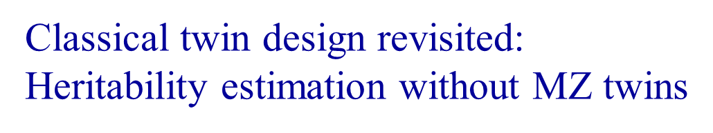
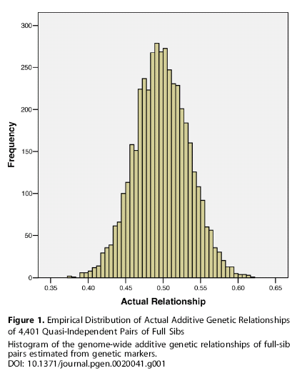
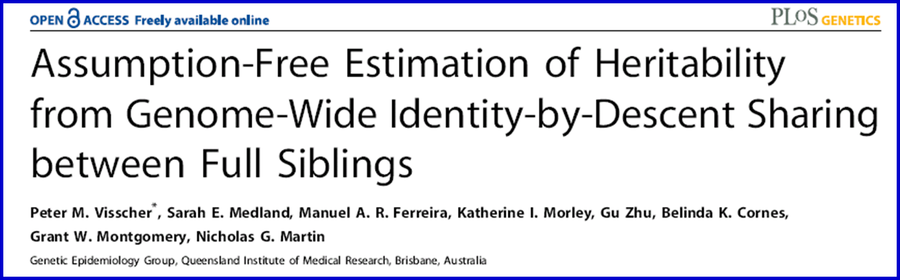
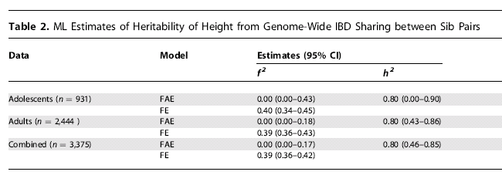
Why do we use the average sib value of r_{a} = 0.5 when we can estimate the (almost) exact values for each sib pair from genetic marker data ?

Slide 41
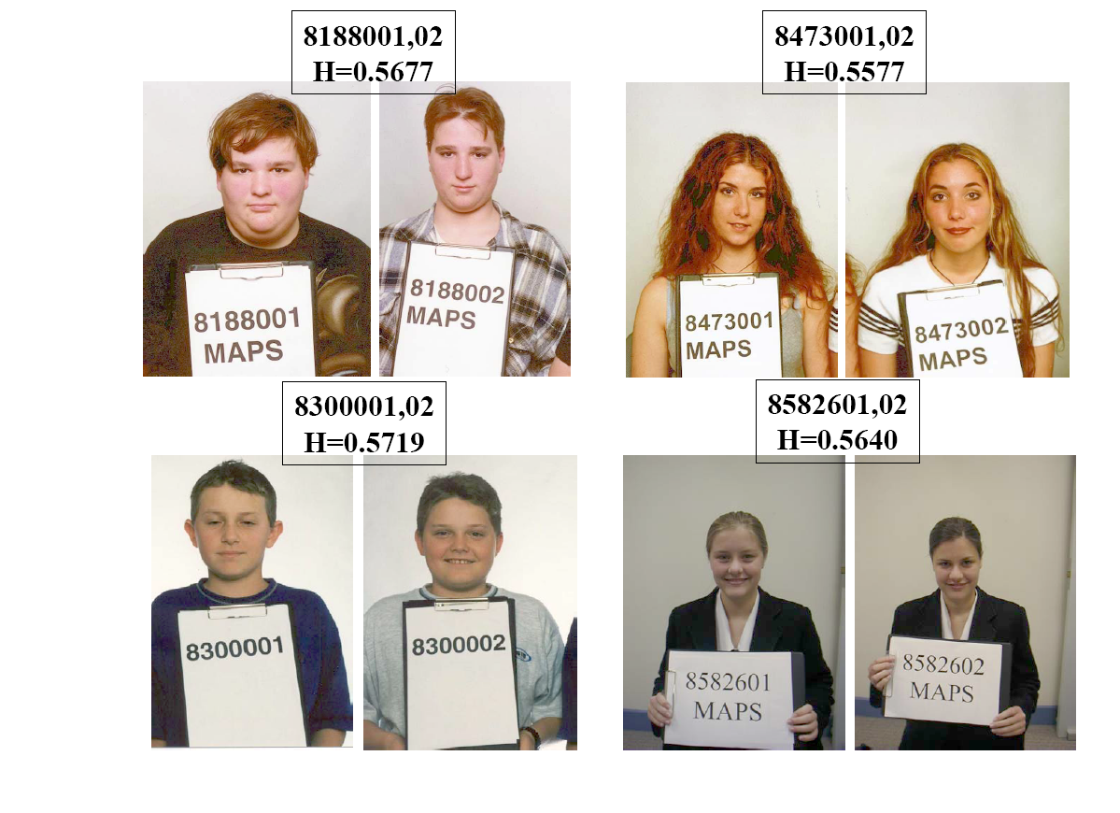

Slide 42
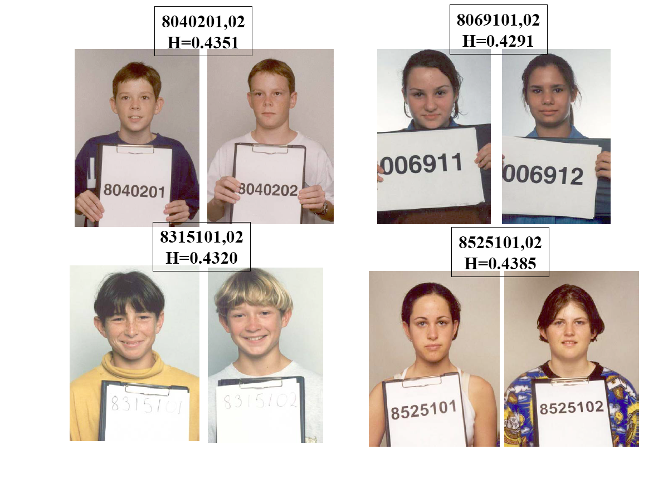

Slide 43
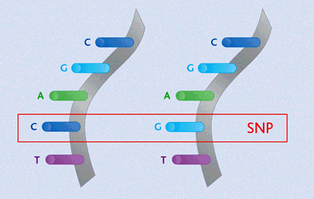
Finding the genes - association
Looks for correlation between specific alleles and phenotype (trait value, disease risk) using single nucleotide polymorphisms (SNPs)

Slide 44

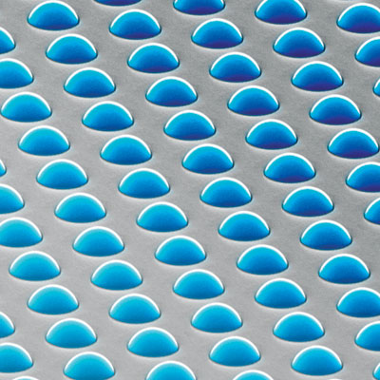
High density SNP arrays – up to 1 million SNPs

Slide 45
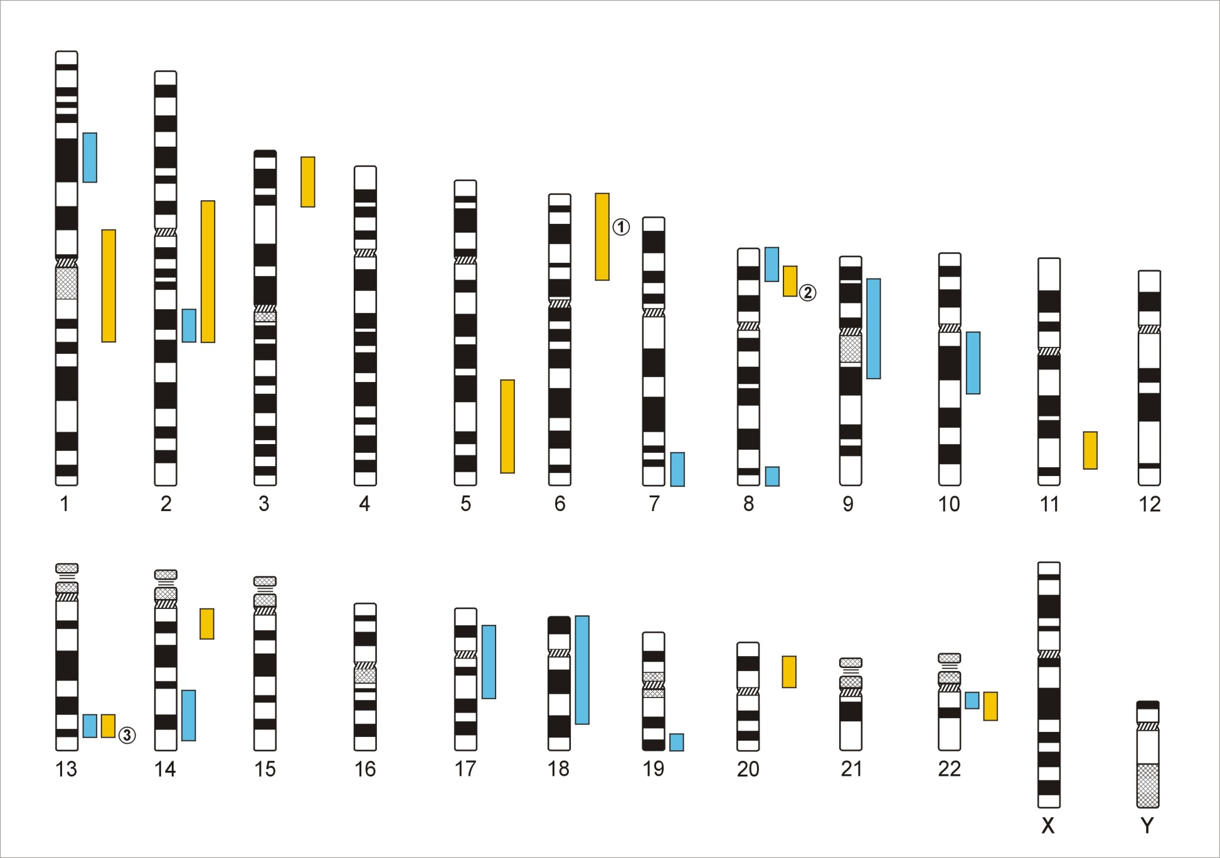
Genome-Wide Association Studies
500,000 – 5,000,000 SNPs
Human Genome - 3,1x10⁹ Base Pairs
Notes:
In a GWA the Genome which contains xx SNPs is examined using … SNPs

Slide 46
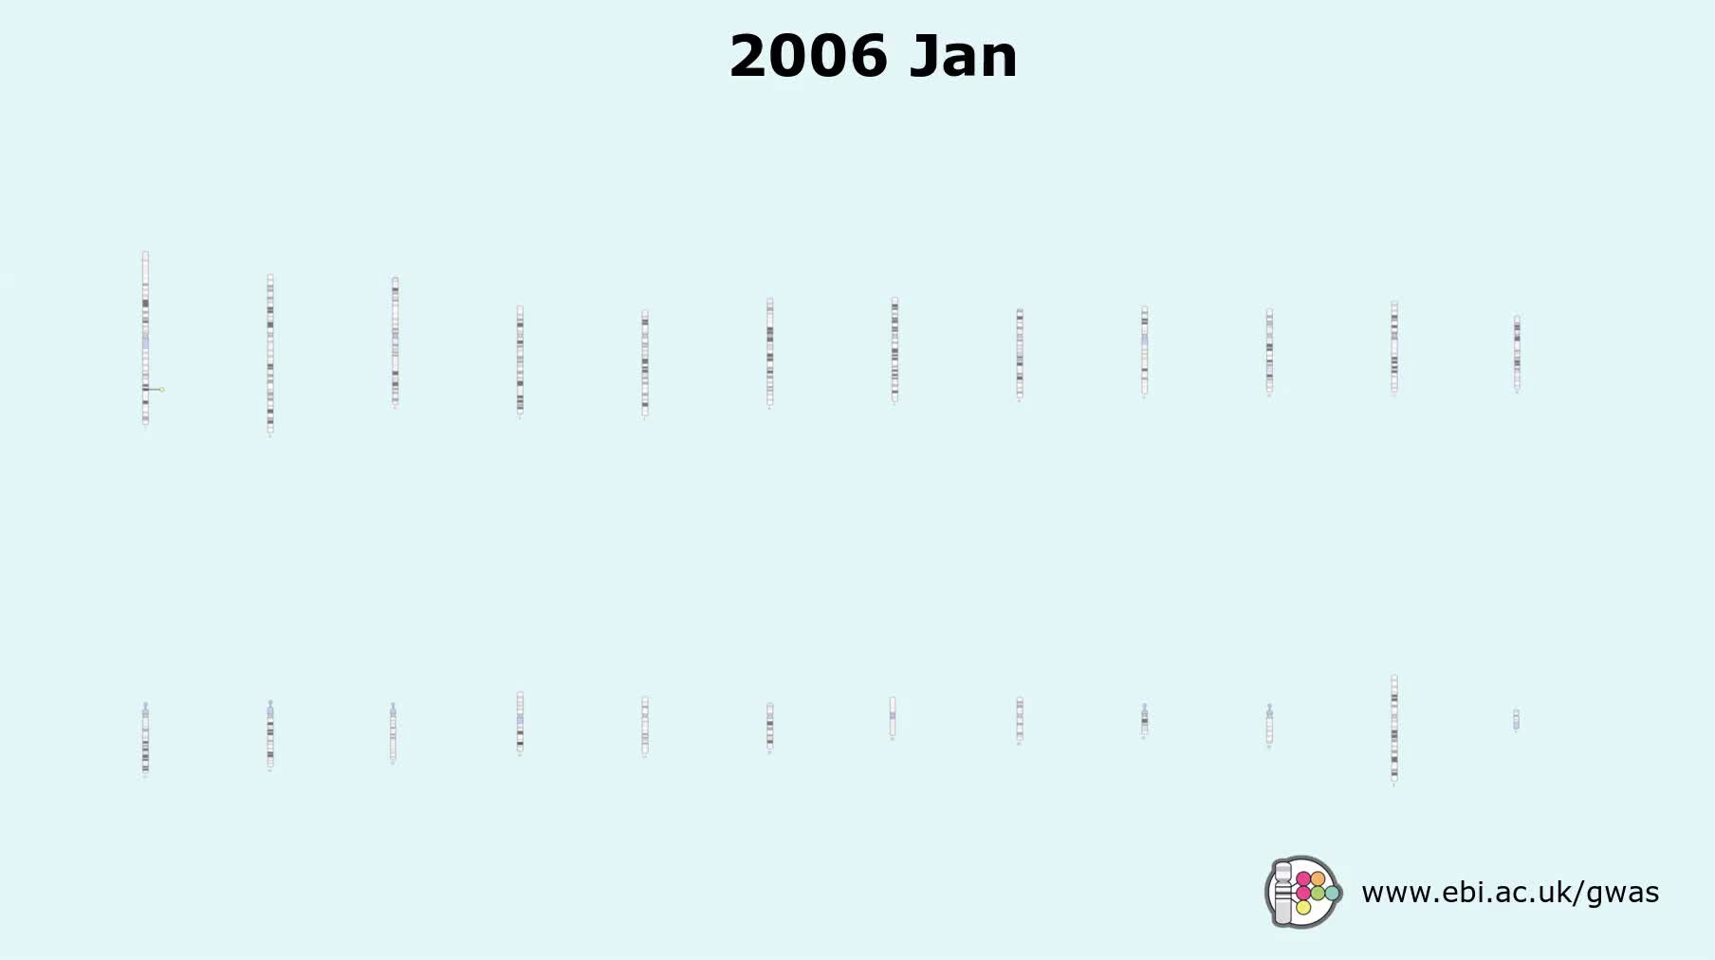
The success of GWAS

Slide 47
Total n = 477,522 (26,827 reporting same-sex sexual behavior)
GCTA h² = 32.4%
(95% CI 10.6 - 54.3)
Across sex Rg = 0.63 (95% CI, 0.48-0.78)

Slide 48
Major Depressive Disorder
130,664 MDD cases , 330,470 controls → 44 independent loci ( P < 5e-8)
Genes that are targets of antidepressant medications were strongly enriched for MDD association signals (P=8.5e-10)
NR Wray….PF Sullivan: bioRxiv Jul. 24, 2017; Nature Genetics, in press

Slide 49
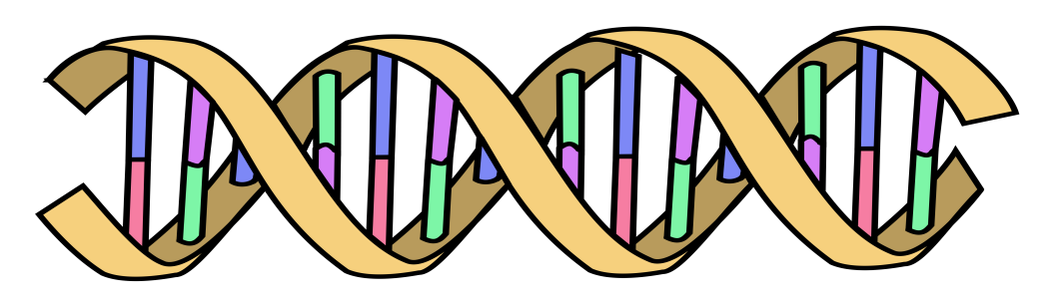
Polygenic Risk Scores
Polygenic Risk Scores capture (part of) someone’s genetic “risk” by summing all risk alleles weighted by the effect sizes estimated in a Genome-Wide Association Study (GWAS)
1×-.02 + 2×.01 + 1×.002 + 0×.03 + 2×.025
Polygenic score:
AC
CC
TT
.052
GG
AT
Effect sized from GWAS
β_{C}=-.02
β_{G}=.01
β_{A}=.002
β_{G}=.03
β_{T}=.025

Slide 50
MDD Polygenic Risk Score predicts risk in independent samples
Odd ratios of MDD per PRS decile relative to the first decile for iPSYCH and anchor cohorts.
Interdecile risk ~2.5

Slide 51
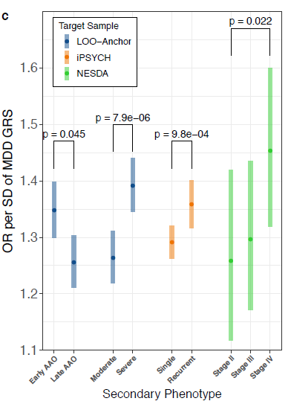
MDD Polygenic Risk Score predicts age at onset, recurrence, and severity
in independent samples
MDD PRS (from out-of-sample discovery sets) were significantly higher in MDD cases with:
earlier age at onset; more severe MDD symptoms (based on number of criteria endorsed)
recurrent MDD compared to single episode
chronic/unremitting MDD (“Stage IV” compared to “Stage II”, first-episode MDD)
Error bars represent 95% CI

Slide 52
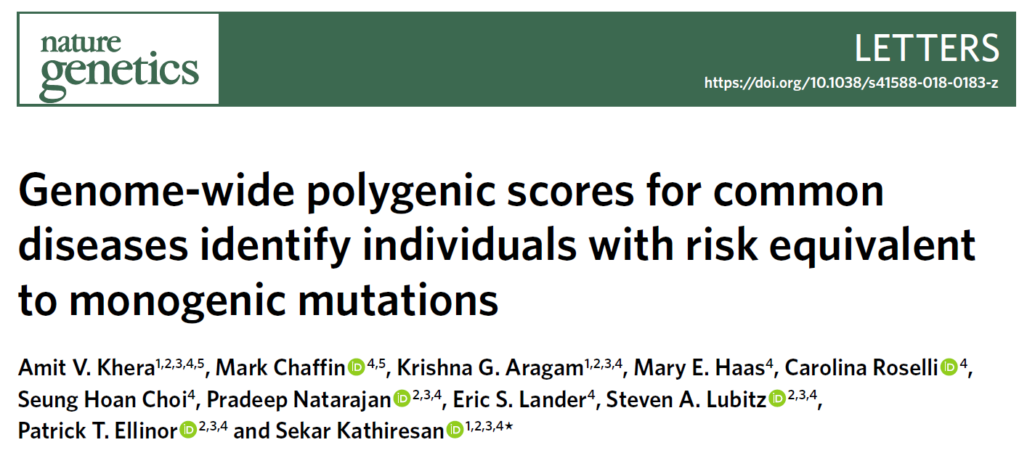
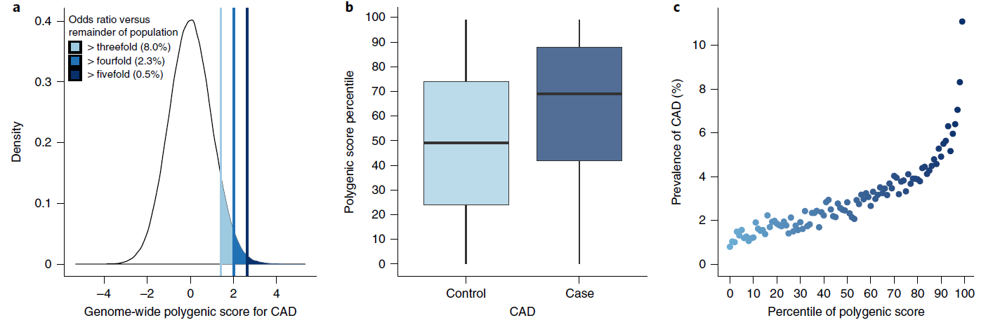
% Population at >3fold increased risk
CAD 8.0%,
atrial fibrillation 6.1%
type 2 diabetes 3.5%
IBD 3.2%
breast cancer 1.5%
“We propose that it is time to contemplate the inclusion of polygenic risk prediction in clinical care... “
Published online 14/8/18

Slide 53
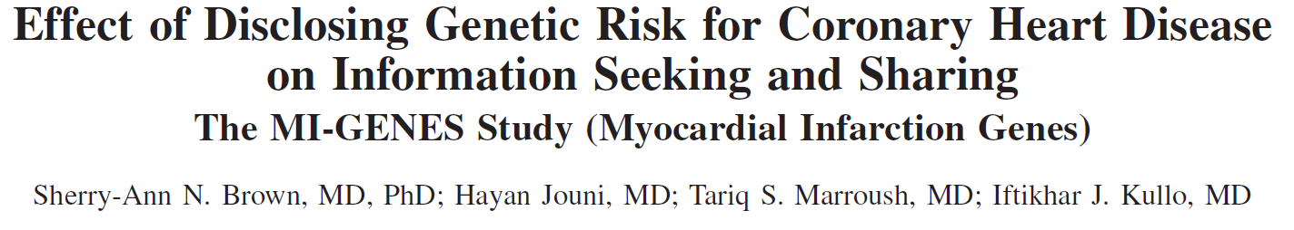
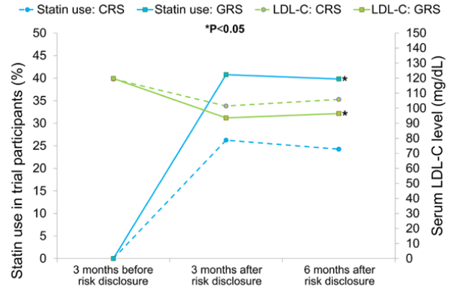
Statin use significantly higher in patients given genetic risk score than conventional risk score

Slide 54
GxE Interaction and Correlation
GxE: SENSITIVITY to E controlled by G
rGE: EXPOSURE to E correlated with (“depends on”) G
Lots of good plant and animal models for both

Slide 55
DIATHESIS-STRESS MODEL IN DEPRESSION
Depression = Diathesis + Stress + Diathesis * Stress
(Disruption of psychological equilibrium)
(Predisposition, Vulnerability)
Hypothesised contribution to risk
Our model:
Depression = PRS + PSLE + NSLE + SS + PRS * PSLE + PRS*NSLE + PRS*SS
PRS: Polygenic Risk Score
PSLE: Personal Stressful Life Event, NSLE: Network Stressful life event, SS Social Support
Familial relatedness modelled using a kinship matrix or a genetic relatedness matrix calculated from SNPs.
All analyses controlled for age, age², sex, age*sex and age²*sex interactions, study, array, and the first four genetic principal components
Scores regressed for covariates to avoid false positive interactions
Mol Psychiatry 23:1590-1596, 2018

Slide 56
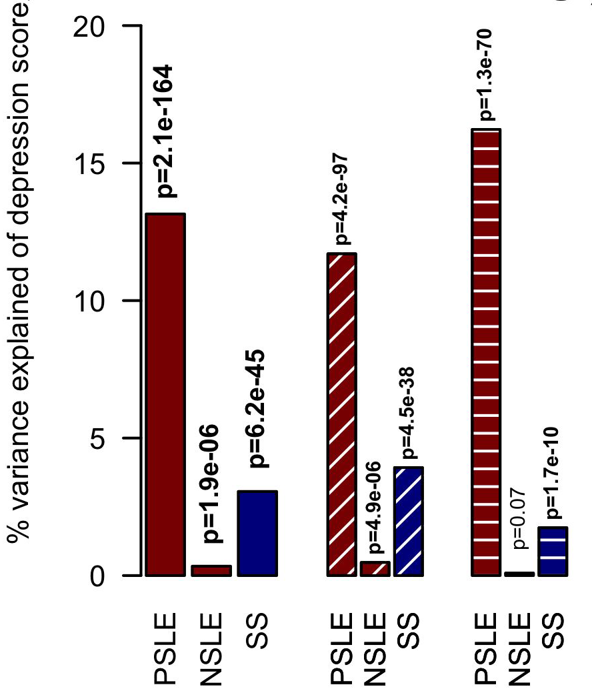
MAIN EFFECTS OF STRESS SCORES
Depression score associated with Personal (PSLE) and network (NSLE) stressful life events and perceived social support (SS). Note sex differences.
♀ females
♂males

Slide 57
TEST OF INTERACTION
Significant interaction
No interaction
No interaction

Slide 58
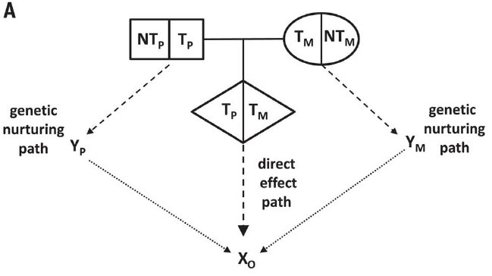
The nature of nurture: Effects of parental genotypes
Augustine Kong ………..Kari Stefansson
Nontransmitted alleles can affect a child through their impacts on the parents and other relatives, a phenomenon we call “genetic nurture.” Using results from a meta-analysis of educational attainment, we find that the polygenic score computed for the nontransmitted alleles of 21,637 probands with at least one parent genotyped has an estimated effect on the educational attainment of the proband that is 29.9% (P = 1.6 × 10⁻¹⁴) of that of the transmitted polygenic score.

Slide 59
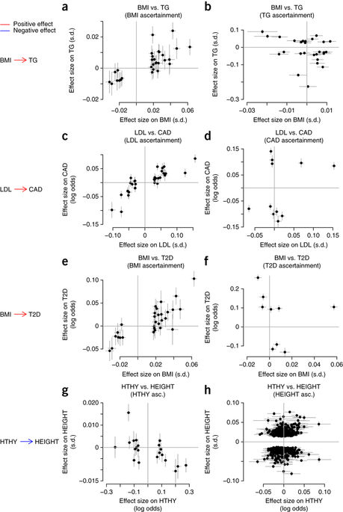
Detection and interpretation of shared genetic influences on 42 human traits
Joseph K Pickrell, Tomaz Berisa, Jimmy Z Liu, Laure Ségurel, Joyce Y Tung & David A Hinds.
Nature Genetics 48; 709–717, 2016
Powerful GWAS for traits A and B can help determine direction of causation

Slide 61
Manhattan plot of the 25OHD (vitamin D) GWAS in the UK Biobank: n=417,580, 143 loci
John McGrath

Slide 62
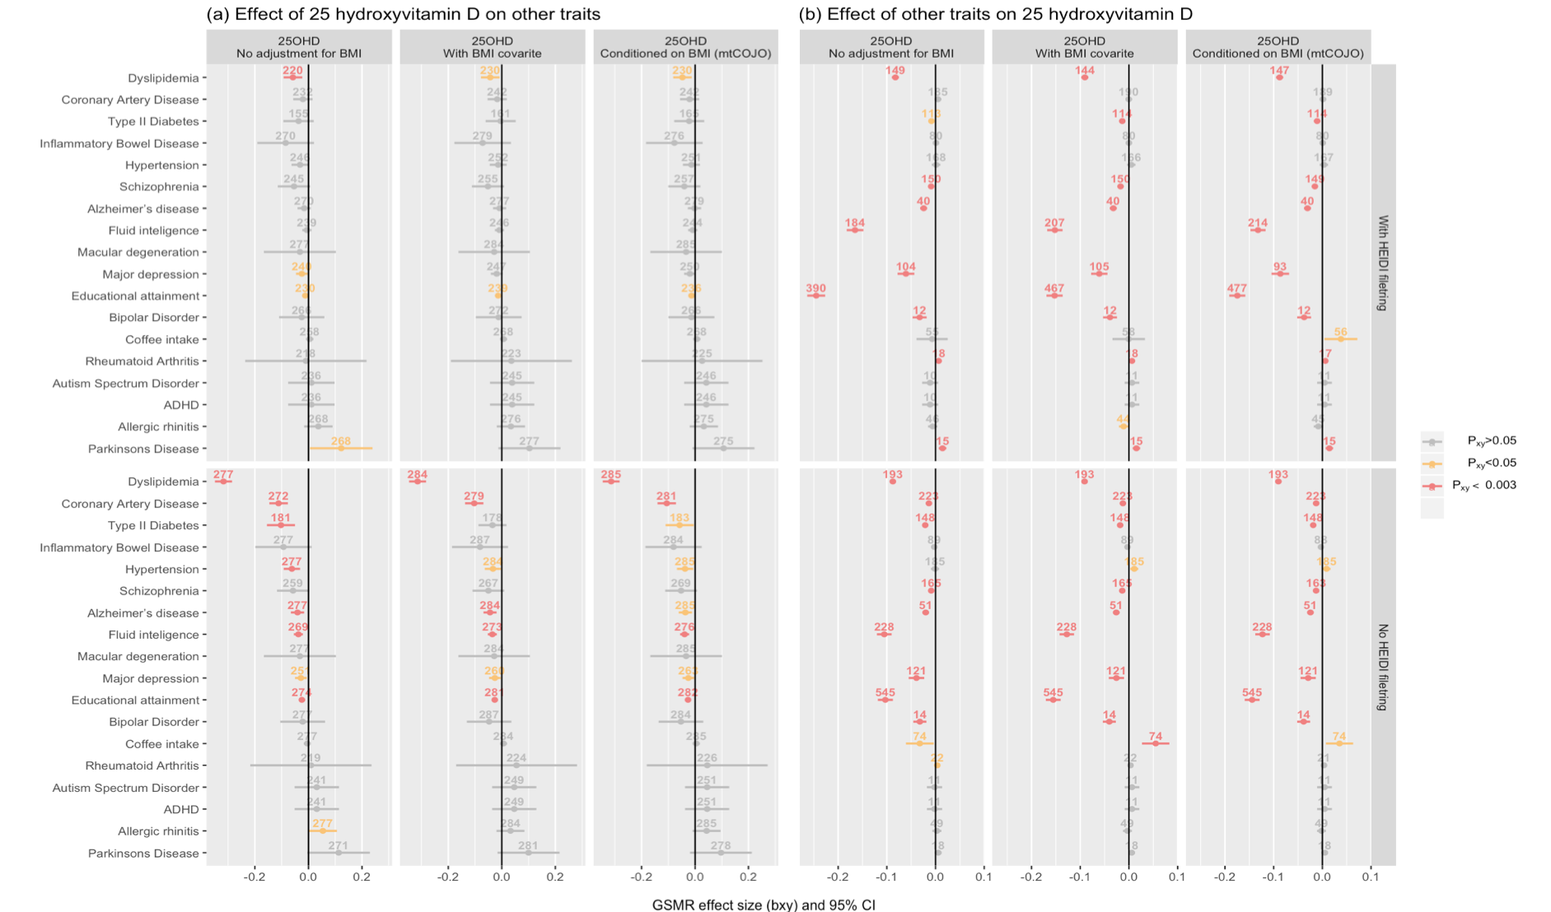
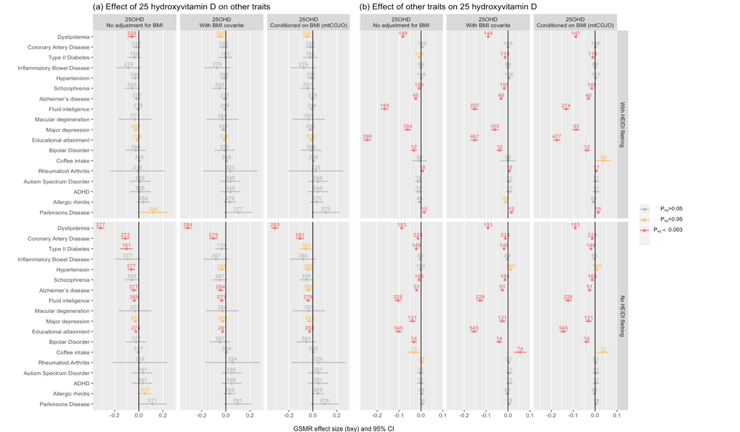
Bidirectional Generalized Summary data level Mendelian Randomization (GSMR) between 25 hydroxyvitamin D concentrations and selected phenotypes
John McGrath

Slide 63
Inference on heritability and selection from WGS data
Heritability estimates from different studies:
Can we recover the ‘still missing’ heritability using WGS data?
Source | Height | BMI | Year
Pedigree studies | ~ 0.8 | ~ 0.4 - 0.6 | < 2010
Genotyped SNPs | ~ 0.45 (0.03) | ~ 0.16 (0.03) | 2010+
Imputed SNPs | ~ 0.56 (0.02) | ~ 0.27 (0.02) | 2015+
Whole Genome | ???
EA SCZ
~0.4 ~0.7
~0.15 ~0.25
~0.2 ~0.3
??? ???

Slide 64

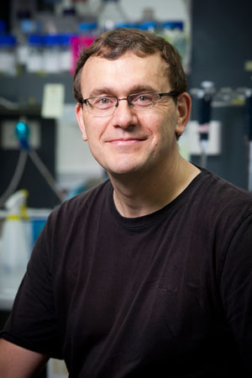
Investigation using TOPMed WGS
TOPMed overview
NIH project, whole genome sequencing of entire cohorts in the US (~30 cohorts)
~40% Europeans
~30% African americans
~16% latinos
~9% Asians
~4% unkown
Median sequencing depth 30x
Multiple data freezes:
54k samples for freeze 5
140k samples for freeze 8
Pierrick Wainschtein
Peter Visscher

Slide 65
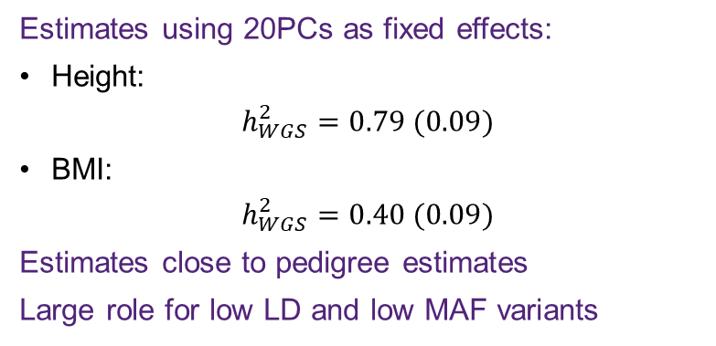
GREML-LDMS using WGS data: recovery of pedigree heritability?
Estimates using 20PCs as fixed effects:
Height:
$$h_{WGS}^{2}=0.79 (0.09)$$
BMI:
$$h_{WGS}^{2}=0.40 (0.09)$$
Estimates close to pedigree estimates
Large role for low LD and low MAF variants
Wainschtein, bioRxiv 2019

Slide 66
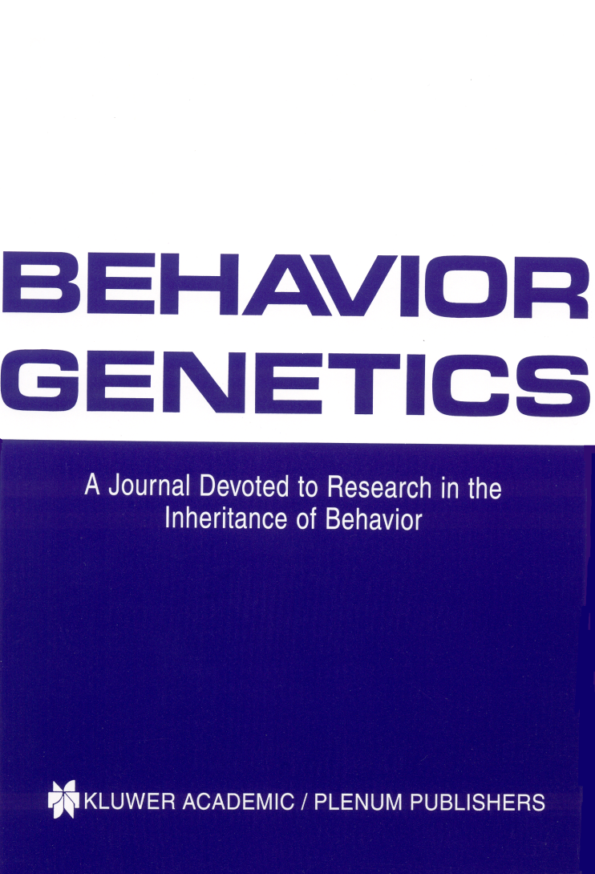
We also run two journals (1)
Editor: John Hewitt
Editorial assistant Christina Hewitt
Publisher: Kluwer /Plenum
Fully online
http://www.bga.org

Slide 67

Editor: Nick Martin
Publisher: Cambridge University Press
Fully online
Fast turnaround
First submission free to workshop participants!!!!!☺

Slide 69
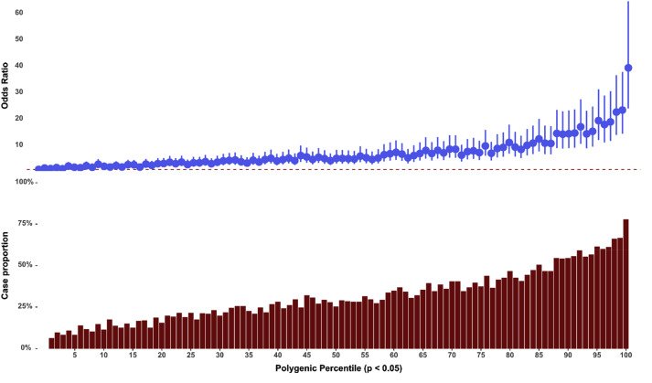
Schizophrenia GWAS: polygenic centile analysis
Independent discovery sample (29,415 cases and 40,101 controls) used to predict to CLOZUK target sample (11,260 cases and 24,542 controls)
Risk of schizophrenia in top 1% is ~40-fold higher than in bottom 1%
Pardinas et al. Nature Genetics 50: 381–389 (2018)

Slide 70
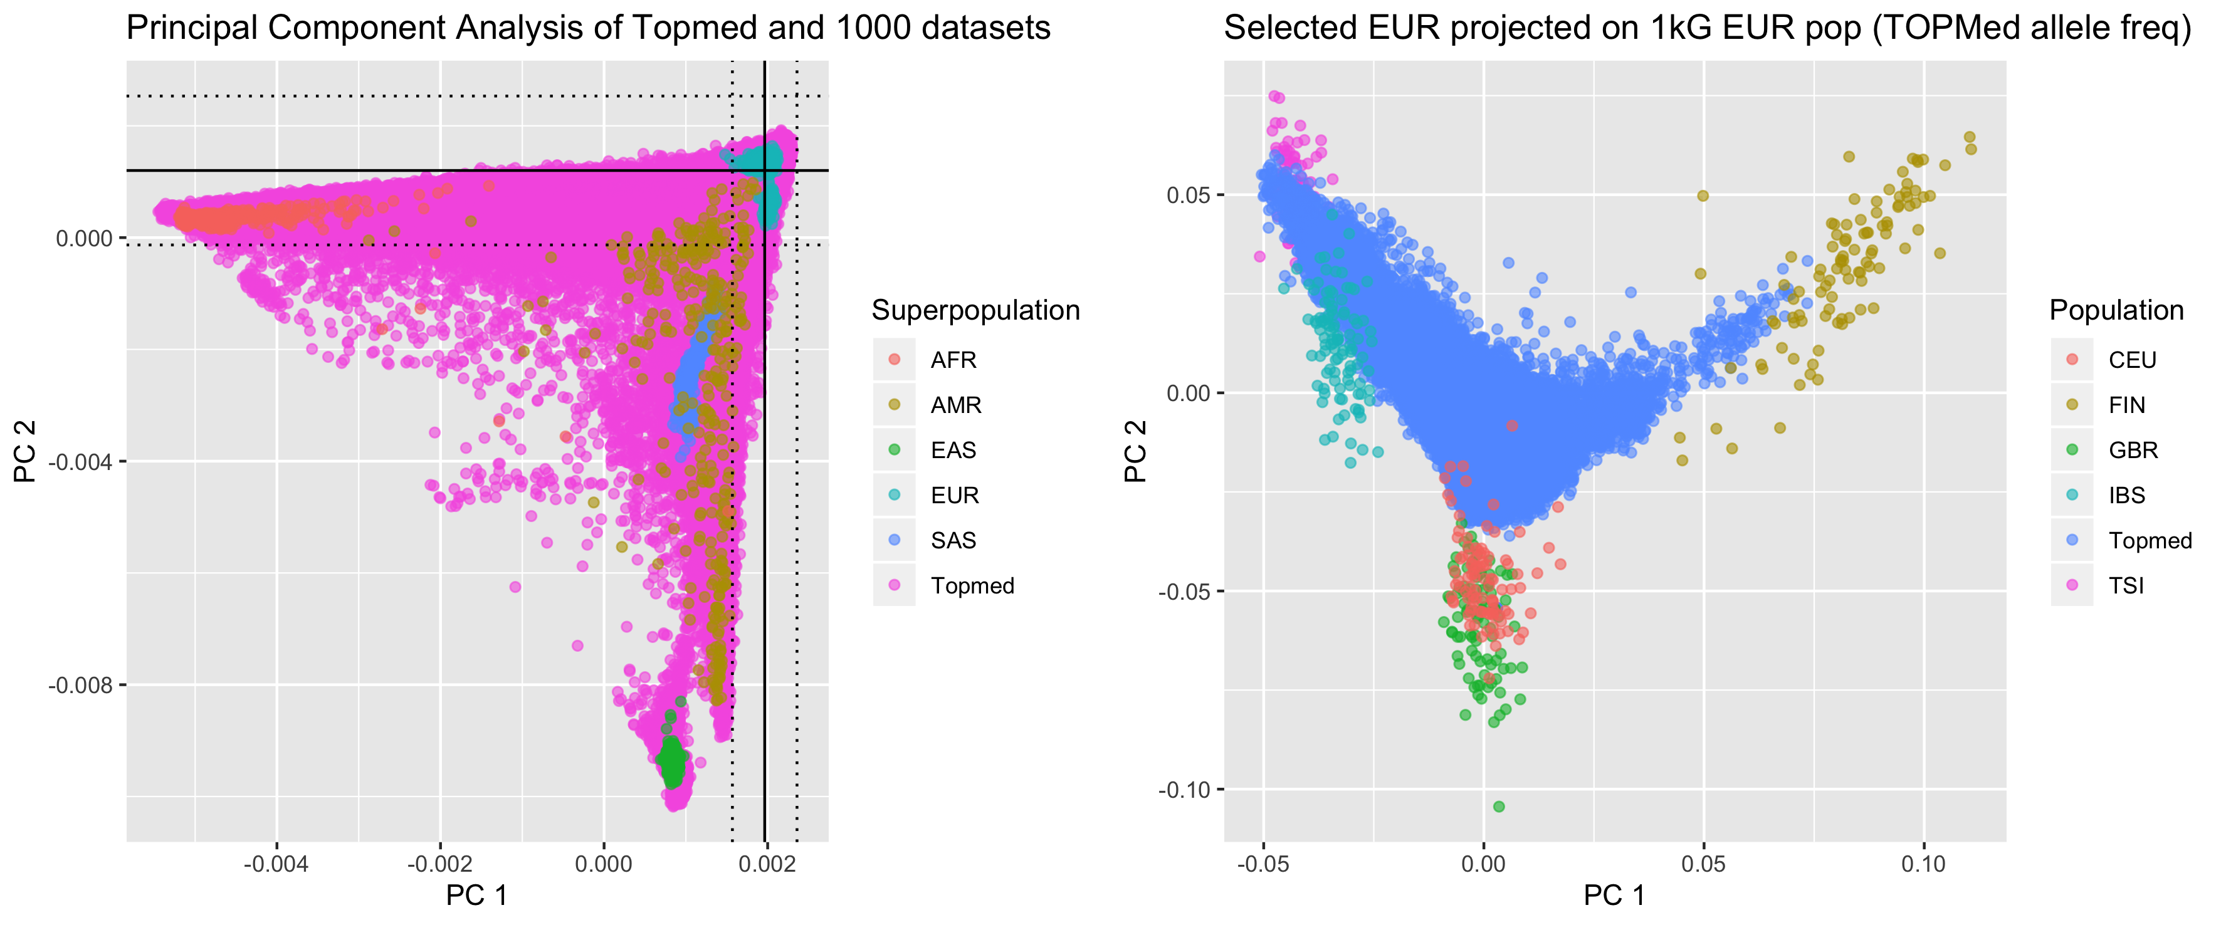
European ancestry selection
Selection of European ancestry samples
  Using HM3 SNPs (1.2M)
  From 1kG population references
  Selected samples within 6sd of EUR pop

Slide 71
Dataset
Analysis parameters:
21,620 unrelated individuals from European ancestry
Genomic Relationship Matrices (GRMs) fitted:
  1 GRM from HM3 SNPs
  7 GRMs from all variants split by MAF
  14 GRM split by MAF and LD (7 AF bins * 2 LD bins)
MAF threshold of 0.0001 (each variant seen > 2x)
47.1M variants
Phenotypes standardized N(0, 1) within each cohort by sex
RINT = rank based inverse normal transformation

Slide 72
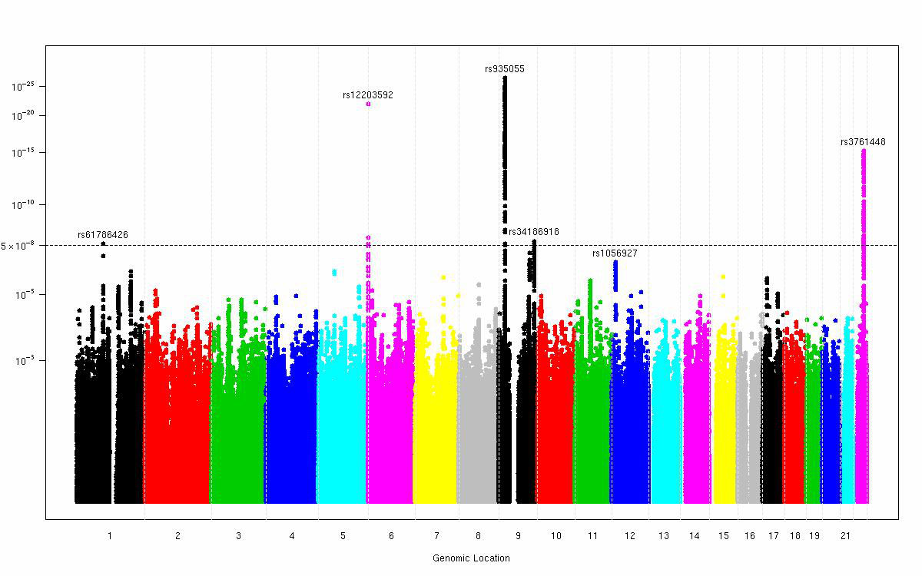
GWAS for moliness(11 studies, 23,000 subjects, 5 hits)
David Duffy, Gu Zhu

Slide 73
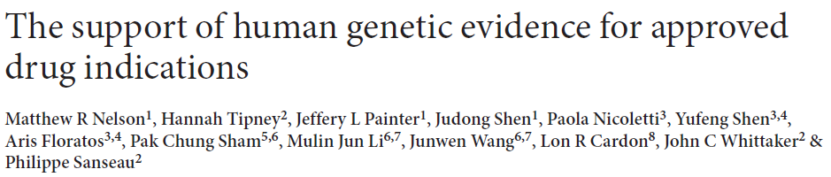
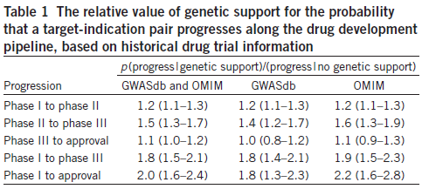
“We estimate that selecting genetically supported targets could double the success rate in clinical development. Therefore, using the growing wealth of human genetic data to select the best targets and indications should have a measurable impact on the successful development of new drugs.”

Slide 74
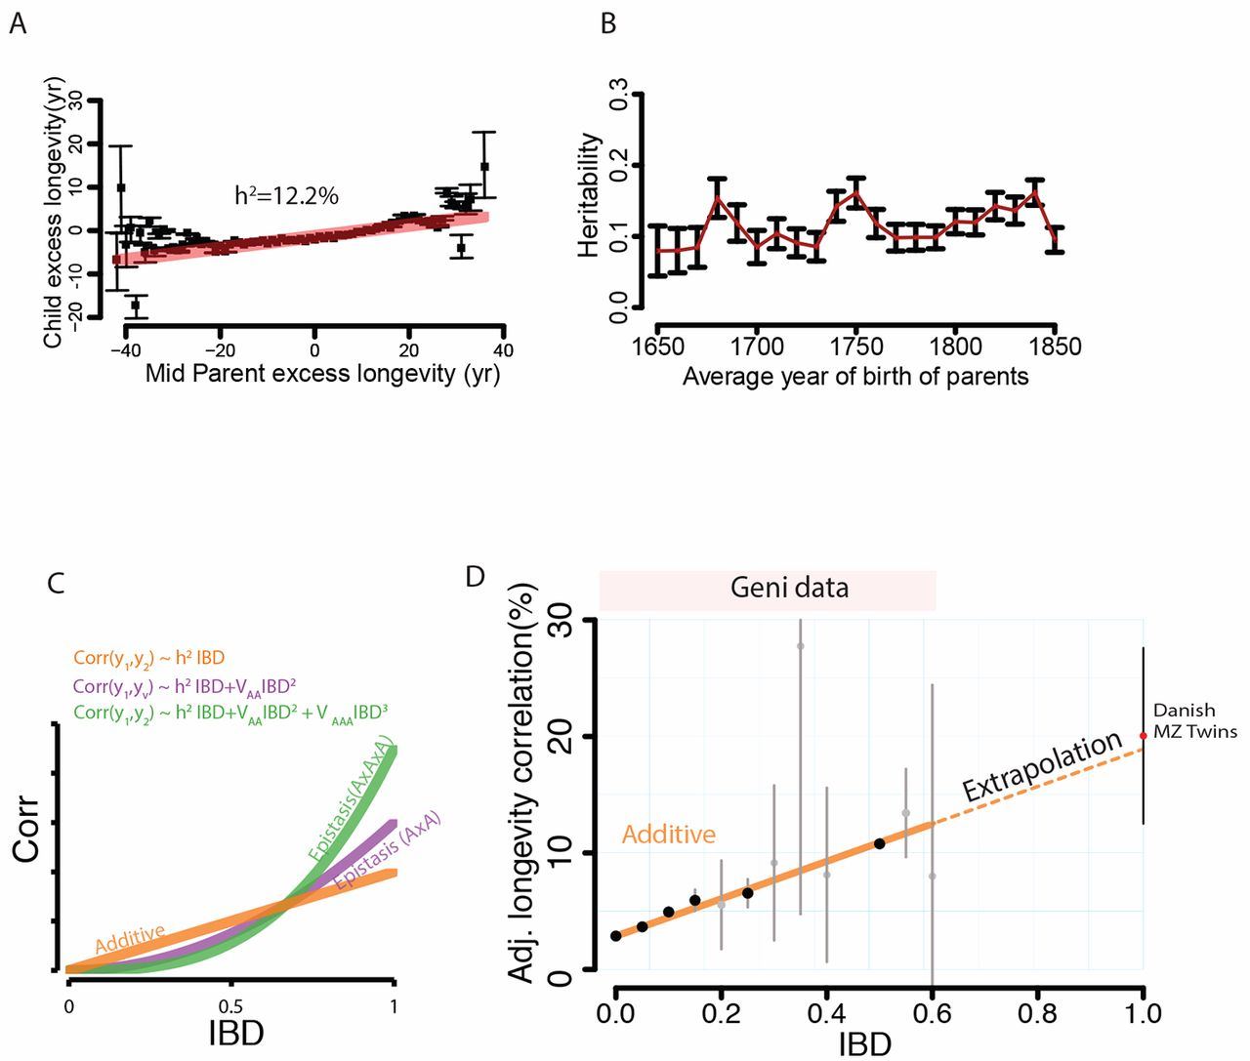
Quantitative analysis of population-scale family trees with millions of relatives
Joanna Kaplanis et al. Science 01 Mar 2018:

Slide 75
“Heredity”

Slide 76
Francis Galton (1822-1911)
1869: Hereditary Genius
1883: Inquiries into Human Faculty and its Development
1884-5: Anthropometic Laboratory at “National Health Exhibition”
Notes:
Astonishing intellectual curiosity: 3-volume biography by his graduate student (Karl Pearson). Self-styled “gentleman”
i.e. didn’t need to earn his living. Could afford to do research. Many interests: numbers (devised vest with grid of pockets to accumulate contingency table from observations); finger-prints; composite photographs; family history (pedigree methods); statistics (devised correlation coefficient);
Measured family resemblance; collected first “twin” data (though Augustine hit on the method in the 4th Cent. Ch. 5 of Civitas Dei.)

Slide 77
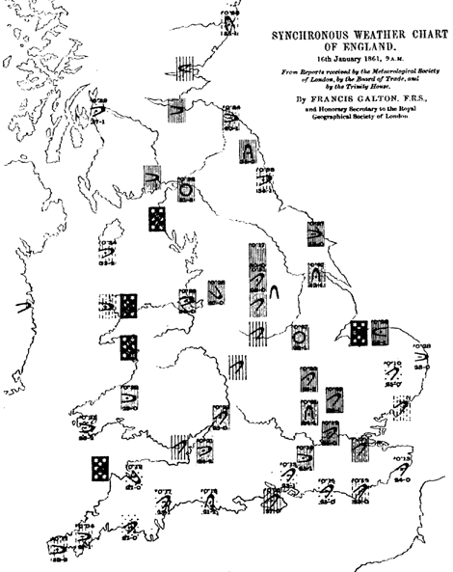
Galton’s Other Work e.g. Meteorology

Slide 78
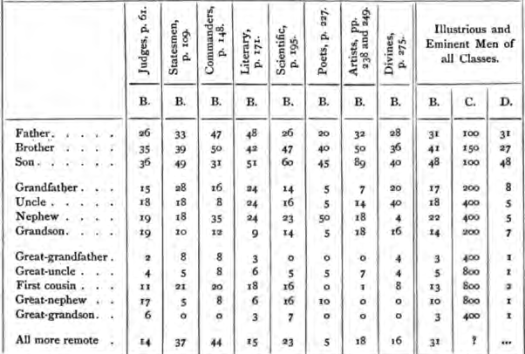
Hereditary Genius (1869, p 317)

Slide 79

Galton’s Anthropometric Laboratory (1884-1885)

Slide 80


Slide 81


Karl Pearson (1857-1936)
1903: On the Laws of Inheritance in Man: I Physical Characteristics (with Alice Lee)
1904: II Mental and Moral Characteristics
1914: The Life, Letters and Labours of Francis Galton

Slide 82


Slide 83

Pearson and Lee’s diagram for measurement of “span” (finger-tip to finger-tip distance)

Slide 84

From Pearson and Lee (1903) p.378

Slide 85

From Pearson and Lee (1903) p.387

Slide 86

From Pearson and Lee (1903) p. 373

Slide 87
Modern Data
The Virginia 30,000 (N=29691)
The Australia 22,000
(N=20480)

Slide 88
Overall sample sizes
Relationship | # of pairs
Parent-offspring Siblings | 25018 18697
Spouses | 8287
DZ Twins MZ Twins | 5120 4623

Slide 89
Nuclear Family Correlations for Stature
(Virginia 30,000 and OZ 22,000)
Notes:
Notice: effects of mother and father equal; correlations for sibs close to parents;
Slight correlation between mates (assortative mating).

Slide 90
Nuclear Family Correlations for Stature and Liberalism/Conservatism
(Virginia 30,000)
Notes:
Compare with stature: notice how much greater assortative mating.

Slide 91
Nuclear Family Correlations for Liberalism/Conservatism
(Virginia 30,000 and Australia 22,000)

Slide 92

Ronald Fisher (1890-1962)
1918: On the Correlation Between Relatives on the Supposition of Mendelian Inheritance
1921: Introduced concept of “likelihood”
1930: The Genetical Theory of Natural Selection
1935: The Design of Experiments

Slide 93
Fisher developed mathematical theory that reconciled Mendel’s work with Galton and Pearson’s correlations

Slide 94

Lindon Eaves

Slide 95
The Extended Phenotype
World
Parents
Me
Spouse
Siblings
Child
Extended Phenotype

Slide 96
Schizophrenia GWAS associations from the meta-analysis of CLOZUK and PGC
total 40,675 cases and 64,643 controls 179 independent GWS SNPs (p<5x10⁻⁸) mapping to 145 independent loci

Slide 97

Lindon Eaves
Andrew Heath
David Fulker

Slide 98


Compared with women in the middle quintile, those in the highest 1% of risk had 4.37- and 2.78-fold risks, and those in the lowest 1% of risk had 0.16- and 0.27-fold risks, of developing ER-positive and ER-negative disease, respectively. This PRS is a
powerful and reliable predictor of breast cancer risk that may improve breast cancer prevention programs.
American Journal of Human Genetics 104, 21–34, January 3, 2019

