Slide 1
GREML: Heritability Estimation Using Genomic Data
Rob Kirkpatrick & Mike Hunter
March 5th, 2020
(Some slides courtesy of Matt Keller)

Slide 2
Overview
Regression Estimates of V_{A}.
Genomic Relatedness Matrices.
GREML.
Combining GREML & SEM.
mxGREML Design.
mxGREML Implementation.

Slide 3
Using genetic similarity at SNPs to estimate V_{A}
Determine extent to which genetic similarity at SNPs is related to phenotypic similarity
Multiple approaches to derive unbiased estimate of V_{A} captured by measured (common) SNPs
Regression (Haseman-Elston)
Mixed effects models (GREML)
Bayesian (e.g., Bayes-R)
LD-score regression

Slide 4
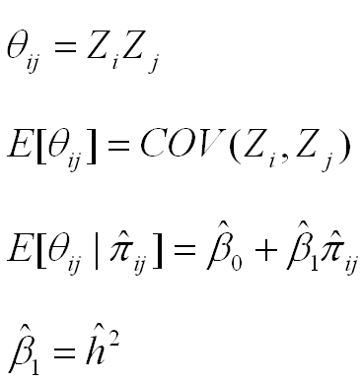
Regression estimates of h2
product of centered scores (here, z-scores)
(the slope of the regression is an estimate of h2)

Slide 5
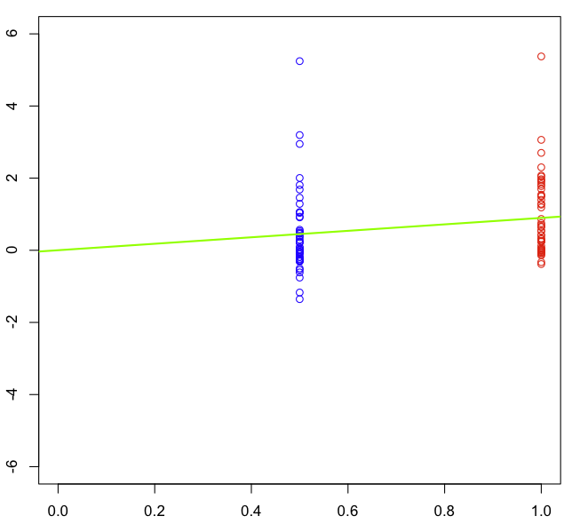
Regression estimates of h2
(the slope of the regression is an estimate of h2)

Slide 6
Regression estimates of h2
COV(MZ)
(the slope of the regression is an estimate of h2)

Slide 7
Regression estimates of h2
COV(DZ)
(the slope of the regression is an estimate of h2)

Slide 8
Regression estimates of h2
2*[COV(MZ)-COV(DZ)] = h2 = slope
(the slope of the regression is an estimate of h2)

Slide 9
Regression estimates of h2
(the slope of the regression is an estimate of h2)

Slide 10
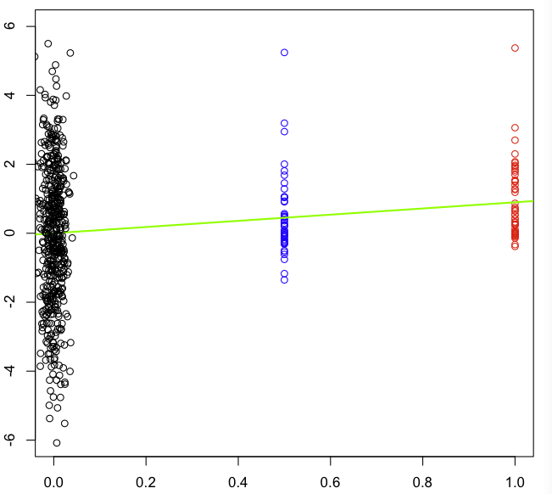
Regression estimates of h2
(the slope of the regression is an estimate of h2)

Slide 11
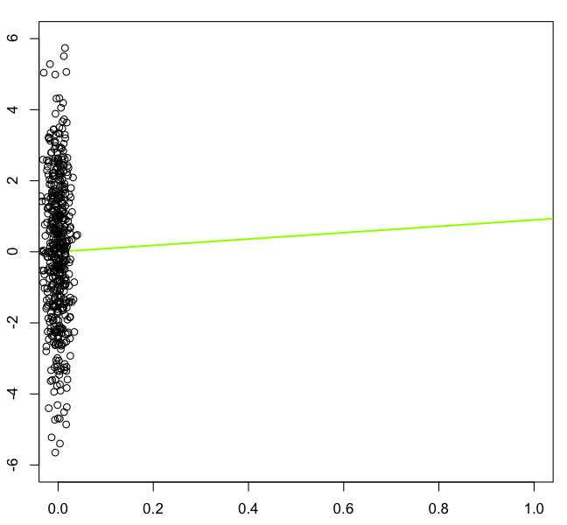
Regression estimates of h2_{snp}
(the slope of the regression is an estimate of h2)

Slide 12
Interpreting h2 estimated from SNPs (h2_{snp})
If close relatives included (e.g., sibs), h2_{snp} ≅ h2 estimated from a family-based method, because great influence of extreme pihats. Interpret h2_{snp} as from these designs.
If use ‘unrelateds’ (e.g., pihat < .05):
h2_{snp} = proportion of V_{P} due to V_{A} captured by SNPs. Upper bound % V_{P} GWAS can detect
Gives idea of the aggregate importance of CVs tagged by SNPs
By not using relatives who also share environmental effects: (a) V_{A} estimate 'uncontaminated' by V_{C} & V_{NA;} (b) does not rely on family study assumptions (e.g., r(MZ) > r(DZ) for only genetic reasons)

Slide 13
Comparison of approaches for estimating h2_{snp}
APPROACH (METHOD) | ADVANTAGES | DISADVANTAGES
HE-regression | Fast. Point estimates usually unbiased | Large SEs (~30% larger than REML). SE estimates biased. Limited model building.

Slide 14
Comparison of approaches for estimating h2_{snp}
APPROACH (METHOD) | ADVANTAGES | DISADVANTAGES
HE-regression | Fast. Point estimates usually unbiased | Large SEs (~30% larger than REML). SE estimates biased. Limited model building.
LD-score regression | Requires only summary statistics; mostly robust to stratification/relatedness | Does not give good estimates of variance due to rare CVs

Slide 15
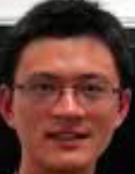
Comparison of approaches for estimating h2_{snp}
APPROACH (METHOD) | ADVANTAGES | DISADVANTAGES
HE-regression | Fast. Point estimates usually unbiased | Large SEs (~30% larger than REML). SE estimates biased. Limited model building.
LD-score regression | Requires only summary statistics; mostly robust to stratification/relatedness | Does not give good estimates of variance due to rare CVs
GREML (e.g., GCTA | Point estimates & SEs usually unbiased. Well maintained & easy to use | Limited model-building (e.g., no nonlinear constraints).

Slide 16
II. Genomic Relatedness Matrices

Slide 17
Notes:
GRMs

Slide 18
Notes:
GRMs

Slide 19
However, there will be variance around these expectations. We will use this variance to get leverage on estimating .
$$V_{A,SNP}$$
Notes:
GRMs

Slide 20
Genomic Relatedness Matrices
OpenMx does not compute GRMs from raw genotype data—use GCTA, plink, etc.
Going from genotypes to GRM can be more complicated—correction for possible uneven LD around trait-relevant loci¹.
Possible to use >1 GRM in analysis—bin markers by, e.g.
Chromosome.
Allele frequency.
Biological pathway.
¹Speed, D., et al. (2013). AJHG, 91, 1011-1021. doi: 10.1016/j.ajhg.2012.10.010.

Slide 21
III. GREML

Slide 22
GREML Model (here, n=3, q=2 fixed effects, m=3 SNPs)
$$y=Xβ+Wu+e$$
3
-5
2
-1.2
1 0.8
0.4
*
=
+
observed y
design matrix of fixed effects (intercept & 1 covariate)
fixed effects

Slide 23
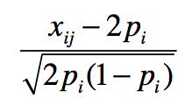
GREML Model (here, n=3, q=2 fixed effects, m=3 SNPs)
$$y=Xβ+Wu+e$$
n×m
3
-5
2
-1.2
1 0.8
0.4
1.15 2.10 -.68
-.58 -.23 .03
1.15 -.23 .03
*
*
=
+
+
observed y
design matrix of fixed effects (intercept & 1 covariate)
fixed effects
design matrix for SNP effects =
SNP effects

Slide 24
GREML Model (here, n=3, q=2 fixed effects, m=3 SNPs)
$$y=Xβ+Wu+e$$
n×m
3
-5
2
-1.2
1 0.8
0.4
1.15 2.10 -.68
-.58 -.23 .03
1.15 -.23 .03
*
*
=
+
+
observed y
design matrix of fixed effects (intercept & 1 covariate)
fixed effects
design matrix for SNP effects =
SNP effects
residuals

Slide 25
GREML Model (after removing fixed effects on y)
$$y−Xβ=Wu+e$$
-.64
-2.58
3.21
1.15 2.10 -.68
-.58 -.23 .03
1.15 -.23 .03
*
=
+
residuals y
design matrix for SNP effects =
SNP effects
residuals

Slide 26
GREML Model (after removing fixed effects on y)
$$y−Xβ=Wu+e$$
-.64
-2.58
3.21
1.15 2.10 -.68
-.58 -.23 .03
1.15 -.23 .03
*
=
+
residuals y
design matrix for SNP effects =
SNP effects
residuals
We aren’t interested in estimating each u_{i} because m >> n usually, and because such individual estimates would be unreliable. Instead, estimate the variance of u_{i}.

Slide 27
GREML Model (after removing fixed effects on y)
$$y−Xβ=Wu+e$$
-.64
-2.58
3.21
1.15 2.10 -.68
-.58 -.23 .03
1.15 -.23 .03
*
=
+
residuals y
design matrix for SNP effects =
SNP effects
residuals
We assume
and therefore

Slide 28
GREML Model (we treat u as random and estimate and thus )
$$var\left(y | X\right)=WW^{T}σ_{u}^{2}+Iσ_{e}^{2}$$
$$=WW^{T}\left(σ_{A}^{2}/m\right)+Iσ_{e}^{2}$$
$$=Gσ_{A}^{2}+Iσ_{e}^{2}$$
.41 1.65 -2.05
1.65 6.66 -8.28
-2.05 -8.28 10.3
1.02 -.01 -.02
-.01 1.00 .02
-.02 .02 .98
0 0
0 1 0
0 0 1
=
$$σ_{A}^{2}$$
+
$$σ_{e}^{2}$$
observed n-by-n var/covar matrix of residuals y
Genomic Relationship Matrix (GRM) at measured SNPs. Each element =
Identity matrix

Slide 29
GREML Model (we treat u as random and estimate and thus )
$$var\left(y | X\right)=WW^{T}σ_{u}^{2}+Iσ_{e}^{2}$$
$$=WW^{T}\left(σ_{A}^{2}/m\right)+Iσ_{e}^{2}$$
$$=Gσ_{A}^{2}+Iσ_{e}^{2}$$
.41 1.65 -2.05
1.65 6.66 -8.28
-2.05 -8.28 10.3
1.02 -.01 -.02
-.01 1.00 .02
-.02 .02 .98
0 0
0 1 0
0 0 1
=
$$σ_{A}^{2}$$
+
$$σ_{e}^{2}$$
observed var/covar
implied var/covar
$$σ_{A}^{2}$$
$$σ_{e}^{2}$$
REML find values of & that maximizes the likelihood of the observed data. Intuitively, this makes the observed and implied var-covar matrices be as similar as possible.

Slide 30
Individual QC
Remove individuals missing > ~.02
Remove close relatives (e.g., --grm-cutoff 0.05)
Correlation between pi-hats and shared environment can inflate h²_{snp} estimates
Control for stratification (usually 5 or 10 PCs)
Different prevalence rates (or ascertainments) between populations can show up as h²_{snp}
Control for plates and other technical artifacts
Be careful if cases & controls are not randomly placed on plates (can create upward bias in h²_{snp})

Slide 31
Big picture: Using SNPs to estimate h2
Independent approach to estimating h2
Different assumptions than family models. Increasingly tortuous reasoning to suggest traits aren’t heritable because methodological flaws
When using SNPs with same allele frequency distribution as CVs, provides unbiased estimate of h2
When using common (array) SNPs to estimated relatedness, generally provides downwardly biased estimate of h2
“Still missing” h2 (h2_{family} – h2_{snp}) provides insight into the importance of rare variants, non-additive, or biased h2_{family}.
But not a panacea. Biases still exist. Issues need to be worked out (e.g., assortative mating, etc.).

Slide 32
III. Combining GREML & SEM.

Slide 33
GSEM¹
R package by Beate St Pourcain (https://gitlab.gwdg.de/beate.stpourcain/gsem ).
1 dedicated function each for fitting CommPthwy, IndePthwy, & “Cholesky”.
Specialized—fast & lean.
Uses fast BLAS (e.g., ATLAS) for good performance.
ML fit.
Path-coefficient parameterization.
¹St Pourcain et.al. (2018). Biological Psychiatry 83: 598-606

Slide 34
mxGREML
OpenMx feature.
Available in OpenMx since v2.2 (June 2015).
Still being developed.

Slide 35
IV. mxGREML Design

Slide 36
Overview of GREML in OpenMx
All participants’ scores on all phenotypes get “stacked” into a single vector, y.
Input dataset is in “vanilla” wide format--has 1 row per individual:
y x
[1,] 7.3119 -0.33
[2,] 0.5069 -0.64
[3,] -1.8111 -0.78
[4,] -8.7180 -0.12
[5,] 6.5651 -0.81
[6,] -2.2380 -0.14

Slide 37
Overview of GREML in OpenMx
All participants’ scores on all phenotypes get “stacked” into a single vector, y.
“Definition variables” not allowed/needed.
User specifies onto which covariates each phenotype is to be regressed.

Slide 38
Overview of GREML in OpenMx
All participants’ scores on all phenotypes get “stacked” into a single vector, y.
“Definition variables” not allowed/needed.
Ordinal phenotypes (incuding binary) must be treated as though continuous.
(You correct the h² estimate for this fact later.)

Slide 39
Overview of GREML in OpenMx
All participants’ scores on all phenotypes get “stacked” into a single vector, y.
“Definition variables” not allowed/needed.
Ordinal phenotypes (incuding binary) must be treated as though continuous.
User must specify model for y.
Mean of y conditioned on covariates, which are columns of matrix X.
var(y | X) is covariance matrix, V, which user must define.

Slide 40
GREML: New, Big Idea
In previous analyses we’ve done so far in OpenMx, the unit of analysis was the family (e.g., twin pair).
But if we can use DNA to determine the weak genetic resemblance among classically unrelated individuals, we can treat the entire sample as one large, extended “family”.
Thus, in GREML, the whole sample is one case, and the sole unit of analysis.

Slide 41
GREML in OpenMx: assumptions
Conditional on covariates X, phenotype vector y is a single draw from a multivariate-normal distribution having (in general) dense covariance matrix, V.
Random effects are normally distributed.
GLS regression (using V⁻¹) is adequate model for phenotypic mean.
Notes:
‘V’ matrix can be sparse, but at present, OpenMx doesn’t know how to internally represent it as a sparse matrix w/r/t storage and operations. Parameters in ‘V’ are variance components, genetic correlations, etc., though the choice of parameterization is entirely up to you. Random effects, including residual, assumed to be normal.

Slide 42
V. mxGREML Implementation

Slide 43
Overview of mxGREML Feature
0. Condensed matrix slots.
1. GREML expectation & (incl. automated data-structuring).
2. GREML fitfunction.

Slide 44
Large Matrices and Memory Efficiency
Demo script…
Main idea—when your OpenMx script involves large matrices that contain no free parameters:
Place options(mxCondenseMatrixSlots=TRUE) near beginning of script.
Always access slots of MxMatrix objects with $, and never with @.

Slide 45
GREML Expectation
Compatible with GREML fitfunction and ML fitfunction (but…).
In OpenMx terms, requires raw continuous data...
But, strictly speaking, does not require raw genotypic or phenotypic data--at minimum, you need:
1 or more GRMs.
Phenotype scores with covariates partialled out.

Slide 46
GREML Expectation
Compatible with GREML fitfunction and ML fitfunction (but…).
In OpenMx terms, requires raw continuous data.
User tells it:
Which algebra/matrix is V.
Arguments for data-structuring.
Whether & how to resize V at runtime due to missing data.

Slide 47
Imagine we have 3 participants and 3 phenotypes, and we’re using the same covariate, x, for all 3 phenotypes…
blockByPheno=TRUE, staggerZeroes=TRUE

Slide 48
GREML fitfunction
Support for analytic derivatives (which we will not do).
Otherwise, use SLSQP, which can calculate numeric fitfunction derivatives in parallel.
Notes:
Analytic derivatives of the restricted loglikelihood can be used to speed up optimization (evaluating the fitfunction is costly).

Slide 49
mxGREML Practical
In the interest of time, we will fit a very simple monophenotype AE model…
See also: https://github.com/RMKirkpatrick/mxGREMLdemos .

Slide 50
Miscellaneous—stuff we didn’t cover
Be careful using GREML with any kind of ascertained sample.
Use of >1 GRM (or other such “relatedness matrix”).
Computational shortcuts available for simple models (e.g., diagonalization).
Technical aspects of computing GRMs.

Slide 51
Acknowledgements
NIH grant DA026119
Mike Neale (PI)
Lindon Eaves
Mike Hunter & Joshua Pritikin
The rest of the OpenMx Development Team

