Slide 1
Model assumptions & extending the twin model
Matthew Keller
Hermine Maes
Brad Verhulst
Boulder 2020

Slide 2
Files you will need are in Faculty drive: /matt/Assumptions2020
Assumptions_mck_2020.pdf (PPT presentation)
CTD.ACDE-param.indet_2020.R (OpenMx script)
PDFs of papers describing details of what we go over here & that correspond to the approach/notation I'm using here

Slide 3
Structural Equation Modeling (SEM) in BG
SEM is great because…
  Directs focus to effect sizes, not “significance”
  Forces consideration of causes and consequences
  Explicit disclosure of assumptions
Potential weakness…
  Parameter reification: “Using the CTD we found that 50% of variation is due to VA and 20% to VC.”
  Should you believe that 50% of variation is truly additive genetic?

Slide 4
True parameters vs. Estimated parameters
VA VC VD VE: true (unknowable) values in the population
VA’, VC’, VD’, VE’: estimated values of VA, VC, VD, VE.
VA’, VC’, VD’, VE’, will differ from VA, VC, VD, VE due to:
1) sampling variability
2) bias (= E[θ’] - θ)
This session is about deriving biases in estimates, how to interpret them in light of these biases, and how to model in ways that minimize bias

Slide 5
How to derive algebraic expectations of variance component estimates
1) In an ACE model, we assume VD=0. So to get algebraic expectations of VA’ and VC’ in an ACE model, write down what CVmz and CVdz are composed of:
    CVmz = VA + VC
    CVdz = ½VA + VC
    2) To get an estimate of one term (e.g., VA) try to think of possible contrasts of linear transformations that get rid of one parameter (e.g., VC) and isolate the other (e.g., VA). Thus:
    CVmz – CVdz = ½VA. Thus 2(CVmz-CVdz) = VA. Thus an estimator of VA:
    VA’ = 2(CVmz – CVdz).
    3) Similarly to get rid of VA and isolate VC:
    VC’ = 2CVdz - CVmz
NOTE: I’m using VY’ rather than the usual VŶ to denote estimates of VY simply due to PPT issues!

Slide 6
Practical 1 – algebraic expectations of ADE
1) Use what we just learned to derive algebraic expectations of the estimates of VA and VD in an ADE model (where we assume VC=0). As a hint, in this situation, we’re assuming:
    CVmz = VA + VD
    CVdz = ½VA + ¼VD
    2) Now to get VA’, think of possible contrasts of linear transformations of CVmz and CVdz that get rid of VD and isolate VA.
    QUESTION1.1: What is your estimator of VA (VA’) in an ADE model?
    3) Now do the same to get VD’
    QUESTION1.2: What is your estimator of VD (VD’) in an ADE model?

Slide 7
How to derive algebraic expectations of bias in estimates due to misspecification
1) We want to know what happens when we misspecify the model (a parameter that is non-zero in real life is omitted in the model). To get at this, first write out your estimate. E.g., in an ACE model, VA’ is:
    VA’ = 2*(CVmz – CVdz).
    2) Next consider what variance components REALLY exist in your estimates. If VD is actually non-zero, then we know:
    CVmz = VA + VD + VC
    CVdz = ½VA + ¼VD + VC
    3) Finally, just plug in the reality to your estimates. Thus, in an ACE:
    VA’ = 2*(VA + VD + VC – ½VA – ¼VD – VC) = VA + 3/2(VD)
    IN word: when VD actually exists and you fit an ACE model, VA’ is biased upwards by 1.5 of whatever VD truly is.
    4) Similarly, VC’ = VC - ½VD. VC’ is biased downward by half of VD.

Slide 8
Practical 2 – deriving biases of ADE
1) Use what we just learned to derive the bias in the VA’ and VD’ in an ADE model (where we assume VC=0). Recall that:
    VA’ = 4CVdz – CVmz
    VD’ = 2CVmz – 4CVdz
    CVmz = VA + VD + VC
    CVdz = ½VA + ¼VD + VC
    2) Now just plug in the constituent variance components into CVmz and CVdz and see how our estimates are biased.
    QUESTION2.1: How is VA’ biased in an ADE model when VC is (contrary to our assumption) actually non-zero?
    QUESTION2.2: How is VD’ biased in an ADE model when VC is (contrary to our assumption) actually non-zero?

Slide 9
Quiz Question 1
1) We must fix to zero (and not estimate) either VC’ or VD’ in an identified classical twin model because: [exactly two answers are correct]
a) these estimates are too highly correlated (multicolinearity problems)
b) you can estimate VC’ and VD’ simultaneously - you just have to fix VA’ to some specific value
c) you can estimate VC’ and VD’ simultaneously - you just have to allow them to go negative (not use path coefficient approach)
d) there are fewer informative statistics (2) than parameters to be estimated (3), thus the full ADCE model is unidentified.

Slide 10
The Classical Twin Design
VC
VD / .25VD
E
C
D
A
VA / .5VA
A
D
C
E
Tw1
Tw2
Notes:
10

Slide 11
Why can’t we estimate VC’ & VD’ at same time using twins only?
Solve the following two equations for VA’, VC’, & VD’:
CVmz = VA + VD + VC
CVdz = ½ VA + ¼ VD + VC
3 unknowns, 2 informative equations. It can't be done. There are no unique solutions. The model is “unidentified”.
In practice, you can detect non-identification by noting that (a) model estimates depend on starting values AND (b) all final models have identical likelihoods
Notes:
11
‘Full’ Model: requires various different types of relative to uniquely solve for each of the unknowns.
Thus let’s start with ACE.

Slide 12
Nonidentification: Practical 3 (using R)
Open CTD.ACDE-param.indet_2020.R in R
Run practical 3A to simulate data where truth is VA=.4, VD=.2, VC=.05 (and thus CVmz=.65; CVdz=.3). Pause for discussion.
Run practical 3B for ADE model on this data. Pause for discussion.
Run practical 3C for ACE model (which we normally wouldn’t do) on same data. Pause for discussion.
Run practical 3D for ADCE model (which we definitely wouldn’t normally do). Pause for discussion:
  Write down your -2LL and your estimates of VA, VC, and VD
  Compare these to your neighbor’s
  WHY are -2LL the same despite different VA’, VC’, and VD’ (that depend on arbitrary start values)
Do not close CTD.ACDE-param.indet_2020.R in R
Notes:
12
‘Full’ Model: requires various different types of relative to uniquely solve for each of the unknowns.
Thus let’s start with ACE.

Slide 13
The CTD: Two statistics give info about within-family resemblance
1
1.00 / .25
E
C
D
A
1.00 / .5
A
D
C
E
Tw1
Tw2
MZ covariance
DZ covariance
Vp
Vp
CVmz
Vp
CVdz
Vp
Notes:
13

Slide 14
ACE Model
1
1.00 / .25
E
C
D
A
1.00 / .5
A
D
C
E
0
0
Tw1
By convention, fit when
CVmz < 2CVdz
Tw2
Vp
Vp
CVmz
Vp
CVdz
Vp
Notes:
14

Slide 15
ADE Model
1
1.00 / .25
E
C
D
A
1.00 / .5
A
D
C
E
0
0
Tw1
By convention, fit when
CVmz > 2CVdz
Tw2
Vp
Vp
CVmz
Vp
CVdz
Vp
Notes:
15

Slide 16
The CTD: Just because we cannot fit VD & VC simultaneously doesn’t mean they’re not there!
However, when we TRY to fit an ADCE model with just twins, there are an infinite number of combinations of VA’, VD’, and VC’ that fit the data equally well = parameter indeterminacy due to model non-identification.
Thus, we just have to fit either an ADE or ACE model and live with potentially biased estimates.
But it’s good to quantify this bias to help in interpreting those estimates.
Notes:
16

Slide 17
Quiz Question 1 again – what do you think now?
1) We must fix to zero (and not estimate) either VC’ or VD’ in an identified classical twin model because: [exactly two answers are correct]
a) these estimates are too highly correlated (multicolinearity problems)
b) you can estimate VC’ and VD’ simultaneously - you just have to fix VA’ to some specific value
c) you can estimate VC’ and VD’ simultaneously - you just have to allow them to go negative (not use path coefficient approach)
d) there are fewer informative statistics (2) than parameters to be estimated (3), thus the full ADCE model is unidentified.

Slide 18
So what is the advantage of estimating variances directly (without a bound) if it doesn’t solve bias due to model misspecification?
Foremost: valid p-values. If we bound estimates, the distribution of -2LL differences under null is not χ² (it’s 50% χ² & 50% with point mass at lower bound; e.g., 0). Thus inflated type-II errors.
Second: eliminates a source of bias due to sampling variability.
  If we think about estimates being random values under repeated draws of data, whenever the estimate hits a zero bound, it creates biases in it’s own estimate (up) and in other estimates (up or down).
  This is a separate (and probably smaller) source of bias from that due to model misspecification.
Note – when you directly estimate variances, it’s easy to transform between VC’ and VD’:
  In ADE model, VC’ you would have gotten in ACE = - ½VD’
  In ACE model, VD’ you would have gotten in ADE = -2VC’
Notes:
18

Slide 19
Quiz Question 2
2) If the assumptions of the CTD model that either VD or VC is zero is violated (i.e., VA, VC, and VD simultaneously affect the phenotype)... [choose all that apply]
a) the interpretation of the estimated parameters should be altered; e.g., VA’ should be considered an amalgam of VA & VD (in ACE model) or of VA & VC (in ADE model)
b) there is no point in doing the analysis
c) the point estimates of the estimated parameters will be biased

Slide 20
Bias in parameter estimates for violation of assumption that either VD or VC is 0
In ACE Models (bias induced in setting VD’ = 0):
VA’ = VA + 3/2VD
VC’ = VC – ½VD
In ADE Models (bias induced in setting VC’ = 0):
VA’ = VA + 3VC
VD’ = VD – 2VC
Notes:
20

Slide 21
Quiz Question 3
3) An ADE model finds that VA’ = .30 and VD’ = .10. This implies that shared environmental factors do not influence the trait in question.
a) TRUE
b) FALSE

Slide 22
Quiz Question 4
4) We run an ADE model and find that VA’ = .69 and that VD’ = .05. If in truth, VC = .10, what will the effect on the estimated parameters be? [choose all that apply]
a) VA’ will be biased (too low)
b) VA’ will be biased (too high)
c) VD’ will be biased (too low)
d) VD’ will be biased (too high)
e) there is no affect on the estimated parameters; however by not estimating VC (aka, fixing it to zero), we underestimated VC

Slide 23
PRACTICAL 4: Sensitivity analysis
Sensitivity analysis: studying what the effects are on estimated parameters when assumptions are wrong
In CTD.ACDE-param.indet_2018.R, run:
FROM “# START PRACTICAL 4”
TO “# END PRACTICAL 4”
Run one section at a time and change the value of VC from 0 to other possible values in an ADE model. What happens to estimates of VA and VD depending on different assumed values of VC?
Notes:
23

Slide 24
Effects of epistasis on these biases
Epistasis (across loci interactions) can increase the degree of the biases because it can reduce the CVdz:CVmz ratio even further than the expected 1:4 under dominance.
However, the degree of bias rests on how strong non-additive genetic influences are. This is an active area of debate.
Epistatic effects will generally come out in the estimates of VD. Thus, interpret VD’ broadly, as a rough estimate of VNA
My take: VA is almost certainly greater than VNA, and evidence for much VD per se is scant. But some traits may show high enough VNA to bias estimates of VC and VD (VNA) down and VA up considerably from twin studies.
Notes:
24

Slide 25
Quiz Question 5
5) What are the typical assumptions of a classical twin model? [choose all that apply]
a) only genetic factors cause MZ twins to be more similar to each other than DZ twins
b) either VD or VC is zero
c) no epistasis
d) no assortative mating
e) no gene-environment interactions or correlations

Slide 26
What are the effects of violations of assumptions in the CTD?
a) Only genetic factors cause MZ twins to be more similar to each other than DZ twins: VA and VD overestimated and VC underestimated
b) Either VD or VC is zero: VA overestimated and VD & VC underestimated
c) No epistasis: VD or VA overestimated and VC underestimated
d) No assortative mating: VA and VD underestimated and VC overestimated
e) No gene-environment interactions or correlations: AxC: VA overestimated; AxE: VE overestimated; passive Cov(A,C): VC overestimated

Slide 27
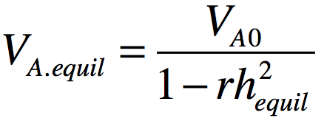

Assortative mating consequence on VA
AM: phenotypic correlation between mating partners
Many examples (e.g., height ~.2; IQ ~ .3; Social attitudes ~ .5)
If AM leads to genetic similarity in partners (as it does if due to choice for similarity), there are genetic consequences:
  Height VA increases in the population because ‘tall’ (‘short’) alleles are more concentrated in individuals than expected.
  E.g., if you’re a ‘tall’ allele sitting in an egg and are waiting around to see what other height genes you’ll get paired with from that sperm swimming to you, they are more likely than chance to be other ‘tall’ alleles (both at the same locus and at others; & this just considers the effects on VA in 1st gen)

Slide 28
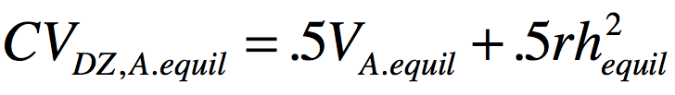
AM consequence on relative covariance
AM increases genetic covariances and correlations between relatives (e.g., sibs, parents, cousins, etc).
  While CVmz increases, it’s correlation is already 1 so it doesn’t increase
Consider again being a ‘tall’ allele in a zygote. This time you are watching your co-twin’s zygote get formed. Regardless of whether you exist (are IBD) in your co-twin’s egg, you can expect more tall alleles swimming to your co-twin’s egg.
Thus, you can also expect to share more ‘tall’ alleles with your sibling(s).
The CVdz that is due to additive genetics is:

Slide 29
Quiz Question 6
6) In the CTD, say that CVmz < 2CVdz, so we fit an ACE model. How would AM tend to affect parameter estimates? [choose all that apply]
a) deflates estimates of VA
b) inflates estimates of VA
c) deflates estimates of VC
d) inflates estimates of VC

Slide 30
Quiz Question 7
7) Say we add parents to the CTD. That gives us 2 additional relative covariance estimate to work with (parent-offspring and spousal) in addition to the normal CVmz and CVdz and allows us to ___________ [choose all that apply]
a) estimate VA, VC, & VD simultaneously
b) account for effects of assortative mating
c) account for passive G-E covariance
d) reduce the bias in estimates of VA, VC, and VD

Slide 31
Classical Twin Design (CTD)
Assumption biased up biased down
  Either VD or VC is zero VA’ VC’ & VD’
  No assortative mating VC’ VD’
  No A-C covariance VC’ VD’ & VA’
1
A
1/.25
A
E
C
C
E
a
c
c
a
e
e
D
D
d
d
P_{T1}
P_{T2}

Slide 32
Adding parents gets us around all these assumptions
Assumption biased up biased down
  Either VD or VC is zero
  No assortative mating
  No A-C covariance
^{We don’t have to make these}
w
q
q
A
A
w
x
C
C
x
a
E
E
a
D
c
e
e
c
D
d
d
P_{Fa}
µ
P_{Ma}
m
m
m
m
A
A
C
1/.25
C
E
a
a
E
e
c
D
D
c
e
d
d
P_{T1}
P_{T2}

Slide 33
We can model VC as either VS or VF
With parents, we can break “VC” up into:
S = env. factors shared only between sibs
F = familial env factors passed from parents to offspring
But we can only estimate one of these (or more technically, one of VA, VS, VF, & VD)
S
C
F
1
1
A
1/.25
A
F
A
A
F
E
a
C
C
a
E
E
S
1/.25
S
E
e
c
D
D
c
e
e
f
a
s
s
a
f
e
d
d
d
D
D
d
P_{T1}
P_{T2}
P_{T1}
P_{T2}

Slide 34
Nuclear Twin Family Design (NTFD)
q
w
w
q
A
F
x
x
F
A
S
f
E
E
f
S
s
a
e
e
a
s
D
d
d
D
P_{Fa}
µ
P_{Ma}
m
m
m
m
Note: m estimated and f fixed to 1
z_{s}
F
A
A
F
E
S
z_{d}
S
E
f
a
s
s
a
f
e
e
D
D
d
d
P_{T1}
P_{T2}

Slide 35
PRACTICAL 5: NTFD analysis
In CTD.ACDE-param.indet_2018.R, run:
FROM “# START PRACTICAL 5”
TO “# END PRACTICAL 5”
What are the estimated values of VA, VD, & VS? [Note: VS = sib environment, equivalent to VC in the CTD]
Notes:
35

Slide 36
Simulated (true) vs. CTD vs. NTFD results
TRUE values CTD estimates NTFD estimates
VA = .30 VA’ = .68 VA’ = .32
VD = .30 VD’ = .04 VD’ = .29
VS = .10 VS’ = 0 VS’ = .13
Note: these are results from a single simulation. The estimates don’t equal the parameters here due to sampling variance. If we ran this a lot of times, NTFD estimates would be unbiased.
Notes:
36

Slide 37
On average across 38 traits
CTD vs. ETFD results*
VA 65% higher in CTD
VD 43% lower in CTD
VC 45% lower in CTD when r(spouse)~0
VC 100% higher in CTD when r(spouse)>0
ETFD results are not perfect, but theory and simulation suggest they are, on average, much more accurate than CTD results.
  Accuracy across all sims: CTD=.14; NTF=.07; ETFD=.045
VG 18% higher in CTD
* Coventry & Keller, 2005

Slide 38
Nuclear Twin Family Design (NTFD)
q
w
w
q
A
F
x
x
F
A
S
f
E
E
f
S
s
a
e
e
a
s
D
d
d
D
P_{Fa}
µ
P_{Ma}
m
m
m
m
Note: m estimated and f fixed to 1
z_{s}
F
A
A
F
E
S
z_{d}
S
E
f
a
s
s
a
f
e
e
D
D
d
d
P_{T1}
P_{T2}
Assumptions:
  Only can estimate 3 of 4: VA, VD, VS, and VF (bias is variable)
  Assortative mating due to primary phenotypic assortment (bias is variable)

Slide 39
Stealth
Include twins and their sibs, parents, spouses, and offspring…
  Gives 17 unique covariances (MZ, DZ, Sib, P-O, Spousal, MZ avunc, DZ avunc, MZ cous, DZ cous, GP-GO, and 7 in-laws)
  88 covariances with sex effects

Slide 40
Additional obs. covs with Stealth allow estimation of VA, VS, VD, VF, VT
A
S
F
D
T
can be estimated simultaneously
= env. factors shared only between twins
T
1
F
A
A
F
E
S
1/.25
S
E
f
a
s
s
a
f
e
e
D
1/0
D
d
d
d
P_{T1}
t
T
T
t
P_{T2}
(Remember: we’re not just estimating more effects. More importantly, we’re reducing the bias in estimated effects –although perhaps at the expense of more variance in estimates)

Slide 41
Stealth
q
w
w
q
A
F
x
x
F
A
S
f
E
E
f
S
s
a
e
e
a
s
D
d
d
D
T
t
P_{Fa}
µ
P_{Ma}
t
T
m
m
m
m
q
w
1
w
q
A
F
x
F
A
1/.25
A
F
x
F
A
S
E
E
S
S
E
E
S
s
a
f
e
f
a
s
s
a
f
e
e
f
a
s
D
e
D
1/0
D
D
d
d
d
d
T
t
P_{Fa}
µ
P_{T1}
t
T
T
t
P_{T2}
µ
P_{Ma}
t
T
m
m
m
m
A
F
F
A
S
E
E
S
s
a
f
e
e
f
a
s
D
d
d
D
T
t
P_{Ch}
P_{Ch}
t
T

Slide 42
Stealth
Assumption biased up biased down
  Primary assortative mating VA, VD, or VF VA, VD, or VF
  No epistasis VA, VD VS
  No AxAge VD, VS VA

Slide 43
Stealth
Assumption biased up biased down
  Primary assortative mating VA, VD, or VF VA, VD, or VF
  No epistasis VA, VD VS
  No AxAge VD, VS VA
Primary AM: mates choose each other based on phenotypic similarity
Social homogamy: mates choose each other due to environmental similarity (e.g., religion)
Convergence: mates become more similar to each other (e.g., becoming more conservative when dating a conservative)

Slide 44
Cascade
~
µ
~
~
~
~
P_{Fa}
P_{Ma}
~
~
~
t
d
s
~
~
s
d
t
q
w
a
~
~
a
w
q
f
~
~
f
A
F
e
e
F
A
S
x
x
S
a
f
E
E
f
a
D
s
e
e
s
D
d
d
T
t
P_{Fa}
P_{Ma}
t
T
m
m
m
m
~
µ
~
~
~
~
~
~
P_{Sp}
P_{T1}
P_{T2}
µ
P_{Sp}
~
~
~
t
d
s
~
~
~
~
s
d
t
q
w
a
~
~
f
a
1
a
~
~
a
w
q
f
~
~
~
~
f
~
~
f
A
F
e
e
F
A
s
s
A
F
e
e
F
A
x
~
1/.25
~
x
S
E
E
S
d
d
S
E
E
S
a
f
f
a
~
~
a
f
f
a
s
e
e
s
t
t
s
e
e
s
D
d
d
D
1/0
D
d
d
D
T
t
P_{Fa}
P_{T1}
t
T
T
t
P_{T2}
P_{Ma}
t
T
m
m
m
m
A
F
F
A
S
E
E
S
s
a
f
e
e
f
a
s
D
d
d
D
T
t
P_{Ch}
P_{Ch}
t
T

Slide 45
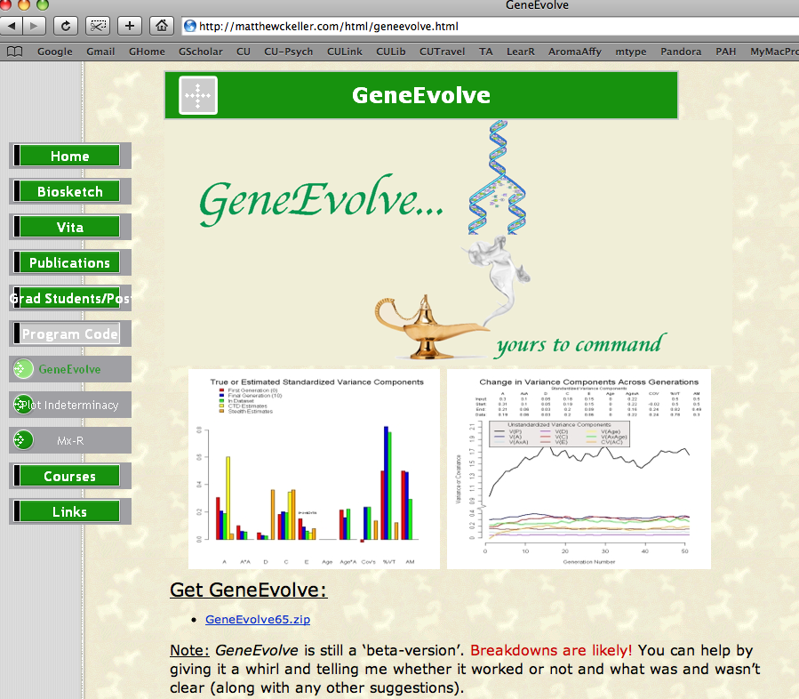
Simulation program: GeneEvolve

Slide 46
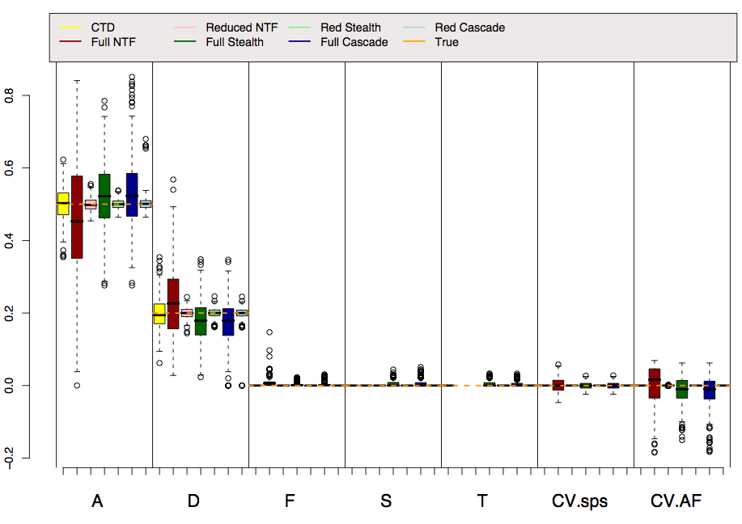
Reality: VA=.5, VD=.2

Slide 47
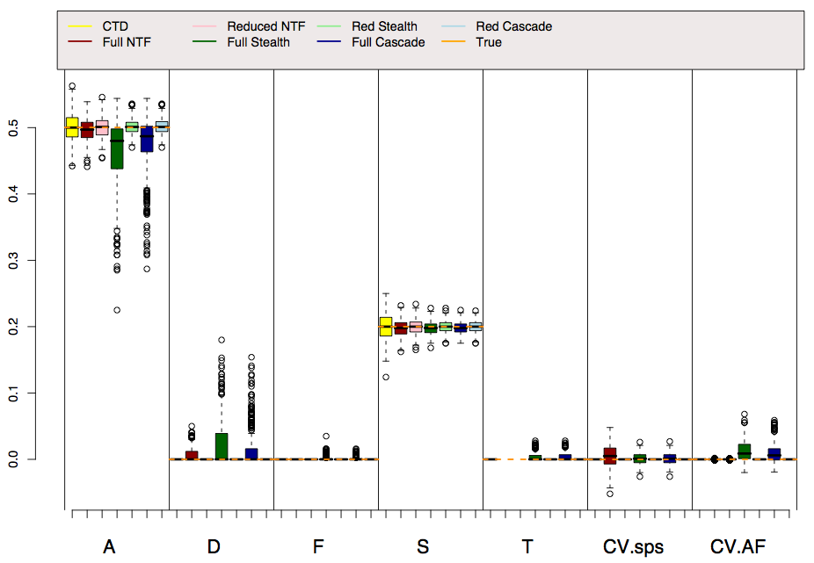
Reality: VA=.5, VS=.2

Slide 48
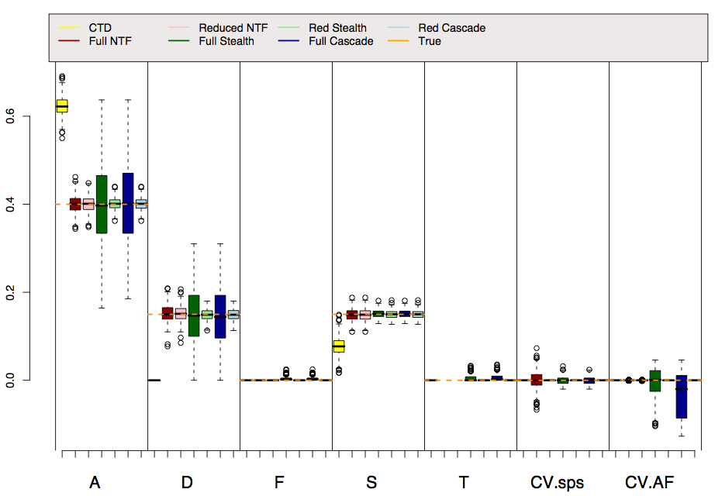
Reality: VA=.4, VD=.15, VS=.15

Slide 49
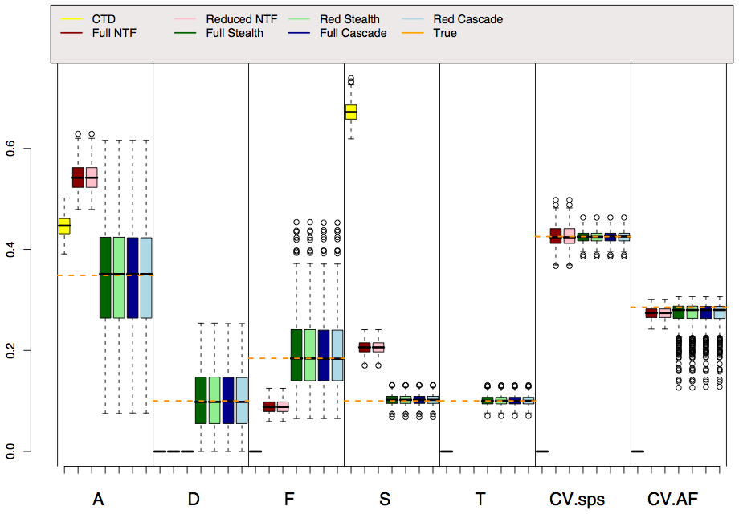
Reality: VA=.35, VD=.15, VF=.2, VS=.15, VT=.15, AM=.3

Slide 50
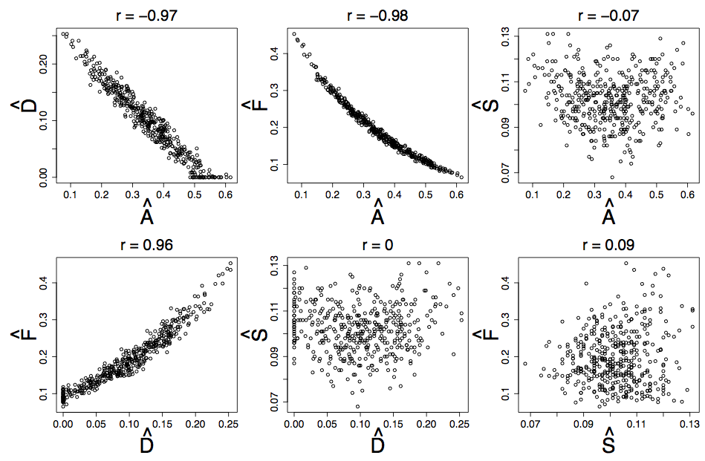
VA,VD, & VF estimates are highly correlated in Stealth & Cascade

Slide 51
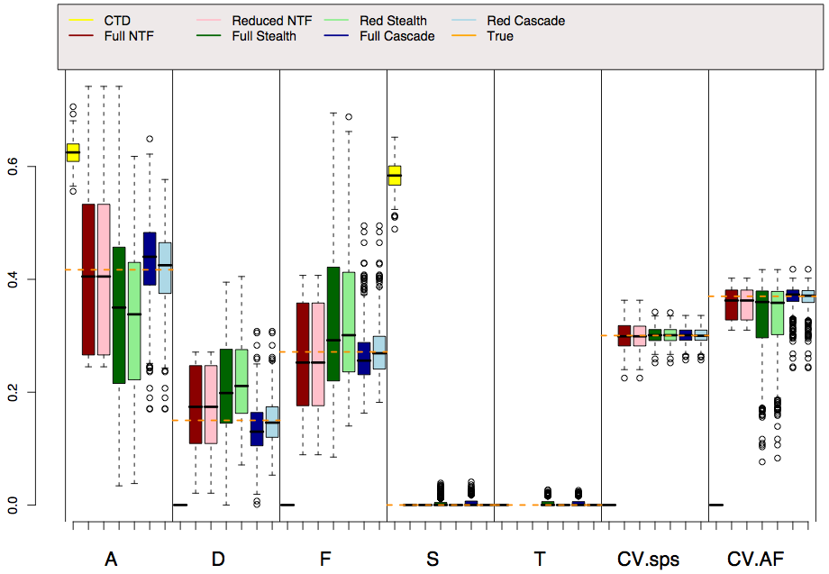
Reality: VA=.45, VD=.15, VF=.25, AM=.3 (Soc Hom)

Slide 52
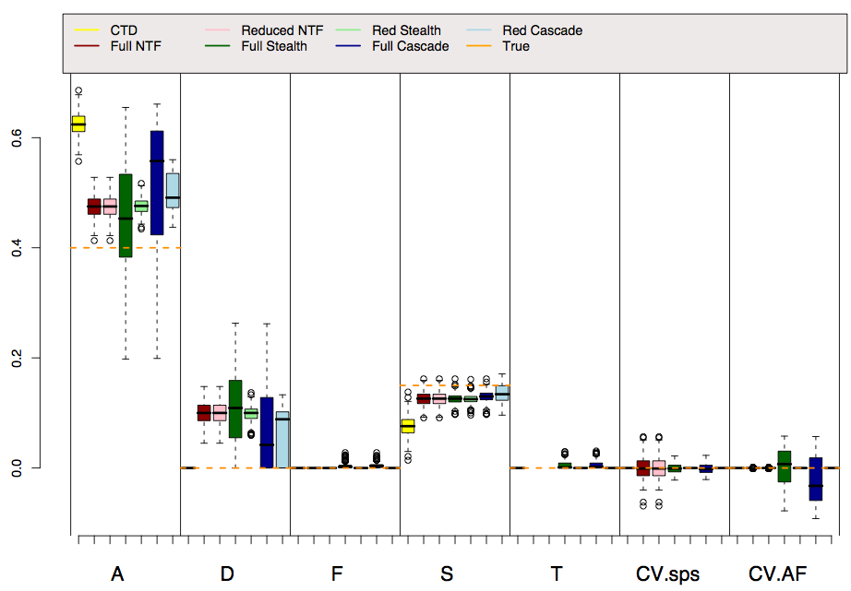
Reality: VA=.4, VA*A=.15, VS=.15

Slide 53
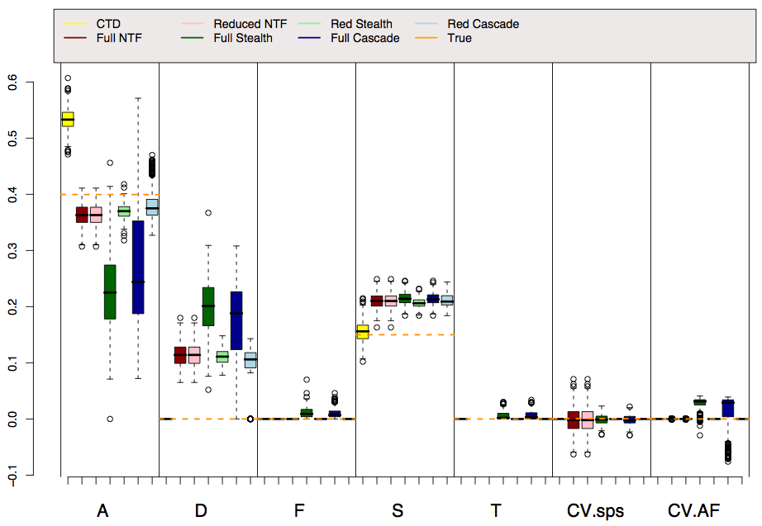
Reality: VA=.4, VA*Age=.15, VS=.15

Slide 54
Conclusions
All models require assumptions. Generally, more assumptions = more biased estimates
Simulations provide independent assessments of the NTFD, Stealth, and Cascade models
  These complicated models work as designed, but they have drawbacks
In all models, but especially the CTD, be cautious of reifying parameter estimates!
  VA’ is amalgam of mostly VA but also VD & VC. VA’/VP’ (in ACE models) or (VA’+VD’)/VP’ (in ADE models) is a decent estimate of broad sense h².
  VD’ & VC’ are likely to be underestimates

Slide 55
Discussion questions
Are ETFDs worth the trouble? Or should we simply adjust our interpretations of estimates from simpler models?
How well do methods work that rely on skewness to fit VA’, VD’, and VC’ simultaneously work?
Should we report full or reduced parameter estimates?
Should we fit variances of latent variables rather than pathways, and hence allow variance component estimates to go negative?

Slide 56
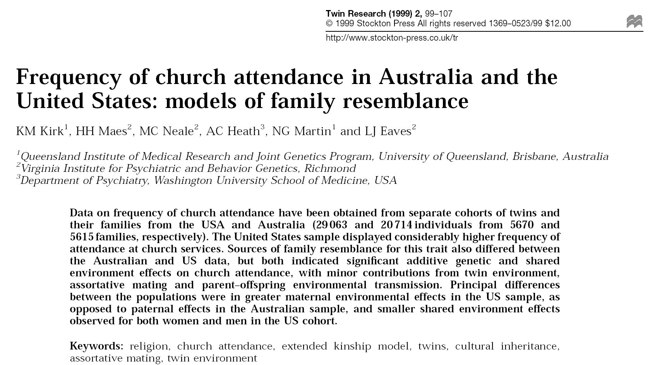
Stealth application

Slide 57
Further reading on this lecture
Eaves LJ, Last KA, Young PA, Martin NG (1978) Model-fitting approaches to the analysis of human behaviour. Heredity 41:249-320
Fulker DW (1982) Extensions of the classical twin method. Human Genetics. Part A: The Unfolding Genome (Progress in Clinical and Biological Research Vol 103A). p. 395-406
Fulker DW (1988) Genetic and cultural transmission in human behavior. Proceedings of the Second International conference on Quantitative Genetics
Eaves LJ, Heath AC, Martin NG, Neale MC, Meyer JM, Silberg JL, Corey LA, Truett K, Walter E (1999) Comparing the biological and cultural inheritance of stature and conservatism in the kinships of monozygotic and dizygotic twins. In: Cloninger CR (Ed) Proceedings of 1994 APPA Conference. p. 269-308
Keller MC & Coventry WL (2005). Quantifying and addressing parameter indeterminacy in the classical twin design. Twin Research and Human Genetics, 8, 201-213
Keller MC, Medland SE, Duncan LE, Hatemi PK, Neale MC, Maes HHM, Eaves LJ. Modeling extended twin family data I: Description of the Cascade Model. Twin Research and Human Genetics, 29, 8-18.
Keller MC, Medland SE, & Duncan LE (2010). Are extended twin family designs worth the trouble? A comparison of the bias, precision, and accuracy of parameters estimated in four twin family models. Behavior Genetics.

