Slide 1
Sensitivity Analyses in Mendelian Randomization Studies
David Evans

Slide 2
This Session
Inverse variance weighted MR
Heterogeneity tests
Multivariable MR
MR Egger
MR Weighted Median

Slide 3
Inverse Variance Weighted Fixed Effects Meta-analysis

Slide 4
Inverse variance weighted (IVW) fixed effects method
There is one underlying ‘true’ effect
All deviations of sample effects from the ‘true’ effect are due to chance
^
^
^
For N studies, each study i contributes more to the meta analysis if its standard error is lower

Slide 5
Calculate p-value
^
^
^
^

Slide 6
Fixed Effects IVW-MR and Weighted Linear regression
IVW is equivalent to a weighted regression of SNP-outcome effects on SNP-exposure effects passing through the origin
The weights are 1/SE_SNP_outcome
The slope is the estimate of the causal effect
Confounders
SNP 1
SNP 2
SNP 3
LDL
CHD
SNP 4

Slide 7
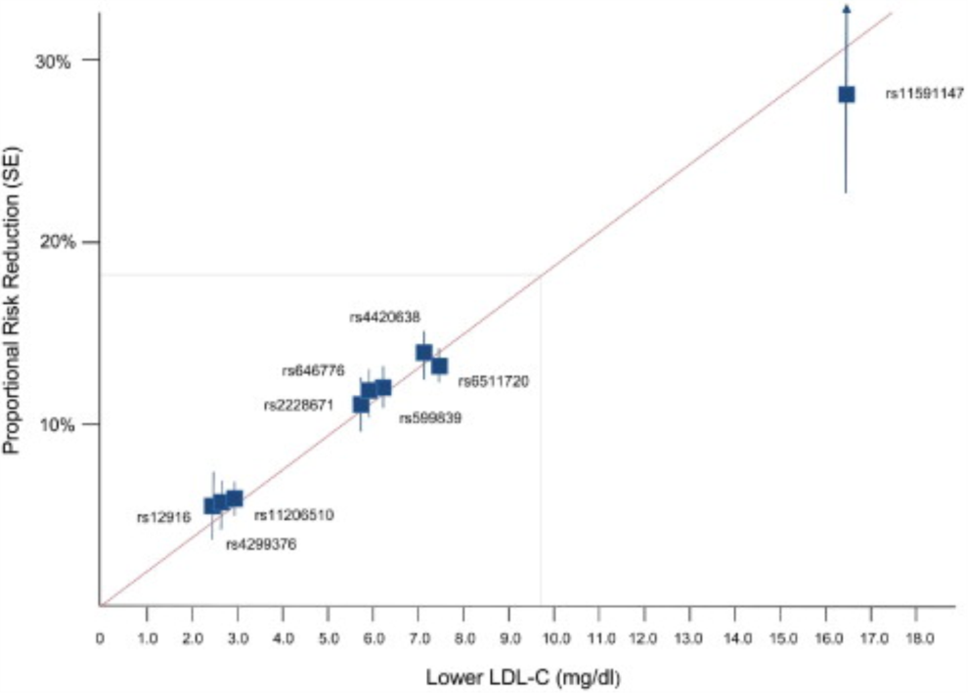
LDL and CHD Risk
Ference et al, JACC 2012

Slide 8
MR methods for handling horizontal pleiotropy
Many methods now exist

Slide 9
What is the problem?
Mendelian Randomization (MR) uses genetic variants to test for causal relationships between phenotypic exposures and disease-related outcomes
Due to the proliferation of GWAS, it is increasingly common for MR analyses to use large numbers of genetic variants
Increased power but greater potential for pleiotropy
Pleiotropic variants affect biological pathways other than the exposure under investigation and therefore can lead to biased causal estimates and false positives under the null

Slide 10
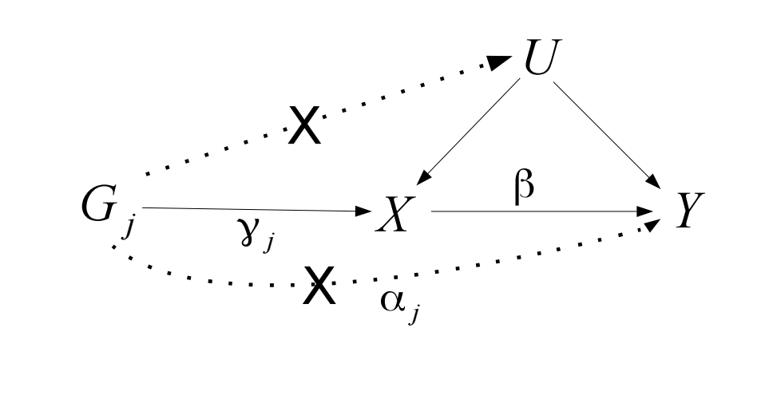
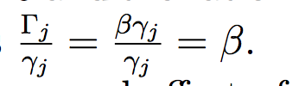
Two Sample MR:
Single Variants
Wald = Beta-GY
Beta-GX
Causal estimate using Wald method:
Notes:
Single causal estimate from the ratio estimator / Wald method

Slide 11
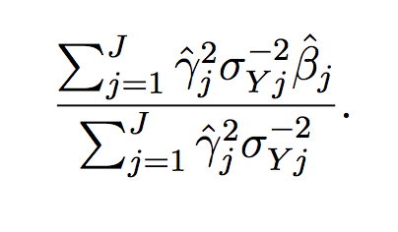

Two Sample MR:
Multiple Variants
Causal estimate using IVW
from summarised data:
(Approximates TSLS)
Notes:
With multiple genetic variants, causal effect estimated using TSLS – weighted average of the ratio estimates calculated using each genetic variant in turn.
If the genetic variants are uncorrelated, inverse-variance weighted estimated using summarized data can be calculated.
In infite samples IVW = TSLS, but will differ slightly in finite samples
Beta-hat = study specific IV estimates (YZ/XZ)

Slide 12
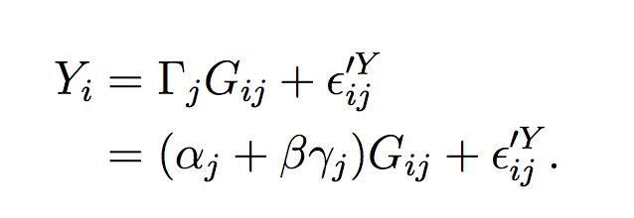

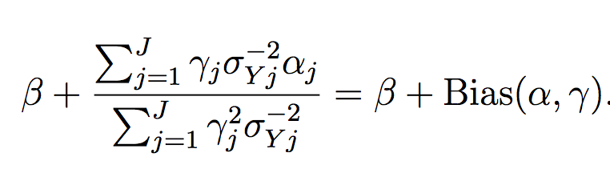
MR – with direct pleiotropy
.
Single variant Wald estimate:
Multiple variant
TSLS / IVW :
Notes:
Estimate will be biased unless alphaj = 0; or the alphaj’s cancel out

Slide 13
Heterogeneity
We expect that each SNP represents an independent study, and each should give an unbiased (if imprecise) estimate of the causal effect of x on y
Heterogeneity, where effect estimates are more different than expected due to standard errors, arises because at least some of the instruments are invalid
Cochran’s Q statistic
n=6 instruments
Expect Q = 5 if there is no heterogeneity
Q is chi-square distributed with n-1 degrees of freedom

Slide 14
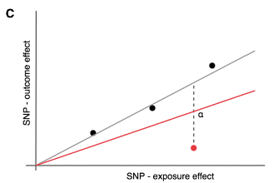
Option 1: Remove outliers
Some SNPs might contribute to the majority of the heterogeneity
If we assume these are the invalid instruments then the IVW estimate excluding them should be less biased
However – beware of:
Cherry picking – remove outliers will artificially provide a more precise estimate
What if the outlier is the only valid instrument, and all the others are invalid?
  E.g. cis-variants for gene expression, DNA methylation, protein levels. CRP levels are best instrumented by variants within the CRP gene region. Most other variants that come up in CRP GWAS are upstream effects related to inflammation

Slide 15
Option 2: Multivariable MR
We are testing for whether X1 has an influence on Y
We know that some instruments for X1 also have influences on X2
This opens up the possibility of horizontal pleiotropy biasing our estimate
What is the X1-Y association adjusting for X2?

Slide 16
Option 3: Fit a model that is robust to some model of horizontal pleiotropy

Slide 17
MR Egger Regression

Slide 18
MR Egger Regression: Central concept
In Mendelian Randomization when multiple genetic variants are being used as IVs, Egger regression can:
  Identify the presence of ‘directional’ pleiotropy
  (biasing the IV estimate)
  provide a less biased causal estimate
  (in the presence of pleiotropy)

Slide 19
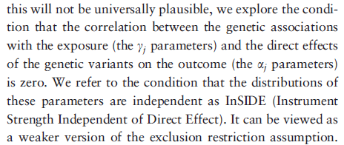
InSIDE Assumption
Relaxing MR’s assumptions
.
W
Notes:
Standard MR has 3 assumptions.
InSIDE relaxes the third assumption

Slide 20
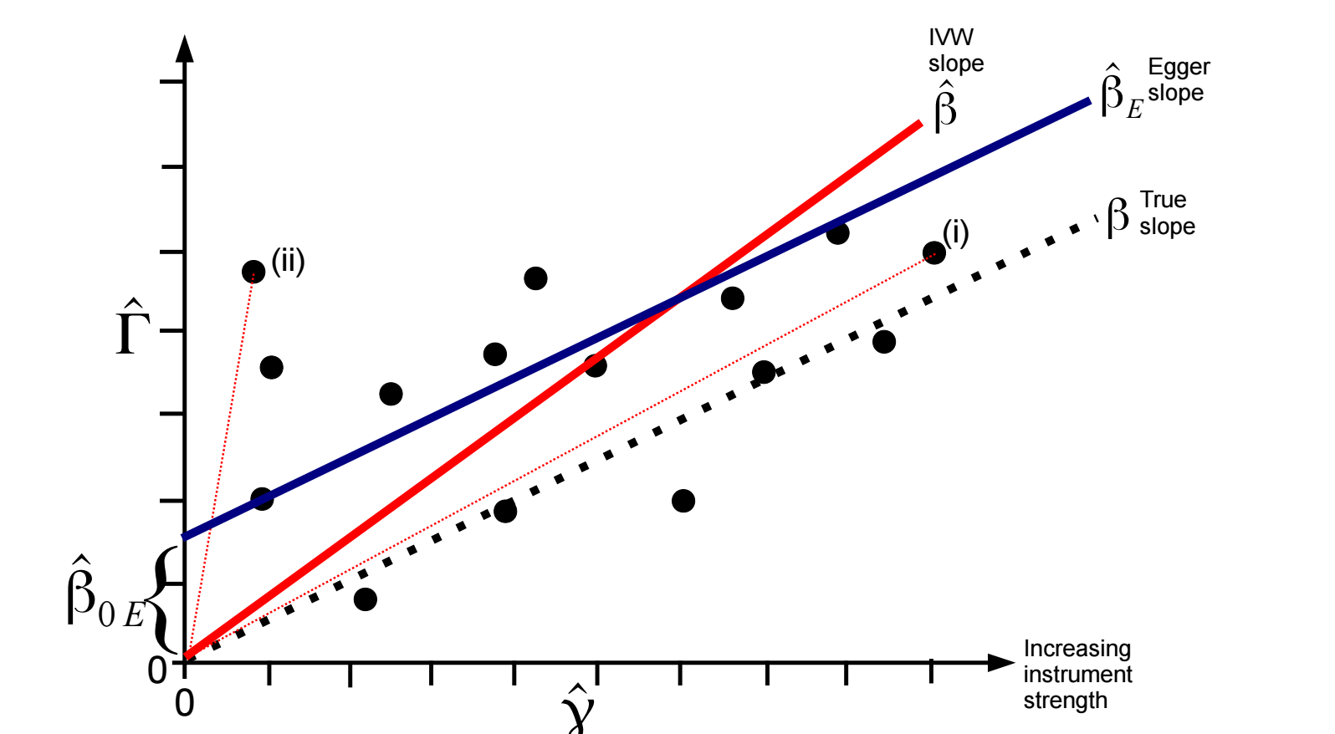
Example:
ALL INVALID INSTRUMENTS
INSIDE ASSUMPTION SATISFIED
SNP – outcome association
SNP – exposure association
Notes:
This is equal to the coefficient
from a weighted regression of the gene–outcome association
estimates (^C j) on the gene–exposure association estimates
(^cj) with the intercept constrained to zero, and
weighted by the inverse of the precision of the IV–outcome
coefficients (r2
Yj ).

Slide 21


InSIDE:
Bias of ratio estimator
SNP – outcome association
SNP – exposure association
Notes:
Since bias is inversely proportional to SNP-exposure association, ratio estimates for stronger genetic variants (such as (i) ) will be on average closer to the true causal effect

Slide 22
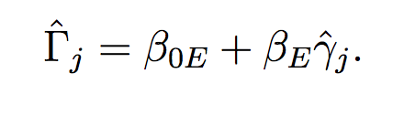
Egger regression:
Intercept not constrained to zero
Egger’s test assesses whether the intercept term is significantly different from zero. The estimated values of the intercept can be interpreted as the average pleiotropic effect across all genetic variants. An intercept term different from zero indicates directional pleiotropy
Notes:
Egger’s test assesses whether the intercept term is significantly different from zero. This will occur if estimates from weaker genetic variants are more skewed towards higher/lower values compared with estimates from stronger genetic variants.
The estimated values of the intercept can be interpreted as average pleiotropic effect across all genetic variants.
An intercept term different from zero indicates overall directional pleiotropy (ie pleiotropy not balanced around the null)

Slide 23
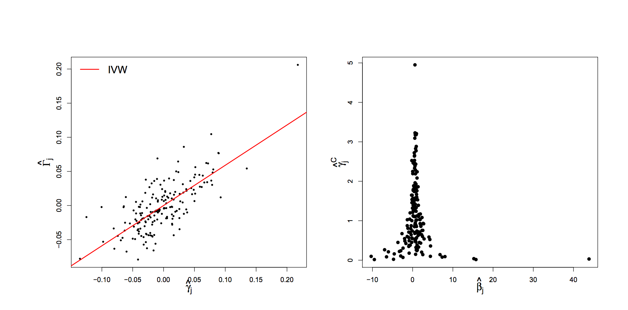
Height and lung function
SNP-Lung Function
SNP-Height
SNP - Height
Causal estimate
IVW = 0.59 (95% CI: 0.50, 0.67 )
Egger = 0.58 (95% CI: 0.50, 0.67); intercept -0.001 p=0.5
Notes:
180 variants for height
Funnel plot suggests little asymmetry present (indicative of no directional pleiotropy); supported by concordance between egger test and IVW, and the lack of significant intercept

Slide 24
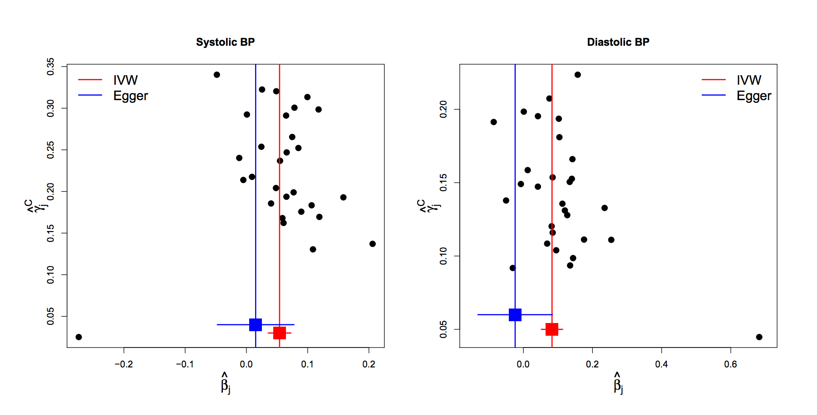
BP and Coronary Disease
FUNNEL PLOTS
Visual evidence for asymmetry
Notes:
Some asymmetry is present in these funnel plots, consistent with directional pleiotropy
Eg for SBP, 10 of the 13 weakest variants have IV estimates greater than the IVW causal effect

Slide 25
BP and Coronary Disease
FUNNEL PLOTS
Notes:
Some asymmetry is present in these funnel plots, consistent with directional pleiotropy
Eg for SBP, 10 of the 13 weakest variants have IV estimates greater than the IVW causal effect

Slide 26
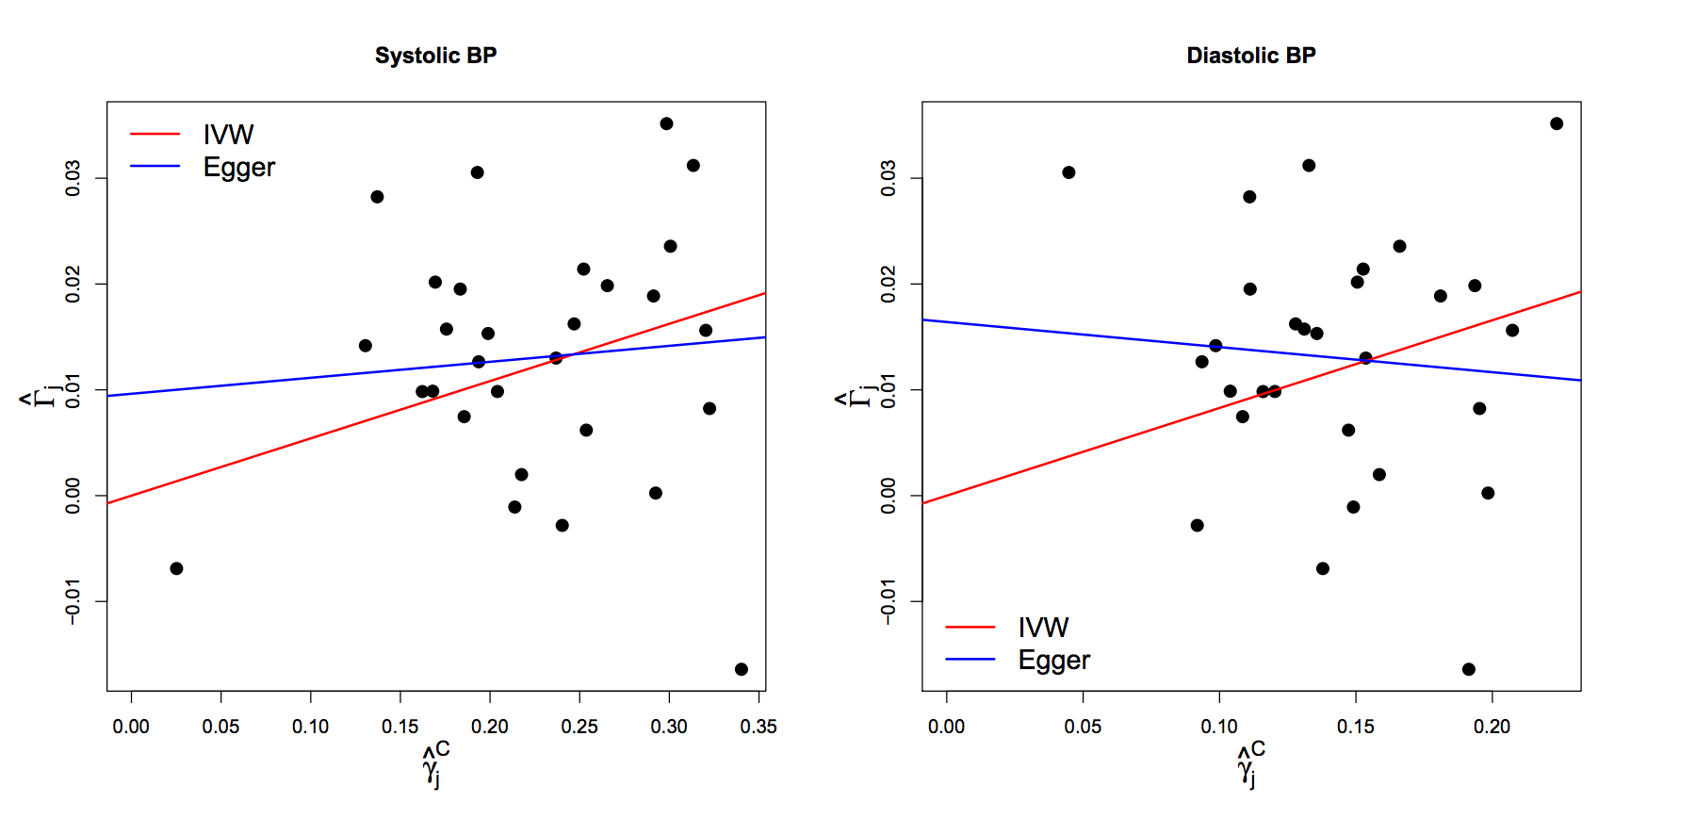
BP and Coronary Disease
Scatter Plots
Egger test for intercept p=0.2
Egger test for intercept p=0.054
Notes:
Intercepts deviate from zero but not strong statistical evidence for difference!

Slide 27
BP and Coronary Disease
FUNNEL PLOTS
IVW= 0.054 logOR/mmHg p=4x10⁻⁶
Egger =0.015 logOR/mmHg p=0.6
IVW= 0.083 logOR/mmHg p=1x10⁻⁵
Egger =-0.024 logOR/mmHg p=0.7

Slide 28
Weighted Median Approach

Slide 29
Simple Median Method
Order instrumental variables estimates and take the median
Like all subsequent estimators it enjoys a 50% breakdown limit

Slide 30
Weighted Median Method
^
γ_{j}²
w_{j}’
w_{j}’ =
___
w_{j} =
____
σ²_{Yj}
Σ_{j}w_{j}’

Slide 31
Penalized Weighted Median Method
Although the invalid IVs do not contribute directly to the median estimate, they do
influence it in small samples
Like all subsequent estimators it enjoys a 50% breakdown limit

Slide 32
Penalized Weighted Median Method
One way of minimizing this problem is down-weighting the contribution to the analysis of genetic variants with heterogeneous ratio estimates
Heterogeneity between estimates can be quantified by Cochrane’s Q statistic:
The Q statistic has a chi-squared distribution on J – 1 degrees of freedom under the null hypothesis of no heterogeneity
Each individual component of Q has a chi-square distribution with 1 df. Bowden proposes using a one sided upper P value (denoted q_{j}):
Q = Σ_{j}Q_{j}
=
^
^
Σ_{j}w_{j}’(β_{j} - β)²
w_{j}* = w’_{j} × min(1, 20q_{j})

Slide 33
Penalized Weighted Median Method

Slide 34
Summary
MR uses natural randomization to mimic an RCT
It is useful, data is abundant, but it is not a panacea for causal inference
Often valuable for proving that an hypothesised association is not causal
Crucial to perform sensitivity analyses and obtain metrics regarding the likely reliability of the MR estimates

Slide 35
References
Bowden et al. Detecting individual and global horizontal pleiotropy in Mendelian randomization: a job for the humble heterogeneity statistic? American Journal of Epidemiology 2018, 187(12), 2681-2685.
Bowden et al. Consistent estimation in Mendelian randomization with some invalid instruments using a weighted median estimator Genet Epidemiol 40(4), 304-14
Bowden et al. Mendelian randomization with invalid instruments: effect estimation and bias through Egger regression. Int J Epidemiol, 44(2), 512-25
Burgess et al. Multivariable Mendelian randomization: the use of pleiotropic genetic variants to estimate causal effects. Am J Epidemiol, 181(4), 251-60
Hemani et al. Evaluating the potential role of pleiotropy in Mendelian randomization studies Human Molecular Genetics, Volume 27, Issue R2, 1 August 2018, Pages R195–R208

