Slide 1
Introduction to Mendelian Randomization:
Using genes to inform causality
David Evans

Slide 2
Some Criticisms of Genetic Studies…
How do you translate the results from genetic studies?
You can’t change people’s genotypes (at least not yet)
You can however modify people’s environments…
Mendelian Randomization is a method of using genetics to inform us about associations in traditional observational epidemiology and MUCH MUCH more…

Slide 3
This Session
Randomized controlled trials
Problems with observational data
Mendelian Randomization (MR):
  How it works
  Core assumptions
  Calculating causal effect estimates
MR example
Limitations of MR

Slide 4
RCTs: the Gold Standard in Inferring Causality
RANDOMISED CONTROLLED TRIAL
Randomization
makes causal inference
possible
RANDOMIZATION METHOD
EXPOSED:
INTERVENTION
CONTROL:
NO INTERVENTION
CONFOUNDERS EQUAL BETWEEN GROUPS
OUTCOMES COMPARED BETWEEN GROUPS

Slide 5
The Need for Observational Studies
Randomized Controlled Trials (RCTs):
  Not always ethical or practically feasible eg anything toxic
  Expensive, requires experimentation in humans
  Should only be conducted on interventions that show very strong observational evidence in humans
Observational studies:
  Association between environmental exposures and disease measured in observational designs (non-experimental)
  eg case-control studies or cohort studies
  Reliably assigning causality in these types of studies is
  very limited

Slide 7
CHD risk according to duration of current Vitamin E
supplement use compared to no use
RR
Rimm et al NEJM 1993; 328: 1450-6

Slide 8
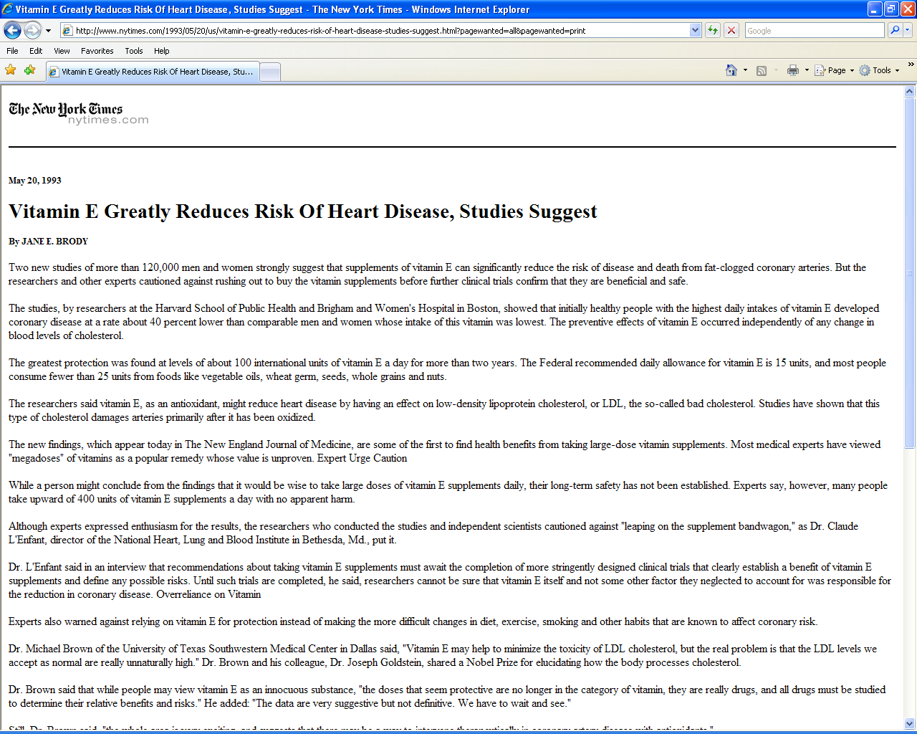

Slide 9


Slide 10
Use of vitamin supplements by US adults, 1987-2000
Percent
Source: Millen AE, Journal of American Dietetic Assoc 2004;104:942-950

Slide 11
Vitamin E supplement use and risk of Coronary Heart Disease
1.0
Stampfer et al NEJM 1993; 328: 144-9; Rimm et al NEJM 1993; 328: 1450-6; Eidelman et al
Arch Intern Med 2004; 164:1552-6

Slide 12
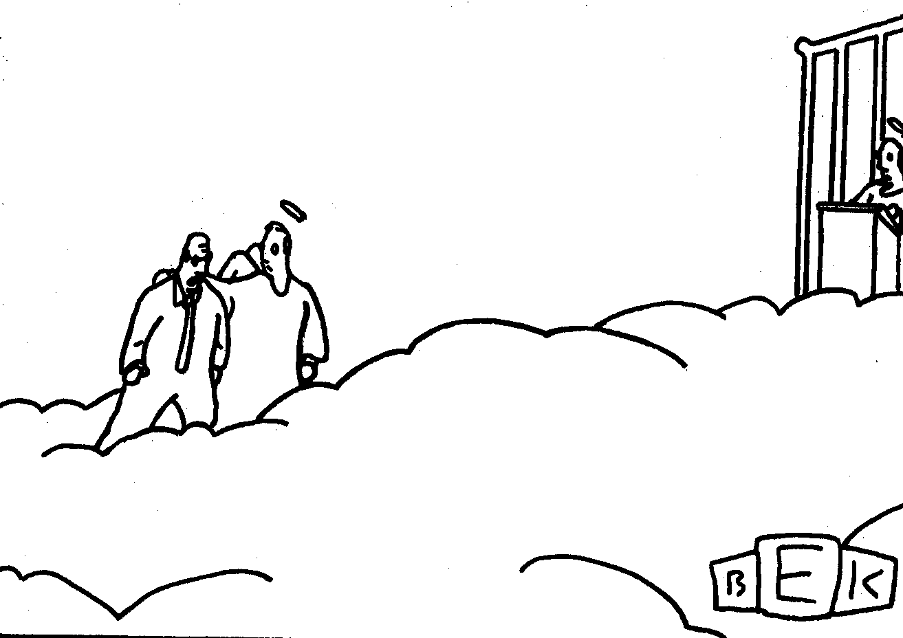
“Well, so much for antioxidants.”

Slide 13
Many other exaMPLEs vitamin c, vitamin a, HRT, many drug targets…….
What’s the explanation?

Slide 14
Vitamin E levels and confounding risk factors:
Childhood SES
Manual social class
No car access
State pension only
Smoker
Obese
Daily alcohol
Exercise
Low fat diet
Height
Leg length
Women’s Heart and Health Study
Lawlor et al, Lancet 2004

Slide 15
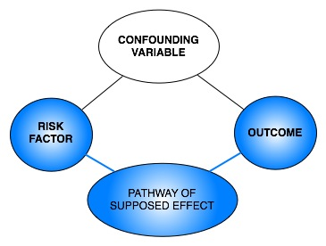
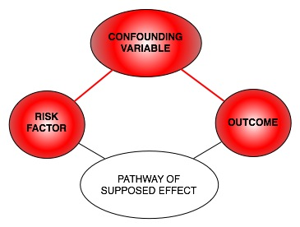
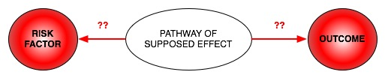
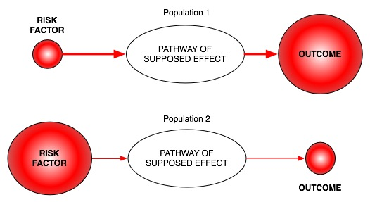
Classic limitations to “observational” science
Confounding
Reverse Causation
Bias

Slide 16

Mendelian randomization
How can it help observational epidemiology?

Slide 17
What does MR do?
Assess causal relationship between two variables
Estimate magnitude of causal effect
How does it do this?
By harnessing Mendel’s laws of inheritance

Slide 18
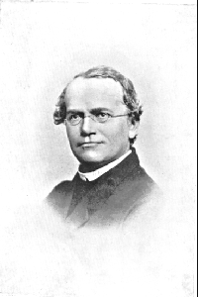
Mendel’s Laws of Inheritance
Segregation: alleles separate at meiosis and a randomly selected allele is transmitted to offspring
2. Independent assortment: alleles for separate traits are transmitted independently of one another
Mendel in 1862

Slide 19
Mendelian randomization and RCTs
MENDELIAN RANDOMIZATION
RANDOMISED CONTROLLED TRIAL
+ independent assortment
RANDOM SEGREGATION
OF ALLELES
RANDOMISATION METHOD
EXPOSED: FUNCTIONAL ALLELLES
CONTROL: NULL ALLELLES
EXPOSED:
INTERVENTION
CONTROL:
NO INTERVENTION
CONFOUNDERS EQUAL BETWEEN GROUPS
CONFOUNDERS EQUAL BETWEEN GROUPS
OUTCOMES COMPARED BETWEEN GROUPS
OUTCOMES COMPARED BETWEEN GROUPS

Slide 20
Mendelian randomization: Smoking and Lung Cancer
MENDELIAN RANDOMIZATION
RANDOMISED CONTROLLED TRIAL
+ independent assortment
RANDOM SEGREGATION
OF ALLELES
RANDOMISATION METHOD
Heavy Smokers:
C/C
Light/Non Smokers:
C/T or T/T
EXPOSED:
SMOKERS
CONTROL:
NON SMOKERS
CONFOUNDERS EQUAL BETWEEN GROUPS
CONFOUNDERS EQUAL BETWEEN GROUPS
LUNG CANCER COMPARED
BETWEEN GROUPS
LUNG CANCER COMPARED
BETWEEN GROUPS

Slide 21
Mendelian Randomization:
3 Core Assumptions
Confounders
(2)
X
SNP
Exposure
Outcome
(1)
X
(3)
(1) SNP is associated with the exposure
(2) SNP is NOT associated with confounding variables
(3) SNP ONLY associated with outcome through the exposure

Slide 22
Why are genetic associations special?
Robustness to confounding due to Mendel’s laws:
  Law of segregation: inheritance of an allele is random and independent of environment etc
  Law of independent assortment: genes for different traits segregate independently (assuming not in LD)
The direction of causality is known – always from SNP to trait
Genetic variants are potentially very good instrumental variables
Using genetic variants as IVs is a special case of IV analysis, known as Mendelian randomization

Slide 23
Calculating Causal Effect Estimates
Confounders
SNP
Exposure
Outcome
β_{SNP-EXPOSURE}
? β _{CAUSAL EXP-OUTCOME}
β_{SNP-OUTCOME}
After SNP identified robustly associated with exposure of interest:
- Wald Estimator
- Two-stage least-squares (TSLS) regression

Slide 26
MR can also be performed using just the results from GWAS
Also known as two-sample MR, SMR, or MR with summary data etc
Advantages:
  The data is readily available, non-disclosive, free, open source
  The exposure and outcome might not be measured in the same sample
  The sample size of the outcome variable, key to statistical power, is not limited by requiring overlapping measures of the exposure
Disadvantages:
  Some extensions of MR not possible, e.g. non-linear MR, use of GxE for negative controls, various sensitivity analyses

Slide 27
Calculating Causal Effect Estimates
Confounders
SNP
Exposure
Outcome
β_{SNP-EXPOSURE}
β_{CAUSAL EXP-OUTCOME}
β_{SNP-OUTCOME}
^
β_{SNP-OUTCOME}
= β_{CAUSAL EXP-OUTCOME} x
β_{SNP-EXPOSURE}
Causal effect by
Wald Estimator* :
β_{SNP-OUTCOME}
^
β_{SNP-EXPOSURE}
σ_{SNP- OUTCOME}
Std Error Wald Estimator :
____________
β_{SNP- EXPOSURE}
*Can be used in different samples (“Two sample MR”)

Slide 28
Calculating Causal Effect Estimates
Confounders
SNP
Weight
BP
β_{SNP-WEIGHT}
β_{CAUSAL WEIGHT-BP}
0.5kg
β_{SNP-BP}
0.9mmHg
BP and weight:
0.9 mmHg/allele
0.5 kg/allele
=1.8 mmHg/kg
^
= change in outcome
per unit change in exposure
Causal effect by
Wald Estimator* :
β_{SNP-OUTCOME}
^
β_{SNP-EXPOSURE}
*Can be used in different samples (“Two sample MR”)

Slide 29
Generate causal estimate
Two-stage least squares
library(sem)
mod1 <- tsls(outcome ~ exposure, ~ allele.score, data=data)
# two-stage least squares with allele score
mod2 <- tsls(outcome ~ exposure, ~ rs123 + rs456 + rs789 + rs1011 + rs1213, data=data)
# two-stage least squares with individual SNPs
library(AER)
mod3 <- ivreg(outcome ~ exposure | allele.score, data=data)
mod4 <- ivreg(outcome ~ exposure | rs123 + rs456 + rs789 + rs1011 + rs1213, data=data)

Slide 30
MR Example using CRP
C-Reactive Protein (CRP) is a biomarker of inflammation
It is associated with BMI, metabolic syndrome, CHD and a number of other diseases
It is unclear whether these observational relationships are causal or due to confounding or reverse causality
This question is important from the perspective of intervention and drug development

Slide 31
Using a genetic instrument for
proinflammatory CRP
U
CRP genotype
Cardiometabolic
traits
CRP
TWO ALTERNATIVES
If CRP DOES NOT causally affect cardiometabolic traits:
CRP gene variant should NOT be related to cardiometabolic traits
If CRP CAUSALLY affects metabolic traits:
CRP gene variant should also be related to these metabolic traits

Slide 32
“Bi-directional Mendelian Randomization”:
Testing causality and reverse causation
?
FTO
Genotype
BMI
CRP
CRP
Genotype
?

Slide 33
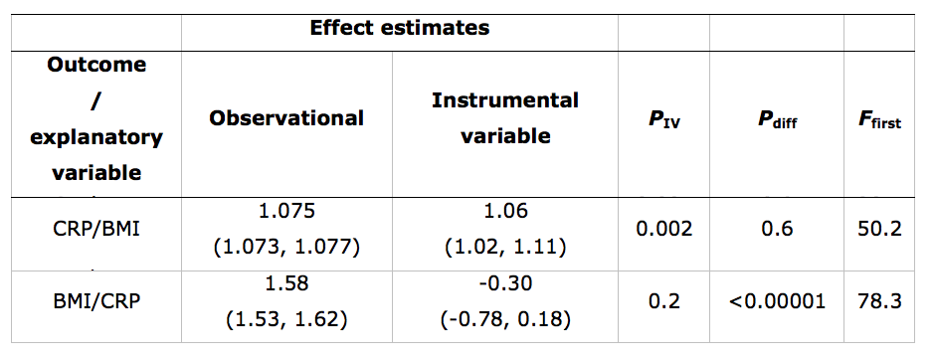
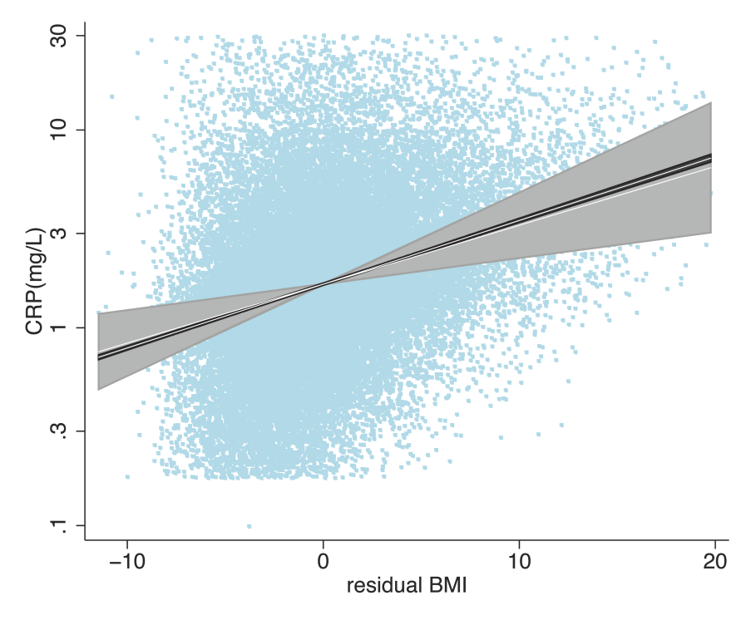
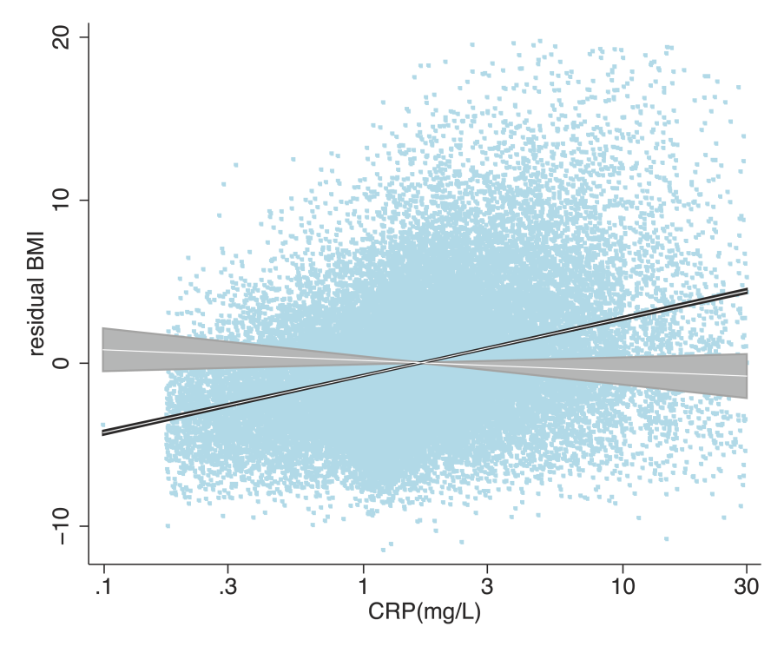

Slide 34
Limitations to Mendelian Randomization
1- Population stratification
2- Canalisation (“Developmental compensation”)
3- The existence of instruments
4- Power and “weak instrument bias”
5- Pleiotropy

Slide 35
Power and Weak Instruments
Power:
  Genetic variants explain very small amounts of phenotypic variance in a given trait
  VERY large sample sizes are generally required
Weak instruments:
  Genetic variants that are weak proxies for the exposure
  Results in biased causal estimates from MR
Different impact of the bias from weak instruments:
  Single Sample MR: to the confounded estimate
  Two-Sample MR: to the null

Slide 36
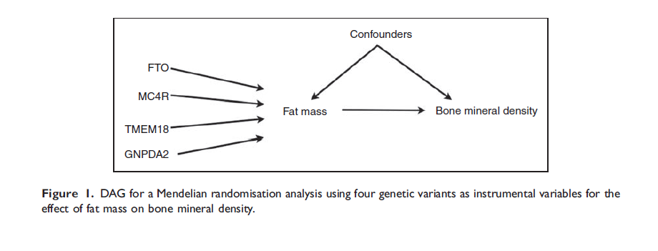
Using Multiple Genetic Variants as Instruments
Palmer et al (2011) Stat Method Res
Allelic scores
Testing multiple variants individually
Meta-analyse individual SNPs

Slide 37
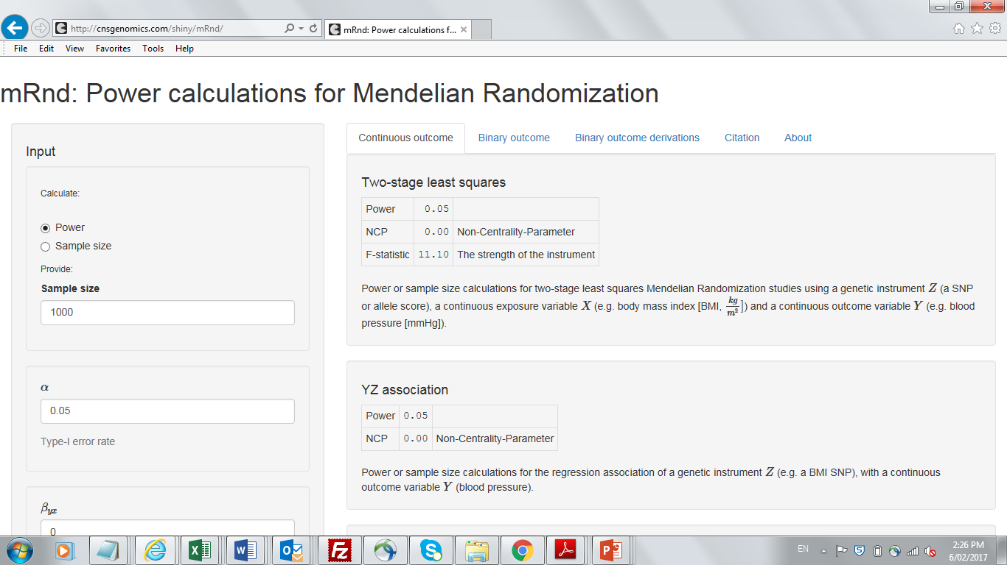
Calculating Power in Mendelian Randomization Studies

Slide 38
Limitations to Mendelian Randomization
1- Population stratification
2- Canalisation (“Developmental compensation”)
3- The existence of instruments
4- Power (also “weak instrument bias”)
5- Pleiotropy

Slide 39
Pleiotropy
Genetic variant influences more than one trait
Horizontal vs Vertical pleiotropy
Outcome
Exposure
Outcome
Exposure
G
G
Vertical Pleiotropy
Horizontal Pleiotropy

Slide 40
Pleiotropy
Genetic variant influences more than one trait
Pleiotropy only violates MR’s assumptions if it involves a pathway outside that of the exposure and is a pathway that affects your outcome
Violation
Outcome
Outcome
Exposure
B1
Exposure
B1
B 2
B 2
G
G

Slide 41



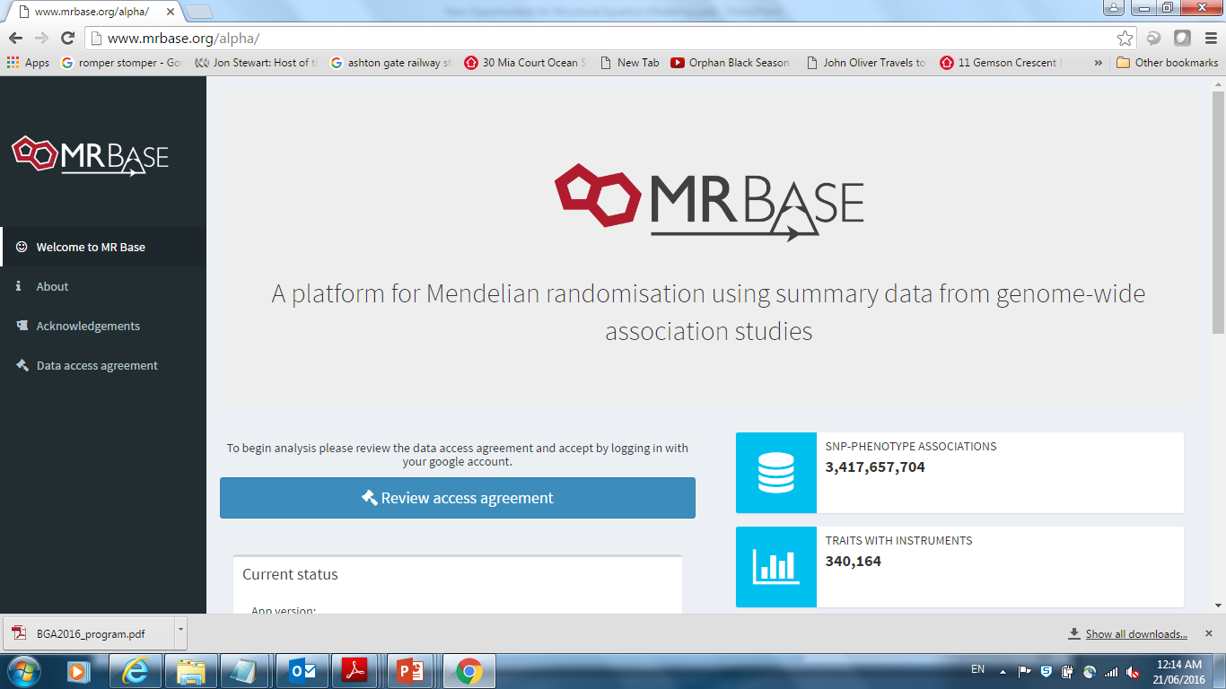
MR Base
http://www.mrbase.org/
Jie “Chris” Zheng
Gib Hemani
Phil Haycock

Slide 42
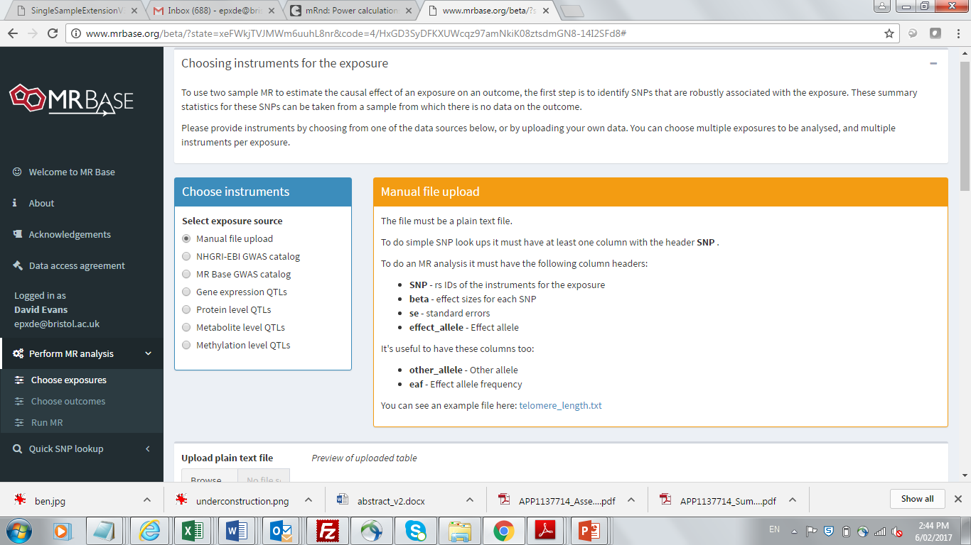

Slide 43
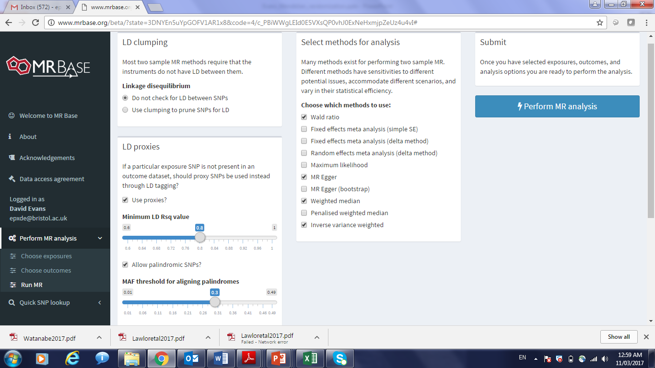

Slide 44
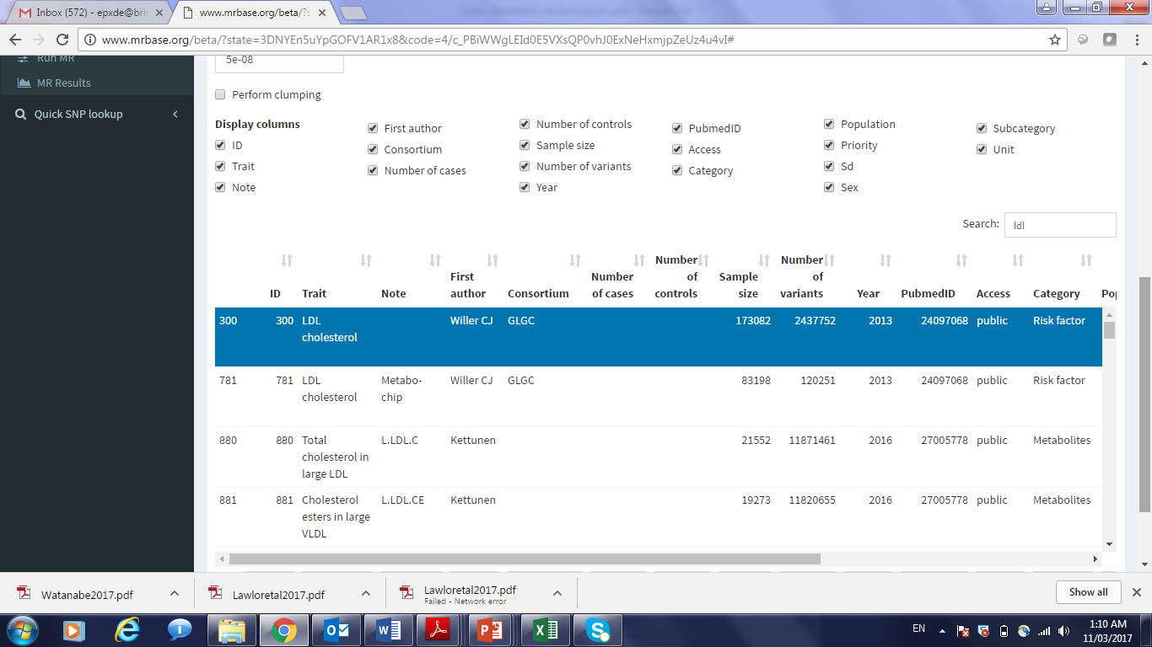

Slide 45
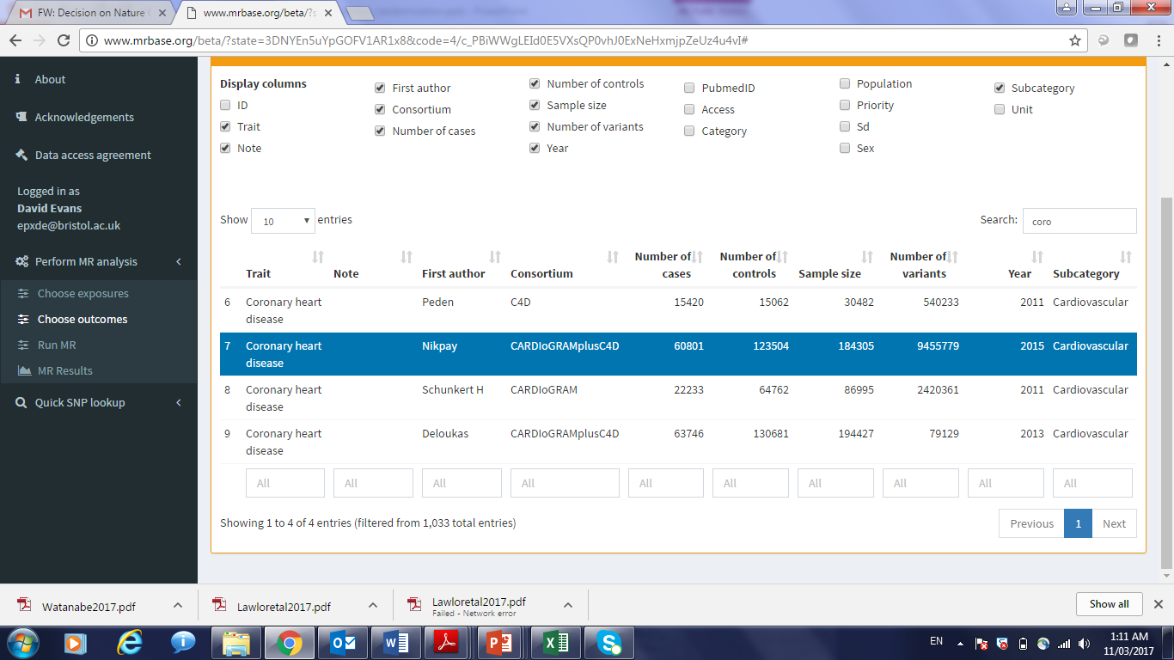

Slide 46
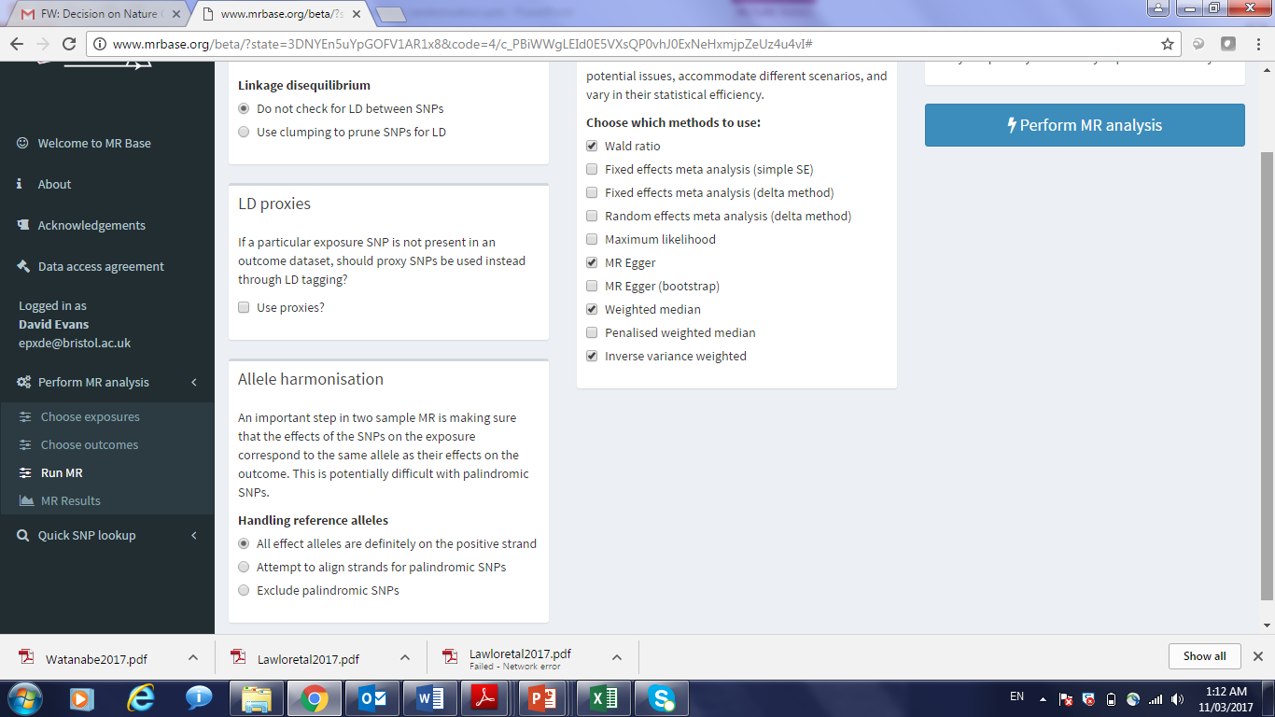

Slide 47
Useful References
Brion et al (2013). Calculating statistical power in Mendelian randomization studies. Int J Epidemiol, 42(5), 1497-501.
Davey-Smith & Hemani (2014). Mendelian randomization: genetic anchors for causal inference in epidemiological studies. Hum Mol Genet, 23(1), R89-98.
Davey-Smith & Ebrahim (2003). “Mendelian randomization”: can genetic epidemiology contribute to understanding environmental determinants of disease? IJE, 32, 1-22.
Davies et al (2018). Reading Mendelian randomization studies: a guide, glossary, and checklist for clinicians. BMJ, Jul 12, 362:k601.
Evans & Davey-Smith (2015). Mendelian randomization: New applications in the coming age of hypothesis free causality. Annu Rev Genomics Hum Genet, 16, 327-50.
Hemani et al. (2018). The MR-Base platform supports systematic causal inference across the human phenome. Elife, May 30, 7, e34408.
Zheng et al. (2017). Recent developments in Mendelian randomization studies. Curr Epidemiol Rep, 4(4), 330-345.

