Slide 1
Introducing polygenic risk scores into the twin design
Estimating r_{AC}
and
MR twin model
Conor V. Dolan
Boulder 2020

Slide 3
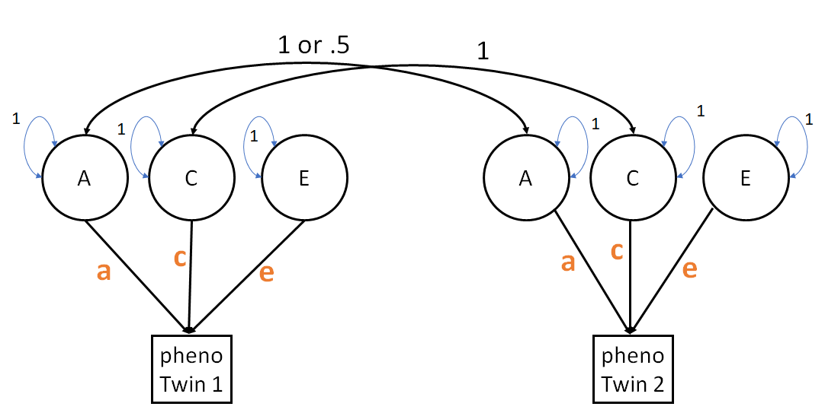
What is var(A) again ? (in a simple model assuming linkage equilibrium)
Notes:
assumption linkage equilbrium

Slide 4
(in a simple model assuming linkage equilibrium)
pheno_{i} = a₀ + a₁*QTL_{A1i} + a₂*QTL_{A2i} +. . . + a_{N}*QTL_{ANi} + e_{i}
var(A) = s²_{Ph_QTL(A)} = a₁²*s²_{QTLA1}+a₂²*s²_{QTLA2}+...+a_{N}²*s²_{QTLAN}
Suppose you have measured QTL₁ to QTL₁₀ and
you have reliable GWAS estimates of a₁ to a₁₀: â₁ to â₁₀
PRS_{i} = â₁*QTL_{A1i} + â₂*QTL_{A2i} +. . . + â₁₀*QTL_{ANi}
var(A*) = a₁₁²*s²_{QTLA11}+a₁₂²*s²_{QTLA12}+...+ a_{N}²*s²_{QTLAN}
var(A) = var(P) + var(A*)
The risk score PGS renders part of the latent A observable.
1 to 10
11 to N
Notes:
assumption linkage equilbrium

Slide 5
Include polygenic risk scores in the ACE twin model to estimate r_{AC}

Slide 6
1 or .5
1
1
1
1
1
1
1
A
C
E
A
C
E
c
a
c
a
e
e
pheno
Twin 1
pheno
Twin 2
var(pheno) = a² + c² + e²
Notes:
Explain regression on unit

Slide 7
1 or .5
1
1 or .5
1
1
1
1
PRS
A
C
E
PRS
A
C
E
a*
c
a*
c
p
e
e
s
s
p
PRS
Twin 1
pheno
Twin 1
PRS
Twin 2
pheno
Twin 2
var(pheno) = a*² +p² + c² + e²
Notes:
Explain regression on unit

Slide 8
Identical models
1
PRS
s
s²
PRS
Twin 1
pheno
Twin 1
PRS
Twin 1
pheno
Twin 1
the standard deviation of PRS is s
the variance of PRS is s²

Slide 9
Nmz = Ndz = 1000 exact data simulation
Standard model ACE
Standard model ACE with P
LB est UB
ACE.A[1,1] 0.490 0.600 0.714
ACE.C[1,1] 0.198 0.300 0.399
ACE.E[1,1] 0.471 0.500 0.532
LB est UB
A*+P 0.492 0.600 0.711
C 0.202 0.300 0.396
E 0.471 0.500 0.532
P 0.047 0.060 0.075
A* 0.433 0.540 0.650
LB est UB
ACE.A[1,1] 0.490 0.600 0.714
ACE.C[1,1] 0.198 0.300 0.399
ACE.E[1,1] 0.471 0.500 0.532
var(pheno) = .60 + .30 + .50
var(pheno) = .54 + .06 + .30 + .50
.60 in standard model is decomposed into .060 (P) and .540 (A)
R² = .06/60 genetic level 10%
R² = .06/1.4 R² phenotypic level 4.28%

Slide 10
1
1
1
1
PRS
A
C
E
a*
c
s*
p
e
1
ε_{p}
b_{p}
P
Twin 1
pheno
Twin 1
Phenotype usually includes measurement error which is absorbed by E.
Here we assume that the PRS is error free. If it is not and we know the reliability (r_{pp}) , we can include that info. The parameter b is fixed to equal:
b_{p} = √{var(P) * (1-r_{pp})}
Notes:
Explain regression on unit

Slide 11
Can we estimate r_{AC}, which not identified in the standard ACE model?
r_{AC}
r_{AC}
P
A
C
E
a*
s
c
e
p
P
Twin 1
pheno
Twin 1
What motivation?
Notes:
Explain regression on unit

Slide 12
Motivation: Fading C... Is it fading parental influence?
Is the decrease in C due to decrease in C proper + decrease in r_{AC}
c² + 2*a*c*r_{AC}
What is decreasing?
c² or r_{AC} in
2*a*c*r_{AC}
probably both
Tucker-Drob & Bates (2015)

Slide 13
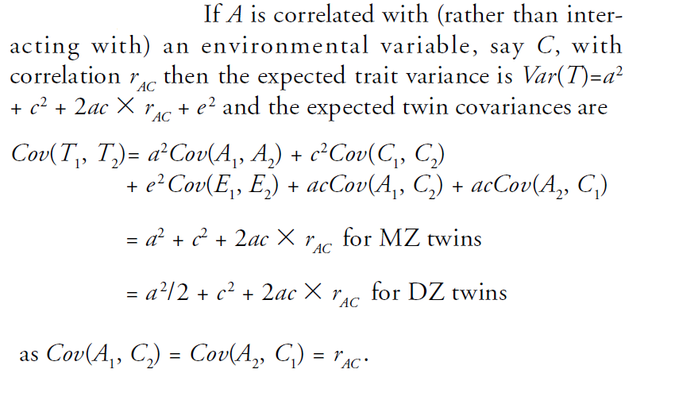
If r_{AC} > 0 the C variance in the ACE model is overestimated
Homework:
Check
Purcell (2002) Twin Research Volume 5 Number 6 pp. 554-571

Slide 14
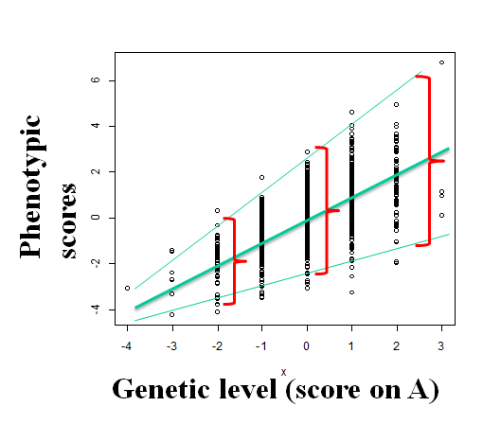
“INTERPLAY” | unmodeled biases
r(AC) | C
r(AE) | A
AxC | A
AxE | E
AxE??? what’s that? (Slide 14 mod)
“don’t reify variance components”
you can have a long discussion about
the magnitude of variance of A in IQ
(but a very short discussion about the proposition var(A) = 0)

Slide 15
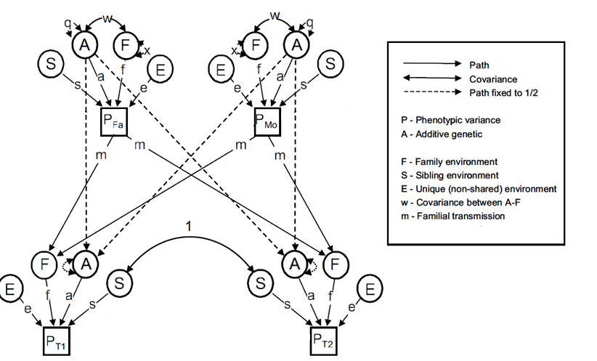
Motivation: Is r_{AC}>0 of interst? Parent influence the environmental of children (recent interest via ‘transmitted’ – ‘non transmitted alleles” design), gives rise to r_{AC} in the offspring (w).
Random mating version
Keller et al (2009) Twin Research and Human Genetics Volume 12 Number 1 pp. 8–18.
½
½
½
½
whence w?

Slide 16
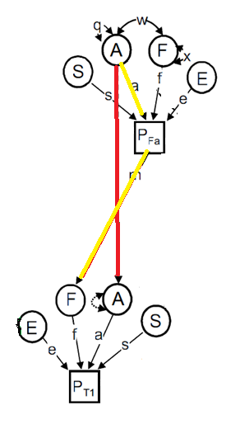
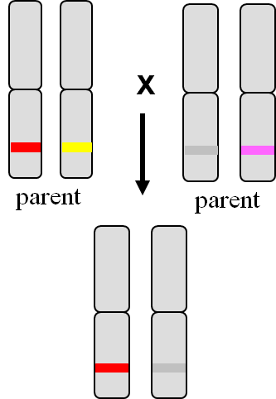
recent interest via ‘transmitted’ – ‘non transmitted alleles” design
What are the transmitted alleles, what are the untransmitted alleles?

Slide 17
Upshot in the offspring (C = F&S in slide 15)
r_{AC}
r_{AC}
r_{AC}
A
C
(F&S)
E
P
A
C
(F&S)
E
c
a*
c
a
e
s
e
p
pheno
Twin 1
P
Twin 1
pheno
Twin 1
r_{AC} not identified
r_{AC} identified ?

Slide 18
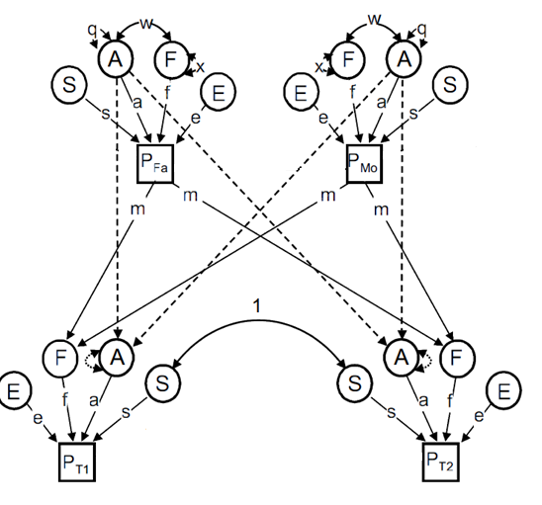
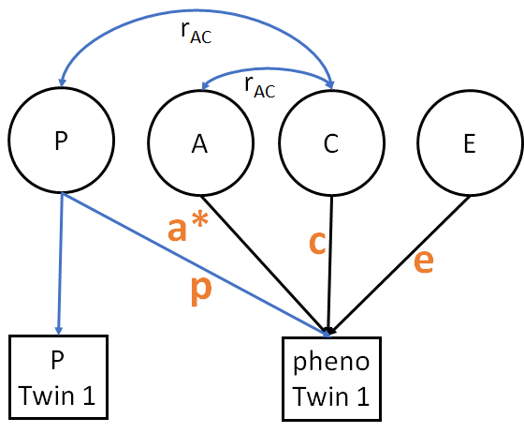
s
Simulation model
Fitted model
here r_{AC} = .105 (model right) and R² of the PGS is .03
(that is .03 effect in the full model)

Slide 19
DZ covariance matrix (r=.542)
T1 T2
T1 1.639 0.888
T2 0.888 1.639
MZ covariance matrix (r=.694)
T1 T2
T1 1.639 1.139
T2 1.139 1.639
Lots of C!
2*.542 - .694 = .39
“39% is due to C”

Slide 20
LB est UB
ACE.A[1,1] 0.349 0.500 0.658
ACE.C[1,1] 0.489 0.638 0.784
ACE.E[1,1] 0.459 0.500 0.546
Nmz = Ndz = 1000
LB est UB
rac - fixed 0 -
E 0.459 0.500 0.546
P 0.057 0.079 0.106
A* 0.306 0.453 0.607
C 0.452 0.596 0.737
LB est UB
rac -.003 0.105 0.242
E 0.459 0.500 0.546
P 0.023 0.050 0.088
A* 0.302 0.450 0.604
C 0.319 0.505 0.678
A 0.349 0.500 0.658

Slide 21
Fix r_{AC} = 0. Likelihood ratio T(1) = 3.61057, p = 0.0574
Power to detect r_{AC} here is .4762 given parameters and Nmz=Ndz=1000
Bad model? Maybe....requires a lot more analyses! (increase r_{AC}, increase %variance due to PGS)

Slide 22
DZ cov matrix
T1 p1 T2 p2
T1 1.638 0.298 0.888 0.186
p1 0.298 1.000 0.186 0.500
T2 0.888 0.186 1.638 0.298
p2 0.186 0.500 0.298 1.000
The R² in regression of phenotype (T) on p (PGS) is .298^2 / 1.638 = .054 (5.4% explained)
LB est UB
rac -.003 0.105 0.242
E 0.459 0.500 0.546
P 0.023 0.050 0.088
A* 0.302 0.450 0.604
C 0.319 0.505 0.678
A 0.349 0.500 0.658
The R² in the true model is
.05 / 1.638 = .030 (3% of the variance)
3% vs. 5.4%
A question.....

Slide 23
r_{AC}
r_{AC}
P
A
C
E
a*
c
s
p
e
P
Twin 1
pheno
Twin 1
Whence the discrepancy (5.4% vs. 3.0%)?

Slide 24
Camelia C Minca & Conor Dolan,
+
Eco de Geus, Dorret Boomsma, Michael C. Neale
Thanks: David Evans

Slide 25
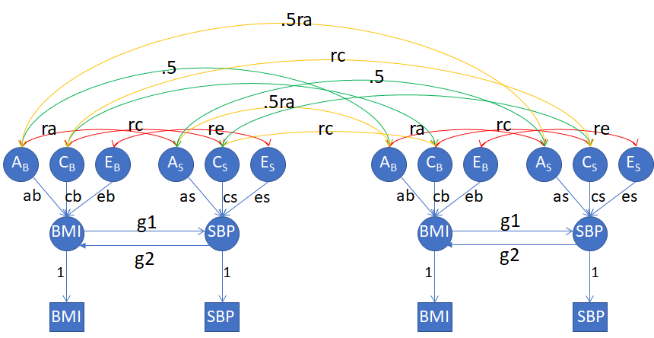
Modeling causality: Towards the Direction of Causation (DoC) model
not identified
Neale & Cardon, 1992 ; Heath et al., 1993; Duffy & Martin, 1994; Verhulst & Estabrook, 2012.
Notes:
One approach to testing causal hypotheses in observational data uses data on family members e.g. MZ and DZ twins.
DoC predicts different cross-twin cross-trait correlations depending on which direction causation flows.
The pathdiagram of such a model is shown in the slide, given two traits - for instance BMI and SBP - observed in DZ twins
With DoC model one may test 5 causal hypotheses wrt the association between two variables:
Major limitation – strong causal hypothesis: the only cause of the correlation between BMI and SBP is the causal influence of BMI on SBP or of SBP on BMI or the reciprocal causal influence between the two traits

Slide 26
rc
re
ra
1
A_{B}
C_{B}
E_{B}
A_{S}
C_{S}
E_{S}
ab
cb
eb
as
cs
es
g1
B
S
g2
0
0
1
1
note “scaling”
BMI
SBP

Slide 27
Special cases (identified models)
Model 1: g1=g2=0; re≠0; rc≠0; ra≠0 (general bivariate model)
Model 2: BMI →SBP, g1 ≠ 0 & re=rc=ra=0 (unidirectional causation)
Model 3: SBP → BMI, g2 ≠ 0 & re=rc=ra=0 (unidirectional causation)
Model 4: BMI→SBP & SBP →BMI; re=rc=ra=0; g1≠0; g2≠0 (reciprocal causation)
Model 5: no association between BMI and SBP

Slide 28
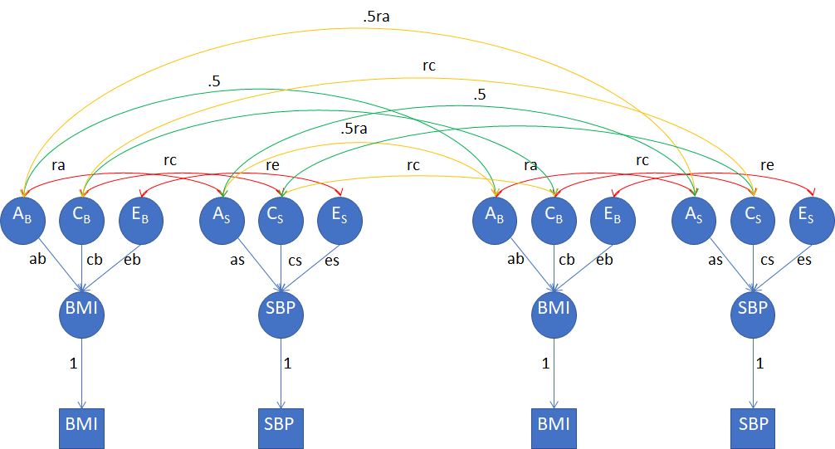
Meike: Bivariate Model
(not var comp version)
Model 1: g1=g2=0; re≠0; rc≠0; ra≠0 (general bivariate model)

Slide 29
.5ra
Nathan: DOC Model (unidir)
rc
.5
.5
.5ra
rc
A_{B}
C_{B}
E_{B}
A_{S}
C_{S}
E_{S}
A_{B}
C_{B}
E_{B}
A_{S}
C_{S}
E_{S}
ab
cb
eb
as
cs
es
ab
cb
eb
as
cs
es
g1
g1
BMI
SBP
BMI
SBP
1
1
1
1
BMI
SBP
F
BMI
SBP
Model 2: BMI →SBP, g1 ≠ 0 & re=rc=ra=0 (overidentified unidirectional causation)

Slide 30
MR
Dave: MR
ra
A_{B}
A_{S}
BMI
g1
SBP
E_{B}
E_{S}
Notes:
Let’s have a closer look at the no pleiotropy assumption.
figure left: BMI directly influences SBP (parameter g1).
In addition A_B (additive genetic effects on BMI) and A_S (additive genetic effects on SBP) are correlated (parameter rA)
I assume that the correlation between A_B and A_S (rA) is due to overlap in the set of loci underlying the genetic variance of A_B and A_S (figure right).
Note that the set of loci X underlies A_B but doesn’t underlie A_S - that is X equals A_B minus A_S
The set of loci Z underlies A_S but does not underlie A_B; that is Z equals A_S set minus A_B
and the set of loci Y underlies the genetic variance of both A_S and A_B; that is, Y is the intersection of A_S with A_B.
Given measured genetic variants we conduct a GWAS of BMI, and based on the results we construct PGS (polygenic scores).

Slide 31
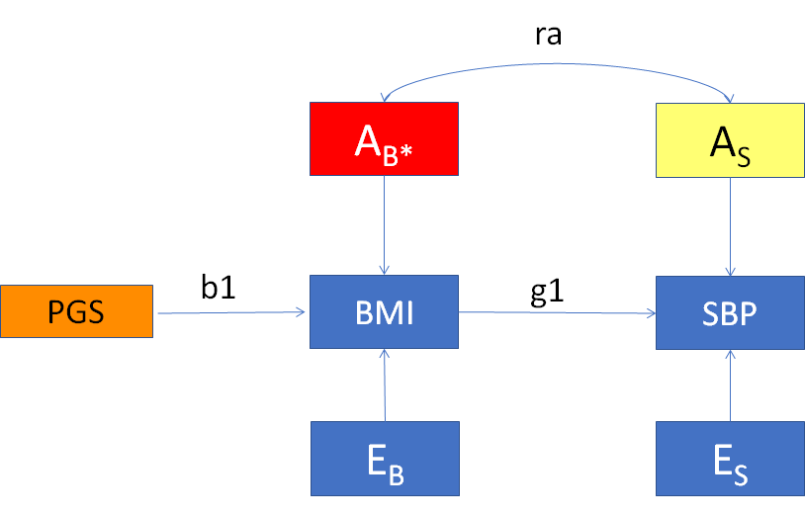
Modeling causality: Mendelian Randomization -
model 1 with PGS & no pleiotropy
Presence of the “instrumental variable PGS” renders g1 identified – the larger the b1 (R² + p-value) the more power to reject g1=0
Notes:
Model 1 with PolyGenic Scores.
This model is correct if and only if the PolyGenic Score is based on a sample of genetic variants taken from set X.
That is, PGS is based on a subset of variants underlying the variance of A_B but outside of the set underlying A_S.
That is, there is no pleiotropy.
Note the asterisk (A_B*) which indicates that in the presence of PGS (as depicted), A_B* is interpretable as a residual.

Slide 32
Modeling causality: Mendelian Randomization –
model 2 with PGS & pleiotropy – violates IV assumption
ra
A*_{B}
A*_{S}
b1
g1
PGS
BMI
SBP
b2
E_{B}
E_{S}
Notes:
Model 2 with PGS.
This model is correct if the PGS is based on a sample of genetic variants taken from set Y;
in other words, PGS is based on a set of loci underlying the variance of both A_B and A_S.
Note the presence of b2 that accommodates the fact that PGS is constructed based on a sample of genetic variants also taken from the set Y, set that also underlies the genetic variance of A_S.
However, this is not consistent with the “no-pleiotropy” assumption associated with the instrument (PGS).

Slide 33
Relaxing MR’s assumptions: Mendelian Randomization meets
the Classical Twin Design (MR-Twin model)... DZ model
.5
.5ra
rc
.5
.5
.5ra
ra
rc
re
rc
ra
rc
re
A_{B}
C_{B}
E_{B}
A_{S}
C_{S}
E_{S}
A_{B}
C_{B}
E_{B}
A_{S}
C_{S}
E_{S}
ab
cb
eb
as
cs
es
ab
cb
eb
as
cs
es
b1
g1
b1
g1
prs
BMI
SBP
prs
BMI
SBP
b2
b2
x
1
1
x
1
1
prs
BMI
SBP
prs
F
BMI
SBP
Notes:
We first checked whether the model is locally identified
For this we used the rank of the Jacobian Matrix
This was an analytical check performed in Maple; we used symbolic algebra rather than sample estimates (the check was performed analytically).

Slide 34
rc
re
ra
1
A_{B}
C_{B}
E_{B}
A_{S}
C_{S}
E_{S}
ab
cb
eb
as
cs
es
1
g1
prs
BMI
SBP
g2
0
0
x
1
1
note “scaling”
x is the stdev of FTO
prs
BMI
SBP

Slide 35
ab cb eb as cs es all freely estimated
 | ra | rc | re | b₁ | b₂ | g₁ | ID?
1 | fr | fr | fr | fr | fr | fr | No
2 | fr | fr | 0 | fr | fr | fr | Yes
3 | fr | fr | fr | fr | 0 | fr | Yes
Numerical check: mxCheckIdentification {OpenMx}
Symbolic check: MAPLE, Mathematica, Maxima (free)
Notes:
If both traits are ACE traits, constraining either re, or rc (within person environmental correlation between the two traits) or b2 to equal zero would render the model identified.
If the exposure variable is an ACE trait and the outcome variable is an AE trait (that is, if we fix cs and rc to zero), all parameters are identified. Note there will still be indirect effects of C_B on SBP, mediated through the causal influence of BMI on SBP - via g1.
This is consistent with what was known from the DoC model’s literature: the model is more powerful if the mode of inheritance for the two traits is different.
The re=0 constraint is commonly employed in the discordant twin design, hence the results that follow are based on the model with this identifying constraint in place.

Slide 36
Model 1: PGS & no pleiotropy
ra
rc
re≠0
A_{B}
C_{B}
E_{B}
A_{S}
C_{S}
E_{S}
ab
cb
eb
as
cs
es
PRS
b1
BMI
g1
SBP
x
b2=0
1
1
PRS
BMI
SBP
Notes:
First, we considered the scenario in which all Assumptions made in a Mendelian randomization study are met, namely:
there is a robust association between the genetic variants in the FTO gene and BMI (b1!=0),
(b) absence of direct association between the genetic instrument (b2=0)
(c) absence of other pathways between genetic variants and outcome.
We simulated data that fit the hypothesized model exactly (given b2 = 0; also re=0 – identifying constraint).
Then we checked whether the parameter g1 (the causal effect of BMI on SBP) used for simulations was recovered correctly.

Slide 37
Model 2: PGS & pleiotropy
ra
rc
re = 0
A_{B}
C_{B}
E_{B}
A_{S}
C_{S}
E_{S}
ab
cb
eb
as
cs
es
PRS
b1
BMI
g1
SBP
x
b2 ≠ 0
1
1
PRS
BMI
SBP
Notes:
Next, we considered the scenario in which FTO has pleiotropic effects, influencing both BMI and SBP.
- a plausible scenario if the instrument is a polygenic risk score (based on a sample of genetic variants underlying the variance of both A_B and A_S).

Slide 39
Adding the second IV for SBP (polygenic score NPPA) Dave: MR
rPG
ra
rc
re
A_{B}
C_{B}
E_{B}
A_{S}
C_{S}
E_{S}
ab
cb
eb
as
cs
es
FTO
b1
BMI
g1
SBP
b3
NPPA
g2
x
1
1
y
FTO
BMI
SBP
FTO
NPPA
As depicted the model is identified with re≠0
To do: study resolution & power & pleiotropy
Notes:
Good news: as depicted (given the classical twin design) the model is identified (Maple + OpenMx exact data simulation), with re≠0

Slide 40
good paper:
Biodemography Soc Biol. 2011;57(1):88-141.
Social science methods for twins data: integrating causality, endowments, and heritability.
Kohler HP¹, Behrman JR, Schnittker J.

Slide 41
Camelia C. Minica
previously, a charming young lady
presently, a charming Nexus 6 Replicant advanced science model

