Slide 1
Introduction to Biometrical Genetics
{in the classical twin design}
Conor Dolan
&
Elizabeth Prom-Wormley
Boulder 2020
Slide acknowledgements (fonts all over the place and inconsistent color coding):
Manuel Ferreira, Pak Sham, Shaun Purcell, Sarah Medland, and Sophie van der Sluis

Slide 2
Outline
Slides 3 -14: What is it about essentially + some basic statistics
Slides 15 – 18: Basic genetic terms
Slides 19 – 28: How a QTL contributes to phenotypic variance
Slides 30 – 37: How a QTL contributes to phenotypic variance
Slides 39 – 51: Genetic variance as a source of phenotypic covariance
Slides 52 - 67 : Genetic variance as a source of phenotypic covariance
Slides 68 - 76: Not part of this talk

Slide 3
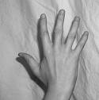
What are we on about when we talk about genetic influences?
“Having 5 fingers genetically determined”
“DNA includes a blueprint to build a hand”
Notes:
Why is the question incorrect?
If there is no variation in the phenotype, it cannot be related to variation in the genotype.
The right question concerns variation.

Slide 4
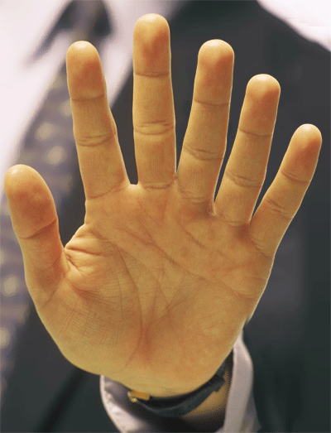
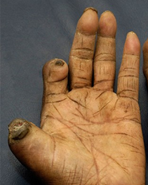
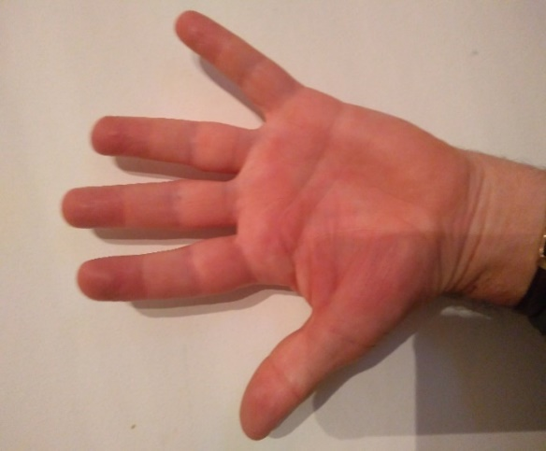
normal
polydactyly
leprosy
phenotypic difference 6 – 5 = +1 with a genetic cause
(related to genetic difference - mutation)
phenotypic difference 3 – 5 = -2 with an environmental cause
(related to environmental difference – bacterium)
Notes:
Behavior genetic research is concerned with
relating individual differences in phenotypes to individual differences at the genetic level and individual differences in environmental influences
Beh Gen research is about explaining DIFFerences in the numbers of fingers
Due to genetic causes or environmental causes? Or both?
The difference between hand one and hand two is 1 (5 fingers-6 fingers), this difference is due to a genetic difference.
The difference between one and three is 1 finger, this difference is due to a environmental difference.
Wikipedia background info
Leprosy, also known as Hansen's disease (HD), is a long-term infection by the bacteria Mycobacterium leprae or Mycobacterium lepromatosis.^{[4][8]} Infection can lead to damage of the nerves, respiratory tract, skin, and eyes.^{[4]} This nerve damage may result in a lack of ability to feel pain, which can lead to the loss of parts of a person's extremities from repeated injuries or infection due to unnoticed wounds.^{[3]}
Polydactyly is not a mendelian disorder. It has many distict causes, including mutations.
In humans, to-date at least 10 loci and six genes causing non-syndromic polydactyly have been identified, including the ZNF141, GLI3, MIPOL1, IQCE, PITX1, and the GLI1.

Slide 5
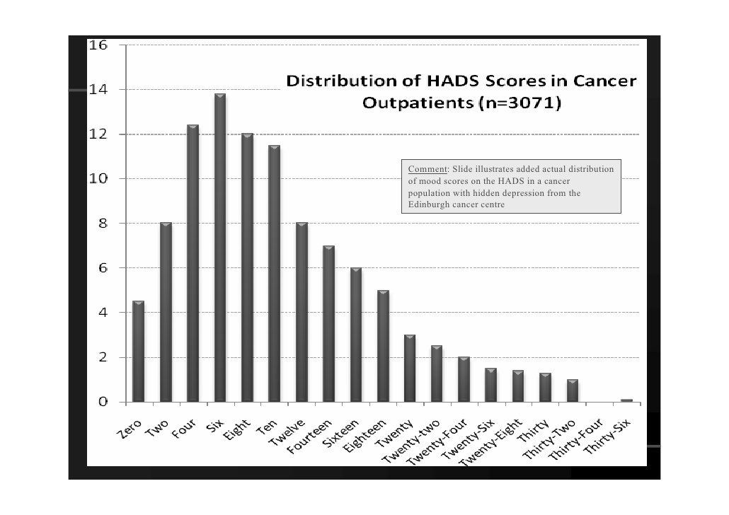
Phenotype: continuously varying, genetically complex.
e.g. (ideally) normally distributed
e.g., binary (dichotomous, 0-1 coded) phenotype
(based on continuous phenotype; liability threshold model).
Normal
Depressed
0
1
The phenotype is a quantitative trait, a metric trait, a complex trait
Notes:
So we’re interested in understanding the causes of phenotypic variation. How to visualize phenotypic variation.
The measurement level is a different story: the phenotype can be continuously varying in principle, but what we see are binary phenotypic scores.
the liability threshold model will be discussed later this week.
Given a continuous phenotype, how do we end up with a dichotomous phenotype?
A depression test may given you a continuous measures, but if that measure is used in diagnosis, you may end up with the dichotomy: depressed vs 'normal (not depressed)'
Body mass index is a continuous measure weight in kg / (length in meters^2), but you may use it to categorize people as 'normal', 'overweight', 'obese' (a three point scale).

Slide 6
Genetically complex:
Individual differences in the phenotype are subject to the effects of many genes of small effects, a.k.a. polygenes, minor genes. How many? Hundreds (Educational Attainment, Height) … Thousands….?
Phenotypic individual differences are attributable to genetic individual differences in a large number of polygenes, a.k.a. QTLs (quantitative trait loci).
Polygenicity implies phenotypic continuous distributions

Slide 7
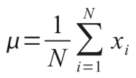
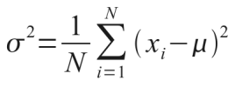
People differ phenotypically
Q. How to quantify individual differences?
Variance: s², σ², σ²_{X} , var(X), V_{X}
mean (X)
variance (X)
x_{i} is the phenotypic value of person i (i=1,...,N)
Notes:
We want to explain why people differ. That is: explain the phenotypic variance. Variance is an important statistical concept, as it quantifies individual differences.
We want to understand individual differences = we want to understand variance.

Slide 8
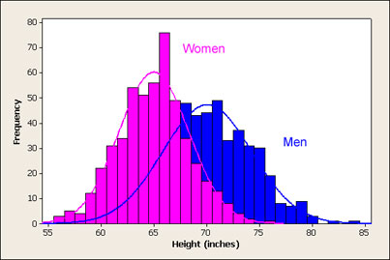
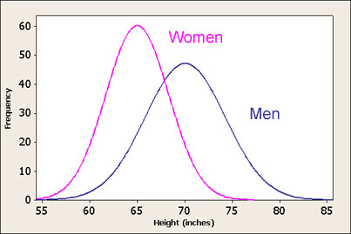
height in inches - sex differences in the distribution
how? sex differences in mean and in variance.
Some continuously distributed phenotypes are
approximately normally distributed e.g., height, IQ.
Notes:
Why are not all complex traits normally distributed?
(think: psychometrics).

Slide 9
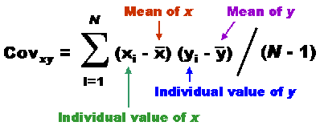
Means, Variances and Covariances
We need the covariance: express the phenotypic
relatedness among family members
Notes:
Remember the formula for mean, variance, and covariance.

Slide 10

Important to understand!
1,1,2,2,3,4,5,5,6,6
mean = (1+1+2+2+3+4+5+5+6+6)/10
= 36/12 = 3.5
f(1) = 2/10 = .2 .2*1 +
f(2) = 2/10 = .2 .2*2 +
f(3) = 1/10 = .1 .1*3 +
f(4) = 1/10 = .1 .1*4 +
f(5) = 2/10 = .2 .2*5 +
f(6) = 2/10 = .2 .2*6
----------
3.5
Notes:
f(1) is the frequency of the value 2 in this sample of 1,1,2,2,3,4,5,5,6,6

Slide 11
1,1,2,2,2,3,4,5,5,5,6,6
mean = 3.5
f(1) = 2/10 = .2 .2*(1-3.5)² +
f(2) = 2/10 = .2 .2*(2-3.5)² +
f(3) = 1/10 = .1 .1*(3-3.5)² +
f(4) = 1/10 = .1 .1*(4-3.5)² +
f(5) = 2/10 = .2 .2*(5-3.5)² +
f(6) = 2/10 = .2 .2*(6-3.5)²
----------------
variance = 3.45
standard deviation (stdev) = √variance
stdev = √3.45 = 1.857
Notes:
X=c(1,1,2,2,3,4,5,5,6,6)
mean(X)
var(X)*9/10
# check
f=c(.2,.2,.1,.1,.2,.2)
x=c(1,2,3,4,5,6)-mean(X)
sum(f*x^2)

Slide 12
covariance
correlation
Cor(X,Y) = Cov(X,Y) / √ [Var(X)*var(Y)] =
= Cov(X,Y) / [stdev(X)*stdev(Y)]
Cor(X,Y) is – stand-alone - interpretable
MZ covariance is 291.... uninterpretable
MZ correlation is .80 .... interpretable

Slide 13
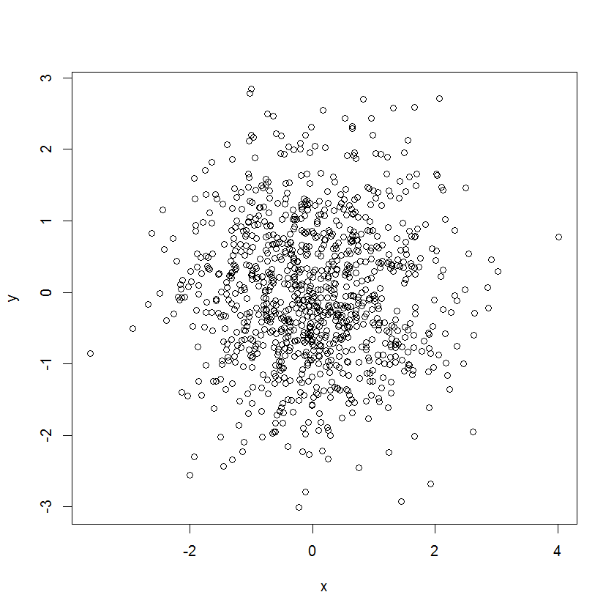
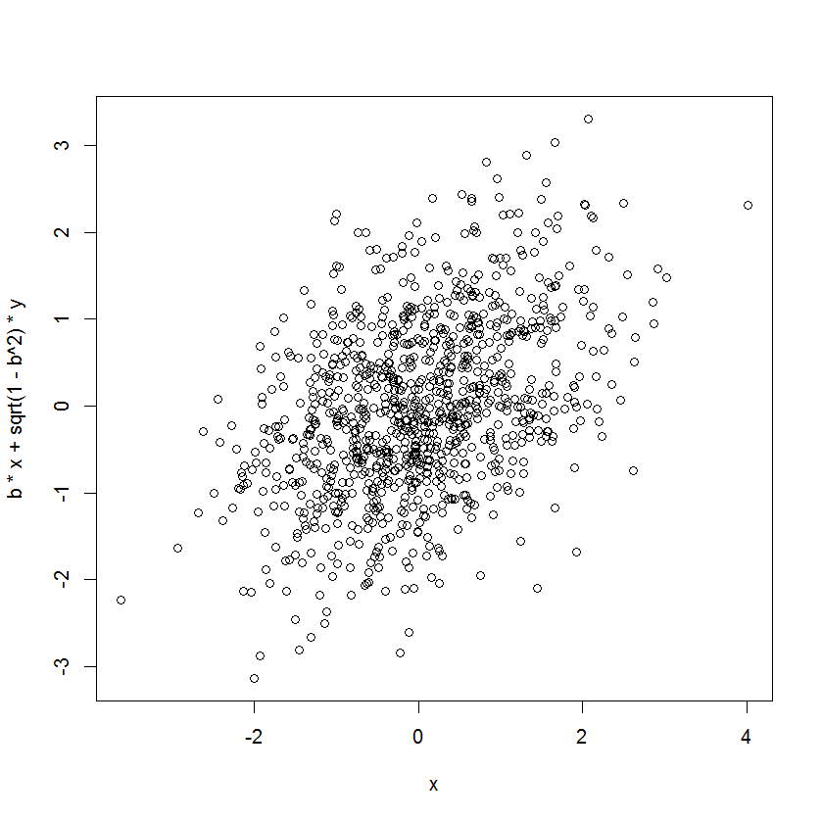
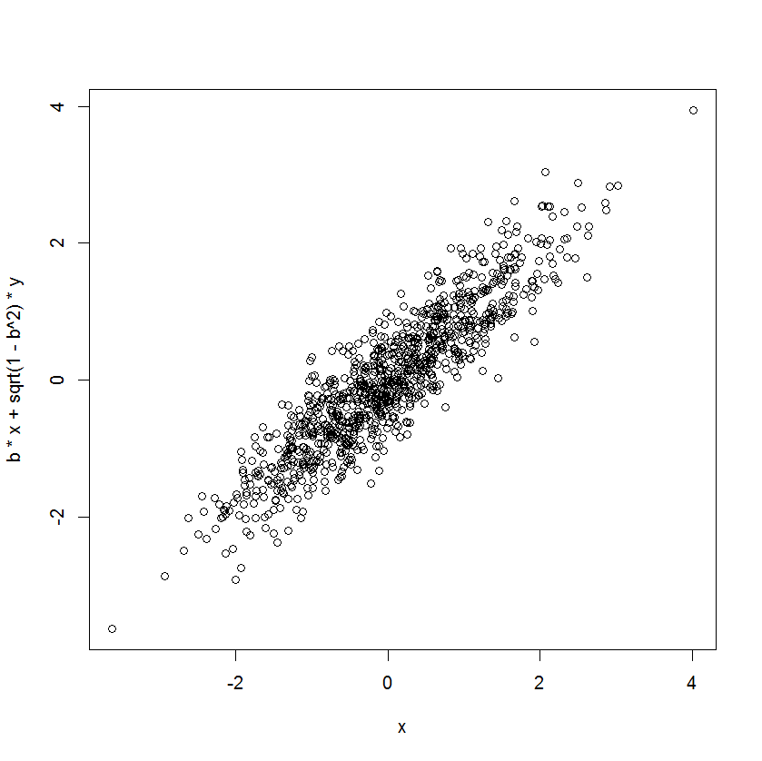
Linear association between continuous variables: covariance or Pearson Product Moment (PPM) Correlation Coefficient, r.
r = 0.00
DZ r = .40
MZ r = .90
twin 2
twin 2
twin 1
twin 1

Slide 14
To what extent, and how, are
individual differences in genetic makeup, and
individual differences in environmental factors, related to
phenotypic (observed) individual differences ?
To what extent, and how, do
individual differences in genotypes, and
individual differences in environmental factors, explain
phenotypic (observed) variance?

Slide 15
terminology
QTL Quantative trait locus: a sequence of DNA base pairs (may be a SNP “snip”: single base pair). a.k.a. genetic variant
Autosomal locus: the site of the QTL on a chromosome (22 pairs + XY). Humans are dipoid (22 pairs autosomal chromosomes + sex chromosomes XY or XX). An autosomal locus is located on one of the 22 pairs.
Allele: an alternative form of a gene at a locus
Genotype: the combination of alleles at a particular locus
Complex phenotype: an observed characteristic, which displays individual differences (in part due to differences at many loci... how many?)

Slide 16
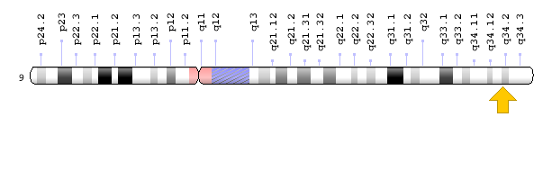
3 alleles A-B-O (blood group)
Locus: autosomal chromosome 9, long arm (q), position 34.2
9q34.2
telomere
centromere
telomere
locus
(of allele A,B, or O)
This is a member of a pair (autosomal chromosomes come in pairs).

Slide 17

Example of a QTL: FNBP1L gene
The FNBP1L gene has been associated with intelligence in two studies:
Mol. Psychiatry 2012 16 (10), 996-1005
Mol. Psychiatry 2011 19(2): 2538.
This gene is on chromosome 1 (1p22,1), and it comprises 106531 bases (106.5Kb). Within this gene the SNP rs236330 specifically is associated with intelligence.
here it is!
Notes:
* "Genome-wide association studies establish that human intelligence is highly heritable and polygenic". 2011, Mol. Psychiatry 16 (10): 996–1005.doi:10.1038/mp.2011.85)
* "Childhood intelligence is heritable, highly polygenic and associated with FNBP1L". Mol. Psychiatry 19(2): 2538. doi:10.1038/mp.2012.184. Authors include Sarah Medland & Nick Martin.

Slide 18
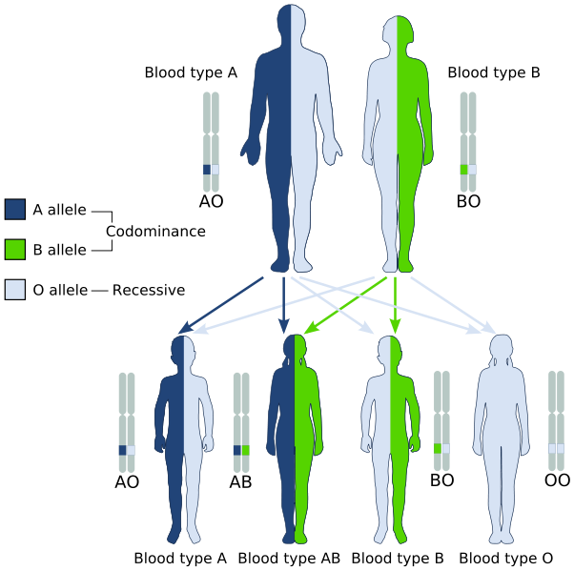
A-B-O locus
chr 9 location 9q34.2
Mendelian inheritance
The law of segregation
Notes:
A text from the WIKI page (“abo blood group”)
The ABO blood type is controlled by a single gene (the ABO gene) with three types of alleles inferred from classical genetics: i, I^{A}, and I^{B}. The gene encodes a glycosyltransferase—that is, an enzymethat modifies the carbohydrate content of the red blood cell antigens. The gene is located on the long arm of the ninth chromosome (9q34). The ABO locus, which is located on chromosome 9, contains 7 exons that span more than 18 kb of genomic DNA. Exon 7 is the largest and contains most of the coding sequence. The ABO locus has three main alleleic forms: A, B, and O. The A allele encodes a glycosyltransferase that bonds α-N-acetylgalactosamine to the D-galactose end of the H antigen, producing the A antigen. The B allele encodes a glycosyltransferase that bonds α-D-galactose to the D-galactose end of the H antigen, creating the B antigen.
In the case of the O allele, when compared to the A allele, exon 6 lacks one nucleotide (guanine), which results in a loss of enzymatic activity. This difference, which occurs at position 261, causes a frameshift that results in the premature termination of the translation and, thus, degradation of the mRNA. This results in the H antigen remaining unchanged in case of O groups.
Law of segregation: During gamete formation, the alleles for each gene segregate from each other so that each gamete carries only one allele for each gene. Law of independent assortment Genes of different traits can segregate independently during the formation of gametes

Slide 19
Consider a single diallelic locus with alleles A and a
Set up the model to relate the locus (A-a) to the phenotypic variance.
How does the locus contribute to phenotypic individual differences?

Slide 20
Population level
Allele frequencies (QTL: diallelic autosomal)
A single autosomal locus, with two alleles
  - Biallelic a.k.a. diallelic
Alleles A and a
- Frequency of A is p
- Frequency of a is q = 1 – p
frequencies in the population
Every individual inherits two alleles
- A genotype is the combination of the two alleles
- e.g. AA, aa (the homozygotes) or Aa (the heterozygote)
* what are the genotype frequencies?

Slide 21
Biometrical model for single biallelic QTL
Biallelic locus
- Genotypes: AA, Aa, aa
- Genotype frequencies: p², 2pq, q²
Mother’s gametes (egg)
A (p)
a (q)
Genotype frequencies (Random mating)
Father’s gametes
sperm
A (p)
AA (p²)
Aa (pq)
a (q)
aA (qp)
aa (q²)
Hardy-Weinberg Equilibrium frequencies
P (AA) = p²
P (Aa) = 2pq
p² + 2pq + q² = 1
P (aa) = q²

Slide 22
Phenotype level: contribution to continuous variation
Biometric Model
aa
Aa
AA
– a
d
+a
Genotypic effect
μ – a
μ + d
μ + a
phenotypie means within each genotype (aa, Aa, AA) ......conditional on genotype
Q: Phenotypic mean conditional on genotype means what?
A: Take all aa individuals and calculate their mean phenotypic value:
μ – a (the phenotypic mean conditional on genotype aa)

Slide 23
Biometrical model for single biallelic QTL
1. Contribution of the QTL to the Mean
Genotypes
AA
Aa
aa
Effect, x
μ + a
μ +d
μ - a
Frequencies, f(x)
p²
2pq
q²
(μ+a)(p²) + (μ+d)(2pq) + (μ–a)(q²) =
μ + a(p²) + d(2pq) – a(q²) =
μ + a(p-q) + 2pqd
the unconditional mean μ + a(p-q) + 2pqd = μ + m
contribution of the QTL m = a(p-q) + 2pqd
see slide 11!

Slide 24
Biometrical model for single biallelic QTL
2. Contribution of the QTL to the Variance (X)
Genotypes
AA
Aa
aa
Effect (x)
μ + a
μ + d
μ - a
Frequencies, f(x)
p²
2pq
q²
m= a(p-q) + 2pqd
s²_{Ph_QTL}
= (a-m)²p² + (d-m)²2pq + (-a-m)²q²
see slide 12!

Slide 25
Q: WAIT!!! What happened to μ?
s²_{Ph_QTL}
= (a-m)²p² + (d-m)²2pq + (-a-m)²q²
actually
((μ + a)–(μ+m))²p² + ((μ + d)–(μ+m)) ²2pq + ((μ-a)–(μ +m)) ²q²
((μ + a)–(μ+m)) = (μ + a–μ-m) = (a-m)
A: μ cancels out.
Notes:
mu (Greek m ) cancels out in the expression for the variance. so that is convenient, and explains why the phenotypic variance attributable to the QTL does not include the term mu.

Slide 26
Biometrical model for single biallelic QTL
s²_{Ph_QTL}
= (a-m)²p² + (d-m)²2pq + (-a-m)²q²
= 2pq[a+(q-p)d]² + (2pqd)²
= s²_{Ph_ QTL(A)} + s²_{Ph_ QTL(D)}
Additive or linear effects give rise to variance component
s²_{Ph_QTL(A)} = 2*pq[a+(q-p)d]² (additive genetic variance)
Dominance or within local allelic interaction effects give rise to variance component
s²_{Ph_QTL(D)} = (2pqd) ² (dominance variance)
Notes:
# numerical check
rm(list=ls(all=TRUE))
N=1000
a=1.5
ds=c(1.5)
mu=10
#for (d in ds) {
d=ds
dose=c(a,d,-a)+mu
p=.3
q=1-p
gf=c(p^2,2*p*q,q^2)
ns=round(N*gf)
i1=c(rep(1,ns[1]),rep(2,ns[2]),rep(3,ns[3]))
g=dose[i1]
mean(g[i1==1])
mean(g[i1==2])
mean(g[i1==3])
mean(g)
mean(g[i1==1])*(sum(i1==1)/N)+
mean(g[i1==2])*(sum(i1==2)/N)+
mean(g[i1==3])*(sum(i1==3)/N)
#
m=a*(p-q)+2*p*q*d
mu+m
# 2pq[a+(q-p)d]2 + (2pqd)2
dose=dose-mu
sA=2*p*q*(dose[1]+(q-p)*dose[2])^2
sD=(2*p*q*dose[2])^2
sG=(a-m)^2*p^2 + (d-m)^2*2*p*q + (-a-m)^2*q^2
print(c(sG, sA+sD, sA, sD, var(g)))

Slide 27
Biometrical model for single biallelic QTL
s²_{Ph_QTL}
= (a-m)²p² + (d-m)²2pq + (-a-m)²q²
= 2pq[a+(q-p)d]² + (2pqd)²
= s²_{Ph_QTL(A)} + s²_{Ph_QTL(D)}
Additive effects: s²_{Ph_QTL(A)} = 2*pq[a]²
Dominance effects: s²_{Ph_QTL(D)} = 0 (d=0)
aa
Aa
AA
μ – a
μ
μ+a
Notes:
What happens if d is zero... ie. the Aa effect is exactly intermediate (in the middle?)

Slide 28
Biometrical model for single biallelic QTL
s²_{Ph_QTL}
= (a-m)²p² + (d-m)²2pq + (-a-m)²q²
= 2pq[a+(q-p)d]² + (2pqd)²
= s²_{Ph_QTL(A)} + s²_{Ph_QTL(D)}
Additive effects: s²_{Ph_QTL(A)} = 2*pq[a+(q-p)d]²
Dominance effects: s²_{Ph_QTL(D)} = (2pqd)²
aa
Aa
AA
μ – a
μ+d
μ+a
Q: what if d =0 and a =0?
Notes:
A: the QTL does not contribute to the phenotypic variance

Slide 29
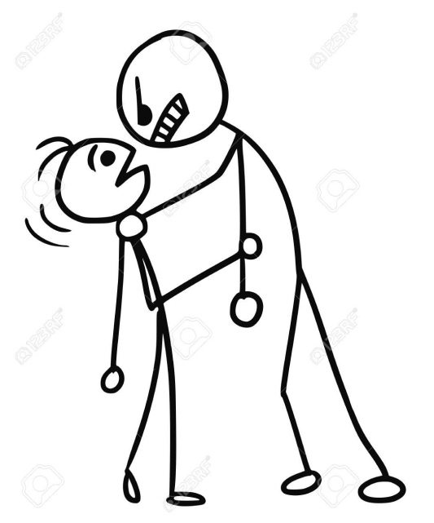
s²_{Ph_QTL(A)} and s²_{Ph_QTL(D)}
I understand,
but I don’t understand
I think I might understand
or not...?
I know the feeling

Slide 30
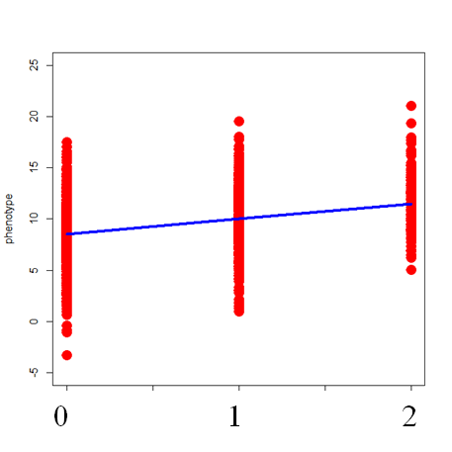
Suppose we measure the QTL and the phenotype and regress X on QTL.The scatterplot of the data
(aa coded 0; Aa coded 1; AA coded 2 - call it QTL_{A}).
we ask:
how much of the phenotypic
variance is explained by the
predictor (QTL_{A})?
In the following slides we look at the regression lines only
(not plotting the residuals – just to avoid clutter).
Notes:
In your R dataframe or your SPSS system file QTL may be coded
AA
Aa
aa
Then the predictor QTL(A) is coded
2
1
0
QLT_A is a variable with numeric values (0,1,2).
So you can ask: what is the mean and variance of QTL_A?
We can do the mean: p^2*2 + 2*p*q*1 + q^2*0 = p^2*2+2*p*(1-p) = 2*p^2 +2*p - 2*p^2 = 2*p
the variance is 2*p*q (that’s homework!!)

Slide 31
Linear regression model y_{i} = a₀ + a₁*x_{i} + e_{i}
x = predictor (variable) ... here: QTL_{A}, values: aa (0), Aa (1) , AA (2)
y = dependent (variable) .... here: phenotype (ph)
e = residual (variable) ....
a₀ = intercept (parameter often denoted b₀)
a₁ = slope or regression coefficient (parameter often denoted b₁)
variance of y equals a₁²*s²_{x} + s²_{e}
variance explained a²*s²_{x}
standard effect size: R² = {a² * s²_{x}} / {a²* s²_{x} + s²_{e}}
y_{predicted} = a₀+a₁*x e_{estimated} = y - y y_{predicted}
var(y_{predicted}) = a₁² *var(x) var(e)
Notes:
R^2 has the same interpretation as heritability. Heritability is an important concept

Slide 32
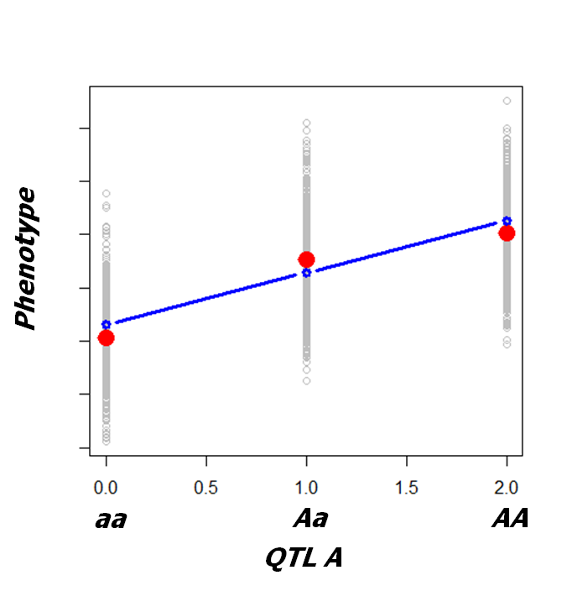
Linear regression model pheno_{i} = a₀ + a₁*QTL_{Ai} + e_{i}
variance of pheno a₁²*s²_{QTLA} + s²_{e}
variance explained a₁²*s²_{QTLA}
Warning!!! Next slides without residual (error) terms

Slide 33
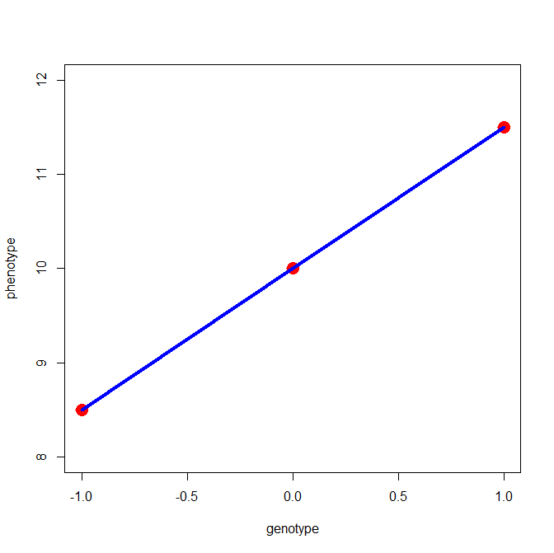
e terms not shown!!!!
μ+a
regression model
ph_{i} = a₀ + a₁*QTL_{Ai} + e_{i}
μ
s²_{Ph_QTL(A)} =2*pq[a+(q-p)d]²
s²_{Ph_QTL(A)} = a₁²*s²_{QTL A}
μ-a
0 1 2
μ-a
μ
μ+a
variance of pheno a₁²*s²_{QTLA} + s²_{e} = 2*pq[a+(q-p)d]² + s²_{e}
variance explained a₁²*s²_{QTLA} = = 2*pq[a+(q-p)d]²

Slide 34
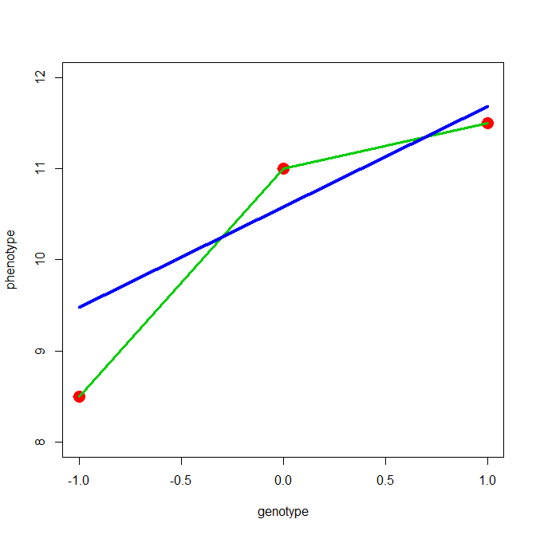
e terms not shown!!!!
μ+a
μ+d
Explained variance (blue line):
s²_{Ph_QTL(A)} =2*pq[a+(q-p)d]²
s²_{Ph_QTL(A)} = a₁²*s²_{QTL A}
Not explained
s²_{Ph_QTL(D)} = (2pqd)²
Important to note:
s²_{e} includes s²_{Ph_QTL(D)}
μ-a
0 1 2
aa
Aa
AA
μ– a
μ+d
μ+a

Slide 35
d=0
d≠0
d≠0
d≠0
s²_{Ph_QTL(A)} always greater than zero (given d ≠ 0 & a>0)
s²_{Ph_QTL(D)} can be zero (additive model d=0)

Slide 36
What about the dominance variance? Can we estimate that?
regression model ph_{i} = a₀ + a₁*QTL_{Ai} + d₁*QTL_{Di} + e_{i}
genotype | QTL_{A} | QTL_{D} | p=.5
AA | 2 | 4*p-2 | 0
Aa (aA) | 1 | 2*p | 1
aa | 0 | 0 | 0
s²_{Ph} = a₁²*s²_{QTLA} + d₁²*s²_{QTLD} + s²_{e}
s²_{Ph_QTL(A)} = a₁²*s²_{QTLA} = 2*pq[a+(q-p)d]²
s²_{Ph_QTL(D)} = d₁²*s²_{QTLD} = (2pqd)²
Dominance deviation can μ+d (positive) or μ-d (negative)
Q: If we know the value of s²_{QTLD} do we know the sign of the dominance deviation?
Notes:
A: no! the value of d is squared: (2*p*q*d)² = (4*p²*q²*d²).
If you know the parameter esitmates (the regression coefficients a (for QTL(A)) and d (for QTL(D)) then we do know the sign of d.
Q: Why does the coding of QTL_D include the parameter p (allele frequency of A)?
A: coding in this manner ensures that the covariance of QTL_A and QTL_D is zero! This means that the explained variance
does not involve this covariance (cov(
i.e., s²_{Ph} = a₁²*s²_{QTLA} + d₁²*s²_{QTLD} + s²_{e}
not
s²_{Ph} = a₁²*s²_{QTLA} + d₁²*s²_{QTLD} +2*a₁d₁*cov(QTLD,QTLA) + s²_{e`}
cov(QTLD,QTLA) = 0!

Slide 37
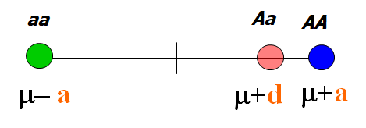
regression model ph_{i} = a₀ + a₁*QTL_{Ai} + d₁*QTL_{Di} + e_{i}
s²_{Ph} = a₁²*s²_{QTLA} + d₁²*s²_{QTLD} + s²_{e}
2*pq[a+(q-p)d]² (2pqd)²
Dominance deviation can μ+d (positive) or μ-d (negative)
Q: If we know the value of s²_{Ph_QTL(D)} do we know the sign of the dominance deviation?
Notes:
A: no! the value of d is squared: (2*p*q*d)² = (4*p²*q²*d²).
If you know the parameter esitmates (the regression coefficients a (for QTL(A)) and d (for QTL(D)) then we do know the sign of d.
Q: Why does the coding of QTL_D include the parameter p (allele frequency of A)?
A: coding in this manner ensures that the covariance of QTL_A and QTL_D is zero! This means that the explained variance
does not involve this covariance (cov(
i.e., s²_{Ph} = a₁²*s²_{QTLA} + d₁²*s²_{QTLD} + s²_{e}
not
s²_{Ph} = a₁²*s²_{QTLA} + d₁²*s²_{QTLD} +2*a₁d₁*cov(QTLD,QTLA) + s²_{e`}
cov(QTLD,QTLA) = 0!

Slide 38
I haven’t measured any QTLs!
What am I supposed to do?
Thank you!
Good question

Slide 39
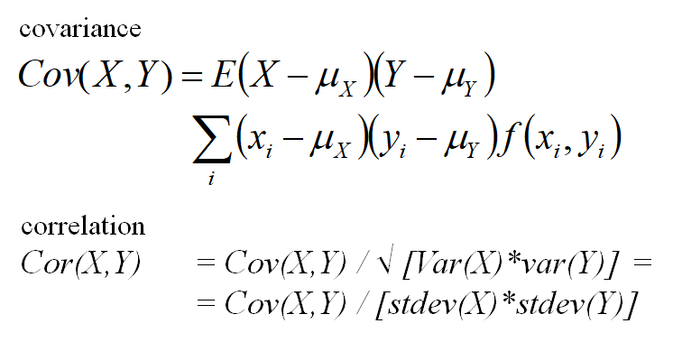
Remember slide 13 ? Of course you do!
Q: How does locus A-a contribute to the phenotypic
covariance among family members?
A: Depends on the exact relationship
Notes:
A; in the next slides
How does the locus A-a manifest in (contribute to) the phenotypic variance? We know the answer.
Now we are asking how does it contribute to the phenotypic covariance among family members. \
There are two ways to answer this question. We'll consider both.

Slide 40
Biometrical model for single biallelic QTL
3. Contribution of the QTL to the Cov (X,Y) -
person 1 (x_{i})
AA
(a-m)
Aa
(d-m)
aa
(-a-m)
AA
(a-m)
(a-m)²
(a-m)
(d-m)
(a-m)
(-a-m)
person 2 (y_{i})
(d-m)
(a-m)
(d-m)
(d-m)²
(d-m)
(-a-m)
Aa
aa
(-a-m)
(a-m)
(-a-m)
(d-m)
(-a-m)
(-a-m)²
m= a(p-q) + 2pqd
Q: What about the f(x_{i}, y_{i})?
Notes:
where is mu (greek m)? not necessary, it consistently cancels out.
A: next slides

Slide 41
Biometrical model for single biallelic QTL
3A. Contribution of the QTL to the Cov (X,Y) – MZ twins
AA
(a-m)
Aa
(d-m)
aa
(-a-m)
AA
(a-m)
p²
(a-m)²
0
(a-m)
(d-m)
0
(a-m)
(-a-m)
Aa
(d-m)
0
(a-m)
(d-m)
2pq
(d-m)²
0
(d-m)
(-a-m)
aa
(-a-m)
0
(a-m)
(-a-m)
0
(d-m)
(-a-m)
q²
(-a-m)²
Cov(X_{i},Y_{j})
= (a-m)²p² + (d-m)²2pq + (-a-m)²q²
= 2pq[a+(q-p)d]² + (2pqd)²
= s²_{Ph_QTL(A)} + s²_{Ph_QTL(D)}

Slide 42
Biometrical model for single biallelic QTL
3B. Contribution of the QTL to the Cov (X,Y) – Parent-Offspring
parent
AA
(a-m)
Aa
(d-m)
aa
(-a-m)
AA
(a-m)
p³
(a-m)²
p²q
(a-m)
(d-m)
0
(a-m)
(-a-m)
child
Aa
(d-m)
p²q
(a-m)
(d-m)
pq
(d-m)²
pq²
(d-m)
(-a-m)
aa
(-a-m)
0
(a-m)
(-a-m)
pq²
(d-m)
(-a-m)
q³
(-a-m)²

Slide 43
given an AA parent, an AA offspring can come from either AA x AA or AA x Aa parental random mating types
AA x AA will occur p² × p² = p⁴
and have AA offspring Prob(AA)=1
AA x Aa will occur p² × 2pq = 2p³q
and have AA offspring Prob(AA)=0.5
and have Aa offspring Prob(Aa)=0.5
AA x aa Not relevant (offspring Aa)
Therefore, P(AA parent & AA offspring) = p⁴ + .5*2*p³q
= p³(p+q)
= p³
Notes:
Alternative
We know that the probability pr(A,B) (probability of outcome A and B)
equals pr(A|B)*pr(B) and pr(A|B) = pr(A,B) / pr(B), where pr(A|B) is the conditional probability of B given A.
what is pr(AAp, AAo) ? note: AAp= AA in parent AAo = AA in offspring
pr(AAp, AAo) = pr(AAo | AAp) * pr(AAp)
pr(AAp) is simple: p^2 (p is the allele A frequency , q=1-p))
GIven parent 1 is AA, the probability of parent 2 AA is p^2 and pr(AAo) = 1
Given parent 1 is AA, the probability of parent 2 Aa is 2*p*q and pr(AAo) = .5
pr(AAp & AAo) = prob(AAo | AAp)*pr(AAp) = (1*p^2 + .5*2*p*q)*p^2 = (p^2+p*q)*p^2 = p^4+p^3*q = p^3*(p+q) = p^2

Slide 44
So can be complicated, but can also be simple ….
Parent
AA
(a-m)
Aa
(d-m)
aa
(-a-m)
AA
(a-m)
p³
(a-m)²
p²q
(a-m)
(d-m)
0
(a-m)
(-a-m)
Offspring
Aa
(d-m)
p²q
(a-m)
(d-m)
pq
(d-m)²
pq²
(d-m)
(-a-m)
aa
(-a-m)
0
(a-m)
(-a-m)
pq²
(d-m)
(-a-m)
q³
(-a-m)²
why zero probability {0}?

Slide 45
Biometrical model for single biallelic QTL
3B. Contribution of the QTL to the Cov (X,Y) – Parent-Offspring
Parent (X)
AA
(a-m)
Aa
(d-m)
aa
(-a-m)
AA
(a-m)
p³
(a-m)²
p²q
(a-m)
(d-m)
0
(a-m)
(-a-m)
Offspring (Y)
(d-m)
(a-m)
(d-m)
(d-m)²
Aa
p²q
pq
pq²
(d-m)
(-a-m)
aa
(-a-m)
0
(a-m)
(-a-m)
pq²
(d-m)
(-a-m)
q³
(-a-m)²
Cov (X_{i},Y_{j})
= (a-m)²p³ + … + (-a-m)²q³
= pq[a+(q-p)d]²
= ½ s²_{QTL(A)}

Slide 46
Biometrical model for single biallelic QTL
3C. Contribution of the QTL to the Cov (X,Y) – Unrelated individuals
p²
2pq
q²
AA
(a-m)
Aa
(d-m)
aa
(-a-m)
p²
AA
(a-m)
p⁴
(a-m)²
2p³q
(a-m)
(d-m)
p²q²
(a-m)
(-a-m)
2pq
Aa
(d-m)
2p³q
(a-m)
(d-m)
4p²q²
(d-m)²
2pq³
(d-m)
(-a-m)
q²
aa
(-a-m)
p²q²
(a-m)
(-a-m)
2pq³
(d-m)
(-a-m)
q⁴
(-a-m)²
Cov (X_{i},Y_{j})
= (a-m)²p⁴ + … + (-a-m)²q⁴
= 0
Note if mating is random - the spousal correlation is zero.
Mother and father are Unrelated individuals !
Notes:
#check
p=.3
q=1-p
tb=matrix(c(
p^4,2*p^3*q,p^2*q^2,
2*p^3*q, 4*p^2*q^2, 2*p*q^3,
p^2*q^2, 2*p*q^3, q^4),3,3,byrow=T)
sum(tb)

Slide 47
Follow same method for full sibs and DZ twins
Derive genotype frequences ....
s1 | s2 | eff | eff | freq | frequency (p(A)=p, p(a)=q=1-p)
AA | AA | a | a | r1 | p**4+p**3*q+p**2*q**2/4
aa | aa | -a | -a | r2 | p**2*q**2/4+p*q**3+q**4
Aa | Aa | d | d | r3 | p**3*q+3*p**2*q**2+p*q**3
AA | Aa | a | d | r4 | p**3*q+p**2*q**2/2
Aa | AA | d | a | r4 | p**3*q+p**2*q**2/2
Aa | aa | d | -a | r5 | p**2*q**2/2+p*q**3
aa | Aa | -a | d | r5 | p**2*q**2/2+p*q**3
AA | aa | a | -a | r6 | p**2*q**2/4
aa | AA | -a | a | r6 | p**2*q**2/4
Notes:
p=.4 # (say A freq)
q=1-p # (a freq)
p1=p**4+p**3*q+p**2*q**2/4+p**2*q**2/4+p*q**3+q**4+
p**3*q+3*p**2*q**2+p*q**3+
p**3*q+p**2*q**2/2+
p**3*q+p**2*q**2/2+
p**2*q**2/2+p*q**3+
p**2*q**2/2+p*q**3+
p**2*q**2/4+
p**2*q**2/4

Slide 48
Biometrical model for single biallelic QTL
3B. Contribution of the QTL to the Cov (X,Y) – DZ twins
DZ twin 1
AA
(a-m)
Aa
(d-m)
aa
(-a-m)
AA
(a-m)
r1
(a-m)²
r4
(a-m)
(d-m)
r6
(a-m)
(-a-m)
Aa
(d-m)
(a-m)
(d-m)
(d-m)²
r5
(d-m)
(-a-m)
DZ twin 2
r4
r2
aa
(-a-m)
r6
(a-m)
(-a-m)
r5
(d-m)
(-a-m)
r3
(-a-m)²
Cov (X_{i},X_{j})
= (a-m)²r1 + … + (-a-m)²r3
= ½ 2pq[a+(q-p)d]² + ¼(2pqd)²
= ½ s²_{QTL(A)} + ¼ s²_{QTL(D)}

Slide 49
Genetic variance shared contributes to the phenotypic covariance
s²_{Ph_QTL(A)} s²_{Ph_QTL(D)}
Unrelateds 0 0
Parent - child ½ 0
full (DZ) sibs ½ ¼
MZ twins 1 1
Q: So how does this help to estimate s²_{Ph_QTL(A)} & s²_{Ph_QTL(D)} ?
A: Come back this afternoon!

Slide 50
Covariance matrix (2x2) in MZ twins
 | MZ1 | MZ2
MZ1 | s²_{Ph1} (variance) | s²_{Ph1},_{Ph2} (covariance)
MZ2 | s²_{Ph1},_{Ph2} (covariance) | s²_{Ph2} (variance)
 | MZ1 | MZ2
MZ1 | s²_{Ph_QTL(A)} + s²_{Ph_QTL(D)} + s²_{rest} | s²_{Ph_QTL(A)} + s²_{Ph_QTL(D)}
MZ2 | s²_{Ph_QTL(A)} + s²_{Ph_QTL(D)} | s²_{Ph_QTL(A)} + s²_{Ph_QTL(D)} + s²_{rest}

Slide 51
 | DZ1 | DZ2
DZ1 | s²_{Ph1} | s²_{Ph1},_{Ph2}
DZ1 | s²_{Ph1},_{Ph2} | s²_{Ph2}
 | DZ1 | DZ2
DZ1 | s²_{Ph_QTL(A)} + s²_{Ph_QTL(D)} + s²_{rest} | ½ s²_{Ph_QTL(A)} + ¼ s²_{Ph_QTL(D)}
DZ1 | ½ s²_{Ph_QTL(A)} + ¼ s²_{Ph_QTL(D)} | s²_{Ph_QTL(A)} + s²_{Ph_QTL(D)} + s²_{rest}

Slide 52
s²_{Ph} = 2pq[a+(q-p)d]² + (2pqd)² + residual variance
1: Genetic variance is due to individual differences in genotype
2: Genotype depends on alleles
3: Alleles are passed on from parents to offspring
4: Relatives share genetic variance, because they share alleles
5: Shared genetic variance contributes to phenotypic covariance
Offspring (DZ twins) share genetic variance, because they share alleles
Parents and Offspring share genetic variance, because they share alleles
Monozygotic (identical) twins share genetic variance, because they share alleles
If I know the proportion of alleles they share at locus,
I'll will know the contribution of the locus to the phenotypic covariance ...
Concept of allele sharing IBD .... IDENTICALLY BY DESCENT

Slide 53
Segregation and identity-by-descent (IBD) in sibpairs
x
parent
parent
¼
A
¼
B
¼
C
¼
D

Slide 54
IDENTITY BY DESCENT (IBD) DZs
Sib 1
1
1
1
1
1
1
1
1
2
1
1
0
2
2
1
2
0
1
2
2
Sib 2
1
0
2
1
2
2
2
2
0
1
1
2
4/16 = 1/4 sibs share BOTH parental alleles IBD = 2
8/16 = 1/2 sibs share ONE parental allele IBD = 1
4/16 = 1/4 sibs share NO parental alleles IBD = 0

Slide 55
IDENTITY BY DESCENT (IBD) MZs
Sib 1
1
1
1
1
1
1
1
1
2
0
0
0
2
2
0
2
0
0
2
2
Sib 2
0
0
2
0
2
2
2
2
0
0
0
2
100% MZ sibs share BOTH parental alleles IBD = 2
0 sibs share ONE parental allele IBD = 1
0 sibs share NO parental alleles IBD = 0

Slide 56
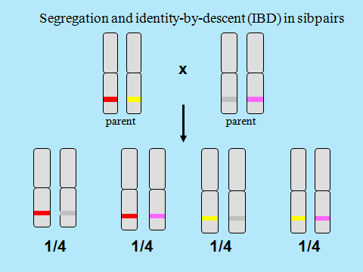
What about parent offsping?
many alleles do they share IBD?
(decending from the grandparent)

Slide 57
(2 alleles IBD) | (1 allele IBD) | (0 alleles IBD)
MZ twins | Parent- Offspring (P-O) | Unrelateds
Cov(MZ) | Cov(P-O) | Cov(Unrelateds)
s²_{Ph_QTL(A)}+ s²_{Ph_QTL(D)} | ½ s²_{Ph_QTL(A)} | 0
slide 43
slide 47
slide 43
Note: spouses given
random mating

Slide 58
(2 alleles IBD) | (1 allele IBD) | (0 alleles IBD)
MZ twins | Parent- Offspring (P-O) | Unrelateds
Cov(MZ) | Cov(P-O) | Cov(Unrelateds)
.25 DZ twins | .50 DZ twins | .25 DZ twins
s²_{Ph_QTL(A)}+ s²_{Ph_QTL(D)} | ½ s²_{Ph_QTL(A)} | 0
average DZ genetic variance sharing (based on IBD):
.25*(s²_{Ph_QTL(A)} + s²_{Ph_QTL(D)} ) + .50*(½s²_{Ph_QTL(A)}) + .25* 0 =
.5*s²_{Ph_QTL(A)}+ .25* s²_{Ph_QTL(D)}
slide 50

Slide 59
s²_{Ph_QTLA} = 2pq[a+(q-p)d]² s²_{Ph_QTLD}= (2pqd)²
IBD=0 0 0 Unrelated
IBD=1 ½ 0 Parent - Offspring
IBD=2 1 1 MZ twins
IBD=0 0 0 25% (¼) DZ twins
IBD=1 ½ 0 50% (½) DZ twins
IBD=2 1 1 25% (¼) DZ twins
average 0*¼+ ½ * ½ +1*¼ 0*¼+0* ½ +1*¼
= ½ = ¼
proportion of alleles
shared IBD
probability of sharing
2 alleles IBD

Slide 60
Q: Why do twins have to be IBD=2 to shared dominance variance?
(prob(IBD=2) = 1)?
A: Because similaries due to dominance effects are related to genotype not individual alleles. You have to have the same genotype to shared dominance variance.
Q: Why does the (average) proportion of alleles shared IBD reflect
shared additive genetic variance?
A: Because similaries due to additive effect are related to individual alleles. Sharing an allele implies sharing additive genetic variance.
Q: If I know MZ twin are IBD=2, do I know what actual alleles they have?
NO: IBD is about sharing alleles, but if not says nothing about the
actual identity of the alleles. However, if relatives are IBD 2, you so know that they have the same alleles (AA and AA, Aa and Aa, or aa and aa).

Slide 61
But all this was about 1 QTL!
What if there are >1 or > 100?
Thank you!
Good question !

Slide 62
Linear regression model N QTLs (N > 1... N>1000)
pheno_{i} = a₀ + a₁*QTL_{A1i} + a₂*QTL_{A2i} +. . . + a_{N}*QTL_{ANi}
+ d₁*QTL_{D1i} + a₂*QTL_{D2i} +. . . + d_{N}*QTL_{DNi} + e_{i}
s²_{Ph_QTL(A)} = 2*p₁q₁ [a₁+(q₁-p₁)d₁] ² +
2*p₁q₁ [a₁+(q₁-p₁)d₁]² + ... + 2*p _{N} q _{N} [a _{N} +(q_{N}-p_{N})d _{N}] ²
s²_{Ph_QTL(A)} = a₁²*s²_{QTLA1}+a₂²*s²_{QTLA2}+...+a_{N}²*s²_{QTLAN}
s²_{Ph_QTL(D)} = (2p₁q₁d₁)² + (2p₂q₂d₂)² + ... + (2p_{N}q_{N}d_{N})²
s²_{Ph_QTL(D)} = d₁²*s²_{QTLD1} + d₂²*s²_{QTLD2} + ... + d_{N}²*s²_{QTLDN}

Slide 63
Covariance matrix (2x2) in DZ and MZ twins
 | MZ1 | MZ2
MZ1 | s²_{A}+ s²_{D} + s²_{E} | s²_{A}+ s²_{D}
MZ2 | s²_{A}+ s²_{D} | s²_{A}+ s²_{D} + s²_{E}
 | DZ1 | DZ2
DZ1 | s²_{A}+ s²_{D} + s²_{E} | ½s²_{A}+ ¼s²_{D}
DZ2 | ½s²_{A}+ ¼s²_{D} | s²_{A}+ s²_{D} + s²_{E}
Point of departure (more or less) for later on

Slide 64
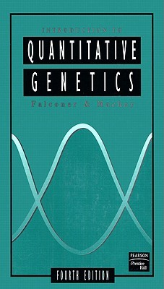
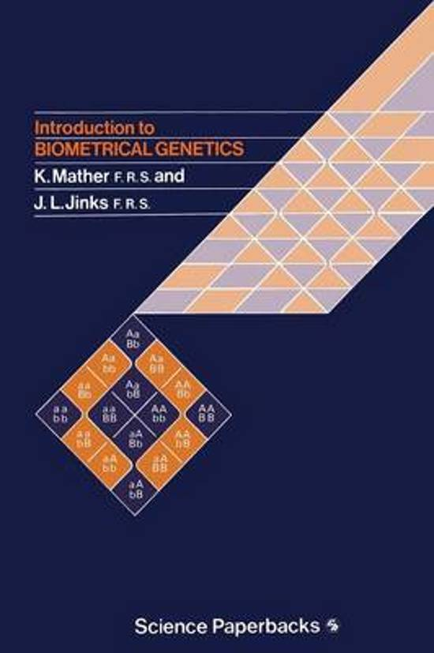
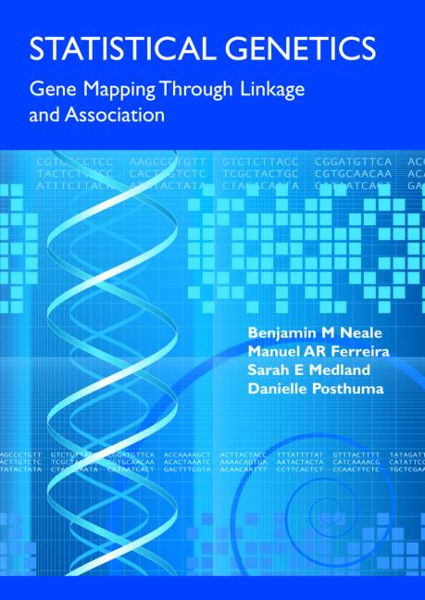
Slide acknowledgement: Manuel Ferreira, Pak Sham, Shaun Purcell, Sarah Medland, and Sophie van der Sluis

Slide 65
Numerical (toy) example.
Suppose a phenotype subject to the influence of one QTL and environmental influences.
You observe the phenotype and the QTL in 500 individuals
I observe the phenotype S in 250 MZ and 250 DZ twin pairs

Slide 66
0 (aa) 1 (AA) 2 (AA)
0.236 (q²) 0.526 (2pq) 0.238 (p²)
variance of the phenotype s²_{Ph} = 1.520
a₀ + a₁*QTL_{Ai} + e_{i}
a₀ -0.561
a₁ 1.111
Multiple R-squared: 0.386
a₀ + a₁*QTL_{Ai} + d₁*QTL_{Di} + e_{i}
a₀ -1.10449
a₁ 1.114
d₁ 1.028
Multiple R-squared: 0.560
0.386 * 1.520 = 0.586
(0.560-0.386)*1.520
= 0.174*1.520 = 0.264
s²_{Ph_QTLA} = 2pq[a+(q-p)d]²
s²_{Ph_QTLD}= (2pqd)²
Notes:
why (0.5059 - 0.4658) ? 0.236 0.526 0.238
because that is the increast in R^2 (the R^2 change). Adding the

Slide 67
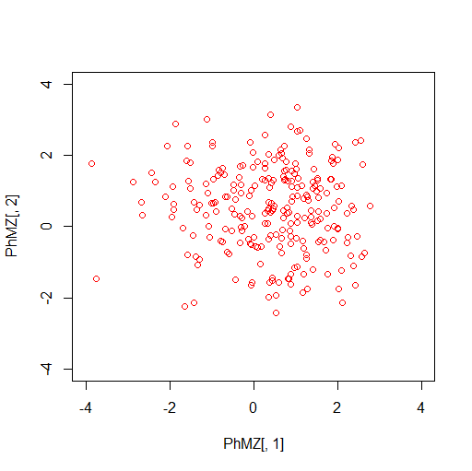
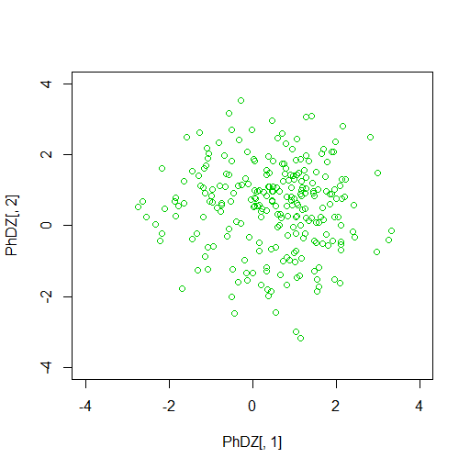
cov(PhMZ) = .525
[,1] [,2]
[1,] 1.466 0.736
[2,] 0.736 1.343
cov(PhDZ) = .192
[,1] [,2]
[1,] 1.559 0.311
[2,] 0.311 1.682
0.736 = s²_{Ph_QTLA} + s²_{Ph_QTLD}
0.311 = ½ s²_{Ph_QTLA} + ¼ s²_{Ph_QTLD}
Notes:
simple method
parameter a² d² e²
calculation 4*r_{DZ}-r_{MZ} 2*r_{MZ}-4*r_{DZ} 1-a²-d²
4*.192 - .525 = .24
2*.525 – 4*.192 = .28

Slide 68
regression model vs biometric model
regression parameter a (henceforth b₁)
=
average effect of allele substitution

Slide 69
predicted values
b₀+b₁*0 (aa)
b₀+b₁*1 (Aa or aA)
b₀+b₁*2 (AA)
difference in regression model
b₀+b₁*1 - (b₀+b₁*0) =
b₀+b₁*2 - (b₀+b₁*1) = b₁
b₁ is the average effect of substituting A for a (or vice versa)
b₁= α
The parameter b₁ in the regression model corresponds to a specific parameter in the biometric model, called α
Now: derive α from the biometric model.
Notes:
oh dear change of notation
b0 (formerly a0) is the intercept
b1 (formerly a) is the regression coefficient

Slide 70
α is the average effect (on the phenotype) of substituting
allele A for allele a - how to derive this?
Subpopulation of individual with first allele A
(AA and Aa).
AA
Aa
Subpopulation of individual with first allele a
(aA and aa).
aA
aa
Population of all individuals
(AA, Aa, aA, aa)

Slide 71
Population of all individuals (HWE)
A
genotype AA; freq = (p*p); effect = a
p
A
p
q
a
genotype Aa; freq = (p*q); effect = d
A
genotype aA; freq = (q*p); effect = d
p
q
a
q
a
genotype aa; freq = (q*q); effect = -a

Slide 72
Subpopulation of individual with first allele A
1st
2st
A
AA (effect a, freq = p)
p
A
p
q
a
AA (effect d, freq = q)
A
p
q
a
conditional mean
α₁ = mean(1st allele=A) = p*a + q*d
q
a

Slide 73
Subpopulation of individual with first allele A₂
A
p
A
p
q
a
A
aA (effect d, freq = p)
p
q
a
q
a
aa (effect -a, freq = q)
1st
2st
conditional mean (1st allele=a)
α₂ = mean(1st allele=a) = p*d + q*-a

Slide 74
average effect of allele substitution α = a + d(q-p)
conditional mean α₁ = mean(1st=A) = (p*a + q*d)
conditional mean (1st=a) α₂ = mean(1st=a) = (p*d + q*-a)
difference α = average effect of allele substitution
α = α₁ - α₂ = (p*a + q*d) - (p*d+q*-a) =
pa +qd -pd +qa =
pa +qa - pd + qd =
(p+q)a +d(q-p) = a + d(q-p)
b₁ is the average effect of substituting A for a (or vice versa)
b₁ = α = (a + d(q-p))

Slide 75
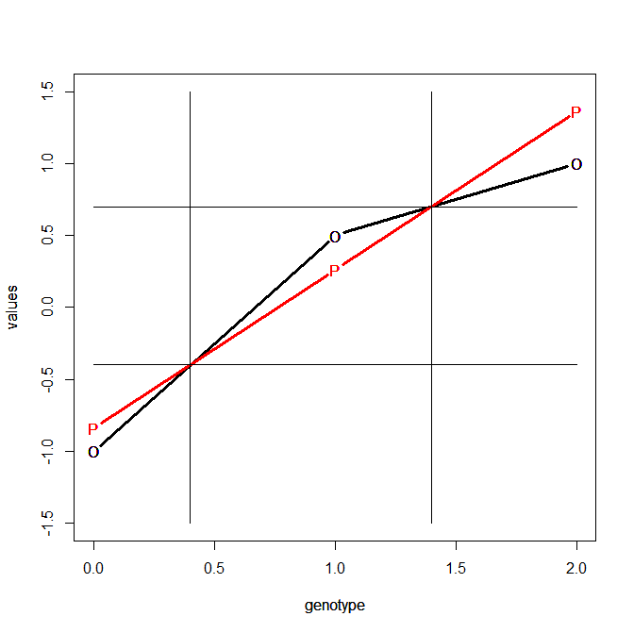
parameter α derived from the biometric model
α₁
α
α₂

Slide 76
α defined in the regression model (b₁) and in the biometric model (α)
b₁ = α = (a + d(q-p))
α₁
α
b₁
α₂

