Slide 1
Sex limitations and Moderation (Interaction) Models
Conor V Dolan & Eveline de Zeeuw
Boulder 2020

Slide 2
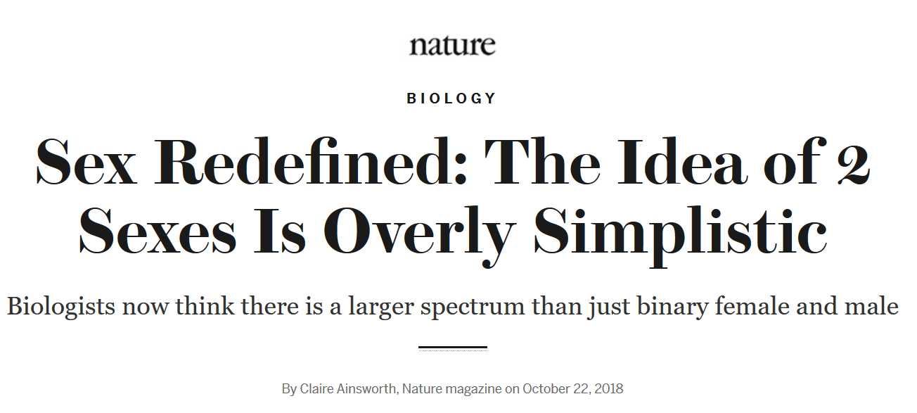

Slide 3
Standard AE model
Ph_{i} – μ = A_{i} + E_{i}
σ²_{A} or .5σ²_{A}
A
E
A
E
σ²_{A}
σ²_{E}
σ²_{A}
σ²_{E}
1
1
1
1
pheno
Twin 1
μ
μ
pheno
Twin 2
1
mean(Ph) = μ
var(Ph) = σ²_{Ph} = 1*σ²_{A}*1+ 1*σ²_{E}*1 = σ²_{A}+ σ²_{E}
Notes:
Basic AE model (leave C out for now).

Slide 4
Ph_{i} – μ = a*A_{i} + e*E_{i}
1 or .5
A
E
A
E
1
1
1
1
a
e
a
e
pheno
Twin 1
μ
μ
pheno
Twin 2
1
mean(Ph) = μ
var(Ph) = σ²_{Ph} = V_{Ph} = a*1*a + e*1*e = a² + e²
Notes:
Basic AE model (leave C out for now).

Slide 5
Here’s the ACE model (variance component):
Σ_{MZ} = σ²_{A} + σ²_{C} + σ²_{E} σ²_{A} + σ²_{C}
σ²_{A} + σ²_{C} σ²_{A} + σ²_{C} + σ²_{E}
μ_{MZ} = μ μ
Σ_{DZ} = σ²_{A} + σ²_{C} + σ²_{E} ½ σ²_{A} + σ²_{C}
½σ²_{A} + σ²_{C} σ²_{A} + σ²_{C} + σ²_{E}
μ_{DZ} = μ μ
NOTE: When we fit this model we assume that the model holds in the population of interest.
- conceptually and statistically a big deal.
Notes:
I am characterizing the distribution of the phenotype in the population of interest.
I am interpreting the results as a decription of the population of interest .... So I have to

Slide 6
What if the population comprises two discernable (sub)populations of interest, e.g., males and females?
Main effect of sex on phenotype
Sex by A (genotype), E (environment) interactions
If we ignore the source of heterogeneity
the estimates of μ, σ²_{E}, σ²_{A} may be biased ...
and even the statistical tests may be affected .... BAD!

Slide 7
What to do?
Include source of heterogeneity, moderator,
in the model (sex, age, .... ANY VARIABLE THEORY prescribes) to render testable the moderation effects.
E.g., diathesis-stress model identifies childhood trauma as a moderator of genetic effects on depression.
Colodro-Conde L, et al. A direct test of the diathesis-stress model for depression. Mol. Psychiatry. 2018;23:1590–1596. doi: 10.1038/mp.2017.130.

Slide 8
What is moderation (a.k.a. interaction)?
To test it (using statistics), and we define it statistically.

Slide 9
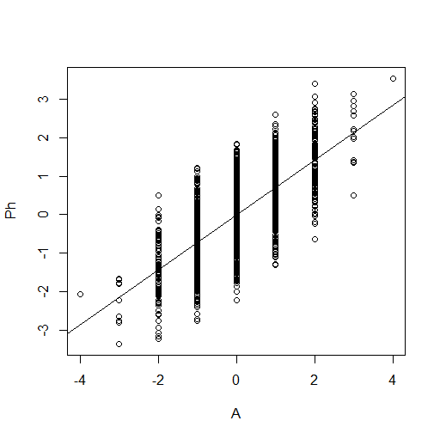
no moderation ... homoskedatic....homogeneity
Environmental
Dispersion
Variance of
E given A score
is approximately
constant
Phenotypic scores
Genetic level (score on A)
Ph_{i} – μ = a*A_{i} + e*E_{i}
Homoskedastic model: e is constant over levels
of A: environmental effects are the same given any A
Notes:
Suppose we measured A and regressed Ph on A. The regression model is linear and homoskedastic: the variance of the residuals are contant over the levels of the the predictor (A). Here we regrees Ph on A, so the residuals are actually E.

Slide 10
Environmental
Dispersion
Variance of
E given A score
is not constant
Phenotypic
scores
Genetic level (score on A)
A x E as “genetic control” of sensitivity to different environments: heteroskedasticity (heterogeneity)
e=f_{e}(A) or σ²_{E} =g_{e}(A) -> Environmental effects (E) systematically vary with A. A moderator ...
Notes:
Heteroskedastic residuals E: the variance of E is NOT the same for different values of A. E variance is the manifestation of environmental contributions to Phenotypic individual differences: So the contributions of E dependent in magnitude on the value of A. Heteroskedasticity here is the manifestation of GxE.

Slide 11
Conditional
variance of A
given E
is not constant
Phenotypic
scores
Environmental level (score on E)
A x E as “environmental control” of genetic effects: heteroskedasticity (a=f_{a}(E) or σ²_{A} =g_{a}(E)).
E moderator
Notes:
We can apply the same reasoning if we encounter heteroscedasticity in the regression of Ph on E. The magnitude of genetic effects depends on the level of E.

Slide 12
Genetic
variance
or (and)
Environmental
(C and / or E)
variance given M
Phenotypic
scores
Moderator level
(score on the measured moderator)
Moderation of effects (A,C,E) by measured moderator M: heteroskedasticity a=f_{a}(M), c=f_{c}(M), e=f_{e}(M) or
σ²_{A} =g_{a}(M), σ²_{C} =g_{c}(M), σ²_{E} =g_{e}(M)
M moderaties the effects of A, C (or D) and E
Notes:
Suppose we regress Ph on a measured moderator variable M. That is a variable which we suspect influences the effects of A, C, or E. Again this interaction (MxA, MxC, MxE) shows up as heteroscedasticity.

Slide 13
Moderators are measured variables – may be binary
A effects moderated by marital status (M):
Unmarried women show greater levels of genetic influence on depression (Heath et al., 1998).
A effects moderated by religious upbringing (M): religious upbringing diminishes A effects on the personality trait of disinhibition (Boomsma et al., 1999).
Sex (as a binary moderator)– discussed below .
Notes:
Other examples

Slide 14

Moderators are measured variables – may be continuous
Age as a moderator of A, C, E variance components (Age x A,C,E interaction)

Slide 15
Intelligence (western / us populations)
Tucker-Drob & Bates (2015)
Notes:
Age as the moderator of the effects of A,C,E (on IQ) here expressed in standardized variance components

Slide 16
ACE model (A,C,E standardized) continuous phenotype
1 or .5
1
A
C
E
A
C
E
c
a
c
a
e
e
pheno
Twin 1
μ
μ
pheno
Twin 2
1
Notes:
Explain regression on unit

Slide 17
ACE model +
Main effect on Means
A
C
E
A
C
E
c
a
c
a
e
e
Pheno
Twin 1
m+ β_{M} M1
m+β_{M}M2
Pheno
Twin 2
1
Notes:
Main effects of moderator M on the phenotype. This is just a linear regression of the phenotype on the moderator M

Slide 18
m
pheno
Twin 1
1
m+ β_{M} M1
pheno
Twin 1
1
M1
β_{M}
equivalent
Two representations of the regression of Phenotype on M ...
Pheno_{i} = m+ β_{M} M1_{i} + residual_{i}
Notes:
Explain the notation, explain the triangle

Slide 19
Summary stats (no moderator)
Means vector
Covariance matrix (r = 1 or ½)
μ μ
Notes:
Now in terms of sum stats. Nothing here

Slide 20
Allowing for a main effect of the moderator M
Means vector (conditional on M)
Covariance matrix (r = 1 or r=½)
Notes:
Moderation of the mean. Regression, the variance components are based on the regression residuals

Slide 21
ACE model + main effect and effect on A path
1
A
C
E
A
C
E
c
c
a+β_{X}M₁
e
a+β_{X}M₂
e
Twin 1
m+ β_{M} M1
m+ β_{M} M2
Twin 1
Twin 2
1
Twin 2
M has main effect + moderation of A effect (a + β_{x}M₁)
Notes:
Extend the moderation from mean to effect of A

Slide 22
A
C
E
1
a+β_{X}M₁
c
e
m+ β_{M} M1
Twin 1
1
Twin 1
If M is binary (0/1) (instead of continuous)
M₁=0 → mean= m & s²_{A} = a²
M₁=1 → mean= m+ β_{M} & s²_{A} = (a+β_{X}M1)²
Test of moderation: test of β_{X}
Notes:
Extend the moderation from mean to effect of A simple case of M=0 vs M=1

Slide 23
A
C
E
s²_{A}
1+β_{X}M₁
1
1
m+ β_{M} M1
Twin 1
1
Twin 1
If M is binary (0/1) (instead of continuous)
M₁=0 → mean= m & s²_{A} = s²_{A}
M₁=1 → mean= m+ β_{M} & s²_{A} = s²_{A} (1+β_{X})²
Test of moderation: test of β_{X}
Notes:
Extend the moderation from mean to effect of A simple case of M=0 vs M=1

Slide 24
1
A
C
E
A
C
E
c +β_{y}M₁
c +β_{y}M₁
a+β_{X}M₁
a+β_{X}M₂
e +β_{z}M₁
e +β_{z}M₁
Twin 1
m+ β_{M} M1
m+ β_{M} M2
Twin 1
Twin 2
1
Twin 2
Main Effect on phenotype (linear regression)
Effect path parameters: Moderation effects (A x M, C x M, E x M interaction).
Test of moderation: Tests of β_{x}, β_{y}, β_{z} (3 df omibus test)
Notes:
If a variable mediates an effect,
significant in the means model, β_{M} > 0
significant increase in a, c or e when β_{M} is fixed to 0
If a variable moderates an effect
β_{X}>0, β_{Y}>0, or β_{Z} > 0
irrespective of β_{M} or any reduction in a, c or e.

Slide 25
s²_{A}
s²_{C}
s²_{E}
A
C
E
1+β_{y}M₁
1+β_{X}M₁
1+β_{z}M₁
1
m+ β_{M} M1
Twin 1
A variance component version
(just the twin 1 member)

Slide 26
Conditional expected variances
Standard Twin Model:
s²_{Ph} = a² + c² + e² or s²_{A} + s²_{C} + s²_{E}
Moderation Model:
Var(Ph|M) =
(a + β_{X}M)² + (c + β_{Y}M)² + (e + β_{Z}M)² or
s²_{A}(1 + β_{X}M)² + s²_{C}(1 + β_{Y}M)² + s²_{E}(1 + β_{Z}M)²
Ph|M mean “the phenotype given a value on M”
or “the phenotype conditional on M”
Notes:
Look at variances

Slide 27
Conditional expected MZ / DZ covariances
Cov(Ph₁,Ph₂|M)_{MZ}= (a+β_{X}M)² + (c+β_{Y}M)²
Cov(Ph₁,Ph₂|M)_{DZ}=½(a+β_{X}M)² + (c+β_{Y}M)²
Cov(Ph₁,Ph₂|M)_{MZ}= s²_{A}(1+β_{X}M)² + s²_{C}(1+β_{Y}M)²
Cov(Ph₁,Ph₂|M)_{DZ}=½s²_{A}(1+β_{X}M)²+s²_{C}(1+β_{Y}M)²
Notes:
A: variances would be moderated (due to beta_Z), covariance would not be

Slide 28
Var (P|M) =
(a + β_{X}M)² + (c + β_{Y}M)² + (e + β_{Z}M)²
h_{st}² |M = (a + β_{X}M)² / Var (P|M)
c_{st}² |M = (c + β_{Y}M)² / Var (P|M)
e_{st}² |M = (e + β_{Z}M)² / Var (P|M)
(h_{st}²|M + c_{st}²|M + e_{st}²|M) = 1
Standardized conditional on value of M..
But h_{st}²|M can vary with M while β_{X} = 0!
same applies to c_{st}²|M and e_{st}²|M
Notes:
Look at standarizatoin

Slide 29
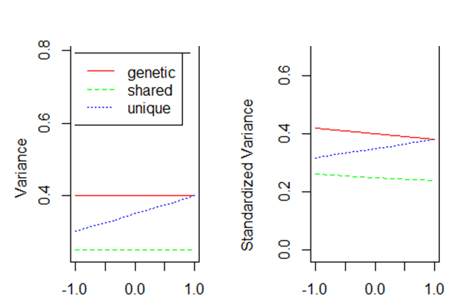
only e moderated
(umx plots)
a,c moderated? nope!
(umx plots)
moderator
moderator
R code in the slide notes
Notes:
# to simulate data - moderation twins with C type moderator
# e.g., SES.
#
rm(list=ls(all=TRUE))
library(MASS)
library(umx)
#
#
#
NMZ=2000
NDZ=2000
#
# a = a0+a1*ses
# c = c0+c1*ses
# e = e0+e1*ses
#
#
# ses with 7 levels coded -3 to 3, 0 is the refernce
#
nses=7
#
#
sescode=c(-3,-2,-1,0,1,2,3)/3 # -1 to 1
# -3 -2 -1 0 1 2 3 #
pses=c(.05,.1,.2,.3,.2,.1,.05) # probability of ses level.
print(sum(pses)==1)
#
NMZs=round(pses*NMZ)
NMZ=sum(NMZs)
NDZs=round(pses*NDZ)
NDZ=sum(NDZs)
#
SESmz=c()
SESdz=c()
for (i in 1:nses) {
SESmz=c(SESmz,rep(sescode[i],NMZs[i]))
SESdz=c(SESdz,rep(sescode[i],NDZs[i]))
}
# main effect of SES
b0=10
b1=.5
# moderation effect - main effects of ACE at ses= 0
a0=sqrt(.4) # var(A)| {ses=0} = .40
c0=sqrt(.25)
e0=sqrt(.35)
# moderation effects associated with ses = 1
a1=0 # sqrt(.4+.05) - sqrt(.4) # var(A)| {ses=1} = .45
c1=0 # no moderation of C
e1=sqrt(.35+.05) - sqrt(.35) #
#
Smz=Sdz=matrix(0,6,6)
diag(Smz)=diag(Sdz)=1
# 1 2 3 4 5 6
# A C E A C E
Smz[1,4]=Smz[4,1]=1 # A
Sdz[1,4]=Sdz[4,1]=1/2 # A
Smz[2,5]=Smz[5,2]=1 # C
Sdz[2,5]=Sdz[5,2]=1 # C
# latent data
mzdat1=matrix(0,NMZ,6)
dzdat1=matrix(0,NMZ,6)
for (i in 1:nses) {
ncor=NMZs[i]/(NMZs[i]-1)
mzdat1[SESmz==sescode[i],1:6]=mvrnorm(NMZs[i],rep(0,6),Sigma=ncor*Smz,emp=T)
ncor=NDZs[i]/(NDZs[i]-1)
dzdat1[SESdz==sescode[i],1:6]=mvrnorm(NDZs[i],rep(0,6),Sigma=ncor*Sdz,emp=T)
}
#
phmz=matrix(0,NMZ,2)
phdz=matrix(0,NDZ,2)
# first regression
phmz[,1]=b0+b1*SESmz+mzdat1[,1]*(a0+a1*SESmz)+
mzdat1[,2]*(c0+c1*SESmz)+
mzdat1[,3]*(e0+e1*SESmz)
phmz[,2]=b0+b1*SESmz+mzdat1[,4]*(a0+a1*SESmz)+
mzdat1[,5]*(c0+c1*SESmz)+
mzdat1[,6]*(e0+e1*SESmz)
#
phdz[,1]=b0+b1*SESdz+dzdat1[,1]*(a0+a1*SESdz)+
dzdat1[,2]*(c0+c1*SESdz)+
dzdat1[,3]*(e0+e1*SESdz)
phdz[,2]=b0+b1*SESdz+dzdat1[,4]*(a0+a1*SESdz)+
dzdat1[,5]*(c0+c1*SESdz)+
dzdat1[,6]*(e0+e1*SESdz)
#
phmz=as.data.frame(cbind(phmz,SESmz,SESmz))
phdz=as.data.frame(cbind(phdz,SESdz,SESdz))
varnames=c('ph_T1','ph_T2','SES_T1','SES_T2')
colnames(phmz)=varnames
colnames(phdz)=varnames
selDVs=c('ph_T1','ph_T2')
selDefs=c('SES_T1','SES_T2')
m1 = umxGxE(selDVs = selDVs, selDefs = selDefs,
dzData = phdz, mzData = phmz)
summary(m1)
# drop a1 get power.
m2 = umxModify(m1, regex =c("am_r1c1"), free=F, name='m2', comparison = TRUE)
summary(m2)
ncp2=mxCompare(m1,m2)[2,7]
if (abs(ncp2)<.00001) ncp2=0
alpha=.05
df=1
crit=qchisq(alpha,df,lower=F)
power_a1=pchisq(crit,df,ncp2,lower=F)
# drop a1 e1 get power.
m3 = umxModify(m1, regex =c("am_r1c1","em_r1c1"), free=F, name='m3', comparison = TRUE)
summary(m3)
ncp3=mxCompare(m1,m3)[2,7]
if (abs(ncp3)<.00001) ncp3=0
alpha=.05
df=2
crit=qchisq(alpha,df,lower=F)
power_a1e1=pchisq(crit,df,ncp3,lower=F)
# check drop c1 power= alpha as e1=0
m4 = umxModify(m1, regex =c("cm_r1c1"), free=F, name='m4', comparison = TRUE)
summary(m4)
ncp4=mxCompare(m1,m4)[2,7]
# the ncp can be negative due to rounding e.g., -2.910383e-11 (as c1 is zero)
if (abs(ncp4)<.00001) ncp4=0
#
alpha=.05
df=1
crit=qchisq(alpha,df,lower=F)
power_c1=pchisq(crit,df,ncp4,lower=F)
print(c(power_a1,power_a1e1,power_c1))
print(c(ncp2,ncp3,ncp4)+c(1,2,1))
#
#cor(phdz[SESdz==0,1:2])
#cor(phmz[SESmz==0,1:2])

Slide 30
1 / .5
1
1
A
C
E
A
C
E
c +β_{y}M₁
c +β_{y}M₁
a+β_{X}M₁
a+β_{X}M₂
e +β_{z}M₁
e +β_{z}M₁
Twin 1
m+ β_{M} M1
m+ β_{M} M2
Twin 1
Twin 2
1
Twin 2
But what have we assumed concerning M?
So far treated like a definition variable (and a fixed regressor).

Slide 31
The M is a measured variable
A
1
a+β_{x}M
m
twin
C
c+β_{y}M
M
β_{M}
e+β_{z}M
E
M is environmental?
Sociaal support? Employment status?
Marital status? (No No and No).
The weather (yes)

Slide 32
E_{c}
C_{c}
A_{c}
E_{u}
C_{u}
A_{u}
e_{m}
c_{m}
a_{m}
e_{u}
c_{u}
a_{u}
M1
T1

Slide 33
r_{E}
r_{C}
r_{A}
E_{c}
C_{c}
A_{c}
E_{u}
C_{u}
A_{u}
e_{m}
c_{m}
a_{m}
e_{t}
c_{t}
a_{t}
M1
T1
cov(M1,T1) = a_{m}r_{E}a_{t} + c_{m}r_{C}c_{t} + e_{m}r_{E}e_{t}
var(T1) = a_{t}² + c_{t}² + e_{t}²

Slide 34
E_{c}
C_{c}
A_{c}
E_{u}
C_{u}
A_{u}
a_{c}
e_{u}
c_{c}
c_{u}
c_{m}
a_{u}
e_{m}
e_{c}
a_{m}
M1
T1
cov(M1,T1) = a_{m}a_{c} + c_{m}c_{c} + e_{m}e_{c}
var(T1) = e_{c}² + c_{c}²+ e_{c}² + e_{u}² + c_{u}²+ e_{u}²

Slide 35
s²_{EM}
s²_{CM}
s²_{AM}
s²_{ET}
s²_{CT}
s²_{AT}
E_{M}
C_{M}
A_{M}
E_{T}
C_{T}
A_{T}
a_{c*}
1
c_{c*}
1
1
1
1
e_{c*}
1
M1
T1

Slide 36
E_{c}
C_{c}
A_{c}
E_{u}
C_{u}
A_{u}
a_{c} + b_{ac}*M1
e_{u} + b_{eu}*M1
c_{u} + b_{cu}*M1
c_{c} + b_{cc}*M1
c_{m}
a_{u} + b_{au}*M1
e_{m}
e_{c} + b_{ec}*M1
a_{m}
M1
T1
var(T1| M1) = (e_{c} + b_{ec}*M1)² + (c_{c} + b_{cc}*M1)²+ (a_{c} + b_{ac}*M1)² +
(e_{u} + b_{eu}*M1)² + (c_{u} + b_{cu}*M1)²+ (a_{u} + b_{au}*M1)²

Slide 37
MZ = DZ = 1
MZ=1 / DZ=.5
MZ = DZ = 1
A_{c}
E_{u}
MZ=1 / DZ=.5
E_{u}
A_{c}
C_{c}
C_{u}
C_{u}
C_{c}
E_{c}
A_{u}
A_{u}
E_{c}
e_{u} + b_{eu}*M1
e_{u} + b_{eu}*M2
a_{c} + b_{ac}*M1
c_{u} + b_{cu}*M1
c_{u} + b_{cu}*M2
a_{c} + b_{ac}*M2
c_{c} + b_{cc}*M1
c_{c} + b_{cc}*M2
c_{m}
a_{u} + b_{au}*M1
a_{u} + b_{au}*M2
c_{m}
e_{m}
a_{m}
e_{c} + b_{ec}*M1
e_{c} + b_{ec}*M2
a_{m}
e_{m}
M1
T1
T2
M2
umx function available!
Notes:
37
One way to model moderation is to use Purcell’s model, which is especially handy if the moderator is continuous.
In the moderation model proposed by Purcell in 2002, the path loadings are allowed to vary as a function of the moderator.
For each individual twin, the moderator values are read in directly and feature in the model as fixed variables.
In the bivariate parameterization, the moderator features twice: as a ‘normal’ variable whose variance is decomposed,
and as a moderator affecting the crosspaths as well as the loadings unique to the trait of interest.
Advantage of this model is that the covariance between M and T can also fluctuate as a function of the moderator itself.
Disadvantage:
lots of parameters need to be estimated.
Moderator and trait variables needs to have same measurement level

Slide 38
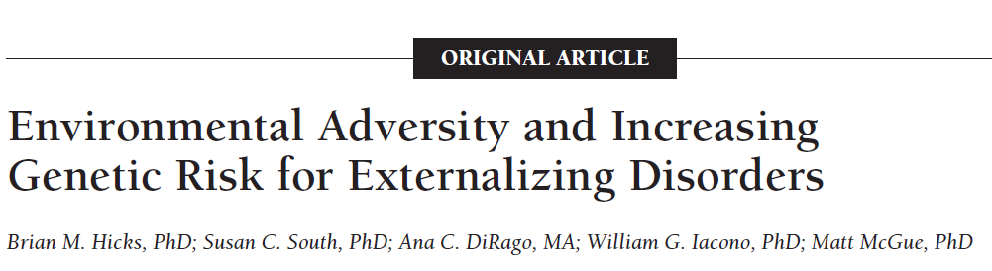
Phenotype: externalizing behavior
Moderators: academic achievement and engagement, antisocial and prosocial peer affiliations, mother-child and father-child relationship problems, and stressful life events.
Arch Gen Psychiatry. 2009;66(6):640-648

Slide 39
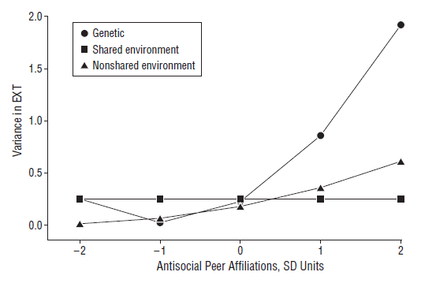

Slide 40
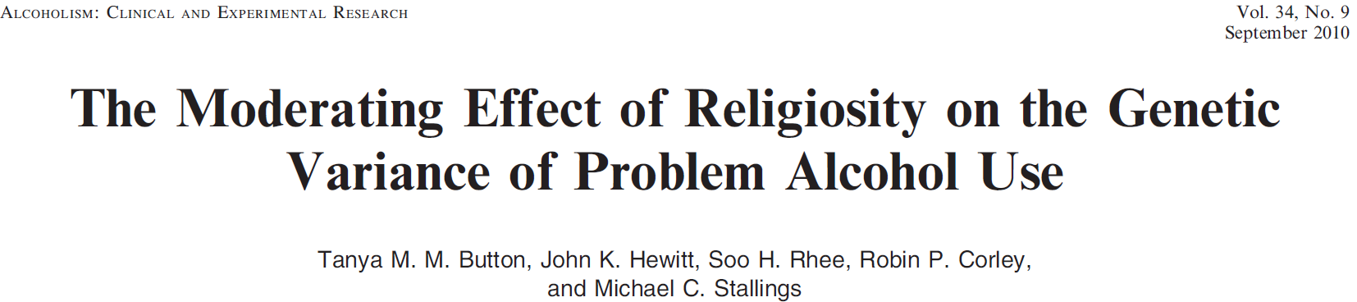
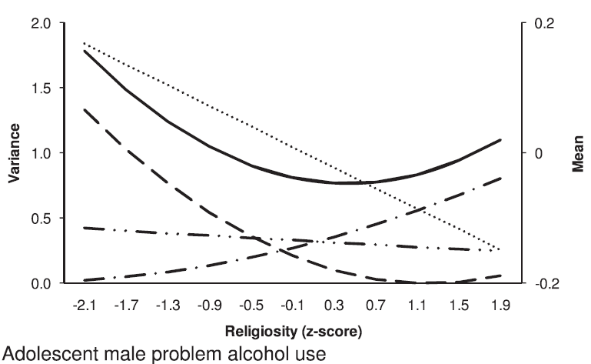


Slide 41
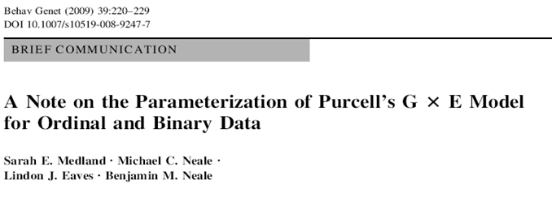
What about non-linear moderation? E.g., extend the model from linear to linear + quadratic.
e_{c} + b_{ec1}*M1 + b_{ec2}*M1²
What about >1 moderators?
Extend the model accordingly
e_{c} + b_{ec1}*SES + b_{ec2}*AGE
What about categorical data?

Slide 42
Sex special case.... DZOS!
... offer unique means to test hypotheses concerning genetic effects.
5 groups MZM, DZM, MZF, DZF, DZOS
Considered in a 5 group model

Slide 43
σ²_{Am} or .5σ²_{Am}
Am
Em
Am
Em
σ²_{Am}
σ²_{Em}
σ²_{Am}
σ²_{Em}
1
1
1
1
pheno
Twin 1
μ_{m}
μ_{m}
pheno
Twin 2
1
mean(Ph_{m}) = μ_{m}
var(Ph_{m}) = σ²_{Ph} = σ²_{Am}+ σ²_{Em}
Males twins
Notes:
Basic AE model (leave C out for now).

Slide 44
σ²_{Af} or .5σ²_{Af}
Af
Ef
Af
Ef
σ²_{Af}
σ²_{Ef}
σ²_{Af}
σ²_{Ef}
1
1
1
1
pheno
Twin 1
μ_{f}
μ_{f}
pheno
Twin 2
1
mean(Ph_{f}) = μ_{f}
var(Ph_{f}) = σ²_{Ph} = σ²_{Af}+ σ²_{Ef}
Females twins
Notes:
Basic AE model (leave C out for now).

Slide 45
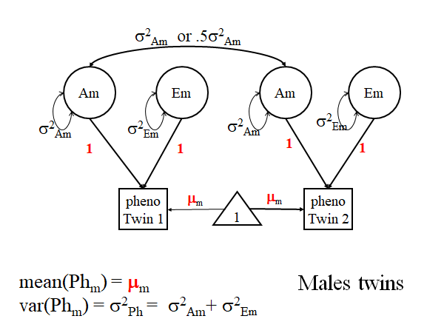
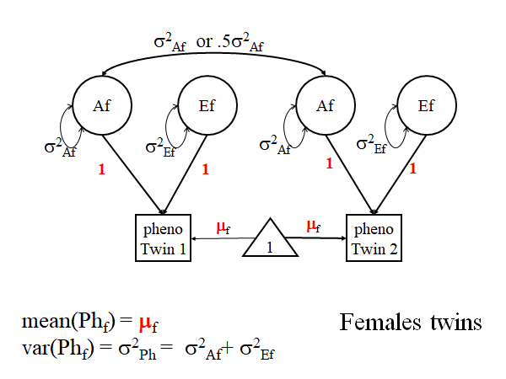
μ_{f} = μ_{m}? sex differences in main effects
s²_{Af} = s²_{Am}? sex differences in A variance
s²_{Ef} = s²_{Em}? sex differences in E variance
(add s²_{Df} = s²_{Dm} or s²_{Cf} = s²_{Cm} )

Slide 46
σ_{Af}σ_{Am} or ½σ_{Af}σ_{Am}
Af
Ef
Am
Em
σ²_{Af}
σ²_{Ef}
σ²_{Am}
σ²_{Em}
1
1
1
1
pheno
Twin f
μ_{f}
μ_{m}
pheno
Twin m
1
DZOS (f,m) twins
Notes:
Basic AE model (leave C out for now).

Slide 47
σ_{Af}σ_{Am} or r_{DZOS}*σ_{Af}σ_{Am}
Af
Ef
Am
Em
σ²_{Af}
σ²_{Ef}
σ²_{Am}
σ²_{Em}
1
1
1
1
pheno
Twin f
μ_{f}
μ_{m}
pheno
Twin m
1
DZOS twins
r_{DZOS}*σ_{Af}σ_{Am} note: r_{DZOS} is not necessarily ½
r_{DZOS} = ½ or r_{DZOS} < ½ ?
Notes:
Basic AE model (leave C out for now).

Slide 48
Models (ACE) (Stat or Subst)
total homogeneity (Subst)
μ_{f} = μ_{m} (main effect absent)
σ²_{Am}=σ²_{Af} & σ²_{Cm}=σ²_{Cf} & σ²_{Ef} =σ²_{Ef}
r_{DZOS} = ½
total variance homogeneity (Stat)
μ_{f} ≠ μ_{m} (main effect present)
σ²_{Am}=σ²_{Af} σ²_{Cm}=σ²_{Cf} & σ²_{Ef} =σ²_{Ef}
r_{DZOS} = ½

Slide 49
μ_{f} ≠ μ_{m} (main effect present)
scalar sex limitation r_{DZOS} = ½ (Stat)
σ²_{Am} ≠ σ²_{Af} & σ²_{Cm} ≠ σ²_{Cf} & σ²_{Ef} ≠ σ²_{Ef}
σ²_{Am} = k*σ²_{Af} & σ²_{Cm} = k*σ²_{Cf} & σ²_{Ef} = k*σ²_{Ef}
k is nonzero positive constant (to be estimated)
raw variances differ, but standardized variances are equal
σ²_{Af} /(σ²_{Af}+σ²_{Cf}+σ²_{Ef}) = k*σ²_{Af} /(k*σ²_{Af}+k*σ²_{Cf}+k*σ²_{Ef})
= k*σ²_{Af} / k*(σ²_{Af}+σ²_{Cf}+σ²_{Ef}) = σ²_{Af} /(σ²_{Af}+σ²_{Cf}+σ²_{Ef})
parsimonious model for sex differences in variance,
but quite restrictive (and not Subst!)

Slide 50
μ_{f} ≠ μ_{m} (main effect present)
non-scalar quantitative sex limitation
r_{DZOS} = ½ (Subst)
σ²_{Am} ≠ σ²_{Af} &/or σ²_{Cm} ≠ σ²_{Cf} &/or σ²_{Ef} ≠ σ²_{Ef}
σ²_{Am} ≠ σ²_{Af} &genetic effects are different, but r_{DZOS} = ½ implies same genes in males and females.
So: sex moderates genetic effects (e.g., gene expression).

Slide 51
μ_{f} ≠ μ_{m} (main effect present)
non-scalar qualitative sex limitation
r_{DZOS} ≠ ½ (Subst)
σ²_{Am} ≠ σ²_{Af} &/or σ²_{Cm} ≠ σ²_{Cf} &/or σ²_{Ef} ≠ σ²_{Ef}
σ²_{Am} ≠ σ²_{Af} genetic effects are different, and r_{DZOS} ≠ ½ implies (at least in part different genes).

Slide 52
Nesting ACE model (cov structure, discarding the means)
non-scalar qualitative
7 parameters: σ²_{Am} σ²_{Af} σ²_{Cm} σ²_{Cf} σ²_{Ef} σ²_{Ef} r_{DZOS})
fix r_{DZOS} = ½ (1 df): non-scalar quantative (omnibus: 3 differences)
6 parameters: σ²_{Am} σ²_{Af} σ²_{Cm} σ²_{Cf} σ²_{Em} σ²_{Ef}
proportionality constraint (2df): scalar
4 parameters: σ²_{Cf} σ²_{Ef} σ²_{Ef} k
set k=1 (1 df): homogeneity
3 parameters σ²_{Cf} σ²_{Ef} σ²_{Ef}

Slide 53
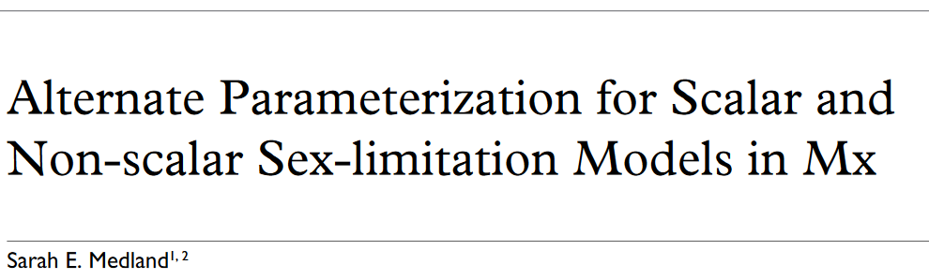
Twin Research Volume 7 Number 3 pp. 299–308

Slide 54
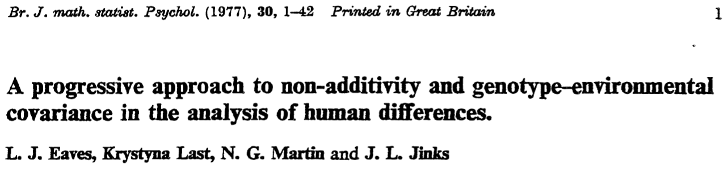
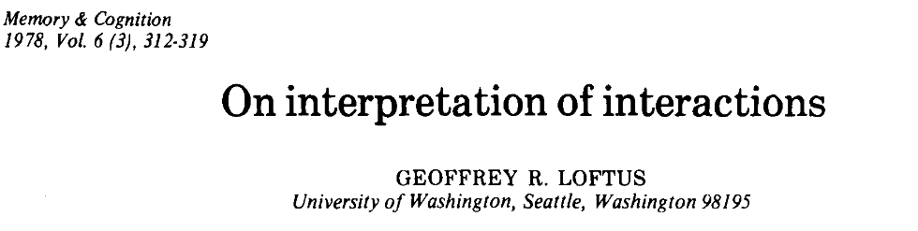
Caveat: Tests of moderation (interaction)
are scale dependent.

Slide 55
Solution???: Common pathway model with appropriate psychometric model (IRT model or a common factor model) & Define moderation at the level of the latent phenotype (Nathan Friday)
A
E
AE moderation
model
a+β_{x}M
e+β_{z}M
M
T
m+ β_{M} M
psychometric
model
1
2
3
4

Slide 56


How would you revise the sex limitations model
if you had a dimensional measure of sex?

