Slide 1
Where have we been and we are going?
Lucía Colodro Conde,
Elizabeth Prom-Wormley, and Sarah Medland

Slide 2
Using SEM to model genetic
and environmental effects on phenotypes
https://www.colorado.edu/ibg/international-workshop/2020-international-statistical-genetics-workshop/workshop-2020-preliminary

Slide 3
Revisiting SEM

Slide 4
In summary, we have been doing processes of:
Specification
Identification
Estimation
Evaluation

Slide 5
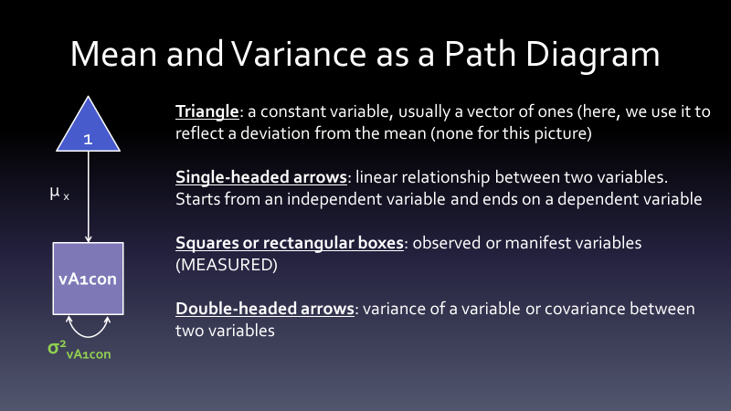

Slide 6
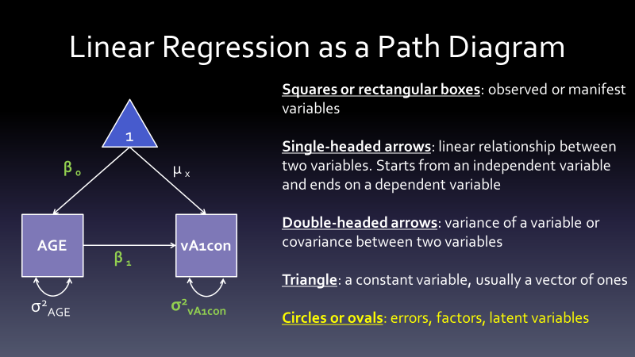

Slide 7
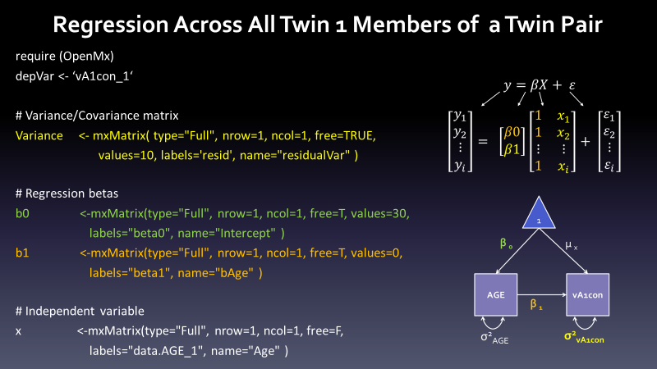

Slide 9
ACE

Slide 10
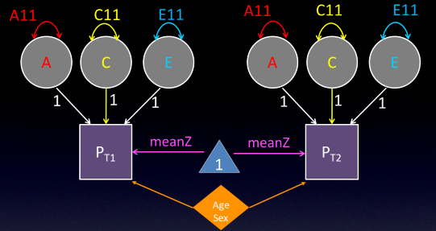

Slide 11
Conventions of path tracing

Slide 12
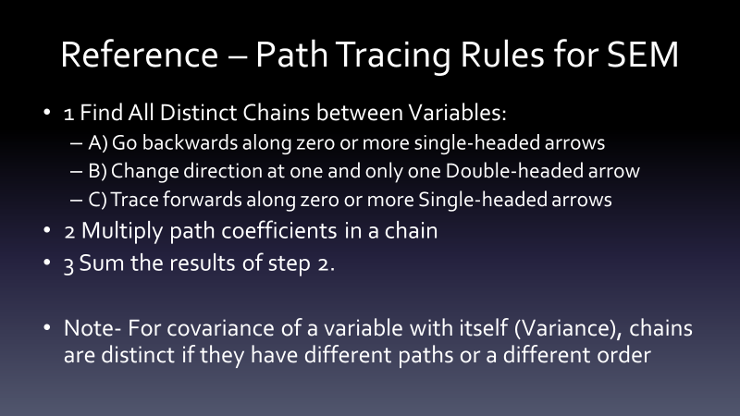
Notes:
<number>

Slide 13
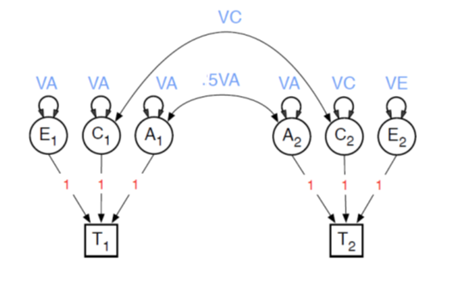
Estimation of path coefficients
Estimation of variance components
MZ
MZ
DZ
DZ
Notes:
<number>

Slide 14
Estimation of path coefficients

Slide 15
Notes:
<number>

Slide 16
Notes:
The expected between any two variables is the sum of all legitimate chains connecting the variables
Since the of a variable is the covariance of the variable with itself, the expected variance will be the sum of all legitimate chains from the variable to itself
<number>

Slide 17
Notes:
<number>

Slide 18
Notes:
Backwards along zero or more single headed arrows.
<number>

Slide 19
Notes:
Change direction at 1 and only 1 double headed arrow
<number>

Slide 20
Notes:
Forward along zero or more single headed arrows.
<number>

Slide 26
Code in estimation of path coefficients
pathA <- mxMatrix( type="Lower", nrow=nv, ncol=nv, free=TRUE, values=svPa, label="a11", lbound=lbPa, name="a" )
pathC <- mxMatrix( type="Lower", nrow=nv, ncol=nv, free=TRUE, values=svPa, label="c11", lbound=lbPa, name="c" )
pathE <- mxMatrix( type="Lower", nrow=nv, ncol=nv, free=TRUE, values=svPe, label="e11", lbound=lbPa, name="e" )
# Create Algebra for Variance Components
covA <- mxAlgebra( expression=a %*% t(a), name="A" )
covC <- mxAlgebra( expression=c %*% t(c), name="C" )
covE <- mxAlgebra( expression=e %*% t(e), name="E" )
# Create Algebra for expected Variance/Covariance Matrices in MZ & DZ twins
covP <- mxAlgebra( expression= A+C+E, name="V" )
covMZ <- mxAlgebra( expression= A+C, name="cMZ" )
covDZ <- mxAlgebra( expression= 0.5%x%A+ C, name="cDZ" )
expCovMZ <- mxAlgebra( expression= rbind( cbind(V, cMZ), cbind(t(cMZ), V)), name="expCovMZ" )
expCovDZ <- mxAlgebra( expression= rbind( cbind(V, cDZ), cbind(t(cDZ), V)), name="expCovDZ" )
<number>

Slide 27
Estimation of variance components

Slide 31
Code in estimation of variance components
## Create Matrices for Variance Components
covA <- mxMatrix( type="Symm", nrow=nv, ncol=nv, free=TRUE, values=valDiag(svPa,nv), label=labLower("VA",nv), name="VA" )
covC <- mxMatrix( type="Symm", nrow=nv, ncol=nv, free=TRUE, values=valDiag(svPa,nv), label=labLower("VC",nv), name="VC" )
covE <- mxMatrix( type="Symm", nrow=nv, ncol=nv, free=TRUE, values=valDiag(svPa,nv), label=labLower("VE",nv), name="VE" )
## Create Algebra for expected Variance/Covariance Matrices in MZ & DZ twins
covP <- mxAlgebra( expression= VA+VC+VE, name="V" )
covMZ <- mxAlgebra( expression= VA+VC, name="cMZ" )
covDZ <- mxAlgebra( expression= 0.5%x%VA+ VC, name="cDZ" )
expCovMZ <- mxAlgebra( expression= rbind( cbind(V, cMZ),
cbind(t(cMZ), V)), name="expCovMZ" )
expCovDZ <- mxAlgebra( expression= rbind( cbind(V, cDZ),
cbind(t(cDZ), V)), name="expCovDZ" )
<number>

Slide 32
What’s the difference?

Slide 33
Path: Implicit (artificial) boundary constraint
Estimate a but a² can never be negative.
As the number of variables in a twin model increases, the number of implicit boundaries in the model increase.
Variance Component: Unbounded
- Estimates VA, VC, and VE can be positive and negative

Slide 34
Why do we prefer the variance component approach?
The statistical significance of the parameters from a univariate ACE model is often assessed using a likelihood ratio test.
Under certain regularity conditions this statistic is asymptotically distributed as χ2 with 1 d.f. BUT these regularity conditions are not met when models have either implicit or explicit bounds.
When boundaries are included, the numerical Type I error rates are lower than theoretically expected.
The null hypotheses that either a²= 0 or c² = 0 are rejected less frequently than would be expected due to chance.
This, causes an increase in Type II errors, where we can falsely conclude the variance component is not significant.
Notes:
<number>

Slide 35
Why do we prefer the variance component approach?
It may fit better
No bias from implicit boundary
Negative variances? Model wrong?

Slide 36
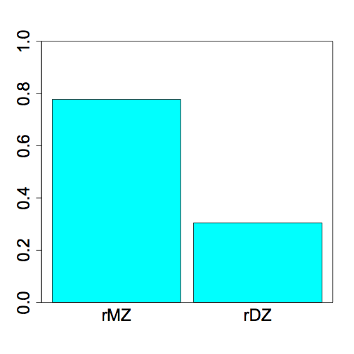
BMI Twin Correlations
A = 2(rMZ-rDZ)
C = 2rDZ - rMZ
E = 1- rMZ
ADE or ACE?
0.78
0.30
<number>

Slide 37
Why do we prefer the variance component approach?

