Slide 1
2020 International Statistical Genetics Workshop
Introduction to Multivariate
Genetic Analysis
PRACTICAL
Lucía Colodro Conde, Meike Bartels,
Elizabeth Prom-Wormley, and Hermine Maes
with thanks to Katrina Grasby, Jose Morosoli, Sarah Medland, and Dorret Boomsma
In \\workshop\Faculty\lucia\2020\Wednesday\twoACEvc_practical_2traits.R
Notes:
<number>

Slide 2
The dataset: Simulated data
Children age ~ 8 years old, 50 % females
Phenotypes are scores on reading, grammar, writing, and math skills.
Available both raw and scaled (mean 0, SD 1) – before restructuring the file to one row per family!
Means and Variances could be equated across Twin Order and Zygosity
No need of sex-limitation model
Age and sex should be included as covariates
We’ll analyse “Read” and “Writ”

Slide 3
Three Concepts
1.- What is the variance due to genetic and (shared and unique) environmental contributions for each trait?
Variance Decomposition
2.- How much of the phenotypic correlation between the traits is accounted for by genetic and (shared and unique) environmental factors?
Covariance Decomposition
3.- To what extent do the genetic factors underlying each trait overlap? And the (shared and unique) environmental factors?
Genetic and Environmental correlations
Notes:
<number>

Slide 4
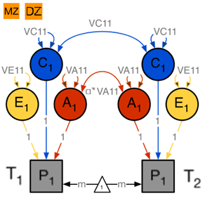
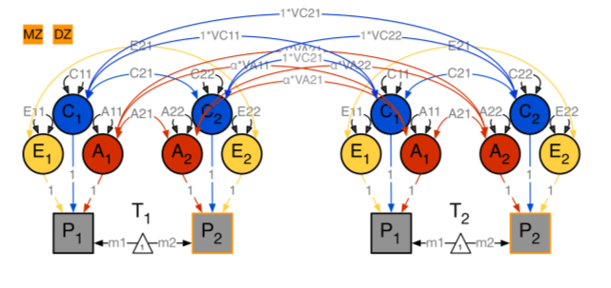
From
univariate
to
multivariate
α = assumed degree of genetic relatedness (1, 0.5)
Notes:
In this case, bivariate.
<number>

Slide 5
Twin Covariances / Correlations
Notes:
WITHIN TWIN
Variance of P1 and P2 same across twins and zygosity groups
Covariance of P1 and P2 same across twins and zygosity groups
CROSS TWIN
There shouldn't be differences between Twin 1 and Twin 2, but there may be differences across zygosities
= Cross-twin within trait covariances differ by zygosity
= Cross-twin cross-trait covariances differ by zygosity
<number>

Slide 6
Twin Covariances / Correlations
Within-twin covariance
Cross-twin covariance
Cross-twin covariance
Within-twin covariance
Notes:
WITHIN TWIN
Variance of P1 and P2 same across twins and zygosity groups
Covariance of P1 and P2 same across twins and zygosity groups
CROSS TWIN
There shouldn't be differences between Twin 1 and Twin 2, but there may be differences across zygosities
= Cross-twin within trait covariances differ by zygosity
= Cross-twin cross-trait covariances differ by zygosity
<number>

Slide 7
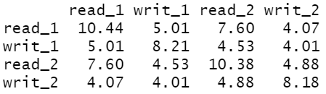
Variance/covariance matrices
Correlation matrices
MZ
MZ
Twin 1
Twin 2
Twin 1
Twin 2
Twin 1
Twin 1
Twin 2
Twin 2
DZ
DZ
Twin 1
Twin 2
Twin 1
Twin 2
Twin 1
Twin 1
Twin 2
Twin 2
Notes:
<number>

Slide 8
Variance/covariance matrices
Correlation matrices
MZ
MZ
Twin 1
Twin 2
Twin 1
Twin 2
Twin 1
Twin 1
Twin 2
Twin 2
DZ
DZ
Twin 1
Twin 2
Twin 1
Twin 2
Twin 1
Twin 1
Twin 2
Twin 2
Notes:
<number>

Slide 9
What are our initial expectations
after looking at the covariance and correlation matrices by zygosity?
Are there common etiological influences?
MZ
Twin 1
Twin 2
Twin 1
Twin 2
DZ
Twin 1
Twin 2
Twin 1
Twin 2
Notes:
<number>

Slide 10
What are our initial expectations
after looking at the covariance and correlation matrices by zygosity?
Are there common etiological influences?
Within-twin Cross-trait covariances
MZ
Twin 1
Twin 2
Twin 1
Twin 2
DZ
Twin 1
Twin 2
Twin 1
Twin 2
Notes:
<number>

Slide 11
What are our initial expectations
after looking at the covariance and correlation matrices by zygosity?
Are there common etiological influences?
Within-twin Cross-trait covariances
Do familial common etiological influences contribute to the covariation?
MZ
Twin 1
Twin 2
Twin 1
Twin 2
DZ
Twin 1
Twin 2
Twin 1
Twin 2
Notes:
<number>

Slide 12
What are our initial expectations
after looking at the covariance and correlation matrices by zygosity?
Are there common etiological influences?
Within-twin Cross-trait covariances
Do familial common etiological influences contribute to the covariation?
Cross-twin Cross-trait covariances
MZ
Twin 1
Twin 2
Twin 1
Twin 2
DZ
Twin 1
Twin 2
Twin 1
Twin 2
Notes:
<number>

Slide 13
What are our initial expectations
after looking at the covariance and correlation matrices by zygosity?
Are there common etiological influences?
Within-twin Cross-trait covariances
Do familial common etiological influences contribute to the covariation?
Cross-twin Cross-trait covariances
Are the common etiological influences genetic and/or environmental (A and/or C)?
MZ
Twin 1
Twin 2
Twin 1
Twin 2
DZ
Twin 1
Twin 2
Twin 1
Twin 2
Notes:
<number>

Slide 14
What are our initial expectations
after looking at the covariance and correlation matrices by zygosity?
Are there common etiological influences?
Within-twin Cross-trait covariances
Do familial common etiological influences contribute to the covariation?
Cross-twin Cross-trait covariances
Are the common etiological influences genetic and/or environmental (A and/or C)?
MZ/DZ ratio of Cross-twin Cross-trait covariances
MZ
Twin 1
Twin 2
Twin 1
Twin 2
DZ
Twin 1
Twin 2
Twin 1
Twin 2
Notes:
<number>

Slide 15
What are our initial expectations
after looking at the covariance and correlation matrices by zygosity?
Are there common etiological influences?
Within-twin Cross-trait covariances
Do familial common etiological influences contribute to the covariation?
Cross-twin Cross-trait covariances
Are the common etiological influences genetic and/or environmental (A and/or C)?
MZ/DZ ratio of Cross-twin Cross-trait covariances
Is there evidence of covariation due to unique environment (E)?
MZ
Twin 1
Twin 2
Twin 1
Twin 2
DZ
Twin 1
Twin 2
Twin 1
Twin 2
Notes:
<number>

Slide 16
What are our initial expectations
after looking at the covariance and correlation matrices by zygosity?
Are there common etiological influences?
Within-twin Cross-trait covariances
Do familial common etiological influences contribute to the covariation?
Cross-twin Cross-trait covariances
Are the common etiological influences genetic and/or environmental (A and/or C)?
MZ/DZ ratio of Cross-twin Cross-trait covariances
Is there evidence of covariation due to unique environment (E)?
Ratio of cross-twin to within-twin cross-trait covariance
MZ
Twin 1
Twin 2
Twin 1
Twin 2
DZ
Twin 1
Twin 2
Twin 1
Twin 2
Notes:
<number>

Slide 17

Variance Components
covA <- mxMatrix( type="Symm", nrow=nv, ncol=nv, free=TRUE, values=valDiag(svPa,nv), labels=labLower("VA",nv), name="VA" )
α = assumed degree of genetic relatedness (1, 0.5)
Notes:
NO NEED TO RUN TWO UNIVARIATES.
<number>

Slide 18
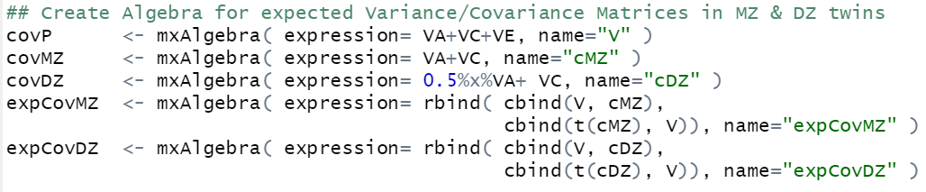
Predicted MZ Twin Covariance
Predicted DZ Twin Covariance
Notes:
<number>

Slide 19

Correlations
corA <- mxAlgebra( expression=solve(sqrt(I*VA))%&%VA, name ="rA" )
$\frac{{VA}_{12}}{\sqrt{\left.{VA}_{11}∗VA_{22}\right)}}$
r_{g}=
Notes:
Remember we get the correlation by dividing genetic covariance by square root of product of genetic variances of two variables
Covariance pre and post multiplied by the inverse of the SD
<number>

Slide 20
Three Important Concepts
1.- What is the variance due to genetic and environmental contributions for each trait?
Variance Decomposition
2.- How much of the phenotypic correlation between the traits is accounted for by genetic and environmental factors?
Covariance Decomposition
3.- To what extent do the genetic factors underlying each trait overlap? And the environmental factors?
Genetic and Environmental correlations
Notes:
<number>

Slide 21
 | SA | SC | SE
Read
Write
Notes:
Standardised variances are easier to interpret
<number>

Slide 22
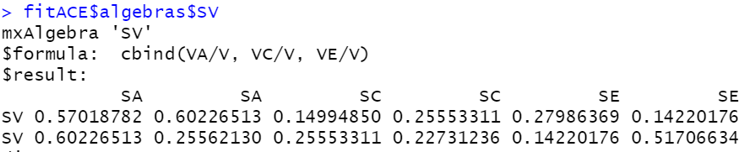
 | SA | SC | SE
Read
Write
Notes:
Standardised variances are easier to interpret
<number>

Slide 23
 | SA | SC | SE
Read | 0.57 (0.44,0.70) | 0.15 (0.03,0.26) | 0.28 (0.24,0.32)
Write
To retrieve the intervals, run: fitACE <- mxRun( modelACE, intervals=T )
Notes:
<number>

Slide 24
 | SA | SC | SE
Read | 0.57 (0.44,0.70) | 0.15 (0.03,0.26) | 0.28 (0.24,0.32)
Write | 0.26 (0.08,0.42) | 0.23 (0.09,0.36) | 0.52 (0.45,0.59)
To retrieve the intervals, run: fitACE <- mxRun( modelACE, intervals=T )
Notes:
<number>

Slide 25
Three Important Concepts
1.- What is the variance due to genetic and (shared and unique) environmental contributions for each trait?
Variance Decomposition
Genetic, common environmental and unique genetic factors (including measurement error) contribute to 57%, 15%, and 28% of the individual differences in read, respectively.
Genetic, common environmental and unique genetic factors (including measurement error) contribute to 26%, 23%, and 52% of the individual differences in write, respectively.
Notes:
<number>

Slide 26
Three Important Concepts
1.- What is the variance due to genetic and (shared and unique) environmental contributions for each trait?
Variance Decomposition
2.- How much of the phenotypic correlation between the traits is accounted for by genetic and (shared and unique) environmental factors?
Covariance Decomposition
3.- To what extent do the genetic factors underlying each trait overlap? And the (shared and unique) environmental factors?
Genetic and Environmental correlations
Notes:
<number>

Slide 27
 | SA12 | SC12 | SE12
Read-write
Notes:
<number>

Slide 28
 | SA12 | SC12 | SE12
Read-write
To retrieve the intervals, run: fitACE <- mxRun( modelACE, intervals=T )
Notes:
<number>

Slide 29
 | SA12 | SC12 | SE12
Read-write | 0.60 (0.40,0.81) | 0.26 (0.08,0.42) | 0.14 (0.08,0.21)
To retrieve the intervals, run: fitACE <- mxRun( modelACE, intervals=T )
Notes:
<number>

Slide 30
 | SA12 | SC12 | SE12
Read-write | 0.60 (0.40,0.81) | 0.26 (0.08,0.42) | 0.14 (0.08,0.21)
Remember the relative importance of the covariance of A, C, and E depends on the r_{ph}.
If r_{ph} is very low, a covariance of 0.60 due to genetic factors means nothing.
To retrieve the intervals, run: fitACE <- mxRun( modelACE, intervals=T )
Notes:
<number>

Slide 31
Three Important Concepts
2.- How much of the phenotypic correlation between the traits is accounted for by genetic and (shared and unique) environmental factors?
Covariance Decomposition
Genetic, common environmental and unique genetic factors contribute to 60%, 26%, and 14% of the covariance between read and write, respectively.
Notes:
<number>

Slide 32
Three Important Concepts
1.- What is the variance due to genetic and (shared and unique) environmental contributions for each trait?
Variance Decomposition
2.- How much of the phenotypic correlation between the traits is accounted for by genetic and (shared and unique) environmental factors?
Covariance Decomposition
3.- To what extent do the genetic factors underlying each trait overlap? And the (shared and unique) environmental factors?
Genetic and Environmental correlations
Notes:
<number>

Slide 33
 | r_{a} | r_{c} | r_{e} | r_{ph}
Read-write
Notes:
<number>

Slide 34
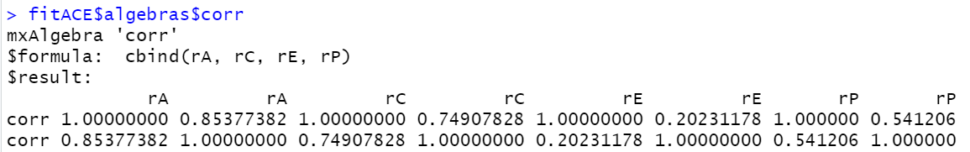
 | r_{a} | r_{c} | r_{e} | r_{ph}
Read-write | 0.85 (0.62,1) | 0.75 (0.33,1) | 0.20 (0.11,0.29) | 0.54 (0.51,0.57)
Notes:
<number>

Slide 35
Three Important Concepts
3.- To what extent do the genetic factors underlying each trait overlap? And the (shared and unique) environmental factors?
Genetic and Environmental correlations
The genetic and common shared environment correlations between read and write are large (r_{a} = .85 and r_{c} = .75); the unique environment correlation is low (r_{e} = .20).
85%, 75%, and 20% of the genetic factors, shared environmental factors, and unique environmental factors between read and write overlap.
Notes:
<number>

Slide 36
Correlations. Interpreting Results
High r_{a} = large overlap in genetic effects on the two traits
  If r_{a} = 1, the two sets of genes influencing each trait overlap completely
If there is a high r_{a} , does it mean that the phenotypic correlation between the traits is largely due to genetic effects?
No: The contribution to r_{ph} is a function of both h² of the traits and r_{a}
  i.e. the substantive importance of genetic effects depends on the value of the r_{a} and the heritability of each phenotype (h²)
√h²_{P1} * r_{g} * √ h²_{P2}
Proportion of r_{ph} due to A:
r_{ph}
Same for r_{c} and r_{e}
Notes:
<number>

Slide 37
Consider write-read
r_{ph} = 0.54 and r_{a} = 0.85
SA_{read}=0.58 and SA_{write}=0.26
What is the contribution to phenotypic correlation attributable to additive genetic effects?
√h²_{P1} * r_{g} * √h²_{P2}
Proportion of r_{ph} due to A:
r_{ph}
Same for r_{c} and r_{e}

Slide 38
Consider write-read
r_{ph} = 0.54 and r_{a} = 0.85
SA_{read}=0.58 and SA_{write}=0.26
What is the contribution to phenotypic correlation attributable to additive genetic effects?
√h²_{P1} * r_{g} * √h²_{P2}
Proportion of r_{ph} due to A:
r_{ph}
Same for r_{c} and r_{e}
Prop of r_{ph} due to A:
(sqrt(0.58)*0.85*sqrt(0.26))/0.54 = 0.61 (61%)
(sqrt(0.15)*0.75*sqrt(0.23))/0.54 = 0.22 (26%)
(sqrt(0.28)*0.20*sqrt(0.52))/0.54 = 0.15 (15%)
Prop of r_{ph} due to C:
Prop of r_{ph} due to E:

Slide 39
Consider write-read
r_{ph} = 0.54 and r_{a} = 0.85
SA_{read}=0.58 and SA_{write}=0.26
What is the contribution to phenotypic correlation attributable to additive genetic effects?
√h²_{P1} * r_{g} * √h²_{P2}
Proportion of r_{ph} due to A:
r_{ph}
Same for r_{c} and r_{e}
Prop of r_{ph} due to A:
(sqrt(0.58)*0.85*sqrt(0.26))/0.54 = 0.61 (61%)
(sqrt(0.15)*0.75*sqrt(0.23))/0.54 = 0.22 (26%)
(sqrt(0.28)*0.20*sqrt(0.52))/0.54 = 0.15 (15%)
 | SA12 | SC12 | SE12
Read-write | 0.60 (0.40,0.81) | 0.26 (0.08,0.42) | 0.14 (0.08,0.21)
Prop of r_{ph} due to C:
Prop of r_{ph} due to E:
Notes:
<number>

Slide 40
Consider write-read
r_{ph} = 0.54 and r_{a} = 0.85
SA_{read}=0.58 and SA_{write}=0.26
What is the contribution to phenotypic correlation attributable to additive genetic effects?
This only makes sense if all the covariances have the same sign
√h²_{P1} * r_{g} * √h²_{P2}
Proportion of r_{ph} due to A:
r_{ph}
Same for r_{c} and r_{e}
Prop of r_{ph} due to A:
(sqrt(0.58)*0.85*sqrt(0.26))/0.54 = 0.61 (61%)
(sqrt(0.15)*0.75*sqrt(0.23))/0.54 = 0.22 (26%)
(sqrt(0.28)*0.20*sqrt(0.52))/0.54 = 0.15 (15%)
 | SA12 | SC12 | SE12
Read-write | 0.60 (0.40,0.81) | 0.26 (0.08,0.42) | 0.14 (0.08,0.21)
Prop of r_{ph} due to C:
Prop of r_{ph} due to E:
Notes:
<number>

Slide 41
Consider other variables with
r_{ph} = 0.54 and r_{a} = 0.85
SA_{P1}=0.10 and SA_{P2}=0.15
What is the contribution to phenotypic correlation attributable to additive genetic effects?
√h²_{P1} * r_{g} * √h²_{P2}
Proportion of r_{ph} due to A:
r_{ph}
Same for r_{c} and r_{e}
Prop of r_{ph} due to A:
(sqrt(0.10)*0.85*sqrt(0.15))/0.54 = 0.20 (20%)

Slide 42
What’s the best fitting model?
Check submodels
Notes:
<number>

Slide 43
Now let’s add more variables!
In \\workshop\Faculty\lucia\2020\Wednesday\twoACEvc_practical_3traits.R

Slide 44
 | SA |  |  | SC |  |  | SE
 | Read | Write | Math_R | Read | Write | Math_R | Read | Write | Math_R
Read
Write
Math_R
 | r_{a} |  |  | r_{c} |  |  | r_{e} |  |  | r_{ph}
 | Read | Write | Math_R | Read | Write | Math_R | Read | Write | Math_R | Write | Read | Math_R
Read
Write
Math_R

Slide 45
 | SA |  |  | SC |  |  | SE
 | Read | Write | Math_R | Read | Write | Math_R | Read | Write | Math_R
Read | 0.58 |  |  | 0.15 |  |  | 0.28
Write | 0.62 | 0.27 |  | 0.24 | 0.22 |  | 0.14 | 0.51
Math_R | 0.69 | 0.60 | 0.58 | 0.22 | 0.31 | 0.15 | 0.09 | 0.08 | 0.27
 | r_{a} |  |  | r_{c} |  |  | r_{e} |  |  | r_{ph}
 | Read | Write | Math_R | Read | Write | Math_R | Read | Write | Math_R | Write | Read | Math_R
Read | 1 |  |  | 1 |  |  | 1 |  |  | 1
Write | 0.85 | 1 |  | 0.74 | 1 |  | 0.19 | 1 |  | 0.54 | 1
Math_R | 0.79 | 0.80 | 1 | 0.98 | 0.86 | 1 | 0.22 | 0.12 | 1 | 0.66 | 0.51 | 1

