Slide 1
Development / longitudinal / repeated measures / time series / (not cross-sectional)
Dorret Boomsma
Eveline de Zeeuw
Conor Dolan
Netherlands Twin Register
Department of Biological Psychology
Vrije Univ., Amsterdam, The Netherlands

Slide 2
General multivariate model for 1 person: Regression of observed variables (y) on latent variables (f)
f
Covariance among variables is accounted for by a smaller number of latent factors.
Model: y = Λ f + e,
where y = observed variables
f = (latent) factor score(s)
e = unique factor / error
Λ = matrix of factor loadings

Slide 3
Structural equation models.
Sometimes x = Λ f + e is referred to as the measurement model, and relations among latent factors as the structural equation model.

Slide 4
Multivariate model
G
λ
General Factor
λ
λ
λ
λ
λ
T0
T1
T2
T4
T5
Phenotype / trait
e
e
e
e
e
E1
E2
E3
E4
E5
Residual / error
If T= time and N of time points get large, what will happen?

Slide 5
Developmental model
F0
b1
F1
b2
F1
b3
F1
b4
F1
T0
T1
T2
T4
T5
T = time / age
e
e
e
e
e
E1
E2
E3
E4
E5
Age

Slide 6
Two general approaches to longitudinal modeling
(not mutually exclusive)
Markov models:
(Vector) autoregressive models for continuous data
(Hidden) Markov transition models discrete data
Growth curve models:
Focus on linear and non-linear growth curves
Typically multilevel or random effects model
Which to use?
Use the model that fit the theory & hypotheses

Slide 7
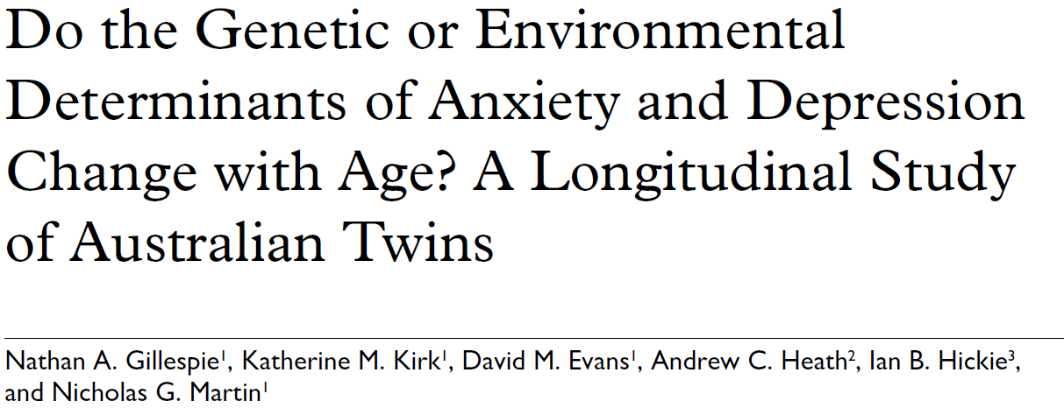
Growth curve modeling ? If you’re interested in growth
trajectories. Linear or non-linear:
Autoregressive modeling ? If you’re interested in e.g. the genetic stability of a trait (e.g combining data).
Can be combined (Nathan Gillespie)

Slide 8
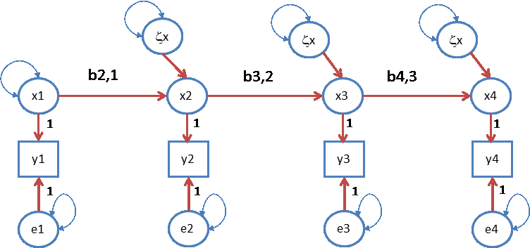
First order autoregression model.
Innovation
var(x₁)
True score
Observation
var(e₁)
“error” / residual
y_{ti} = b_{0t} + x_{ti} + e_{ti} (measurement model)
x_{ti} = b_{t-1,t} x_{t-1i} + ζx_{ti} (structural model)

Slide 9
First order autoregression model.
var(e₁)
var(e₄)
Identification issue: var(e₁) and var(e₄) are not identified. Solution set to zero, or equate :
var(e₁) = var(e₂) , var(e₃) = var(e₄)
Notes:
Ar(1) as a phenotypic model

Slide 10
.51
.51
.51
ζx
ζx
ζx
1
.7
.7
.7
x1
x2
x3
x4
1
1
1
1
y1
y2
y3
y4
1
1
1
1
e1
e2
e3
e4
.25
.25
.25
.25
Covariance matrix
1.250 0.70 0.49 0.343
0.700 1.25 0.70 0.490
0.490 0.70 1.25 0.700
0.343 0.49 0.70 1.250
Correlation matrix
1.0000 0.560 0.392 0.2744
0.5600 1.000 0.560 0.3920
0.3920 0.560 1.000 0.5600
0.2744 0.392 0.560 1.0000
Cov y1,y2: (0.7*1 = 0.7; cov y1, y2 = 0.7*0.7*1 = 0.49, etc.

Slide 11
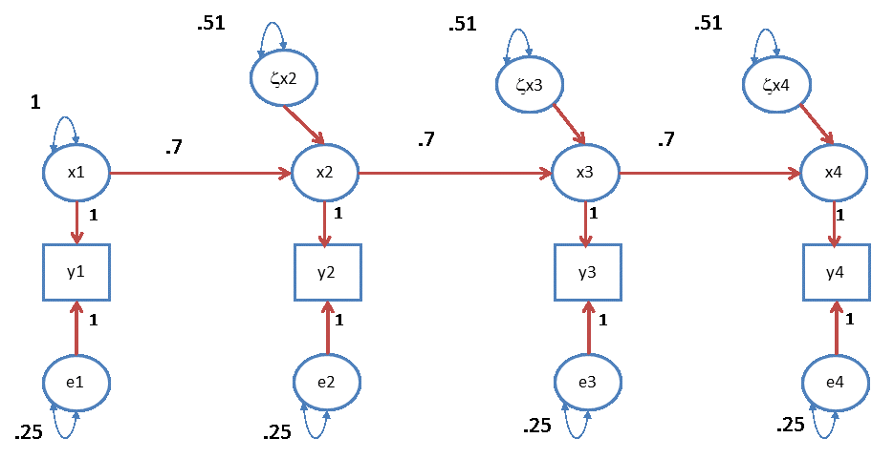
reliability: rel(x_{t}) = var(x_{t}) / {var(x_{t}) + var(e_{t})}
= 1/ (1+.25) = 1/1.25 = .8
R²: b_{t-1,t}² var(x_{t-1}) / {b_{t-1,t}² var(x_{t-1}) + var(ζx_{t})}
= {.7² * 1} / (.7² * 1 + .51) = .49/1 = .49
Correlation (t,t+1) : b_{t-1,t} var(x_{t-1}) / {sd(y_{t-1}) * sd(y_{t})}
={.7 * 1} / {√ 1.25*√1.25} = .56

Slide 12
0
0
0
ζx2
ζx3
ζx4
x1
x2
x3
x4
1
1
1
1
y1
y2
y3
y4
1
1
1
1
e1
e2
e3
e4
What happens if var(zxt) = 0? (i.e. no innovation).
The answer is in the next slide. This slide is followed by a presentation of the model in matrix notation. For you to study later.

Slide 13
Special case: factor model var(ζx_{t}) (t=2,3,4) = 0
b_{2,1}
b_{3,2}
b_{4,3}
x1
x2
x3
x4
1
1
1
1
y1
y2
y3
y4
1
1
1
1
e1
e2
e3
e4
x1
y1
y2
y3
y4
1
1
1
1
e1
e2
e3
e4

Slide 14
These models can be applied to phenoypic, genetic and environmental timeseries.
Estimation of genetic and environmental correlations
Animal / experimental studies
Bi/multivariate twin / family analyses
Bivariate SNP analyses
LD-score regression

Slide 15
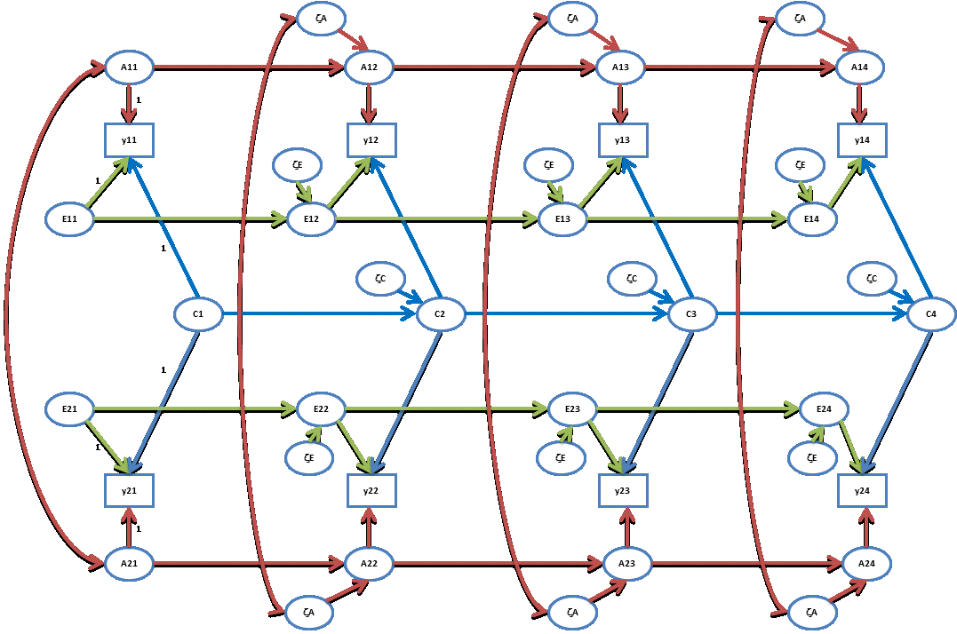

Slide 16
Multivariate decomposition of phenotypic covariance matrix (TxT, say T=4):
Σ_{ph} = Σ_{A} + Σ_{C} + Σ_{E}
Σ_{ph1} Σ_{ph12}
Σ_{ph12} Σ_{ph2} =
Σ_{A} + Σ_{C} + Σ_{E} r⊗Σ_{A} + Σ_{C} + Σ_{E}
r⊗Σ_{A} + Σ_{C} + Σ_{E} Σ_{A} + Σ_{C} + Σ_{E}
(r=1 or .5)

Slide 17
Σ_{ph} = Σ_{A} + Σ_{C} + Σ_{E}
Estimate Σ_{A} directly, unstructured
a TxT covariance matrix, with
T*(T+1) / 2 elements
T=4 ...... T*(T+1) / 2 = 10

Slide 18
Σ_{ph} = Σ_{A} + Σ_{C} + Σ_{E}
Model Σ_{A} using a simplex model
Σ_{A} = (Ι−Β)_{A}⁻¹ Ψ_{A} (Ι−Β)_{A}^{-1t} + Θ_{A}
R script involves matrix notation .....

Slide 19
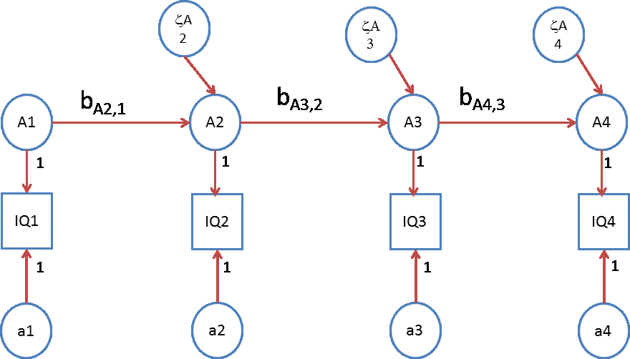
Σ_{A} = (Ι−Β_{A}) ⁻¹ Ψ_{A} (Ι−Β_{A}) ⁻¹ ^{t} + Θ_{A}
Β_{A} = 0 0 0 0
b_{A21} 0 0 0 0 b_{A32} 0 0
0 0 b_{A43} 0

Slide 20
Σ_{A} = (Ι−Β_{A}) ⁻¹ Ψ_{A} (Ι−Β_{A}) ⁻¹ ^{t} + Θ_{A}
Ψ_{A} = var(A₁) 0 0 0
0 var(ζ_{A2}) 0 0 0 0 var(ζ_{A3}) 0
0 0 0 var(ζ_{A4})

Slide 21
Σ_{A} = (Ι−Β_{A}) ⁻¹ Ψ_{A} (Ι−Β_{A}) ^{−1τ} + Θ_{A}
Θ_{A} = var(a₁) 0 0 0
0 var(a₂) 0 0 0 0 var(a₃) 0
0 0 0 var(a₄)
Constraint on residuals, e.g.:
var(a1)=var(a2)=var(a3)=var(a4)

Slide 22
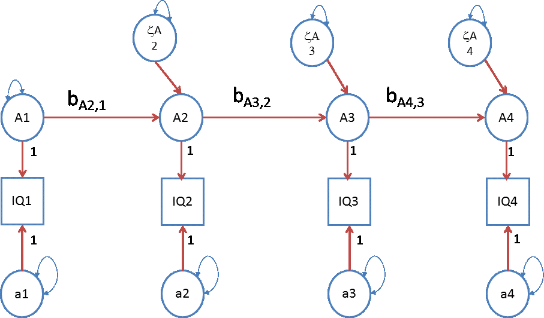
The genetic A simplex .....
.... same applies to C and E

Slide 23
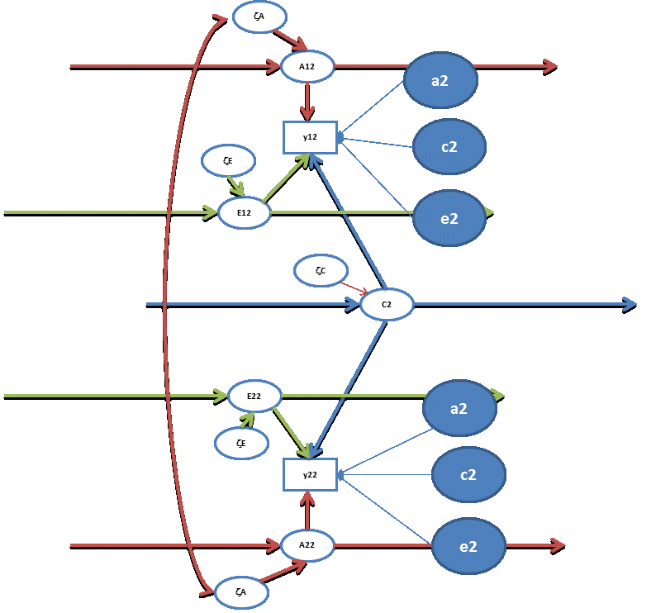
Occasion specific effects
required:
var(a1) = var(a2)
var(a3) = var(a4)
var(e1) = var(e2)
var(e3) = var(e4)
var(c1) = var(c2)
var(c3) = var(c4)

Slide 24
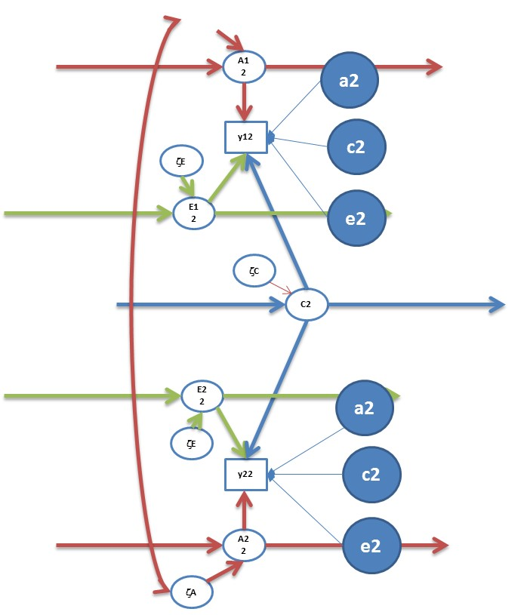
Question: h², c², and e² at each time point?
var(y_{t}) =
{var(A_{t}) + var(a_{t})} +
{var(C_{t}) + var(c_{t})} +
{var(E_{t}) + var(e_{t})}
h²= {var(A_{t}) + var(a_{t})} / var(y_{t})
c²= {var(C_{t}) + var(c_{t})} / var(y_{t})
e²= {var(E_{t}) + var(e_{t})} / var(y_{t})

Slide 25
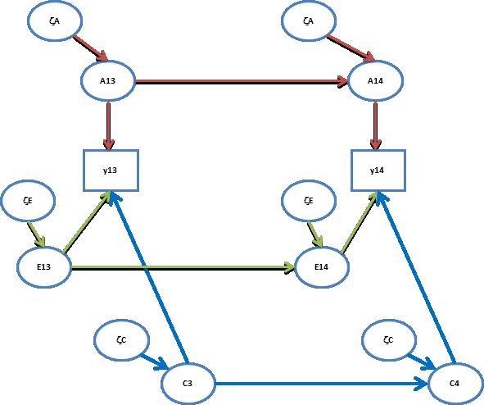
Q: contributions to stability (A,C,E) t-1 to t?
b_{At-1,t}² var(A_{t-1}) / {b_{At-1,t}² var(A_{t-1}) + var(ζA_{t})}
b_{Ct-1,t}² var(C_{t-1}) / {b_{Ct-1,t}² var(C_{t-1}) + var(ζC_{t})}
b_{Et-1,t}² var(E_{t-1}) / {b_{Et-1,t}² var(E_{t-1}) + var(ζE_{t})}
R² (pheno) =
R² (add gen) +
R² (shared env) +
R² (unshared env)

Slide 26
contributions of A to Phenotypic stability t-1 to t
b_{At-1,t}² var(A_{t-1})
{b_{At-1,t}² var(A_{t-1}) + var(ζA_{t})} + {b_{Ct-1,t}² var(C_{t-1}) + var(ζC_{t})}
+ {b_{Et-1,t}² var(E_{t-1}) + var(ζE_{t})}

Slide 27
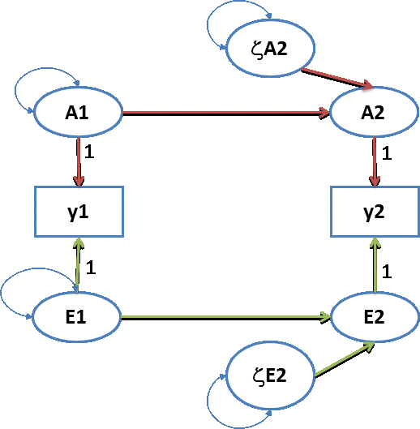
.0195
Σ_{A} = .2 .184
.184 .2
.2
.95
Σ_{E} = .8 .4
.4 .8
.8
Σ_{y} = Σ_{A} + Σ_{E} = 1 .584
.584 1
.5
.6
h² at t=1? answer: .2 (e²=.8)
h² at t=2? answer: .2 (r²=.8)
correlation between A1 and A2? .184 / (√.2*√.2) = .92
correlation between E1 and E2? . 4 / (√.8*√.8) = .50
covariance between Y1 and Y2? .584
contribution of A to covariance Y1 and Y2? .184/.584 = .315
contribution of E to covariance Y1 and Y2? .4/.584 = .685

Slide 28
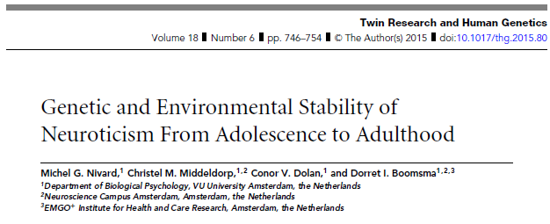
This stability model can be applied at the genetic and non-genetic level.

Slide 29
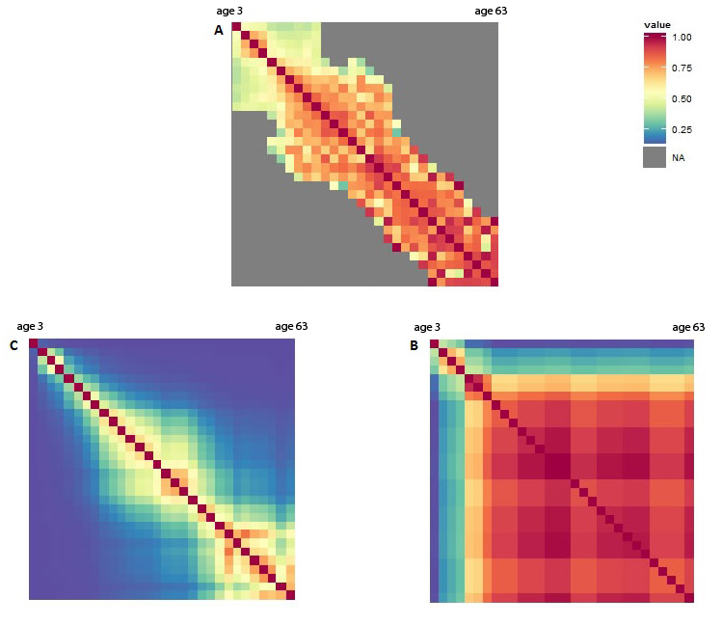
Phenotypic
e.g. Nivard et al, 2014
A
E
Anx/depression stability due to A and E from 3y to 63 years

Slide 30
1
1
1
1
A1
A2
A3
A4
0.81 (0.11)
0.87 (0.051)
0
0
A1
A2
A3
A4
0.76 (0.25)
0.87 (0.12)
0.34 (0.30)
1
1
1
1
tt1
tt2
tt3
tt4
Genetic Simplex (type D personality). Latent factors in circles, twin-time data in squares. Loadings from latent to observed traits and variation of innovations constrained at 1. Correlations between twins are specified at the level of the innovations (1 for MZ and 0.5 for DZ pairs).

Slide 31
1
1
1
1
A1
A2
A3
A4
0.81 (0.11)
0.87 (0.051)
0
0
A1
A2
A3
A4
0.76 (0.25)
0.87 (0.12)
0.34 (0.30)
1
1
1
1
tt1
tt2
tt3
tt4
Innovation genetic variance
Variance due to Genetic Transmission
Total V(A)

Slide 32
1
1
1
1
A1
A2
A3
A4
0.81 (0.11)
0.87 (0.051)
0
0
A1
A2
A3
A4
0.76 (0.25)
0.87 (0.12)
0.34 (0.30)
1
1
1
1
tt1
tt2
tt3
tt4
A Innovation | 0.81^2=0.66 | 0.87^2=0.76 | 0 | 0
Transmission | - | 0.66*0.76=0.50 | 1.26*0.87=1.10 | 1.10*0.34
Total V(A) | 0.66 | 1.26 | 1.10 | 0.37

Slide 33
We will look at several approaches in an analysis of BMI data in young twins from the Netherlands Twin Register.
1) Saturated model
2) Cholesky ‘model’ (decomposition)
3) Simplex model
The BMI data set has data on 35,120 kids starting at birth.
We selected kids with complete data only and will analyze BMI at age 4, 7, 9 and 12 years.

Slide 34
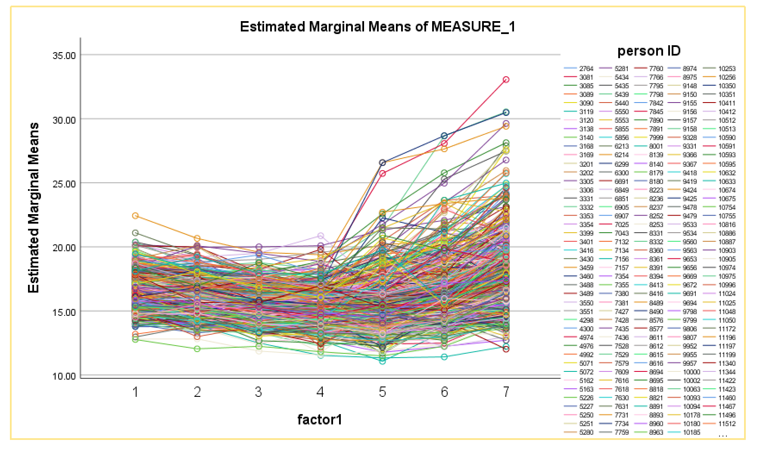
For 7 ages: 1.5, 2, 3, 4 , 7, 10 and 12 years (N= 734): individual data

Slide 35
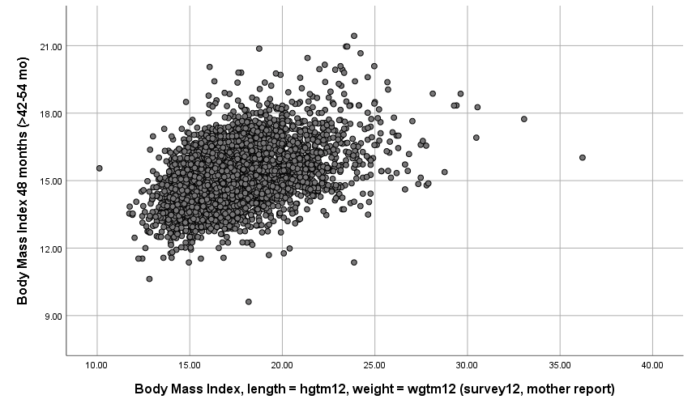
overweight
obese
www.voedingscentrum.nl/professionals/kindervoeding-0-4-jaar/babyenkindervoeding/bmi-jongens-en-meisjes.aspx

Slide 36
Correlations
BMI across age (bold: all data / below diagonal : complete data)
BMI 4 yr 1 .580 .493 .431
BMI 7 yr .590 1 .729 .658
BMI 10 yr .515 .743 1 .785
BMI 12 yr .442 .670 .803 1

Slide 37
1990-2017 trends in overweight and obesity for kids 4-18 year

Slide 38
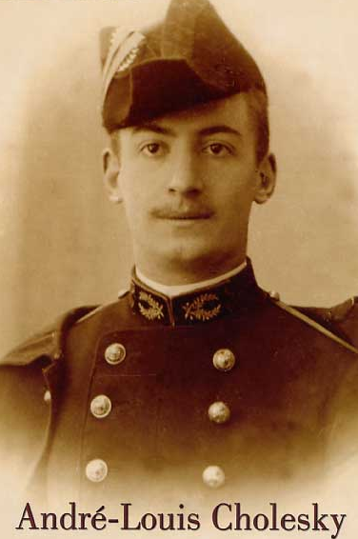
QUIZ
1) you have > 1 observation per person (from twin pairs) and fit a saturated model: what is the output / information ?
2) on the same data you fit a Cholesky decomposition: what is the information contained in the output?
3) if you aim for a model which recognizes time dependency in data what are the options?

Slide 39
QUIZ
1) > 1 observation per person (from twin pairs) and fit a saturated model: what is the output / information ?
????????????????
...
...

Slide 40
QUIZ
1) > 1 observation per person (from twin pairs) and fit a saturated model: what is the output / information ?
????????????????
An estimate for the mean value of the traits in twins
An estimate of the correlation for all traits in (MZ and DZ) pairs
An estimate of the phenotypic correlation between traits
An estimate of the (MZ and DZ) cross-correlations between traits
All of the above (except a))

Slide 41
QUIZ
2) on the same data you fit a Cholesky ‘model’ (decomposition): what is the information contained in the output?
The phenotypic correlations
The genetic correlations
The environmental correlations
b and c

