Slide 1
Univariate Modeling in umx
Timothy C. Bates
tim.bates@ed.ac.uk

Slide 2
Roadmap for this interactive tutorial on Univariate Twin Analysis
Introducing and installing umx
Using umx to model genetic and environmental effects on total variance of a trait
umxACEv models with ACE and ADE decomposition
Comparing models
umxCompare to compare umxACEv() and umxACE() models
Testing fit of reduced models
umxModify to create AE, CE and E-Only Models

Slide 3
Installing umx
Typically installing umx from CRAN will be fine
install.packages("umx")
At the workshop, we might roll out new features, so using the development version will give access to these for everyone during the workshop
devtools::install_github("tbates/umx")
Note: this requires install.packages("devtools")
Dependencies
umx will try and install all its dependencies, but cannot always catch everything it needs
The response is straightforward: Read those messages and just install the package(s) being requested
So if the message “There is no package "XML" ”
install.packages("XML")
devtools::install_github("tbates/umx")

Slide 4
What version of umx, OpenMx, R do I have?
umxVersion()
umx version: 3.0.6
OpenMx version: 2.17.2.12 [GIT v2.17.2-12-gbe68a5e]
R version: R version 3.6.1 (2019-07-05)
Platform: x86_64-apple-darwin15.6.0
MacOS: 10.15.4
Default optimizer: CSOLNP
NPSOL-enabled?: Yes
OpenMP-enabled?: Yes
You can update OpenMx with:
install.OpenMx(c("NPSOL", "travis", "CRAN", "open travis build page")

Slide 5
General production line
make → modify → compare → summarize → plot
m1 = umxACEv(mzData = mzData, dzData= dzData)
umxSummary(m1)
plot(m1)
m2 = umxACE(mzData = mzData, dzData= dzData)
umxCompare(m1, m2)
m3 = umxModify(m1, "c_r1c1", comparison = TRUE)

Slide 6
umx implements a wide range of Twin Modeling Functions
umxACEv, umxACE
Factor models:
umxCP()
umxIP()
Gene-environment interaction
umxGxE(), umxGxEbiv(), umxGxE_window
Others:
umxSexLim
umxMendelianRandomization()
umxSimplex
umxDoC
Path-based SEM
umxTwinMaker
Each has a umxSummary() and plot() method
Many other functions, e.g.
umxReduce()
umxEFA()
Explore ?umx
Look at the families of functions
Look at the help!
umx help has path diagrams, lots of real examples

Slide 7
Many other handy functions
Other Reporting Functions
parameters()
Show model parameters
umxAPA:
formats many things
umx_set_optimizer()
umx_set_auto_plot()
power.ACE.test(AA = .3, CC = 0, update = c"a", MZ_DZ_ratio= .85, n= 141, power = NULL, method = "empirical")
Twin Data functions
umx_long2wide()
umx_wide2long()
umx_make_TwinData()
Simulate twin data, inc GxE
umx_make_MR_data()
umx_residualize()
Flexible residualization, inc. twin data
umx_scale_wide_twin_data()
Allows scaling of wide data
umx_make_twin_data_nice

Slide 8
How to run an ACE analysis in umx
umxACEv()
Read the help ?umxACEv
umxACE()
Read the help ?umxACE

Slide 9
umxACEv: Many parameters… most can be ignored!
umxACEv(name = "ACE", selDVs, dzData, mzData, sep)
Less-often used parameters: , dzAr = 0.5, dzCr = 1, type, addStd = TRUE, addCI = TRUE, numObsDZ, numObsMZ, boundDiag, weightVar, equateMeans = TRUE, bVector = FALSE, autoRun, optimizer
nb: Some options not completed. e.g. fixed-effect covariates

Slide 10
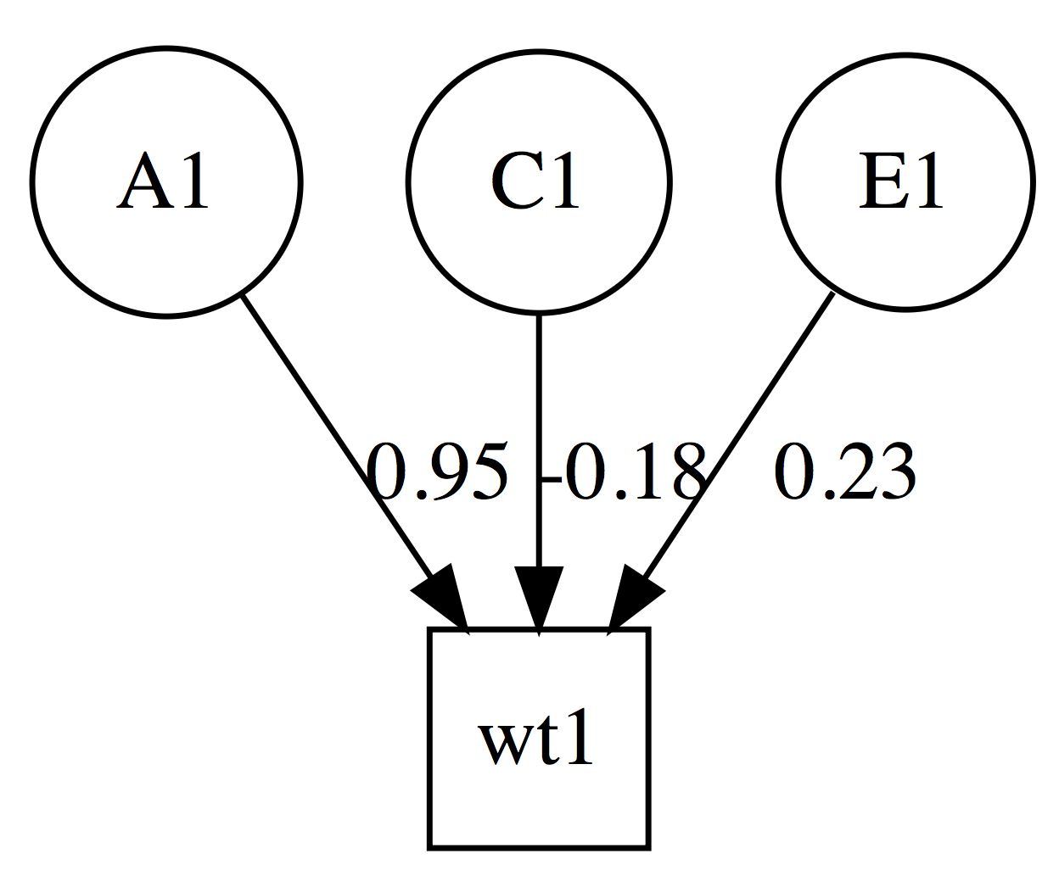
umxACEv: just the parameters we need
m1 = umxACEv(selDVs = "wt", suffix ="", dzData=dzData, mzData=mzData)
All variables continuous
treating data as raw
Running ACE with 4 parameters
ACE -2×log(Likelihood) 27278.55 (df=4)
Standardized solution
| | A1| C1| E1|
|:---|----:|-----:|----:|
|wt1 | 0.95| -0.18| 0.23|

Slide 11
plot(model)
plot() will make a graph, and open it in your browser
Can also output pdf or .dot
OmniGraffle or VISIO to edit plots for publication.
umx_set_auto_plot(TRUE/FALSE)
umx_set_plot_file_suffix()

Slide 12
What’s in the file plot() saves? Graphviz “dot” language (like S (R’s parent), invented at Bell Laboratories
digraph G { splines = "FALSE"; # Latents a1 [shape = circle]; c1 [shape = circle]; e1 [shape = circle]; # Manifests ht1 [shape = square]; a1 -> ht1 [label = "0.92"]; c1 -> ht1 [label = "0.14"]; e1 -> ht1 [label = "0.36"]; {rank = same; ht1 }; {rank = min ; a1 }; {rank = max ; c1; e1 }; }

Slide 13
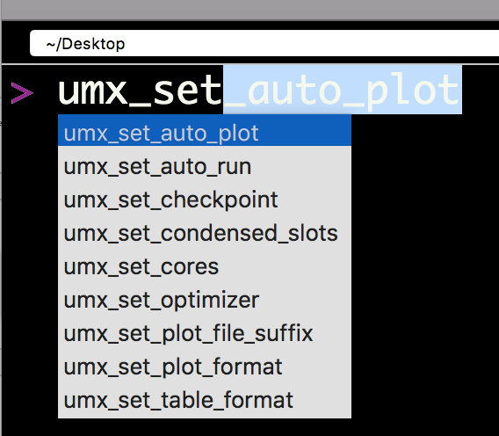
Table output
Markdown by default
Can be latex, html,…
umx_set_table_format()
Current format is'markdown'. Valid options are 'latex', 'html', 'markdown', 'pandoc', and 'rst'>

Slide 14
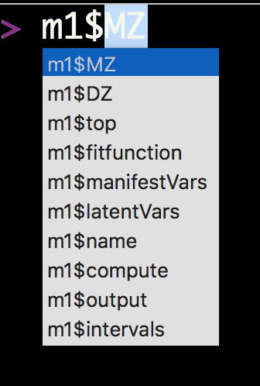
What’s inside this model?
“top” is a model that contains all the shared matrices and algebras
MZ is a model contains the MZ data and how to optimize this
DZ is a model contains the DZ data and how to optimize this

Slide 15
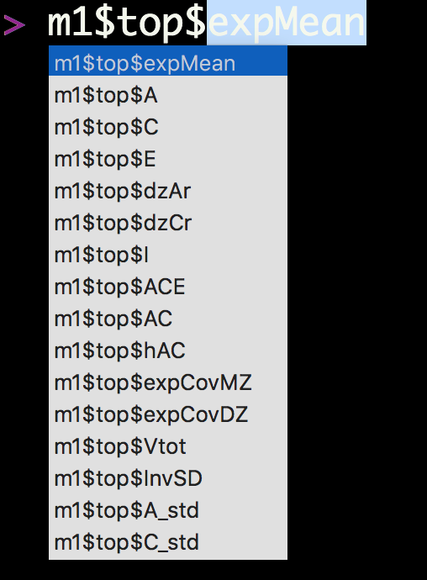
What’s inside top?
A, C, and E are matrices for our three variance components.
dzAr and dzCr are our .5 and 1 expected correlations for DZs

Slide 16
FullMatrix 'expMean’
$labels wt1 wt2
means "expMean_r1c1" "expMean_r1c1”
$values wt1 wt2
means 58.81 58.81
$free wt1 wt2
means TRUE TRUE

Slide 17
SymmMatrix 'A'
$labels [,1]
[1,] "A_r1c1”
$values [,1]
[1,] 82.36
$free [,1]
[1,] TRUE
$lbound: No lower bounds assigned.
$ubound: No upper bounds assigned.

Slide 18
m1$top$ACE
mxAlgebra 'ACE’
$formula: A + C + E
$result: [,1]
[1,] 86.61276
dimnames: NULL

Slide 19
m1$top$expCovMZ
mxAlgebra 'expCovMZ’
$formula: rbind(cbind(ACE, AC), cbind(AC, ACE))
$result: wt1 wt2
wt1 86.61 66.35
wt2 66.35 86.61
dimnames: [1] "wt1" "wt2"
[2] "wt1" "wt2"

Slide 20
Univariate model of weight
#' # ======================= #' # = Univariate model of weight = #' # ======================= #' require(umx) #' data(twinData) # ?twinData from Australian twins. #' #' # Things to note: ACE model of weight will return a NEGATIVE variance in C. #' # This is why we have ACEv! It suggests we need a different model #' # In this case: ADE. #' # Other things to note: #' # 1. umxACEv can figure out variable names: provide "sep" and "wt" -> "wt1" "wt2" #' # 2. umxACEv picks the variables it needs from the data. #' #' mzData = twinData[twinData$zygosity %in% "MZFF", ] #' dzData = twinData[twinData$zygosity %in% "DZFF", ]
#' m1 = umxACEv(selDVs = "wt", sep = "", dzData = dzData, mzData = mzData)

Slide 21
ADE model
ADE model
What’s the difference for ACE and ADE?
Just change dzCr to .25

Slide 22
Evidence for dominance ? (DZ correlation set to .25)
m2 = umxACEv(selDVs ="wt", sep = "", dzData = dzData, mzData = mzData, dzCr = .25)
note: the underlying matrices are still called A, C, and E.
I catch this in the summary table, so columns are labeled A, D, and E.
However, currently, the plot will say A, C, E.

Slide 23
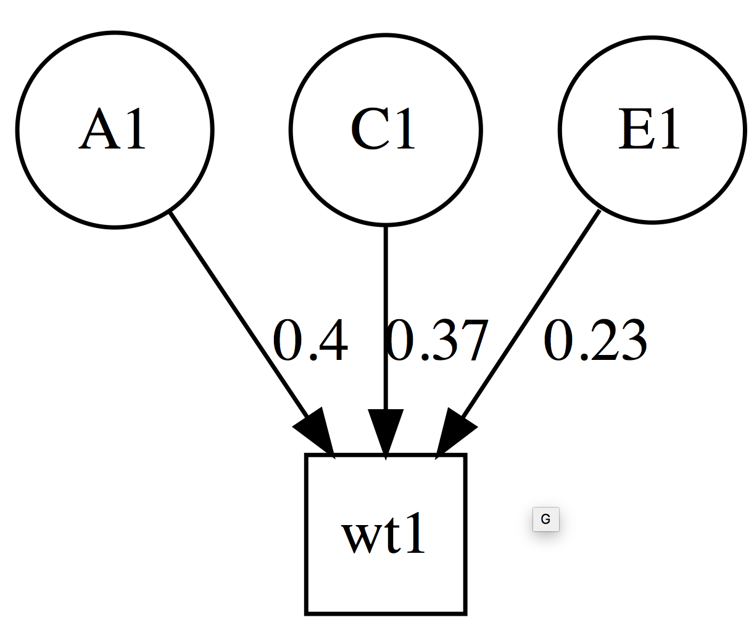
Table and plot: what changed?
| | A1| D1| E1|
|:---|---:|----:|----:|
|wt1 | 0.4| 0.37| 0.23|

Slide 24
Something to Try:
umxSummary(m2, report="html")
What happened?

Slide 25
umxACE
?umxACE
m1=umxACE(selDVs="wt", sep="", dzData=dzData, mzData=mzData)
ACE -2 × log(Likelihood)'log Lik.' 27287.23 (df=4)
Standardized solution
| | a1|c1 | e1|
|:---|----:|:--|----:|
|wt1 | 0.87|. | 0.49|

Slide 26
umxACE with dominance instead of C
m2 = umxACE("ADE", selDVs = selDVs, sep="", dzData = dzData, mzData = mzData, dzCr = .25)
umxCompare(m2, m1) # ADE seems better?
| | a1| d1| e1|
|:---|----:|----:|----:|
|wt1 | 0.63| 0.61| 0.48|

Slide 27
What about if we compare umxACEv and umxACE?
m1 = umxACEv("ADEvari", selDVs = selDVs, sep="", dzData = dzData, mzData = mzData, dzCr = .25)
m2 = umxACE("ADEchol", selDVs = selDVs, sep="", dzData = dzData, mzData = mzData, dzCr = .25)
umxCompare(m1,m2)
|Model | EP|∆ -2LL |∆ df |p | AIC|Compare with Model |
|:-------|--:|:------|:----|:--|--------:|:------------------|
|ADEvari | 4| | | | 19506.55| |
|ADEchol | 4|0 |0 | | 19506.55|ADEvari |

Slide 28
Modify model
umxModify allows you to modify, re-run and summarize a model.
new= umxModify(m1, update="label",
name = "newName", comparison=TRUE)
Less commonly needed parameters
master = NULL, regex = FALSE, free = FALSE, value = 0, newlabels = NULL, freeToStart = NA, name = NULL, verbose = FALSE, intervals = FALSE, comparison = FALSE, autoRun = TRUE)

Slide 29
Modify model
m3 = umxModify(m2, update = "C_r1c1", name = "AE", comparison = T)
This will:
Make a new model “m3” with name “AE”
Drop parameter "C_r1c1” from this model
Run the new model
Print a comparison of fit of m2 and m3

Slide 30
We can modify this model, dropping dominance component (matrix is still called C)
m3= umxModify(m2,update="C_r1c1",comparison=T, name="AE")
| | A1|D1 | E1|
|:---|----:|:--|----:|
|wt1 | 0.76|. | 0.24|
|Model | EP|∆ -2LL |∆ df |p | AIC | Compare with Model|
|:-----|--:|:------|:----|:-----|--------:|:------------------|
|ADE | 4| | | | 19506.55| |
|AE | 3|8.675 |1 |0.003 | 19513.23|ADE |

Slide 31
We can attempt to drop A
m4= umxModify(m2,update="A_r1c1",comparison=T, name="DE")
umxCompare(m2, c(m3, m4))
|Model | EP|∆ -2LL |∆ df |p | AIC|Compare with Model |
|:-----|--:|:---------|:----|:-----|--------:|:------------------|
|ADE | 4| | | | 19506.55| |
|AE | 3|8.6750179 |1 |0.003 | 19513.23|ADE |
|DE | 3|8.2983642 |1 |0.004 | 19512.85|ADE |

Slide 32
Easter egg: umxReduce()
Try umxReduce(m1) where m1 is your umxACE model
(or a umxGxE() model…)
It will do all the sensible things an expert might wonder about:
C or D?
Drop C?
Drop A?

Slide 33
Well done!
#================================================== # = Well done!
# = Now you can make and modify twin models
# = in umx ☺
#==================================================

