Slide 1
Multivariate Models
  ACE
    umxACEv; umxACE
  Factor models:
    Independent Pathway: umxIP
    Common Pathway: umxCP

Slide 2
Baseline “model” vs. models that expose theory to risky tests of their predictions
Are my phenotypes influenced by the same genes?
Is there more than one ”set” of gene effects?
Decompose depression into components?
Do A, C, E factors contribute in the same ways to the covariance between traits?

Slide 3
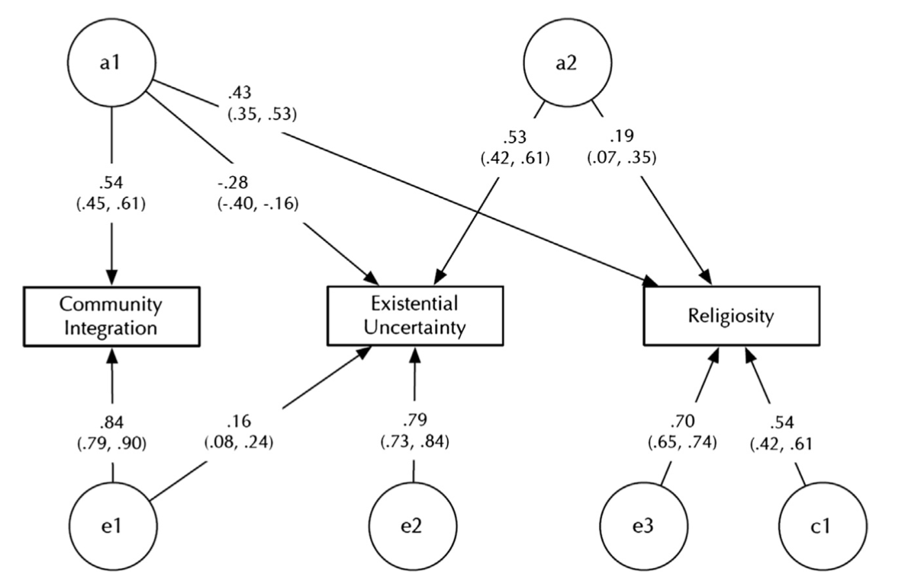

One trait or more?
Is community the same (genetically) as religiosity?

Slide 4
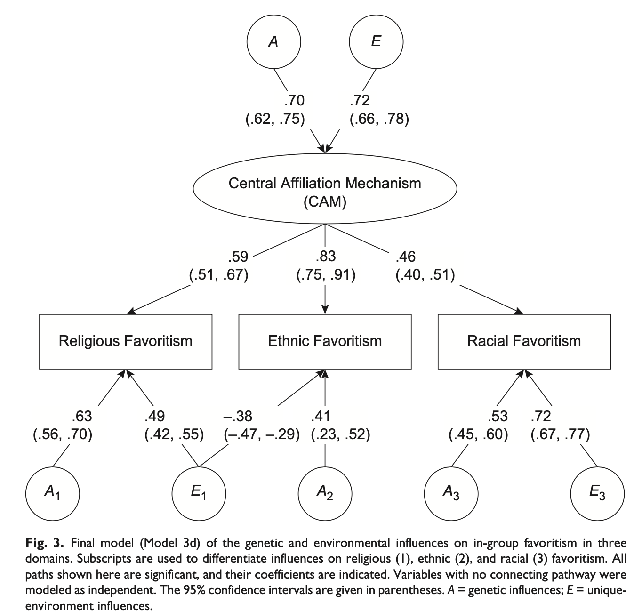

What is the human affiliation system(s)?

Slide 5
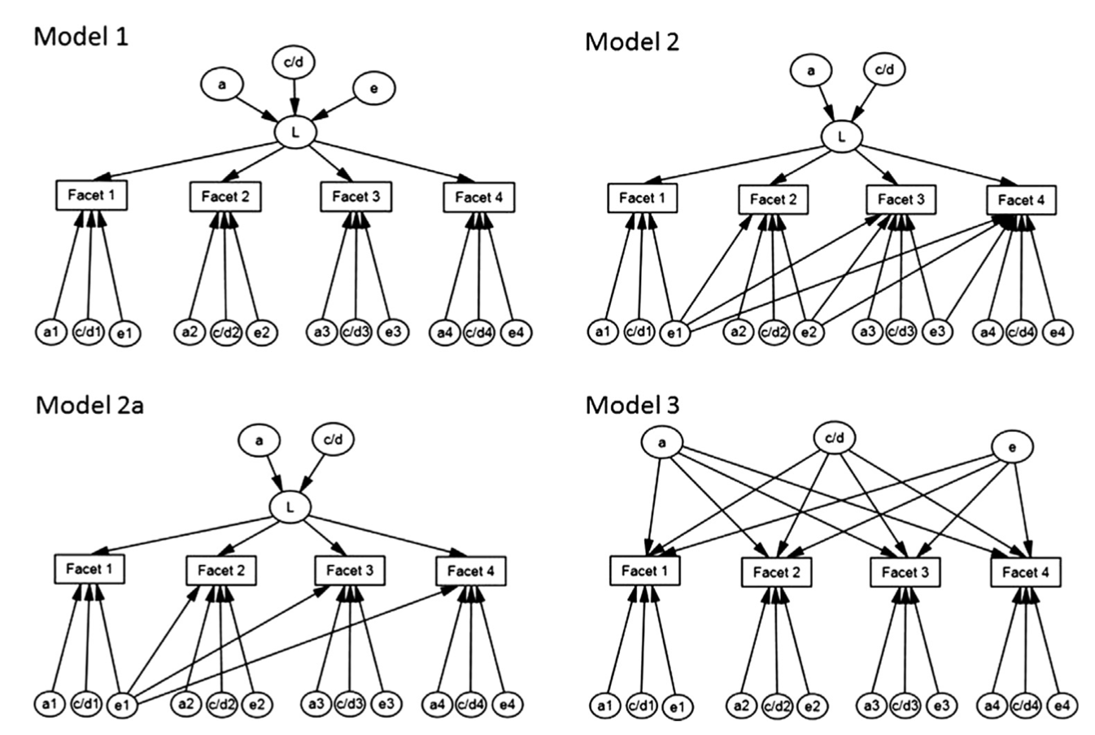

Do genes operate via personality domains? Or only via facet-facet associations?

Slide 6

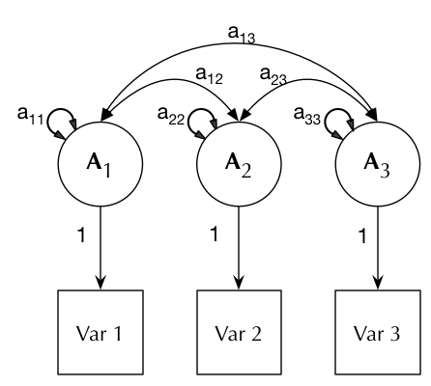
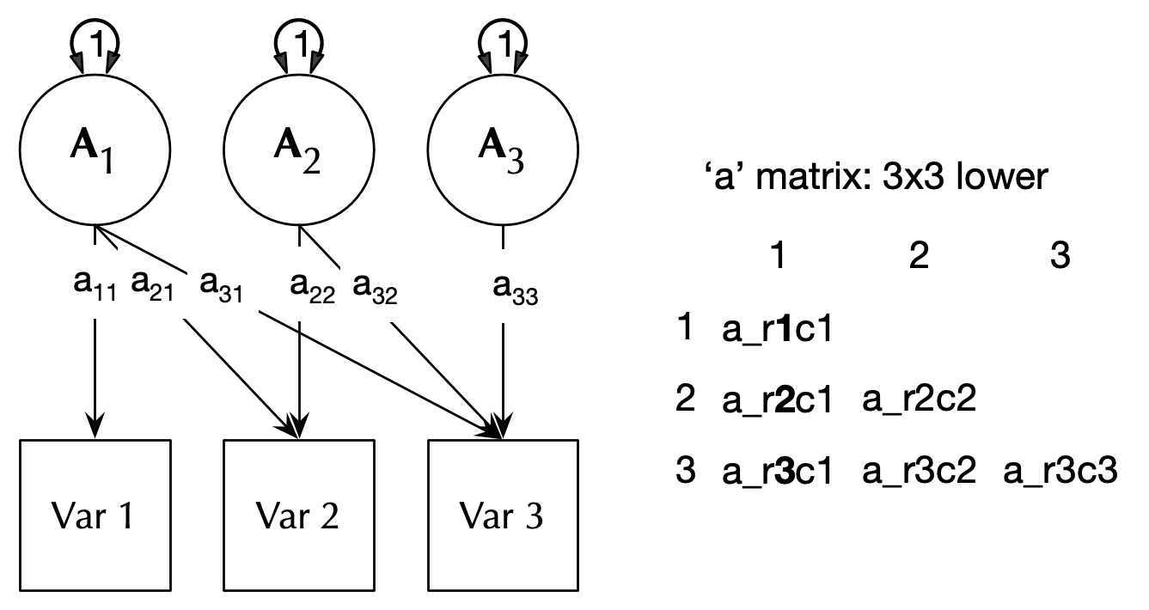
We’ve been introducing the ACEv model.
And the ACE Cholesky model

Slide 7
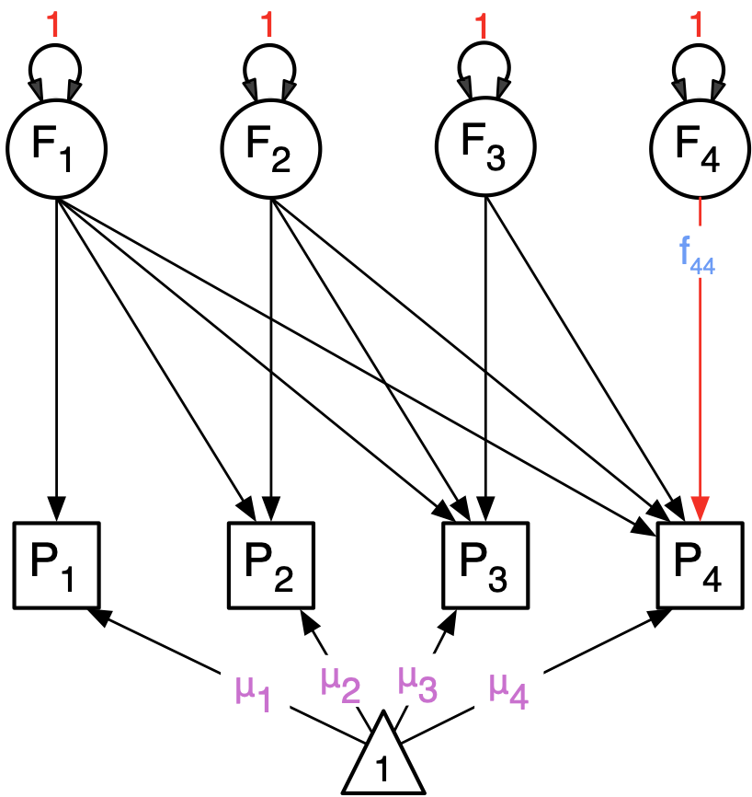
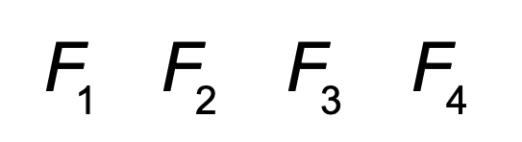
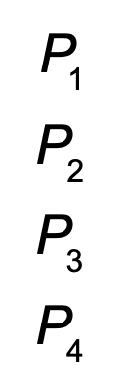
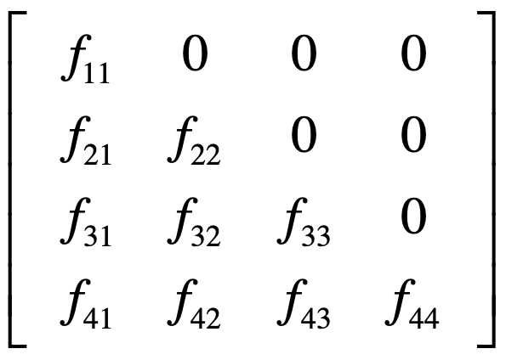
The Cholesky decomposition: Factors load on all Variables but those previous

Slide 8
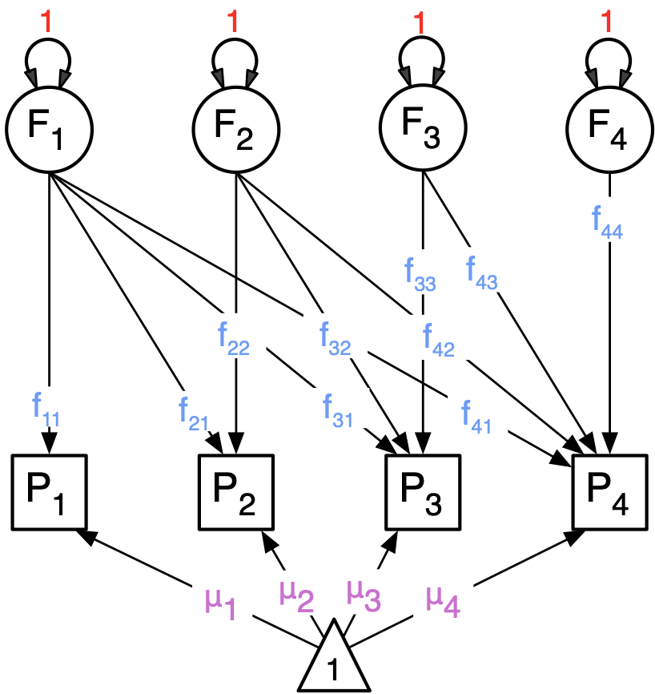
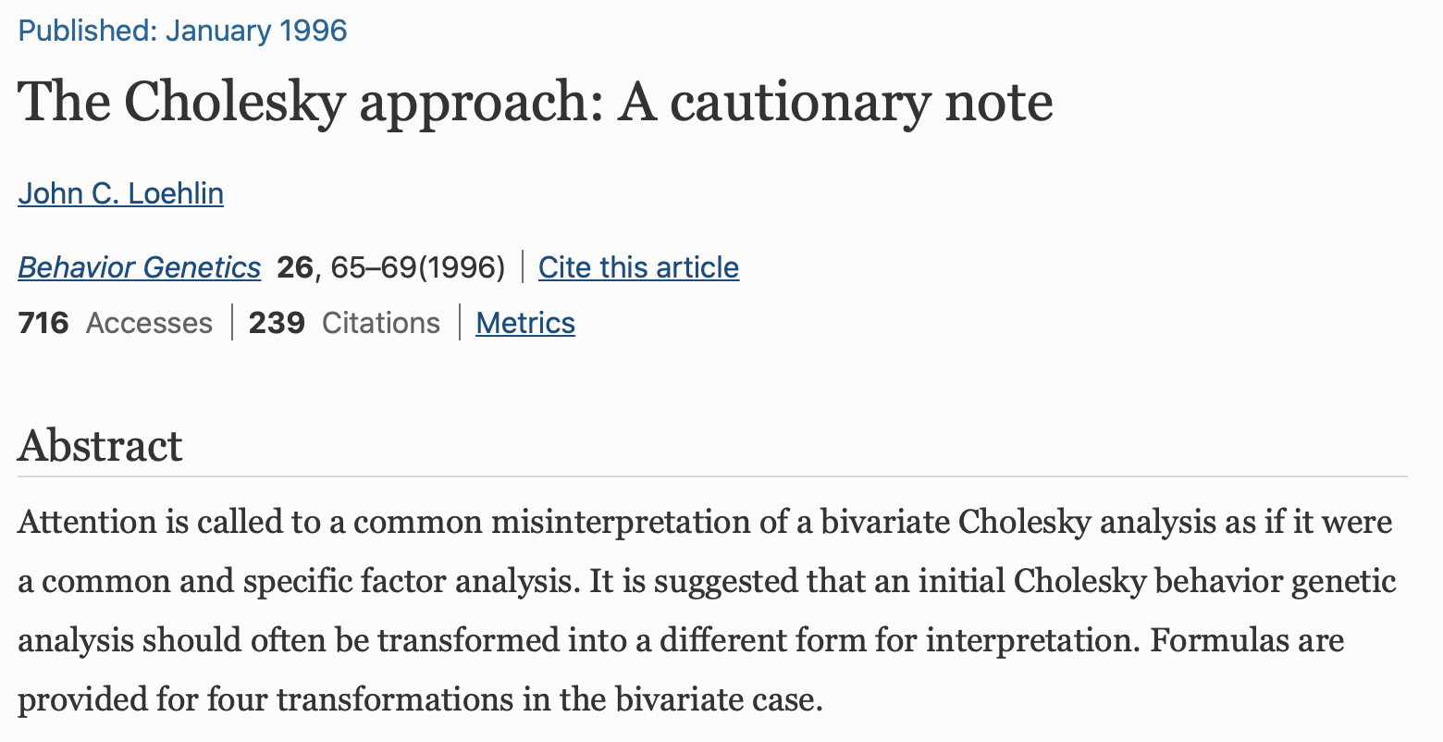
Can we re-arrange this model?
(Think factor analysis and factor rotation)

Slide 9
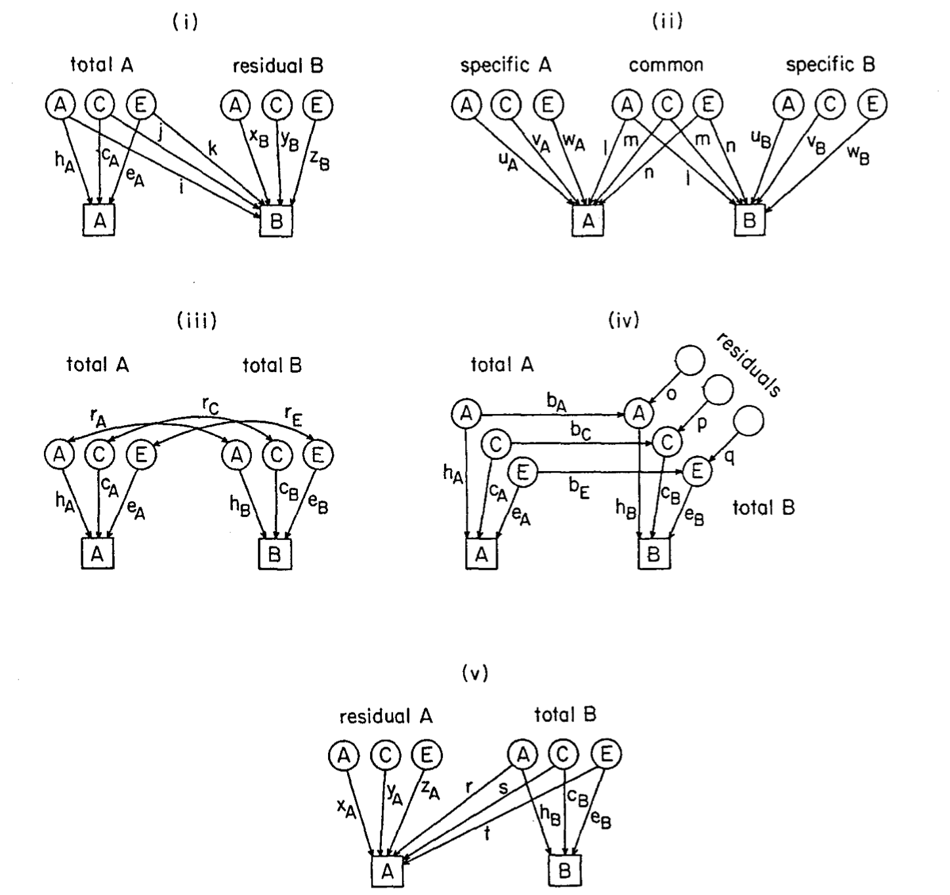
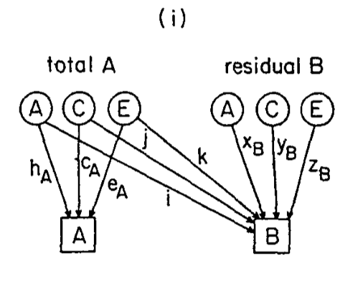
All equivalent

Slide 10
Theoretical Models
Independent Pathway
Common Pathway

Slide 11
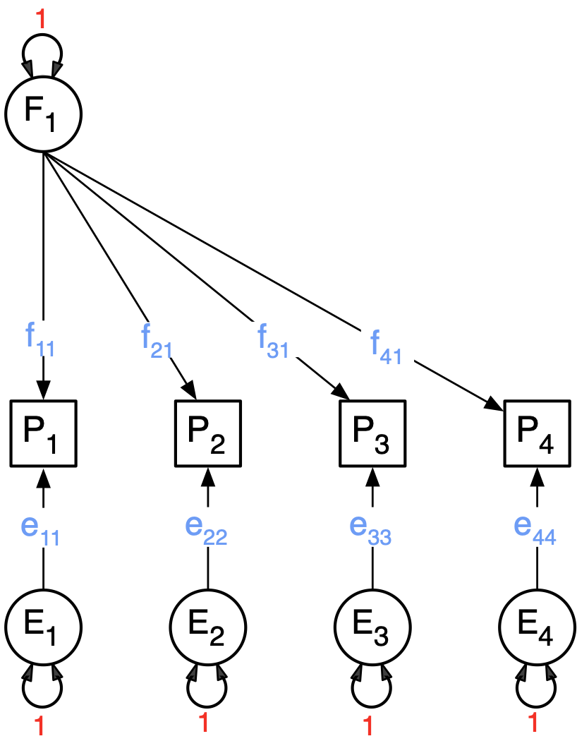

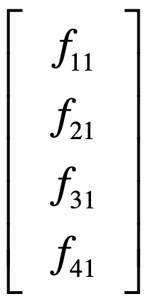
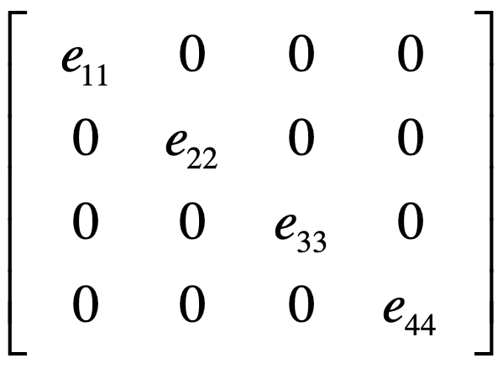
General factor + Residuals

Slide 12
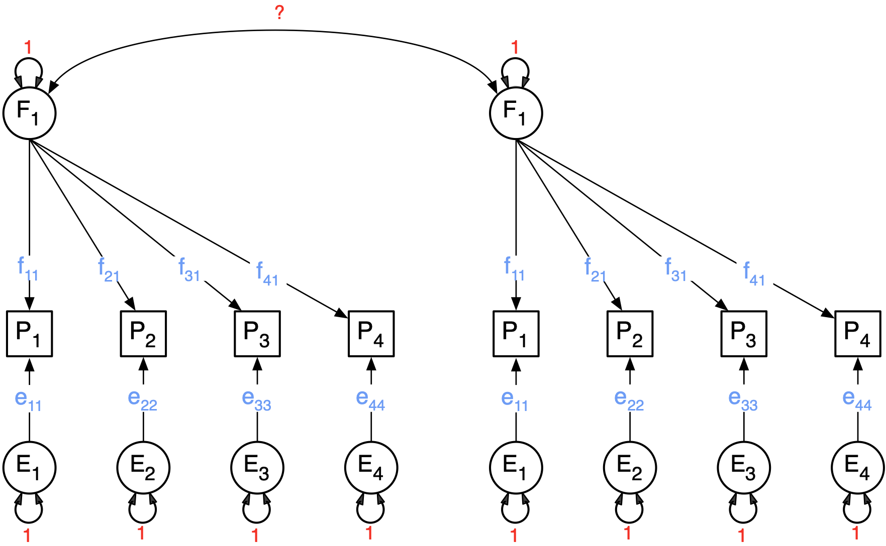
In Twins we duplicate this for a pair (or more), and then duplicate the result for MZ and DZ (or more)

Slide 13
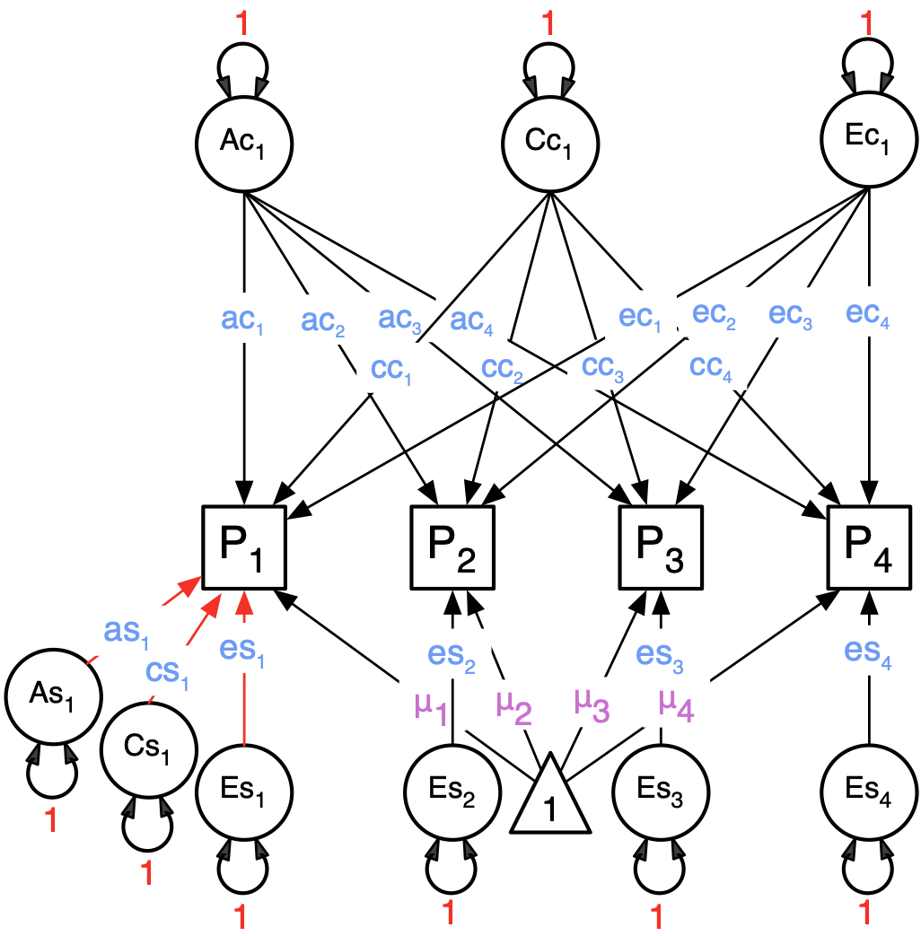
Independent Pathway Model
  Biometric model
  Allows covariance structures for A, C and E to differ among each other

Slide 14
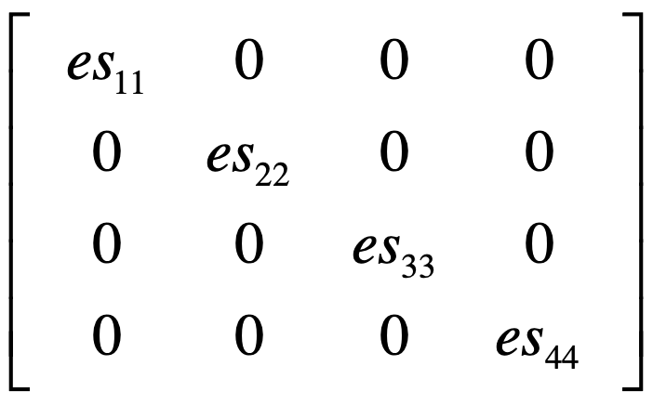
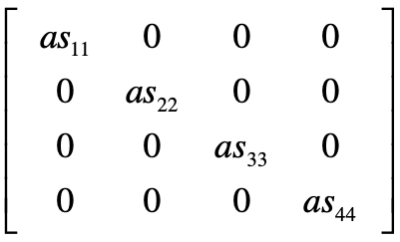
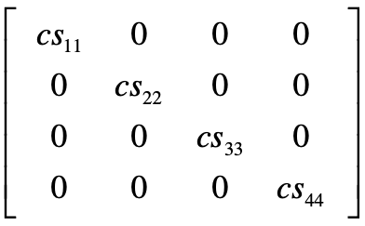
General A, C, and E factors, and A, C, and E Specific factors

Slide 15
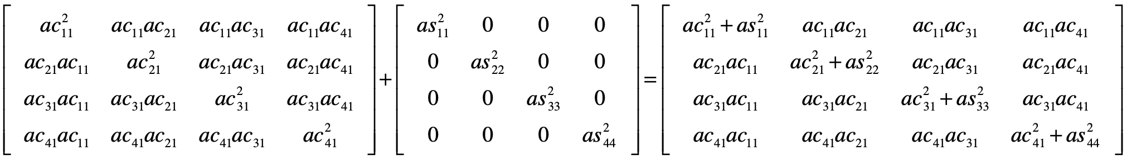
Total A Covariance: we add up the components
ac %*% t(ac)
as %*% t(as)
object: CovA
matrix name:A
covA <- mxAlgebra( expression=ac %*% t(ac) + as %*% t(as), name="A" )

Slide 16
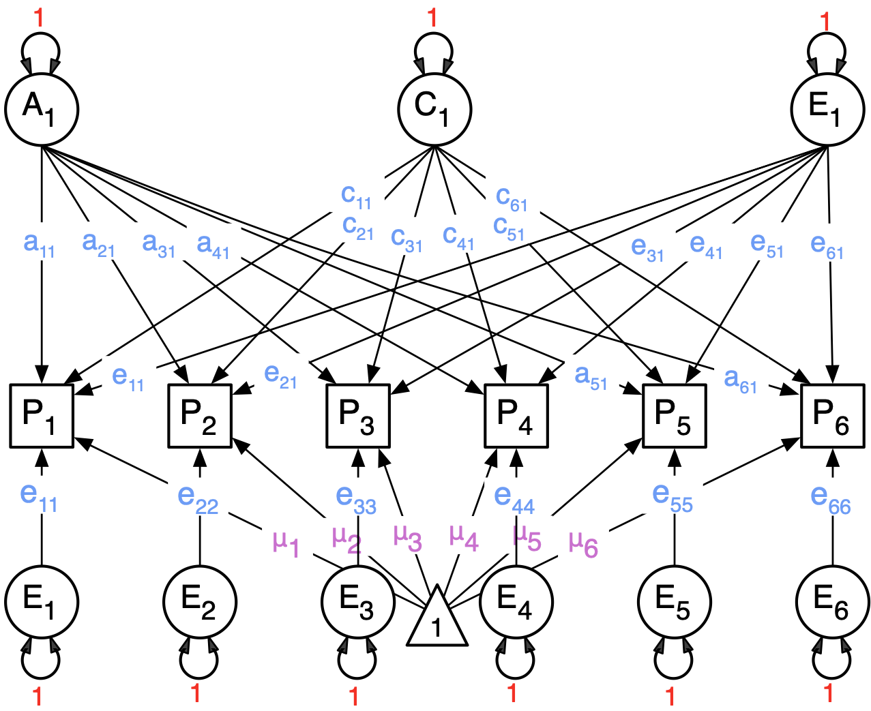
IP Model: Can we add more general factors?

Slide 17
Identification
Be careful when adding factors: total parameters per source of variance can not exceed (nv*(nv+1))/2
For a common factor with only 2 indicators the two factor loadings on the latent factor need to be equated OR instead a correlation could be estimated between the residual factors (of the same source of variance) on the two indicators.

Slide 18
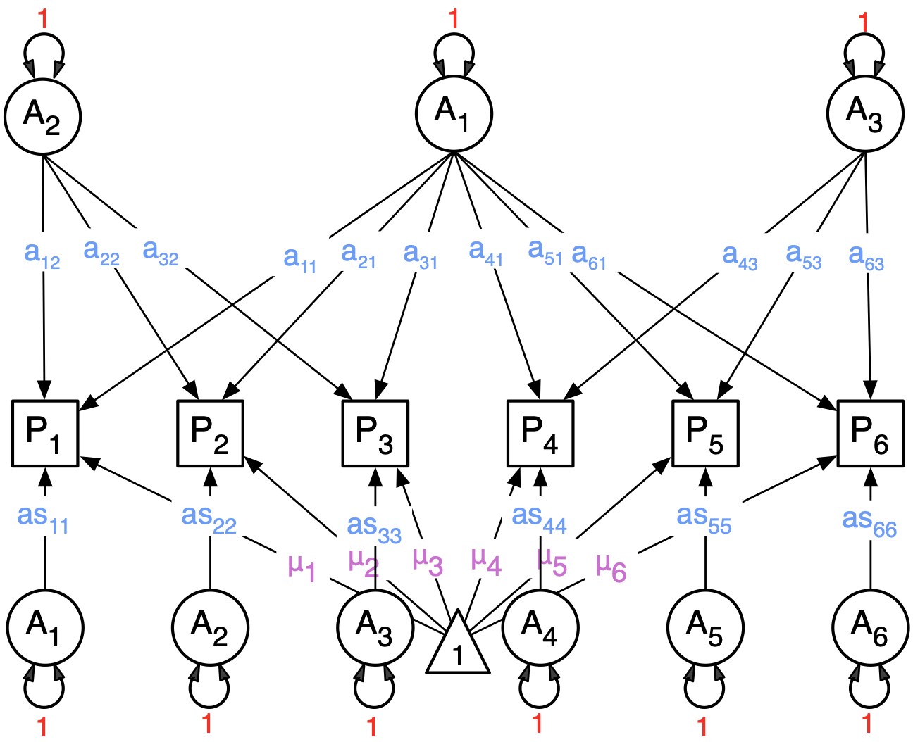
Bi-factor model implemented as 3 factors with a bi-factor configuration (1 general)

Slide 19
Common Pathway Model
  Psychometric model
  Same covariance structure for A, C and E

Slide 20
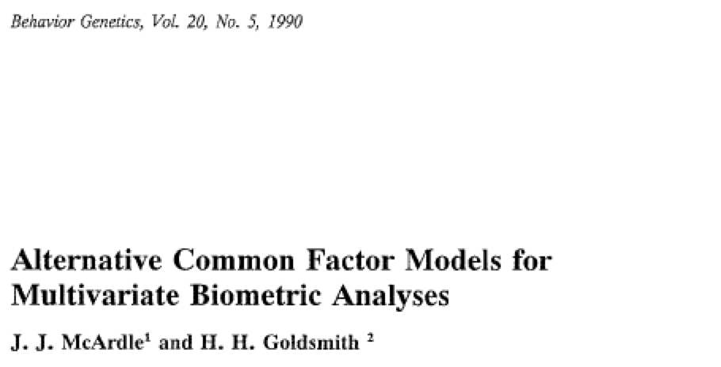
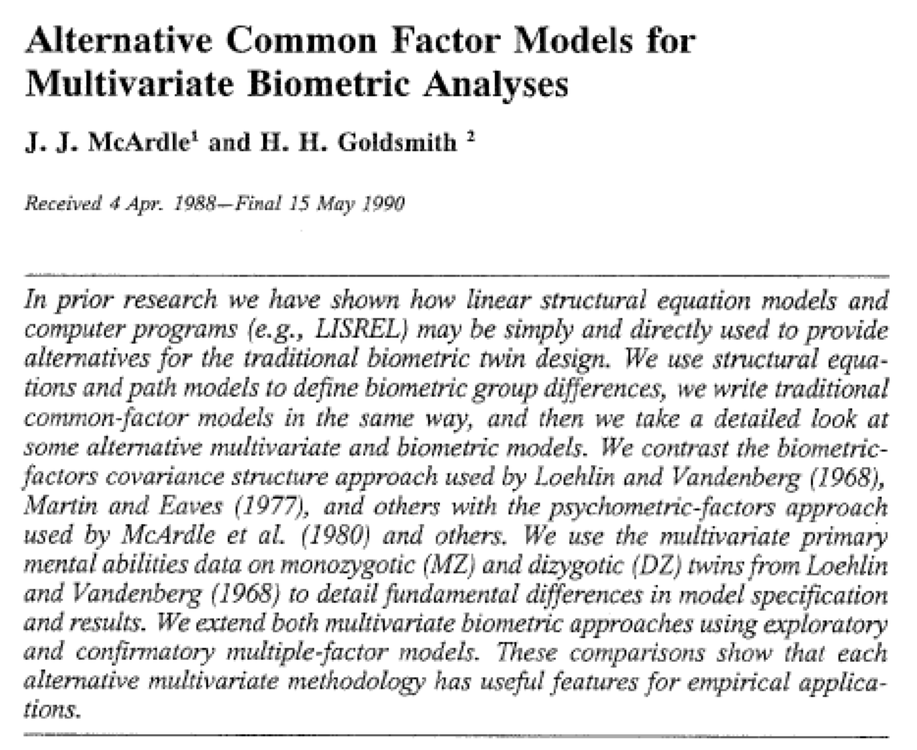

Slide 21
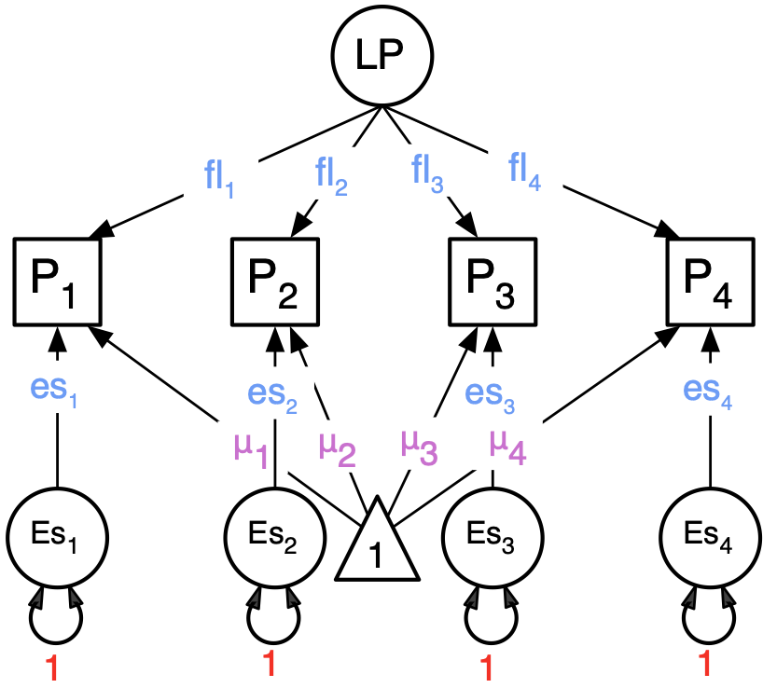
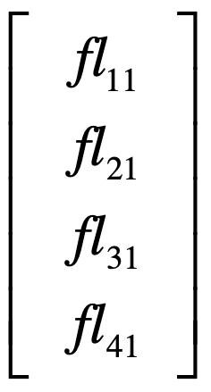
Unlike the IP model, we implement latent traits, and these load (Factor Loadings) on our manifests (“items”)

Slide 22
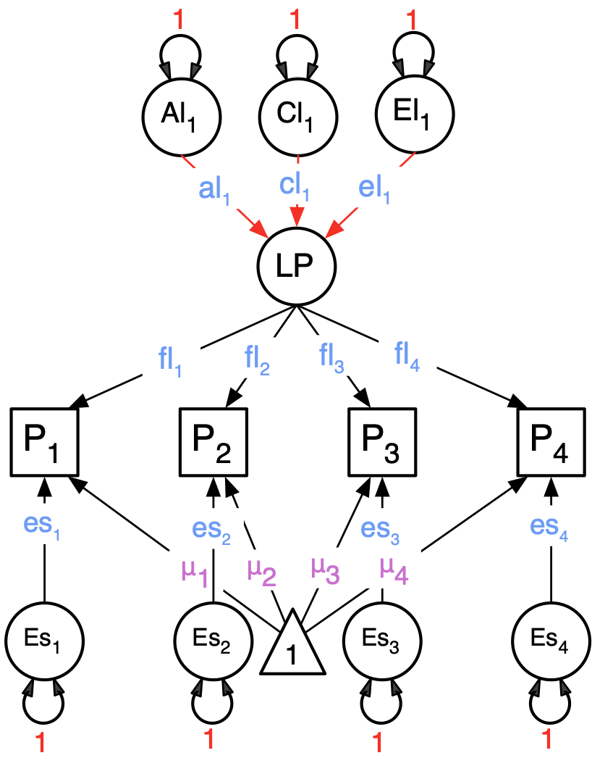
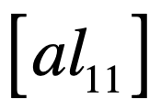
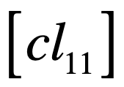
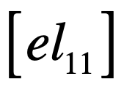
Explaining a Latent Phenotype with ACE components

Slide 23
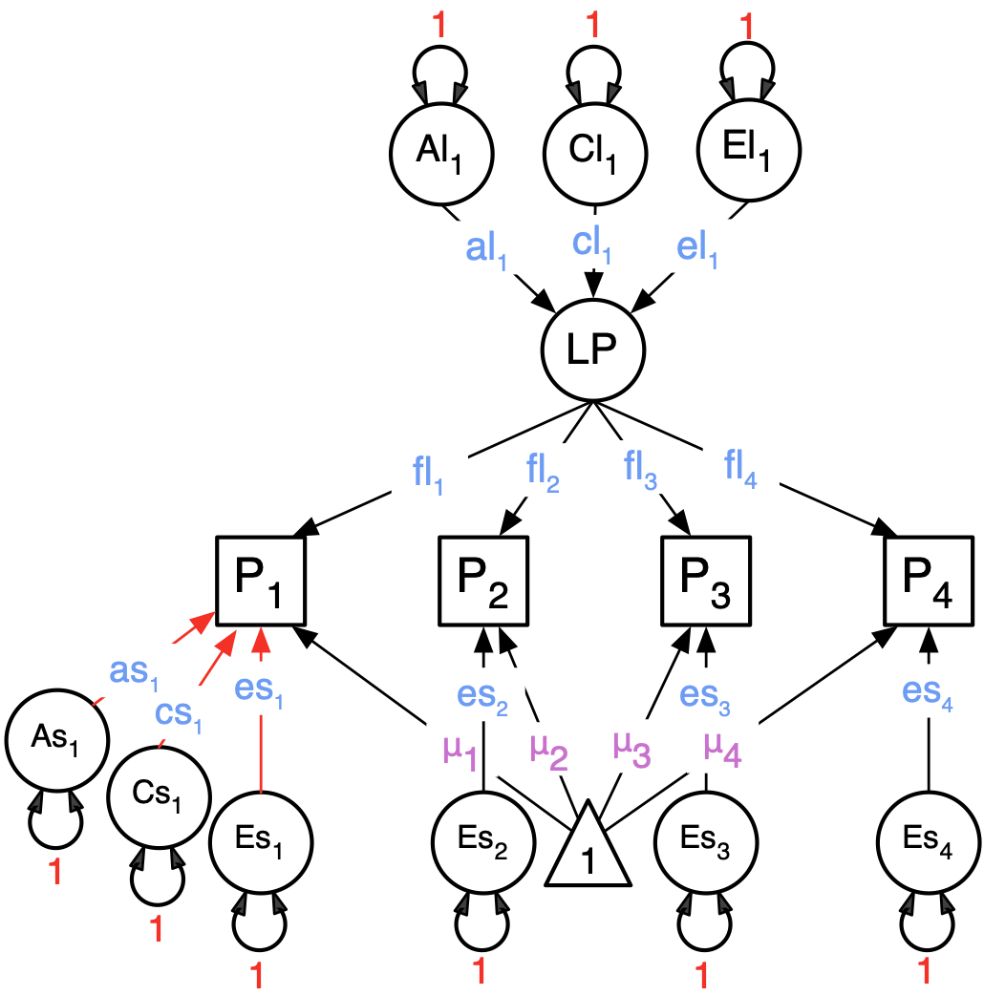
CP Model: Latent common trait + ACE Specifics

Slide 24
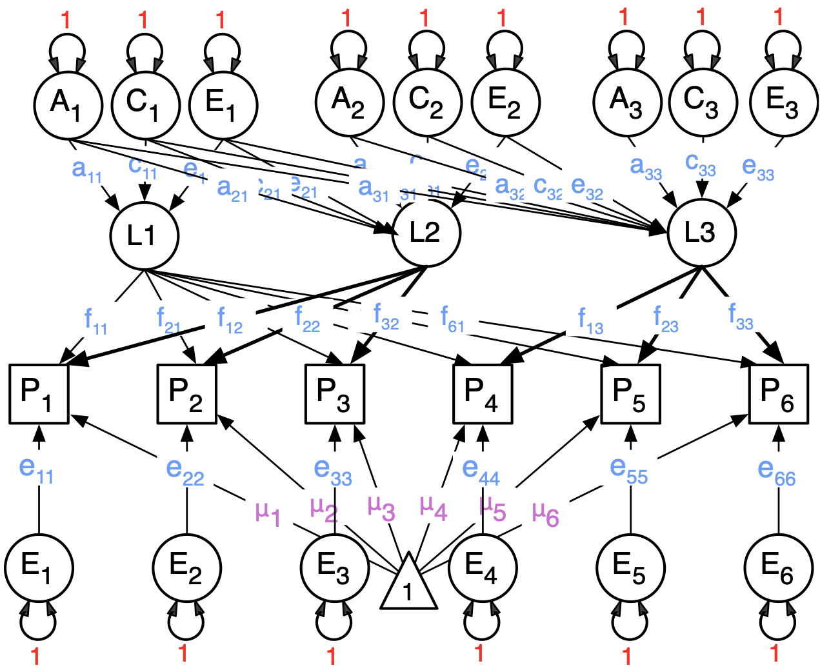
Extensible: 3-factor CP model
(not nearly used widely enough!)

Slide 25
Nesting: Can we get from a CP model to an IP model by deleting paths?
Comparisons require nesting
  (or AIC)

Slide 26
Nesting: Independent Pathway: 3 factors

Slide 27
umxCP & umxIP practical
Timothy C. Bates

Slide 28
Theoretical models of phenotypes

Slide 29
OpenMx note
Some problems are solved more readily by some optimizers than others.
In this case, SLSQP is often better than CSOLNP
umx_set_optimizer("SLSQP")

Slide 30
umxCP parameters
umxCP(name= "CP", selDVs, dzData, mzData, sep, nFac = 1)
Other parameters:
  freeLowerA = FALSE, freeLowerC = FALSE, freeLowerE = FALSE, correlatedA = FALSE, equateMeans = TRUE, dzAr = 0.5, dzCr = 1, addStd = T, addCI = TRUE, autoRun = getOption("umx_auto_run"), optimizer = NULL

Slide 31
umxCP()
Use umxCP() to build m1: A common factor model of the GFF
Does it fit significantly worse than a base model (m0) built with umxACEv() ?
data(GFF)
base=c("gff", "hap", "sat", "AD", "SOMA", "SOC")
tmp= umx_scale_wide_twin_data(base, sep="_T", data=GFF)
mzData= subset(tmp, zyg_2grp == "MZ")
dzData= subset(tmp, zyg_2grp == "DZ")

Slide 32
Running umxCP
m1= umxCP(selDVs= base, sep="_T", mzData=mzData, dzData= dzData)

Slide 33
What does table about “common factor” mean?
'log Lik.' 30945.15 (df=33)
Common Factor paths
| | A| C| E|
|:---------------|---:|----:|----:|
|Common.factor.1 | 0.7| 0.38| 0.61|

Slide 34
Loading of each trait on the Common Factors
| | CP1|
|:----|-----:|
|gff | 0.44|
|hap | 0.81|
|sat | 0.82|
|AD | -0.66|
|SOMA | -0.43|
|SOC | -0.40|

Slide 35
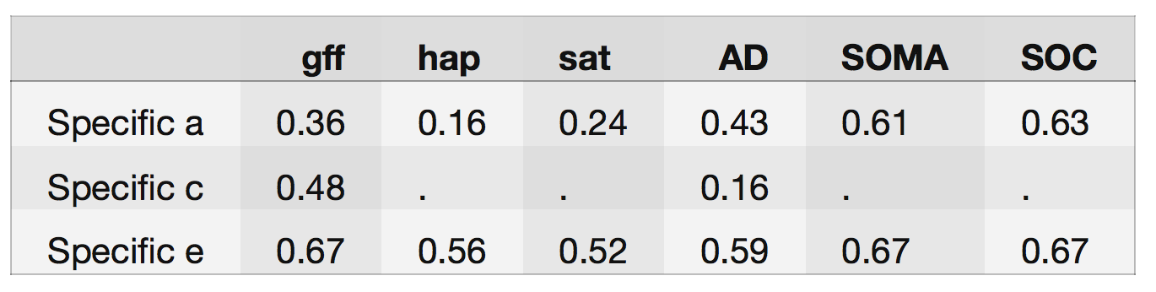
Standardized specific loadings

Slide 36
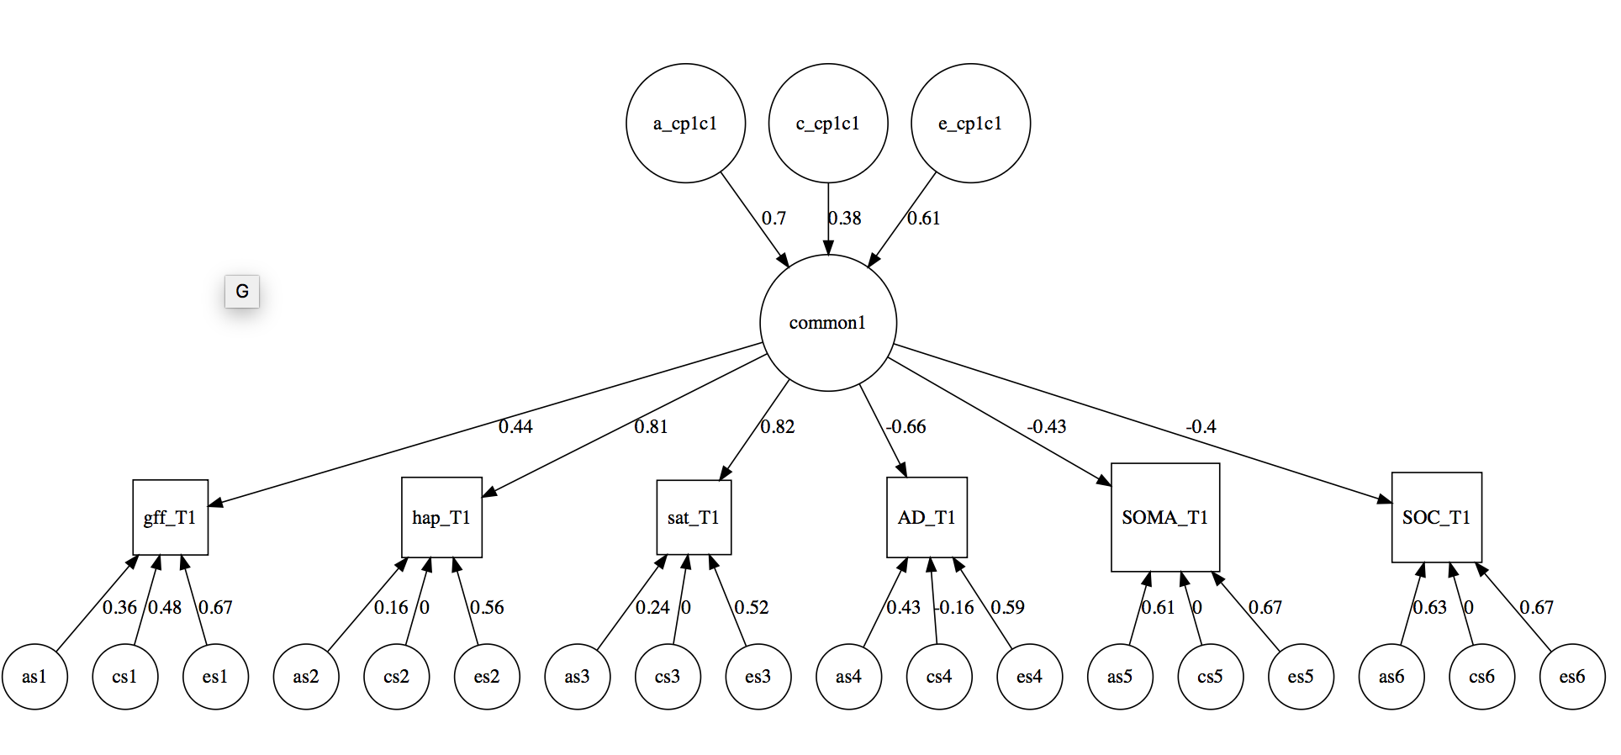

Slide 37
Improve the CP model fit
Make m2 = umxCP() model with 2 common factors
  What did you need to set to do that?
Is it better than the 1 factor model?
  What umx function lets you compare models?
Does it (still) fit significantly worse than the baseline model?
  Can you compare more than one model?

Slide 38
Identification: How many common factors are allowed?
Sources of variance allow us to fit parameters
  Sources of variance = number of phenotypes = “nv” here
Total parameters/nv must be < (nv ∗ (nv + 1))/2
  Why nv*nv+1/2?
For a single common factor with only 2 indicators, you would have to equate the factor loadings of the 2 indicators to identify the model
  Alternatively, remove the common factor and add a correlated residual
If in doubt, try mxCheckIdentification()
  When not identified, lists the offending parameters

Slide 39
umxCompare
umxCompare(base, comparison, all = TRUE, digits = 3)
umxCompare(base = m1, comparison =c(m2, m3) )
umxCompare(base = c(m1, m2), comparison =c(m2, m3) )

Slide 40
Questions
Is a better AIC higher or lower?
Is AIC -2432 or -1980 to be preferred?

Slide 41
Common Pathway fit with different #s of factors
✓ Build a 1-factor model
✓ Build a 2-factor model
Build a 3-factor model
Test for a 1 factor vs a 2 factor vs a 3 factor CP?

Slide 42
Common Pathway Modification
Test for each common factor being A and E (only – no C)?
  Need to drop C from the common factors
Test for every specific factor being only E?
  Hypothesis: Residuals are measurement error (or at least unshared effects)
  Need to drop what from the residuals?
Fit an ADE model
  Does it fit as well or better than ACE?
  What parameter needed to be changed?

Slide 43
Functions that will help: parameters()
parameters(x, pattern = ".*",
digits = 2, thresh = c("all", "above", "below", "NS", "sig"), b = NULL)
  parameters(m1, pattern = "cp")

Slide 44
parameters(m1, pattern="cp")
name Estimate
7 a_cp_r1c1 0.70
8 c_cp_r1c1 0.38
9 e_cp_r1c1 0.61
28 cp_loadings_r1c1 0.45
29 cp_loadings_r2c1 0.83
30 cp_loadings_r3c1 0.82
31 cp_loadings_r4c1 -0.70
32 cp_loadings_r5c1 -0.46
33 cp_loadings_r6c1 -0.39

Slide 45
Functions that will help: umxModify
umxModify(lastFit, update, master, regex = FALSE, free = FALSE, value = 0, newlabels, freeToStart = NA, name, comparison = FALSE, autoRun = TRUE)

Slide 46
Common Pathway Modification
Test for each common factor being A and C (only – no E)?
  Need to drop E from the common factors

Slide 47
Common Pathway Modification
Test for every specific factor being only E?
  Hypothesis: The residuals are measurement error (or at least unshared effects)
  Need to drop what from the residuals?

Slide 48
Common Pathway Modification
Fit an ADE model
  What parameter needed to be changed?
  Does it fit as well or better than ACE?

Slide 49
Common Pathway Modification:
AP (advanced placement question) ☺
A friend thinks common environment determines one common factor, while the others are a mixture of A and C
  Can you test her hypothesis?

Slide 50
Same again for umxIP (independent pathway)
Build a 1 factor IP model
  ip1 = umxIP()
Compare a 1 factor vs a 2 factor vs a 3 factor IP?
Test for each A influence having the same loading?
  What does that imply?
Can you test for every specific factor being only E?
Can you fit an ADE model with umxIP?

