Slide 1
Introduction to
Multivariate Genetic Analysis
Meike Bartels & Lucia Colodro Conde
With thanks to
Hermine Maes, Elizabeth Prom-Wormley, and many others

Slide 4


Slide 5
Looking for a PhD or Postdoc?
PhD project:
Social Media Language and Wellbeing; Understanding the Exposome-Genome interplay
4-years, paid position
Postdoc project
A Comprehensive Framework for Well-being.
In this project we will use genomic, epigenomic, exposome, and well-being data and network approaches to understand the multi-layers interplay
3-years, paid position, 20-40% teaching

Slide 6
Introduction to
Multivariate Genetic Analysis
Meike Bartels & Lucia Colodro Conde
With thanks to
Hermine Maes, Elizabeth Prom-Wormley, and many others

Slide 7
Research Questions
Univariate Analysis:
What are the contributions of additive genetic, dominance/shared environmental, and unique environmental factors to the variance?
Bivariate Analysis:
What are the contributions of genetic, dominance/shared environmental, and environmental factors to the covariance between two traits?

Slide 8
Example 1
Why do traits correlate/covary?
How can we explain the association?
Shared Genes (r_{G})
Shared shared environment (r_{C})
Shared Non-shared environment (r_{E})

Slide 9
Example 2
How do traits develop over time?
Does one trait in childhood lead to another trait in adolesence?
Shared/ Stable Genes (r_{G})
Shared/ Stable shared environment (r_{C})
Shared/ Stable Non-shared environment (r_{E})
Time₁
Time₂

Slide 10
Sources of Information
Two traits measured in twin pairs
Interested in:
  Cross-trait covariance within individuals
  Cross-trait covariance between twins
  MZ:DZ ratio of cross-trait covariance between twins

Slide 11
Paper and Pencil Exercise

Slide 12
Observed Covariance Matrix- Univariate
 | Twin 1 | Twin 2
Twin 1 | Variance T1
Twin 2 | Covariance T1-T2 | Variance T2

Slide 13
Observed Covariance Matrix- Bivariate
Twin 1
Twin 2
 | Phenotype 1 | Phenotype 2 | Phenotype 1 | Phenotype 2
Phenotype 1 | Variance P1
Phenotype 2 | Covariance P1-P2 | Variance P2
Phenotype 1
Phenotype 2
Twin 1
Twin 2

Slide 14
Observed Covariance Matrix
Twin 1
Twin 2
 | Phenotype 1 | Phenotype 2 | Phenotype 1 | Phenotype 2
Phenotype 1 | Variance P1
Phenotype 2 | Covariance P1-P2 | Variance P2
Phenotype 1 | Within-trait P1 | Cross-trait | Variance P1
Phenotype 2 | Cross-trait | Within-trait P2 | Covariance P1-P2 | Variance P2
Twin 1
Twin 2

Slide 15
Observed Covariance Matrix
Twin 1
Twin 2
 | Phenotype 1 | Phenotype 2 | Phenotype 1 | Phenotype 2
Phenotype 1 | Variance P1
Phenotype 2 | Covariance P1-P2 | Variance P2
Phenotype 1 | Within-trait P1 | Cross-trait | Variance P1
Phenotype 2 | Cross-trait | Within-trait P2 | Covariance P1-P2 | Variance P2
Within-twin covariance
Twin 1
Within-twin covariance
Twin 2

Slide 16
Observed Covariance Matrix
Twin 1
Twin 2
 | Phenotype 1 | Phenotype 2 | Phenotype 1 | Phenotype 2
Phenotype 1 | Variance P1
Phenotype 2 | Covariance P1-P2 | Variance P2
Phenotype 1 | Within-trait P1 | Cross-trait | Variance P1
Phenotype 2 | Cross-trait | Within-trait P2 | Covariance P1-P2 | Variance P2
Within-twin covariance
Twin 1
Cross-twin covariance
Within-twin covariance
Twin 2

Slide 17
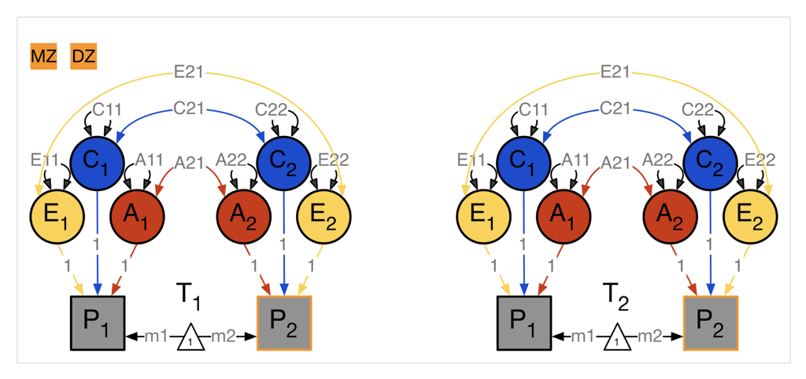
Within-Twin Covariance

Slide 18
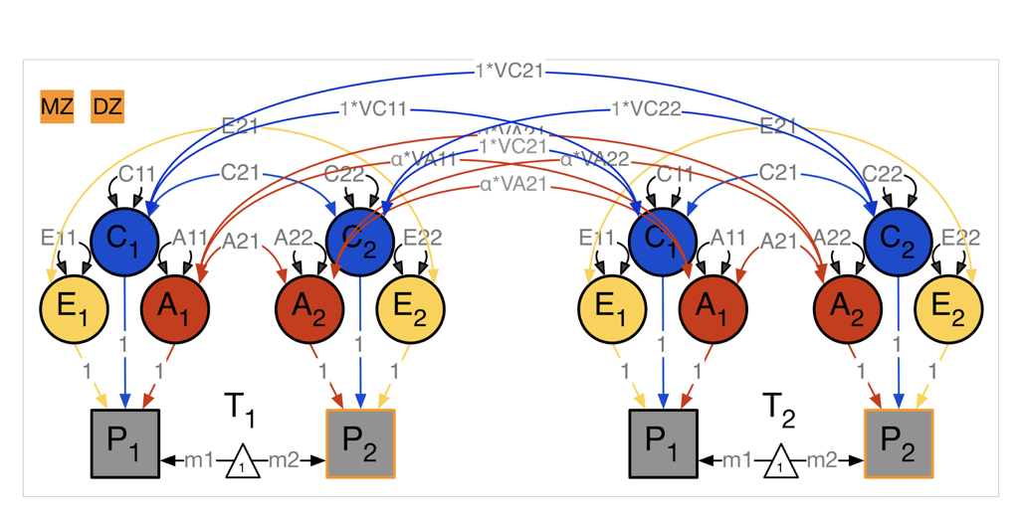
Cross-Twin Covariance

Slide 19
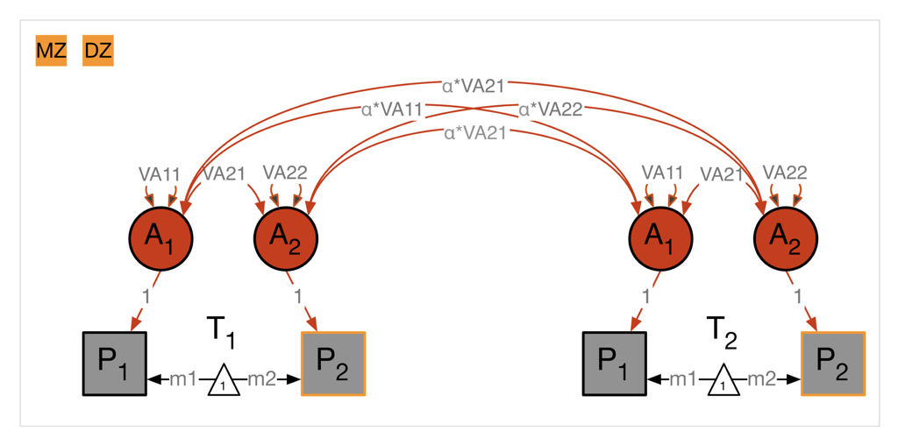
A Cross-Twin Covariance

Slide 20
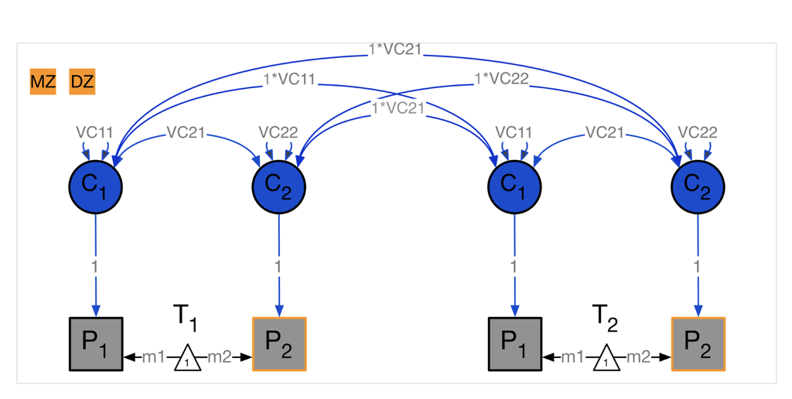
C Cross-Twin Covariance

Slide 21
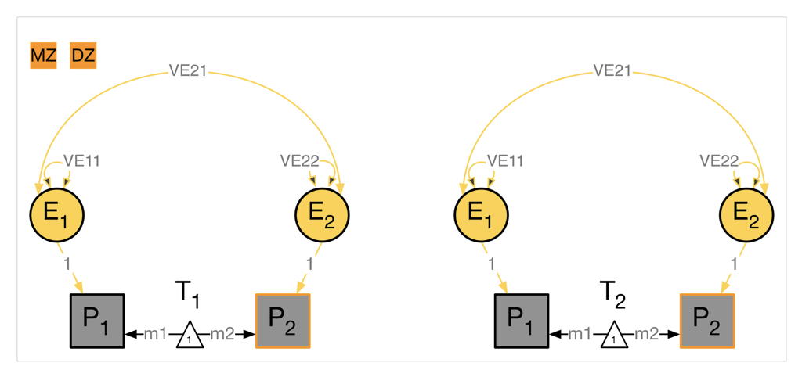
E Cross-Twin Covariance

Slide 22
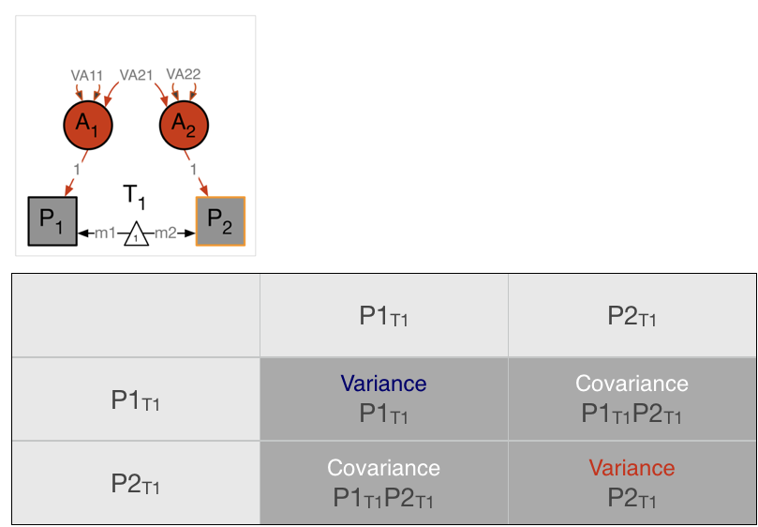
Bivariate within Twin Covariance Matrix
TWIN 1
TWIN 1

Slide 23
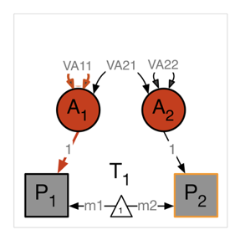
Bivariate within Twin Covariance Matrix
TWIN 1
VA11
TWIN 1

Slide 24
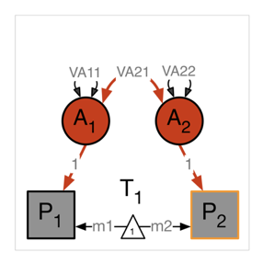
Bivariate within Twin Covariance Matrix
TWIN 1
VA11
TWIN 1
VA21

Slide 25
Bivariate within Twin Covariance Matrix
TWIN 1
VA11
VA21
TWIN 1
VA21

Slide 26
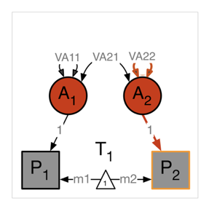
Bivariate within Twin Covariance Matrix
TWIN 1
VA11
VA21
TWIN 1
VA21
VA22

Slide 27
Bivariate cross Twin Covariance Matrix
TWIN 1
TWIN 1

Slide 28
Bivariate cross Twin Covariance Matr
TWIN 1
TWIN 2

Slide 29
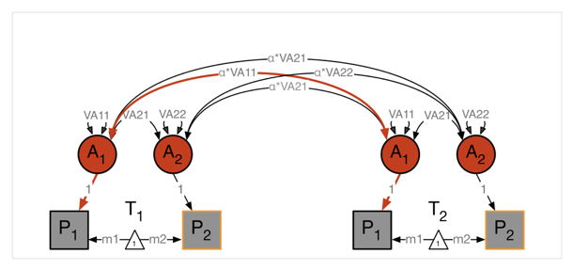
Bivariate cross Twin Covariance Matr
TWIN 1
TWIN 2

Slide 30
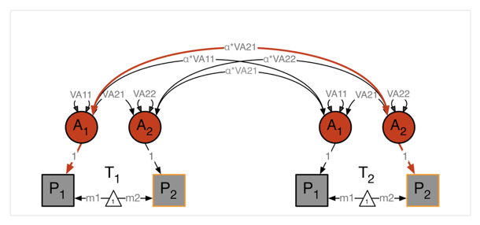
Bivariate cross Twin Covariance Matr
TWIN 1
TWIN 2

Slide 31
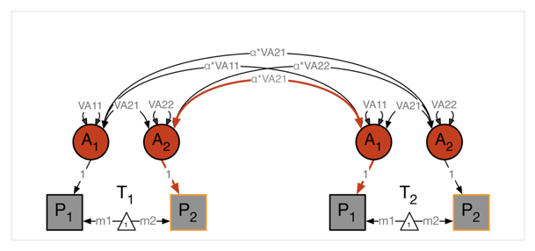
Bivariate cross Twin Covariance Matr
TWIN 1
TWIN 2

Slide 32
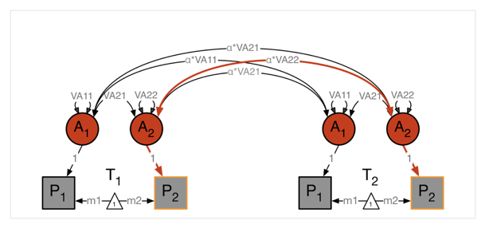
Bivariate cross Twin Covariance Matr
TWIN 1
TWIN 2

Slide 33
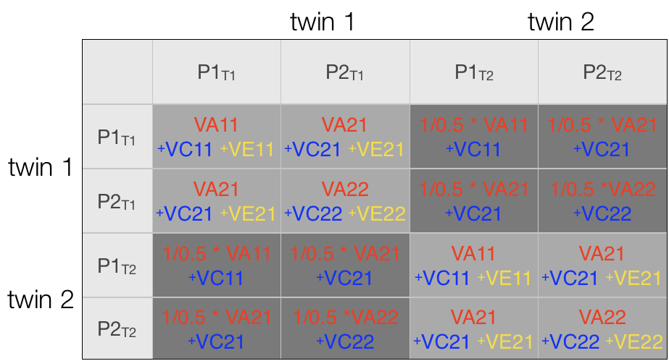
Predicted Twin Covariance Matrix

Slide 34
Predicted MZ Twin Covariance Matrix

Slide 35
Predicted DZ Twin Covariance Matrix

Slide 36
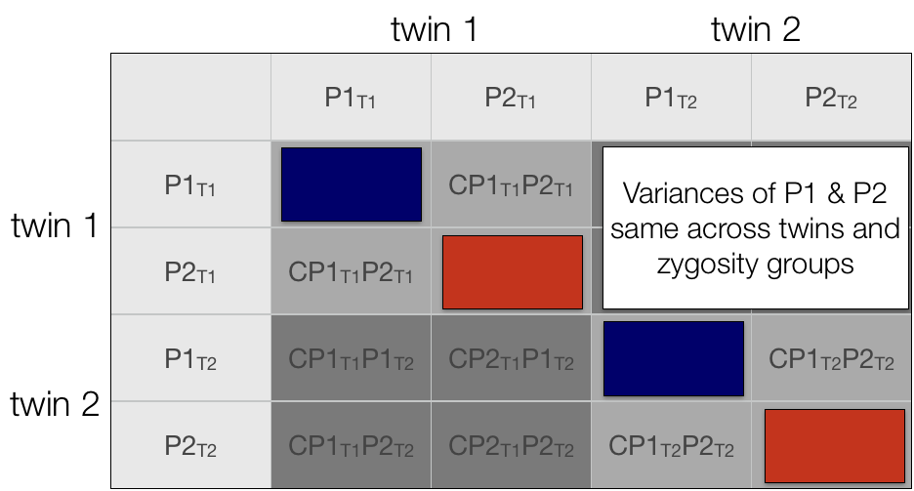
Bivariate Twin Covariance Matrix

Slide 37
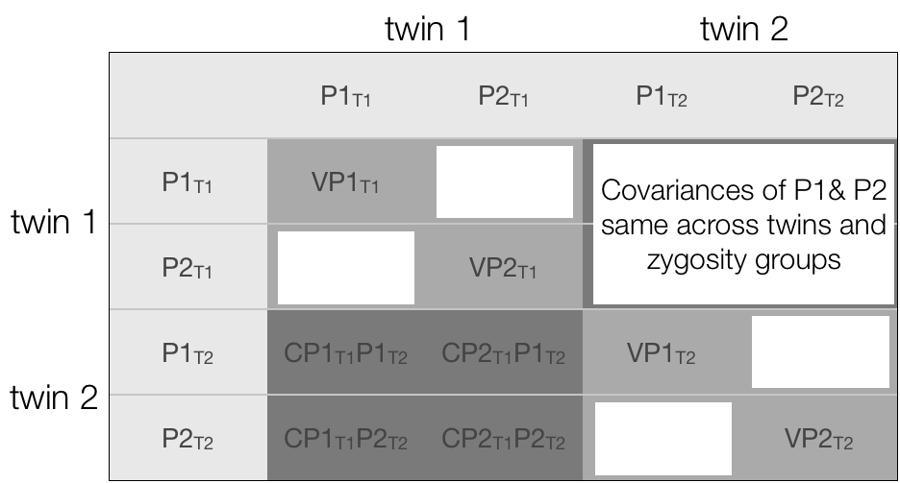
Bivariate Twin Covariance Matrix

Slide 38
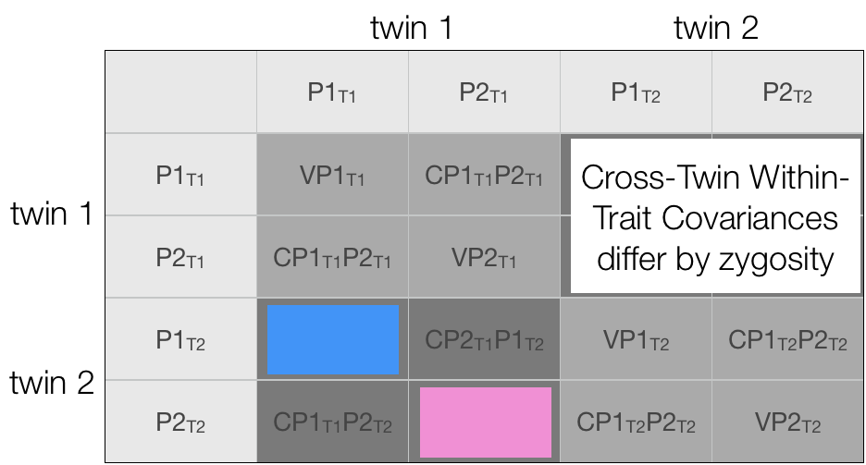
Bivariate Twin Covariance Matrix

Slide 39
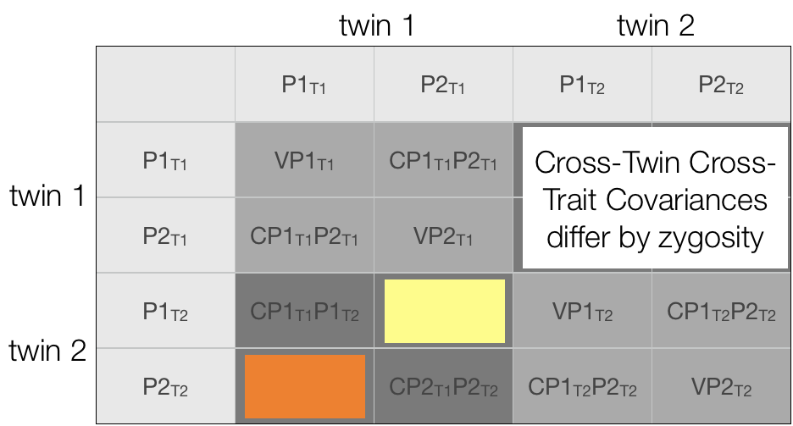
Bivariate Twin Covariance Matrix

Slide 40
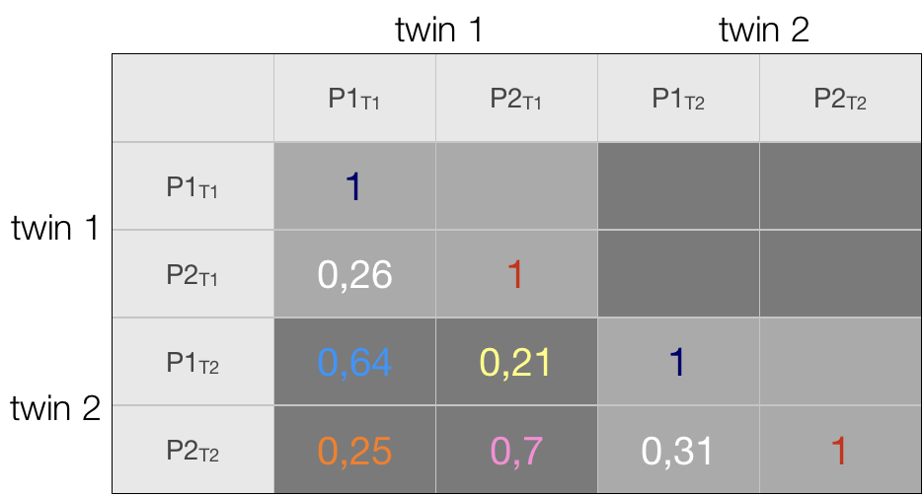
Bivariate MZ Twin Covariance Matrix

Slide 41
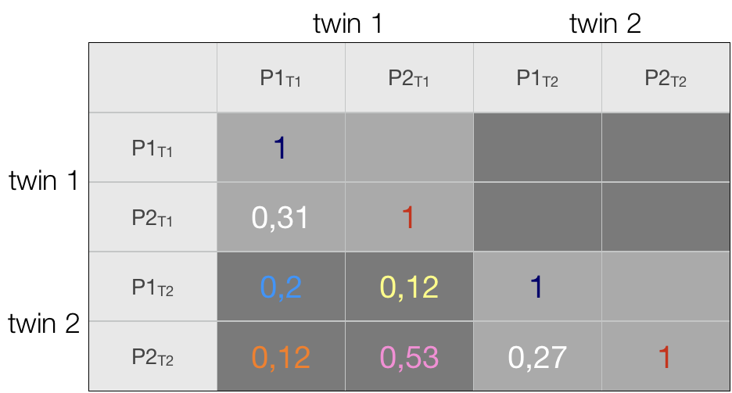
Bivariate DZ Twin Covariance Matrix

Slide 42
Bivariate Twin Covariance Matrix
MZ
DZ

Slide 43
Summary
Within-individual cross-trait covariance implies common aetiological influences
Cross-twin cross-trait covariance implies common aetiological influences are familial
Whether familial influences are genetic or environmental shown by MZ:DZ ratio of cross-twin cross-trait covariances

