Slide 1
Estimation of SNP-heritability (h²_{SNP}) using linear mixed models
Loic Yengo
University of Queensland
5th of March, 2019

Slide 3
Outline
Linear Mixed Models
GREML (Genome-based Restricted Maximum Likelihood) estimation
Computational challenges in GREML estimation
Bias in SNP-heritability due to model misspecification
Power to detect SNP heritability

Slide 4
Outline
Linear Mixed Models
GREML (Genome-based Restricted Maximum Likelihood) estimation
Computational challenges in GREML estimation
Bias in SNP-heritability due to model misspecification
Power to detect SNP heritability

Slide 5
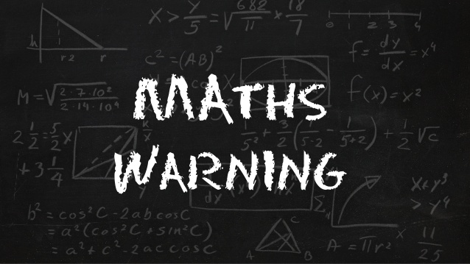

Slide 6
Linear Mixed Models?
Linear?
A (quantitative) trait of interest (y) is model as a linear combination of multiple variables:
y = β₀ + β₁x₁ + … + β_{K}x_{K} + u₁z₁ + … + u_{M}z_{M} + e
Mixed?
We distinguish between “K fixed effects” and “M random effects”.

Slide 7
Linear Mixed Models?
Linear?
A (quantitative) trait of interest (y) is model as a linear combination of multiple variables:
y = β₀ + β₁x₁ + … + β_{K}x_{K} + u₁z₁ + … + u_{M}z_{M} + e
Mixed?
We distinguish between “K fixed effects” and “M random effects”.
The difference between “fixed” and “random” is not strictly arbitrary.
Fixed effects are parameters for which you actually want to know the value.
Random effects are often considered as “nuisance” parameters.
With genetic data, we often model SNPs effects as random because there are too many of them.

Slide 8
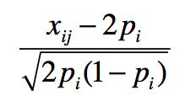
Assumptions
In this model, random effects are
SNP effects: u_{j} (SNP j)
Environmental effects: e_{i} (individual i)
We often assume random effects to be independent and such as
E[u_{j}] = 0 and var[u_{j}] = σ²_{g} /M [σ²_{g}: genetic variance]
var[e_{i}] = σ²_{e} [environmental variance]
Which implies
var[y] = σ²_{g} + σ²_{e} => SNP heritability: h²_{SNP} = σ²_{g} /[σ²_{g} + σ²_{e} ].
z_{ij} = scaled genotype.
y = β₀ + β₁x₁ + … + β_{K}x_{K} + u₁z₁ + … + u_{M}z_{M} + e

Slide 9
Assumptions about random effects
In this model, random effects are
SNP effects: u_{j} (SNP j)
Environmental effects: e_{i} (individual i)
We often assume random effects to be independent and such as
E[u_{j}] = 0 and var[u_{j}] = σ²_{g} /M [σ²_{g}: genetic variance / M: number of SNPs analyzed]
var[e_{i}] = σ²_{e} [environmental variance]
var[y] = σ²_{g} + σ²_{e} => SNP heritability: h²_{SNP} = σ²_{g} /[σ²_{g} + σ²_{e} ].

Slide 10
Assumptions about random effects
In this model, random effects are
SNP effects: u_{j} (SNP j)
Environmental effects: e_{i} (individual i)
We often assume random effects to be independent and such as
E[u_{j}] = 0 and var[u_{j}] = σ²_{g} /M [σ²_{g}: genetic variance / M: number of SNPs analyzed]
var[e_{i}] = σ²_{e} [environmental variance]
var[y] = σ²_{g} + σ²_{e} => SNP heritability: h²_{SNP} = σ²_{g} /[σ²_{g} + σ²_{e} ] = σ²_{g} /var[y].

Slide 11
Outline
Linear Mixed Models
GREML (Genome-based Restricted Maximum Likelihood) estimation
Computational challenges in GREML estimation
Bias in SNP-heritability due to model misspecification
Power to detect SNP heritability

Slide 12
Maximum Likelihood Estimation (MLE)
Key idea 1: Observed data are generated by random process.
Key idea 2: Random process corresponds to probability distribution (Normal, Poisson, etc.)
Key idea 3: MLE looks for the probability distribution that is most likely to have generated the data.

Slide 13
Maximum Likelihood Estimation (MLE)
We classically assume normal distribution as u_{j}~N(0,σ²_{g} /M) and e_{i}~N(0,σ²_{e}) [M SNPs].
NxN Genetic Relationship
Matrix (GRM)
y|X ~ N(Xβ, σ²_{g} [ZZ’/M] + σ²_{e}I_{N})
Notations
y|X: distribution of y conditional on X
N(m,v): [multivariate] normal distribution with mean m and variance v.
I_{N}: NxN identity matrix (1’s on the diagonal and 0’s elsewhere).

Slide 14
Genetic Relationship Matrix (GRM)
y|X ~ N(Xβ, σ²_{g} [GRM] + σ²_{e}I_{N})
Example of GRM between N=3 individuals
(over m=1000 SNPs)
[$bash] zless myGRM.grm.gz
1 1 1000 0.99
1 2 1000 -0.01
1 3 1000 0.01
2 2 1000 1.03
2 3 1000 0.03
3 3 1000 1.01
.99 -0.01 .01
-.01 1.07 .03
-.03 .001 1.01
0 0
0 1 0
0 0 1
Tells us something about relatedness in the sample (GRM $≈$ 2x Kinship).
Computationally costly…but can be re-used multiple times.
(3) Eigen decomposition of that matrix yields principal components.

Slide 15
REstricted?
REML = MLE on residualised data!
When our focus in on estimating variance components (σ²_{g} and σ²_{e}), we prefer to use a REstricted Maximum Likelihood estimation (REML).
The principle is simply to remove (residualise) the fixed effects from the inference.
When sample size is large, MLE and REML are equivalent. [distinguish REML from GREML]
y*|X ~ N(0, σ²_{g} [ZZ’/M] + σ²_{e}I_{N})

Slide 16
Outline
Linear Mixed Models
GREML (Genome-based Restricted Maximum Likelihood) estimation
Computational challenges in GREML estimation
Bias in SNP-heritability due to model misspecification
Power to detect SNP heritability

Slide 17
Computational challenge in GREML
A number of algorithms have been developed to estimate variance components under GREML (at least 3 implemented in GCTA, Yang et al. 2011 --reml-alg option).
Computational complexity is however cubic with respect to sample size ~O(N³),i.e. if you increase your sample size by a factor k, computational time is increased by a factor ~k³.
Alternatives are approximate inference as implemented in BOLT-LMM software (Loh et al. 2015) or “divide and conquer” approaches.

Slide 18
Computational challenge in GREML
A number of algorithms have been developed to estimate variance components under GREML (at least 3 implemented in GCTA, Yang et al. 2011 --reml-alg option).
Computational complexity is however cubic with respect to sample size ~O(N³),i.e. if you increase your sample size by a factor k, computational time is increased by a factor ~k³.
Alternatives are approximate inference as implemented in BOLT-LMM software (Loh et al. 2015) or “divide and conquer” approaches.

Slide 19
Computational challenge in GREML
A number of algorithms have been developed to estimate variance components under GREML (at least 3 implemented in GCTA, Yang et al. 2011 --reml-alg option).
Computational complexity is however cubic with respect to sample size ~O(N³),i.e. if you increase your sample size by a factor k, computational time is increased by a factor ~k³.
Alternatives are approximate inference as implemented in BOLT-LMM software (Loh et al. 2015) or “divide and conquer” approaches.

Slide 20
Outline
Linear Mixed Models
GREML (Genome-based Restricted Maximum Likelihood) estimation
Computational challenges in GREML estimation
Bias in SNP-heritability due to model misspecification
Power to detect SNP heritability

Slide 21
Few things to be aware of…
h²_{SNP}<h² in general when SNPs poorly tag causal variants.
However, even if causal variants are “captured”, biases may still arise because of specific features of the genetic architecture of traits (e.g. LD pruning). [Can be fixed with MAF or LD stratification]
Also, under assortative mating interpretation of estimates of SNP heritability can be challenging.
It is important to use unrelated individuals to estimate SNP heritability, otherwise estimates can be biased by shared environment (as for family-based estimates). Classical GRM thresholds are >0.05 or >0.025.

Slide 22
Few things to be aware of…
h²_{SNP}<h² in general when SNPs poorly tag causal variants.
However, even if causal variants are “captured”, biases may still arise because of specific features of the genetic architecture of traits (e.g. LD pruning). [Can be fixed with MAF or LD stratification]
Also, under assortative mating interpretation of estimates of SNP heritability can be challenging.
It is important to use unrelated individuals to estimate SNP heritability, otherwise estimates can be biased by shared environment (as for family-based estimates). Classical GRM thresholds are >0.05 or >0.025.

Slide 23
Few things to be aware of…
h²_{SNP}<h² in general when SNPs poorly tag causal variants.
However, even if causal variants are “captured”, biases may still arise because of specific features of the genetic architecture of traits (e.g. LD pruning). [Can be fixed with MAF or LD stratification]
Also, under assortative mating interpretation of estimates of SNP heritability can be challenging.
It is important to use unrelated individuals to estimate SNP heritability, otherwise estimates can be biased by shared environment (as for family-based estimates). Classical GRM thresholds are >0.05 or >0.025.

Slide 24
Few things to be aware of…
h²_{SNP}<h² in general when SNPs poorly tag causal variants.
However, even if causal variants are “captured”, biases may still arise because of specific features of the genetic architecture of traits (e.g. LD pruning). [Can be fixed with MAF or LD stratification]
Also, under assortative mating interpretation of estimates of SNP heritability can be challenging.
It is important to use unrelated individuals to estimate SNP heritability, otherwise estimates can be biased by shared environment (as for family-based estimates). Classical GRM thresholds are >0.05 or >0.025.

Slide 25
Few things to be aware of…
h²_{SNP}<h² in general when SNPs poorly tag causal variants.
However, even if causal variants are “captured”, biases may still arise because of specific features of the genetic architecture of traits (e.g. LD pruning). [Can be fixed with MAF or LD stratification]
Also, under assortative mating interpretation of estimates of SNP heritability can be challenging.
It is important to use unrelated individuals to estimate SNP heritability, otherwise estimates can be biased by shared environment (as for family-based estimates). Classical GRM thresholds are >0.05 or >0.025.

Slide 26
Outline
Linear Mixed Models
GREML (Genome-based Restricted Maximum Likelihood) estimation
Computational challenges in GREML estimation
Bias in SNP-heritability due to model misspecification
Power to detect SNP heritability

Slide 27
How can I know if my sample is large enough?
Visscher et al. (2014) derived the expectation of the standard error (SE) of estimates of SNP heritability as
SE(h²_{SNP}) $≈$ 1/[N SD[GRM]]
In Europeans SD(GRM) $≈$ 10⁻⁵. Therefore SE(h²_{SNP}) $≈$ 316/N.
.
If N=10⁵, then expected SE is ~0.003 [10 divide and conquer => SE~0.01].
Consequence: e.g. need N> 3,500 to detect an heritability of ~0.2 (Expected SE $≈$ 0.09).
Power calculator: https://cnsgenomics.shinyapps.io/gctaPower/

Slide 28
Summary (1)
LMM are special cases of linear regression models that involves fixed and random effects.
If we assuming all SNPs to have random effects on a trait, then the variance of these effects measures the SNP heritability.
REML = Maximum likelihood estimation on “residualised” data wrt to fixed effects.
GREML estimation is computationally costly when sample size (N) is large!

Slide 29
Summary (2)
h²_{SNP}<h² in general when SNPs poorly tag causal variants.
However, even if causal variants are “captured”, biases may still arise because of specific features of the genetic architecture of traits (e.g. LD pruning). [Can be fixed with MAF or LD stratification]
Also, under assortative mating interpretation of estimates of SNP heritability can be challenging.
It is important to use unrelated individuals to estimate SNP heritability, otherwise estimates can be biased by shared environment (as for family-based estimates). Classical GRM thresholds are >0.05 or >0.025.

Slide 30
References
GCTA
Yang et al. (2010). Nat. Genet. 42(7):565-9
Yang et al. (2011). AJHG. 88(1):76-82
BOLT-LMM
Loh et al. (2015). Nat. Genet. 47:284–290
Loh et al. (2018). Nat. Genet. 50(7):906-908
Power to detect heritability
Visscher et al. (2014). Plos Genet. 10(4):e1004269
REML

Slide 31
Estimation of SNP-heritability (h²_{SNP}) using linear mixed models – practical using GCTA
Loic Yengo
University of Queensland
5th of March, 2019

Slide 32
GCTA
A command line software (similar to PLINK)
Version 1.92 available for Linux, Mac and Windows
Initially developed for estimation of SNP heritability
Has now multiple functionalities
Mixed-Model GWAS
LD score calculations
Principal Components Analysis
Gene-based test.
Etc.
Many examples available on the website: http://cnsgenomics.com/software/gcta/#GREMLanalysis

Slide 33
Locate the data and software
Create a folder for the practical…please type
(replace “yourFolder” with the name of your own folder, e.g. mine is “yengo”)
datPath=/scratch/201903/yengo
gctaPath=/opt/gcta_1.92.0beta3
plinkPath=/usr/bin
pracPath=/scratch/201903/yourFolder/practical_greml
mkdir –p $pracPath

Slide 34
Ideas of the practical
Run GCTA to calculate GRM, identify related individuals
Run --reml on two traits
A trait where causal variants are rare with some effect from shared environment
A trait where causal variants are poorly tagged.
Run MAF stratified analysis

Slide 35
Exercise 1
Calculate GRM...
$gctaPath/gcta64 --bfile $datPath/mydata --make-grm-bin --out $pracPath/mydata_allSNPs
…and identify unrelated individuals
$gctaPath/gcta64 --grm $pracPath/mydata_allSNPs --grm-singleton 0.05 --out $pracPath/unrelated

Slide 36
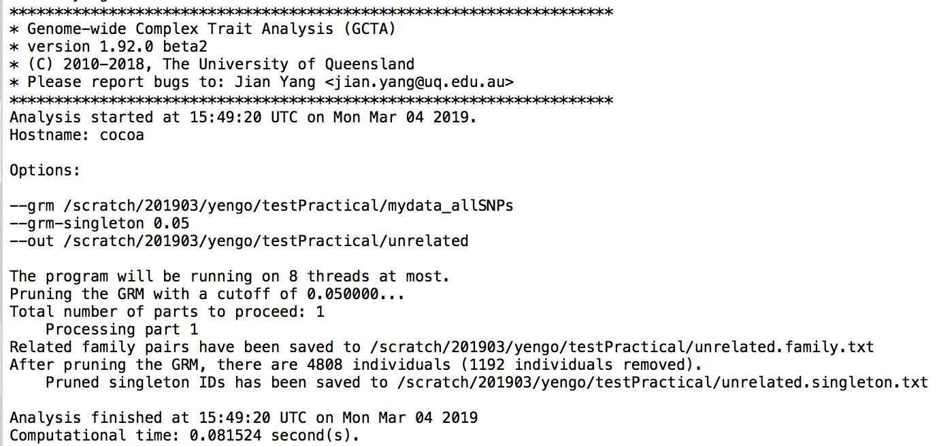
Exercise 1

Slide 37
Exercise 2
Estimate SNP heritability of trait 1 with and without relatives.
$gctaPath/gcta64 --grm $pracPath/mydata_allSNPs --pheno $datPath/mydata.phen --mpheno 1 --reml \
--out $pracPath/trait1_with_relatives
$gctaPath/gcta64 --grm $pracPath/mydata_allSNPs --pheno $datPath/mydata.phen --mpheno 1 --reml \
--out $pracPath/trait1_without_relatives --grm-cutoff 0.05
What can you conclude?

Slide 38
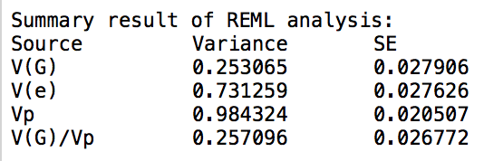
Exercise 2
Estimate SNP heritability of trait 1 with and without relatives.
$gctaPath/gcta64 --grm $pracPath/mydata_allSNPs --pheno $datPath/mydata.phen --mpheno 1 --reml \
--out $pracPath/trait1_with_relatives
$gctaPath/gcta64 --grm $pracPath/mydata_allSNPs --pheno $datPath/mydata.phen --mpheno 1 --reml \
--out $pracPath/trait1_without_relatives --grm-cutoff 0.05
What can you conclude?
heritability

Slide 39
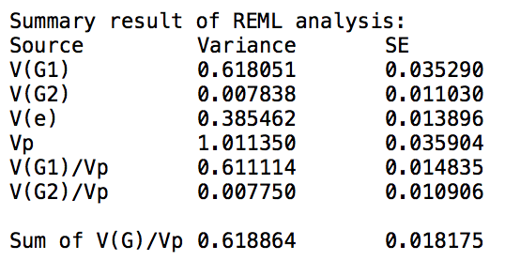
Exercise 3
Calculate MAF stratified GRMs…
$gctaPath/gcta64 --grm $pracPath/mydata_allSNPs --pheno $datPath/mydata.phen --mpheno 2 --reml \
--keep $pracPath/unrelated.singleton.txt --out $pracPath/trait2_allSNPs
$gctaPath/gcta64 --mgrm $pracPath/mgrm.txt --pheno $datPath/mydata.phen --mpheno 2 --reml \
--keep $pracPath/unrelated.singleton.txt --out $pracPath/trait2_maf_stratified

Slide 40
Extensions
Estimate heritability of diseases
Add covariates explain structure of phen file.
Haseman-Elston (HE) regression is implemented in GCTA.
e.g.: gcta64 --HEreg --grm test --pheno test.phen --out test
Estimation of genetic correlation between traits

