Slide 1
Biometrical Models and Introduction to Genetic Analysis
Pak Sham, University of Hong Kong
4th March 2019
The 2019 International Workshop on Statistical Genetics Methods for Human Complex Traits

Slide 2
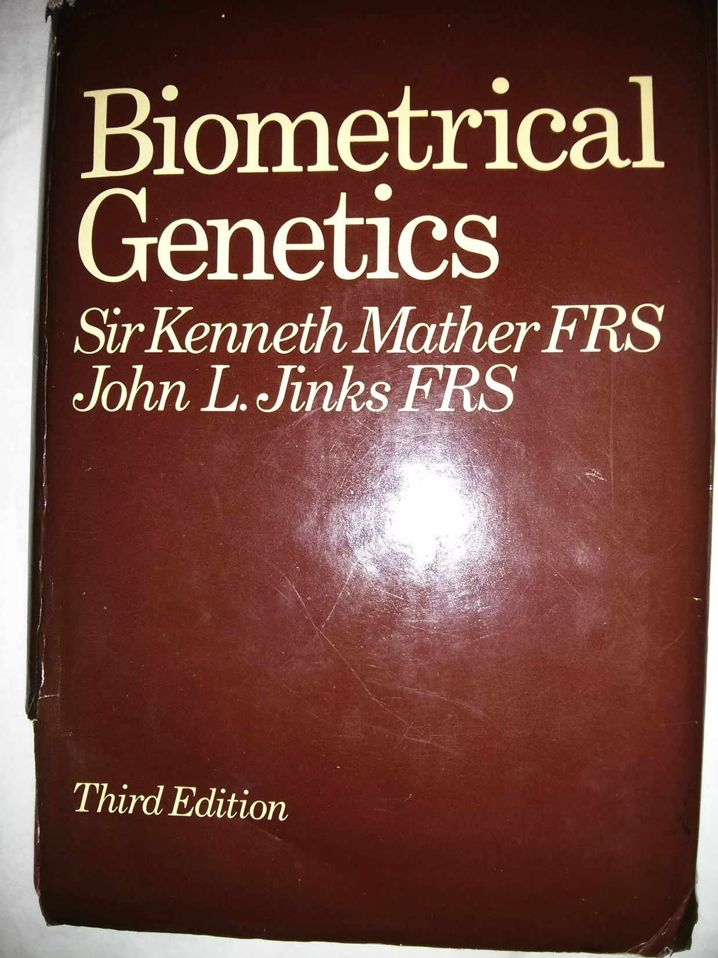
What is biometrical genetics?
How do genes contribute to the biometrical (statistical) properties of continuous (quantitative) traits in the populations
For single trait, biometrical properties include
Means and Variances in individuals
Covariances between relatives
For multiple traits, biometrical properties also include
Covariances between different traits in the same individual
Covariances between different traits in different (related) individuals

Slide 3
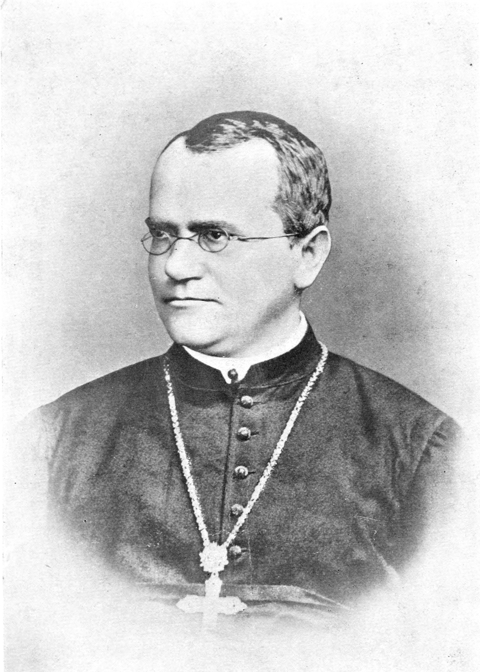
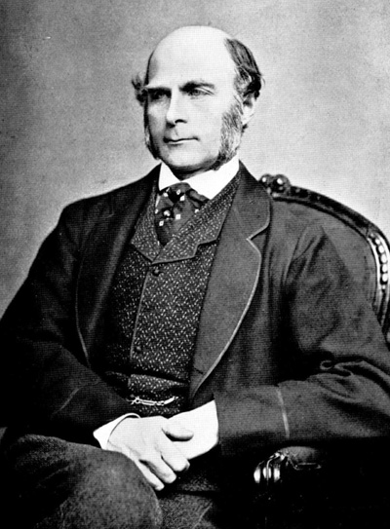
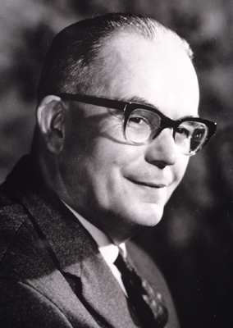
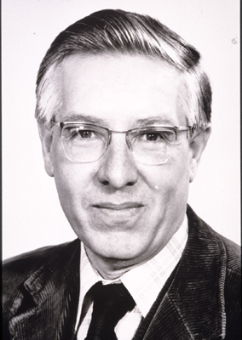
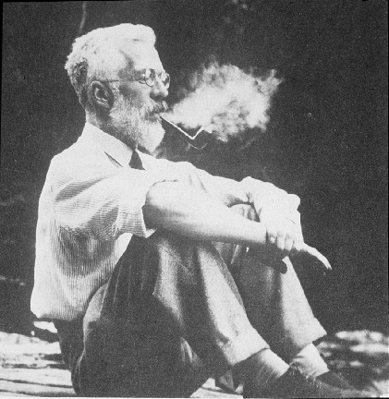
History of biometrical genetics
Mendel
Genes
Galton
Biometrics
Mather
Jinks
Biometrical genetics
Fisher
Correlation between relatives on the supposition of mendelian inheritance
Fulker
Eaves
Statistical modelling in biometrical genetics

Slide 4
Genes are discrete entities
Mendelian disorders are caused by mutations in a single gene
Mendelian disorders are also discrete entities
How can discrete entities produce continuous variation?
https://gameofthrones.fandom.com/wiki/Dwarfism

Slide 5
Origin of continuous variation
Continuous (quantitative) variation can be explained by polygenic inheritance
The sum of independent and approximately equal influences will approach a continuous, normal distribution, as the number of influences increases (central limit theorem)
1 Gene
→ 3 Genotypes
→ 3 Phenotypes
2 Genes
→ 9 Genotypes
→ 5 Phenotypes
3 Genes
→ 27 Genotypes
→ 7 Phenotypes
4 Genes
→ 81 Genotypes
→ 9 Phenotypes
https://www.youtube.com/watch?v=kDkmSI39sWQ

Slide 6
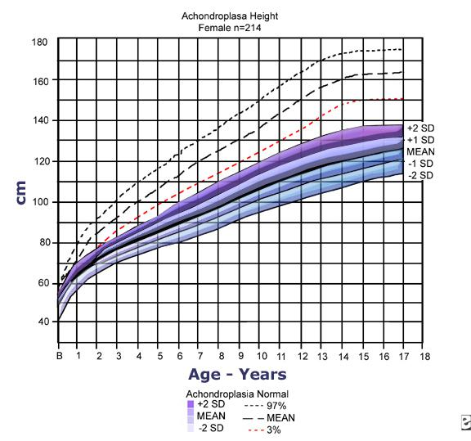
Major loci and polygenes
Quantitative traits can be influenced by genetic mutations with very large effects (major loci) in addition to multiple genetic variants with small effects (polygenes)
Adult males with achondroplasia have mean height of 52 inches, compared to the population adult male mean of 69 inches. This difference of 17 inches is almost 6 standard deviations of adult male height in the general population.
Thus even the tallest adults with achondroplasia are seldom taller than the shortest adults without achondroplasia.
Height for females with achondroplasia (mean/standard deviation [SD]) compared to normal standard curves. The graph is based on information from 214 females. Adapted from Horton WA, Rotter JI, Rimoin DL, et al. Standard growth curves for achondroplasia. J Pediatr. 1978 Sep; 93(3): 435-8.

Slide 7
Genetic polymorphisms, alleles, genotypes
A genetic polymorphism is a variable site in the genome (e.g. single nucleotide polymorphism, SNP)
The alternative sequences at a locus are called alleles, often denoted as capital and small letters (e.g. A, a)
The alleles present at the polymorphic site (locus) of an individual is called his or her genotype (e.g. AA, aa, Aa)

Slide 8
Analysis of variance
Fisher developed Analysis of Variance (ANOVA) for “factorial designs”, where the factors have discrete levels (e.g. binary).
The overall variance of a trait is decomposed into components due to the main effects of the factors, two-way interactions, 3-way interactions, etc., in a hierarchical fashion
 | 0 | 1
0
1

Slide 9
Biometrical model for single locus
Consider the effects of a single locus on a quantitative trait
All other influences are considered as “error” or “residual”, which are assumed to be uncorrelated and have no interaction with the locus being considered
In Fisher’s convention, effects are measured from the “midpoint” of two homozygous genotypes
Model: Y = c + X + R
Genotype
means
0
aa
Aa
AA
X:
-a
d
+a
AA
c + a
-a
R: Residual influences
Aa
c + d
aa
c – a
Note: we do not distinguish paternal from maternal transmitted alleles, implicitly assuming that their effects are the same

Slide 10
Population genotype frequencies
We also need to specify the frequencies of the 3 genotypes in the population
In a large population under random mating, the frequencies of genotypes AA, Aa and aa follow the binomial proportions s p²:2pq:q², where p and q (=1-p) are the frequencies of alleles A and a
Genotypes in such proportions are said to be in Hardy-Weinberg equilibrium; deviation from such proportions is called Hardy-Weinberg Disequilibrium (HWD)

Slide 11
Derivation of Hardy-Weinberg proportions
Parental frequencies – not necessarily in Hardy-Weinberg proportions
Genotype | Frequency
AA | P
Aa | Q
aa | R
Allele | Frequency
A | P+Q/2
a | R+Q/2

Slide 12
Random mating
Under random mating, the mating type frequencies are
 | AA | Aa | aa
AA | P² | PQ | PR
Aa | PQ | Q² | QR
aa | PR | QR | R²

Slide 13
Mendelian segregation
Aa
Mendel’s law of segregation: when a parent has heterozygous genotype Aa, there is equal probability for the two alleles (A and a) to be transmitted to an offspring)
1/2
1/2
A
a

Slide 14
Segregation ratios
According to Mendel’s law of segregation, the offspring genotype frequencies for the mating types are:
 | AA | Aa | aa
AA | AA | AA:Aa 0.5:0.5 | Aa
Aa | AA:Aa 0.5:0.5 | AA:Aa:aa 0.25:0.5:0.25 | Aa:aa 0.5:0.5
aa | Aa | Aa:aa 0.5:0.5 | aa

Slide 15
Offspring genotype frequencies
Averaging over the mating types, the offspring genotype frequencies are
Genotype | Frequency
AA | P²+PQ+Q²/4 = (P+Q/2)²
Aa | 2PR+PQ+QR+Q²/2 = 2(P+Q/2)(R+Q/2)
aa | R2+QR+Q²/4 = (R+Q/2)²

Slide 16
Offspring allele frequencies
Averaging over the genotypes, the offspring allele frequencies are
Allele | Frequency
A | (P+Q/2)² + (P+Q/2)(R+Q/2) = P+Q/2
a | (R+Q/2)² + (P+Q/2)(R+Q/2) = R+Q/2

Slide 17
Hardy-Weinberg equilibrium
The genotype can be thought of as consisting of 2 independent factors, one from each parent (as in a 2-way factorial design)
 | A | a
A | p² | pq | p
a | pq | q² | q
 | p | q

Slide 18
Biometrical model: mean
The mean effect of genotype under Hardy-Weinberg Equilibrium is thus
Genotype AA Aa aa
Frequency p² 2pq q²
Effect a d -a
Mean m = p²(a) + 2pq(d) + q²(-a)
= (p-q)a + 2pqd

Slide 19
Biometrical model: variance
The variance of the genotypic effect is therefore
Genotype AA Aa aa
Frequency p² 2pq q²
(X-m)² (a-m)² (d-m)² (-a-m)²
Variance = (a-m)²p² + (d-m)²2pq + (-a-m)²q²
= 2pq[a+(q-p)d]² + (2pqd)²
(intermediate steps not shown)

Slide 20
Average allele effect, additive variance
The first variance component is due the additive effects of the two alleles of the genotype:
The presence of dominance (i.e. when d$≠$0) means that the effect of an allele depends on the other allele in the genotype:
When the other allele is A, the effect of allele A is a-d (i.e. effect of AA – effect of Aa)
When the other allele is a, the effect of allele A is a+d (i.e. effect of Aa – effect of aa)
Therefore the average effect of allele A = p(a-d)+q(a+d) = a+(q-p)d
If genotype is coded additively as G= number allele A in the genotype (i.e. G = 0, 1 or 2), then the regression coefficient is the trait on G is a + (q-p)d
Thus the additive genetic variance is (a+(q-p)d)² Var(G) = 2pq(a+(q-p)d)²
The second component of the variance, (2pqd)², is therefore attributed to the dominance deviation (2nd order interaction between the 2 alleles at the genotype at the same locus)

Slide 21
Variance components and heterozygosity
2pq is the expected heterozygosity of a biallelic locus under Hardy-Weinberg equilibrium
When p=q=1/2, the expected heterozygosity takes its highest value of 1/2. As allele frequency approaches 0 or 1, heterozygosity approaches 0
Additive genetic variance is proportional to the expected heterozygosity
Dominance genetic variance is proportional to the square of the expected heterozygosity
Dominance genetic variance declines much more rapidly than additive genetic variance, as allele frequency approaches 0 or 1. (Why is this intuitively obvious?)

Slide 22
Covariance between pairs of relatives
AA Aa aa
AA (a-m)²
Aa (a-m)(d-m) (d-m)²
aa (a-m)(-a-m) (-a-m)(d-m) (-a-m)²
The matrix is symmetrical, therefore upper triangular elements are not shown,
The covariance between relatives of a certain class is the
weighted average of these cross-products, where each
cross-product is weighted by its frequency in that class.

Slide 23
Genetic identity-by-descent (IBD)
For two-locus genotype frequencies of two relatives, the concept of genetic identity by descent is helpful
DNA segments (e.g. genes) are identical-by-descent if they are descended from, and therefore replicates of, a single ancestral DNA segment.
The IBD genetic segments should have identical genetic sequence (unless new mutation has occurred)
At any autosomal location, two individuals can share 0, 1 or 2 alleles
There are 3 genetic relationships where the IBD sharing is the same throughput the genome (What are these?)
AB CD
AC
AD

Slide 24
IBD for MZ twins
AB
CD
AC
AC
MZ twins share 2 alleles IBD for all loci

Slide 25
IBD for parent-offspring (PO)
AB
CD
AC
When the parents are unrelated to each other, PO pairs share 1 allele IBD at all loci

Slide 26
IBD for unrelated individuals
Two unrelated individuals share 0 alleles IBD at all loci

Slide 27
Covariance of MZ twins
AA Aa aa
AA p²
Aa 0 2pq
aa 0 0 q²
Covariance = (a-m)²p² + (d-m)²2pq + (-a-m)²q²
= 2pq[a+(q-p)d]² + (2pqd)²
= V_{A} + V_{D}

Slide 28
Covariance for parent-offspring (P-O)
AA Aa aa
AA p³
Aa p²q pq
aa 0 pq² q³
Covariance = (a-m)²p³ + (d-m)²pq + (-a-m)²q³
+ (a-m)(d-m)2p²q + (-a-m)(d-m)2pq² = pq[a+(q-p)d]²
= V_{A} / 2

Slide 29
Covariance for unrelated pairs (U)
AA Aa aa
AA p⁴
Aa 2p³q 4p²q²
aa p²q² 2pq³ q⁴
Covariance = (a-m)²p⁴ + (d-m)²4p²q² + (-a-m)²q⁴
+ (a-m)(d-m)4p³q + (-a-m)(d-m)4pq³
+ (a-m)(-a-m)2p²q²
= 0

Slide 30
IBD: half sibs
AB
CD
EE
IBD Sharing Probability
0 ½
1 ½
AC
CE/DE
Average IBD sharing = 0(1/2) + 1(1/2) = 1/2
In terms of IBD sharing, half siblings are similar to
Parent-offspring for ½ of the genome
Unrelated individuals for ½ of the genome

Slide 31
Covariance: half sibs
Genotype frequencies are weighted averages:
½ Parent-offspring (when IBD=1)
½ Unrelated (when IBD=0)
Covariance = ½(V_{A}/2) + ½(0)
= ½V_{A}

Slide 32
IBD: full sibs
IBD paternal alleles
IBD Sharing Probability
0 1/4
1 1/2
2 1/4
 | 0 | 1
0 | 0 | 1
1 | 1 | 2
IBD maternal alleles
Average IBD sharing = 0(1/4) + 1(1/2) + 2(1/4) = 1
In terms of IBD sharing, full siblings are similar to
MZ twins for ¼ of the genome
Parent-offspring for ½ of the genome
Unrelated individuals for ¼ of the genome

Slide 33
Covariance: full sibs
Genotype frequencies are weighted averages:
¼ MZ twins (when IBD=2)
½ Parent-offspring (when IBD=1)
¼ Unrelated (when IBD=0)
Covariance = ¼(V_{A}+V_{D}) + ½(V_{A}/2) + ¼ (0)
= ½V_{A} + ¼V_{D}

Slide 34
Generalization: proportion of alleles IBD (π)
IBD can be expressed as a proportion $π$ (= number IBD / 2), thus $π$= 0, 1/2 or 1
The probability distribution $π$ is Prob($π$=0), Prob($π$=1/2), Prob($π$=1)
E($π$) = Prob($π$=1) +(1/2) Prob($π$=1/2)
Var($π$) = Prob($π$=1) +(1/4) Prob($π$=1/2) – (E($π$))²
Relationship E(π) Var(π) Prob(π=1)
MZ 1 0 1
Parent-Offspring 0.5 0 0
Unrelated 0 0 0
Half sibs 0.25 0.0625 0
Full sibs 0.5 0.125 0.25

Slide 35
Covariance: general relative pair
The covariance is a weighted average of the covariances for MZ twins, parent-offspring and unrelated individuals
Covariance = Prob($π$=1)(V_{A}+V_{D}) + Prob($π$=1/2)(V_{A}/2) + Prob($π$=0)(0)
= (Prob($π$=1)+Prob($π$=1/2)/2)V_{A} + Prob($π$=1)V_{D}
= E(π)V_{A} + Prob($π$=1)V_{D}

Slide 36
Kinship coefficient
The kinship coefficient (K) between two individuals is defined as the probability that two alleles, one from each individual, drawn at random at an autosomal locus, will be identical-by-descent (IBD)
Let the paternal and maternal alleles of individuals 1 and 2 be denoted G_{1P}, G_{1M}, G_{2P}, G_{2M}. The genotypes of the 2 individuals, additively coded (0,1,2), would be G₁=G_{1P},+G_{1M} and G₂=G_{2P},+G_{2M}
The covariance between the two genotypes is
Cov(G₁, G₂) = Cov(G_{1P},G_{2P})+Cov(G_{1P},G_{2M})+Cov(G_{1M}, G_{2P})+Cov(G_{1M},G_{2M})
In the absence of inbreeding, Var(G₁) = Var(G₂) = 2pq, and each covariance term is either pq when the alleles are IBD or 0 when they are not. Also, each allele of one person can be IBD with at most 1 allele of the other person. In this scenario E($π$) is equivalent to 2K and represents the correlation between G₁ and G₂
K is of wider applicability than E($π$) when there is inbreeding

Slide 37
“Attenuation” of kinship
If two individuals (A and B) have kinship coefficient K, what is the kinship coefficient between A and the offspring of B, assuming that the other parent of this offspring is unrelated to A?
At any genomic location, the offspring of B will have inherited 1 of the 2 DNA segments of B.
When a DNA segment is drawn at random from the offspring of B, there is a probability ½ that this is inherited from B, and probability ½ that this is inherited from the other parent.
If the segment is inherited from B, then there is probability K that it is IBD with a segment drawn from the corresponding genomic location from A.
If the segment is inherited from the other parent, then the probability is 0 because the other parent is unrelated to A.
Therefore the kinship coefficient between A and the offspring of B is ½K.
Applying this result recursively, we can show that the Kinship coefficient between two individuals sharing one common ancestor is equal to (½)^{g+1}, where g is the number of meioses separating the 2 individuals

Slide 38
Inbreeding coefficient
The inbreeding coefficient of an individual , I, is the probability that the 2 alleles at any locus are IBD. It is equal to the kinship coefficient of his or her parents, since in meiosis an allele is randomly drawn from the genotype of a parent.
Inbreeding inflates the variance of a additively coded genotype:
Var(G) = Var(G_{P})+Var(G_{M})+2Cov(G_{P},G_{M})
Inbreeding also inflates the covariance between the additively coded genotypes of 2 individuals, since now it is possible for an allele in one person to be IBD with both alleles of the other person.

Slide 39
Two-locus biometrical genetic model
Generalize biometrical model to 2 loci
This is necessary only when there is either correlation or interaction between the 2 loci; otherwise the loci can be considered separately
Two-locus Interactions include
second-order inter-loci interactions involving 1 allele each locus, additive-additive (AA)
third-order interactions involving both alleles from one locus and 1 allele from the other, additive-dominance (AD)
fourth-order interactions involving both alleles from both loci, dominance-dominance (DD)
For 2 loci, there are 3x3=9 genotypic groups (assuming no parent-of-origin effect). In principle, if we can write down the trait means and population frequencies of these 9 genotypic groups, then we can proceed with variance partitioning using a hierarchical ANOVA, when the two loci are not correlated. This is straightforward by computer program but tedious by hand - see Sham (1997) Statistics in Human Genetics, Chapter 5.

Slide 40
Covariance of epistatic components
The AA interaction between 2 alleles are shared by 2 individuals when the 2 alleles are both IBD, and not shared when at least one of them is not IBD. When the 2 loci are independent, the probability of sharing is the product of proportion of IBD sharing of the 2 loci, $π_{1}π_{2}$. For a particular class of relative pairs, the expected covariance is E($π_{1}π_{2}$)=[E($π$)]²
Similarly, the expected covariance of the AD interactions for a class of relative pairs is E($π$)Prob($π$=1)
Finally, the expected covariance of the DD interactions for a class of relative pairs is [Prob($π$=1)]²

Slide 41
Covariance: general relative pair
Including 2 loci interactions, the covariance for 2 relatives of a given class is:
Covariance = E(π)V_{A} + P($π$=1)V_{D} + [E(π)]²V_{AA} + E(π)P($π$=1)V_{AD} + [P($π$=1)]²V_{DD}
This can be further extended to epistasis involving more than 2 loci

Slide 42
Genetic linkage - two-locus transmission
The correlation between 2 loci depends on “linkage”
Given a heterozygous genotype Aa, the 2 possible haplotypes (A and a) are equally likely to be transmitted to an offspring (Mendel’s first law)
How about an individual heterozygous for two loci, AaBb, what are the probabilities of transmitted each of the 4 haplotypes AB, Ab, aB, ab?
If segregation at the 2 loci are independent, then transmission probability of each haplotype is ½ x ½ = ¼.
This is true when the loci are on different chromosomes (Mendel’s second law), but not when they are on the same chromosome.
Which two types will be more likely to be transmitted?
AaBb
Parent
AB
Ab
ab
aB
Gametes

Slide 43
Haplotypes and recombination
Parental haplotypes
Likely gametes
(Non-recombinants)
Unlikely gametes
(Recombinants)
A₁
Q₁
A₁
Q₁
A₁
Q₂
A₂
Q₂
A₂
Q₂
A₂
Q₁
Haplotype = set of alleles inherited from the same parent
Alleles that were inherited together from the previous generation are more likely to be transmitted together to the next generation, if the loci are on the same chromosome
Alleles which have different parental origins but are transmitted together in the same gamete are called “recombinant”
The proportion of gametes of 2 loci that are recombinant is called the recombination fraction
Two loci are “linked” if their recombination fraction is less than 1/2

Slide 44
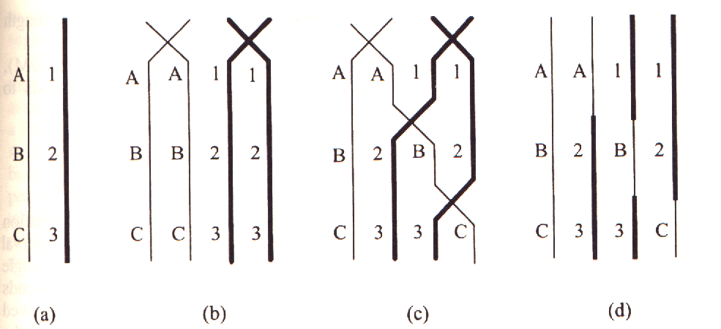
Crossovers during meiosis
A chromosome inherited from a parent is usually not transmitted intact to a offspring
Instead, crossovers between chromatids occur during meiosis, resulting in each transmitted chromosome being a hybrid of alternating segments of the paternal and maternal chromosomes
Notes:
Linkage is due to the tendency for alleles on the same chromosome to be co-transmitted. In this diagram, alleles A, B and C are on one chromosome, while alleles 1, 2 and 3 are on the homologous chromosome. During meiosis, crossovers occur between the homologous chromosomes to form recombinants, for example, a chromosome containing allele A alongside alleles 2 and 3. The closer the two alleles, the less likely that they will be separated by crossover during meiosis.

Slide 45
Fully Informative Gametes
AABB
aabb
Recombinants and non-recombinants can be inferred in double backcross data.
The offspring of the double backcross constitute fully informative gametes
AaBb
aabb
AaBb
aabb
Aabb
aaBb
Non-recombinant
Recombinant

Slide 46
Population haplotype frequencies
 | B | b
A | pr | ps | p
a | qr | qs | q
 | r | s
If there is no association between alleles of the two loci, then the frequency of each haplotype is equal to the product of the frequencies of its constituent alleles
Two loci with such haplotype frequencies are said to be in linkage equilibrium

Slide 47
Linkage Disequilibrium (LD)
Deviation of haplotype frequencies from the product of constituent allele frequencies is called linkage disequilibrium
The deviation D is a measure of linkage disequilibrium
The normalized D’ measure = D/D_{max}. When D>0, it cannot exceed the smallest value which causes either ps-D<0 or qr-D<0. Similar consideration applies when D<0.D’=1 implies that 1 of the 4 haplotypes is absent.
The r² measure is D²/pqrs and represents the squared correlation between the two haplotypes coded numerically. An r² of 1 implies that 2 of the 4 haplotypes are absent, and that the 2 loci have equal allele frequencies.
 | B | b
A | pr+D | ps-D | p
a | qr-D | qs+D | q
 | r | s

Slide 48
Decay of LD through recombination
Gametes
Frequency of AB gametes = (1-θ)(pr+d)+θpr = pr+(1-θ)D
Thus, the LD measure D decays by a factor of (1-θ) per generation.
For unlinked loci, any LD will quickly decay to near 0, whereas for tightly linked loci, any LD will be maintained for many degenerations.
In any case, once the haplotype frequency decays to pr, it will tend to stay at that frequency (other than random fluctuations), hence “linkage equilibrium”)
1-θ
θ
Non-recombinant
Recombinant
Pr+D
1-(pr+D)
pr
1-pr
AB
Others
AB
Others

Slide 49
Impact of LD on biometrical model
Denote the additive genetic effects of loci 1 and 2 by G₁ and G₂, with additive variances V_{1A} and V_{2A} respectively.
In the absence of LD, the variance of the total additive genetic effects G=G₁+G₂ is simply V_{1A}+V_{2A}
However, in the presence of LD, G₁ and G₂ are correlated, and the variance of G becomes V_{1A}+V_{2A}+2Cov(G₁,G₂) =V_{1A}+V_{2A}+2r$√$(V_{1A}V_{2A}), where r is the correlation between the trait increasing alleles of the 2 loci.
Denote the the total additive effects of person 1 and person 2 as (G₁₁+G₁₂) and (G₂₁+G₂₂), respectively, the covariance between these total genetic effects is
Cov(G_{11,}G₂₁)+Cov(G_{12,}G₂₂)+Cov(G_{11,}G₂₂)+Cov(G_{12,}G₂₁) = E($π$)[(V_{1A}+V_{2A}+2r$√$(V_{1A}V_{2A})
Thus the correlation between the additive effects remains unchanged at E($π$)
We do not attempt to address the impact of LD on dominance or epistasis.

Slide 50
LD allows indirect association analysis
If the correlation between a trait and the un-genotyped causal locus is $β$ and the correlation between the causal locus and a genotyped marker locus is r, then the overall correlation the trait and the genotyped marker locus is r$β$
When r is close to 1, testing the marker locus is almost equivalent to testing the causal locus – this makes indirect association feasible
However, when r is modest this results in substantial reduction in the association signal, such that the sample size needs to be increased by a factor of 1/r² to achieve the same statistical power as an direct association analysis of the causal SNP.
https://www.nature.com/articles/nrg1521

Slide 51
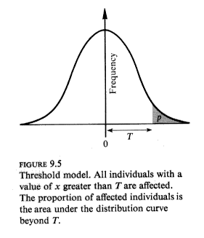
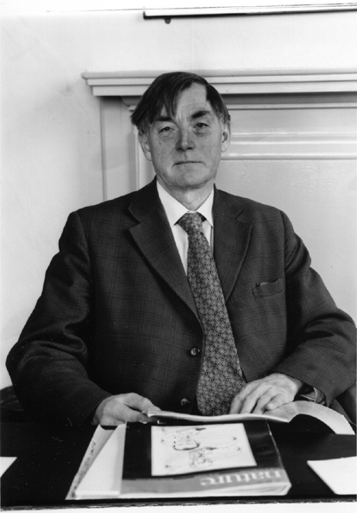
Quasi-continuous phenotypes
Some disease traits are apparently discrete (e.g. myocardial infarction) but reflect an underlying continuous process, e.g. coronary artery narrowing).
When the underlying continuous process cannot be measured, a latent variable called liability is introduced. When liability exceeds a certain threshold, the diseases occurs
Liability is assumed to be normally distributed, so that biometrical models developed for continuous traits apply
Douglas Falconer 1965: Inheritance of liability to certain diseases estimated from incidence among relatives

Slide 52
Neglected topics
Environmental influences
Gene-environment correlation and interaction
Multivariate (i.e. multi-trait) models
Assortative mating
Selection
Mutation
Random genetic drift

Slide 53
Data analysis under biometrical models
Biometrical genetic models provide a coherent understanding of the genetic contributions to the statistical properties of traits in the population.
Biometrical genetic models also provide a useful framework for the statistical analysis of data

Slide 54
Regression analysis for association
Regression analysis is appropriate for testing and estimating the fixed effects of one of more genetic loci on a trait
Linear or logistic regression are commonly used for continuous and binary traits, respectively. Ordinal logistic regression and Cox regression may be appropriate for ordinal or time-to-event data, respectively.
With appropriate coding of genetic effects, main effects and interactions can be directly tested and estimated
For example, coding the genotypes additively as aa, Aa and AA as 0, 1 and 2, the regression coefficient of trait on genotype can be directly interpreted as the allelic effect of A.
Similarly, coding the dominance of aa, Aa and AA as p², -p(1-p), and (1-p)² will directly test and estimate twice the dominance deviation

Slide 55
Variance components model for linkage
The contribution of the additive genetic variance of a particular locus to the covariance of a trait between relative pairs depends on the proportion of alleles IBD at that locus ($π$); higher $π$ leads to higher trait covariance
Other than MZ twins, parent-offspring pairs and unrelated individuals (but see later), there is variation of $π$ across the genome
The allows the covariance of the an unmeasured additive effect between relative pairs to be specified as a function of $π$ at a specific locus. When $π$ can be estimated from genotyped SNPs at the near the locus, then its effect on trait covariance can be specified as a random effect in a linear mixed model.
Model fitting (e.g. by restricted maximum likelihood) then provide an estimate the additive genetic variance at the specific locus.
This analysis is called variance components quantitative trait locus (QTL) linkage analysis, because the estimate would capture of effects of loci that are linked to the specific locus, as well as those of the specific locus itself.
The use of sib pairs for variance components QTL linkage analysis was a popular approach in the late 1990s. This is seldom used now because of low statistical power when effect size is small.

Slide 56
Variance components model for heritability
Instead of using the variation of $π$ across the genome for a given class of genetic relationship, we can exploit the differences of E($π$) for different relationships to estimate the total additive genetic variance of a trait (which when expressed as a proportion of the total trait variance is the narrow-sense heritability).
The classic twin design can be analyzed by a variance components model, where the additive genetic effects are specified to have an correlation of 1 for MZ twins and 0.5 for DZ twins (since E($π$)=1 for MZ twins, 0.5 for DZ twins).
A dominance component can be specified by specifying correlation of 1 for MZ twins and 0.25 for DZ twins (since Prob($π$=1)=1 for MZ twins and 0.25 for DZ twins).
Shared environmental influences for both MZ and DZ twins are specified to have correlation 1, whereas non-shared environment influences for both MZ and DZ twins are specified to have correlation 0.

Slide 57
Variance components models for heritability
Random effects models can be applied to individuals not known to be related, to estimate heritability, since all pairs of individuals share common ancestors if their genealogies are traced back far enough.
Such remote genetic relationships between pairs of individuals, effectively E($π$), can be estimated from numerous SNPs across the genome.
The estimated remote genetic relationships are then used to specify the covariance in additive genetic effects between pairs of individuals in a random effects model (first proposed in the GCTA method)
This allows the heritability due to common variation in the genome to be estimated.

Slide 58
More complex structural equation models
In principle, association, linkage and heritability analyses can all be combined in a single statistical model involving both fixed and random effects and their correlations and interactions, as well as complications such as assortative mating.
Such an analysis can be formulated in a structural equations model framework, allowing joint estimation of the multiple effects, and hypothesis testing of different components of the model.

