Slide 1
GenomicSEM
Michel Nivard (m.g.nivard@vu.nl)

Slide 2
GenomicSEM
Michel Nivard (m.g.nivard@vu.nl)
Andrew Grotzinger

Slide 3
GenomicSEM
Michel Nivard (m.g.nivard@vu.nl)
Elliot Tucker-Drob
Andrew Grotzinger

Slide 4
The wish to explore genetic correlations between traits is universal
Most GWAS correlate their trait of interest with a set of potentially related traits.
This has become a standard figure in any large GWAS effort.

Slide 5
Liu et al Substance use, NG 2019
Abdellaoui loneliness, NG 2019

Slide 6
Jansen et al. Alzheimer’s Disease NG, 2019
Linner et al. Risk seeking Behaviour, NG 2019

Slide 7
In GWAS we frequently consider only only a slice of the matrix
Jansen et al, Insomnia, NG, 2019

Slide 8
So consider the full correlation/covariance matrix:

Slide 9
So consider the full correlation/covariance matrix:
Hypothetical GIANT consortium figure

Slide 10
So consider the full correlation/covariance matrix:
Hypothetical SSGAC consortium figure

Slide 11
Our solution: GenomicSEM
Apply structural equation model, to estimated genetic covariance matrices
Make sure we are able to infer things about the parameter (are they equal, are they > 0 are they < 1)
SEE PREPRINT: https://www.biorxiv.org/content/10.1101/305029v1
AND GITHUB: https://github.com/MichelNivard/GenomicSEM
TUTORIALS: https://github.com/MichelNivard/GenomicSEM/wiki

Slide 12
Ultra short primer on SEM

Slide 13
Imagine we knew the generating causal process
1
x
.40
y
1
.84
u_{y}
y = .40 x + u_{y}
x ~ (0,1) , u_{y} ~ (0,.84)

Slide 14
Imagine we knew the generating causal process
1
x
.40
y
1
.84
u_{y}
.60
z
1
u_{z}
.64
y = .40 x + u_{y}
x ~ (0,1) , u_{y} ~ (0,.84)
z = .60 y + u_{z}
u_{z} ~ (0,.64)

Slide 15
Imagine we knew the generating causal process
Implied covariance matrix
in the population
1
x
.40
y
1
.84
u_{y}
1.00
.40 | 1.00
.24 | .60 | 1.00
.60
cov(x,y,z)_{pop} =
z
1
u_{z}
.64
y = .40 x + u_{y}
x ~ (0,1) , u_{y} ~ (0,.84)
z = .60 y + u_{z}
u_{z} ~ (0,.64)

Slide 16
In practice, we only observe the sample data, and we propose a model
observed covariance matrix
in a sample
covariance matrix
in population
.94
.33 | 1.02
.27 | .62 | 1.02
1.00
.40 | 1.00
.24 | .60 | 1.00
≈

Slide 17
For the proposed model, estimate parameters from the data, and evaluate model fit to the data
.94
.33 | 1.02
.27 | .62 | 1.02
cov(x,y,z)_{sample} =
b_{xy}
1
σ²_{uy}
σ²_{x}
x
y
u_{y}
b_{yz}
z
1
u_{z}
σ²_{uz}
6 unique elements in the covariance matrix being modeled
5 free model parameters
1 df

Slide 18
For the proposed model, estimate parameters from the data, and evaluate model fit to the data
.94
.33 | 1.02
.27 | .62 | 1.02
cov(x,y,z)_{sample} =
.35
1
.90
.94
x
y
u_{y}
.61
.94
.33 | 1.03
.20 | .63 | 1.00
z
1
u_{z}
.63
cov(x,y,z)_{implied} =

Slide 19
The model that we fit may include some variables for which we do not observe data
σ²_{F} (= 1 for scaling)
y_{k} = λ_{k}F + u_{k}
F
F ~ (0, σ²_{F}) , u_{yk} ~ (0, σ²_{uk})
F is unobserved.
Parameters are estimated from,
and fit is evaluated relative to,
the sample covariance matrix for y₁-y_{k}.
λ₁
λ₂
λ₃
λ₄
λ₅
y₁
y₂
y₃
y₄
y₅
u_{y1}
u_{y2}
u_{y3}
u_{y4}
u_{y5}
σ²_{u1}
σ²_{u2}
σ²_{u3}
σ²_{u4}
σ²_{u5}

Slide 20
The model that we fit may include some variables for which we do not observe data
σ²_{F1}
F₁
b₁₂
F₂
1
σ²_{uF1}
u_{F1}
(= 1 for scaling)
(= 1 for scaling)
λ₁₁
λ₁₂
λ₁₃
λ₁₄
λ₁₅
λ₂₁
λ₂₂
λ₂₃
λ₂₄
λ₂₅
y₁
y₂
y₃
y₄
y₅
z₁
z₂
z₃
z₄
z₅
u_{y1}
u_{y2}
u_{y3}
u_{y4}
u_{y5}
u_{z1}
u_{z2}
u_{z3}
u_{z4}
u_{z5}
σ²_{uy1}
σ²_{uy2}
σ²_{uy3}
σ²_{uy4}
σ²_{uy5}
σ²_{uz1}
σ²_{uz2}
σ²_{uz3}
σ²_{uz4}
σ²_{uz5}

Slide 21
Some basic rules for SEM
Cannot estimate more parameters then UNIQUE ellements in the covariance matrix.
Each parameter has to have a unique functional relationship to the observed covariances.

Slide 22
Start with GWAS Summary Statistics for the Phenotypes of Interest
No need for raw data
No need to conduct a primary GWAS yourself: Download them online!
sumstats for over 3700 phenotypes have been helpfully indexed at http://atlas.ctglab.nl/
sumstats for over 4000 UK Biobank phenotypes are downloadable at http://www.nealelab.is/uk-biobank

Slide 23
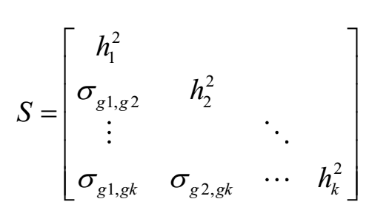
Stage 1 Estimation: Multivariable LDSC
Create a genetic covariance matrix, S: an “atlas of genetic correlations”
Diagonal elements are
(heritabilities)
Off-diagonal elements are
coheritabilities

Slide 24
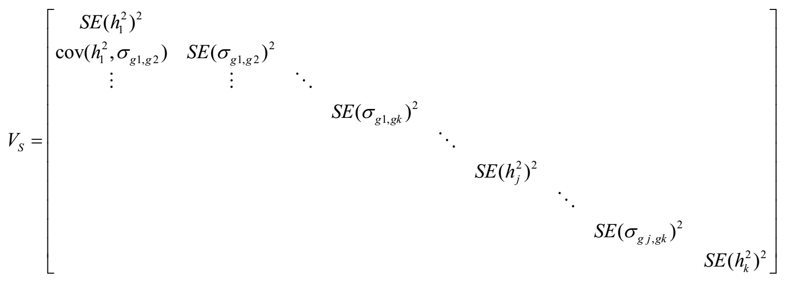
Stage 1 Estimation: Multivariable LDSC
Also produced is a second matrix, V, of squared standard errors and the dependencies between estimation errors
Diagonal elements are
squared standard errors of
genetic variances and covariances
Off-diagonal elements are dependencies between estimation errors used to directly model dependencies that occur due to sample overlap from contributing GWASs

Slide 25
Function we minimize:
s <- vector of unqiue elements in S:
$F_{WLS}= (s−Σ(θ)\text{)}’ \text{∗ }\text{diag}\text{(}\text{V}\text{)}\text{−1 }\text{∗ (}s−Σ(θ))$

Slide 26
How to use genomicSEM (WITHOUT SNPs)
Step 1: download and munge data for traits you want to analyse
R function: munge()
Step 1b: Download LD scores
(wget https://data.broadinstitute.org/alkesgroup/LDSCORE/eur_w_ld_chr.tar.bz2)
Step 2: run Ldscore regression
R function: ldsc()
Step 3: run a model!
R functions: usermodel(),

Slide 27
How to use genomicSEM (WITH SNPs)
Step 1: download and munge data for traits you want to analyse
R function: munge()
Step 1b: Download LD scores
(wget https://data.broadinstitute.org/alkesgroup/LDSCORE/eur_w_ld_chr.tar.bz2)
Step 2: run Ldscore regression
R function: ldsc()
Step 3: read the sumstats into R:
R function: sumstats()
Step 4: For each SNP, add the SNP to the covariance matrix S and V
R function: addSNP()
Step 5: Run the model X million times:
R functions: userGWAS(), userGWASpar() commonfactorGWAS(), commonfactorGWASpar()

Slide 28
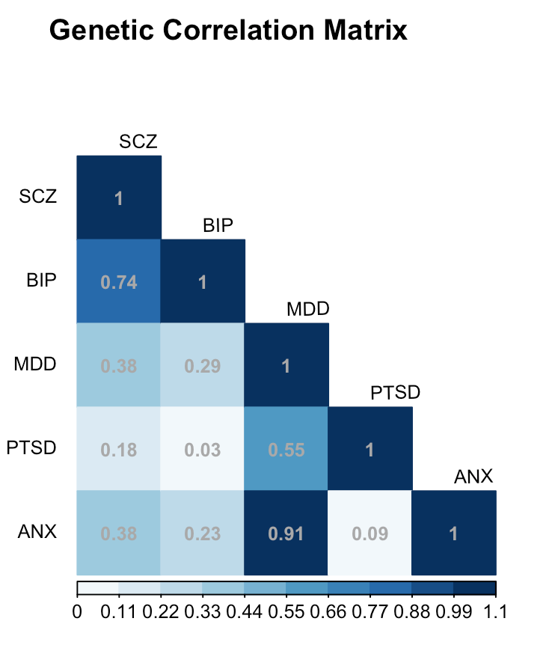
1
p_{G}
.86 (.06)
.53 (.08)
.81 (.06)
.29 (.09)
.46 (.04)
SCZ_{g}
BIP_{g}
MDD_{g}
PTSD_{g}
ANX_{g}
1
1
1
1
1
u_{SCZ}
u_{BIP}
u_{MDD}
u_{PTSD}
u_{ANX}
.26 (.11)
.35 (.11)
.79 (.07)
.91 (.44)
.71 (.36)
Notes:
General factor structure. Larger loadings on schizophrenia and bipolar is consistent with previous research
Fix

Slide 29
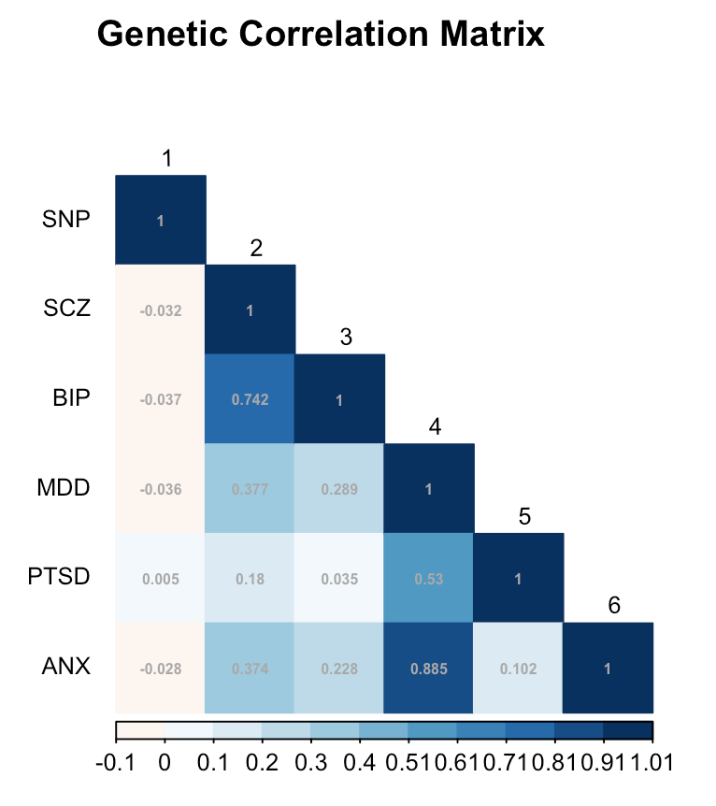
u_{p}
.998 (.049)
1
rs4552973
-.045 (.008)
p_{G}
1
.86 (.06)
.53 (.08)
.81 (.06)
.29 (.09)
.46 (.04)
SCZ_{g}
BIP_{g}
MDD_{g}
PTSD_{g}
ANX_{g}
1
1
1
1
1
u_{SCZ}
u_{BIP}
u_{MDD}
u_{PTSD}
u_{ANX}
.26 (.11)
.35 (.11)
.79 (.07)
.91 (.44)
.71 (.36)
Notes:
There are two ways we can think of how latent factors fit with GWAS. Just heard about GWAS of individual indicators. Another way to think about it is, what if we have done GWAS already, is it dead or is there something we can do with it.
Just delete the twin model slide.
Other applications we want to mention?

Slide 30
Show them the WIKI
This is just a stage direction for me…..
https://github.com/MichelNivard/GenomicSEM/wiki

Slide 31
Step 1: munge sumstats : Example code
sums <- c("GWAS_EA_excl23andMe (1).txt", "adhd_eur_jun2017”)
names <- c("EA", "ADHD")
N <- c(766345,55374)
munge(files = sums,trait.names = names,hm3 = "w_hm3.noMHC.snplist", N = N)

Slide 32
Step 2: run LDSC, example code:
# ADHD, sigarets per day, EA, blood prerasure and BMI
traits <- c("ADHD.sumstats.gz","smoking.sumstats.gz","EA.sumstats.gz",
"BP.sumstats.gz","BMI.sumstats.gz")
sample.prev = c(.36,NA,NA,.29,NA)
population.prev = c(.06,NA,NA,.29,NA)
ld ="eur_w_ld_chr/"
wld="eur_w_ld_chr/"
ldsc.object <- ldsc(traits = traits,
sample.prev = sample.prev,
population.prev = population.prev,
ld = "eur_w_ld_chr/",
wld = "eur_w_ld_chr/",
trait.names = c("ADHD","smoking","EA","BP","BMI"))

Slide 33
Step 3a: specify a model
We use the R formula language, slightly extended:
Regression:
A ~ B
(Co)variance:
A ~~ A; A ~~ B
Factor:
F1 =~ A + B + C + D
Fix a parameter:
A ~~ 1*B (the covariance between A and B is 1)

Slide 34
Lets make that a bit more specific
A
B
C
Model1 <- “ A ~ B
B ~ C”
Model2 <- “ A ~ B
A ~ C
B ~~ C”
B
A
C

Slide 35
Lets make that a bit more specific
Model3 <- “ F1 =~ NA*A + B + C
F1 ~~ 1*F1”
1
F1
A
B
C

Slide 36
Lets make that a bit more specific
Model3 <- “ F1 =~ 1*A + B + C”
F1
1
A
B
C

Slide 37
BUT: SEM is not a magical technique!
y1
y1
y1
y1
y1
y1
y2
y3
y2
y3
y2
y3
y2
y3
y2
y3
y2
y3

Slide 38
BUT: SEM is not a magical technique!
1. Their is a risk of overfitting, that is if you fit MANY models, its not likely that the best fitting model will generalize to new data
Solutions: 1) preregister which models you will consider, STICK TO YOUR SELECTION (or explain yourself)
2) develop models on the odd chromosomes, then validate on the even chromosomes.
3) Find other GWASes of the same trait(s) and confirm your chosen model fits those data well.
Some of these best Practices implemented here →

Slide 39
PRACTICAL!
Copy the folder : faculty/michel/2019/practical_1
open the Rstudio project by doubleclicking: practical.Rproj
Run the code up to line 24, this took ~ 3-5 minutes on my laptop (fingers crossed it will finish soonish on yours…)

Slide 40
PRACTICAL!
I have provided munged GWAS sumstats for:
High blood pressure (BP)
BMI, smoking (packs per day in smokers), educational attainment (EA), ADHD
I provide a baseline model for you:
BP ~ smoking + EA + ADHD + BMI
And all correlations between the variables on the right hand side

Slide 41
PRACTICAL!
I provide a baseline model for you:
BP ~ smoking + EA + ADHD + BMI
And all correlations between the variables on the right hand side
Smk
EA
BP
ADH
BMI

Slide 42
PRACTICAL
But we are scientists, and we don’t want to fool ourselfs, so you must write your model(s) down on paper, as away of preregistering them!
I preregister the following (silly!!) model:
michel.model <- “ BP ~ ADHD + EA
ADHD ~ BMI + smoking
EA ~ BMI + smoking
BMI ~~ smoking”

Slide 43
Michel’s preregistration
EA
Smk
BP
ADH
BMI

Slide 44
Fit statistics I
CFI values theoretically range from 0 to 1, with higher values indicating good fit. CFI values of .90 and above are typically considered acceptable fit, and values of .95 and above are typically considered good model fit.
SRMR values below .10 indicate acceptable fit, values less than .05 indicate good fit, and a value of 0 indicates perfect fit. It is positively-biased, with larger bias resulting when the contributing univariate GWAS samples are lower powered.

Slide 45
Bonus practical for on the flight back
The folder: michel/2019/practical_2 contains munged sumstats from 6 neuroticism items in UK biobank.
There is a script to read the munged sumstats into R, and run exploratory factor model.
The script further contains the code to run a 2 factor model,
You can write a script to fit a single factor model, and compare the fit.
Which model is ”better”?

