Slide 1


Phenomics
Michael Neale & Joshua Pritikin
Virginia Institute for Psychiatric & Behavioral Genetics
Virginia Commonwealth University
Boulder Workshop
8 March 2019

Slide 2
Outline
Measuring Complex Traits
Drug factors vs. Symptom factors
Genomewide Structural Equation Modeling
Testing Hypotheses about Gene Action: FTND
Obligate Missingness
Developmental Issues
Future Directions including GREML

Slide 3
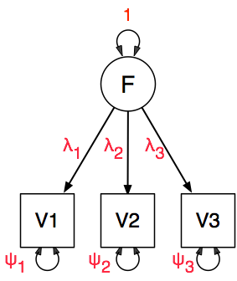
Measurement Invariance: Factor Model
Usually want to know
about F, the latent factor!
Indirect measurement

Slide 4
Correlations across Substances: Add Health
 | Stimulants | Tranquilizers | Marijuana
Stimulants | 1
Tranquilizers | 0.74 | 1
Marijuana | 0.63 | 0.66 | 1
Factor Loadings | 0.84 | 0.87 | 0.75
Medland & Neale (2010) An integrated phenomic approach to multivariate allelic association. European Journal of Human Genetics18:233–239
Aged 18-26; N=864

Slide 5
DRD2 Association Results (Add Health)
Univariate associations
  Stimulants: χ²=3.88, β= -.18, p < .05
  Tranquilizers: χ²=1.65, β= .13, NS
  Marijuana: χ²=2.60, β= .11, NS
Factor level association
  χ²=0.65, kF= .06, NS
Item level association
  χ²=13.91 (3df; p < 0.005)
  β_{Stimulants} = -0.19
  β_{Tranquilizers}= 0.14
  β_{Marijuana} = 0.11

Slide 6
MNI Causes Errors of Inference
Sum Scores & Factor Scores Depend on Model
Item-level Differences May:
  Invalidate Group Mean Tests (Association even)
  Invalidate Group Variance Tests
MI Still Rarely Tested

Slide 7
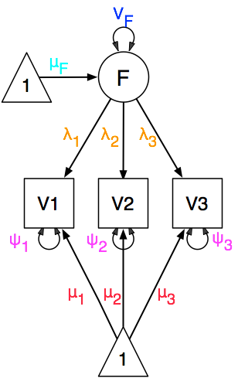
Invariance: Five Potential Types of Difference
Factor Variances
Factor Means
Factor Loadings
Item Variances
Item Means

Slide 8
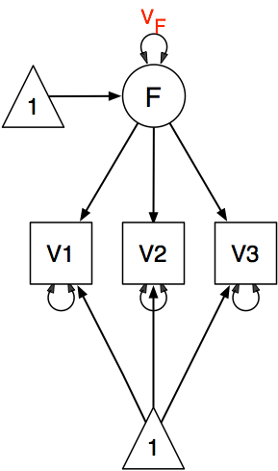
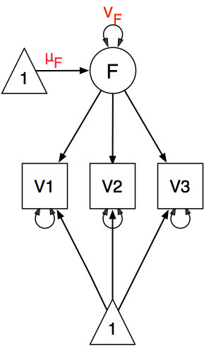
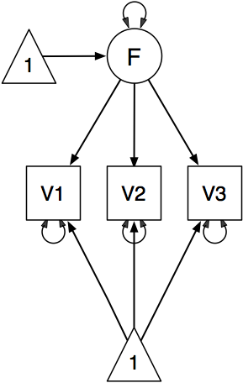
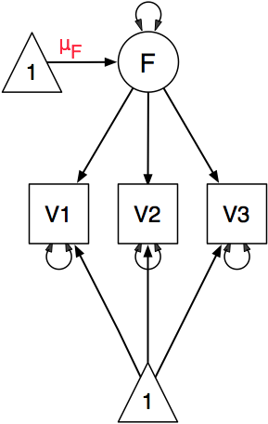
Invariance Models of Factor-Level Effects
1. No Covariates
2. Age/Sex on
Factor Mean
3. Age/Sex on
Factor Variance
4. Age/Sex on Factor
Mean and Variance

Slide 9
MI Application: National Survey of Drug Use in Households (NSDUH)
Substance Abuse and Mental Health Services Administration (SAMSA) regular data collection
~50,000 persons per assessment
Face-to-face Interviews(!)
Audio-Computer-Assisted Testing

Slide 10
Map Items to DSM-IV Substance Abuse and Dependence Criteria
A1 During the past 12 months, did using marijuana or hashish cause you to have serious problems like this either at home, work, or school?
A2 During the past 12 months, did you regularly use marijuana or hashish and then do something where using marijuana or hashish might have put you in physical danger?
A3 During the past 12 months, did using marijuana or hashish cause you to do things that repeatedly got you in trouble with the law?
A4 Did you continue to use marijuana or hashish even though you thought it caused problems with family or friends?

Slide 11
DSM-IV Dependence Criteria
D1 During the past 12 months, did you need to use more marijuana or hashish than you used to in order to get the effect you wanted?
D3 Were you able to keep to the limits you set, or did you often use marijuana or hashish more than you intended to?
D4 During the past 12 months, did you want to or try to cut down or stop using marijuana or hashish?
D5 During the past 12 months, was there a month or more when you spent a lot of your time getting or using marijuana or hashish?
D6 This question is about important activities such as working, going to school, taking care of children, doing fun things such as hobbies and sports, and spending time with friends and family.
  During the past 12 months, did using marijuana or hashish cause you to give up or spend less time doing these types of important activities?
D7 Did you continue to use marijuana or hashish even though you thought it was causing you to have physical problems?

Slide 12
Test of Item Mean Invariance: Marijuana in NSDUH
Strong evidence of MNI with respect to age and sex
Examine individual items
Four column heatmap for significance of effects
  Item Means & Factor Variances
  Sex and Age
Compare across self-reported race

Slide 13
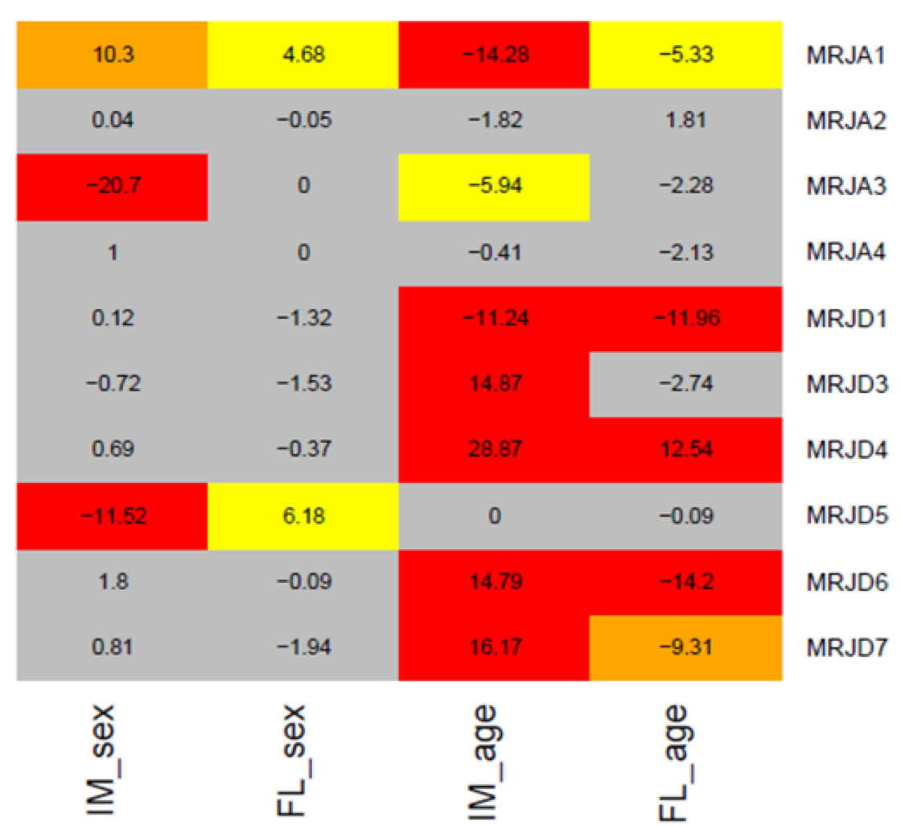
-2lnL Likelihood Ratio Test Statistics:
Marijuana Item Means & Factor Loadings
Entire
Sample
Sex
Age
Work
Danger
Law
Friends
Tol
>Intend
TryCut
TimeGet
TimeOther<
PhysProb
+/- sign denotes direction

Slide 14
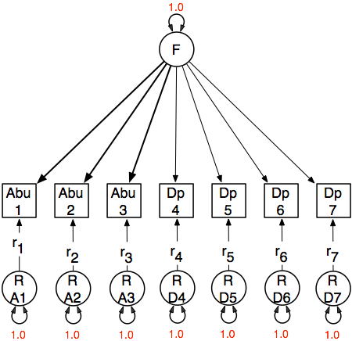
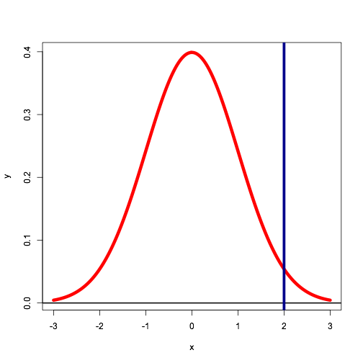
Estimating Factor Scores
f Factor Score
Factor Loadings

Slide 15
ML Estimation of Factor Scores
f Factor Score
Factor Score * Likelihood of items conditional on factor score
Items independent conditional on factor score:
Means and variances change according to size of factor loadings
Factor Loadings

Slide 16
Alcohol
Misclassified
(overestimated)
relative to target
individual

Slide 17
Drug vs Symptom Factors
DSM III-R/IV drug abuse and dependence symptoms for cannabis, sedatives, stimulants, cocaine, opioids and hallucinogens
13 misuse symptoms measured across six illicit substance categories (78 items)
4179 males born 1940–1970 from the population-based Virginia Adult Twin Study of Psychiatric and Substance Use Disorders
Confirmatory factor analyses tested specific hypotheses regarding the latent structure of substance misuse

Slide 18
Drug vs Symptom Factors
Clark, S. L., Gillespie, N. A., Adkins, D. E., Kendler, K. S., and Neale, M. C. (2016). Psychometric modeling of abuse and dependence symptoms across six illicit substances indicates novel dimensions of misuse. Addict Behav, 53:132–40. PMCID: PMC4679450.

Slide 19
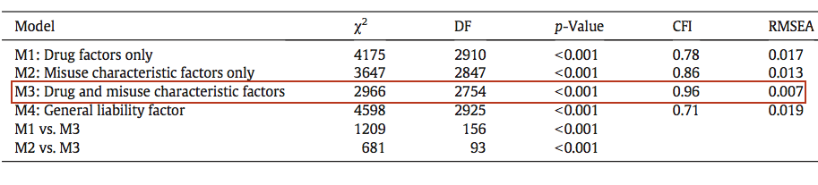
Drug vs Symptom Factors
Adding symptom factors dramatically improves fit
Majority of variance in many Sx due to symptom not drug factor

Slide 20
Factor Score Notes
Factor scores do not all have same error variance
Factor scores of A, C & E components may correlate highly
Latent trait may be non-normal (Schmitt et al 2006 Multiv Behav Res)
Factor loadings (precision) may vary across the distribution and give spurious GxE results
Variation may be discrete not continuous
For PRS, consider trait as measured at GWAS

Slide 21
Mild Cognitive Impairment VETSA Data: CHD & AD PRS
Ischemic heart disease: summary measure history of
myocardial infarction, cardiac procedure or angina.
Group | Cognitively Normal | Amnestic MCI
N | 1119 | 89
Age, mean (SD) | 56.7 (3.3) | 57.2 (3.5)
APOE-ε4+ | 29.4% | 26.2%
Ischemic Heart Disease* | 13.3% | 3.5%
Depressive symptoms, mean (SD) | 7.8 (7.6) | 9.0 (8.4)
Diabetes | 10.7% | 11.5%

Slide 22
Plots of the interaction of an Alzheimer’s disease polygenic risk score with A) a prevalent coronary artery disease polygenic risk score (CAD-PRS) and B) an incident CAD-PRS on amnestic mild cognitive impairment (MCI) status. The regression coefficient of the AD-PRS on amnestic MCI status is on the y-axis and is plotted across varying levels of CAD-PRSs on the x-axis. The dashed red line indicates the threshold of statistical significance for the AD-PRS as a predictor of aMCI status. In A the AD-PRS is more predictive of risk for aMCI to the right of the dashed line (i.e., people with higher AD-PRSs are more likely to have aMCI if they also have higher incident CAD--RSs). In B the AD-PRS is a significant predictor of increased risk for aMCI to the left of the dashed line but is not significant to the right of the dashed line.

Slide 23
Item Response Probability
Example item response probability shown in white
Possible population distribution in green
f(x)
normal
pdf
Response
Probability
Cumulative Normal
0.4
1
0.3
.75
0.2
.5
0.1
.25
.0
-4
-3
-2
-1
0
1
2
3
4
z-score

Slide 24
AFQT
100 Items
Subscales
1 Arithmetic
    Reasoning
2 Mathematics
    Knowledge
3 Word
    Knowledge
4 Paragraph
    Comprehension
Script & Fake Data are in
workshop/faculty/mcn/2019

Slide 25
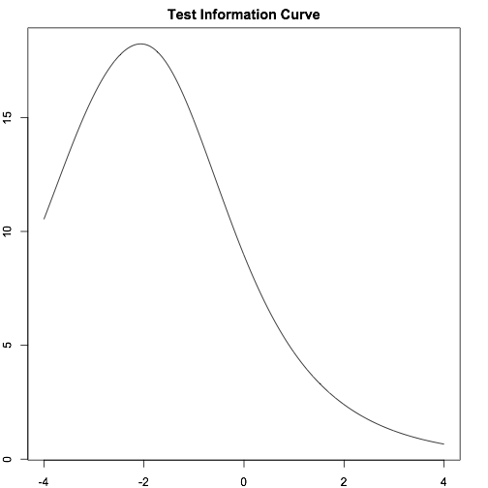
AFQT: Overall Test Information Curve
More information
at left
By design
Consequences for
GxE?

Slide 26
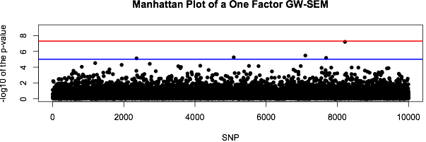
Genome-wide SEM
Avoid problems with factor scores
Fit factor or growth curve models to ordinal data
Include effect of SNP on factor or items
Repeat for the other 8m-1 SNPs
Manhattan plot results
http://goo.gl/f44UmD
Verhulst, B, Maes, H, & Neale, M (2017) GW-SEM: A Statistical Package to Conduct Genome-Wide Structural Equation Modeling. Behav Genet 47(3):345-359

Slide 27
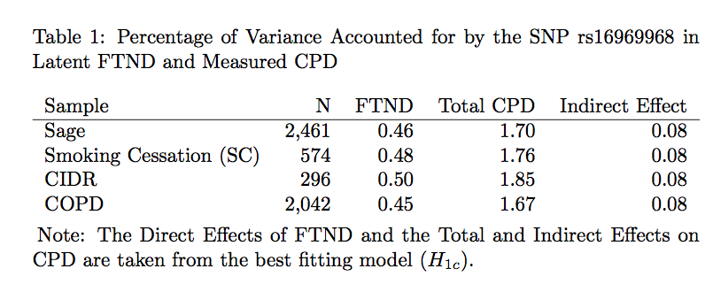
Testing Hypotheses about Gene Action: FTND
rs16969968 Neuronal acetylcholine receptor subunit α-5 CHRNA5 associated with both ND and CPD
What is the mechanism of action?
CPD mere symptom of FTND
Increases CPD increases addiction?
Feedback loop between CPD and addiction?

Slide 28
H1a SNP Causes Factor Only
rs16969968 CHRNA5

Slide 29
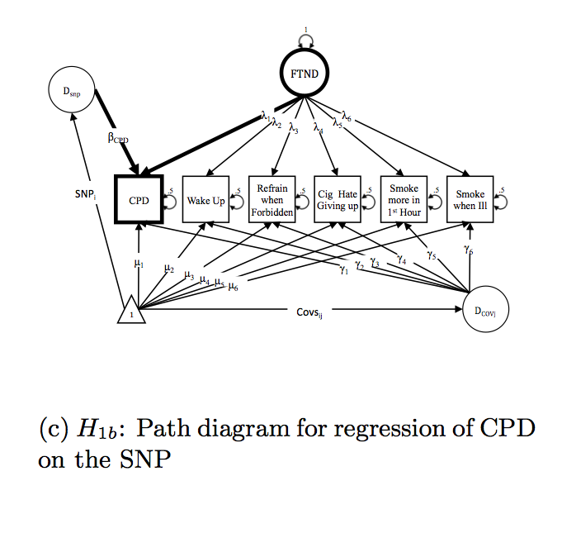
H1b SNP Causes CPD Only

Slide 30
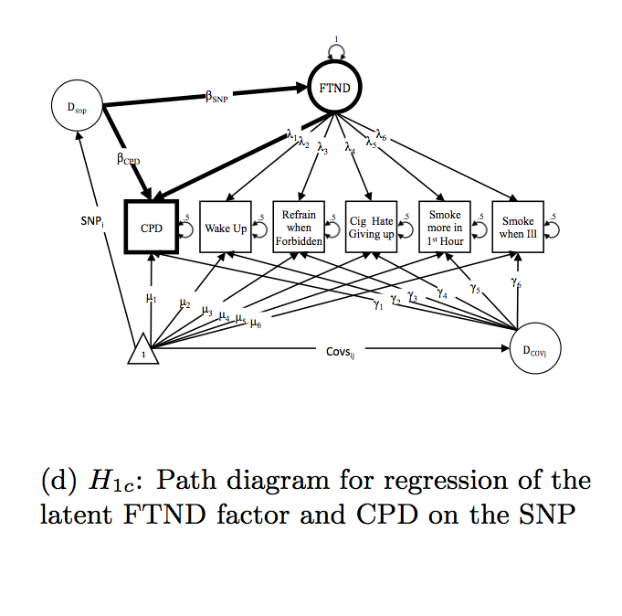
H1c SNP Causes Factor & CPD

Slide 31
H2a CPD Only & CPD causes Factor

Slide 32
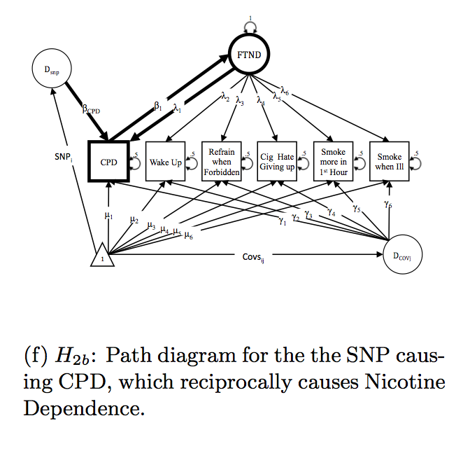
H2b SNP to CPD & Reciprocal Factor

Slide 33
Two Factor Model

Slide 34
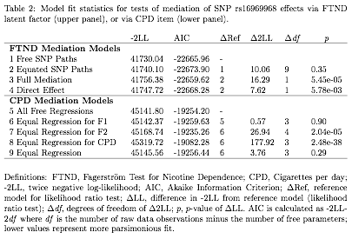
Model-Fitting Results: Bidirectionality
> mxCompare(BidirectionalFit,TwoFit1a)
base comparison ep minus2LL df AIC diffLL diffdf p
1 FullRev <NA> 44 41709.37 32194 -22678.63 NA NA NA
2 FullRev Full 40 41730.04 32198 -22665.96 20.67327 4 0.0003675709

Slide 35
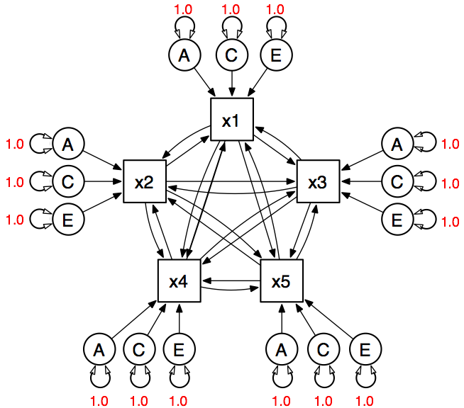
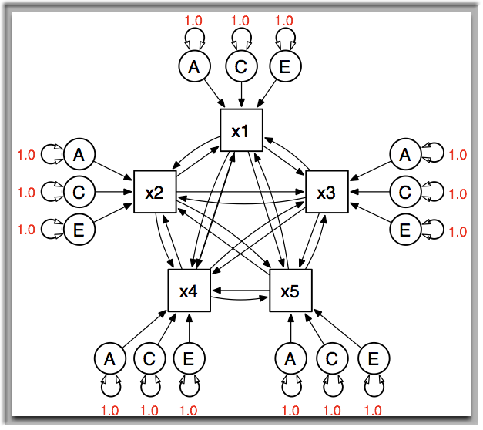
Factor Model Alternative: Mutualism
Identified
with data
from relatives
MZ & DZ Twins or
adoptees needed for A/C
resolution

Slide 36
What if Variation is Discrete?
Latent Class and Latent Profile Models
Factor Mixture Models
Latent Growth Curve Mixture Models
Regime Switching

Slide 37

Mixture Distributions
Pearson, K. (1894). Contributions to the mathematical theory of evolution. II. Skew variation in homogeneous material. Philosophical Transactions of the Royal Society of London A, 186, 343-414.
Skewness in a set of measurements of the ratio of forehead to body length of crabs
Two species or one?

Slide 38
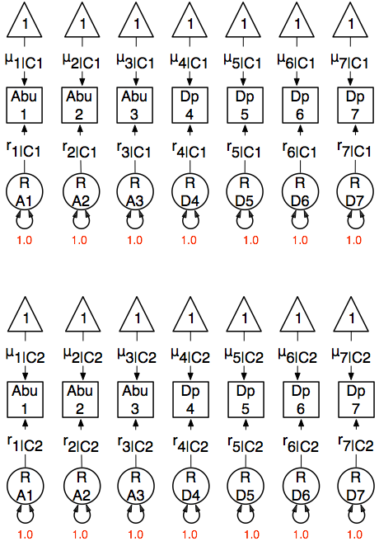
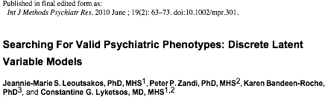
Latent Class (Subgroup) Model
Class 1
probability p
Text
Text
Text
Conditionally
Independent?!
Expensive!
Class 2
probability (1-p)

Slide 39
Factor Mixture Model
Class 1
probability p
Text
Text
Text
Very Expensive!
Class 2
probability (1-p)

Slide 40
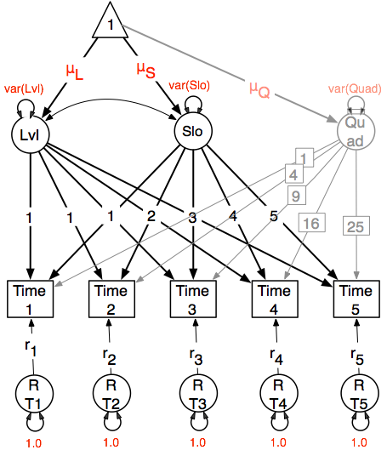
Growth Curve Mixture Model
Class 1
probability p
Text
Text
Text
Class 2
probability (1-p)

Slide 41
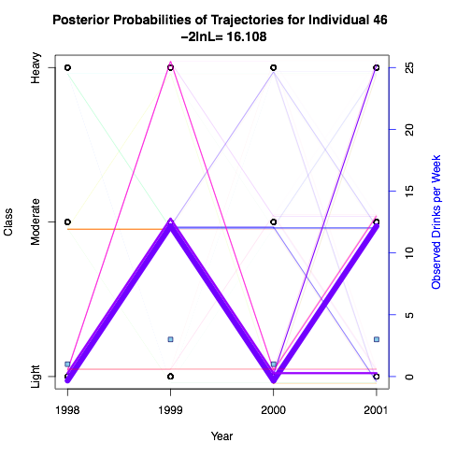
Regime Switching Model
Text
Text
Text

Slide 42
Obligate Missingness
Estimating correlation between Stem and Probe
  3+ categories of Stem and at least 2 lead to probe
  2 binary Stem items and endorsing either or both = probe
  Binary Stem but collected from relatives who correlate < 1
Do not mark missing probes as zero! Usually causes inflated item correlations

Slide 43
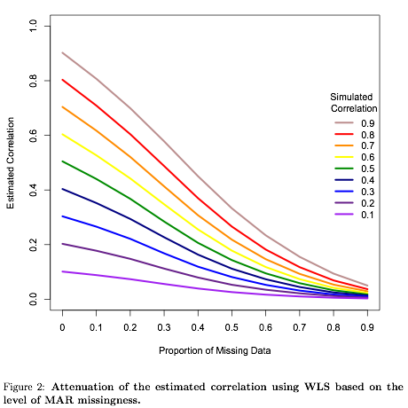
Obligate Missingness
Stem: Have you ever used cocaine? 0/1/2
Probe: Was it difficult to cut down or quit?
Probe items are MAR conditional on Stem being 1 or 2
WLS but not ML drastically attenuate correlation estimate
Must code probes as missing!

Slide 44
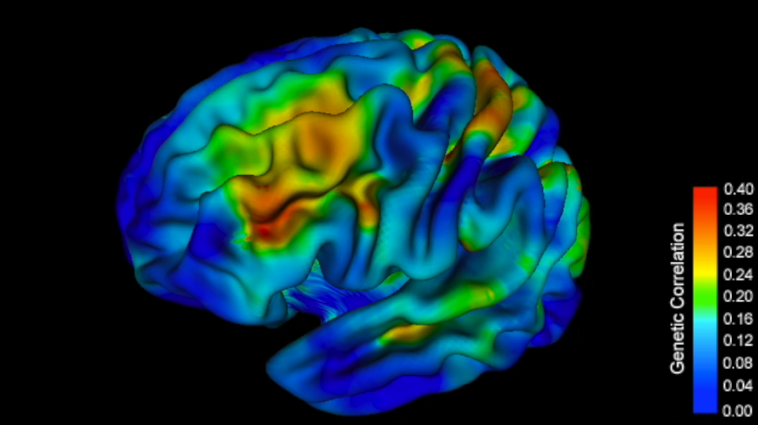
Genetic Correlations Vary with Age 8-18yrs, Giedd Study N~700

Slide 45
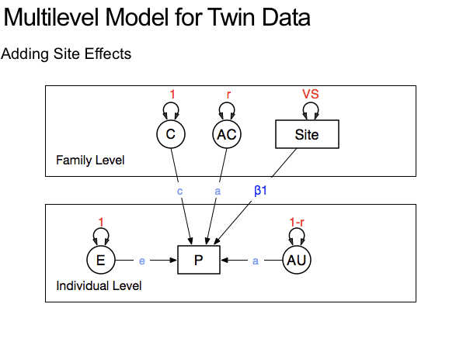

Slide 46
Genetic Heterogeneity with Age/Cohort
Neuroticism within-person .6 correlation over 10 years
Twin studies show rG < 1 over time
Expressed genetic factors change during development
Substance Use

Slide 47
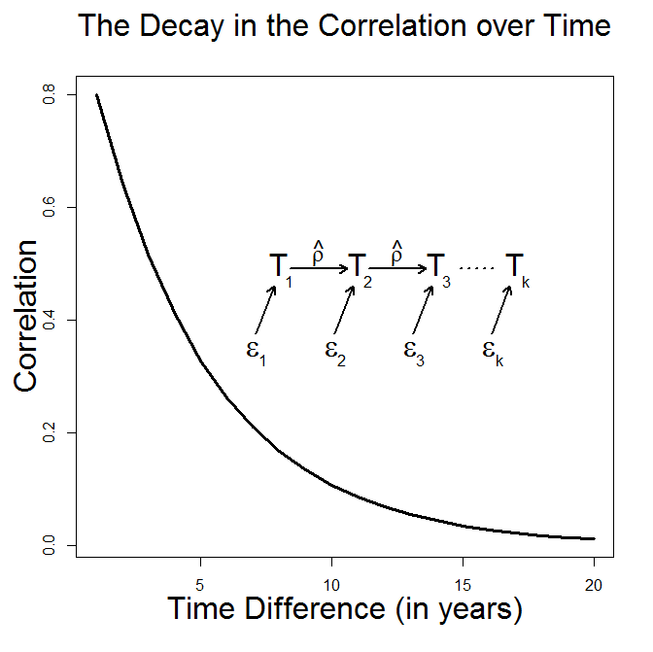
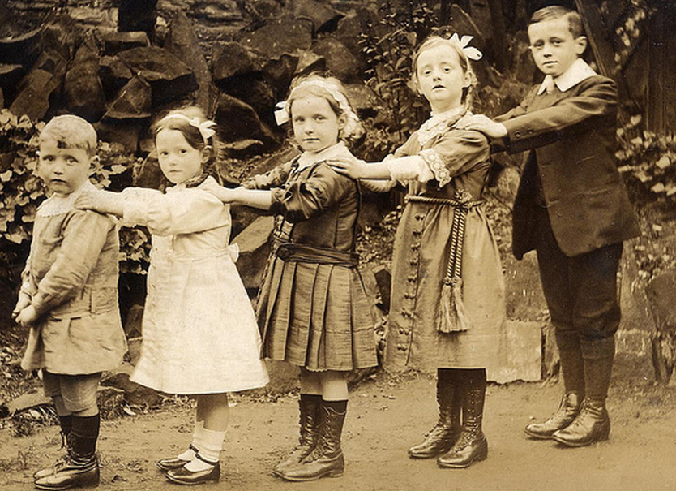
Different age, different genes?

Slide 48
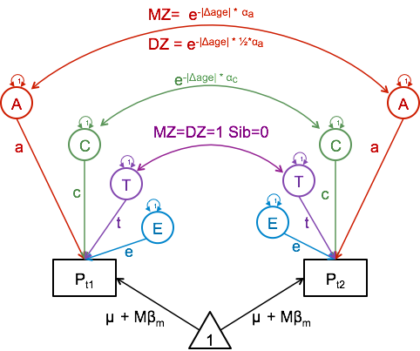
Age-Related Decay of Correlation
Verhulst, B., Eaves, L. J., and Neale, M. C. (Jul 2014). Moderating the covariance between family member’s substance use behavior. Behav Genet, 44(4):337–46.
Cov = Acov * e^{-|Δage|*αa} + Ccov * e^{-|Δage|*αc} + Tcov

Slide 49
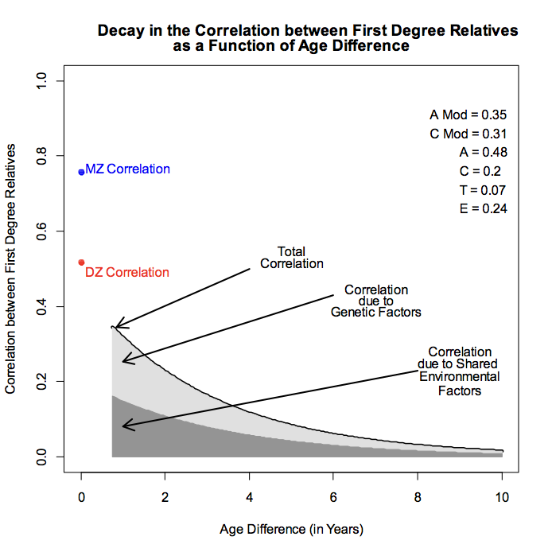
Application
Virginia 30,000 Data on Smoking
Twins, their parents, spouses, sibs and children
Twins only here, N=14,763
Crude smoking measure (1980s)
(1) never smoked, (2) used to smoke but gave it up, (3) smoked on and off, (4) smoked most of his/her life.
Strong evidence of decay
with age difference

Slide 50
Future Directions
Use Genetic relatedness matrices GRMs in place of close family relatives
  Technical challenges, invert 20k x 20k matrices or larger
Extend GW-SEM
Extend tests for direction of causation with combined twin family, multivariate and repeated measures data
Dynamical models for high density repeated measures

Slide 51
Acknowledgements
NIDA R01 DA-18673
NIDA R25 DA-26119
NIMH R25 MH-19918
Study participants
Workshop participants
OpenMx Team
VIPBG
Brad Verhulst
Shaunna Clarke
Hermine Maes
Steve Aggen
Joshua Pritikin
Computers

