Slide 1



Genetic correlation and LD Score Regression
Benjamin Neale, Ph.D.
Analytic and Translational Genetics Unit, MGH
Stanley Center for Psychiatric Research & Program in Medical and Population Genetics, Broad Institute

Slide 2
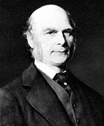
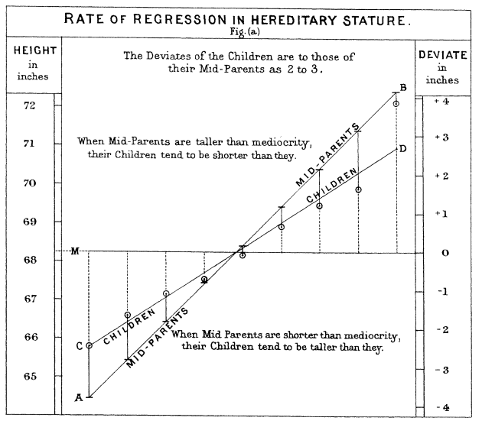
Francis Galton
Twin and family studies
Relatives are more similar than random pairs
Identical twins are more similar than fraternal twins
Average estimate of heritability 49%
69% of twin studies support a purely additive genetic model

Slide 3
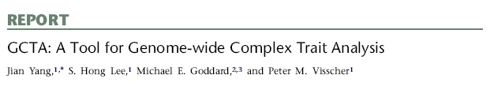
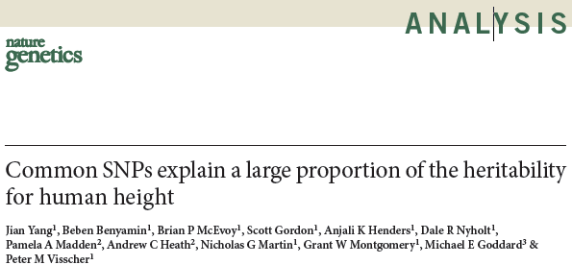
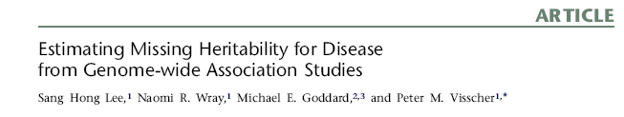
GREML/GCTA
Use estimated genetic similarity
heritability

Slide 4

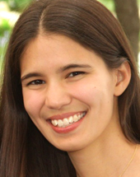
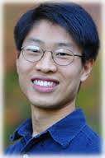


LD Score regression
With thanks
Brendan Bulik-Sullivan
Hilary Finucane
Po-Ru Loh
Mark Daly
Alkes Price

Slide 5
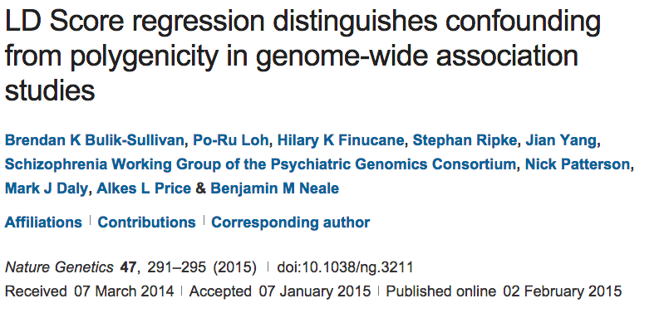
How does LD shape association?

Slide 6
How does LD shape association?
Lonely SNPs [no LD]
LD blocks

Slide 7
How does LD shape association?
Lonely SNPs [no LD]
LD blocks
*
Causal variants
*
Association
All markers correlated with a causal variant show association

Slide 8
How does LD shape association?
Lonely SNPs [no LD]
LD blocks
*
Causal variants
*
Association
Lonely SNPs only show association if they are causal

Slide 9
What happens under polygenicity?
Lonely SNPs [no LD]
LD blocks
*
Causal variants
Assuming a uniform prior, we see SNPs with more LD friends showing more association
The more you tag, the more likely you are to tag a causal variant

Slide 10
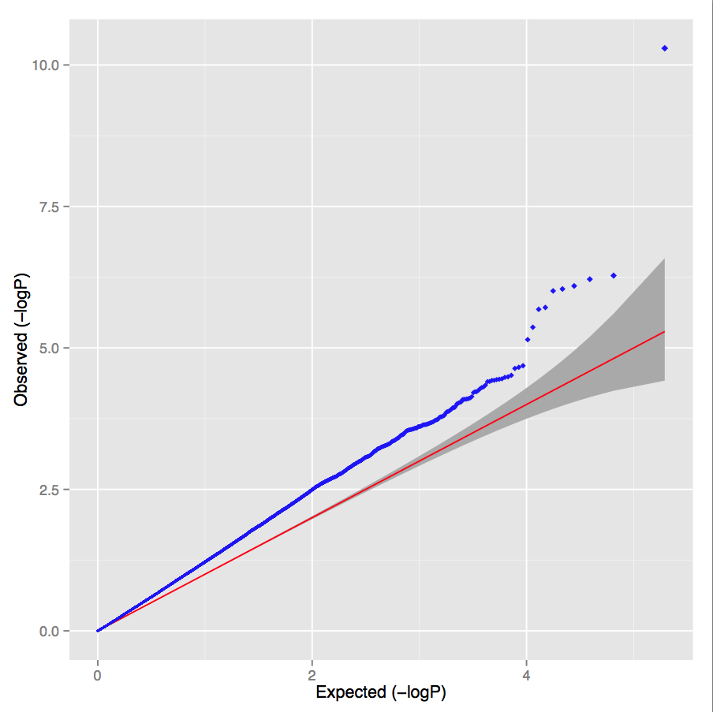
Simulated polygenic architecture
Lambda = 1.30 LD score intercept = 1.02

Slide 11
What happens under stratification?
Lonely SNPs [no LD]
LD blocks
*
Causal variants
Under pure drift we expect LD to have no relationship to differences in allele frequencies between populations

Slide 12
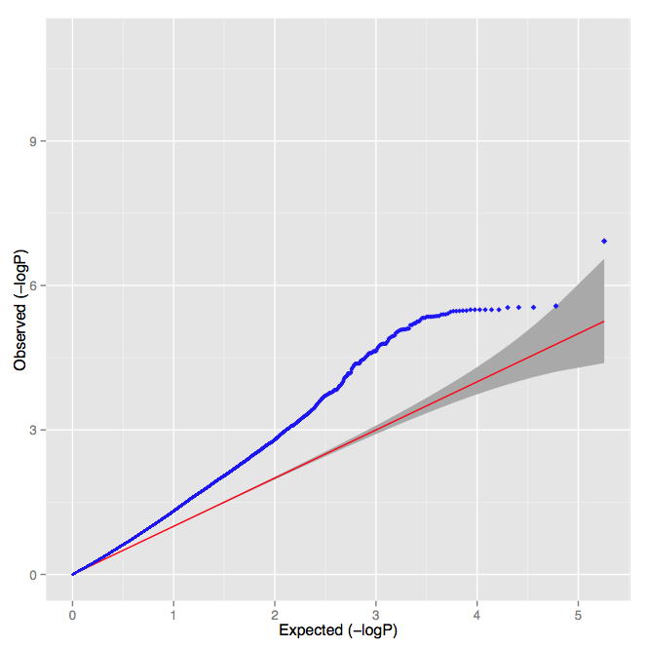
UK controls versus Sweden controls
Lambda = 1.30 LD score intercept = 1.32

Slide 13
PGC Schizophrenia
Lambda = 1.48
Intercept = 1.06
Slope p-value < 10⁻³⁰⁰
Overwhelming majority of inflation is consistent with polygenic architecture

Slide 14
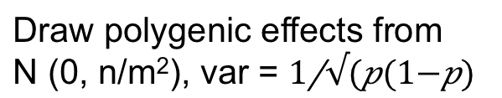
LD Score regression
Draw polygenic effects from
N (0, n/m²), var =
β
What is the E[χ²] for variant j?
New estimator of heritability
where N=sample size, M=# of SNPs, a=inflation due to confounding,
h²g is heritability (total obs.) and l_{j} is the LD Score
Bulik-Sullivan et al. Nature Genetics 2015
Yang et al. EJHG 2011

Slide 15
Questions for the audience
What are the model assumptions?
What are ways we can relax some of those assumptions?

Slide 16
Analysis of UK Biobank

Slide 17

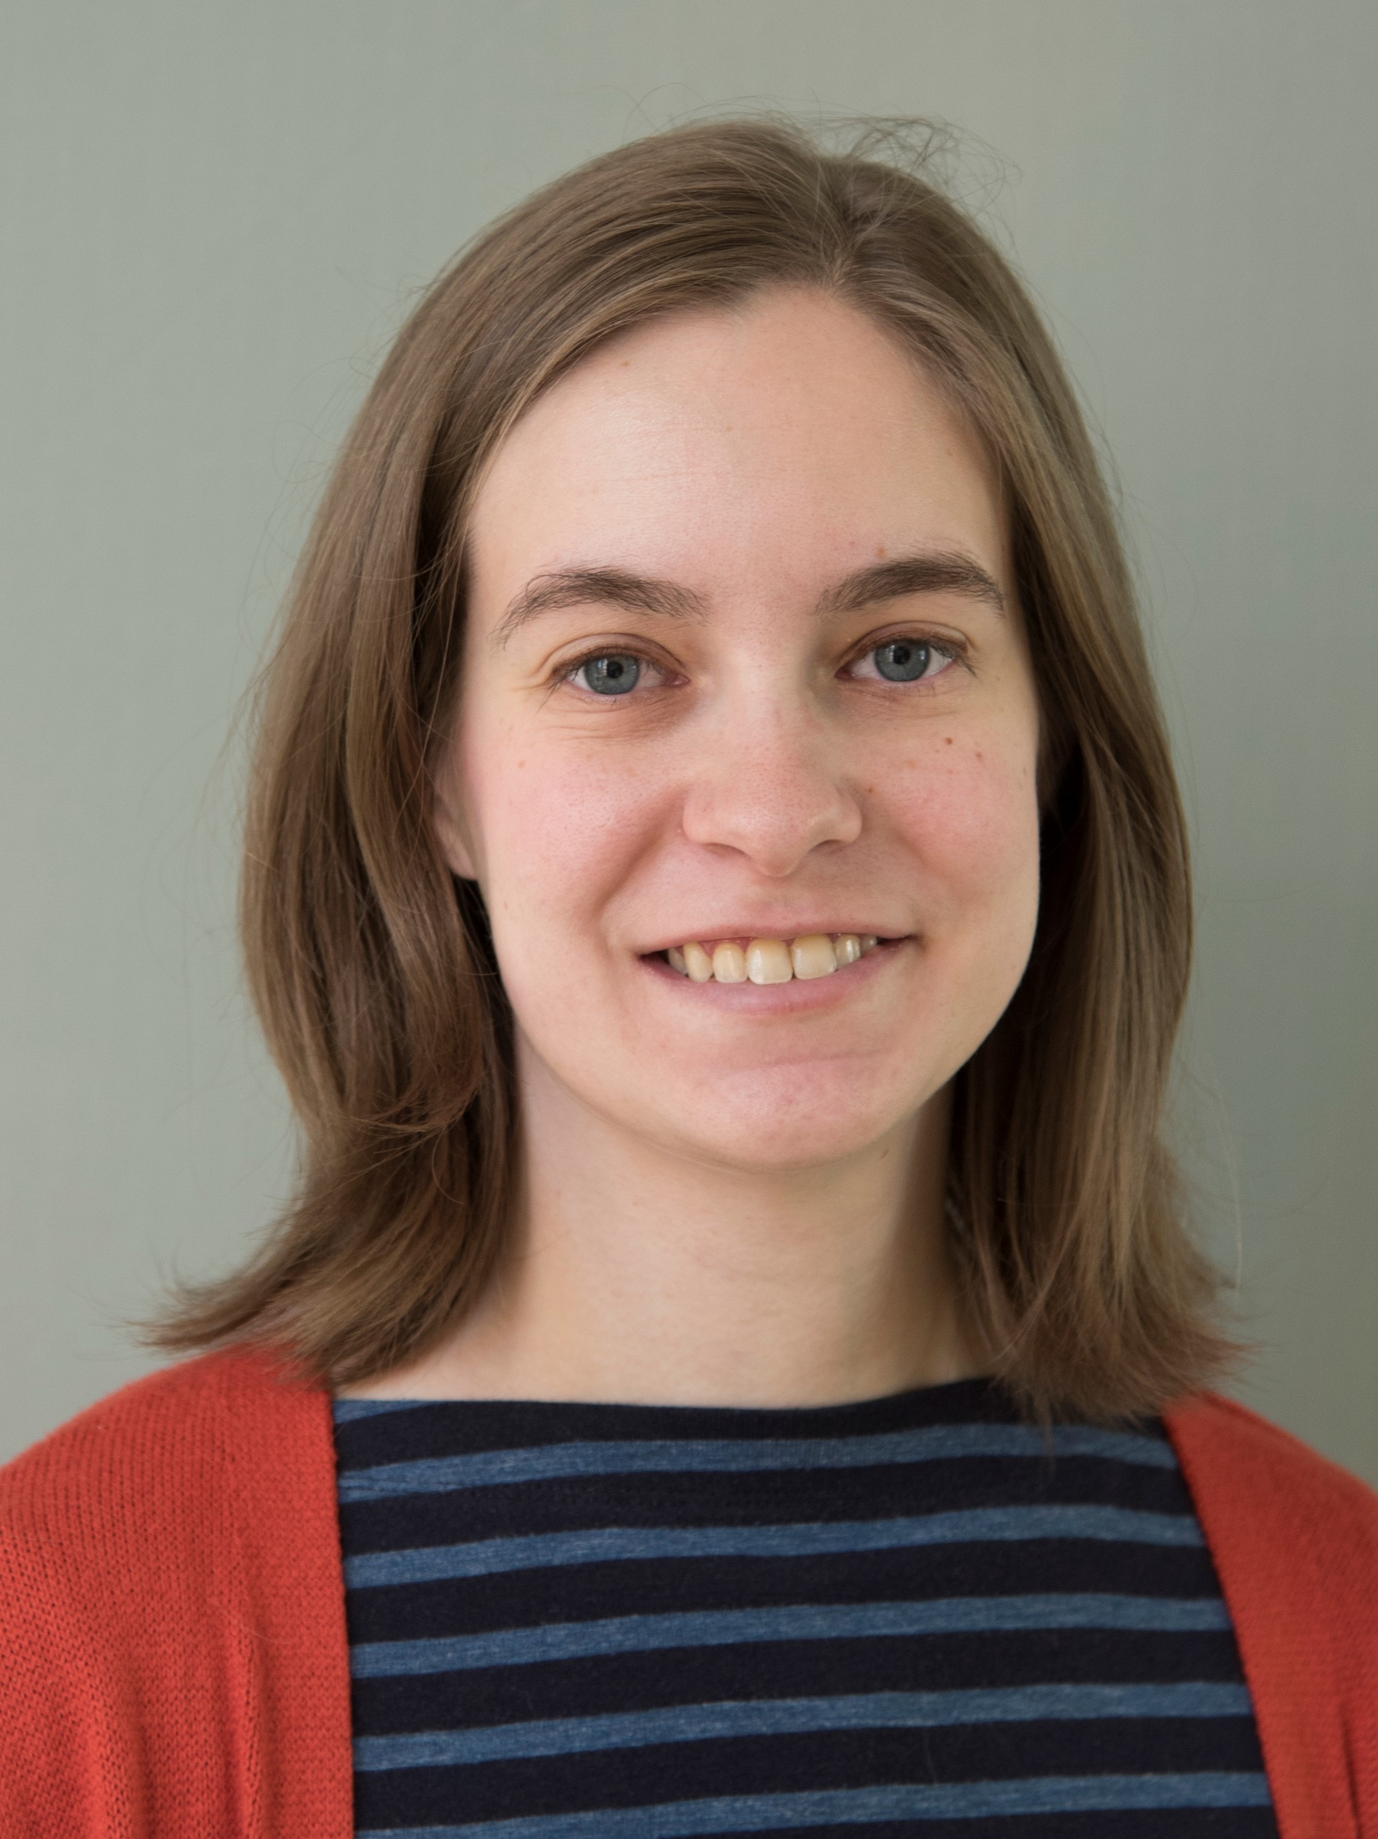


GWAS of UK Biobank
Download and decryption
Software
development
Phenotype
wrangling
QC and GWAS
Heritability analysis
Raymond Walters
Sam Bryant
Cotton Seed
Andrea Ganna, Duncan Palmer,
Caitlin Carey
Liam Abbott
Dan Howrigan
Also thanks to:
Verneri Anttila
Krishna Aragam
Alex Baumann
Jon Bloom
Joanne Cole
Mark J. Daly
Mark J. Daly
Rob Damien
Steven Gazal
Jackie Goldstein
Mary Haas
Joel Hirschhorn
Eric Jones
Sekar Kathiresan
Dan King
Ruchi Munshi
Tim Poterba
Manuel Rivas
Sailaja Vedantam
Notes:
So how did we actually do this in practice?
Stress team science aspect of this work. Much coordination to run smoothly and be successful.
Many different expertise, each played a key role
Hear from people who were very involved at different stages (how we were able to do this, what we did exactly, and what we’re learning in downstream analyses)

Slide 18

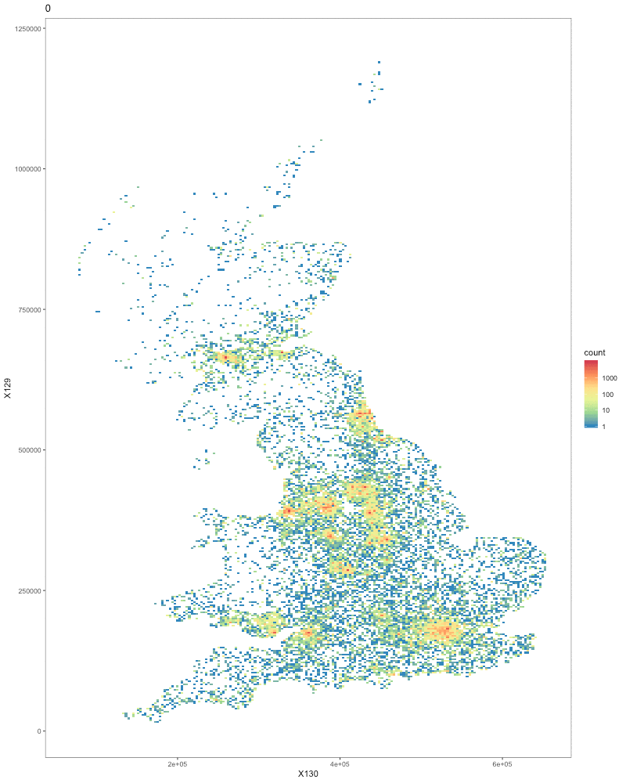
Follows health and well-being of 500,000 participants
Genotyped using the Affymetrix Biobank Array
Lots of phenotypes collected [needs harmonization]
Lots of opportunity!

Slide 19
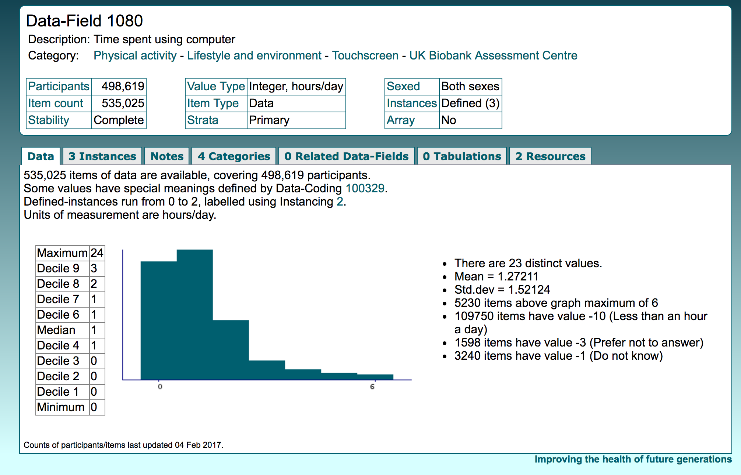
Example self-report

Slide 20
PHESANT!
Copious thanks to Millard LAC, Davies NM, Gaunt TR, Davey Smith G, Tilling K. PHESANT: a tool for performing automated phenome scans in UK Biobank. bioRxiv (2017)

Slide 21
What’s on the array?
Imputed to HRC + 1KG

Slide 22
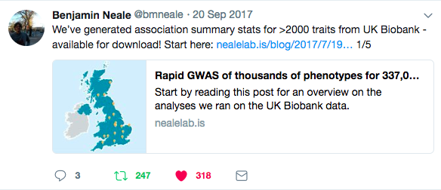
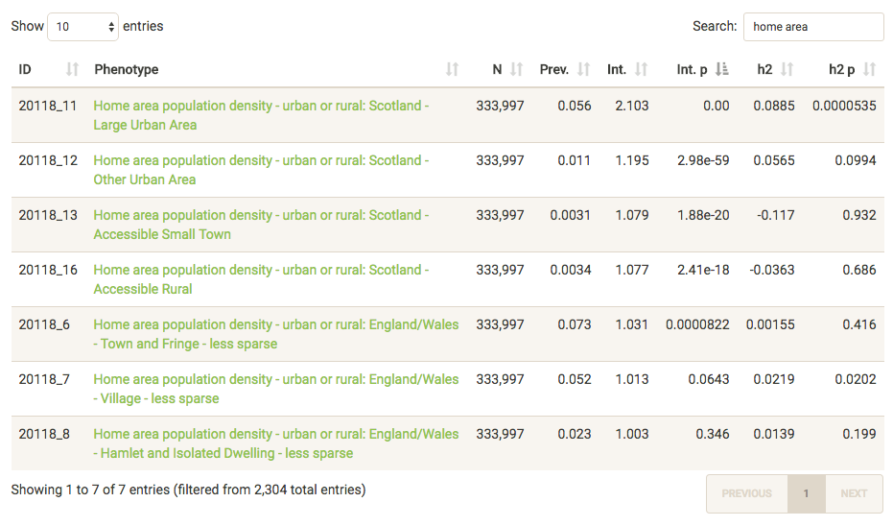
Round 1 GWAS
Fall 2017, the Neale lab…
  GWASed 2,419 phenotypes
    Blogged about it
    Put them on dropbox
      And people made browsers
  Estimated h² for all of them
  Made an h² browser
    Blogged about that too
Nealelab.is/blog

Slide 23


GWASbot!
@SbotGWA
Trait info: http://www.ukbiobank.ac.uk/data-showcase/
All things UK Biobank GWAS: http://www.nealelab.is/uk-biobank/
Andrea Ganna

Slide 24
Heritability at scale!
Description: http://www.nealelab.is/blog/2017/9/15/heritability-of-2000-traits-and-disorders-in-the-uk-biobank
Browser: https://nealelab.github.io/UKBB_ldsc/

Slide 25
9,928 GWAS later… let’s talk h²
using LD score regression
Estimating heritability from GWAS summary statistics

Slide 26
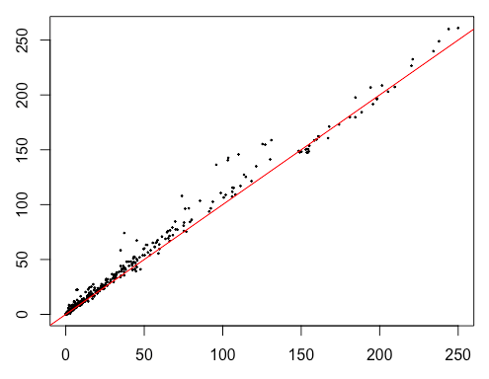
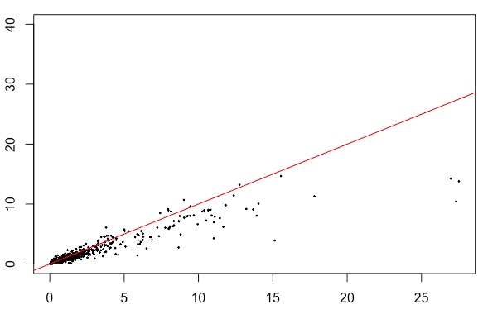
How do round 2 ldsc results compare?
Raymond Walters
Intercept less significant
h2 more significant with stable estimates
Intercept -log₁₀(p) of new
h² -log₁₀(p) of new
Intercept -log₁₀(p) of old
h² -log₁₀(p) of old

Slide 27
Contrasting raw phenotypes to
inverse rank normalize transformed

Slide 28
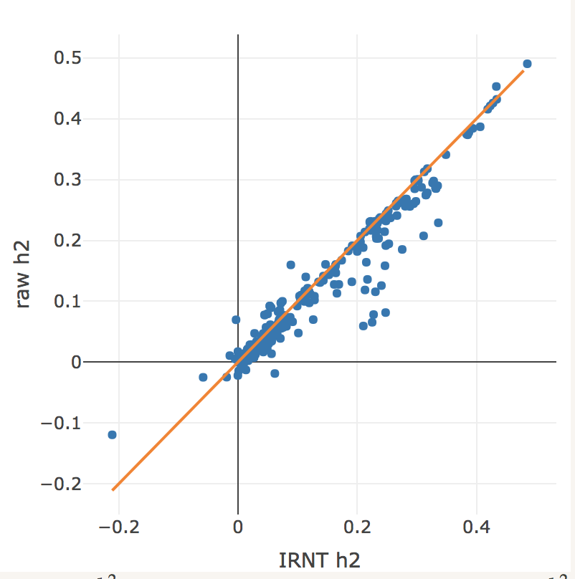
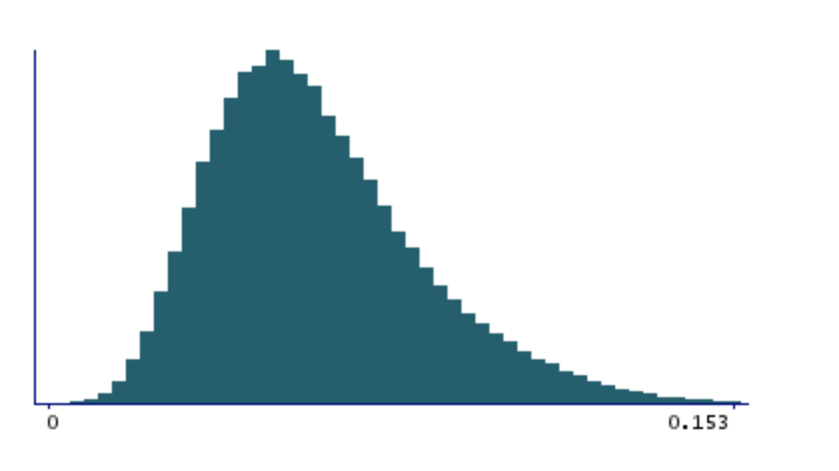
Let’s look at heritability
Raymond Walters
Lymphocyte count
Reticulocyte count
Reticulocyte %
High light scatter reticulocyte %
Reticulocyte count

Slide 29
What about sex-specific effects?
Raymond Walters
Sex-specific GWAS allow us to scan for:
  Differences in female vs. male h²
    E.g. could indicate differences in variance of environmental effects, measurement differences
  female vs. male r_{g} < 1
    E.g. relative effects of different SNPs differ by sex
Can also test for SNP-level differences
  Slower and labor intensive, so h², r_{g} can help prioritize
To start: look at 448 phenotypes with Neff > 10000 in both sexes and z-score of h2 > 4 is at least 1 sex

Slide 30
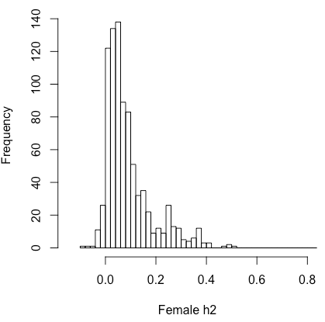
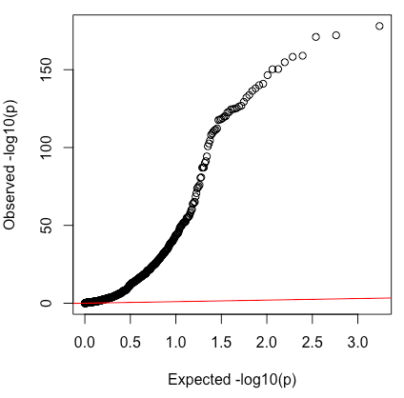
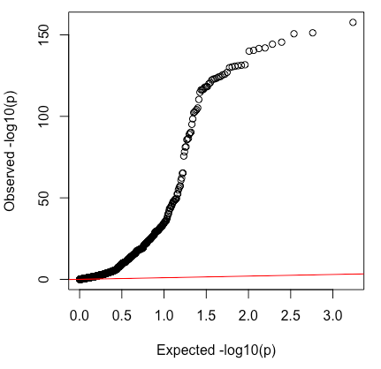
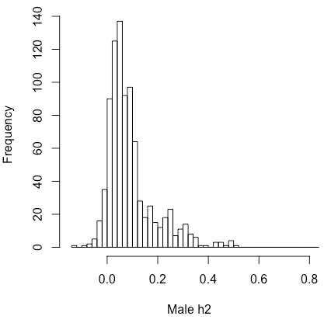
Strong h² observed in both sexes
>70% of traits at least nominally heritable in each sex
  P < .05
Mean h² ~ .09
Consistent with joint analysis of both sexes

Slide 31
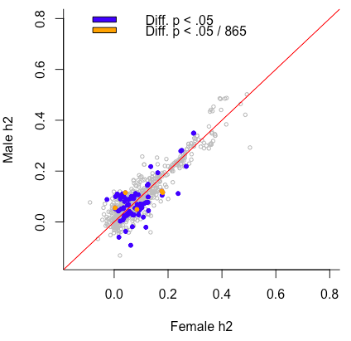
Is h² equal across sexes?
h² strongly correlated across sex
~10% of traits have nominally
different h2 between sexes
description | Fem. h2 | Male h2 | P diff
Average weekly beer plus cider intake | 0.0416 | 0.1152 | 3.11E-10
Diastolic blood pressure, automated | 0.1799 | 0.1160 | 1.13E-06
Systolic blood pressure, automated | 0.1768 | 0.1208 | 1.03E-05
Number of operations, self-reported | 0.0845 | 0.0491 | 2.53E-05
Duration of vigorous activity | 0.0037 | 0.0555 | 3.91E-05

Slide 32
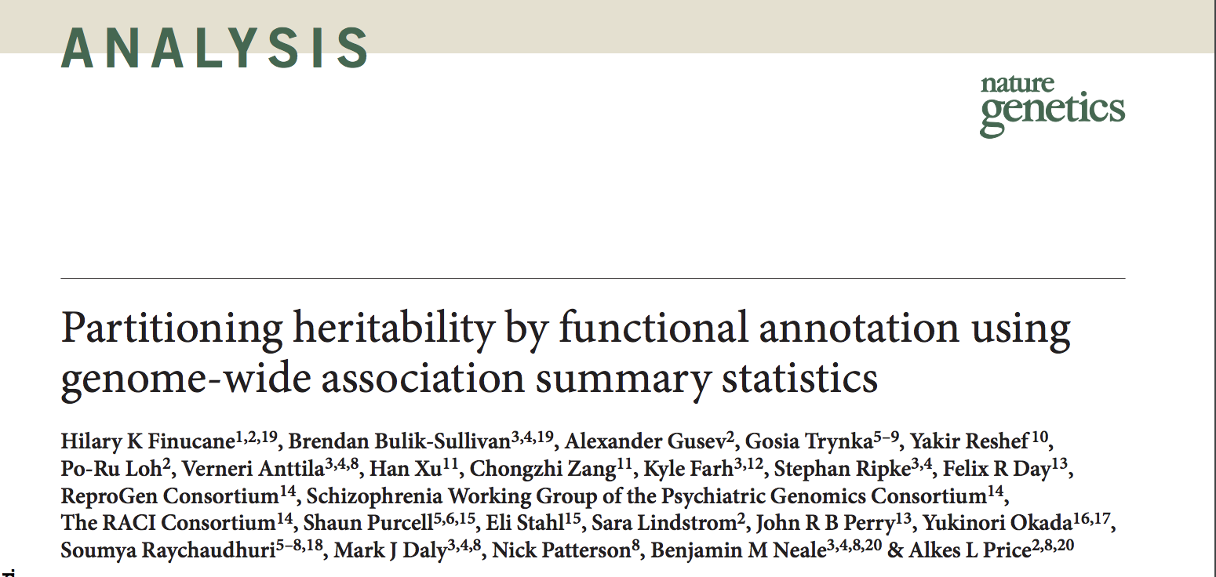
Functional partitioning
Lonely SNPs [no LD]
DHS
LD blocks
Coding
*
Causal variants
LD Score 9 1 4 1 5
Finucane et al. 2015 Nat Gen

Slide 33
Functional partitioning
Lonely SNPs [no LD]
DHS
LD blocks
Coding
*
Causal variants
LD Score 9 1 4 1 5
DHS Score 5 0 0 0 0
Coding Score 0 0 1 1 3
Finucane et al. 2015 Nat Gen

Slide 34
Annotations

Slide 35
Datasets for GWAS
Selected for a Z>7 for h²
Phenotype | Reference |  | Phenotype | Reference
Height | Lango Allen, 2010 |  | Schizophrenia | PGC, 2014
BMI | Speliotes, 2010 |  | Bipolar | Sklar, 2011
Age of menarche | Perry, 2014 |  | Anorexia | Boraska, 2014
LDL | Teslovich, 2010 |  | Education years | Rietveld, 2013
HDL | Teslovich, 2010 |  | Ever smoked | TAG, 2010
Triglycerides | Teslovich, 2010 |  | Rheumatoid Arth | Okada, 2014
CAD | Schunkert, 2011 |  | Crohn’s Disease | Jostins, 2012
T2D | Morris, 2012 |  | Ulcerative Colitis | Jostins, 2012
Fasting Glucose | Manning, 2012

Slide 36
Average enrichments per class
Collapsed results across 17 traits
Category | % SNPs | % h² | Enrichment
Conserved | 2.6 | 34.7 | 13.4x
Coding | 1.5 | 10.4 | 7.0x
H3K4me3 | 13.3 | 34.4 | 2.6x
H3K4me3 (peaks) | 4.2 | 15.8 | 3.8x

Slide 37
Specific trait enrichments
Fantom5 Enhancers massively enriched for Immune traits
Conservation > Coding
  both significantly enriched

Slide 38
Cell type enrichments
77 from H3K4me1
81 from H3K4me3
27 from H3K9ac
35 from H3K27ac
hierarchical clustering
into sets
Warning
P-value scale changes
Use the lines as guides

Slide 39
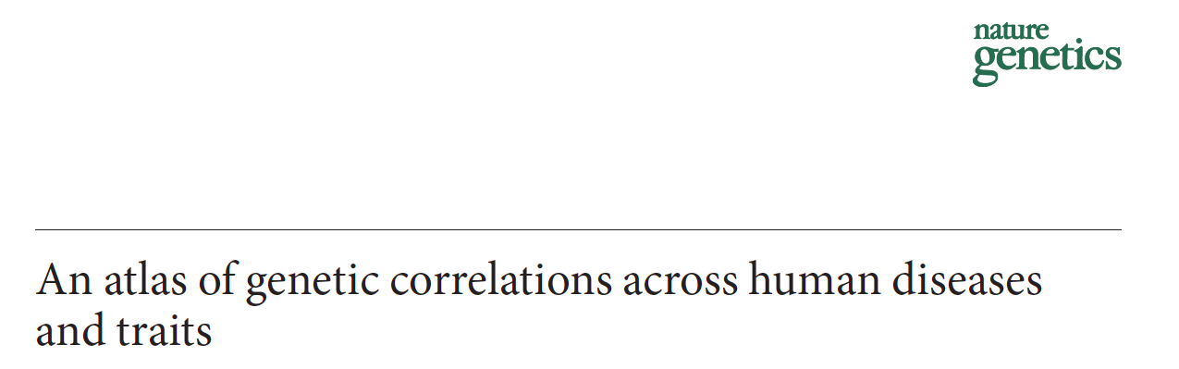
Genetic Correlation
Method in:

Slide 40
Potential sources of genetic correlation
Genetic
effects
Genetic
effects
Trait 1
Trait 2
Trait 1
Trait 2
Trait 1 exerts causal effect on Trait 2
Genetic effects influence
Trait 1 and Trait 2

Slide 41
LD Score regression
Genetic correlation
Trait 1
Slope estimates heritability

Slide 42
LD Score regression
Genetic correlation
Trait 1
We can a second trait and obtain two heritability estimates
Trait 2

Slide 43
LD Score regression
Genetic correlation
Trait 1
Z*Z = χ²
So we can estimate genetic covariance from the product of the Z-scores
Trait 2

Slide 44
LD Score regression
Genetic correlation
Trait 1
Z*Z = χ²
So we can estimate genetic covariance from the product of the Z-scores for the two traits
R_{G} = 0.5
Trait 2
R_{G}

Slide 45
LD Score regression
Genetic correlation
Trait 1
Here R_{G} = 0
This approach is robust to sample overlap as all variants are equally inflated
Trait 2
R_{G}

Slide 46
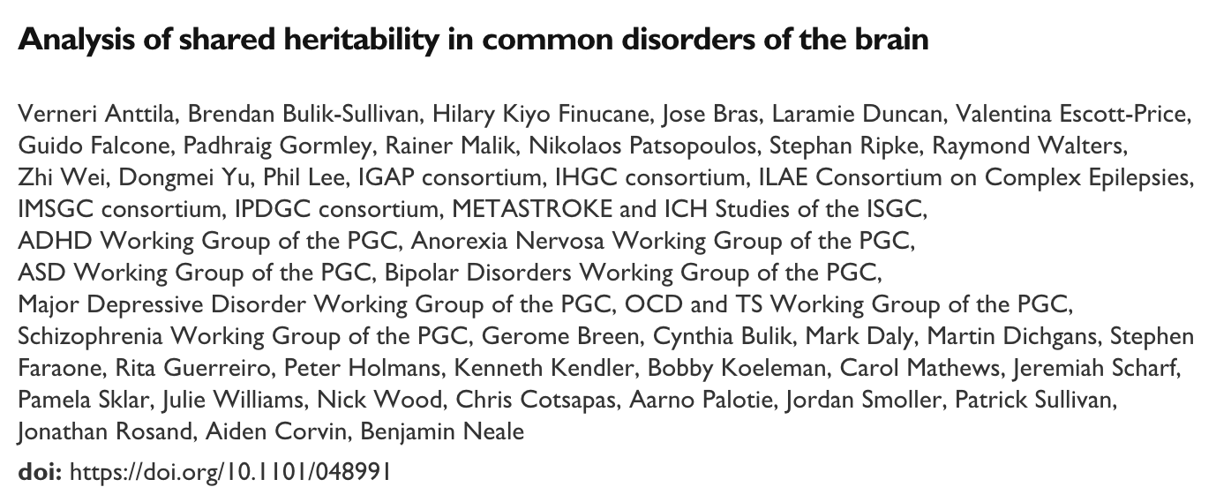


Brainstorm Project
Verneri Anttila
Aiden Corvin
Brendan Bulik-Sullivan
Hilary Finucane
Jonathan Rosand
Aarno Palotie
Mark Daly
Patrick Sullivan
Bobby Koeleman
Nick Wood
Julie Williams
Alessandro Biffi
Jeremiah Scharf
Kenneth Kendler
Stephan Ripke
Alkes Price
Chris Cotsapas
Padhraig Gormley
Zhi Wei
Rainer Malik
Hailiang Huang
Andrea Byrnes
Dongmei Yu
Laramie Duncan
Kai-How Farh
Namrata Gupta
Miriam Raffeld
…and many, many others
in their respective study groups

Slide 47
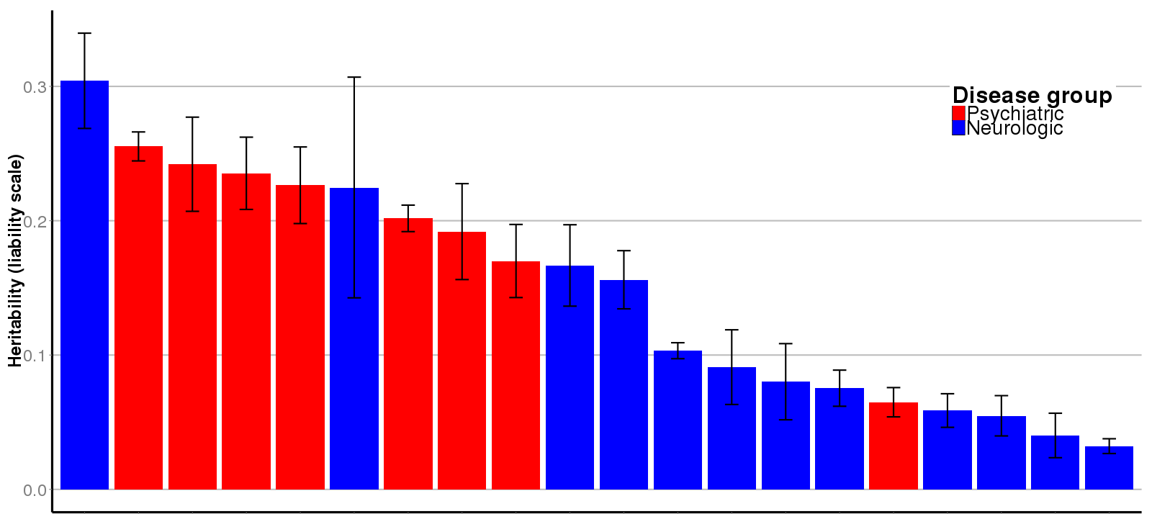
Univariate heritability from common variation
GGE = Generalized Epilepsy
SCZ = Schizophrenia
OCD = Obsessive Compulsive Disorder
AUT = Autism
TSY = Tourette’s Syndrome
ICH = Intracerebral Hemorrhage
BPD = Bipolar Disorder
MDD = Major Depressive Disorder
ANO = Anorexia Nervosa
MSC = Multiple Sclerosis
MWO = Migraine without Aura
MIG = Migraine
MWA = Migraine with Aura
EOS = Early Onset Stroke
AZD = Alzheimer’s Disease
ADD = Attention Deficit/Hyperactivity
EPI = Epilepsy (all)
ISS = Ischemic Stroke
NFE = Non-acquired focal epilepsy
PKD = Parkinson’s Disease
GGE
SCZ
OCD
AUT
TSY
ICH
BPD
MDD
ANO
MSC
MWO
MIG
MWA
EOS
AZD
ADD
EPI
ISS
NFE
PKD
It’s all heritable!

Slide 48
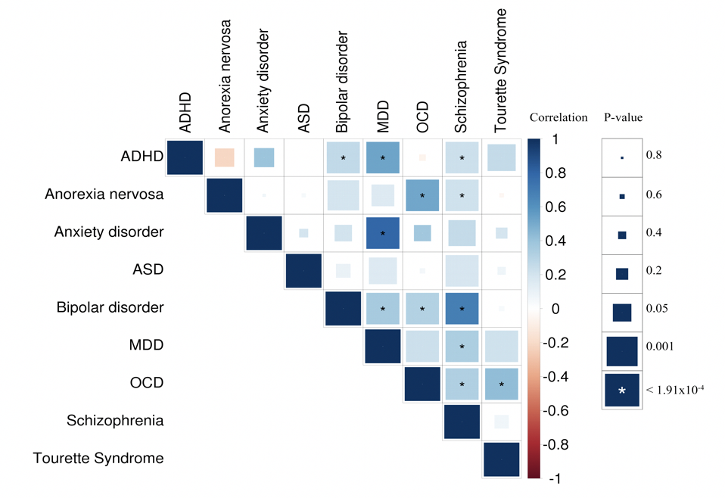
Brainstorm – within psychiatry

Slide 49
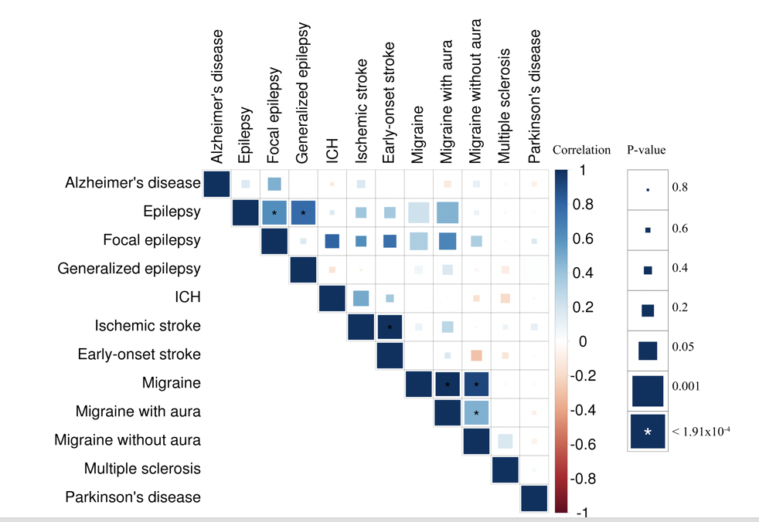
Brainstorm within neurology

Slide 50
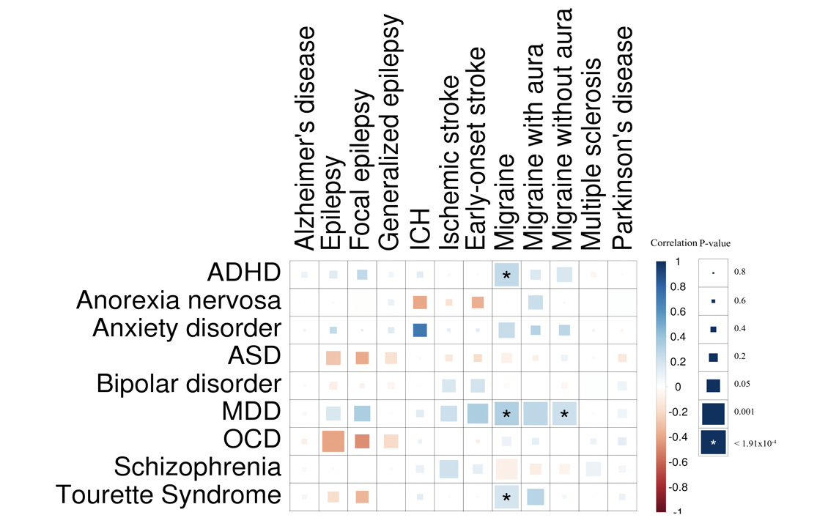
Brainstorm – across neurology and psychiatry

Slide 51
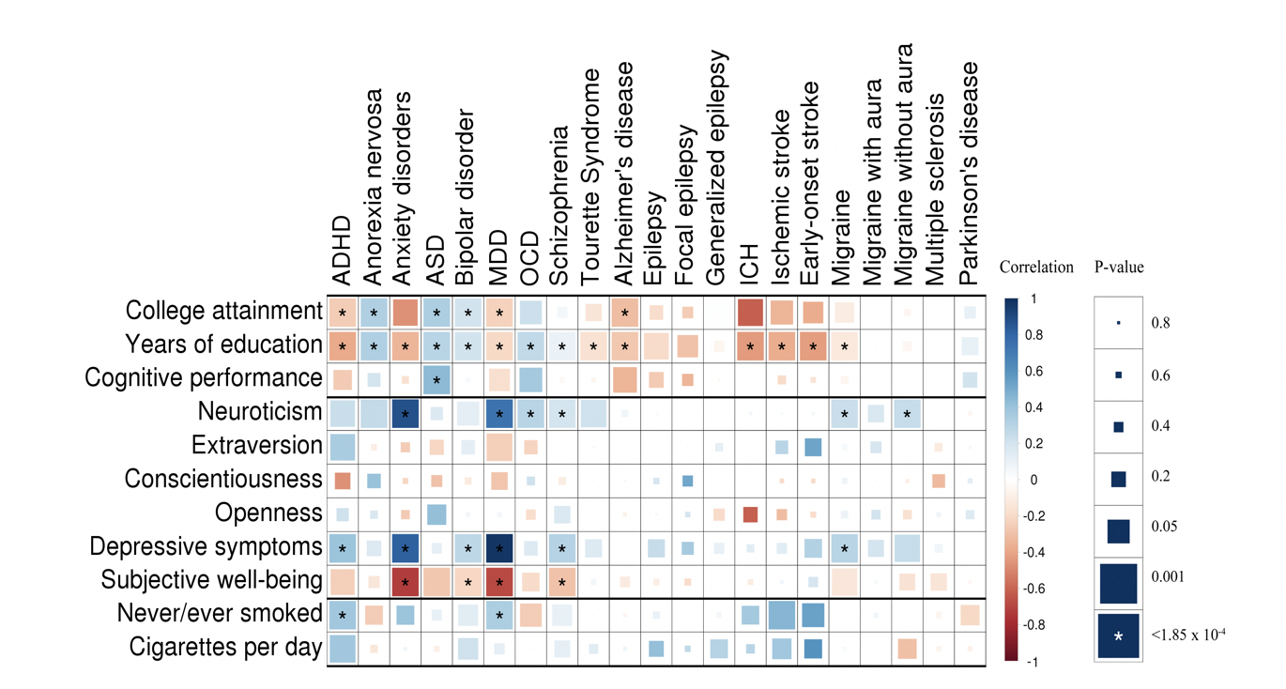
Brainstorm – take it further?

Slide 52
Generalizations of genetic correlation
Genetic sharing across men and women

Slide 53


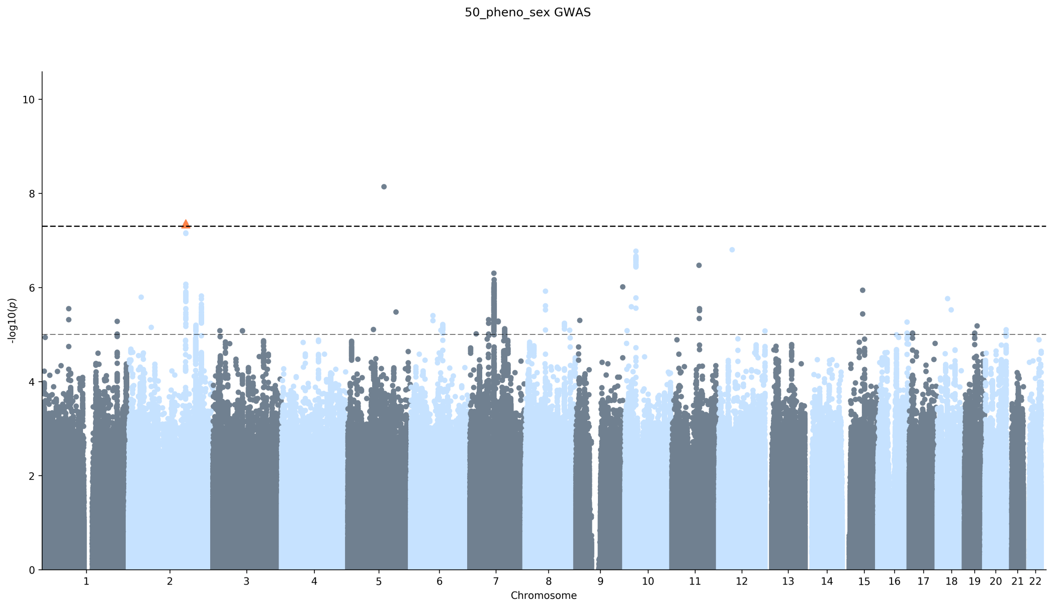

Female (1) vs male (0) GWAS
Michel Nivard Matthijs van der Zee
h² (ldsc) = 0.012 (0.002)

Slide 54
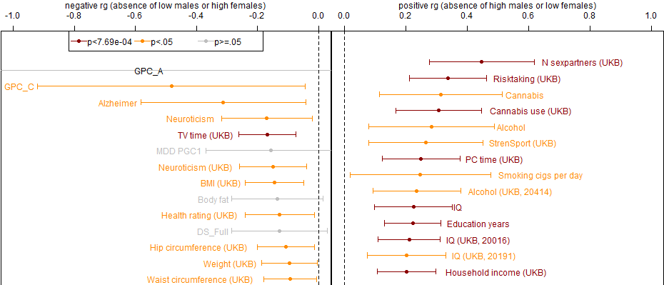
Differential ascertainment bias

Slide 55
Male/Female genetic correlation
Next step is to look at genetic correlation between female and male results for each trait
  Again using LD score regression
Focus on 448 traits with significant h² in at least one sex
  After Bonferroni correction for 865 traits

Slide 56
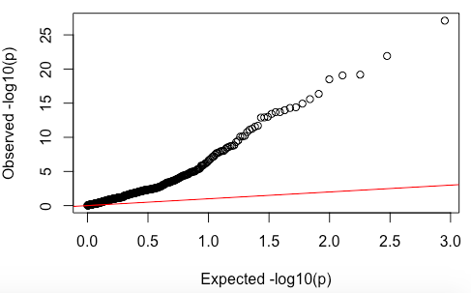
Genetic correlation estimate between females and males
Hernia
Disease of urinary system
Cereal type: Bran cereal

Slide 57
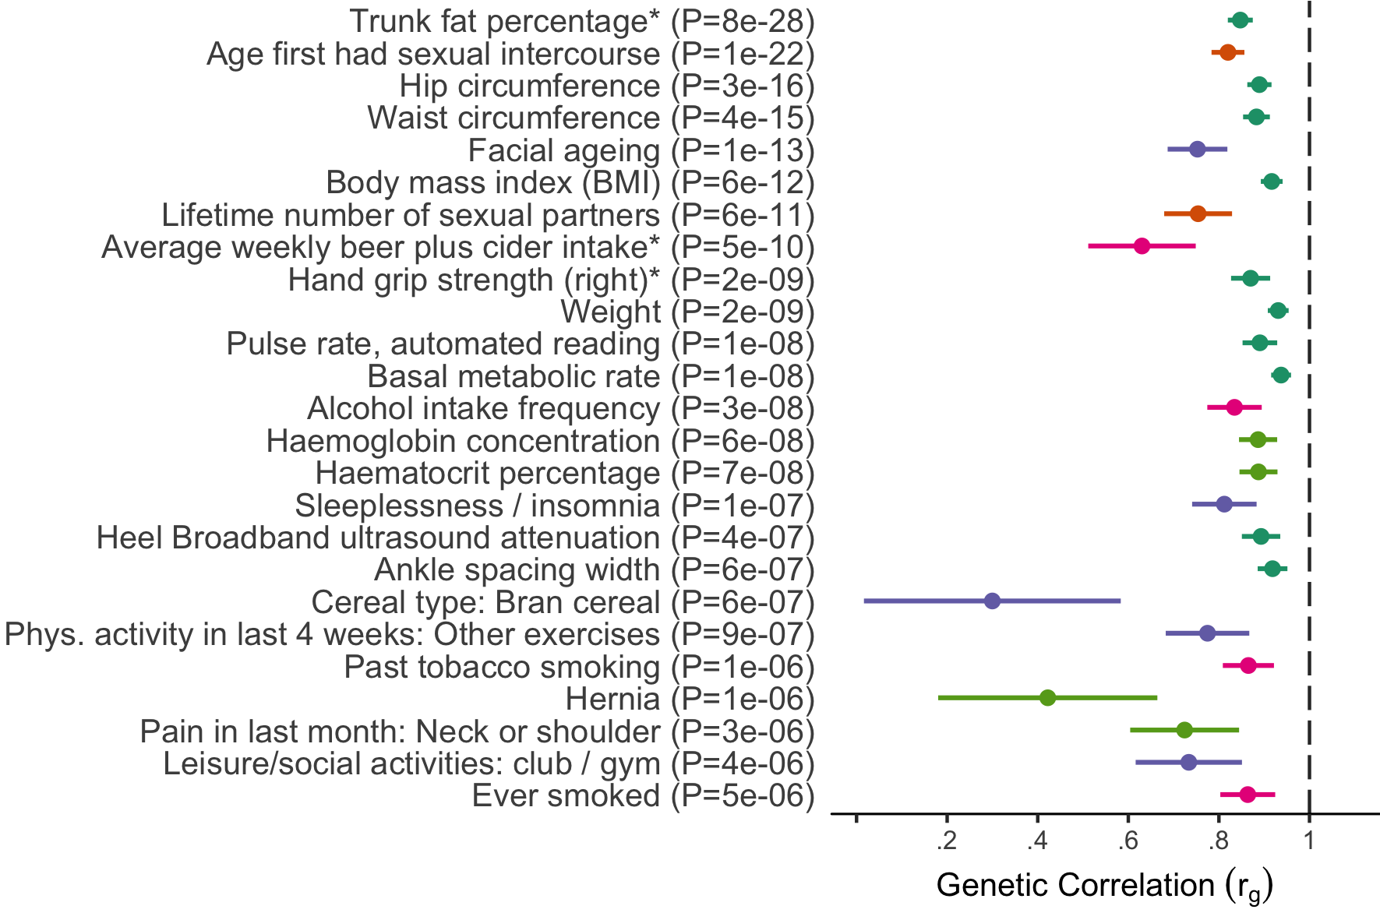
Phenotypes with male/female rg significantly < 1 (p < 1e-5)

Slide 58
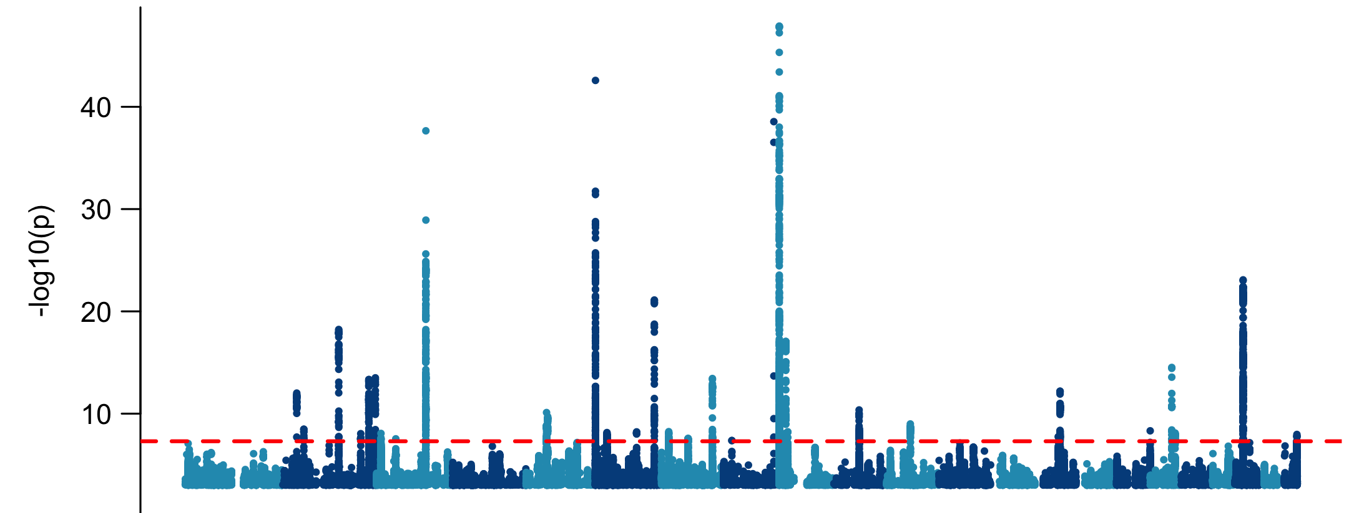
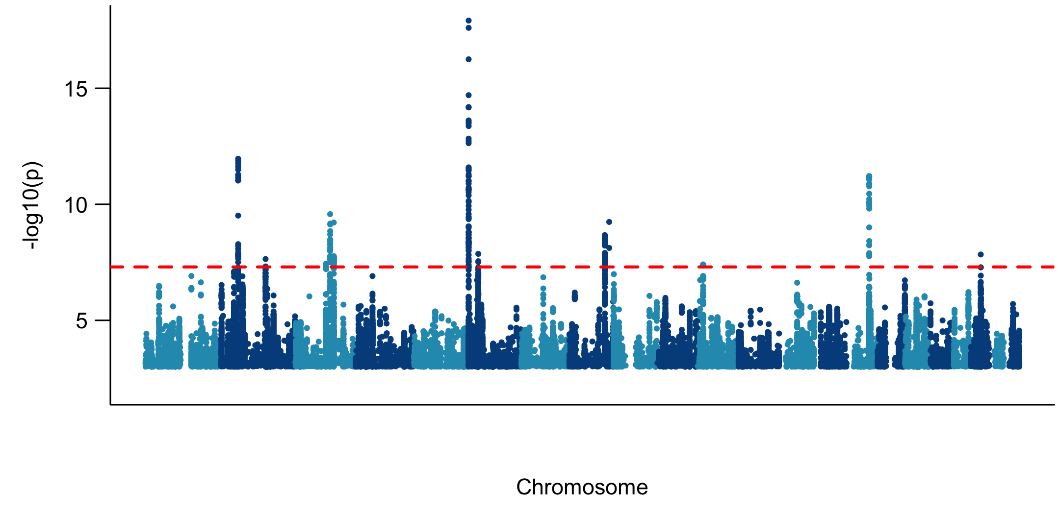
DOCK8
Facial aging
IRF4
Male GWAS
PAX1
Female GWAS

Slide 59
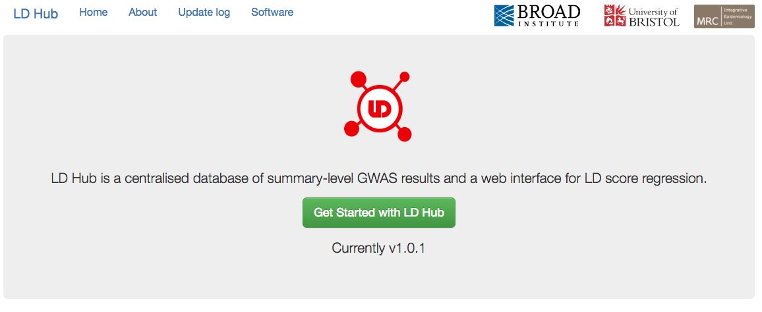

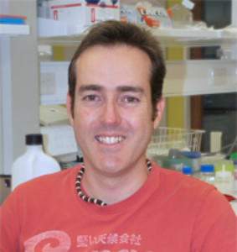
You can do it yourself ldsc.broadinstitute.org
Jie Zheng
David Evans

Slide 60
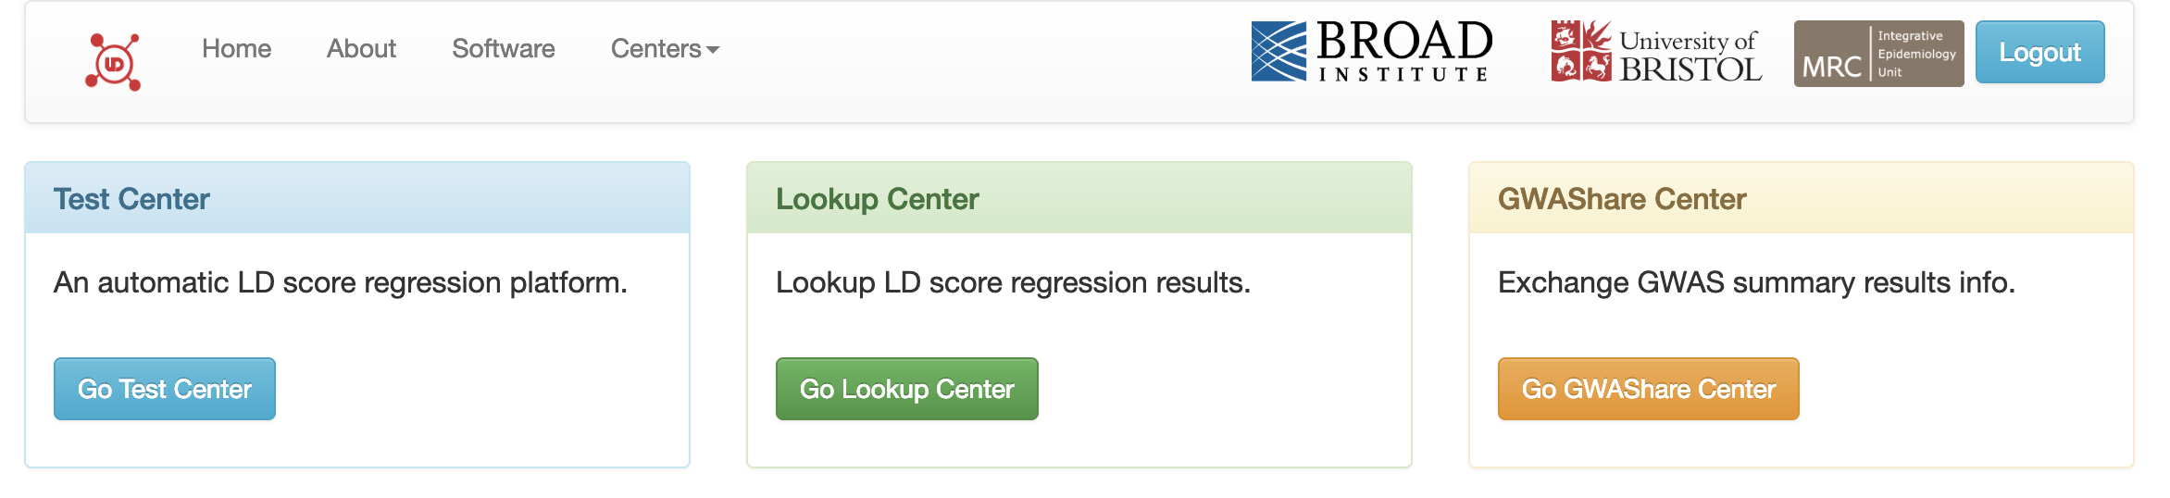
LD Hub practical

Slide 61
Test center
Running your results through LD-score genetic correlation

Slide 62
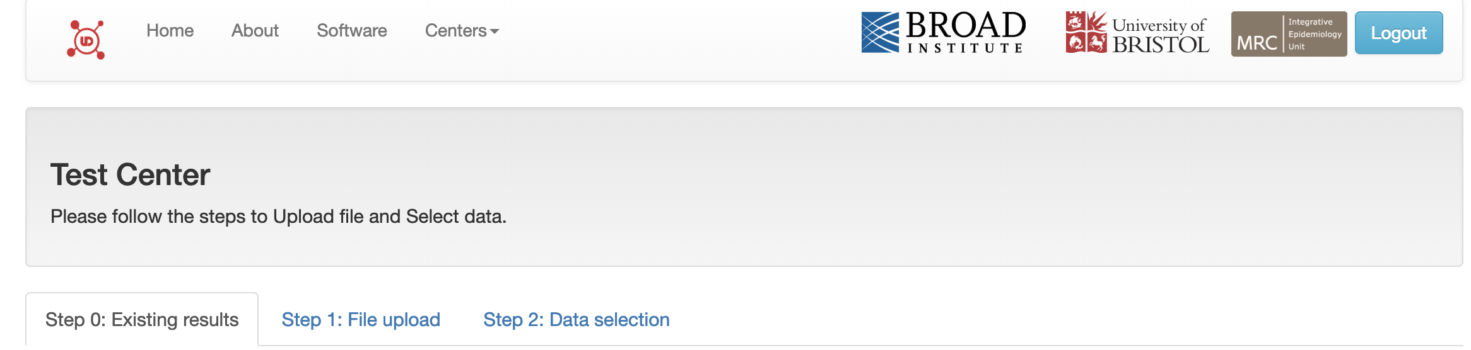
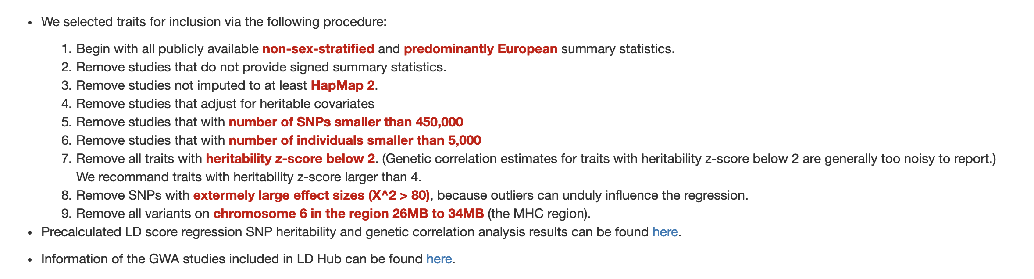
Test center

Slide 63
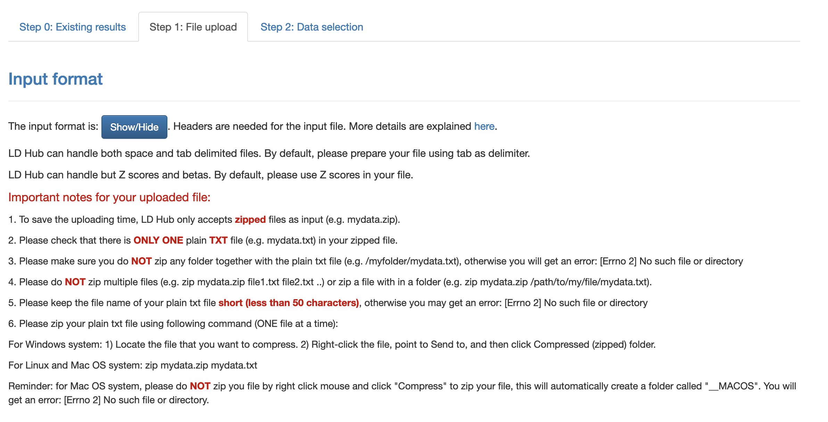
Uploading your own results

Slide 64
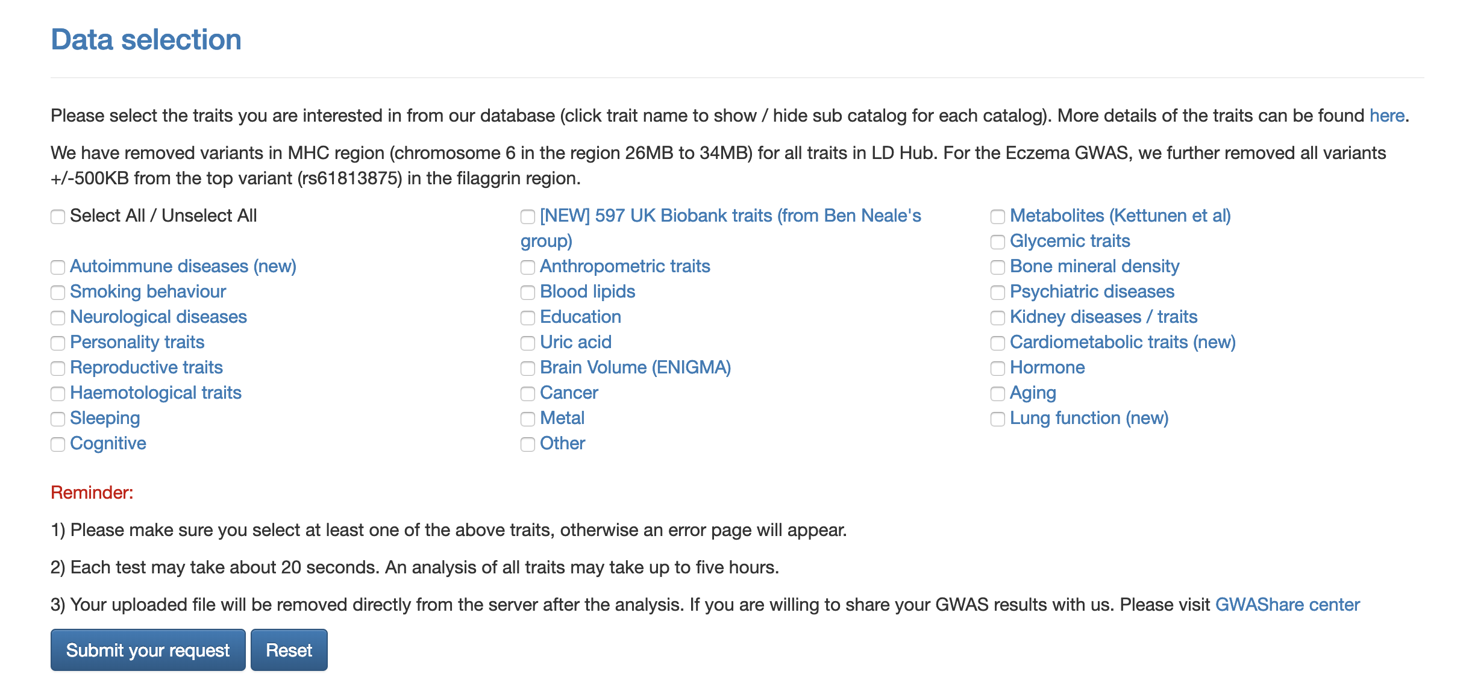
Pick your traits to compare

Slide 65
Lookup center
Browse previously generated results

Slide 66
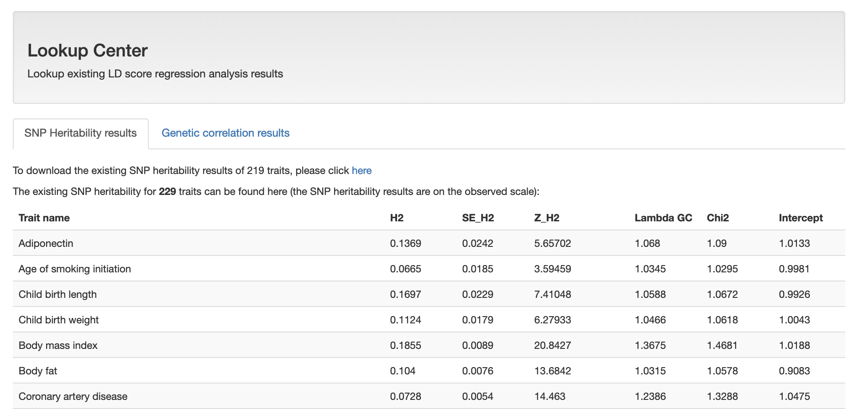
Heritability

Slide 67
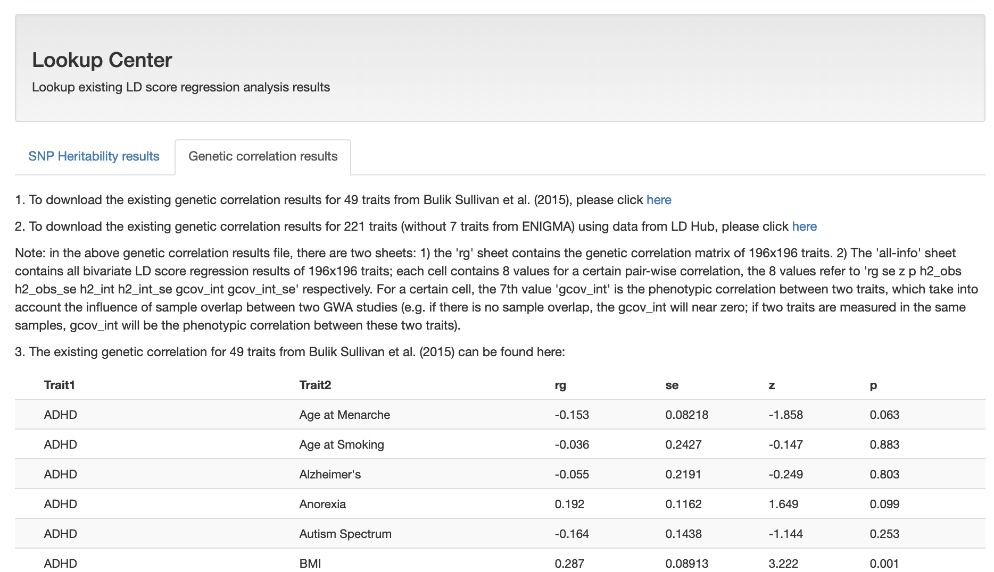
Genetic correlation

Slide 68
LD Hub practical
Sharing and exchanging GWAS results

Slide 69
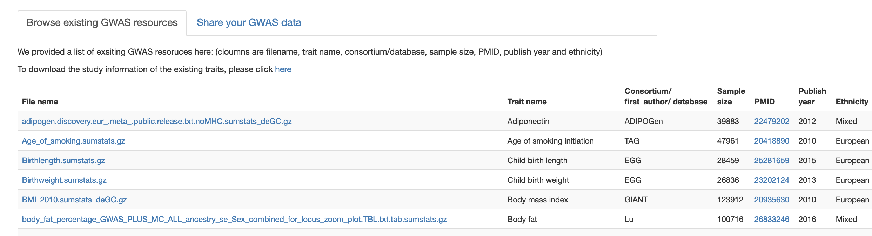
Download results or share your own!

