Slide 1

Imputation
Sarah Medland
Boulder 2019

Slide 2
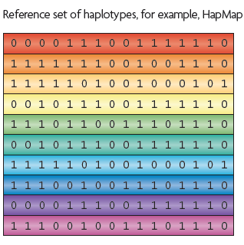
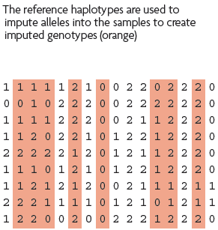
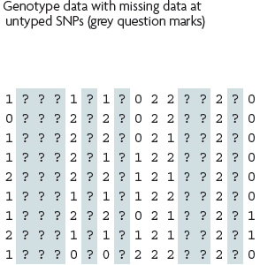
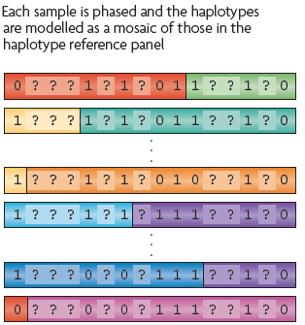
What is imputation? (Marchini & Howie 2010)

Slide 3
3 main reasons for imputation
  Meta-analysis
  Fine Mapping
  Combining data from different chips
Other less common uses
  sporadic missing data imputation
  correction of genotyping errors
  imputation of non-SNP variation

Slide 4
Combining data from different chips
Example
    750 individuals typed on the 370K
    550 individuals typed on the 610K
Power
  MAF .2
  SNP explaining 1% total variance
  alpha 5e-08
    N=1300, NCP 13.07, power .0331
    N=750, NCP 7.54 , power .0034
    N=550, NCP 5.53 , power .0009

Slide 5
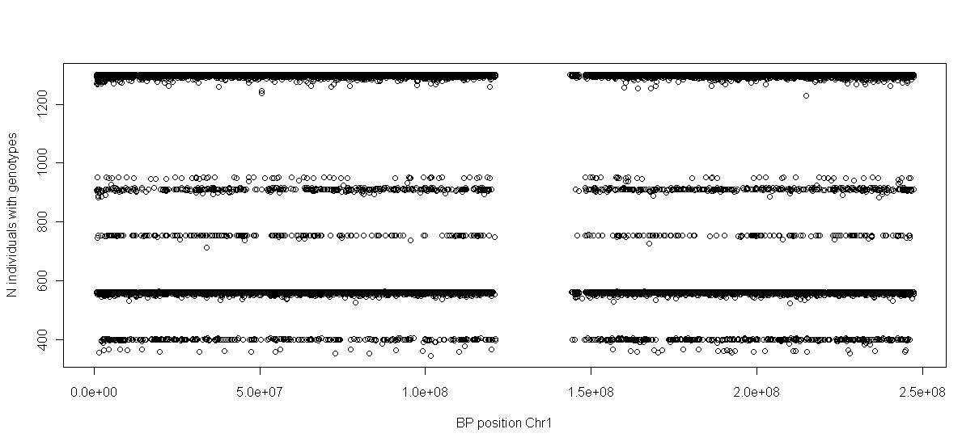
Another way of looking at this

Slide 6
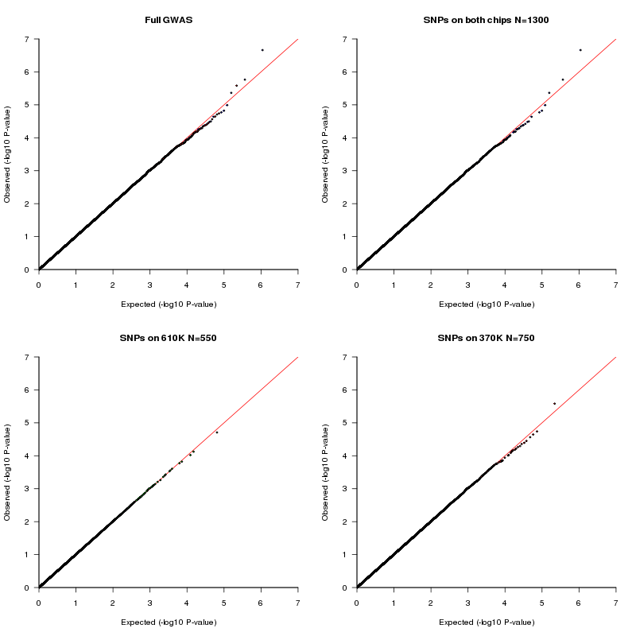
QQ-plot

Slide 7
Solution
Impute all individuals to a single reference based on the SNPs that overlap between the chips
Single distribution of NCP and power across all SNP
qq plot and manhattan describes the full sample with the same degree of accuracy

Slide 8
Imputation programs
minimac3
Impute2
Beagle – not frequently used
never use plink for imputation!

Slide 9
How do they compare
Similar accuracy
Similar features
Different data formats
  minimac3 –> custom vcf format
    individual=row snp=column
  Impute2 –> snp=row individual=column
Different philosophies
  Frequentist vs Bayesian

Slide 10



minimac3
http://genome.sph.umich.edu/wiki/Minimac3
Built by Gonçalo Abecasis, Yun Li, Christian Fuchsberger and colleagues
Analysis options
  SAIGE
  BoltLMM
  plink2

Slide 11


Impute2
https://mathgen.stats.ox.ac.uk/impute/impute_v2.html
http://genome.sph.umich.edu/wiki/IMPUTE2:_1000_Genomes_Imputation_Cookbook
Built by Jonathan Marchini, Bryan Howie and colleges
Downstream analysis options
  SNPtest
  Quicktest

Slide 12
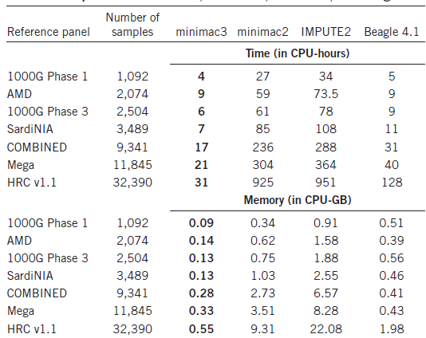
Timing & Memory
from
Das et al 2016
Prior to EAGLE2

Slide 13
Options for imputation
DIY – Use a cookbook!
  http://genome.sph.umich.edu/wiki/Minimac3_Imputation_Cookbook OR http://genome.sph.umich.edu/wiki/IMPUTE2:_1000_Genomes_Imputation_Cookbook
UMich Imputation Server
  https://imputationserver.sph.umich.edu/
Sanger Imputation Server
  https://imputation.sanger.ac.uk/

Slide 14
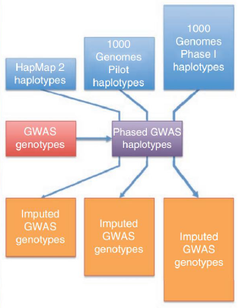
Today – discuss the 2 step approach
1000 Genomes Phase II haplotypes
Step 1
Step 2
Imputed GWAS genotypes

Slide 15
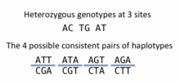
What is phasing
In this context it is really Haplotype Estimation
We take genotype data and try to reconstruct the haplotypes
  Can use reference data to improve this estimation

Slide 16
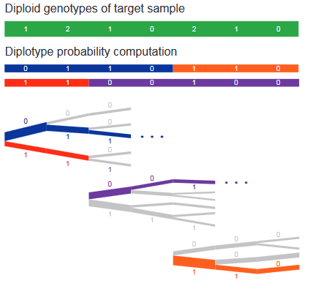
Phasing in Eagle
Input a target sample and a library of reference haplotypes
Selection of conditioning haplotypes.
Generation of HapHedge data structure.
Exploration of the diplotype space.

Slide 17
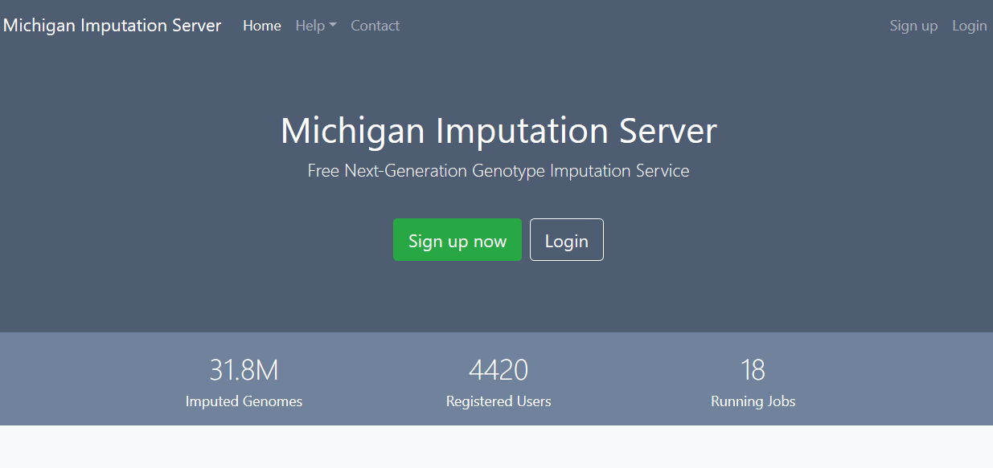

Slide 18
Check your data
  Exclude snps with excessive missingness (>5%), low MAF (<1%), HWE violations (~P<10⁻⁶), Mendelian errors
  Drop strand ambiguous (palindromic) SNPs – ie A/T or C/G snps
  Update build and alignment (b37)
  Output your data in the expected format for the phasing program you will use
    Check the naming convention for the program and reference you want to use
    rs278405739 OR 22:395704

Slide 19
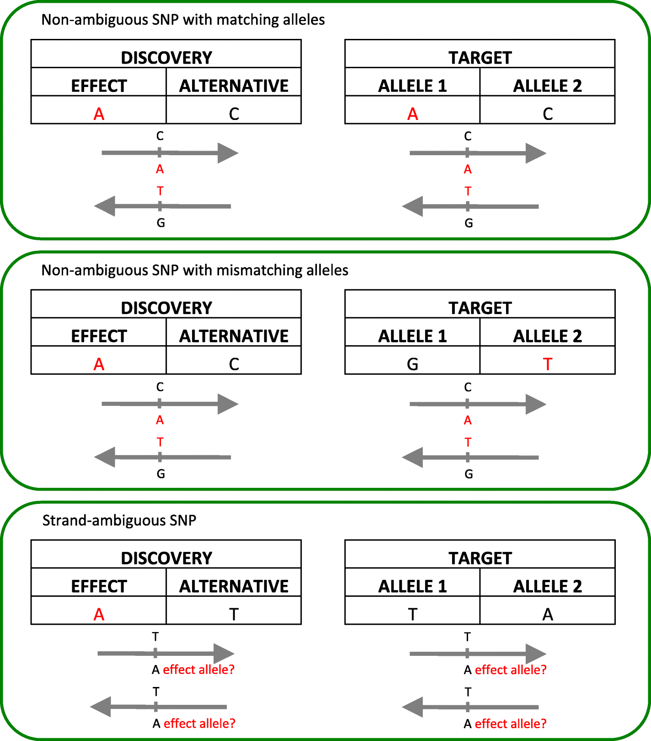
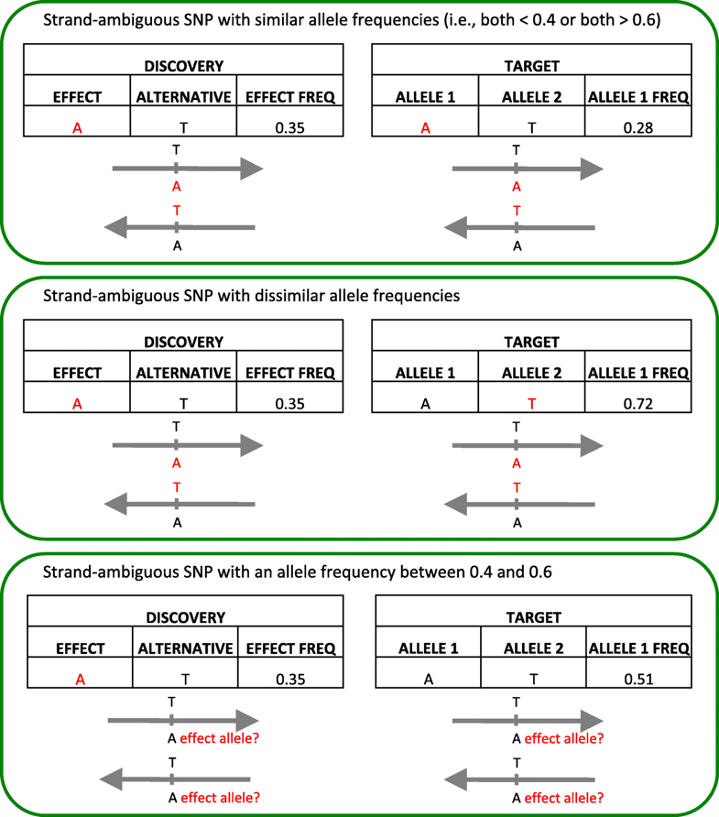
Ambiguous SNPs (A/T and C/G)

Slide 20
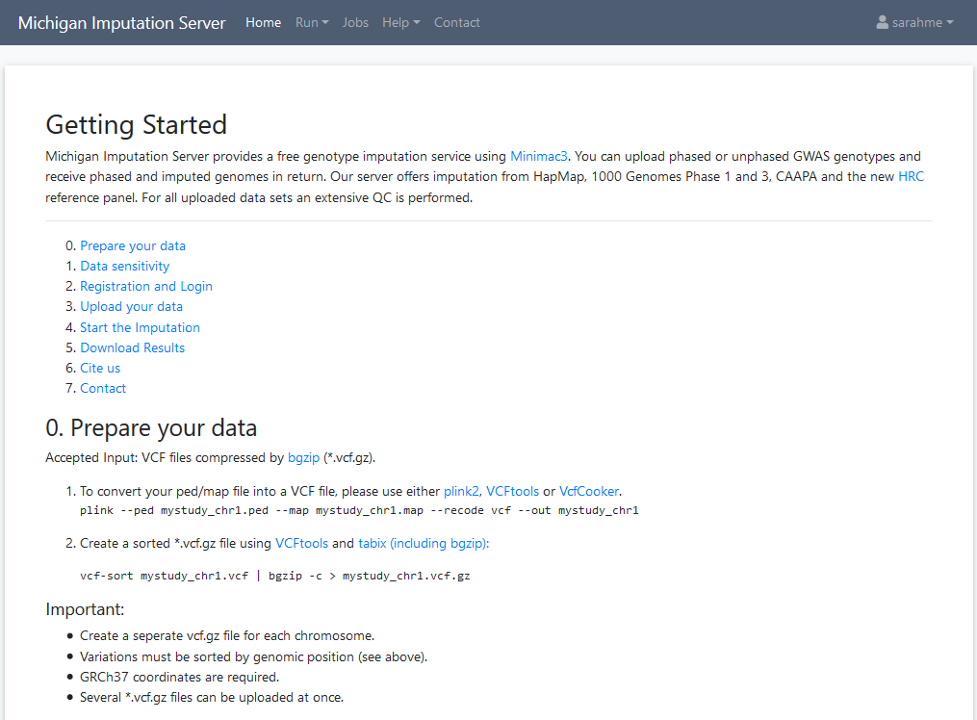

Slide 21
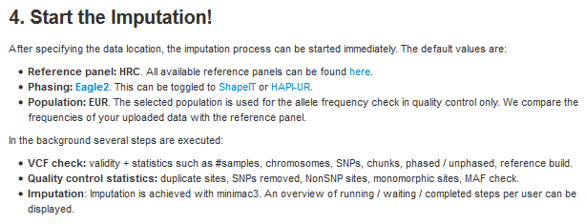
UMich imputation Server

Slide 22
Chose your reference
Current Publically Available References
  HapMapII (no phased X data officially released)
  1KGP – phase 1 version v3
  1KGP – phase 3 version v5
Future non-public references only available via custom imputation servers
  HRC - 64,976 haplotypes 39,235,157 SNPs
  CAPPA – African American/Carabbean
  TopMed

Slide 23
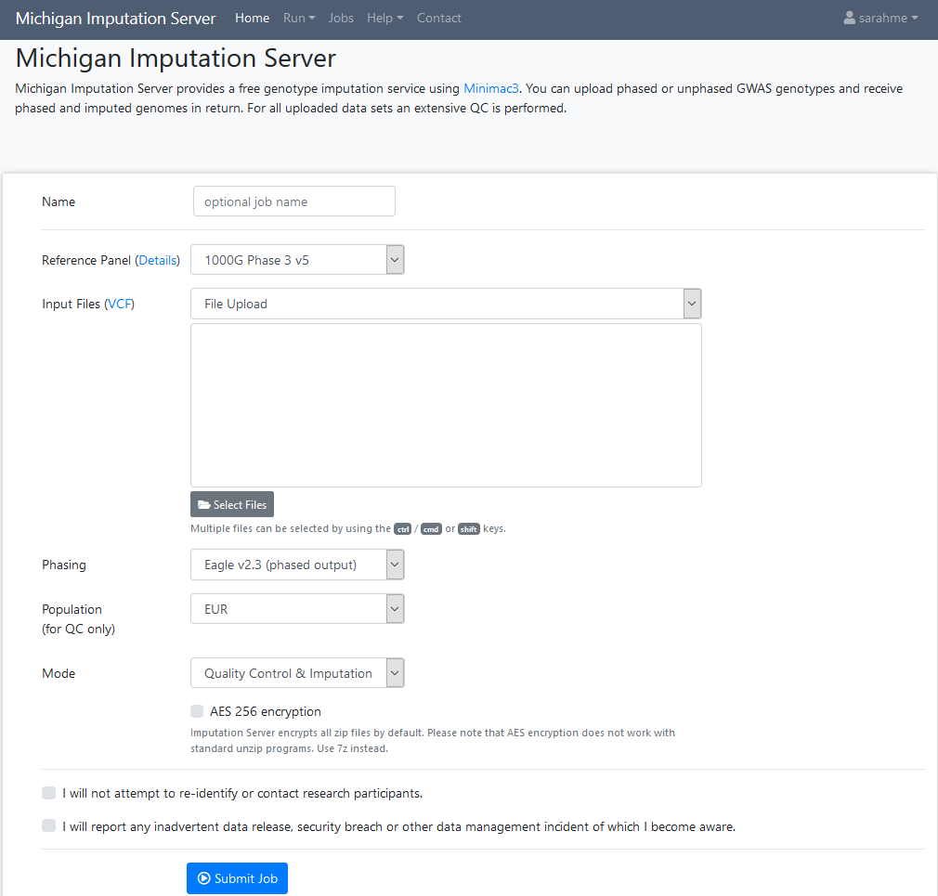

Slide 24
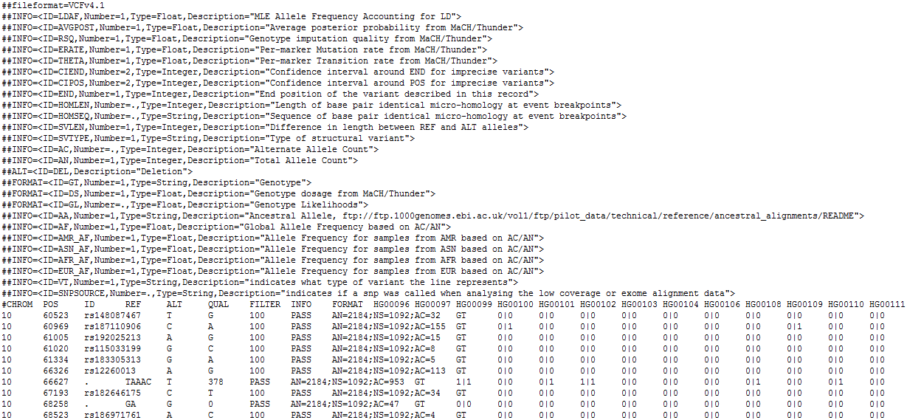
References are in vcf format

Slide 25
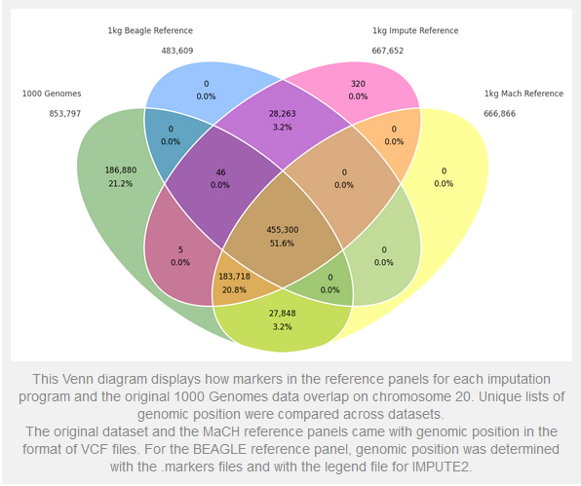
Not all references are equal!!
The Beagle and IMPUTE versions of the references contain variants that do not appear in the publically available 1KGP data!
The 1KGP references still contain multiple locations with more than 1 variant
&
Multiple variants in more than one place!

Slide 26
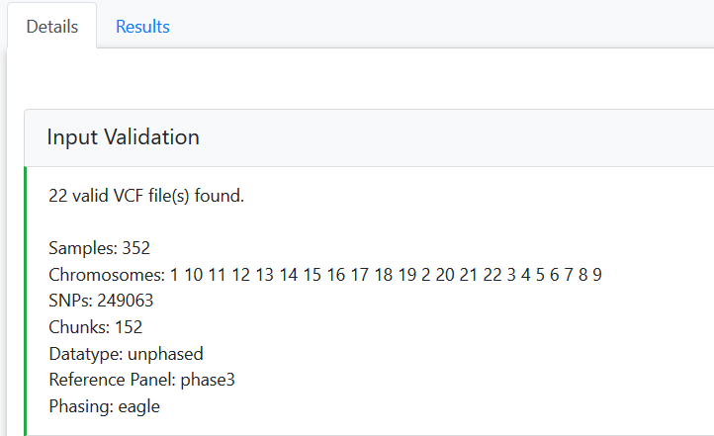
QC on the imputation server

Slide 27
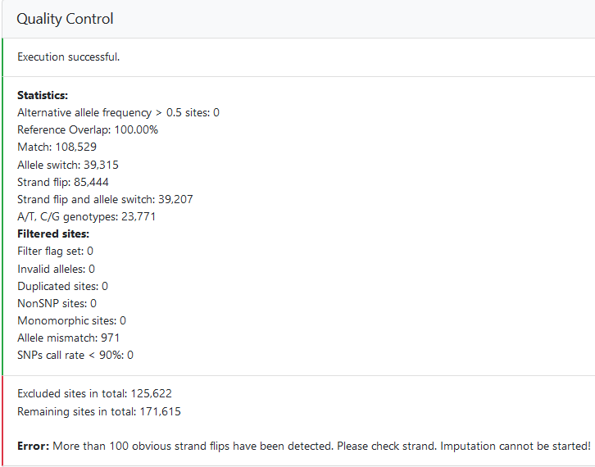

Slide 28
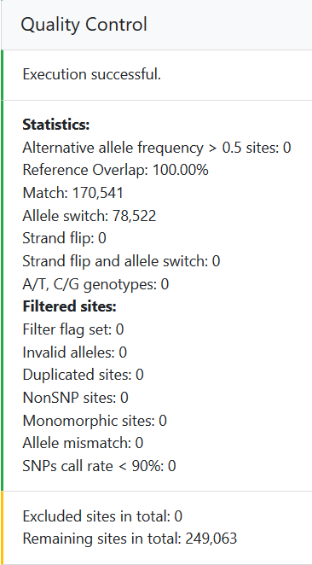

Slide 29
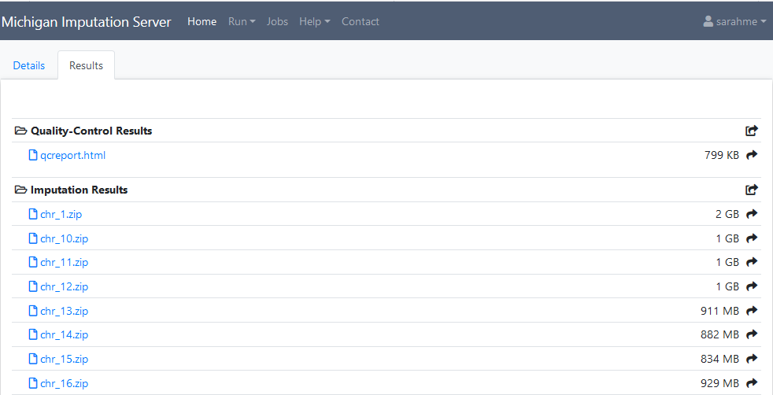
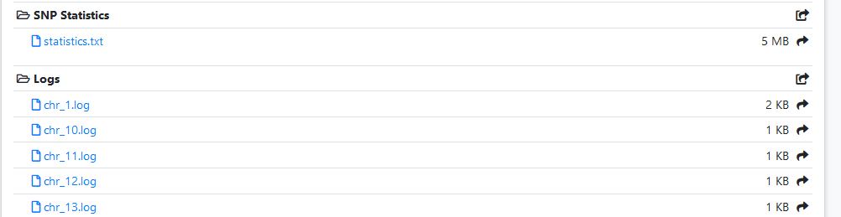

Slide 30
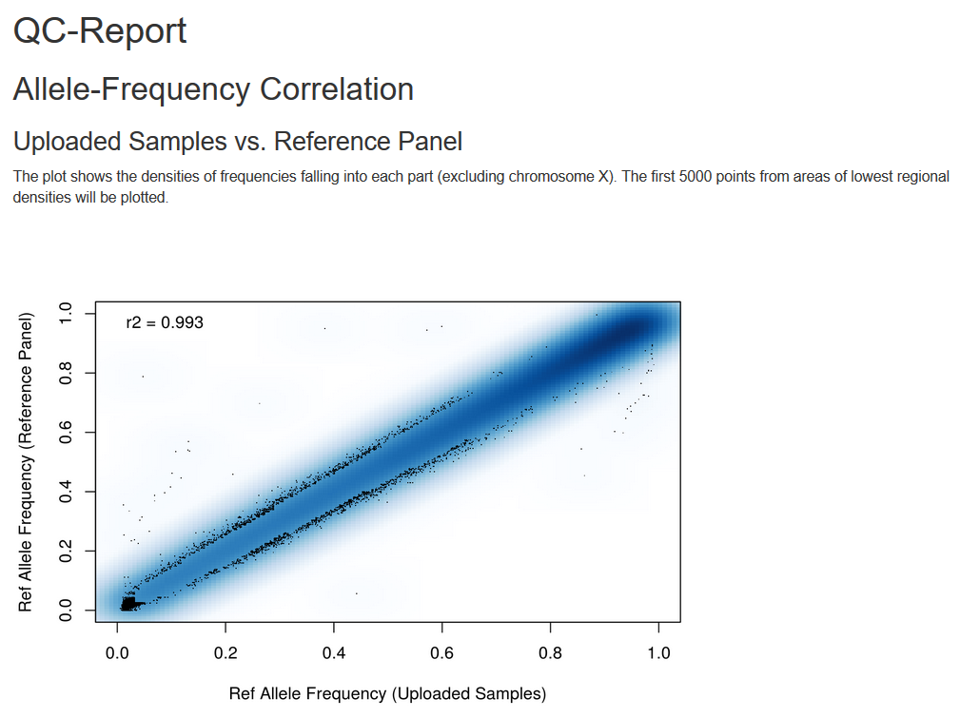

Slide 31
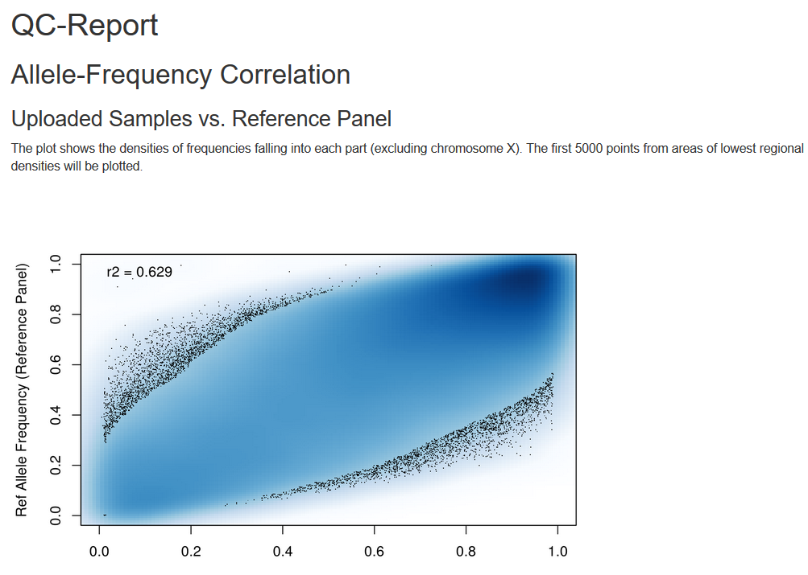

Slide 32
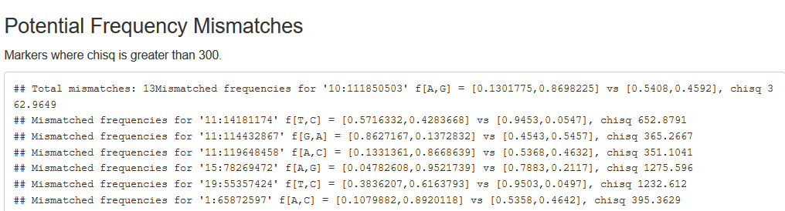
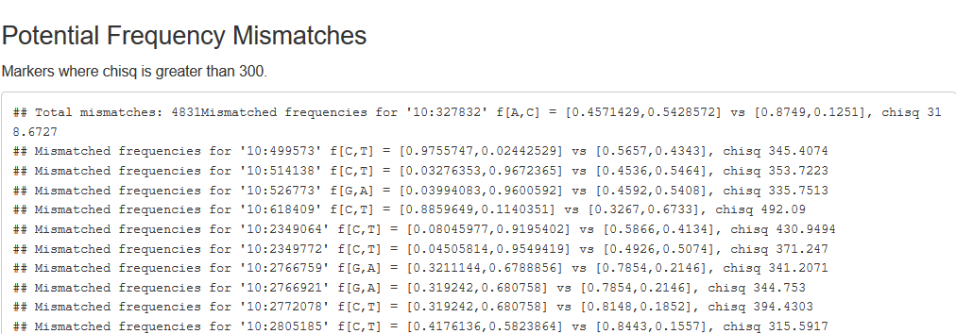

Slide 33
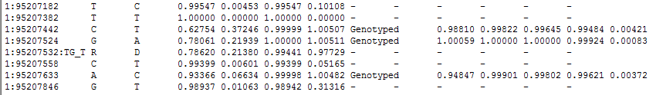
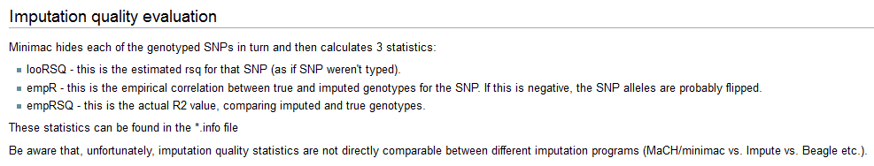
Output
Info files

Slide 34
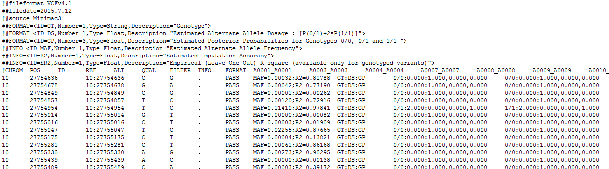
Output
3 main genotype output formats
  Probs format (probability of AA AB and BB genotypes for each SNP)
  Hard call or best guess (output as A C T or G allele codes)
  Dosage data (most common – 1 number per SNP, 1-2)

Slide 35
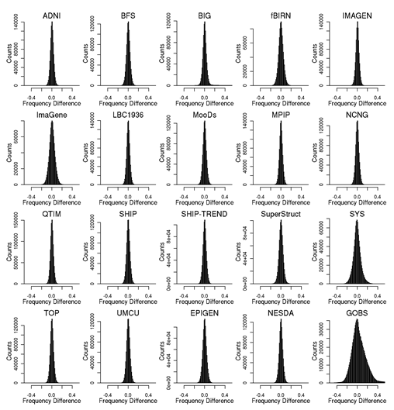
Post imputation QC
After imputation you need to check that it worked and the data look ok
Things to check
  Plot r² across each chromosome look to see where it drops off
  Plot MAF-reference MAF

Slide 36
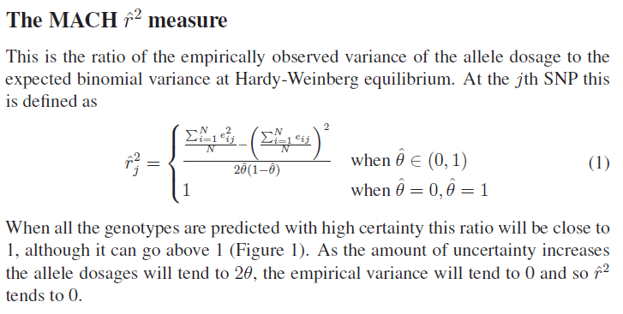
Issue – the r² metrics differ between imputation programs

Slide 37
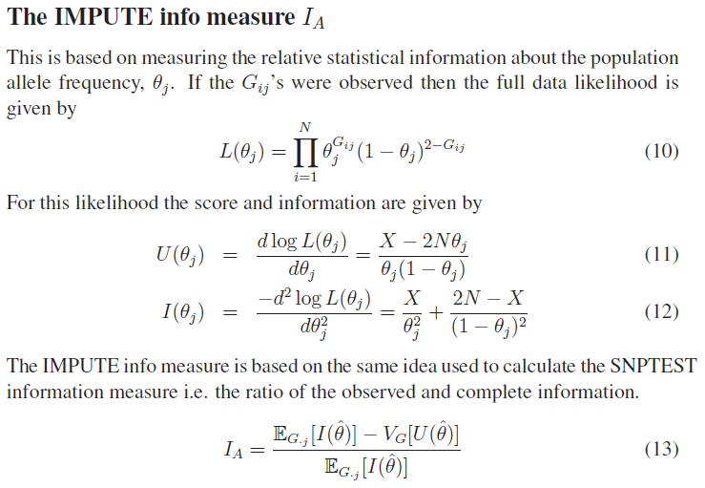
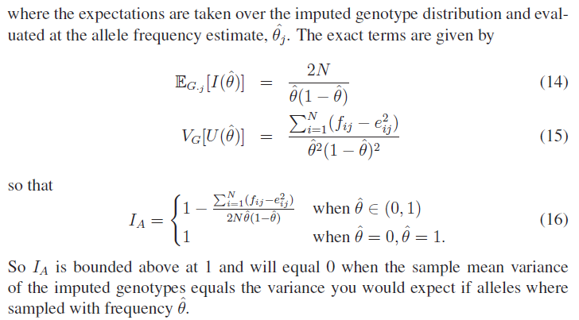

Slide 38
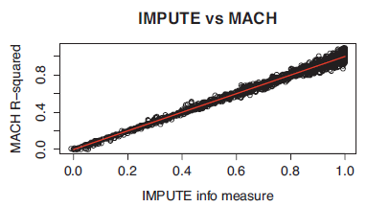
In general fairly close correlation
  rsq/ ProperInfo/ allelic Rsq
    1 = no uncertainty
    0 = complete uncertainty
    .8 on 1000 individuals = amount of data at the SNP is equivalent to a set of perfectly observed genotype data in a sample size of 800 individuals
      Note Mach uses an empirical Rsq (observed var/exp var) and can go above 1

Slide 39
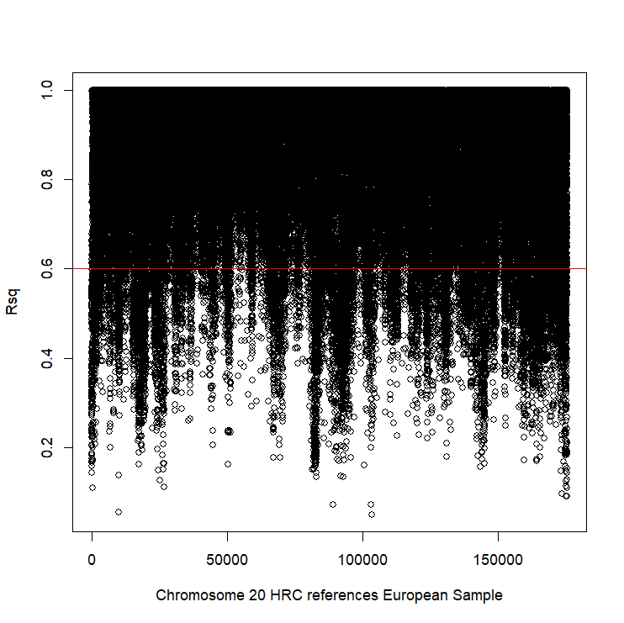
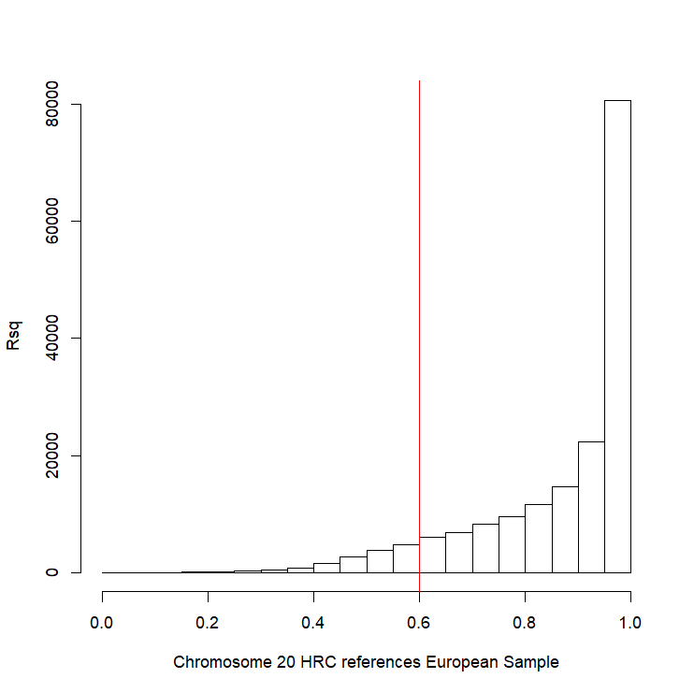
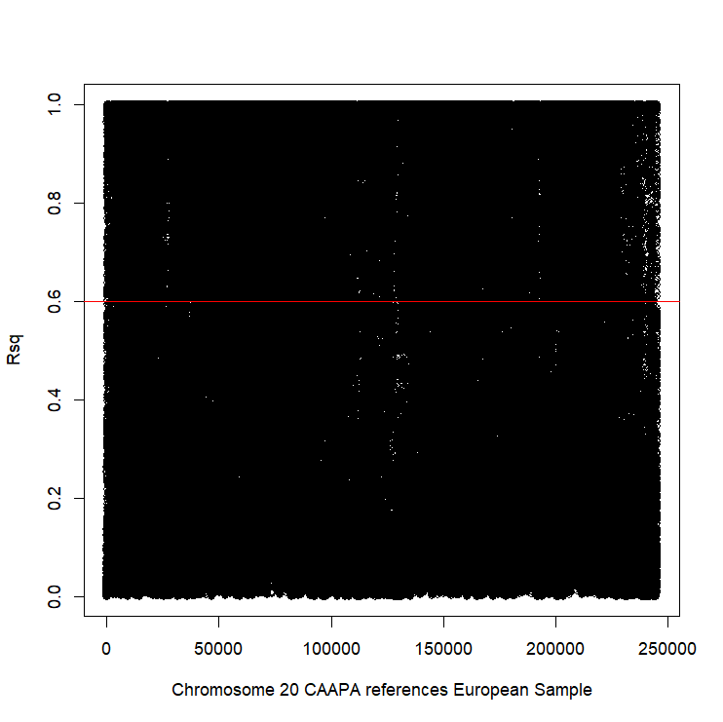
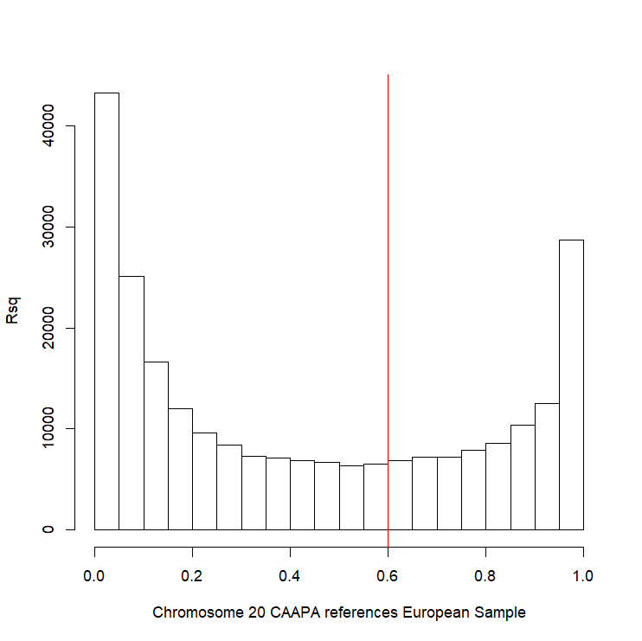
Good imputation
Bad imputation

Slide 40
Post imputation QC
Next run GWAS for a trait – ideally continuous, calculate lambda and plot:
  QQ
  Manhattan
  SE vs N
  P vs Z
Run the same trait on the observed genotypes – plot imputed vs observed

Slide 41
If you are running analyses for a consortium they will probably ask you to analyse all variants regardless of whether they pass QC or not…
(If you are setting up a meta-analysis consider allowing cohorts to ignore variants with MAF <.5% and low r2 – it will save you a lot of time)

Slide 42
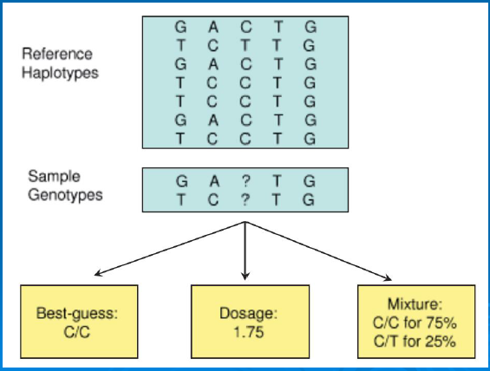
Choices of analysis methods

Slide 43
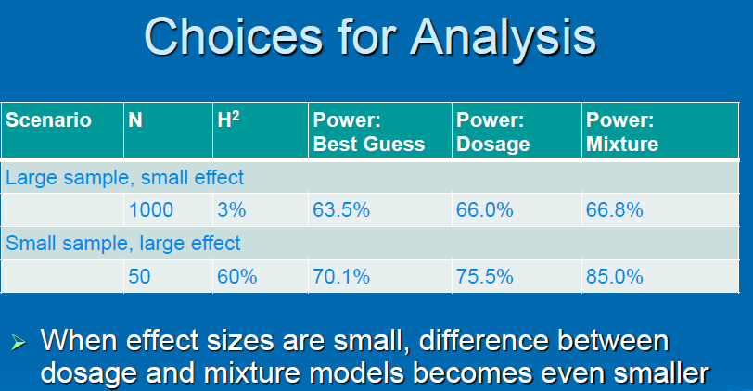

Slide 44
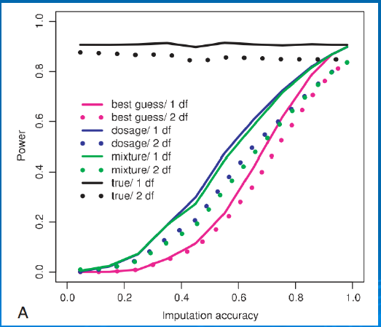

Slide 45
Analysis of Imputed data using SAIGE

Slide 46
Why SAIGE
PROS
Fast
Low memory
Can cope with UKB size data
Correctly models zygosity and relatedness
Continuous or Binary
CONS
2 stages
1 trait at a time
Phenotypes and covariates all in one file

Slide 47
Step 1
Runs the LMM and creates a pre-processed r data file
Rscript step1_fitNULLGLMM.R
--plinkFile=sparse
--phenoFile=phenoAD.txt
--phenoCol=AD
--covarColList=PC1,PC2,PC3,PC4
--sampleIDColinphenoFile=FID_IID
--traitType=binary
--outputPrefix=AD > AD.log

Slide 48
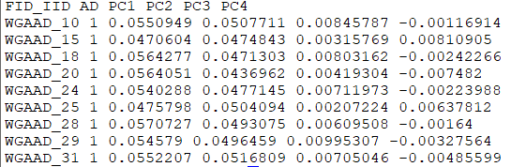
Phenotype/Covariate file
Simple format – headers, space delim
Binary traits are 0/1
Need to join FID and IID with an underscore _ as this is the ID format in the imputed data

Slide 49
Plink (hard call) genotypes for relatedness estimation
Doesn’t need to be all available data – can be a sparse file
  Todays files contains ~75,000 snps
plink --bfile QCed --indep-pairwise 10000kb 5 .2 --out prune
plink --bfile QCed --extract prune.prune.in --make-bed --out sparse

Slide 50
Step 1
Runs the LMM and creates a pre-processed r data file
Rscript step1_fitNULLGLMM.R
--plinkFile=sparse
--phenoFile=phenoAD.txt
--phenoCol=AD
--covarColList=PC1,PC2,PC3,PC4
--sampleIDColinphenoFile=FID_IID
--traitType=binary
--outputPrefix=AD > AD.log

Slide 51
It will make 4 files
Log, Rda, varianceRatio.txt, _30markers.SAIGE.results.txt
R
load("example.rda")
names(modglmm)
modglmm$theta
#theta: a vector of length 2. The first element is the dispersion parameter estimate and the second one is the variance component parameter estimate
#coefficients: fixed effect parameter estimates
#linear.predictors: a vector of length N (N is the sample size) containing linear predictors
#fitted.values: a vector of length N (N is the sample size) containing fitted mean values on the original scale
#Y: a vector of length N (N is the sample size) containing final working vector
#residuals: a vector of length N (N is the sample size) containing residuals on the original scale

Slide 52

Step 2
Rscript step2_SPAtests.R
--vcfFile=chr19.dose.vcf.gz
--vcfFileIndex=chr19.dose.vcf.gz.tbi
--sampleFile=sample.txt
--vcfField=DS
--chrom=19
--minMAF=0.01 --minMAC=5
--GMMATmodelFile=AD.rda
--varianceRatioFile=AD.varianceRatio.txt
--SAIGEOutputFile=AD.chr19.SAIGE.txt
--numLinesOutput=2
--IsOutputAFinCaseCtrl=TRUE &> AD.chr19.SAIGE.log

Slide 53
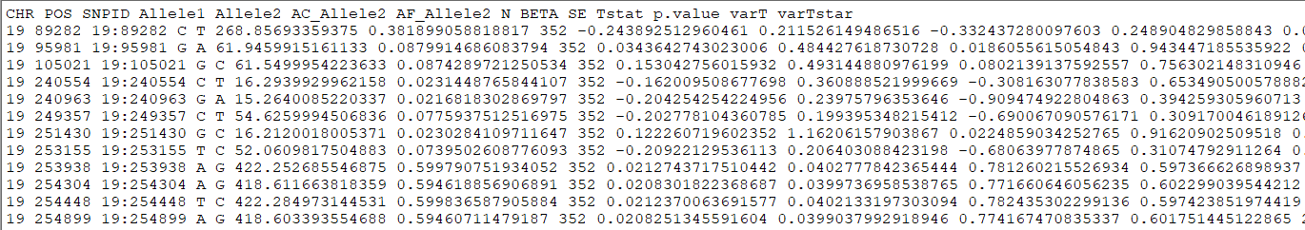
Output
CHR: chromosome POS: genome position
SNPID: variant ID Allele1: Ref allele
Allele2: Alt allele AC_Allele2: allele count of Alt allele
AF_Allele2: allele freq of Alt allele N: sample size
BETA: effect size of A2 SE: standard error of BETA
Tstat: score statistic p.value: p value with SPA applied
p.value.NA: p value when SPA is not applied
Is.SPA.converge: whether SPA is converged or not
varT: estimated variance of score statistic with sample related incorporated
varTstar: variance of score statistic without sample related incorporated

Slide 54
Merge the GWAS results with the R2 from the imputation files and keep only those results with r2 >= 0.6 (i.e. good imputation quality)
#### Merge results GWAS with imputed information file and filter by R2 >= 6 (the results have been filtered by MAF before)
# Extract columns of interest in GWAS results: CHR POS SNPID Allele1 Allele2 AF_Allele2 N BETA SE Tstat p.value
zcat AD.chr19.SAIGE.txt.gz | awk '{print $1,$2,$3,$4,$5,$7,$8,$9,$10,$11,$12}' > temp_AD.chr19.results.txt
# Extract columns of interest in imputation information: SNP Rsq
zcat ../saige/chr19.info.gz | awk '{print $1,$7}' > temp_chr19.info.txt
# Merge information from the GWAS and R2
awk 'NR==FNR{a[$1]=$2; next} $3 in a{print $0,a[$3]}' temp_chr19.info.txt temp_AD.chr19.results.txt > temp
# Filer by R2 >= 0.6 and put the header
echo 'CHR POS SNPID Allele1 Allele2 AF_Allele2 N BETA SE Tstat p.value Rsq' > AD.chr19.results.QC.txt
awk '{if ($12>=0.6) print $0}' temp >> AD.chr19.results.QC.txt
#### Plot the results: Manhattan plot and regional plot
awk '{if (NR>1) print $1,$2,$11}' temp_AD.chr19.results.QC.txt > temp_plot.AD.chr19.txt
sort -k11 -g temp_AD.chr19.results.QC.txt | head # lowest p-value at 19:45422946 , p = 9.3515193823689e-16
awk '{if (NR==1) print $1,$2,$3,$11; else if ($2>= 44922946 && $2<= 45922946) print $1,$2,"chr"$3,$11}' AD.chr19.results.QC.txt > temp_ld.AD.chr19.txt

Slide 55
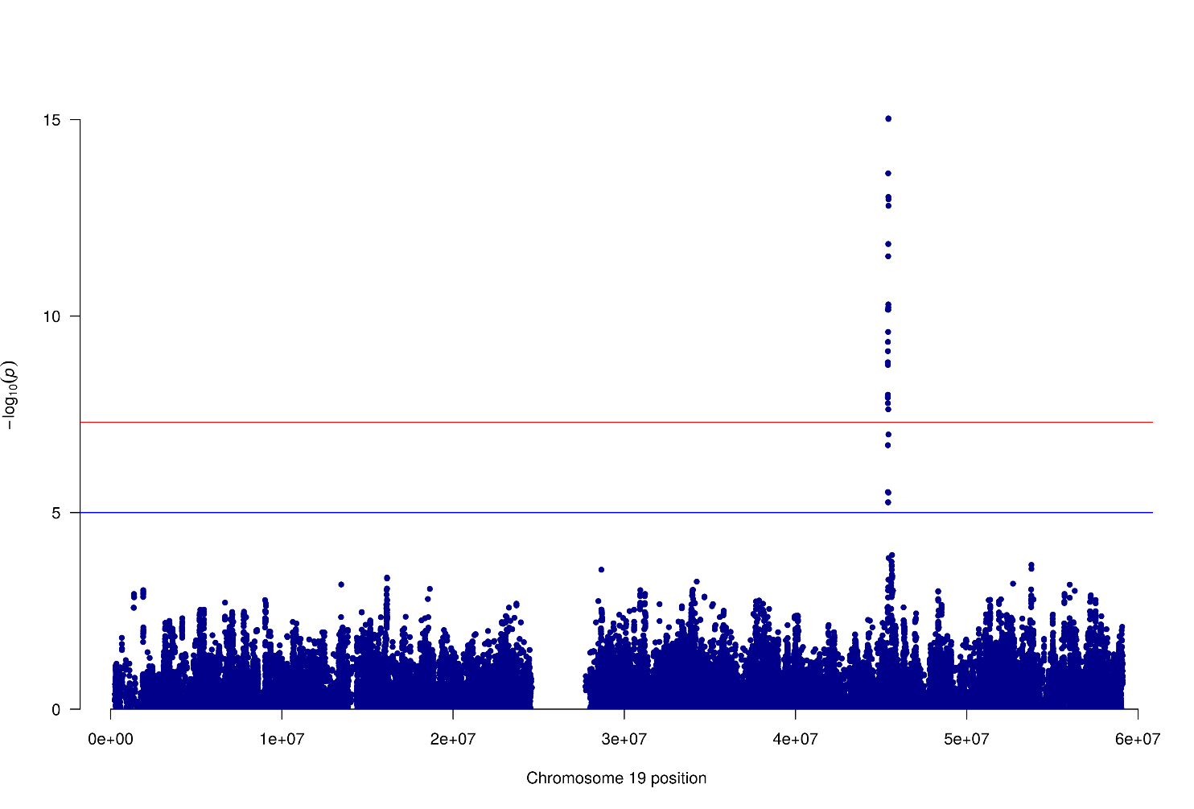
Imputed results (Manhattan plot only chr19)

Slide 56
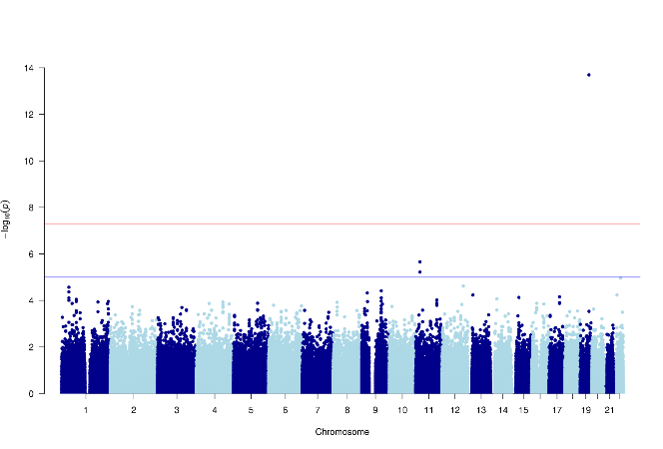
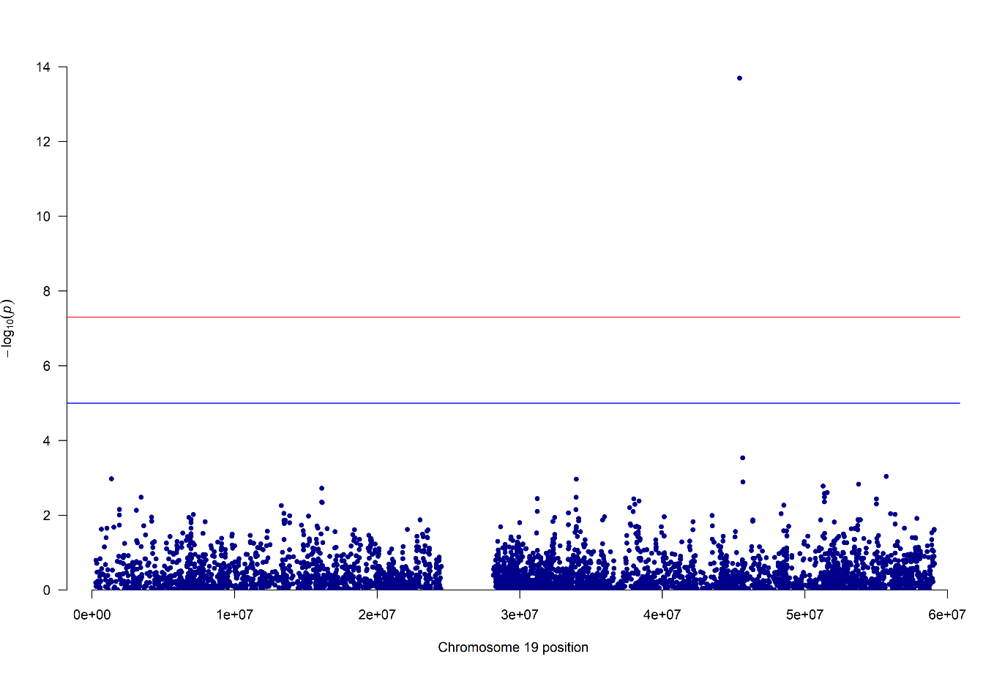
Remember the genotyped results!

Slide 57

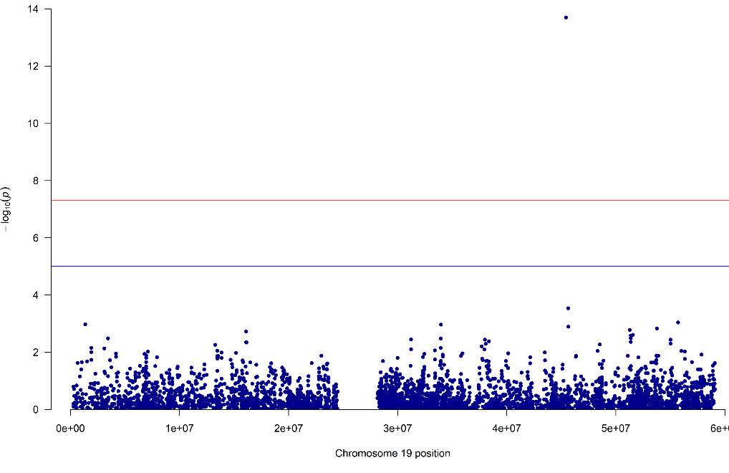
And Compare…
Genotyped
Imputed

Slide 58
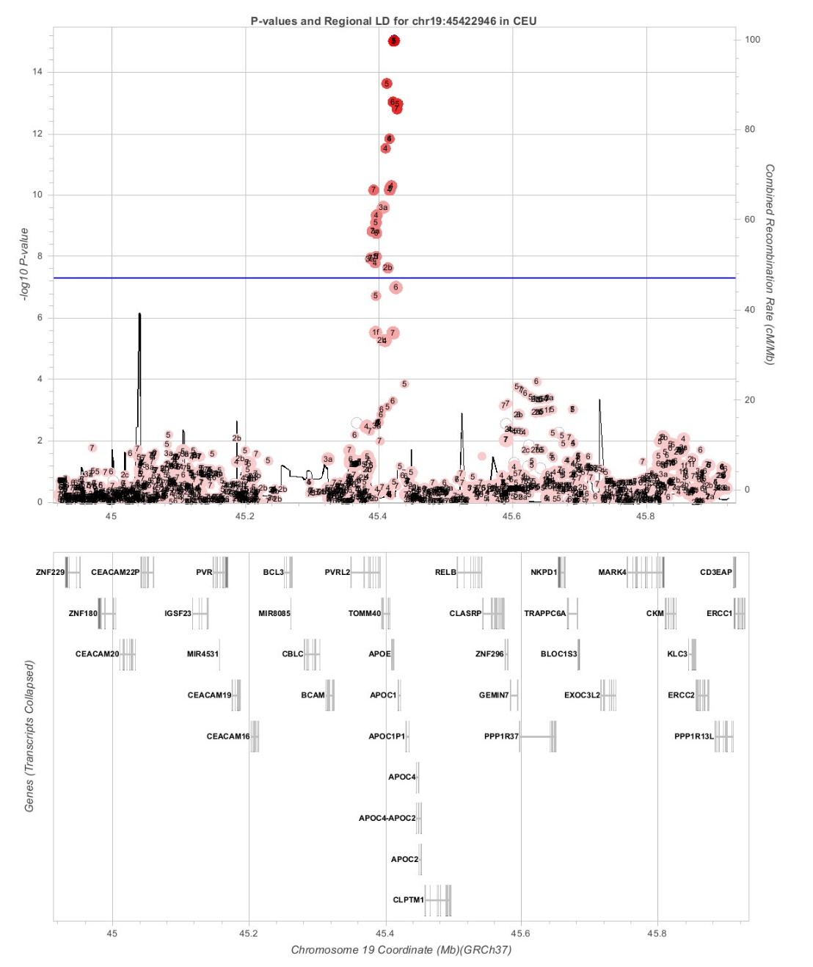
Imputed results (regional plot)

Slide 59

And Compare…
Genotyped
Imputed

Slide 60
Questions?

Slide 61
Extra slides

Slide 62
Step 1 – How to phase
  Data is usually broken into manageable chunks
  ~20Mb
  Each phased independently
  ./eagle
  --vcfRef HRC.r1-1.GRCh37.chr20.shapeit3.mac5.aa.genotypes.bcf
  --vcfTarget chunk_20_0000000001_0020000000.vcf.gz
  --geneticMapFile genetic_map_chr20_combined_b37.txt
  --outPrefix chunk_20_0000000001_0020000000.phased
  --bpStart 1
  --bpEnd 25000000
  --chrom 20
  --allowRefAltSwap

Slide 63
Step 2 - Imputation
Compares the phased data to the references and infers the missing genotypes. Calculate accuracy metrics
./Minimac3
--refHaps HRC.r1-1.GRCh37.chr1.shapeit3.mac5.aa.genotypes.m3vcf.gz
--haps chunk_1_0000000001_0020000000.phased.vcf
--start 1
--end 20000000
--window 500000
--prefix chunk_1_0000000001_0020000000
--chr 20
--noPhoneHome
--format GT,DS,GP
--allTypedSites

Slide 64
Phasing in Eagle
Input a target sample and a library of reference haplotypes
Selection of conditioning haplotypes.
Eagle2 first identifies a subset of 10,000 conditioning haplotypes by ranking reference haplotypes according to the number of discrepancies between each reference haplotype and the homozygous genotypes of the target sample.

Slide 65
Generation of HapHedge data structure.
Eagle2 next generates a HapHedge data structure on the selected conditioning haplotypes.
The HapHedge encodes a sequence of haplo- type prefix trees (i.e., binary trees on haplotype prefixes) rooted at a sequence of starting positions along the chromosome, thus enabling fast lookup of haplotype frequencies

Slide 66
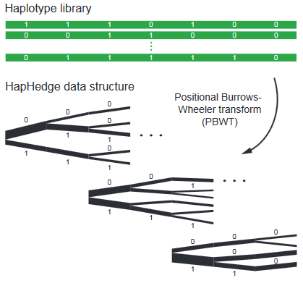

Slide 67
Exploration of the diplotype space.
Having prepared a HapHedge of conditioning haplotypes, Eagle2 performs phasing using a hidden Markov model
Consolidates reference haplotypes sharing common prefixes reducing computation.

