Slide 1
Sex differences and the X chromosome
Sarah Medland
Boulder 2019

Slide 2
Thinking about sex differences using the language of heterogeneity
Are these differences due to differences in the magnitude of the effects (quantitative)?
e.g. Is the contribution of genetic effects greater/smaller in males than in females?
Are the differences due to differences in the source/nature of the effects (qualitative)?
e.g. Are there different genetic effect influencing the trait in males and females?

Slide 3
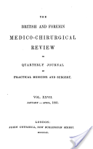
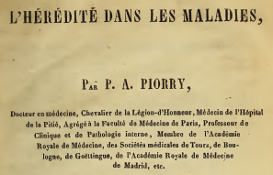
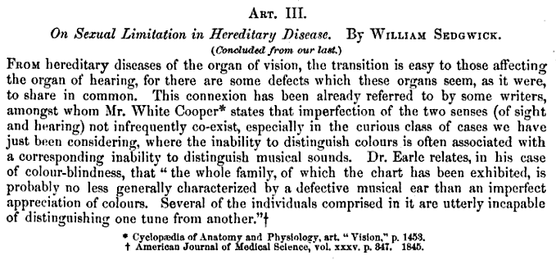
The language of heterogeneity
1861
Sex differences = Sex limitation
1948
1840

Slide 4
The language of heterogeneity
Quantitative - differences in the magnitude of the effects | Qualitative - differences in the source/nature of the effects
Models Scalar | Models Non-scalar

Slide 5
The language of heterogeneity
Scalar limitation (Quantitative)
% of variance due to A,C,E are the same between groups
The total variance is not ie:
var_{Female} = k*var_{Male}
A_{Female} = k*A_{Male}
E_{Female} = k*E_{Male}
k here is the scalar

Slide 6
The language of heterogeneity
Non-Scalar limitation
var_{Female} ≠ var_{Male}
A_{Female} ≠ A_{Male}
E_{Female} ≠ E_{Male}

Slide 7
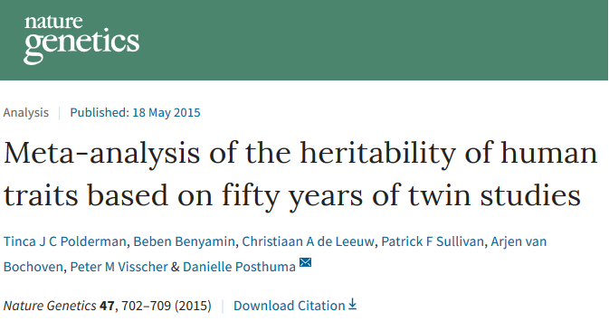
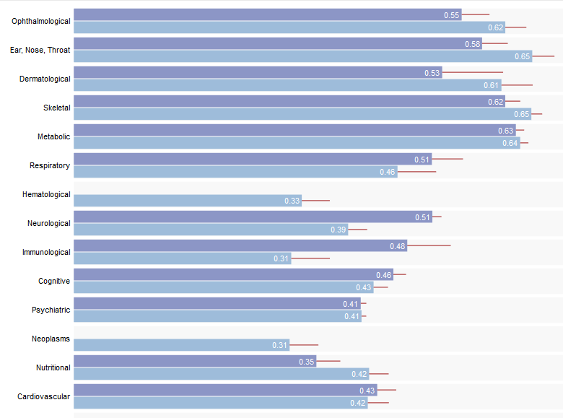
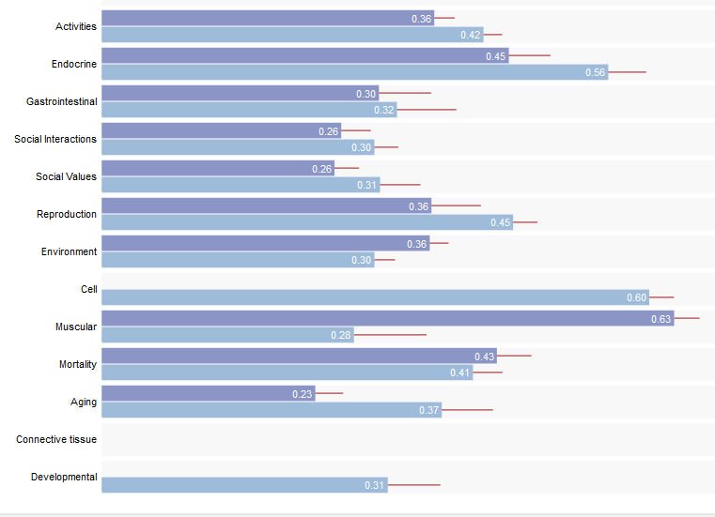

Slide 8
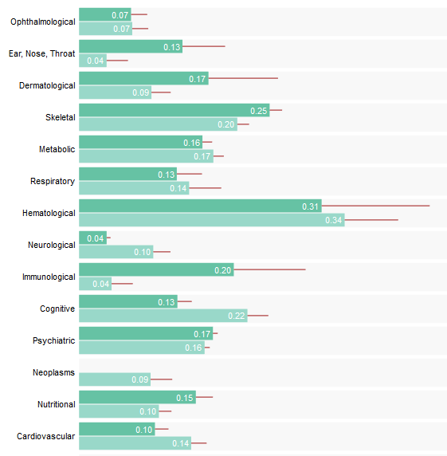
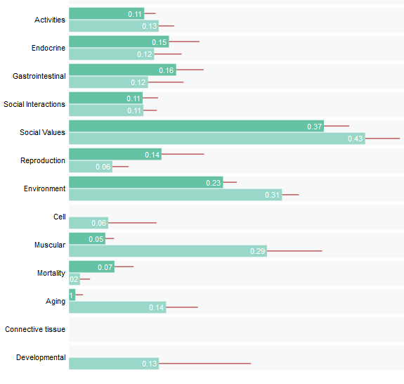

Slide 9
How can we test for this in a GWAS?
Check for sex differences the phenotypic distributions or frequencies
Check for interactions between SNP effects and sex
Make sure you include a main effect of sex when you do this
Plink 1.9 – include sex in the cov file and request main effects and interactions
plink --bfile mydata --linear interaction --covar my.cov --sex

Slide 10
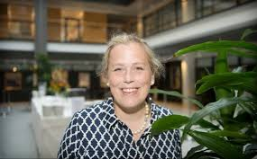
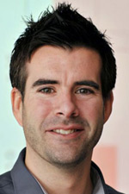
Other ways of doing this?

Slide 11
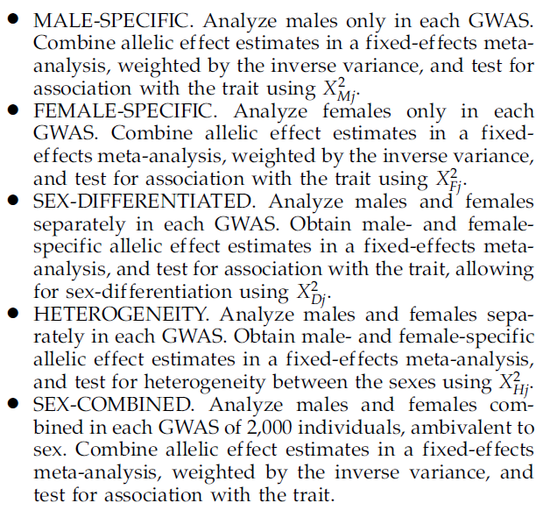
1df
1df
2df
1df
1df
Implementation in the GWASMA software package

Slide 12
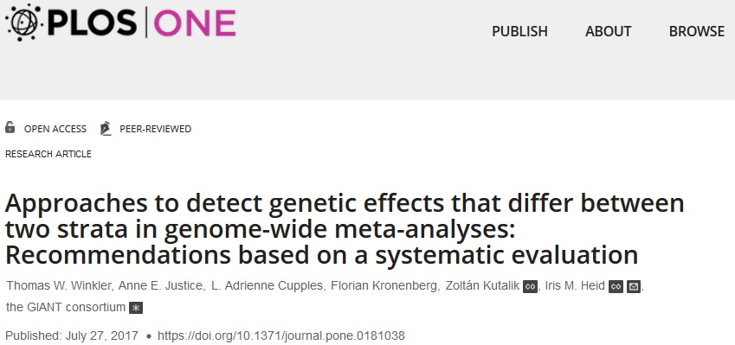
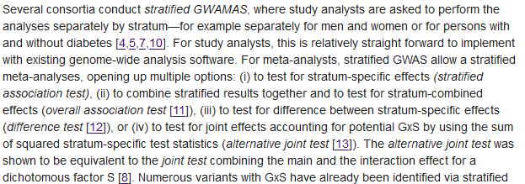

Slide 13
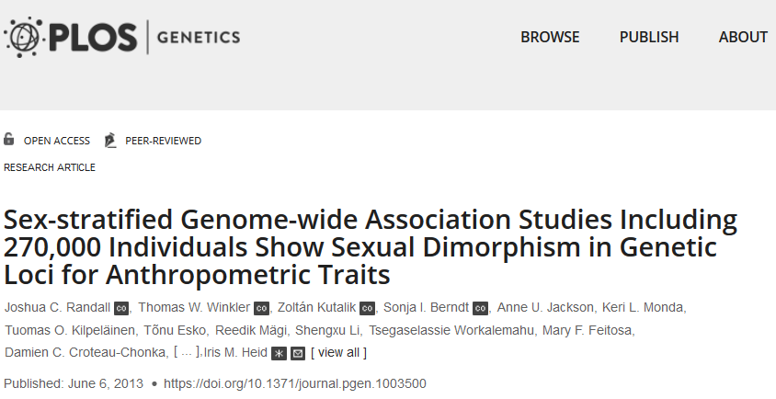

Slide 14
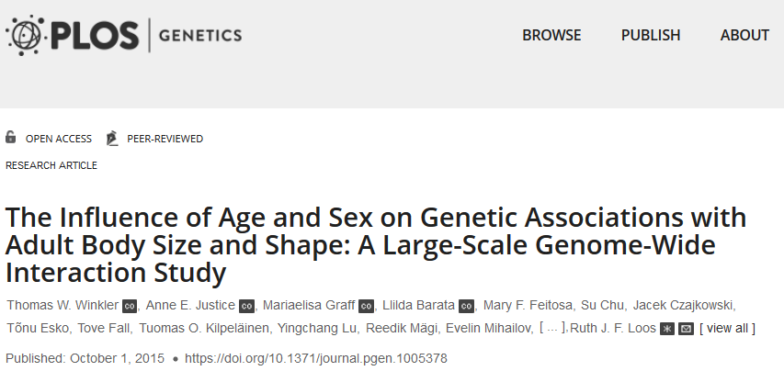

Slide 15
What about X?

Slide 16
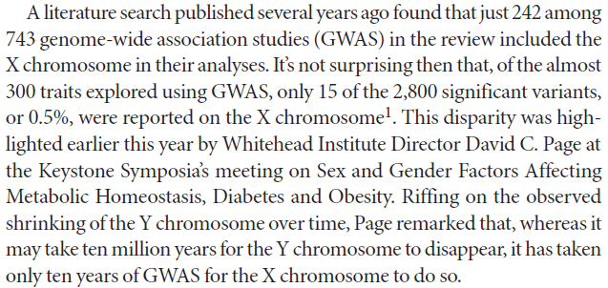

Slide 17
Let’s fact check this
GWAS catalogue
https://www.ebi.ac.uk/gwas/

Slide 18
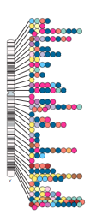
As of 2019-01-31, the GWAS Catalog contains 3764 publications and 107785 unique SNP-trait associations.
537 of these associations (0.5%) are on the X chromosome
2 are on the Y chromosome

Slide 19
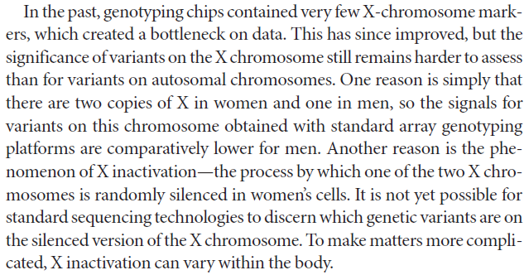
Why is this is case?

Slide 20
2 points here
Coverage on chips
Still a major issue
Many annotation errors
Modelling of X effects
X Inactivation
Dosage compensation

Slide 21
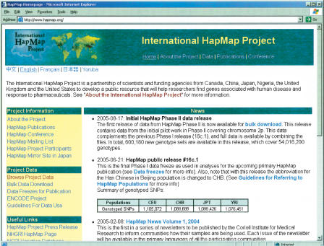
A critical 3rd point
HapMap2 never
released X references
for imputation

Slide 22
Dosage compensation
Dosage compensation is the process by which organisms equalize the expression of genes between members of different biological sexes
Different species have different methods
Random inactivation of one ♀ X (eg mammals)
not all genes along the X chromosome are subject to X-inactivation
active expression at some loci is required for homologous recombination with the pseudo-autosomal region (PAR) of the Y chromosome during meiosis
10-25% of human X chromosome genes outside of the PARs show weak expression from the inactive X chromosome.
Two-fold increased transcription of a single ♂ X (eg Drosophila)
Decreased transcription of both hermaphroditic Xs by half (eg C. elegans)

Slide 23
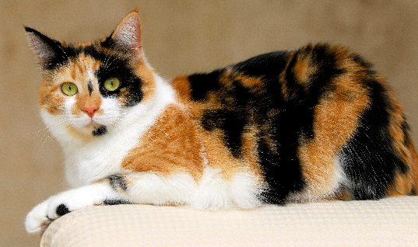
X inactivation (the canonical version)
the inactive chromosome is silenced through methylation

Slide 24
X inactivation (the canonical version)
In humans inactivation happens during the late blastocyst stage, after implantation. It is theoretically random and inherited by the daughter cells

Slide 25
What this means analytically
The variance of females for expression/effect of X linked variants will be ½ that of males
Using a test designed for autosomes will not account for this properly
To the extent that X has a substantial effect on a phenotype you are analysing you might expect to see Var_{MALE} > Var_{FEMALE}

Slide 26
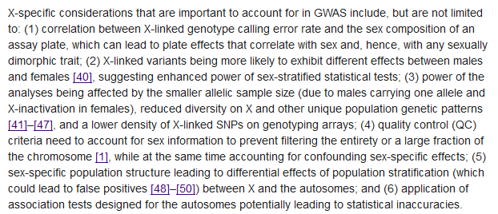
Implications for QC & Type I error

Slide 27
How can we analyse X properly?

Slide 28
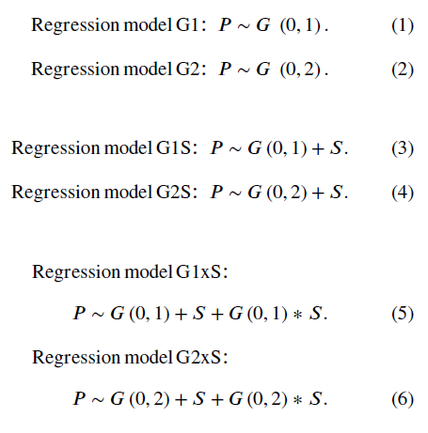
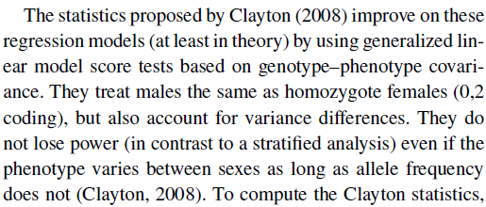
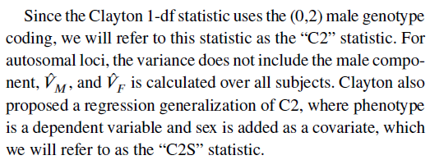
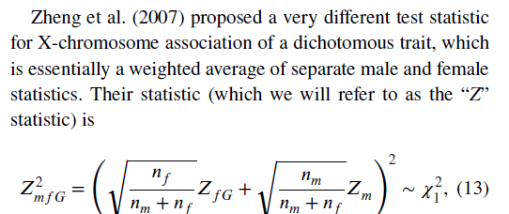
P, G, and S stand for phenotype, genotype, and sex

Slide 29
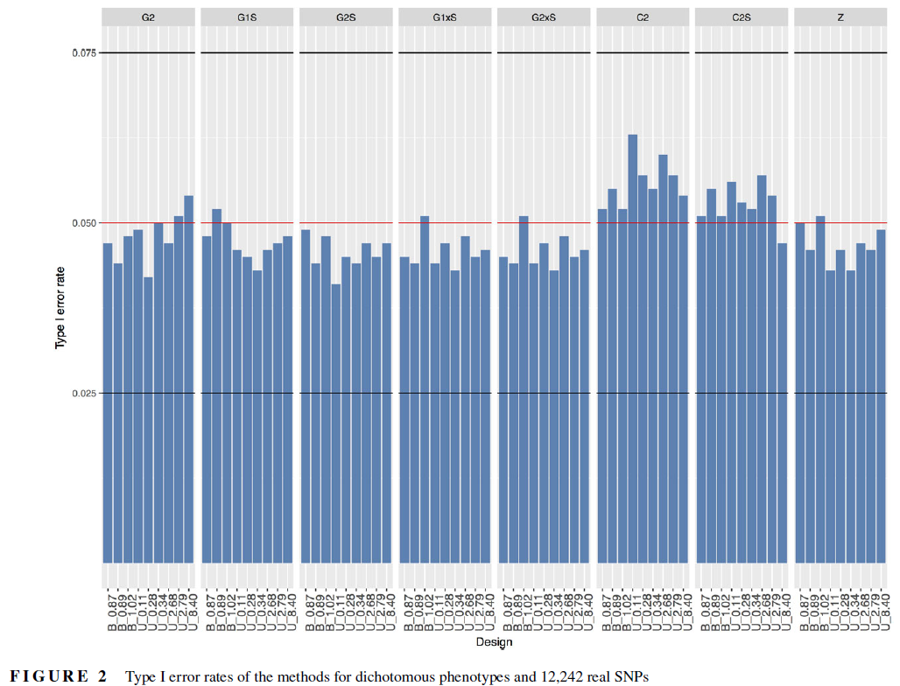

Slide 30
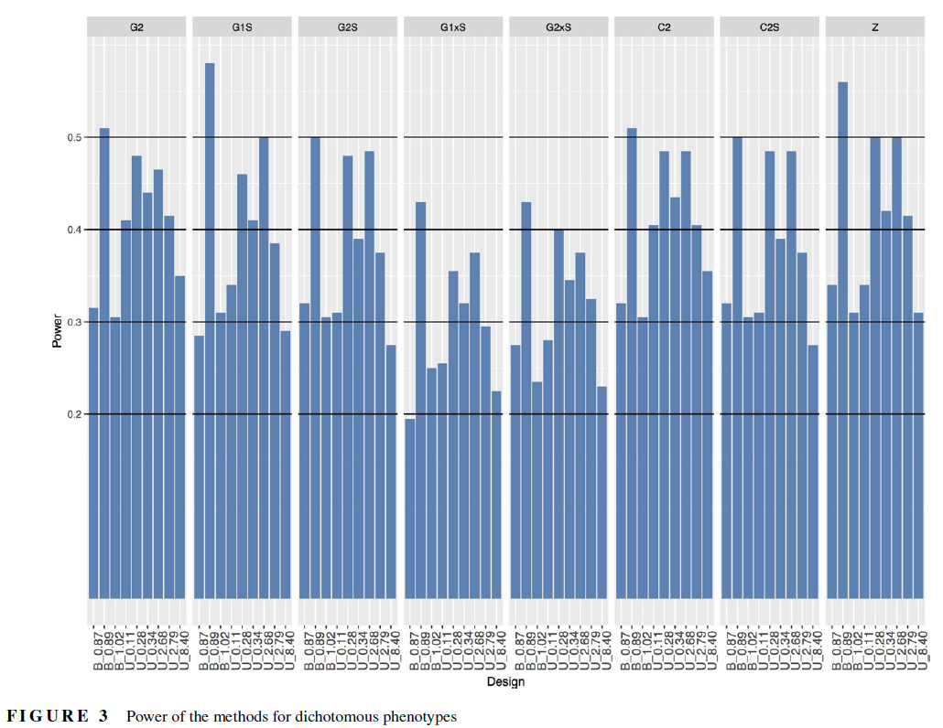

Slide 31
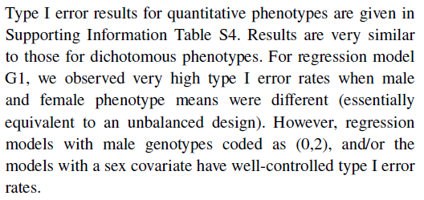
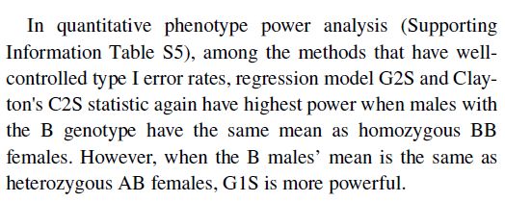

Slide 32
My reading of this is these are currently the best models
G1S = plink --bfile mydata --linear --xchr-model 1 --covar mydata.cov --out Xchromosome
G2S = plink --bfile mydata --linear --xchr-model 2 --covar mydata.cov --out Xchromosome

Slide 33
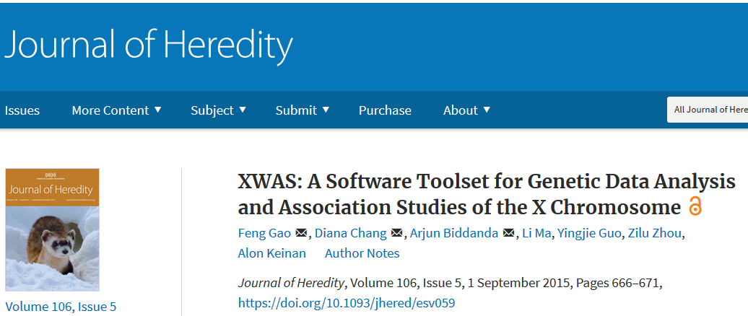
Other software to think about

Slide 34
A last word on the topic

