Slide 1















33rd International Workshop on Statistical Genetic Methods for Human Complex Traits
Ben Neale (codirector)
David Evans (codirector)
Nick Martin
Dorret Boomsma
Pak Sham
Mike Neale
Hermine Maes
Sarah Medland
Danielle Posthuma
Meike Bartels
Abdel Abdellaoui
Michel Nivard
Jenny van Dongen
Hilary Martin
John Hewitt (cohost)
Matt Keller (cohost)
Jeff Lessem
Stacey Cherny
Luke Evans
Cotton Seed
Tim Poterba
Lucia Colodro Conde
Katrina Grasby
Kyoko Watanabe
Aysu Okbay
Loic Yengo
Michael Simpson
Joshua Pritikin

Slide 2

The genetics of complex traits: historical context and current challenges
Nick Martin
Queensland Institute
of Medical Research
Brisbane
Boulder workshop
March 4, 2019

Slide 3
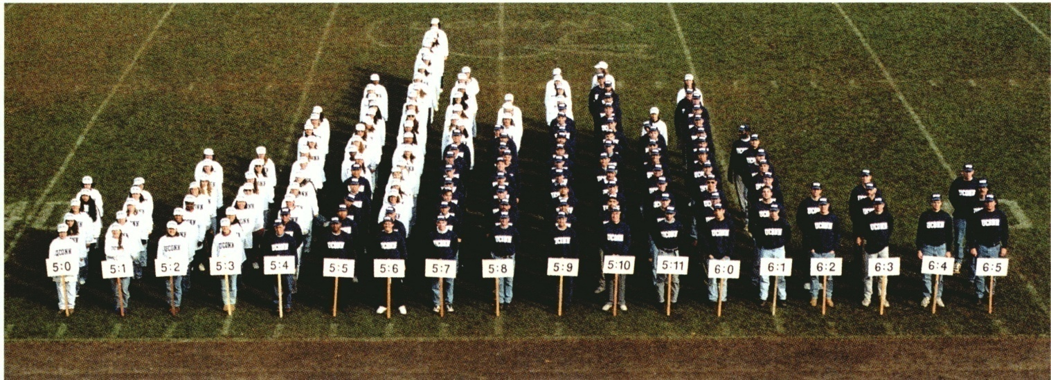
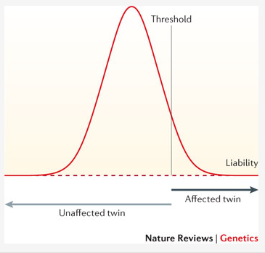
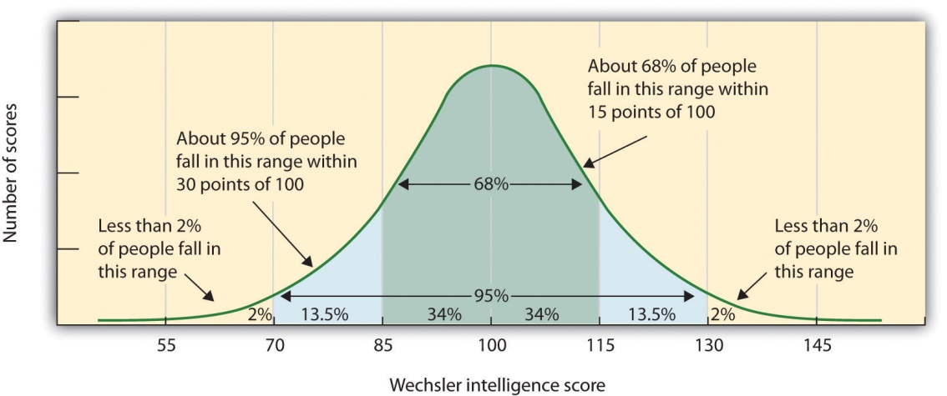
Human variation: Height
Human variation: IQ

Slide 4
Genetic Epidemiology:
Stages of Genetic Mapping
Are there genes influencing this trait?
  Genetic epidemiological (twin / family) studies OR heritability based on measured genetic variants
Where are those genes?
  Linkage analysis
What are those genes?
  Association analysis (meta-analysis / pathway)
How do they work beyond the sequence?
  Epigenetics, transcriptomics, proteomics
What can we do with them ?
  Translational medicine

Slide 5
Total mole count for MZ and DZ twins
MZ twins - 153 pairs, r = 0.94
DZ twins - 199 pairs, r = 0.60
400
400
300
300
Twin 1
Twin 1
200
200
100
100
0
0
0
100
200
300
400
0
100
200
300
400
Twin 2
Twin 2

Slide 6
4 Stages of Genetic Mapping
Are there genes influencing this trait?
  Genetic epidemiological studies
Where are those genes?
  Linkage analysis
What are those genes?
  Association analysis
What can we do with them ?
  Translational medicine

Slide 7
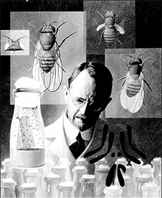
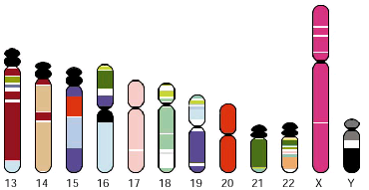
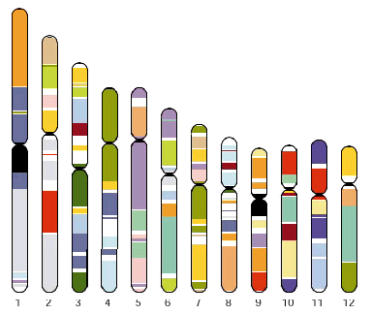
Linkage analysis
Thomas Hunt Morgan – discoverer of linkage

Slide 8
x
1/4
1/4
1/4
1/4

Slide 9
IDENTITY BY DESCENT
Sib 1
Sib 2
4/16 = 1/4 sibs share BOTH parental alleles IBD = 2
8/16 = 1/2 sibs share ONE parental allele IBD = 1
4/16 = 1/4 sibs share NO parental alleles IBD = 0

Slide 10
Total nevus count correlations by IBD class at D9S942
IBD = 0 (51 PAIRS)
IBD = 1 (99 PAIRS)
IBD = 2 (49 PAIRS)
MZ (156 PAIRS)
Heterogeneous (χ²₂=12.58, p=0.002)

Slide 11
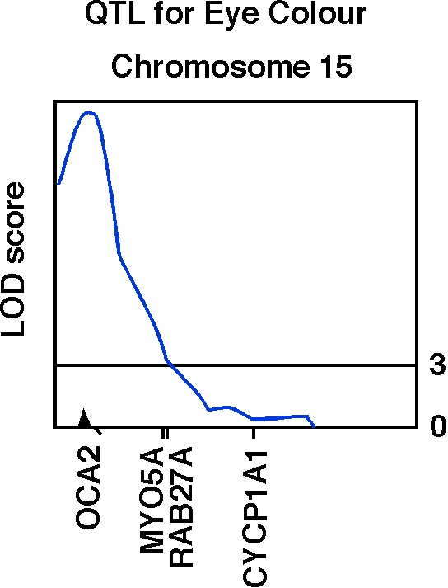
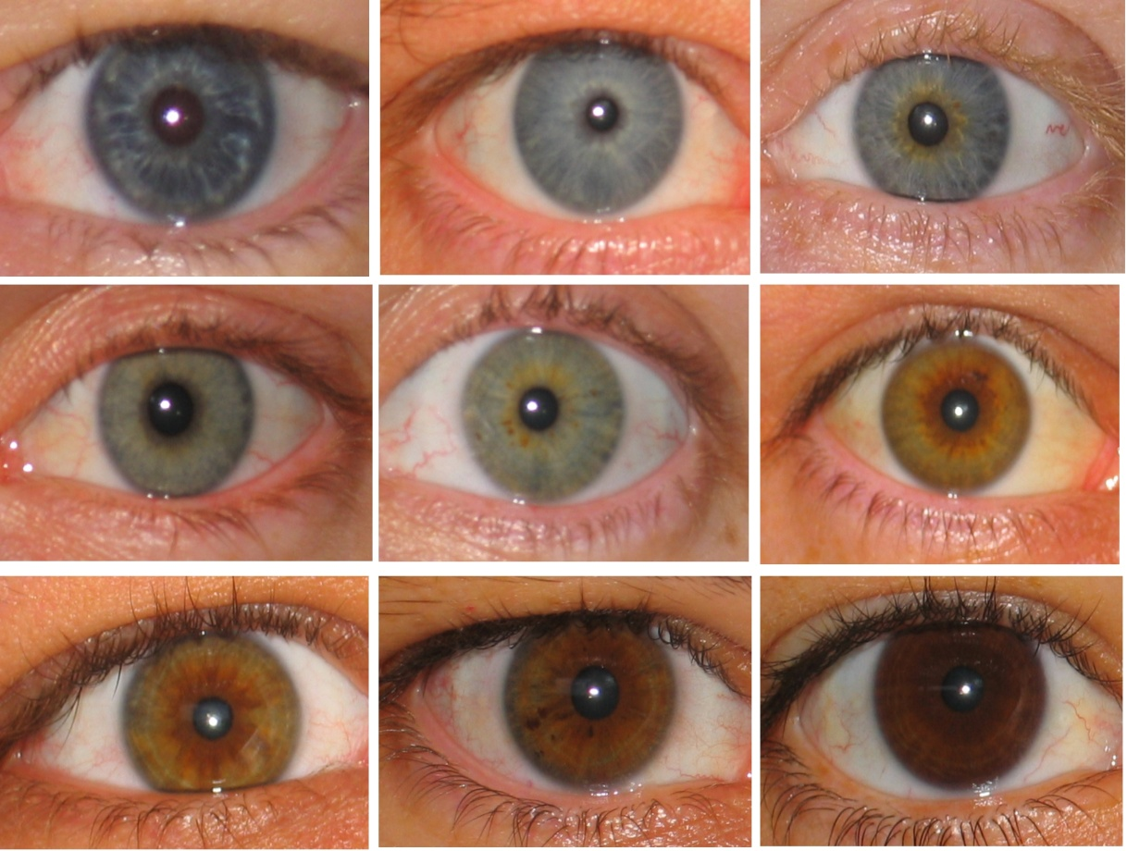
Human OCA2 and eye colour
Zhu et al., Twin Research 7:197-210 (2004)

Slide 12
Linkage analysis is badly underpowered for complex traits with small gene effect sizes
So we need a much more sensitive way to find the genes

Slide 13
Complex disorders account for most health burden
Examples
  Ischaemic heart disease (30-50%, F-M)
  Breast cancer (12%, F)
  Colorectal cancer (5%)
  Recurrent major depression (10%)
  ADHD (5%)
  Bipolar (2%)
  Schizophrenia (1%)
  Non-insulin dependent diabetes (5%)
  Asthma (10%)
  Essential hypertension (10-25%)
  etc…..

Slide 14
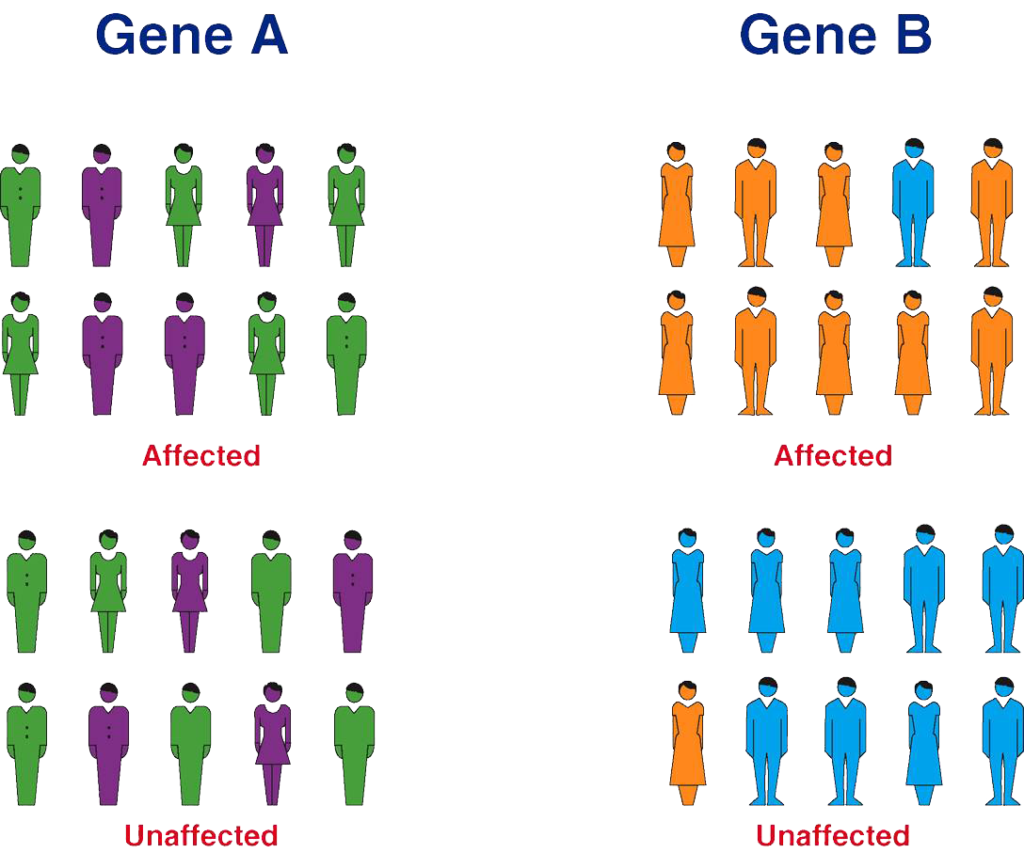
Basic principle of genetic association studies
Genetic Variant 1
Genetic Variant 2
Notes:
But the real revolution, many of use would see as one of the landmarks in human biology of the last decade, has been the advent of Genome Wide Association Studies. The basic principle is extremely simple – you are just looking for genetic variants, like the one indicated in orange, in the ‘germline DNA’ [usually isolated from blood cells] of cases vs controls, carrying any disease or trait that has any genetic basis at all; and of course the technology depends on the ability to measure 100,000s genetic variants all at once – which we can now do reliably, quickly and cheaply

Slide 15
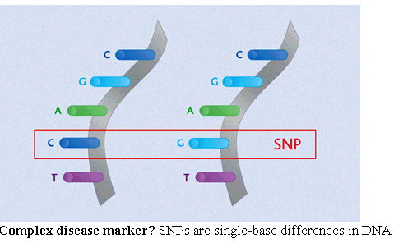
Association analysis
looks for correlation between specific alleles and phenotype (trait value, disease risk)
Single Nucleotide Polymorphisms (SNPs)

Slide 16
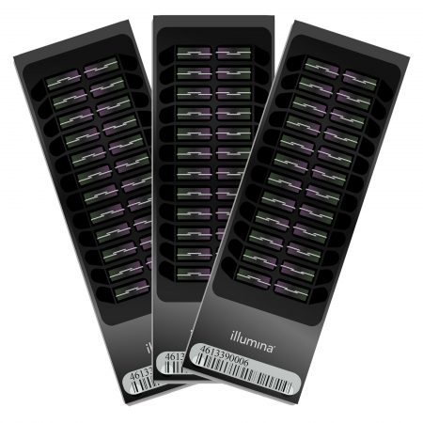
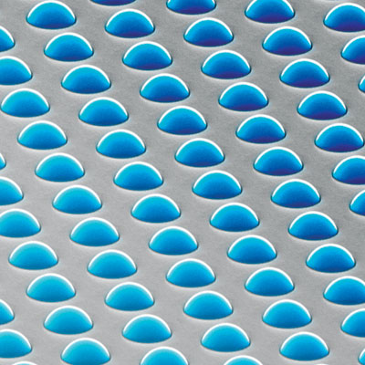
High density SNP arrays – up to 1 million SNPs

Slide 17
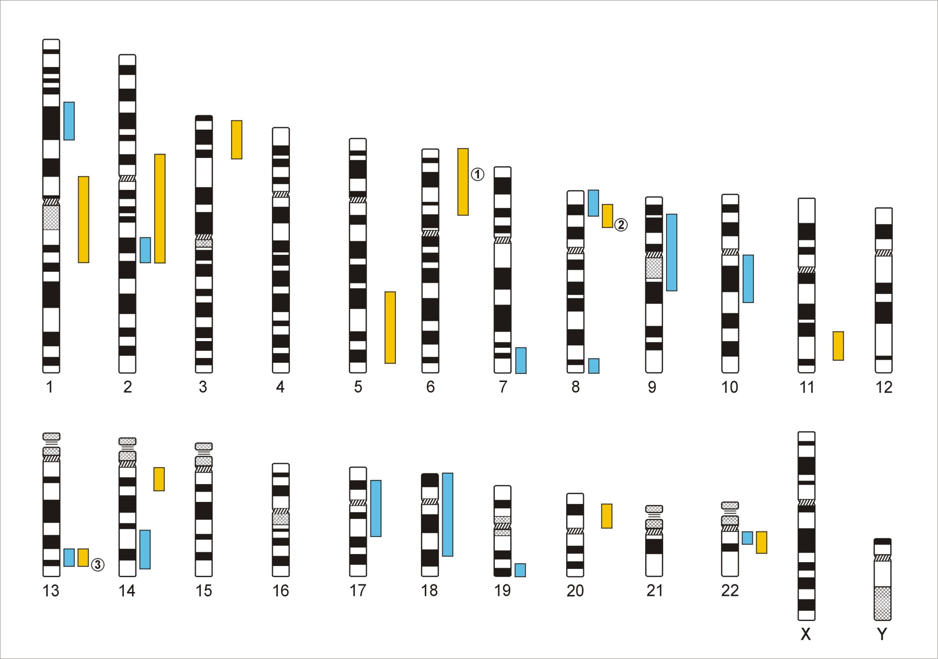
Genome-Wide Association Studies
500,000 – 5,000,000 SNPs
Human Genome - 3,1x10⁹ Base Pairs
Notes:
In a GWA the Genome which contains xx SNPs is examined using … SNPs

Slide 18
Linkage disequilibrium
David Evans

Slide 19
Linkage disequilibrium
time

Slide 20
Indirect association
this SNP will be associated with disease

Slide 21
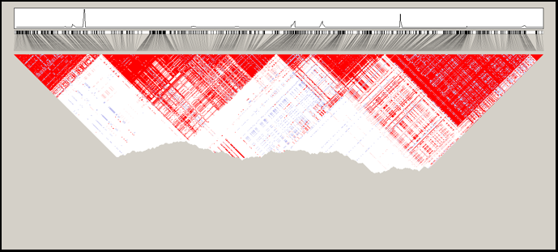
Linkage disequilibrium blocks
Jeff Barrett

Slide 22
Genetic Case Control Study
Controls
Cases
G/T
G/G
T/T
T/T
T/T
T/G
T/G
T/T
T/G
T/G
G/G
T/G
T/G
T/T
Allele G is ‘associated’ with disease

Slide 23
Allele-based tests (case-control)
Each individual contributes two counts to 2x2 table.
Test of association
where
X² has χ² distribution with 1 degrees of freedom under null hypothesis.
 | Cases | Controls | Total
G | n_{1A} | n_{1U} | n_{1·}
T | n_{0A} | n_{0U} | n_{0·}
Total | n_{·A} | n_{·U} | n··

Slide 24
Simple Regression Model of Association
(continuous trait)
Y_{i} = α + βX_{i} + e_{i}
where
Y_{i} = trait value for individual i
X_{i} = number of ‘A’ alleles an individual has
1.2
1
0.8
Y
0.6
0.4
0.2
0
X
0
1
2
Association test is whether β > 0

Slide 25
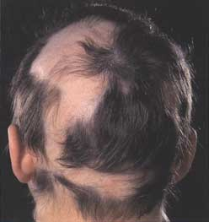
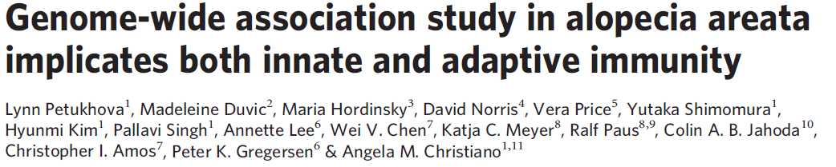
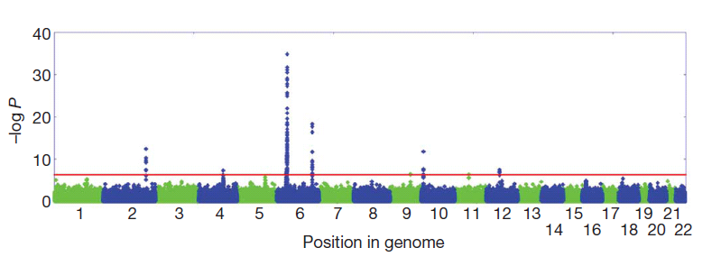

Slide 26
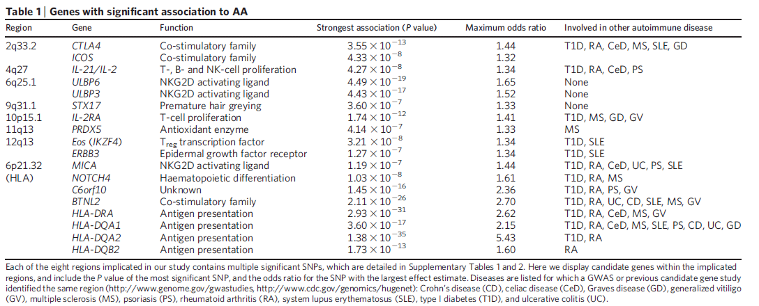
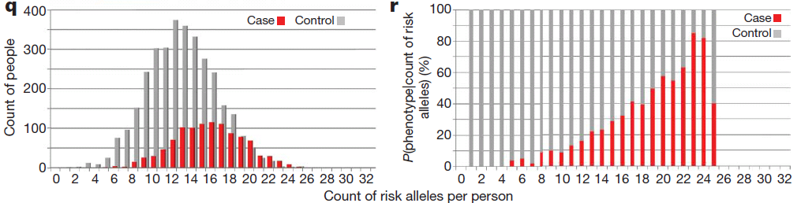

Slide 27
Ditte Demontis , Raymond Walters …. Sarah Medland …. Benjamin Neale
we developed a novel model to meta-analyze the GWAS of the continuous measure of ADHD with the clinical diagnosis in the ADHD GWAS. In brief, we perform a z-score based meta-analysis using a weighting scheme derived from the SNP heritability and effective sample size for each phenotype that fully accounts for the differences in measurement scale
20,183 ADHD cases
35,191 controls
12 independent GWS loci,
How to combine binary and continuous measures in GWAS

Slide 28
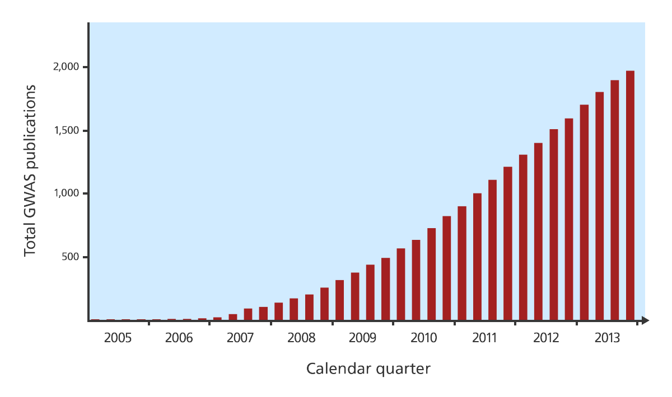
GWAS publications since 2005

Slide 29
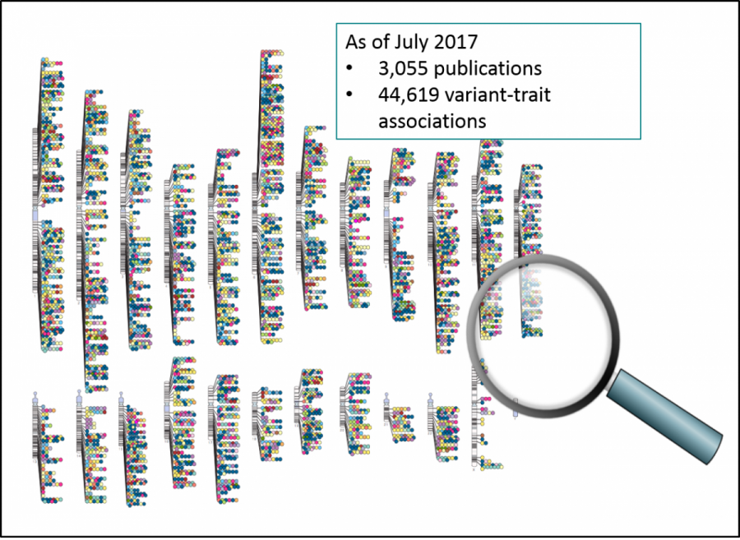

Slide 30
Functional interpretation GWAS results
Find the right target gene

Slide 31
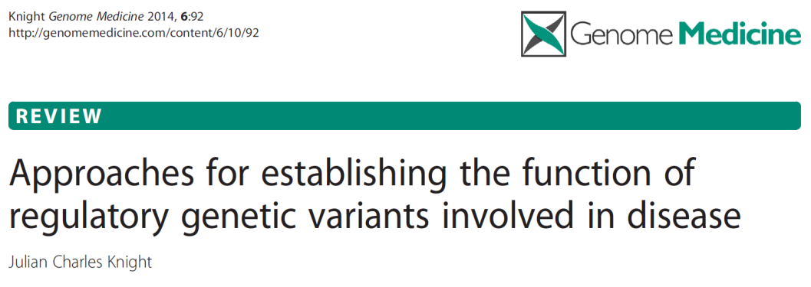
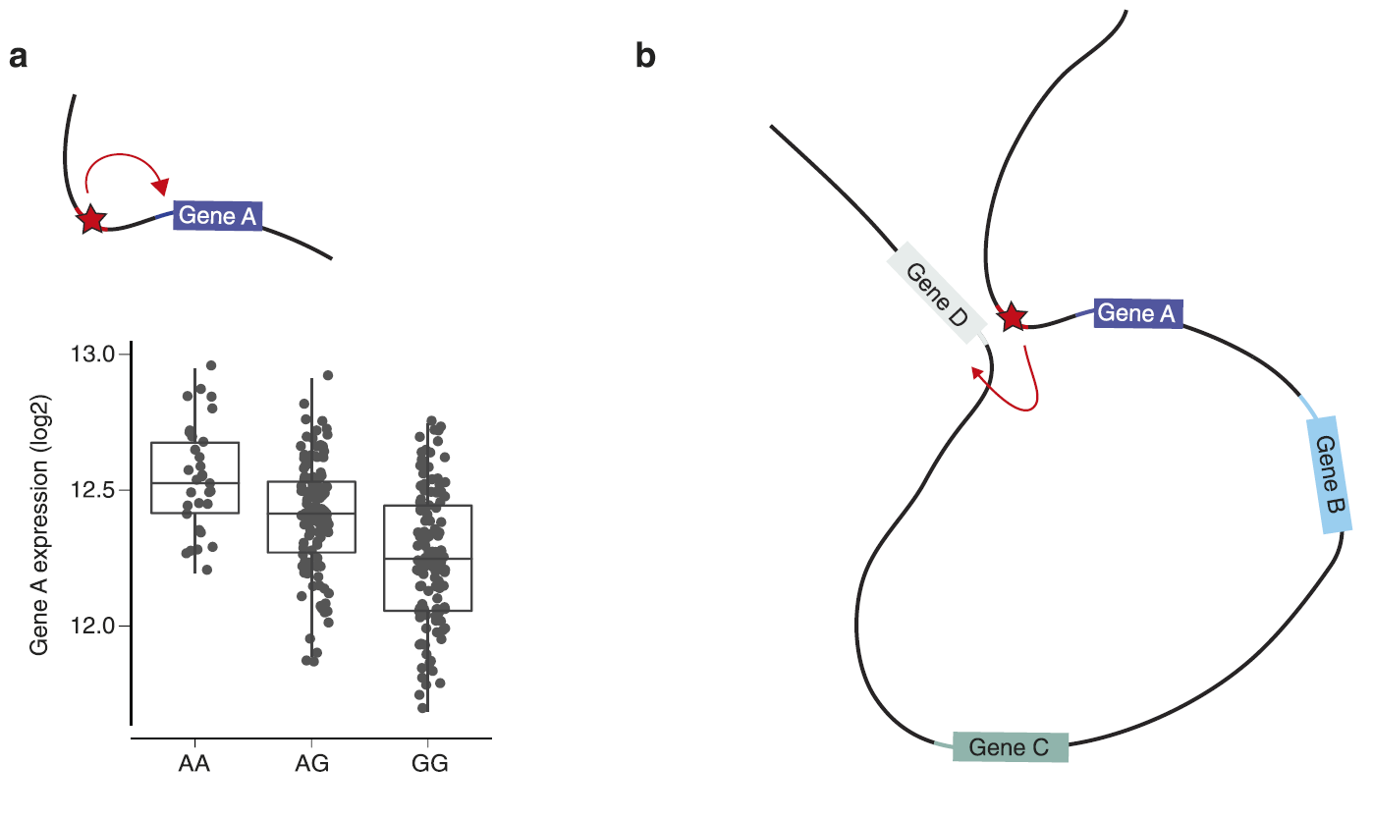
A local cis-acting variant in a regulatory element affects allele-specific transcription factor binding affinity and is associated with differential expression of gene A (see chart)

Slide 32
The same variant can modulate expression of gene D at a distance through DNA looping that brings the regulatory enhancer element close to the promoter of gene D on the same chromosome.

Slide 33
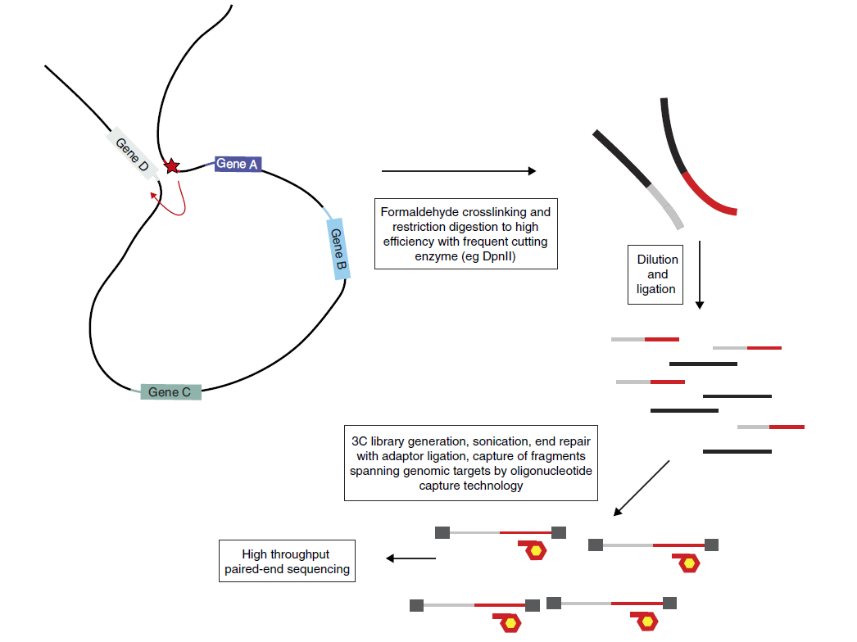
Chromatin conformation capture (3C) to find the target of a disease-associated SNP within an enhancer element
Can detect interactions from ~20kb to ~800kb

Slide 34
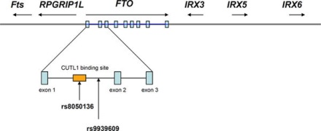
Obesity-associated variants within FTO form long-range functional connections with IRX3
Smemo et al 2014

Slide 35
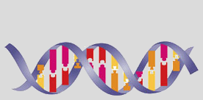
INQUISIT: Integrated eQTL and in silico prediction of gene targets
GENE
EXPRESSION
CANDIDATE SNP CLASS
GENOMIC
ANNOTATION
FEATURE
PRIORITISATION
SCORE
EXPERIMENTAL VALIDATION
In silico deleterious
Down weigh candidate genes that are not expressed in MCF7 or HMEC cells
Exonic/
Splice site
In vitro
assays
Genic
Somatically mutated
TSS proximity
Chromatin signature
Weigh potential candidate SNPs by enriched chromatin features
Promoter
Enriched TF binding
Reporter
assays
eQTL
Somatically mutated
Non-
coding
Experimental interactions
Computational prediction
3C,
Reporter
assays
Michailidou et al Nature 2017
Enhancer
TAD
Enriched TF binding
eQTL
Somatically mutated
Notes:
Developed by Jonathan Beesley, specifically for predicting targets in breast tissue – but can be adapted for another tissue
A comprehensive way of trying to predict the target genes – considers that every candidate causal risk variant could potentially be coding, or in a promoter or more distal regulatory feature
We ‘validated’ by showing that they are greatly enriched for genes known to drive breast cancer through somatic mutations, so having shown that, a driver gene gets an additional point in the algorithm
TSS = transcription start site
TF = transcription factor
TAD = topologically associating domain

Slide 36
Ways to increase power
Imputation

Slide 37
Imputation
a g a g t t g a g g g a a c c t g a g a a
t g a g a c g a g g g a a a t t g a g a c
t g c g a c g g t g a t t c t c c a g a c
a g c g a c g a t g g t a c t t g a t c a
t a a g t t a g t a a t t c c c g a g c a
t g c a a t g a g g g a a a t t g t t a a
a g a g a c g g g g g a a a t t c t g c c
Reference haplotypes via sequencing studies
eg. 1000 Genomes Project
g a g g t a a
g c t a t t c
a t g g t t a
g c g g c a a
g c t g t t c
g c g g c a a
g t g g t a c
a t t a c a a
Slide from Jonathan Marchini

Slide 38
Imputation
a g a g t t g a g g g a a c c t g a g a a
t g a g a c g a g g g a a a t t g a g a c
t g c g a c g g t g a t t c t c c a g a c
a g c g a c g a t g g t a c t t g a t c a
t a a g t t a g t a a t t c c c g a g c a
t g c a a t g a g g g a a a t t g t t a a
a g a g a c g g g g g a a a t t c t g c c
Reference haplotypes via sequencing studies
eg. 1000 Genomes Project
? g ? ? ? a ? ? g ? g ? ? ? t ? ? a ? ? a
? g ? ? ? c ? ? t ? a ? ? ? t ? ? t ? ? c
? a ? ? ? t ? ? g ? g ? ? ? t ? ? t ? ? a
? g ? ? ? c ? ? g ? g ? ? ? c ? ? a ? ? a
? g ? ? ? c ? ? t ? g ? ? ? t ? ? t ? ? c
? g ? ? ? c ? ? g ? g ? ? ? c ? ? a ? ? a
? g ? ? ? t ? ? g ? g ? ? ? t ? ? a ? ? c
? a ? ? ? t ? ? t ? a ? ? ? c ? ? a ? ? a
Slide from Jonathan Marchini

Slide 39
Imputation
a g a g t t g a g g g a a c c t g a g a a
t g a g a c g a g g g a a a t t g a g a c
t g c g a c g g t g a t t c t c c a g a c
a g c g a c g a t g g t a c t t g a t c a
t a a g t t a g t a a t t c c c g a g c a
t g c a a t g a g g g a a a t t g t t a a
a g a g a c g g g g g a a a t t c t g c c
Reference haplotypes via sequencing studies
eg. 1000 Genomes Project
g a g g t a a
g c t a t t c
a t g g t t a
g c g g c a a
g c t g t t c
g c g g c a a
g t g g t a c
a t t a c a a
Imputation of unobserved alleles via matching of shared haplotypes
Slide from Jonathan Marchini

Slide 40
Imputation
a g a g t t g a g g g a a c c t g a g a a
t g a g a c g a g g g a a a t t g a g a c
t g c g a c g g t g a t t c t c c a g a c
a g c g a c g a t g g t a c t t g a t c a
t a a g t t a g t a a t t c c c g a g c a
t g c a a t g a g g g a a a t t g t t a a
a g a g a c g g g g g a a a t t c t g c c
Reference haplotypes via sequencing studies
eg. 1000 Genomes Project
a g a g t a g a g g g t a c t t g a t c a
t g c g a c g g t g a t t c t t c t g c c
t a a a a t g a g g g a a a t t g t t a a
t g a g a c g a g g g a a c c c g a g c a
a g c g a c g a t g g t a a t t c t g c c
a g a g a c g a g g g a a c c t g a g a a
t g c a a t g a g g g a a a t t g a g a c
t a a g t t a g t a a t t c c t g a t c a
Imputation of unobserved alleles via matching of shared haplotypes
Slide from Jonathan Marchini

Slide 41
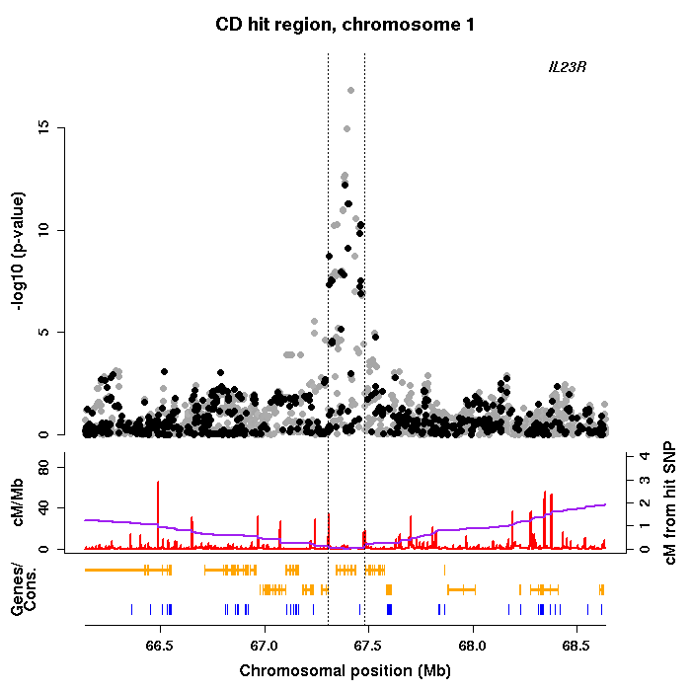
Imputation
a g a g t t g a g g g a a c c t g a g a a
t g a g a c g a g g g a a a t t g a g a c
t g c g a c g g t g a t t c t c c a g a c
a g c g a c g a t g g t a c t t g a t c a
t a a g t t a g t a a t t c c c g a g c a
t g c a a t g a g g g a a a t t g t t a a
a g a g a c g g g g g a a a t t c t g c c
GWAS of imputed genotypes
Increased power
Better resolution
Facilitates meta-analysis
a g a g t a g a g g g t a c t t g a t c a
t g c g a c g g t g a t t c t t c t g c c
t a a a a t g a g g g a a a t t g t t a a
t g a g a c g a g g g a a c c c g a g c a
a g c g a c g a t g g t a a t t c t g c c
a g a g a c g a g g g a a c c t g a g a a
t g c a a t g a g g g a a a t t g a g a c
t a a g t t a g t a a t t c c t g a t c a
Slide from Jonathan Marchini

Slide 42

https://imputationserver.readthedocs.io/en/latest/reference-panels/

Slide 43
Ways to increase power
Increase sample size

Slide 44
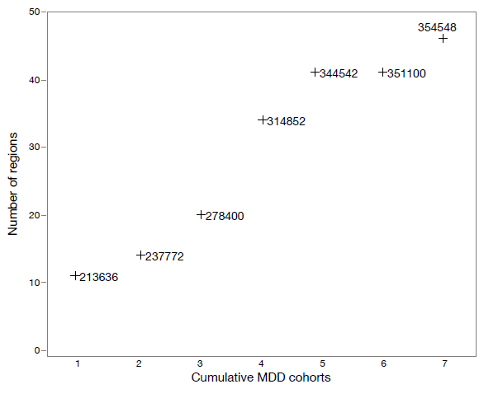
Larger samples lead to more SNP discovery
Results of GWA meta-analysis of seven cohorts for MDD. (a) Relation between adding cohorts and number of genome-wide significant genomic regions. Beginning with the largest cohort (1), added the next largest cohort (2) until all cohorts were included (7). The number next to each point shows the total effective sample size.

Slide 45
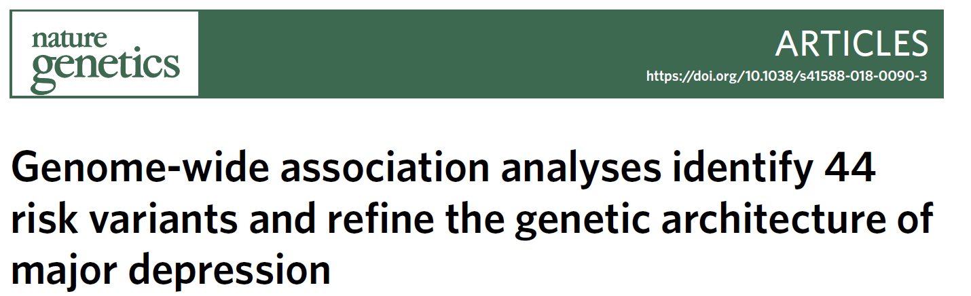
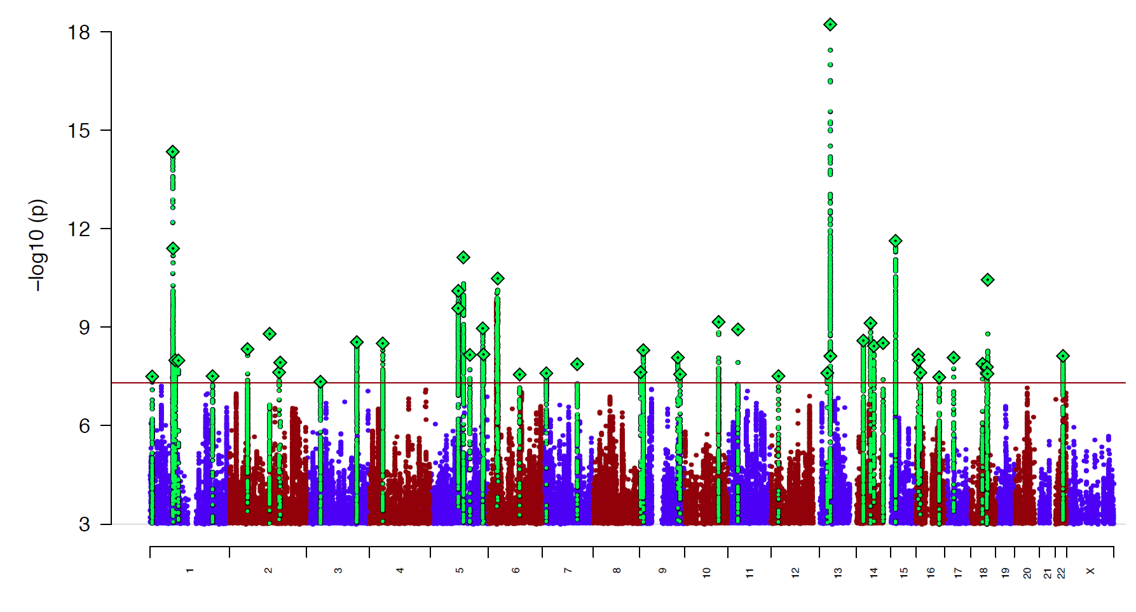
Depression : 135K MDD Cases and 345K Controls
44 hits
Nat Genet. 2018 May;50(5):635-637.
Led by Naomi Wray

Slide 46
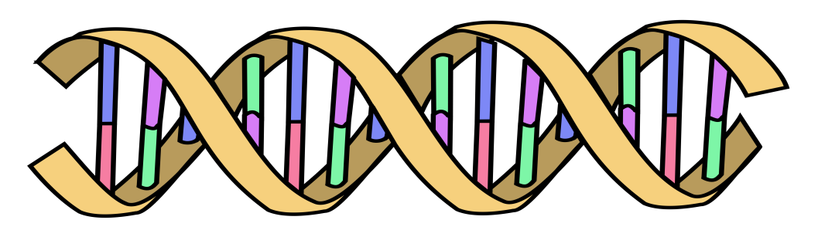
Polygenic Risk Scores
Polygenic Risk Scores capture (part of) someone’s genetic “risk” by summing all risk alleles weighted by the effect sizes estimated in a Genome-Wide Association Study (GWAS)
1×-.02 + 2×.01 + 1×.002 + 0×.03 + 2×.025
Polygenic score:
AC
CC
TT
.052
GG
AT
Effect sized from GWAS
β_{C}=-.02
β_{G}=.01
β_{A}=.002
β_{G}=.03
β_{T}=.025
Wray, Visscher, Goddard, 2007 – Oz!

Slide 47
MDD Polygenic Risk Score predicts risk in independent samples
Odd ratios of MDD per PRS decile relative to the first decile for iPSYCH and anchor cohorts.
Interdecile risk ~2.5

Slide 48
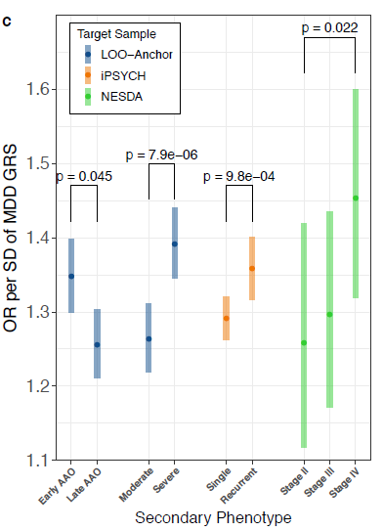
MDD Polygenic Risk Score predicts age at onset, recurrence, and severity
in independent samples
MDD PRS (from out-of-sample discovery sets) were significantly higher in MDD cases with:
earlier age at onset; more severe MDD symptoms (based on number of criteria endorsed)
recurrent MDD compared to single episode
chronic/unremitting MDD (“Stage IV” compared to “Stage II”, first-episode MDD)
Error bars represent 95% CI

Slide 49
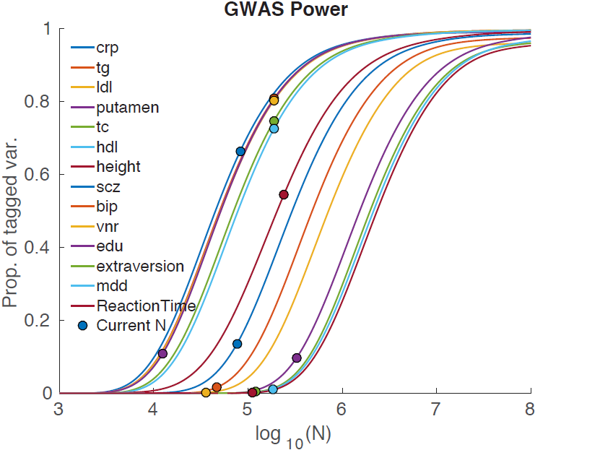
MDD
Holland et al. 2017, biorXiv

Slide 50
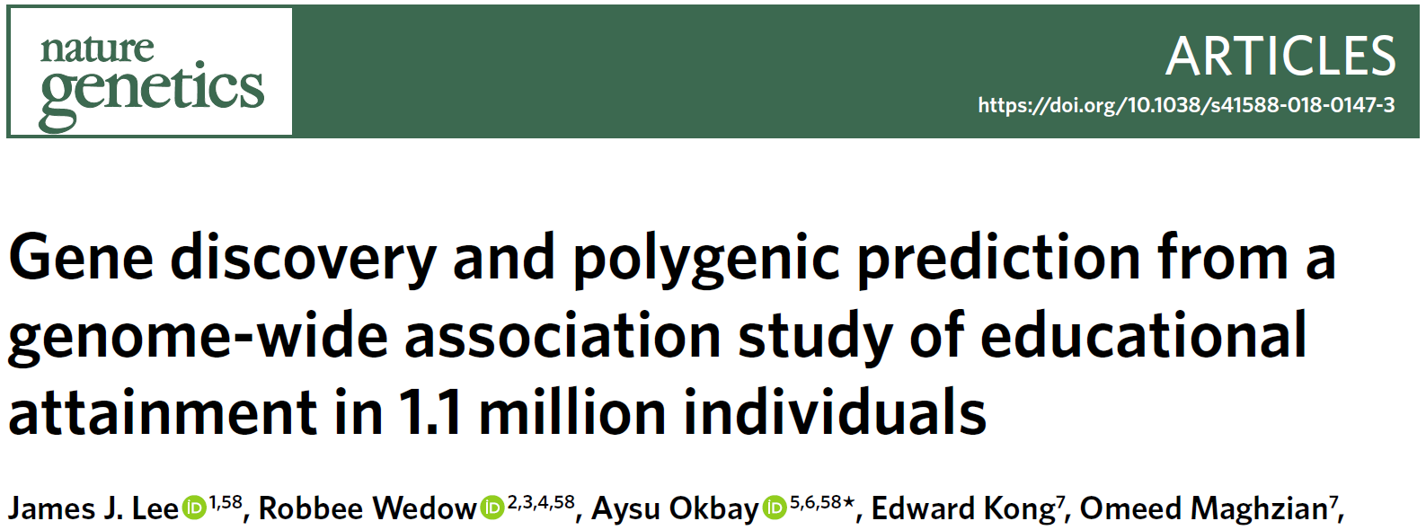
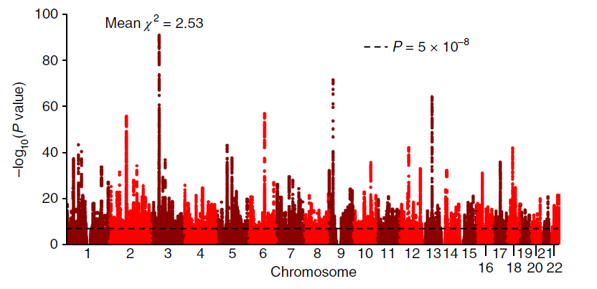
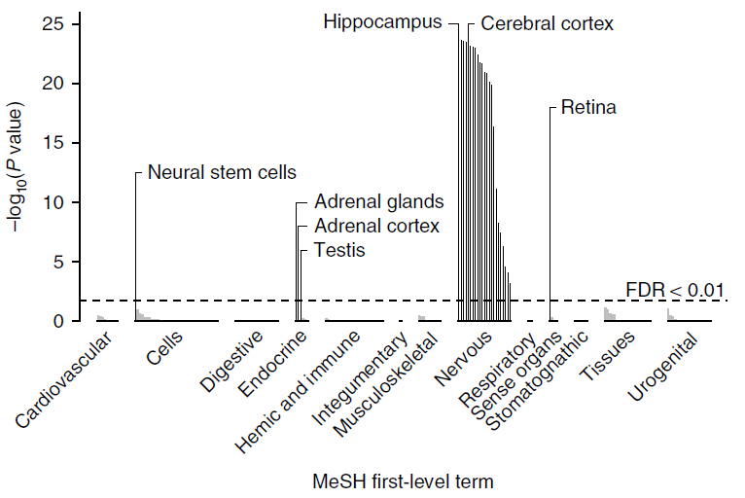
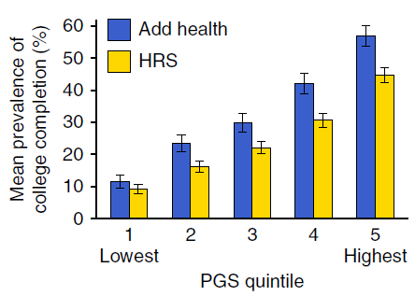
1,271 independent GWS SNPs
implicate genes involved in brain-development processes and neuron-to-neuron communication
polygenic scores explain 11–13% of the variance in educational attainment and 7–10% of the variance in cognitive performance.
Nat Genet. 2018 Aug;50(8):1112-1121

Slide 52
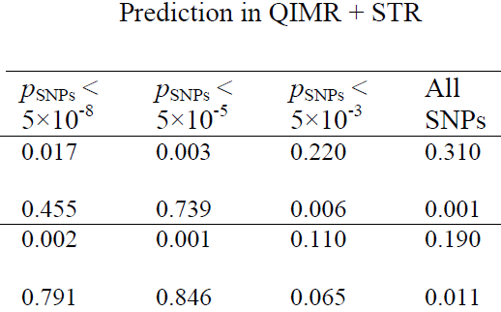
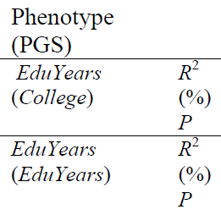
The value of DZ twins for within-pair association tests for ruling out population stratification
Within-family regression results of the polygenic scores on College and EduYears in the QIMR and Swedish Twin Registry cohorts using SNPs selected from the meta-analysis excluding the QIMR and STR cohorts.
Analyses for QIMR are based on 572 full-sib pairs from independent 572 families. Analyses for STR are based on 2,774 DZ twins from 2,774 independent families.
Science. 2013 Jun 21;340:1467-71

Slide 53
Ways to increase power
Refine the phenotype

Slide 54
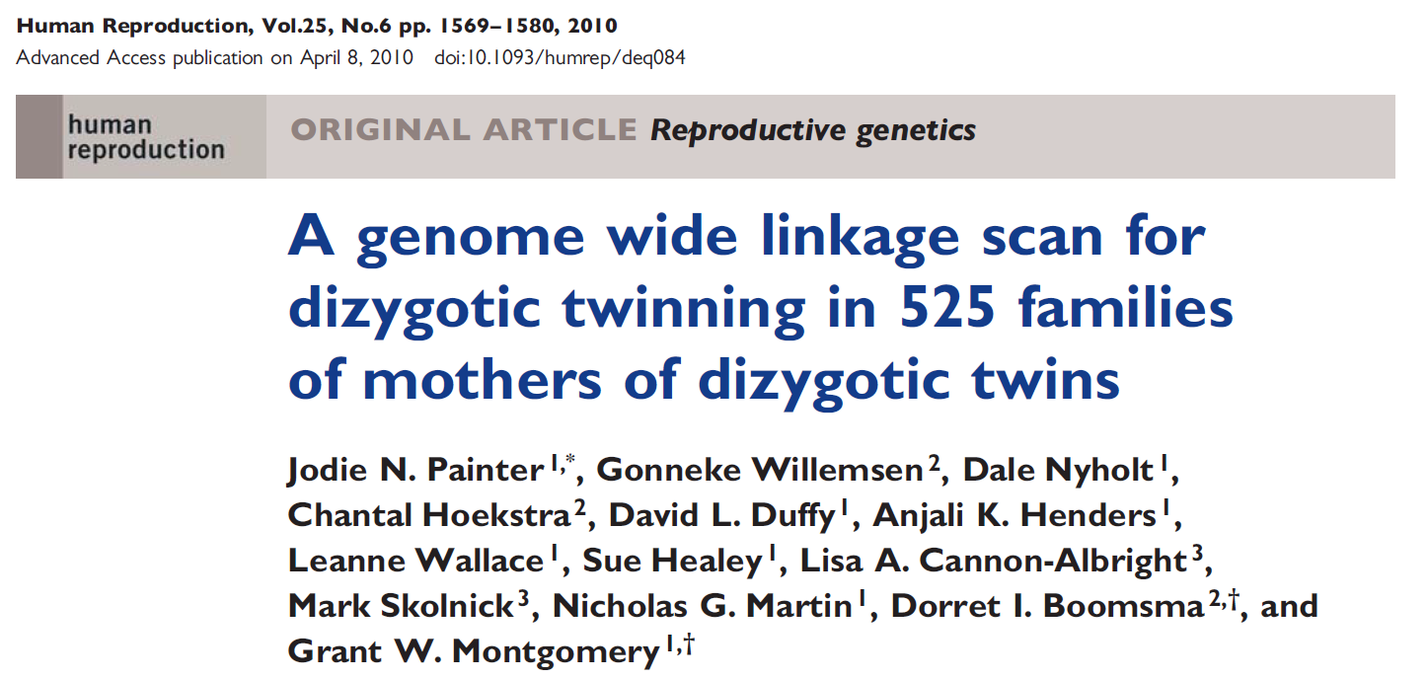


Slide 55
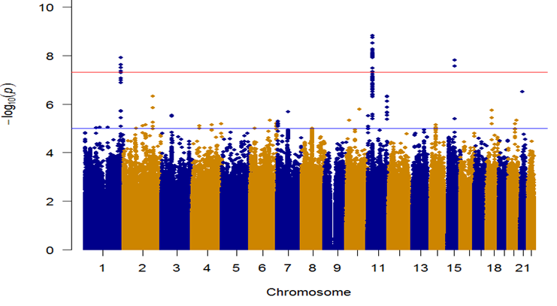
The importance of accurate phenotyping: GWAS for Being a Mother of DZ Twins - Before and after removing mothers who had used assisted reproductive technology
Hamdi Mbarek
SNP 1, P=1.22E-08
SNP 2, P=1.53E-09
SNP 3, P=1.563E-08

Slide 56
Ways to increase power
Combine related phenotypes

Slide 57
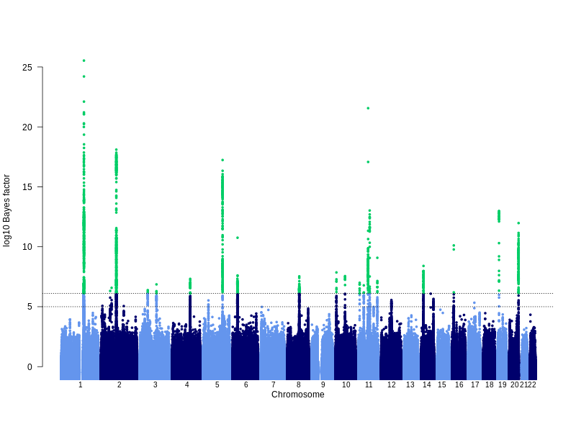
GWAS for eczema (21k cases, 98k controls, 27 hits)
Lavinia Paternoster
Notes:
Manhattan plot showing results of the trans-ethnic meta-analysis.
Explain bayes factor and cut-off equivalent to p-value 5x10-8

Slide 58
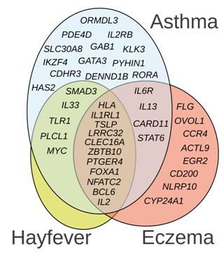
Risk factors overlap
(Thomsen 2006; van Beijsterveldt 2007)
ENVIRONMENTAL risk factors:
20% to 70% shared
COMMON TRIGGERS
GENETIC risk factors:
40% to 60% shared
COMMON MOLECULAR MECHANISMS
Manuel Ferreira

Slide 59
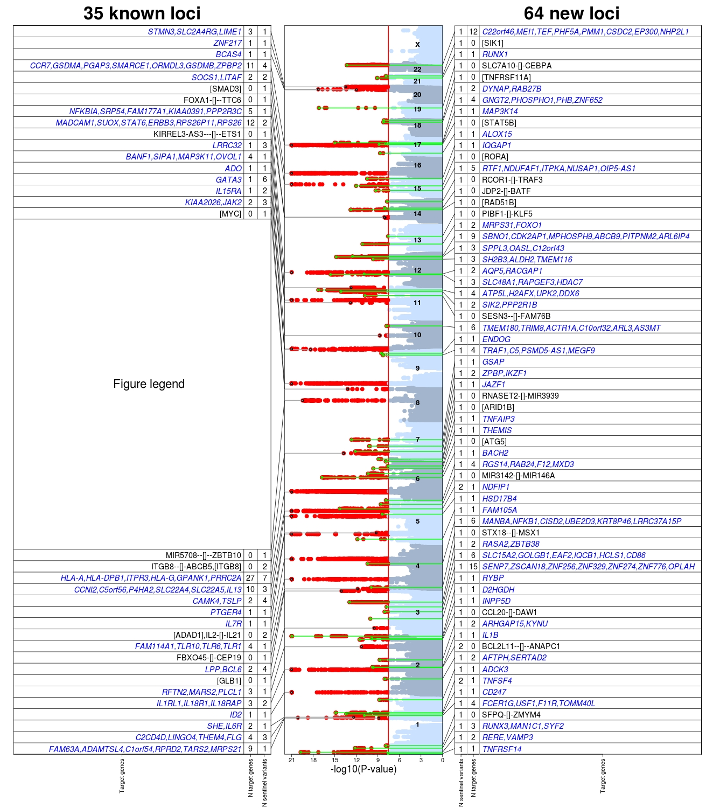
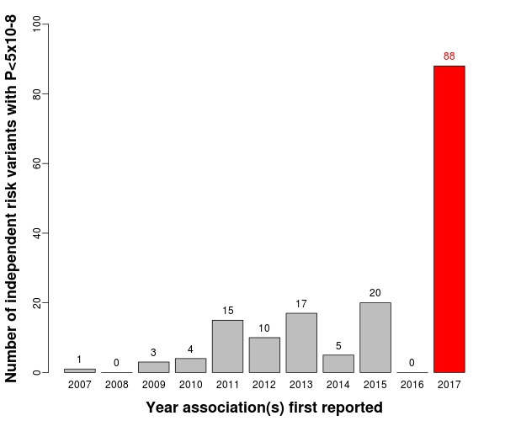
Manuel Ferreira

Slide 60
Ways to increase power
Use ungenotyped relatives as proxy cases (GWAX)

Slide 61
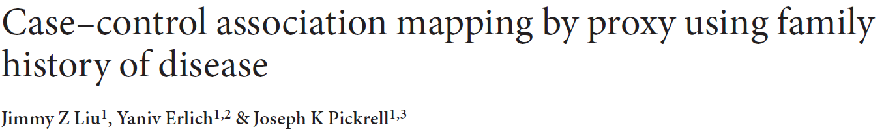
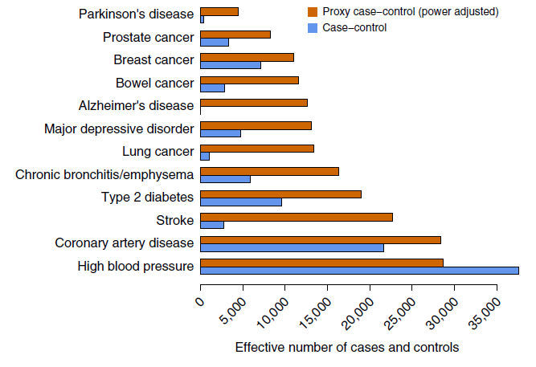
(GWAX)
For late-onset or rapidly lethal diseases it may be more practical to identify family members of cases.

Slide 62
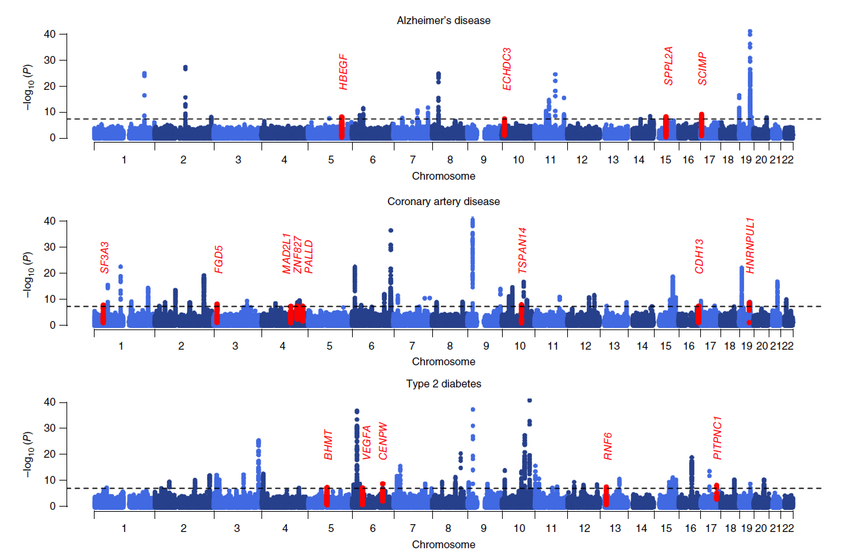
Meta-analysis results for GWAX + case-control studies
New hits are shown in red

Slide 63
Applications of GWAS
Investigate genetic correlation
The genetics of nurture
Direction of causation

Slide 64
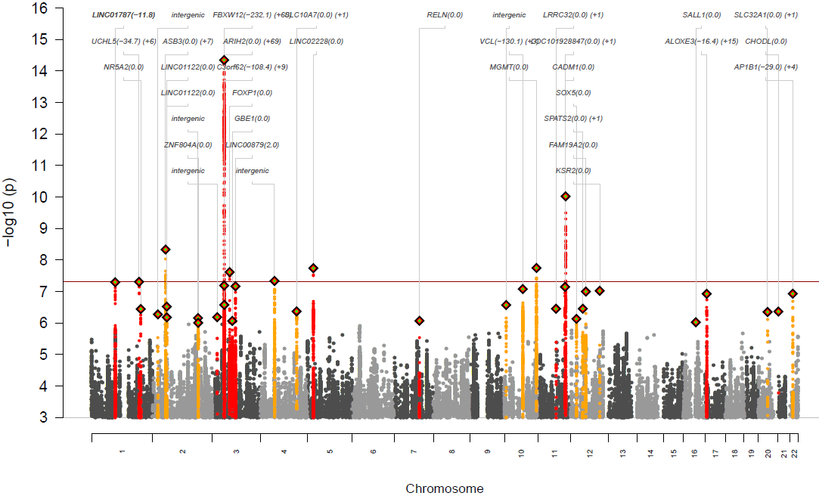
GWAS meta-analysis of anorexia nervosa (16,991 cases and 56,059 controls)

Slide 65
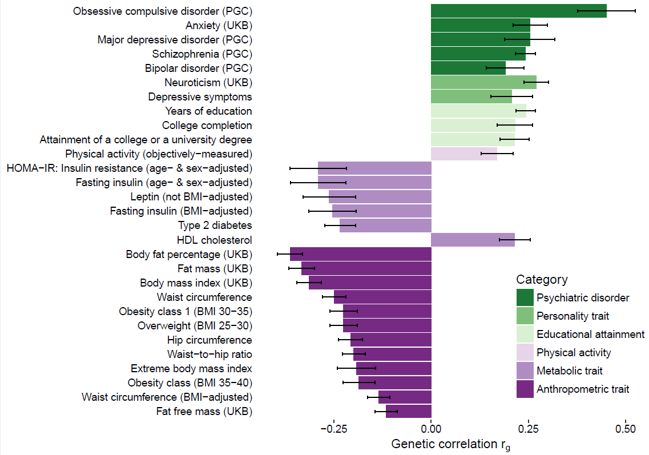
Significant genetic correlations (SNP-Rg) and 95% confidence intervals (error bars) between anorexia nervosa and traits, as estimated by LD score regression

Slide 66

The nature of nurture: Effects of parental genotypes
Augustine Kong ………..Kari Stefansson
Nontransmitted alleles can affect a child through their impacts on the parents and other relatives, a phenomenon we call “genetic nurture.” Using results from a meta-analysis of educational attainment, we find that the polygenic score computed for the nontransmitted alleles of 21,637 probands with at least one parent genotyped has an estimated effect on the educational attainment of the proband that is 29.9% (P = 1.6 × 10⁻¹⁴) of that of the transmitted polygenic score.

Slide 67

Detection and interpretation of shared genetic influences on 42 human traits
Joseph K Pickrell, Tomaz Berisa, Jimmy Z Liu, Laure Ségurel, Joyce Y Tung & David A Hinds.
Nature Genetics 48; 709–717, 2016
Powerful GWAS for traits A and B can help determine direction of causation

Slide 68
Pushing power to the limit
Search for rare variants

Slide 69

used an ExomeChip11 to test the association between 241,453 variants (of which 83% are coding variants with a MAF ≤ 5%) and adult height variation in 711,428 individuals (discovery and validation sample sizes were 458,927 and 252,501, respectively)
The ExomeChip is a genotyping array designed to query in very large sample sizes coding variants identified by whole-exome DNA sequencing of approximately 12,000 participants

Slide 70


Slide 71


NATURE | VOL 562 | 11 OCTOBER 2018

Slide 72
Mouth ulcers in UK BioBank n > 461k, 97 variants

Slide 73

Mendelian gene discovery

Slide 74
Translation of GWAS results
Find the causal variant that is actionable

Slide 75

Schizophrenia: meta-analysis of 49 case control samples (34,241 cases and 45,604 controls)
JULY 2014
128 independent SNPs
(P<5e-8, r²<0.1, 3Mb windows)
108 different regions (conservative)
2 4 J U LY 2 0 1 4 | VO L 5 1 1 | N AT U R E | 4 2 1

Slide 76


From: Decreased Dendritic Spine Density on Prefrontal Cortical Pyramidal Neurons in Schizophrenia
Arch Gen Psychiatry. 2000;57(1):65-73. doi:10.1001/archpsyc.57.1.65
Basilar dendrites and spines on dorsolateral prefrontal cortex layer 3 pyramidal neurons from normal control subject (A) and 2 subjects with schizophrenia (B and C). The calibration bar equals 10 µm.

Slide 77



Slide 78



Slide 79


Schematic of the findings and model of Sekar et al.4. Careful refinement of the schizophrenia GWAS locus in the MHC revealed that structural alleles of the C4 locus increase schizophrenia risk. These structural alleles increase C4A RNA levels in human brain, which predict a subsequent increase in C3, increasing synaptic pruning. A mouse knockout of C4 demonstrated that C3 levels decreased and synaptic pruning in the visual system was disrupted, which may be consistent with the model whereby an increase in human C4A expression results in increased synaptic pruning in schizophrenia. Points of potential convergence of other influences that may increase risk for this complex condition, such as environment and other genetic influences, are also indicated.

Slide 80


Statin use significantly higher in patients given genetic risk score than conventional risk score

Slide 81


% Population at >3fold increased risk
CAD 8.0%,
atrial fibrillation 6.1%
type 2 diabetes 3.5%
IBD 3.2%
breast cancer 1.5%
“We propose that it is time to contemplate the inclusion of polygenic risk prediction in clinical care... “
Published online 14/8/18

Slide 82


Compared with women in the middle quintile, those in the highest 1% of risk had 4.37- and 2.78-fold risks, and those in the lowest 1% of risk had 0.16- and 0.27-fold risks, of developing ER-positive and ER-negative disease, respectively. This PRS is a
powerful and reliable predictor of breast cancer risk that may improve breast cancer prevention programs.
American Journal of Human Genetics 104, 21–34, January 3, 2019

Slide 83


“We estimate that selecting genetically supported targets could double the success rate in clinical development. Therefore, using the growing wealth of human genetic data to select the best targets and indications should have a measurable impact on the successful development of new drugs.”

Slide 84

We also run two journals (1)
Editor: John Hewitt
Editorial assistant Christina Hewitt
Publisher: Kluwer /Plenum
Fully online
http://www.bga.org

Slide 85

Editor: Nick Martin
Publisher: Cambridge University Press
Fully online
Fast turnaround
First submission free to workshop participants!!!!!☺

Slide 86

Charcot-Marie-Tooth disease: > 1000 Mendelian mutations identified in 85+ genes
Timmerman …….Zuchner Hum. Genet 2014

