Slide 1
Introduction to sequencing
Hilary Martin
Wellcome Sanger Institute
Hinxton (near Cambridge), UK

Slide 2
Plan for lecture
The sequencing revolution
Technical aspect of sequencing studies
  Coverage
  Exomes versus genomes
  Alignment
  Variant calling
  Quality control
  Contamination
Variant consequences and annotation
Interpretation of de novo mutations
Importance of well-matched controls

Slide 3
Human genome project
Public effort - 1990-2003; $3 billion; hierarchical shotgun (“clone by clone”)
Private effort (Celera) – 1998-2001; $300 million; whole-genome shotgun
Both produced chimeric assemblies of multiple people
Hierarchical shotgun sequencing
Whole-genome shotgun sequencing
Notes:
The HGP uses a "hierarchical shotgun" (or "clone by clone") approach in which individual large DNA fragments of known position are subjected to shotgun sequencing (i.e., shredded into small fragments that are sequenced, and then reassembled on the basis of sequence overlaps).
The hierarchical shotgun method has an advantage in that the global location of each individual sequence is known with certainty, but it requires constructing a map large fragments covering the genome.
The Celera project uses a "whole genome shotgun" approach developed by Dr. Venter, in which the entire genome is shredded into small fragments that are sequenced and put back together on the basis of sequence overlaps.
The whole genome shotgun strategy involves breaking the entire genome into several hundred thousand random clones.
After sequencing each clone, Celera then reassembles the sequences of several hundred thousand fragments into their proper order using pattern-recognition software.

Slide 4
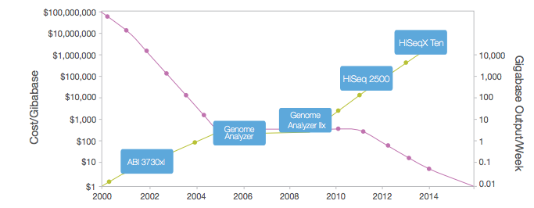
Cost of sequencing
Reminder: human genome 3 Gigabases
Due to errors, we tend to sequence 20-30X to obtain high quality sequence i.e. 60-90Gb → currently ~$1000/genome
https://www.illumina.com/content/dam/illumina-marketing/documents/products/illumina_sequencing_introduction.pdf

Slide 5
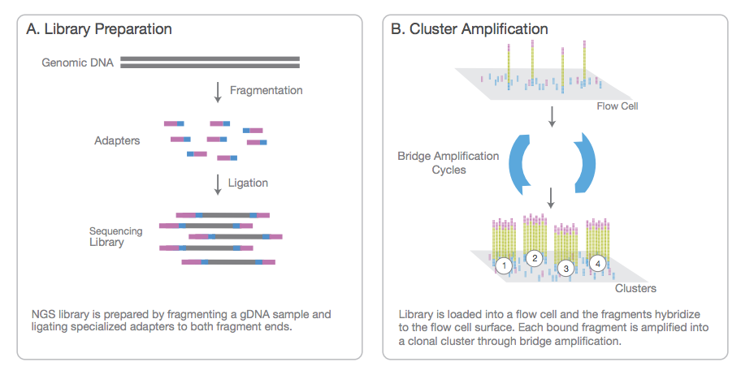
Illumina sequencing

Slide 6
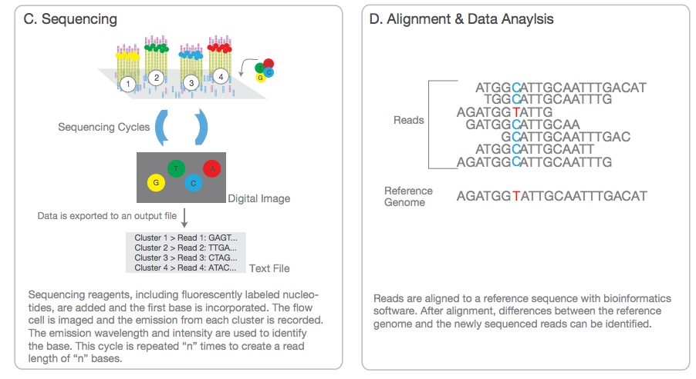
Illumina sequencing

Slide 7
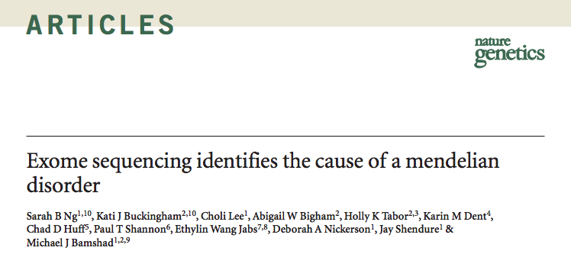
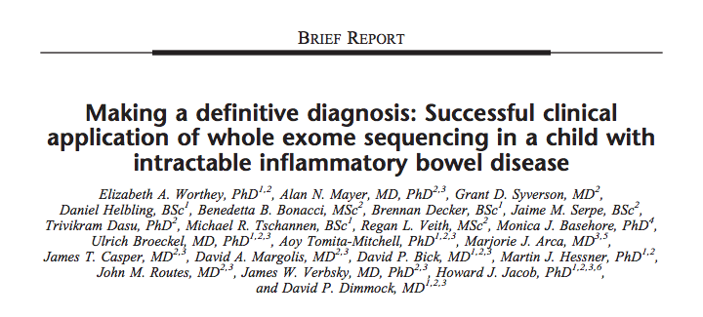
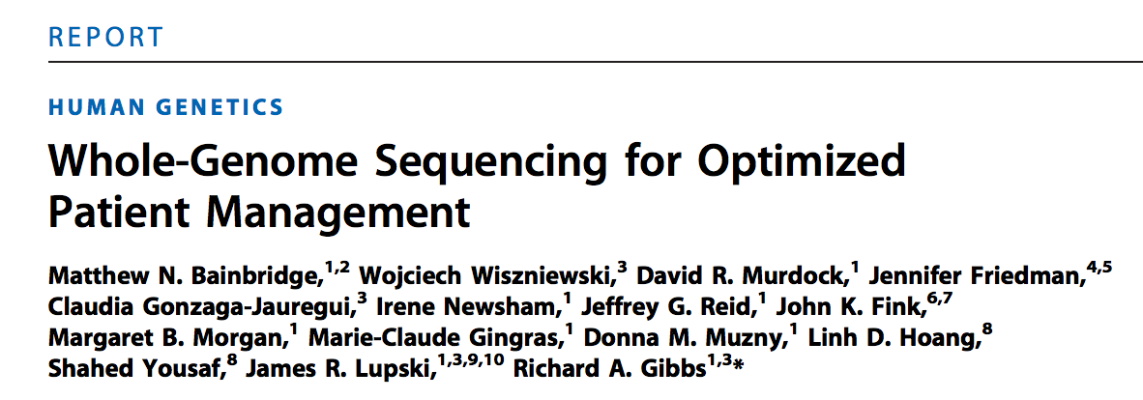
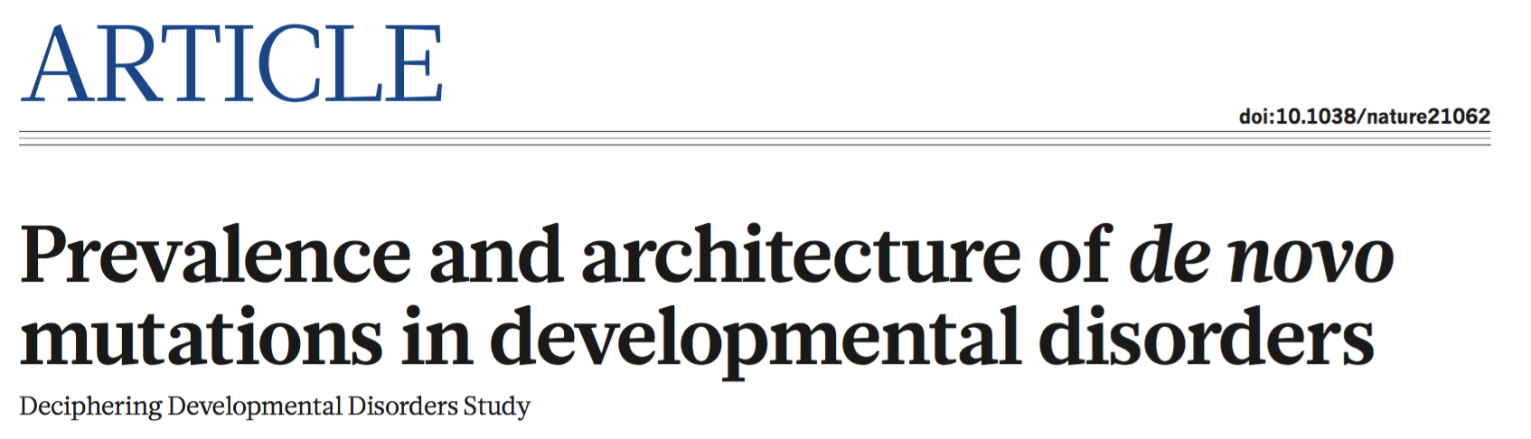
Direct sequencing has enormous potential

Slide 8
…and tremendous challenges
Managing and processing vast quantities of data into variation
Interpreting millions of variants per individual
  An individual’s genome harbors:
    ~100,000 exonic variants
    ~80 point nonsense (loss-of-function) mutations
    ~100-200 frameshift mutations
    Tens of splice site mutations, CNV-induced gene disruptions
For very few of these do we have any conclusive understanding
of their medical impact in the population

Slide 9
Plan for lecture
The sequencing revolution
Technical aspect of sequencing studies
  Coverage
  Exomes versus genomes
  Alignment
  Variant calling
  Quality control
  Contamination
Variant consequences and annotation
Interpretation of de novo mutations
Importance of well-matched controls

Slide 10
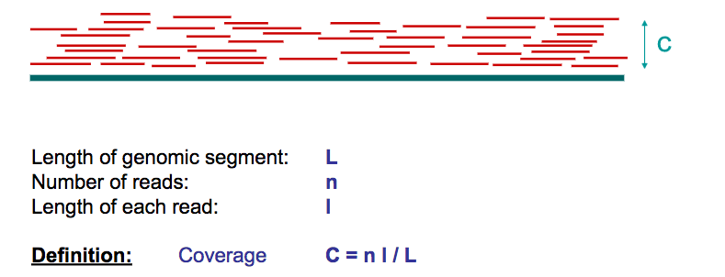
Coverage
Coverage (or depth) is the average number of reads that include a given nucleotide in the reconstructed sequence.
Typically use 20-30X coverage to obtain high-quality sequence for human genomes.
For some purposes, even very low-coverage sequencing (4X, 1X, 0.2X!) is useful.

Slide 11
Why do we need >1X (or >2X) coverage?
Humans are diploid – number of reads covering each allele follows a binomial distribution
Need to distinguish real variants from sequencing errors, especially since some errors are systematic.

Slide 12
Plan for lecture
The sequencing revolution
Technical aspect of sequencing studies
  Coverage
  Exomes versus genomes
  Alignment
  Variant calling
  Quality control
  Contamination
Variant consequences and annotation
Interpretation of de novo mutations
Importance of well-matched controls

Slide 13
Technologies for sequencing humans
 | Whole-genome sequencing (WGS) | Whole-exome sequencing (WES)
Amount of sequence | 3Gb | 30Mb
Typical coverage | 30X (for high quality) | Average 60-180X
Library preparation | Randomly shear, then do hybridisation-based capture of exonic DNA fragments | Shotgun sequence - randomly shear and capture
Advantages | Covers (most of) the whole sequence (fairly) unbiased ascertainment | Cheaper ($200-300) Focuses on coding regions
Disadvantages | expensive (~$1000 for 30X) too expensive to do at very high coverage | Uneven coverage, biases Harder to call large copy number variants
Common applications | Reference panels for imputation Complex traits | Mendelian diseases Interrogate rare coding variants in complex traits

Slide 14
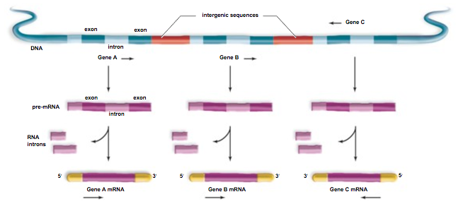
The exome
Exome = all the exons (bits of the genome that encode proteins)

Slide 15
Targeted exome capture
Hybridisation to oligonucleotide probes attached to magnetic beads
Bamshad et al., Nature Review Genetics, 2011
Notes:
Exome sequencing as a tool for Mendelian disease gene discovery
Michael J. Bamshad, Sarah B. Ng, Abigail W. Bigham, Holly K. Tabor, Mary J. Emond, Deborah A. Nickerson & Jay Shendure
Nature Reviews Genetics 12, 745-755 (November 2011)

Slide 16
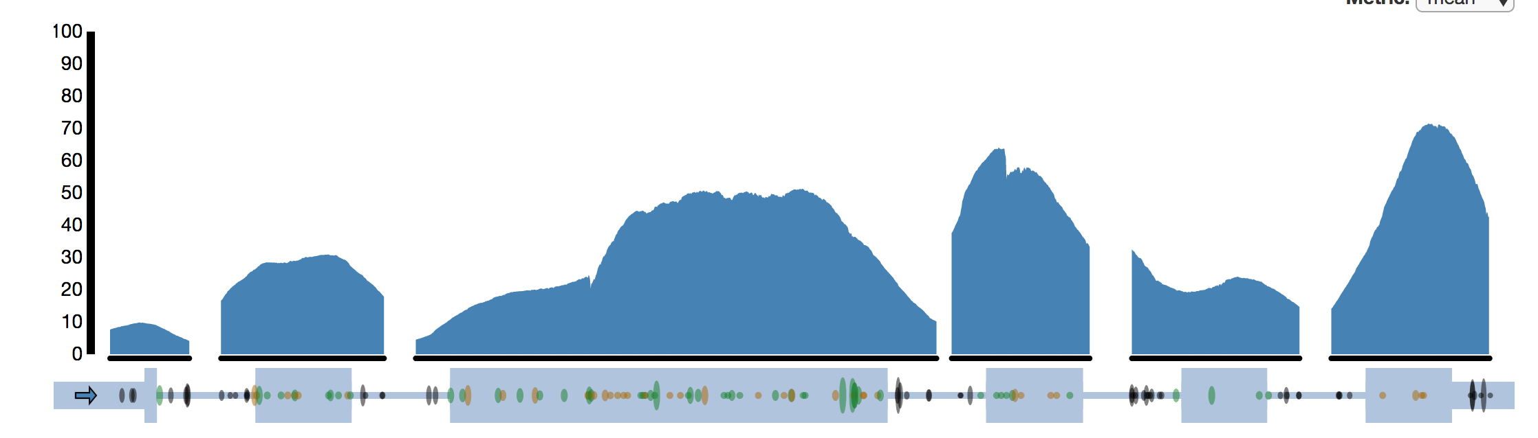
Variable coverage in exome sequencing
Reference bias: we tend to observe more reads mapping to the reference allele than the alternate allele
WES shows a greater reference bias than WGS (53% versus 50.3%) – due to capture probes as well as mapping bias

Slide 17
Depth considerations
Mendelian disease - need high coverage to be sure rare/de novo variants are real (20-30X WGS, or >60X WES)
Complex disease
  High coverage needed to interrogate rare variants – 15X now considered to get a good balance between sensitivity and specifitiy
  Low coverage may still be useful to study common variants (genotypes can be improve by imputation)
Imputation reference panel – want large number of haplotypes, low coverage sufficient for common variants
Somatic mutations – variants in <<50% of reads, so need high coverage (often >100X for tumours)

Slide 18
Plan for lecture
The sequencing revolution
Technical aspect of sequencing studies
  Coverage
  Exomes versus genomes
  Alignment
  Variant calling
  Quality control
  Contamination
Variant consequences and annotation
Interpretation of de novo mutations
Importance of well-matched controls

Slide 19
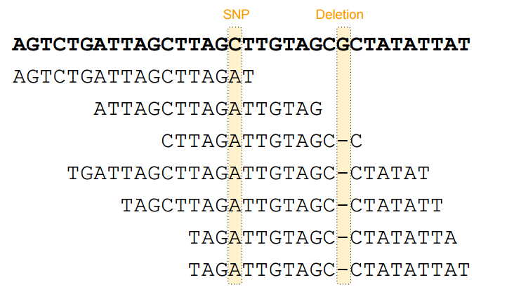
Step 1: Aligning to a reference
Torsten Seemann
Notes:
Torsten Seemann

Slide 20
Finding the true origin of each read is a computationally demanding and important first step
Region 1
Region 2
Region 3
Reference genome
Mapping and alignment algorithm
Detects correct read origin and flags them with high certainty
Enormous pile of short reads from NGS
Detects ambiguity in the origin of reads and flags them as uncertain
Many different alignment programs
Commonly used aligner: BWA-MEM (Li and Durbin) - robust, accurate ‘gold standard’
SAM/BAM/CRAM files
Ben Neale

Slide 21
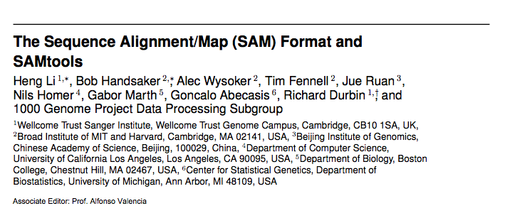
The SAM/BAM/CRAM file format
file format was designed to capture all of the critical information about next-generation sequencing data in a single indexed and compressed file
contains read sequence, base quality scores, location of alignments, differences relative to reference sequence, MAPQ
has enabled sharing of data across centers and the development of tools that work across platforms
more info at http://samtools.sourceforge.net/
BAM and CRAM files are compressed versions of SAM
Ben Neale

Slide 22
Repeats cause problems with sequence data
Simple repeats
Paralogs resulting from genome duplication
Repeated domains found in many different proteins
Reference: TAGTAGTAGTAGTAGTAGTAGTAGT
Where to put the read TAGTAGTAGT ?
Treangen and Salzberg, Nat. Rev, Genet., 2011
Notes:
Difficult or impossible to know which copy of the repeat the read comes from – can lead to mis-mapping or regions that are impossible to map to uniquely

Slide 23
Mapping quality
quantifies the probability that a read is misplaced
depends on base quality scores at mismatched bases, and also how many other possible mappings there are throughout the genome
Notes:
Important metric the quantifies the probability that a read is misplaced
depends on base quality scores at mismatched bases, and also how many other possible mappings there are throughout the genome

Slide 24
Plan for lecture
The sequencing revolution
Technical aspect of sequencing studies
  Coverage
  Exomes versus genomes
  Alignment
  Variant calling
  Quality control
  Contamination
Variant consequences and annotation
Interpretation of de novo mutations
Importance of well-matched controls

Slide 25
Variant calling
The process of ascertaining variants (SNPs, indels, copy number variants, structural variants) in the mapped sequencing reads, and genotyping individuals at those variants

Slide 26
The Genome Analysis Toolkit (GATK)
toolkit for processing sequence data (post-alignment), calling and filtering variants
supports any BAM-compatible aligner
many tools developed in GATK: base quality score recalibration, HaplotypeCaller, multi-sample genotyping, variant filtering, variant quality score recalibration
memory and CPU efficient, cluster friendly and are easily parallelized
being used at many sites around the world
More info: http://www.broadinstitute.org/gsa/wiki/
Ben Neale

Slide 27
Variant Call Format (VCF)
Reference
Allele
Alternate
Allele
Variant quality Score
Filter
Chromosome
Position
SNP ID
#CHROM | POS | ID | REF | ALT | QUAL | FILTER
chr8 | 1952745 | rs2272608 | C | T | 771045 | PASS
chr8 | 3219437 | rs28455997 | T | C | 153017 | PASS
N.B. differs from A1/A2 on genotyping chips, or minor/major allele
INFO
AC=1;AF=0.125;AN=6;BaseQRankSum=0.124;ClippingRankSum=0;DP=200767;ExcessHet=0.0003; FS=1.214;InbreedingCoeff=0.0426;MLEAC=2036;MLEAF=0.125;MQ=60;MQRankSum=0; QD=16.95;ReadPosRankSum=0.048;SOR=0.837
AC=2;AF=0.078;AN=6;BaseQRankSum=0;ClippingRankSum=0;DP=53124;ExcessHet=0;FS=0; InbreedingCoeff=0.0555;MLEAC=1306;MLEAF=0.081;MQ=59.69;MQRankSum=0;QD=18.37; ReadPosRankSum=0;SOR=0.667
INFO field contains meta-data about the variant
AC, AF, AN = allele count [of the ALT allele], allele frequency, allele number
DP: Approximate read depth across all individuals (N.B. in this case, there were ~8000 individuals in the original VCF)
More on the other variant-level quality metrics in the next few slides
Notes:
Similar to the VCF output from minimac3 seen in the imputation prac, except these are genotypes from sequence data
##INFO=<ID=AC,Number=A,Type=Integer,Description="Allele count in genotypes, for each ALT allele, in the same order as listed”
##INFO=<ID=AF,Number=A,Type=Float,Description="Allele Frequency, for each ALT allele, in the same order as listed"> ##INFO=<ID=AN,Number=1,Type=Integer,Description="Total number of alleles in called genotypes"> ##INFO=<ID=BaseQRankSum,Number=1,Type=Float,Description="Z-score from Wilcoxon rank sum test of Alt Vs. Ref base qualities">
##INFO=<ID=ClippingRankSum,Number=1,Type=Float,Description="Z-score From Wilcoxon rank sum test of Alt vs. Ref number of hard clipped bases">
##INFO=<ID=DP,Number=1,Type=Integer,Description="Approximate read depth; some reads may have been filtered">
##INFO=<ID=DS,Number=0,Type=Flag,Description="Were any of the samples downsampled?"> ##INFO=<ID=END,Number=1,Type=Integer,Description="Stop position of the interval"> ##INFO=<ID=ExcessHet,Number=1,Type=Float,Description="Phred-scaled p-value for exact test of excess heterozygosity"> ##INFO=<ID=FS,Number=1,Type=Float,Description="Phred-scaled p-value using Fisher's exact test to detect strand bias"> ##INFO=<ID=HaplotypeScore,Number=1,Type=Float,Description="Consistency of the site with at most two segregating haplotypes">
##INFO=<ID=InbreedingCoeff,Number=1,Type=Float,Description="Inbreeding coefficient as estimated from the genotype likelihoods per-sample when compared against the Hardy-Weinberg expectation"> ##INFO=<ID=MLEAC,Number=A,Type=Integer,Description="Maximum likelihood expectation (MLE) for the allele counts (not necessarily the same as the AC), for each ALT allele, in the same order as listed"> ##INFO=<ID=MLEAF,Number=A,Type=Float,Description="Maximum likelihood expectation (MLE) for the allele frequency (not necessarily the same as the AF), for each ALT allele, in the same order as listed"> ##INFO=<ID=MQ,Number=1,Type=Float,Description="RMS Mapping Quality"> ##INFO=<ID=MQRankSum,Number=1,Type=Float,Description="Z-score From Wilcoxon rank sum test of Alt vs. Ref read mapping qualities">
##INFO=<ID=QD,Number=1,Type=Float,Description="Variant Confidence/Quality by Depth"> ##INFO=<ID=RAW_MQ,Number=1,Type=Float,Description="Raw data for RMS Mapping Quality"> ##INFO=<ID=ReadPosRankSum,Number=1,Type=Float,Description="Z-score from Wilcoxon rank sum test of Alt vs. Ref read position bias">
##INFO=<ID=SOR,Number=1,Type=Float,Description="Symmetric Odds Ratio of 2x2 contingency table to detect strand bias">

Slide 28

Variant Call Format (VCF)
Reference
Allele
Alternate
Allele
Variant quality Score
Filter
Chromosome
Position
SNP ID
#CHROM | POS | ID | REF | ALT | QUAL | FILTER
chr8 | 1952745 | rs2272608 | C | T | 771045 | PASS
chr8 | 3219437 | rs28455997 | T | C | 153017 | PASS
INFO
AC=1;AF=0.125;AN=6;BaseQRankSum=0.124;ClippingRankSum=0;DP=200767;ExcessHet=0.0003; FS=1.214;InbreedingCoeff=0.0426;MLEAC=2036;MLEAF=0.125;MQ=60;MQRankSum=0; QD=16.95;ReadPosRankSum=0.048;SOR=0.837
AC=2;AF=0.078;AN=6;BaseQRankSum=0;ClippingRankSum=0;DP=53124;ExcessHet=0;FS=0; InbreedingCoeff=0.0555;MLEAC=1306;MLEAF=0.081;MQ=59.69;MQRankSum=0;QD=18.37; ReadPosRankSum=0;SOR=0.667
FORMAT | person1 | person2 | person3
GT:AD:DP:GQ:PL | 0/0:27,0:27:81:0,81,1070 | 0/1:17,14:31:99:449,0,613 | 0/0:31,0:31:87:0,87,1305
GT:AD:DP:GQ:PL | 0/0:11,0:11:21:0,21,315 | 0/1:2,2:4:71:71,0,71 | 0/1:2,7:9:52:187,0,52
FORMAT field indicates the structure of the GENOTYPE fields
GT: genotype (0/0, 0/1, 1/1); AD: allele depth (ref, alt), DP (depth)
PL: normalized, phred-scaled likelihoods for genotypes; GQ: genotype quality
Notes:
Phred-scaled likelihood scaled so the most likely genotype has a value of 0
Genotype quality is the the difference between the most likely and second most likely genotype – we want this to be high; a typical filter is >20 or >30
##FORMAT=<ID=AD,Number=R,Type=Integer,Description="Allelic depths for the ref and alt alleles in the order listed"> ##FORMAT=<ID=DP,Number=1,Type=Integer,Description="Approximate read depth (reads with MQ=255 or with bad mates are filtered)"> ##FORMAT=<ID=GQ,Number=1,Type=Integer,Description="Genotype Quality"> ##FORMAT=<ID=GT,Number=1,Type=String,Description="Genotype"> ##FORMAT=<ID=MIN_DP,Number=1,Type=Integer,Description="Minimum DP observed within the GVCF block"> ##FORMAT=<ID=PGT,Number=1,Type=String,Description="Physical phasing haplotype information, describing how the alternate alleles are phased in relation to one another"> ##FORMAT=<ID=PID,Number=1,Type=String,Description="Physical phasing ID information, where each unique ID within a given sample (but not across samples) connects records within a phasing group">
##FORMAT=<ID=PL,Number=G,Type=Integer,Description="Normalized, Phred-scaled likelihoods for genotypes as defined in the VCF specification">
##FORMAT=<ID=RGQ,Number=1,Type=Integer,Description="Unconditional reference genotype confidence, encoded as a phred quality -10*log10 p(genotype call is wrong)"> ##FORMAT=<ID=SB,Number=4,Type=Integer,Description="Per-sample component statistics which comprise the Fisher's Exact Test to detect strand bias.">

Slide 29
Multiallelic variants
Multiple alternate alleles are possible at the same site
#CHROM | POS | ID | REF | ALT | QUAL | FILTER
chr1 | 236739260 | . | C | G,T | 4855970 | PASS
INFO
AC=1,1;AF=0.084,0.459;AN=6;BaseQRankSum=-0.428;ClippingRankSum=0;DP=272799; ExcessHet=0;FS=0;InbreedingCoeff=0.0499;MLEAC=1368,7505;MLEAF=0.084,0.46;MQ=60.06;MQRankSum=0;QD=23.01;ReadPosRankSum=0.114;SOR=1.078
FORMAT | person1
GT:AD:DP:GQ:PL | 0/0:38,0,0:38:99:0,99,1374,99,1374,1374
person2 | person3
0/2:20,0,11:31:99:345,404,1078,0,674,641 | 0/1:27,22,0:49:99:668,0,804,747,869,1616
Notes:
##FORMAT=<ID=PGT,Number=1,Type=String,Description="Physical phasing haplotype information, describing how the alternate alleles are phased in relation to one another">
##FORMAT=<ID=PID,Number=1,Type=String,Description="Physical phasing ID information, where each unique ID within a given sample (but not across samples) connects records within a phasing group">

Slide 30
Plan for lecture
The sequencing revolution
Technical aspect of sequencing studies
  Coverage
  Exomes versus genomes
  Alignment
  Variant calling
  Quality control
  Contamination
Variant consequences and annotation
Interpretation of de novo mutations
Importance of well-matched controls

Slide 31
Discovery versus genotyping
In genotype data, we know the variants are real – we just need to work out what individuals’ genotypes are
In sequence data, we also have a discovery problem – which variants are real? – as well as a genotyping problem

Slide 32
Different levels of QC
Sample-level (e.g. number of heterozygous and non-reference homozygous calls, missingness, contamination, number of singletons)
Variant-level (e.g. mapping quality, strand bias, overall depth, Hardy-Weinberg)
Genotype-level (e.g. genotype quality, depth, allele balance)

Slide 33
What filters do we use?
Problem: correlated sequencing errors and mapping artefacts drive false positives (cause loss of power, spurious conclusions)
The following should be random if the sequencing technology is working as expected:
  Strand bias – 5’-to-3’ and 3’-to-5’ reads should give equal representation of alternate allele
  Base quality – ALT and REF base calls should not differ systematically in quality
  Variant position in read
  Allele bias – at heterozygous sites, the number of ALT reads should follow a binomial distribution with p=0.5 (genotype level)
Notes:
Also, some of the processes that give rise to errors in the sequencing are similar to the actual biological processes the drive the production of new mutations

Slide 34
Variant Call Format (VCF)
Reference
Allele
Alternate
Allele
Variant quality Score
Filter
Chromosome
Position
SNP ID
#CHROM | POS | ID | REF | ALT | QUAL | FILTER
chr8 | 1952745 | rs2272608 | C | T | 771045 | PASS
chr8 | 3219437 | rs28455997 | T | C | 153017 | PASS
N.B. differs from A1/A2 on genotyping chips, or minor/major allele
INFO
AC=1;AF=0.125;AN=6;BaseQRankSum=0.124;ClippingRankSum=0;DP=200767;ExcessHet=0.0003; FS=1.214;InbreedingCoeff=0.0426;MLEAC=2036;MLEAF=0.125;MQ=60;MQRankSum=0; QD=16.95;ReadPosRankSum=0.048;SOR=0.837
AC=2;AF=0.078;AN=6;BaseQRankSum=0;ClippingRankSum=0;DP=53124;ExcessHet=0;FS=0; InbreedingCoeff=0.0555;MLEAC=1306;MLEAF=0.081;MQ=59.69;MQRankSum=0;QD=18.37; ReadPosRankSum=0;SOR=0.667
INFO field contains meta-data about the variant
AC, AF, AN = allele count, allele frequency, allele number
DP: Approximate read depth across all individuals (N.B. in this case, there were ~8000 individuals in the original VCF)
FS: Phred-scaled p-value using Fisher's exact test to detect strand bias
BaseQRankSum: Z-score from Wilcoxon rank sum test of Alt Vs. Ref base qualities
ReadPosRankSum: Z-score from Wilcoxon rank sum test of Alt vs. Ref read position bias
Notes:
This is just highlighting in blue some of these variant quality score metrics for strand bias, differences in Alternate versus Reference allele base qualities and position within the read
##INFO=<ID=AC,Number=A,Type=Integer,Description="Allele count in genotypes, for each ALT allele, in the same order as listed”
##INFO=<ID=AF,Number=A,Type=Float,Description="Allele Frequency, for each ALT allele, in the same order as listed"> ##INFO=<ID=AN,Number=1,Type=Integer,Description="Total number of alleles in called genotypes"> ##INFO=<ID=BaseQRankSum,Number=1,Type=Float,Description="Z-score from Wilcoxon rank sum test of Alt Vs. Ref base qualities">
##INFO=<ID=ClippingRankSum,Number=1,Type=Float,Description="Z-score From Wilcoxon rank sum test of Alt vs. Ref number of hard clipped bases">
##INFO=<ID=DP,Number=1,Type=Integer,Description="Approximate read depth; some reads may have been filtered">
##INFO=<ID=DS,Number=0,Type=Flag,Description="Were any of the samples downsampled?"> ##INFO=<ID=END,Number=1,Type=Integer,Description="Stop position of the interval"> ##INFO=<ID=ExcessHet,Number=1,Type=Float,Description="Phred-scaled p-value for exact test of excess heterozygosity"> ##INFO=<ID=FS,Number=1,Type=Float,Description="Phred-scaled p-value using Fisher's exact test to detect strand bias"> ##INFO=<ID=HaplotypeScore,Number=1,Type=Float,Description="Consistency of the site with at most two segregating haplotypes">
##INFO=<ID=InbreedingCoeff,Number=1,Type=Float,Description="Inbreeding coefficient as estimated from the genotype likelihoods per-sample when compared against the Hardy-Weinberg expectation"> ##INFO=<ID=MLEAC,Number=A,Type=Integer,Description="Maximum likelihood expectation (MLE) for the allele counts (not necessarily the same as the AC), for each ALT allele, in the same order as listed"> ##INFO=<ID=MLEAF,Number=A,Type=Float,Description="Maximum likelihood expectation (MLE) for the allele frequency (not necessarily the same as the AF), for each ALT allele, in the same order as listed"> ##INFO=<ID=MQ,Number=1,Type=Float,Description="RMS Mapping Quality"> ##INFO=<ID=MQRankSum,Number=1,Type=Float,Description="Z-score From Wilcoxon rank sum test of Alt vs. Ref read mapping qualities">
##INFO=<ID=QD,Number=1,Type=Float,Description="Variant Confidence/Quality by Depth"> ##INFO=<ID=RAW_MQ,Number=1,Type=Float,Description="Raw data for RMS Mapping Quality"> ##INFO=<ID=ReadPosRankSum,Number=1,Type=Float,Description="Z-score from Wilcoxon rank sum test of Alt vs. Ref read position bias">
##INFO=<ID=SOR,Number=1,Type=Float,Description="Symmetric Odds Ratio of 2x2 contingency table to detect strand bias">

Slide 35
Value of simultaneous variant calling in multiple individuals
Sensitivity: greater statistical evidence compiled for true variants seen in >1 individual
Specificity: deviations in metrics that flag false positive sites become much more statistically significant e.g. allele balance, strand bias
Distinguishing missing genotype from homozygous reference
Ben Neale
Notes:
It’s best to do variant calling across multiple samples at once

Slide 36
Variant filtration strategies are still evolving
VQSR is one approach
variant quality score recalibration (VQSR) aims to enable variant filtering in order to balance sensitivity and specificity
uses machine learning to learn the annotation profile of good versus bad variants across a dataset, by integrating information from multiple QC metrics
requires a set of “true sites” as input e.g. HapMap3 sites
calculates log odds ratio of being true variant versus being false under trained Gaussian mixture model - VQSLOD added to INFO field
http://gatkforums.broadinstitute.org/gatk/discussion/39/variant-quality-score-recalibration-vqsr

Slide 37
An important variant-level QC metric
Transition:transversion ratio across the dataset
purines
Transitions (Ti) within purines/pyrimidines
vs transversions (Tv) between them
pyrimidines
transitions are expected to occur twice as frequently as transversions
Ti:Tv is typically ~2 across the whole genome, versus ~3 in protein coding regions
not relevant for genotype data since we know the variants are real
most useful at the individual level, as it changes with sample size (larger sample sizes → more recurrent C>T mutations)
Notes:
Transitions occur more often than transversions because of the high mutability of methylated cytosines, which mutate to thymines spontaneously
Ti:Tv is higher in exomes because because transversions are much more likely to change the encoded amino acid, especially in the third base of a codon, so are less frequenct
MOST INFORMATIVE AT AN INDIVIDUAL LEVEL
Human mutations don't occur randomly. In fact, transitions (changes from A <-> G and C <-> T) are expected to occur twice as frequently as transversions (changes from A <-> C, A <-> T, G <-> C or G <-> T). Thus, another useful diagnostic is the ratio of transitions to transversions in a particular set of SNP calls. This ratio is often evaluated separately for previously discovered and novel SNPs.
Across the entire genome the ratio of transitions to transversions is typically around 2. In protein coding regions, this ratio is typically higher, often a little above 3. The higher ratio occurs because, especially when they occur in the third base of a codon, transversions are much more likely to change the encoded amino acid.
One of the most surprising features of many variant lists in humans is that C->T changes (C reference, T variant) are more frequent than T->C changes. Likewise, G->A changes are more frequent than A->G changes.
At first, this might seem a bit puzzling. For example, perhaps we might expect that the two counts should be extremely similar. However, the reference makes perfect biological sense -- and the explanation below is due to Tom Blackwell.
The major mechanism for new mutations (in warm-blooded animals) is deamination of 5'-methyl C to uracil (equivalently T) producing (C -> T) or, on the complementary strand, (G -> A). This was first studied for CpG dinucleotide sites, but it also occurs at lower rates throughout the genome at any C whether followed by G or not.
More often than not, we expect that the reference genome will include the most common allele, which is also likely to be the ancestral allele. Thus, if C->T mutations are more common than T->C mutations, we expect to see an imbalance of C->T versus T->C changes. Further, when comparing rare and common variants, we expect the imbalance to be stronger for lower frequency variants.

Slide 38
Plan for lecture
The sequencing revolution
Technical aspect of sequencing studies
  Coverage
  Exomes versus genomes
  Alignment
  Variant calling
  Quality control
  Contamination
Variant consequences and annotation
Interpretation of de novo mutations
Importance of well-matched controls

Slide 39
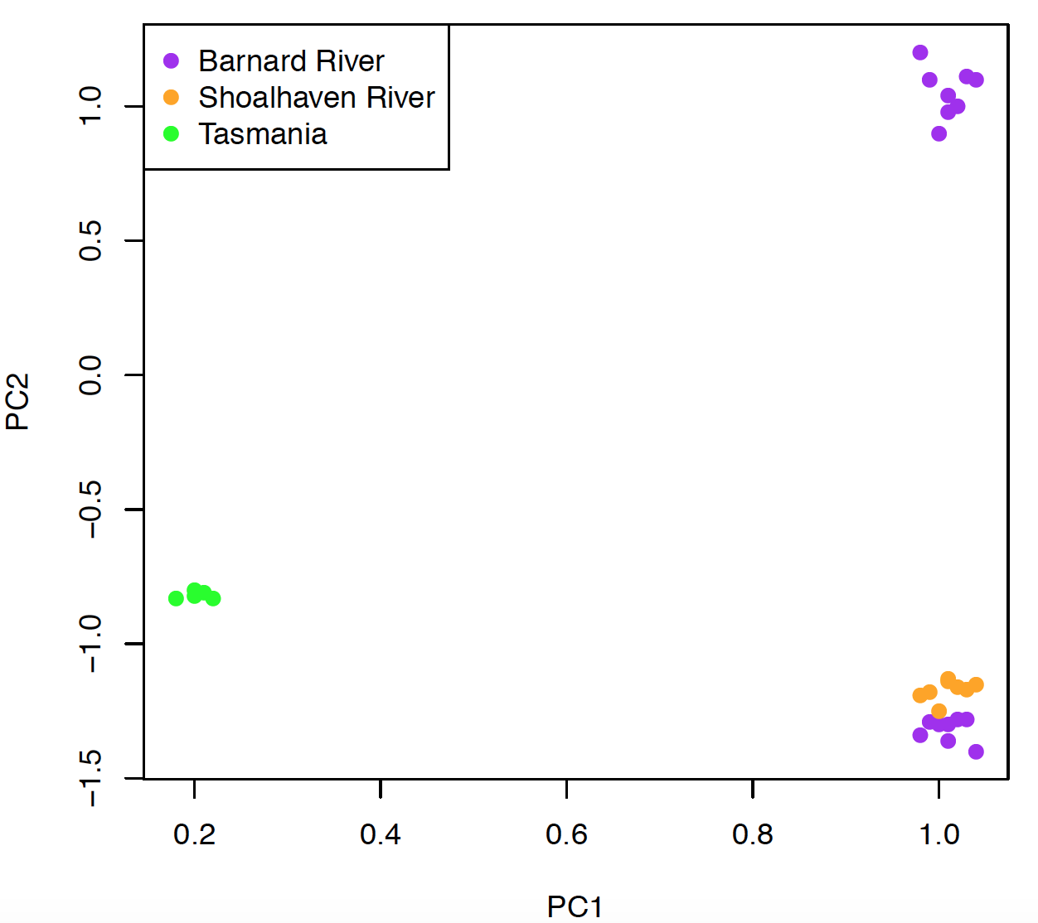
A cautionary tale: another peril of sequence data
Sequenced ~60 platypus samples
Two groups of samples from the same river fell far apart on the PCA
Noticed that this was driven by dense heterozygous SNPs falling in exons, present only in some lanes in those samples

Slide 40
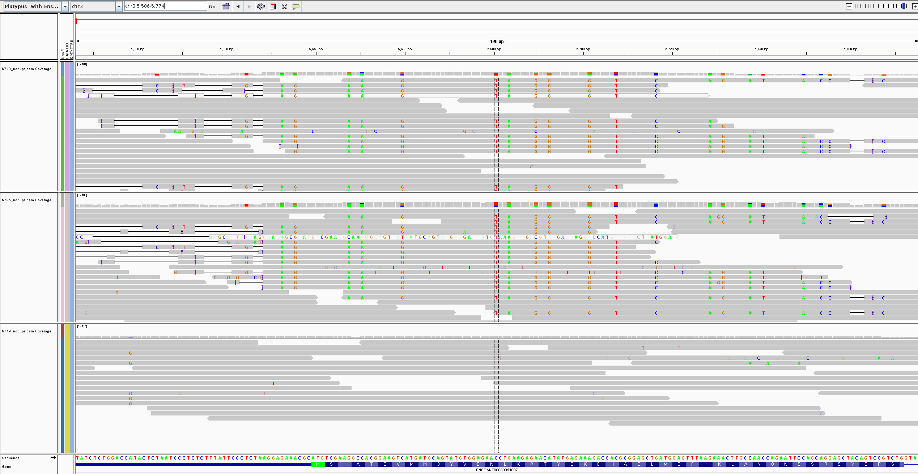
Notes:
Noticed that this was driven by dense heterozygous SNPs falling in exons, present only in those samples

Slide 41
A cautionary tale: a new platypus sub-species?
contamination
Turns out some sequencing lanes had been contaminated with human exome sequencing libraries
Human exonic reads still close enough to platypus exons to align
Would never see something like this with genotype chip data

Slide 42
More common contamination problems
contamination between samples multiplexed in the same sequencing lane (‘index hopping’)
people who have just eaten ham for lunch before spitting
bacterial/viral contamination
Rarer problems:
  saliva samples from kids that contains parental saliva
  people who have had bone marrow transplants

Slide 43
Summary: QC for sequencing versus genotype data
in sequence data, there is a discovery problem as well as a genotyping problem (i.e. the variants may not be real variants at all) – need to filter sites as well as genotypes
contamination is more of a problem for sequencing than genotyping data
error modes greatly differ between sequencing and genotyping chips
spontaneous DNA damage (e.g. at chemically modified nucleotides) leads to false variants in reads
Notes:
THIN DOWN
VQSR - to identify error modes; important
QC and filtering of sites as well as genotypes

Slide 44
Plan for lecture
The sequencing revolution
Technical aspect of sequencing studies
  Coverage
  Exomes versus genomes
  Alignment
  Variant calling
  Quality control
  Contamination
Variant consequences and annotation
Interpretation of de novo mutations
Importance of well-matched controls

Slide 45
Coding variant consequences
Synonymous – same amino acid
Missense – different amino acid
Nonsense (loss-of-function) – premature stop codon
Splicing mutation - disrupts splicing (often leading to loss-of-function)
Ben Neale
Notes:
To those of you who did undergraduate genetics, this will all be known

Slide 46
Alternative splicing

Slide 47
Annotation
process of adding information about frequency, expected functional consequence etc. of variants
  is the variant found in dbSNP? Is it found in 1000 Genomes? At what frequency in each population?
  functional consequence – synonymous, missense, nonsense, splicing etc.
functional consequence often differs depending on transcript (e.g. exon may be present in some but not all transcripts)

Slide 48
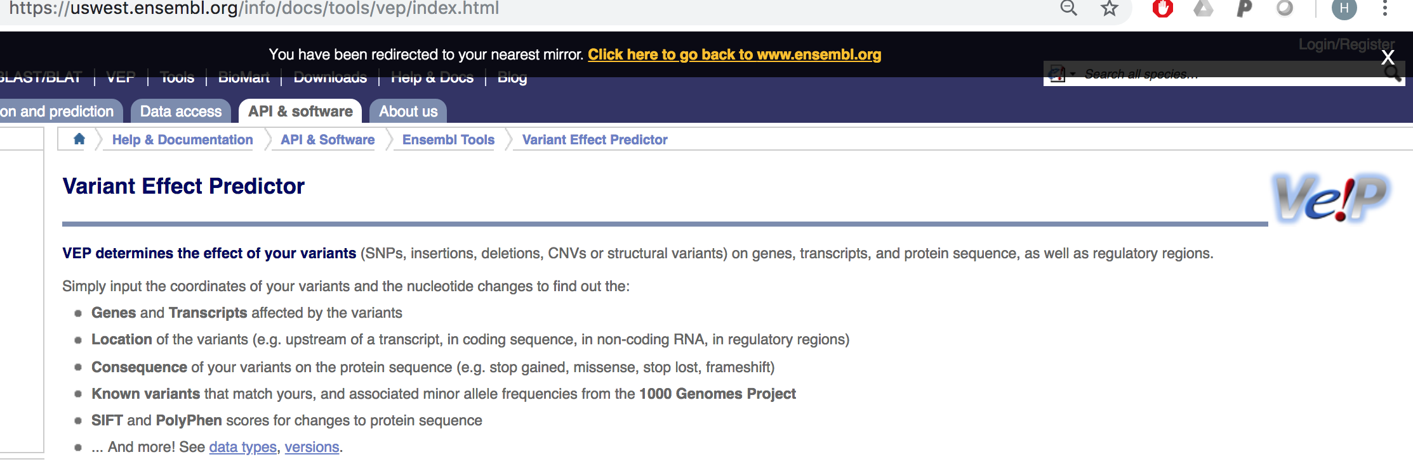
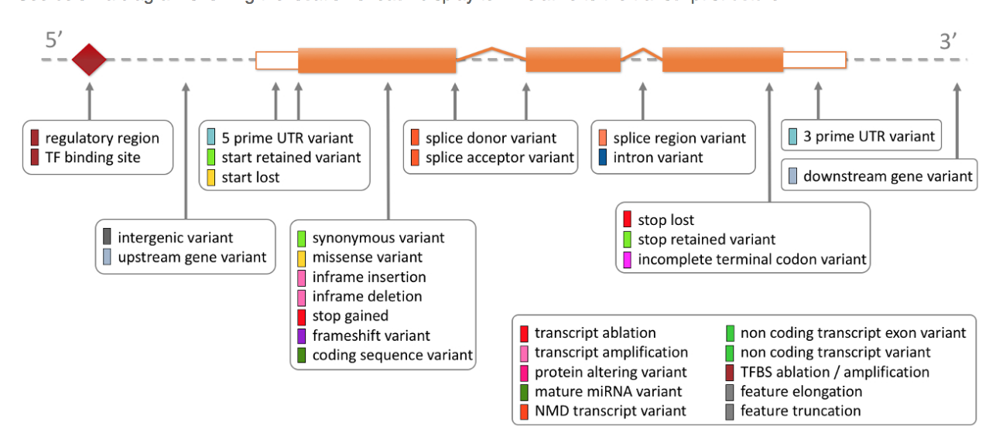
Variant Effect Predictor
Make sure you use the correct version of the reference genome (GRCh37 versus GRCh38)!)
https://uswest.ensembl.org/info/genome/variation/prediction/predicted_data.html
Notes:
VEP consequence string
Transcript-allele pairs
Often like to take the worse consequence for a variant

Slide 49
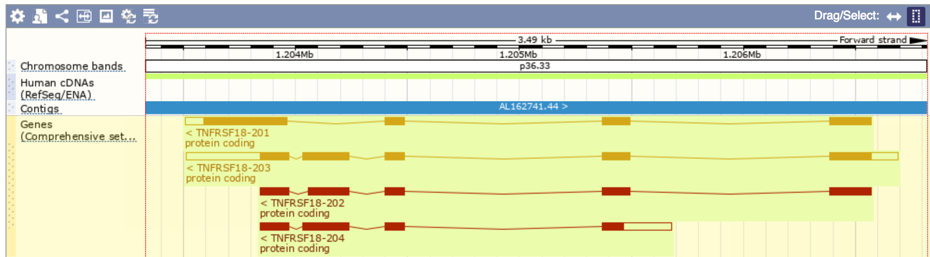
Variant annotation is specific to the alternate allele and the transcript
CHROM | POS | ID | REF | ALT
chr1 | 1203891 | . | C | A,T
SYMBOL | Gene
TNFRSF18 | ENSG00000186891
Location | Allele | Consequence | IMPACT | Feature | EXON | Codons
1:1203891-1203891 | A | synonymous_variant | LOW | ENST00000328596 | 4/4 | gcG/gcT
1:1203891-1203891 | T | synonymous_variant | LOW | ENST00000328596 | 4/4 | gcG/gcA
1:1203891-1203891 | A | stop_gained | HIGH | ENST00000379265 | 5/5 | Gag/Tag
1:1203891-1203891 | T | missense_variant | MODERATE | ENST00000379265 | 5/5 | Gag/Aag
1:1203891-1203891 | A | stop_gained | HIGH | ENST00000379268 | 5/5 | Gag/Tag
1:1203891-1203891 | T | missense_variant | MODERATE | ENST00000379268 | 5/5 | Gag/Aag
1:1203891-1203891 | A | stop_gained | HIGH | ENST00000486728 | 4/4 | Gag/Tag
1:1203891-1203891 | T | missense_variant | MODERATE | ENST00000486728 | 4/4 | Gag/Aag

Slide 50
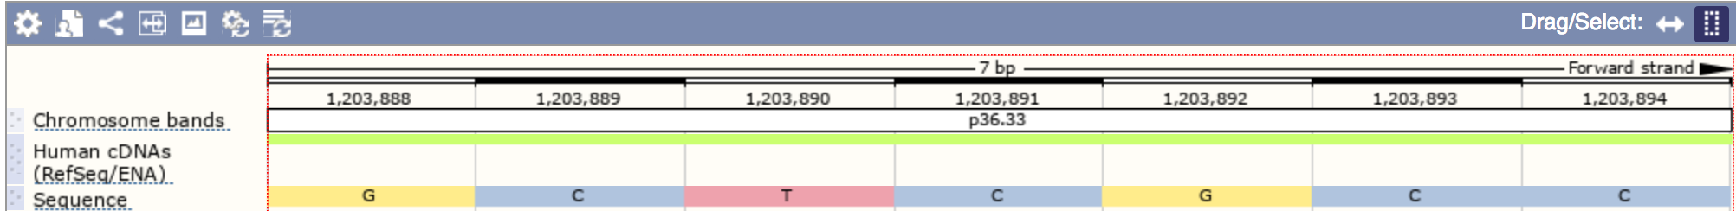
Variant annotation is specific to the alternate allele and the transcript
CHROM | POS | ID | REF | ALT
chr1 | 1203891 | . | C | A,T
SYMBOL | Gene
TNFRSF18 | ENSG00000186891
Location | Allele | Consequence | IMPACT | Feature | EXON | Codons
1:1203891-1203891 | A | synonymous_variant | LOW | ENST00000328596 | 4/4 | gcG/gcT
1:1203891-1203891 | T | synonymous_variant | LOW | ENST00000328596 | 4/4 | gcG/gcA
1:1203891-1203891 | A | stop_gained | HIGH | ENST00000379265 | 5/5 | Gag/Tag
1:1203891-1203891 | T | missense_variant | MODERATE | ENST00000379265 | 5/5 | Gag/Aag
1:1203891-1203891 | A | stop_gained | HIGH | ENST00000379268 | 5/5 | Gag/Tag
1:1203891-1203891 | T | missense_variant | MODERATE | ENST00000379268 | 5/5 | Gag/Aag
1:1203891-1203891 | A | stop_gained | HIGH | ENST00000486728 | 4/4 | Gag/Tag
1:1203891-1203891 | T | missense_variant | MODERATE | ENST00000486728 | 4/4 | Gag/Aag
ENST00000328596
ENST00000379265
ENST00000379268
ENST00000486728

Slide 51
Loss-of-function variants are often of particular interest
LoFs are variants that severely affect the function of a protein-coding gene
typically do so by deleting it or prompting nonsense-mediated decay (degradation of mRNA molecules with premature stop codons – protects cells against aberrant proteins that may be deleterious)
LoFs also called protein truncating variants (PTVs)
tend to be more deleterious than other types of variants

Slide 52
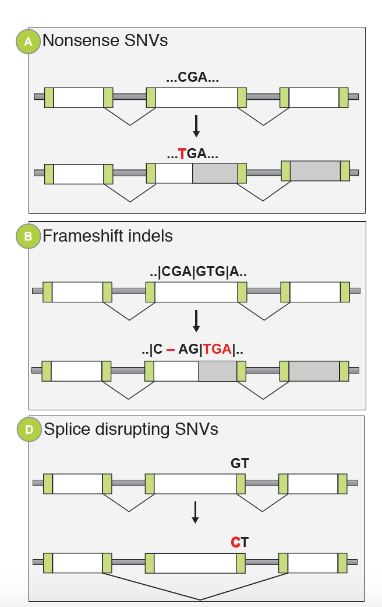
Different types of LoFs
Breaks the GT-AG rule
Notes:
99% of mammalian splice sites follow the ‘GT-AG’ dinucleotide rule such that the first two and last two nucleotides in the intron are GT and AG, respectively.
Large deletions are also LoF

Slide 53
Challenges to identifying true LoFs
the fraction of variants that are sequencing/calling errors is higher for LoFs than other types of variants
calling indels and large copy number variants from sequence data is particularly difficult, and they are enriched for LoFs
validation of variants (usually via Sanger sequencing) is necessary for some applications
LOFTEE can be used (as a plugin to VEP) to filter out spurious LoFs based on gene/transcript annotation features/errors
Daniel MacArthur

Slide 54
Plan for lecture
The sequencing revolution
Technical aspect of sequencing studies
  Coverage
  Exomes versus genomes
  Alignment
  Variant calling
  Quality control
  Contamination
Variant consequences and annotation
Interpretation of de novo mutations
Importance of well-matched controls

Slide 55
Why study de novo mutations?
mutations that occurred in the egg or sperm (or one of their precursor cells) and are hence are not present in all the cells in a parent’s body
the most damaging mutations are likely to be de novo – they have not yet been subject to negative selection
abundant evidence for a large role of de novo mutations in severe, early- onset diseases (e.g. developmental disorders)
some contribution to later onset diseases e.g. schizophrenia, but likely to account for few cases
Notes:
There is a background rate of neutral variation.
More de novo events found in a gene indicate it as important to disease, but how many do we need to decide that it is important?

Slide 56
Interpretation of de novo mutations
multiple de novo mutations in a gene in a cohort of disease cases are often used as evidence for that gene’s role in disease.
as we sequence large numbers of individuals, we can easily see recurrent mutations in a particular gene just by chance
need to understand the expectation for de novo variation so we can establish a statistical framework with which to evaluate the results of exome/genome sequencing studies
Slide from Kaitlin Samocha

Slide 57
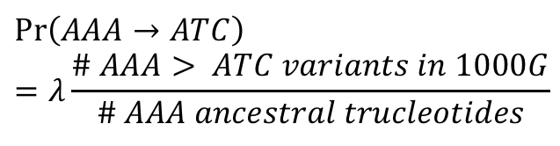
Creating a model of, and statistical framework for, evaluating de novo variation
$$\operatorname{Pr}\left(AAA→ATC\right)=λ\frac{\# AAA> ATC variants in 1000G}{\# AAA ancestral trucleotides}$$
Change Probability
AAA → ACA a
AAA → AGA b
AAA → ATA c
AAC → ACC d
AAC → AGC e
AAC → ATC f
…
…ATCGGCTGG…
…ATCGACTGG…
…CTCACCGGA…
…CTCACTGGA…
Created a mutation rate table:
4³ x 3 = 192 possible mutations
…CCTAGCTAA…
…CCTGGCTAA…
…TACGGA…
Per gene:
Pr(synonymous)
Pr(missense)
Pr(nonsense)
Pr(splice site)
Used the sequence to determine each gene’s probability of mutating
ACG
AAG
AGG
ATG
Also corrected for sequencing depth
Slide from Kaitlin Samocha
Samocha et al., Nat Genet, 2014
Notes:
When predicting expected number of de novo mutations in a gene by chance, obviously gene length will play a major role, but also need to take into account local sequence context
determined the probability of a given base mutating into one of the three other possible bases, taking into account the trinucleotide context –192 different possible mutations
Used variants in 1000 Genomes in intergenic regions to build this mutation rate table
Across the sequence, we tallied the number of observations for each of the 64 (4^3) possible trinucleotides and, for each SNP, considered the chimp allele to be ancestral and determined the trinucleotide (XY₁Z) to trinucleotide (XY₂Z) change that occurred.
To determine the probability of a given trinucleotide mutating, we divided the number of mutations in that trinucleotide context by the number of occurrences of the trinucleotide.
This probability is adjusted by a proportionality constant, λ, that gives the mutation rate of that trinucleotide for a single generation.
In the end, we have a mutation rate table that contains the probability of any of the 192 (63*3) possible mutations.

Slide 58
Per-gene probabilities of mutation are small, but consider the number of “candidate” genes and number of samples
Example probabilities of mutation per gene, per trio:
Probability of seeing >1 de novo in the same gene is quite high once you have a few hundred samples
class | rate
synonymous | 9.88E-6
missense | 2.36E-5
nonsense | 1.14E-6
Splice site | 6.82E-7
frameshift | 1.30E-6
sample size | Probability of >1 de novo
 | missense | LoF | either
100 | 0.053 | 0.001 | 0.068
200 | 0.208 | 0.004 | 0.268
300 | 0.465 | 0.009 | 0.597
Loss-of-function (LoF)
Probability of de novo LoF or missense in a gene expressed in fetal brain = 0.23
Notes:
So for a single trio, the probabilities of mutation in an individual gene are very low
Supposing you’re working on a rare neurodevelopmental disorder, you might be particularly interested in de novos in a gene expressed in the fetal brain – but note that this is a large fraction of genes, so actually, the probability of observing a de novo LoF or missense in a single individual is about 1/4
once you have e.g. a few hundred samples, the probability of observing more than one de novo LoF or missense variant in the same gene just by chance is quite high – about 0.6

Slide 59
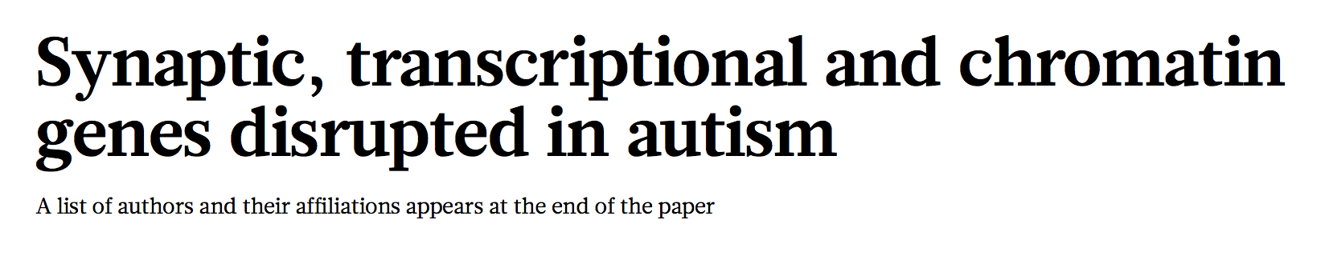
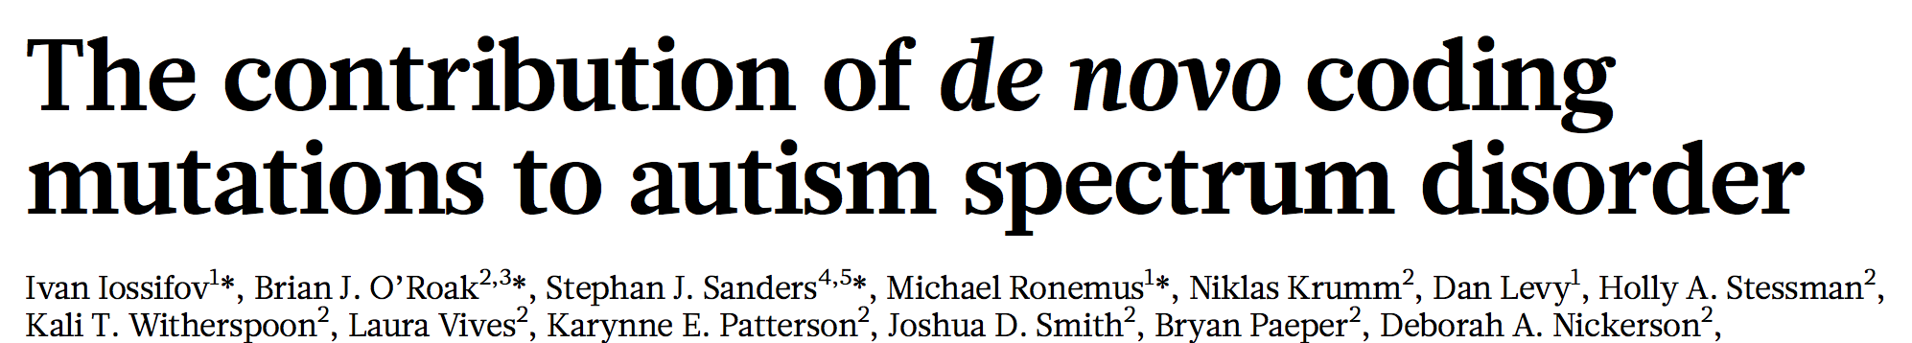
Do we see more deleterious de novo variants in cases than expected?
Application to de novo variation found in cases with autism spectrum disorders (ASD)
3,982 cases with ASD
2,078 unaffected siblings
AA
AA
AC
Autism Sequencing Consortium (ASC)
Simons Simplex Collection (SSC)
Slide from Kaitlin Samocha
Notes:
One of the earliest applications of this approach was used in a study of cases with autism, plus their parents and unaffected parents

Slide 60
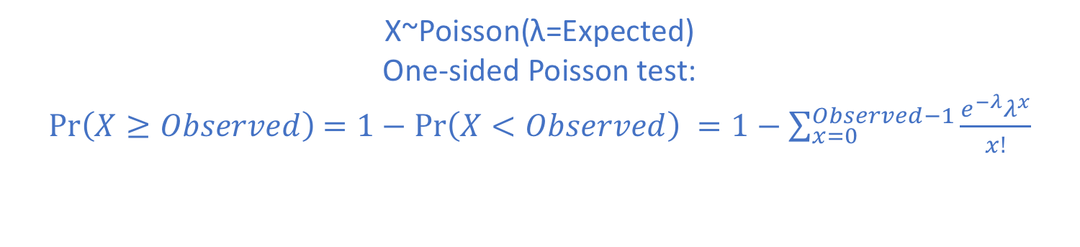
Genome-wide excess of both missense and loss-of-function (LoF) de novo variants in ASD cases
Sample set | N | Consequence | Observed | Expected | one-sided Poisson p-value
affected siblings | 3982 | synonymous | 1048 | 1092.66 | 0.91
 |  | missense | 2814 | 2470.03 | 7x10⁻¹²
 |  | LoF | 579 | 341.26 | 9x10⁻³²
unaffected siblings | 2078 | synonymous | 532 | 570.20 | 0.95
 |  | missense | 1258 | 1288.98 | 0.8
 |  | LoF | 190 | 178.08 | 0.2
X~Poisson(λ=Expected)
One-sided Poisson test:
$\operatorname{Pr}\left(X≥Observed\right)$ $=1−\operatorname{Pr}\left(X<Observed\right) =1−\sum_{x=0}^{Observed−1}{\frac{e^{−λ}λ^{x}}{x!}}$
Genome-wide burden of synonymous: should have observed≈expected
→ can use this metric to set threshold for calling de novos accurately
Samocha et al 2014; De Rubeis et al 2014; Iossifov et al 2014
Notes:
This table compares the number of observed and expected de novos that are synonymous, missense or LoF in either the affected or unaffected siblings
We can test with a Poisson test whether the observed number is significantly higher than the expected
We can see that there’s no significant enrichment of de novo synonymous – this is important, as they’re a negative control, we don’t expect them to be contributing to the disorder
There is a significant enrichment of de novos LoFs and missense in the affected but not unaffected siblings , implying that a subset of these are contributing to the disorders
In R, compute: ppois(Observed-1,Expected,lower.tail=F)

Slide 61
Is there a significant excess of de novo variants in a specific gene?
Six genes cross the significance threshold for harboring multiple de novo variants in ASD cases
Gene | # LoFs Observed | # LoFs Expected | p-value
CHD8 | 7 | 0.0604 | 5.51E-13
DYRK1A | 5 | 0.0201 | 2.71E-11
SYNGAP1 | 5 | 0.0313 | 2.46E-10
ADNP | 4 | 0.0176 | 3.93E-09
ARID1B | 5 | 0.0674 | 1.10E-08
DSCAM | 4 | 0.0551 | 3.69E-07
GRIN2B | 3 | 0.0221 | 1.77E-06
SCN2A | 4 | 0.0825 | 1.81E-06
SUV420H1 | 3 | 0.0236 | 2.16E-06
ANK2 | 4 | 0.1227 | 8.57E-06
POGZ | 3 | 0.0583 | 3.16E-05
Bonferroni correction for multiple testing
p< 5x10⁻⁷ (0.01/20,000 genes)
27 more genes with at least 2 de novo LoF variants not shown
Slide from Kaitlin Samocha
Samocha et al. 2014; De Rubeis et al. 2014; Iossifov et al. 2014
Notes:
We can also do a test for de novo enrichment for each gene individually
Need to do a Bonferroni correction since we’re testing a large number of genes – note that each test is independent of the others
Int his example, there were 7 genes that pass multiple testing

Slide 62
Plan for lecture
The sequencing revolution
Technical aspect of sequencing studies
  Coverage
  Exomes versus genomes
  Alignment
  Variant calling
  Quality control
  Contamination
Variant consequences and annotation
Interpretation of de novo mutations
Importance of well-matched controls

Slide 63
Case/control studies
sequence datasets often used to do per-variant or gene-based burden tests comparing cases and controls
can’t always afford to sequence both cases and controls, so use publicly available controls → lots of potential artefacts
as far as possible, we need to harmonise:
  sequencing (same technology, depth, sequencing centre)
  read mapping
  variant calling
usually interested in rare variants, so having ancestry-matched controls is particularly important, since rare variants tend to be more geographically localized than common variants
Notes:
To identify disease-causing mutations in cases, we need to know which genetic variants are found in the healthy population, and at which frequencies
(Sequencing unaffected family members also helps rule out candidate mutations in Mendelian disease studies)

Slide 64
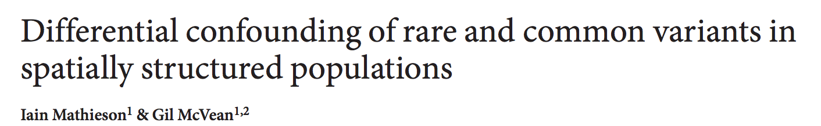
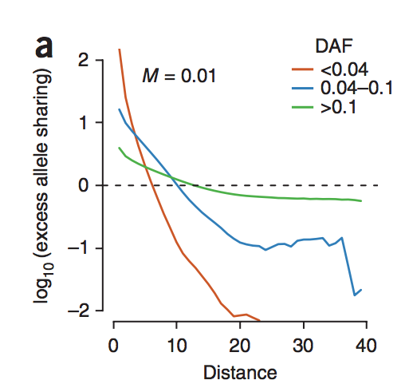
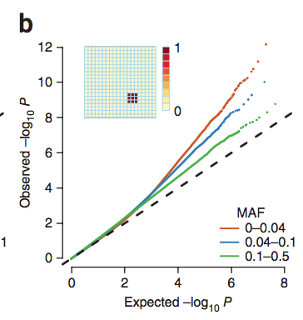
Population stratification of rare variants
Plot of excess allele sharing: ratio of how much more likely two individuals at a given spatial distance are to share a derived allele compared to what would be expected in a homogenous population
Quantile-quantile plot of association test P values broken down by allele frequency for a small, sharply defined region of constant non-genetic risk
N.B. the scenarios simulated in this paper are probably more extreme than reality
Notes:
They show that individuals who are geographically close together are much more likely to share rare variants but this is less extreme for common variants
They simulate various scenarios of geographically localized disease risk, where localized risk is elevated due to an environmental factor
they show that for rare variants in particular, simply correcting for principal components doesn’t correct for this

Slide 65



Publicly available controls
Since 2010, several projects have made large databases of sequence variation in healthy individuals available
These are very valuable, but if you can afford to sequence in-house controls alongside your cases too, this is even better
2,500 low-coverage whole genomes, various ancestries
6,500 European and African American exomes
(caveat: focused on heart, lung and blood disorders)
4,000 low-coverage whole genomes (TwinsUK and ALSPAC)
6,000 exomes of people with extreme phenotypes of specific conditions
~125k exomes, ~15k genomes, various ancestries, some with complex diseases

Slide 66
Value of in-house controls
plot shows distribution of number of “novel” heterozygous protein-altering variants per person, across 500 people in a clinical WGS project (WGS500)
“novel” is defined based on absence from different control datasets (2500 individuals from 1000 Genomes, 6500 from ESP, 499 from WGS500)
filtering against in-house control datasets sequenced and processed in same way as patient samples helps to eliminate artefacts (erroneous variant calls)
Notes:
Let us first pretend that the causal mutation in each of the 198 WGS500 individuals
is a novel heterozygous coding variant. If novelty is defined by absence from
dbSNP, 1000 Genomes and ESP, there are, on average, 384 such variants in each individual
(SD = 107; range 253-813) (Figure 3.1; Table 3.3). If we also filter out variants
seen in other unrelated WGS500 samples, the mean number of novel heterozygous
coding variants is 163 (SD = 89; range 84-508). Thus, including information from
WGS500 reduces the number of candidate variants under this model by 58% across
all samples. This reduction is greater for the 173 Caucasians than for the 25 non-
Caucasians (62% vs. 44%), which we discuss further below.
Suppose now that we imagine the causal variant is inherited by a simple recessive
model, but do not have parental information (Figure 3.2; Table 3.4). We are looking
for rare homozygous coding variants, and will set an allele frequency cuto↵ of 0.5%.
If we filter based on the frequency in 1000 Genomes and ESP alone, each person has
an average of 240 such variants (SD = 28; range 184-349), excluding individuals with large regions of homozygosity due to consanguinity or uniparental disomy. If we also
filter variants based on their frequency in unrelatedWGS500 samples (0 homozygotes,
2 heterozygotes), the average number of variants meeting these criteria is only 6
(SD = 10; range 0-67). This constitutes a 98% reduction, and is very similar for
Caucasians and non-Caucasians.

Slide 67
Limitations in using external sequencing datasets as controls
differences in coverage, mapping, variant calling or QC between your dataset and theirs may lead to mis-estimation of allele frequency for variants in some regions
these differences become very apparent when doing genome/exome-wide analyses
beware poorly matched ancestry e.g. a singleton in gnomAD may be more common in a tiny Swiss village
certain populations still poorly represented in publicly available datasets
publicly available datasets not necessarily useful as controls for complex disease studies because have not been screened for those phenotypes

Slide 68
Up next: Konrad Karczewski on gnomAD and constraint

