Slide 1

The Genome Aggregation Database (gnomAD)
Konrad Karczewski
March 4, 2019
@konradjk
broad.io/gnomad_lof

Slide 2
Identifying true LoF variants is challenging
LoFs are rare
LoFs are enriched for artifacts

Slide 3
Identifying true LoF variants is challenging
LoFs are rare
LoFs are enriched for artifacts

Slide 4
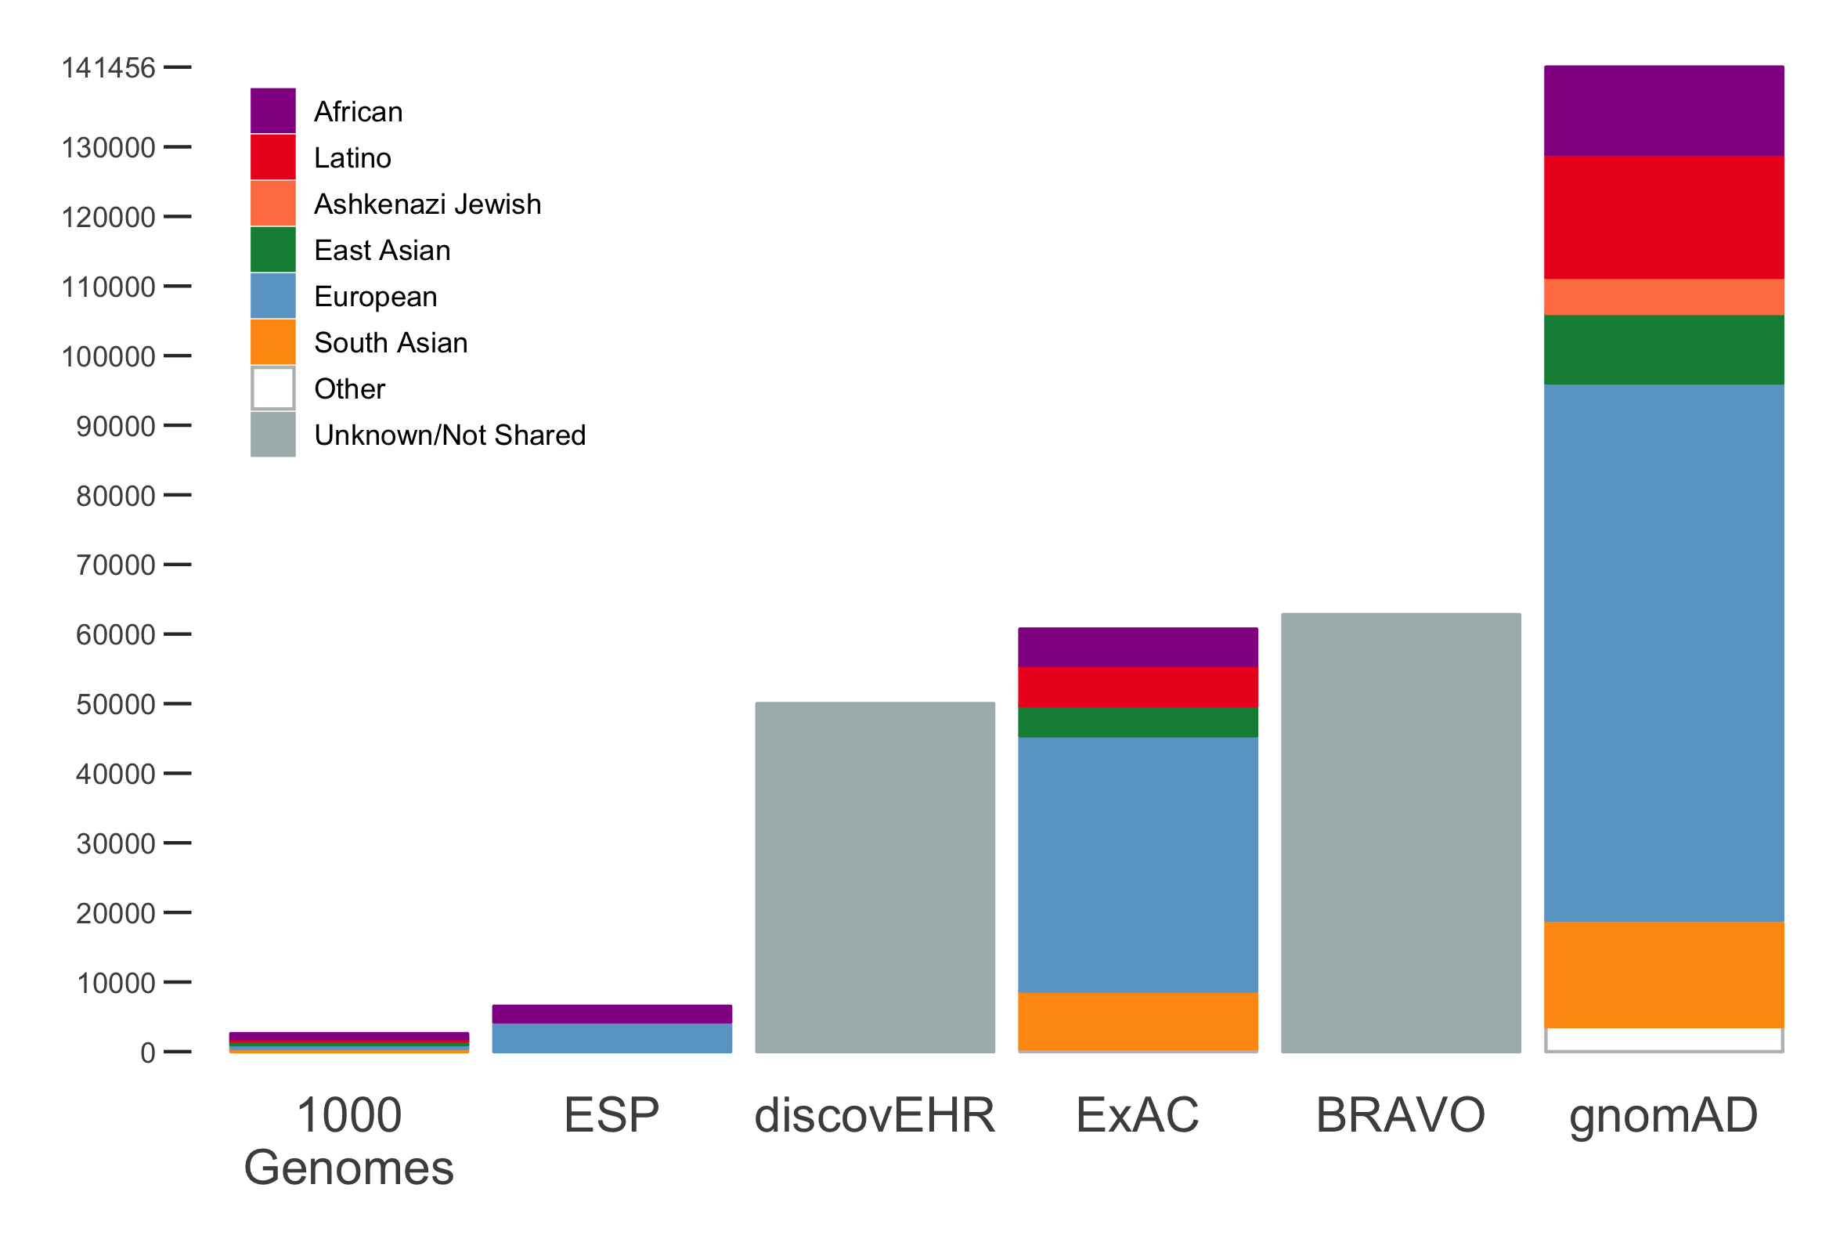
Increasing the scale of reference databases
gnomAD: 125,748 exomes and 15,708 whole genomes

Slide 5

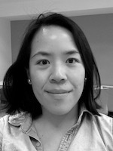
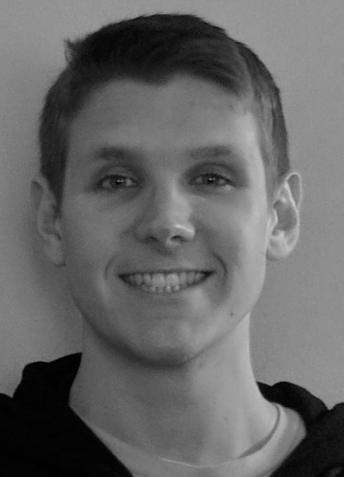
gnomAD 2.1.1
Data provided by 109 PIs
  1.3 and 1.6 petabytes of BAM files
Uniformly processed and joint called
  12 and 24 terabyte VCFs
Developed a novel QC pipeline
  Complete pipeline publicly available: broad.io/gnomad_qc
All QC and analysis performed using Hail: hail.is
  Scalable to thousands of CPUs
  Enabled rapid iteration (few hours for each component, few days for entire process)
Broad Genomics Platform
Broad Data Sciences Platform
Grace
Tiao
Laurent
Francioli
Cotton Seed
Tim Poterba

Slide 6
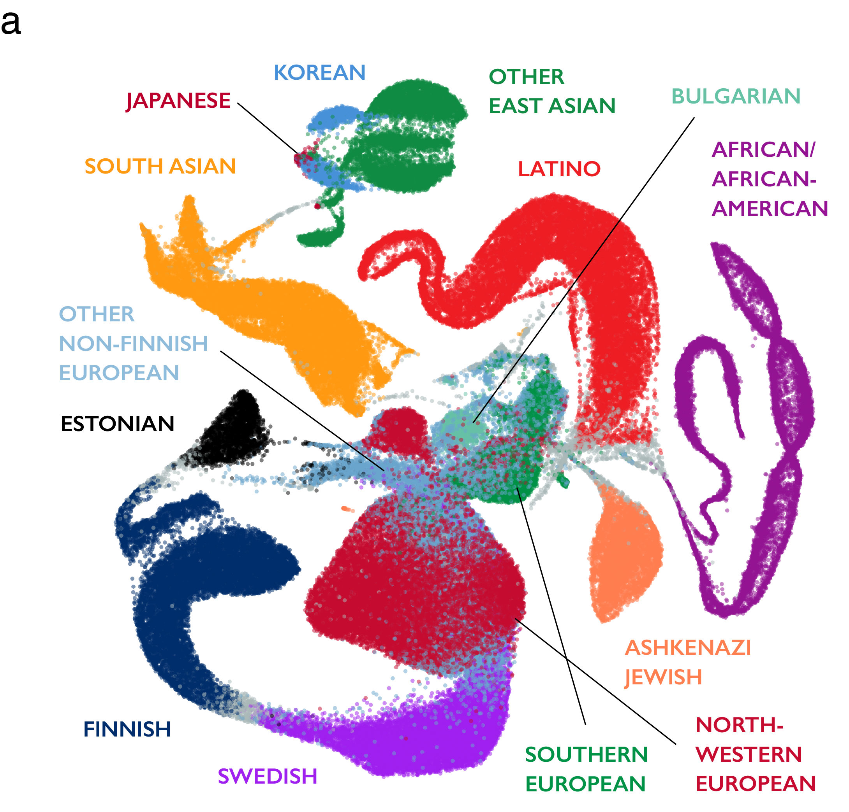
gnomAD 2.1.1
Sub-continental ancestry
Subsets:
  controls-only
  non-neuro/non-psychiatric
  non-cancer
  non-TOPMed Bravo
Grace
Tiao
Laurent
Francioli
http://gnomad.broadinstitute.org

Slide 7
Staggering amounts of variation
gnomAD 2.1 contains:
  230M variants in 15,708 genomes
  15M variants in 125,748 exomes

Slide 8
Staggering amounts of LoFs
gnomAD 2.1 contains:
  230M variants in 15,708 genomes
  15M variants in 125,748 exomes
Of these, we observe 515,326 loss-of-function (LoF) variants
  Stop-gained
  Essential splice
  Frameshift indel

Slide 9
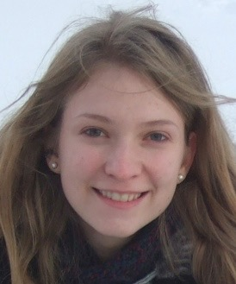
Detecting genes depleted for LoFs
(Samocha et al. 2014; Lek et al. 2016)
Mutational model that predicts the number of SNVs in a given functional class we would expect to see in each gene in a cohort
Kaitlin Samocha

Slide 10
Most genes are depleted of LoF variation
Many are extremely depleted (<20% observed compared to expected)
  Including most known dominant Mendelian genes
Using upper bound of confidence interval corrects for small genes
 | MED13L |  |  | FNDC3B
Phenotype | Severe Intellectual Disability |  |  | None
 | Observed | Expected | Obs/Exp (CI) | Observed | Expected | Obs/Exp (CI)
Synonymous | 462 | 465 | 0.993 (0.92-1.07) | 271 | 266 | 1.02 (0.92-1.13)
LoF | 0 | 102 | 0 (0-0.029) | 0 | 68 | 0 (0-0.043)

Slide 11
Resolving the spectrum of LoF intolerance
Binning this spectrum into deciles
More depleted
More constrained
More tolerant
Less constrained

Slide 12
Resolving the spectrum of LoF intolerance
Known haploinsufficient genes have ~10% of the expected LoFs
Notes:
116

Slide 13
Resolving the spectrum of LoF intolerance
Autosomal recessive genes are centered around 60% of expected
Gene list from:
Blekhman et al., 2008
Berg et al., 2013
Notes:
1164

Slide 14
Resolving the spectrum of LoF intolerance
Some genes, e.g. olfactory receptors, are unconstrained
Notes:
350

Slide 15
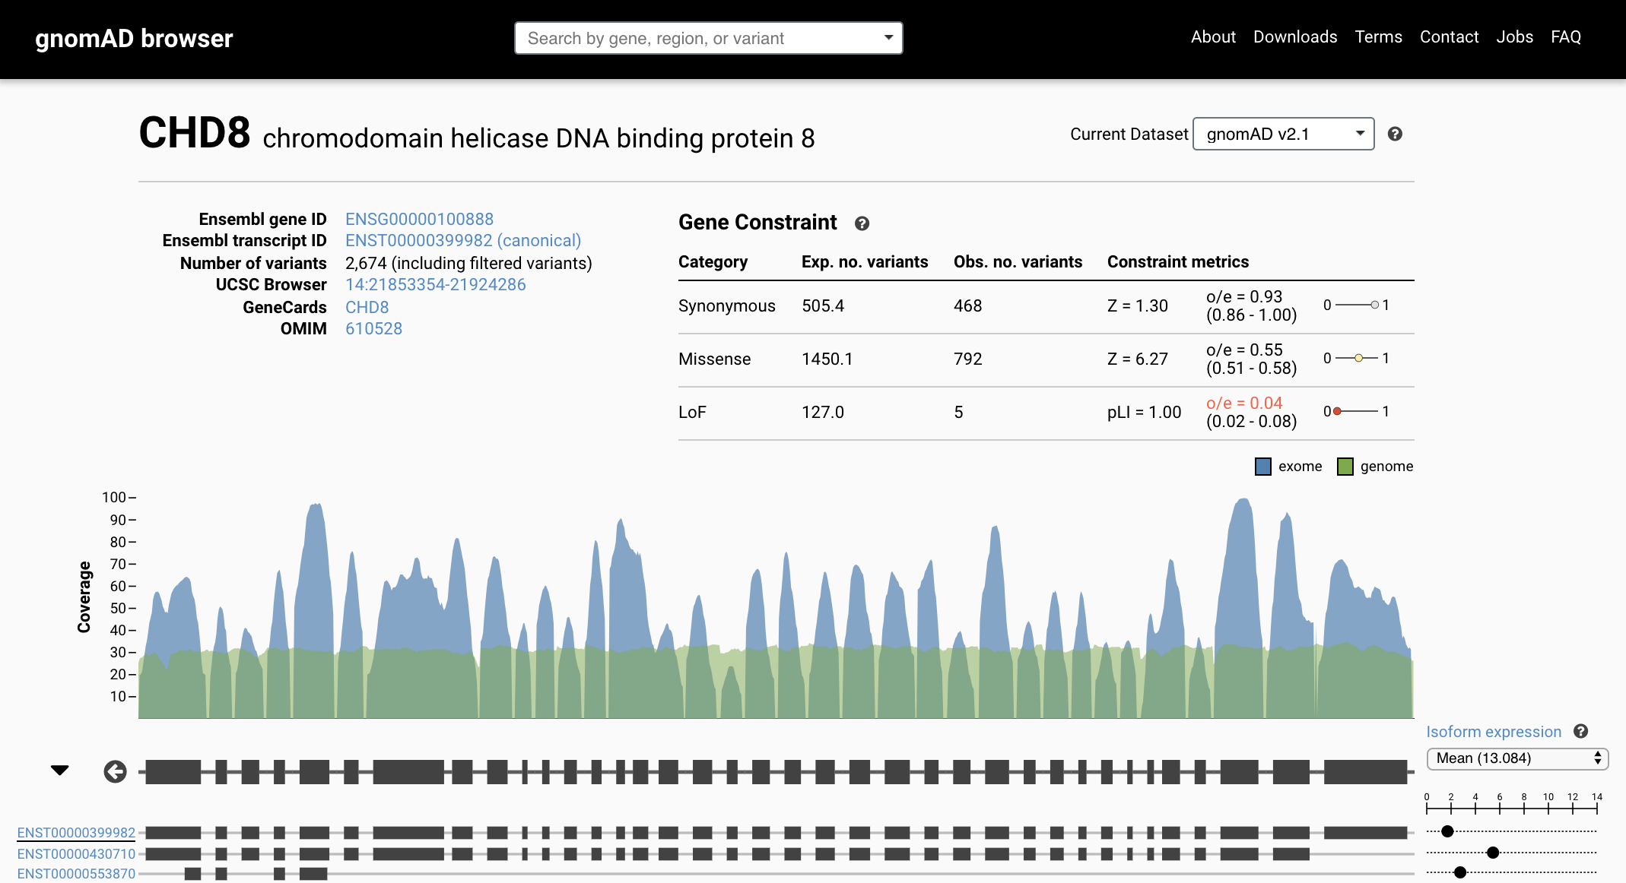
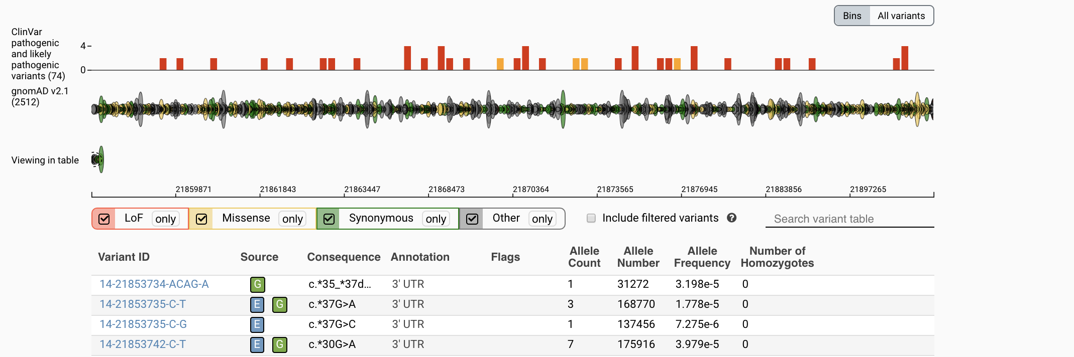
Data publicly released with no publication restrictions
gnomad.broadinstitute.org
Dataset selection box
Constraint metrics
Tissue isoform expression
Matt
Solomonson
Gene model with transcripts
Pathogenic Clinvar Variants
Nick Watts

