Slide 1
Simulation – software, applications, and approaches
Luke Evans
CU Boulder & IBG
March 8, 2019
LOCATION: Faculty folders/luke/2019/Friday_simulation_practical
Copy that into your directory, cd into it.

Slide 2
Postdoctoral & Graduate Student Positions Available at University of Colorado Institute for Behavioral Genetics
Complex Trait Statistical Genetics
Nicotine use, mental health
Contact me or Matt Keller
Luke.m.evans@Colorado.edu
Matthew.c.keller@gmail.com

Slide 3
Why would you want to make up your own data?
What do you think?
Idea 1
Idea 2
…

Slide 4
Why would you want to make up your own data?
Some reasons I’ve thought of:
Test new methods or compare across methods with the same data (equal footing to compare)
Identify the key assumptions for an analysis
Test how robust an analysis is to violations of those assumptions
Introduce new variables that you might be interested in
Get a sense of statistical power, or how variable something might be by chance alone.

Slide 5
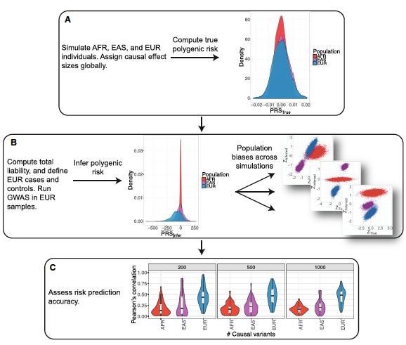
Example #1: How does human demographic history impact genetic risk prediction?
Alicia Martin et al. 2017 AJHG 100:635-649
Used coalescent simulations based on previously-estimated human demography to generate many replicates of human populations
Created phenotypes, assessed associations in EUR population, tested PRS in a OTHER populations
Notes:
If you’re interested in doing PRS work, how would the lack of diverse samples impact your prediction accuracy?
What factors should you be considering when you’re running a PRS analysis?

Slide 6
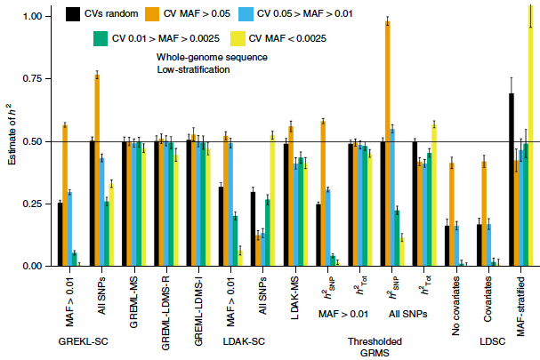
Example #2: How do different h²_{SNP} methods perform across varying complex trait genetic architectures?
Evans et al. 2018 Nat. Gen. 50:737-745.
Used whole genome sequence data to simulate phenotypes from different genetic architectures
Methods to estimate h²_{SNP} all have key assumptions, how robust are these approaches when those assumptions are not met?
Notes:
What are the assumptions underlying each of the models in the figure?
What happens when a model assumption is violated? Is the estimate likely going to be a good one?

Slide 7
How would you actually simulate data?
Lots of different ways!
R – rbinom function, for example, or more complex ways if you want linkage, relatives, demography, mutation, etc.
Sequence simulators
Forward-time or coalescent
Hudson’s ms, MSPRIME, GeneEvolve just a couple of examples (see papers in directory)
Scale to whole genomes & large sample sizes? Existing LD patterns or just simulate based on average recombination rates? Mutation rates? Demography? Long time frames or only several generations? Environmental influences? Selection?
Many things to consider!
Just use real genotype data & assign effect sizes to particular variants
Maintain existing structure of the data – LD, polymorphism, etc.
What data are available? Samples & sample sizes? Biases, ascertainment, etc.?

Slide 8
1. Just make up some new genotypes & phenotypes in R
Generate some genotypes & phenotypes in R with the rbinom function
FILE: Genotype_simulation_1.R
Run through 1a, 1b, 1c (you’ll have to do a few things yourself in the R code)
1d is another example, simulating genotypes in different populations – optional if you want

Slide 9
1. Just make up some new genotypes & phenotypes in R
Generate some genotypes & phenotypes in R with the rbinom function
FILE: Genotype_simulation_1.R
Run through 1a, 1b, 1c (you’ll have to do a few things yourself in the R code)
1d is another example, simulating genotypes in different populations – optional if you want
Simplest way to simulate genotypes!
What sources of variation influence genotypes?
What other things might you change or add that could influence your trait?
Notes:
What sources of variation influence genotypes?
Range of allele frequencies? Distribution of the allele frequencies? Additive effects vs. other models of gene action?
What other extensions might you come up with?
Structure? Distribution of effect sizes? Non-independence of loci? Heritability?

Slide 10
2. Real Data (or in this case, a simulated genotype dataset, but for our purposes, it’s the same thing)
Genotypes obtained from some real data set
(here simulated from GeneEvolve).
Phenotypes generated from some model (you decide! Your choice matters!), either in R yourself, or in PLINK, GCTA, etc.
What kinds of data? What are the impacts of simulating from any of the following?
Sequence data: 1KGv3, TOPMed, HRC
Imputed data: UK Biobank, maybe your own?
Array data: Lots! Just look through dbGaP.

Slide 11
2. Real Data (or in this case, a simulated genotype dataset, but for our purposes, it’s the same thing)
Options to simulate phenotypes from existing genotypes
GCTA, Plink, others
Can specify
Causal variants – how do you choose?
Trait heritability – what impact might this have?
Allelic effect sizes – what distribution might you draw effect sizes from?
Case control - specify prev. & ascertainment

Slide 12
2. Real Data (or in this case, a simulated genotype dataset, but for our purposes, it’s the same thing)
Practical #2 – generate some phenotypes from randomly chosen causal variants of different MAF ranges
Step 1: Randomly choose some CVs based on some criteria (here, MAF)
Step 2: Use that list of CVs to create phenotypes with GCTA from a real plink binary file set.
Step 3: Do some test on the simulated phenotypes, to see what the influence of your assumptions are.
Here, we’re going to test the influence of CV MAF on your estimates of GCTA-based heritability – You’ve already done something like this during Loic’s session, so it should be familiar to you.
The single GRM is from common variants, kind of the basic h2SNP model (previously computed, in the simulation_2/ directory)
FILE: simulation_2.bash
NOTE: In the terminal run command “bash” first, before you copy & paste any of the commands, so that you’re running in bash rather than another shell

Slide 13
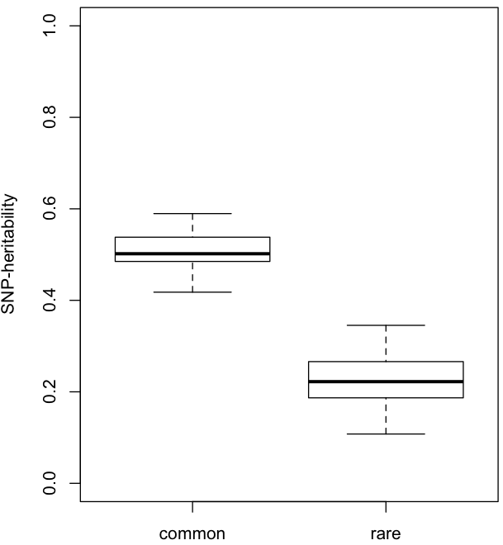
Simulation 2: Varying MAF of causal variants:
SNP-heritability
Why does it the analysis underestimate the true trait heritability when the causal variants are rare (or at least rarer than the markers)?
- See Loic’s talk & practical
Common Rare
Causal Variant MAF

Slide 14
What are your assumptions? What are their impacts? Vary them in simulations & find out.
What are you assuming in your analysis?

Slide 15
What are your assumptions? What are their impacts? Vary them in simulations & find out.
What are you assuming in your analysis?
MAF-effect size relationship or none?
LD-effect size relationship or none?
Panmictic population or stratification effects?
Polygenicity?
Shared environments or independent environments for all individuals in the sample?
Combinations of these and others?
There are lots of assumptions for even a simple GWAS…

Slide 16
What are your assumptions? What are their impacts? Vary them in simulations & find out.
What are you assuming in your analysis?
MAF-effect size relationship or none?
LD-effect size relationship or none?
Panmictic population or stratification effects?
Polygenicity?
Shared environments or independent environments for all individuals in the sample?
Combinations of these and others?
There are lots of assumptions for even a simple GWAS…
Alter these relationships, then test what that will do to the phenotype, results, and your conclusions.

Slide 17
What are your assumptions? What are their impacts? Vary them in simulations & find out.
What are you assuming in your analysis?
MAF-effect size relationship or none?
LD-effect size relationship or none?
Panmictic population or stratification effects?
Polygenicity?
Shared environments or independent environments for all individuals in the sample?
Combinations of these and others?
There are lots of assumptions for even a simple GWAS…
Alter these relationships, then test what that will do to the phenotype, results, and your conclusions.
What kinds of data? What are the impacts of simulating from any of the following?
Sequence data: Biases from sequencing itself?
Imputed data: What variants are imputed? Imputation quality?
Array data: Why are particular SNPs on genotyping chips?

Slide 18
3. Vary assumptions and test your models
Practical #3 – generate some genotypes & phenotypes, varying the assumptions (the generating model), and see how it impacts your conclusions
FILES:
Step 1 - FILE simulation_3.R – generate effect sizes with different assumptions, specifically making betas related to MAF.
Step 2 - FILE simulation_3.bash - Bash script to run GCTA to first make the phenotypes with your MAF-scaled betas, then estimate heritability (think back to Loic’s talk – what is the impact of MAF & LD on estimates?).
Step 3 - FILE simulation_3.R – at the end of the script, visualize how all of these different simulations (all with the same TRUE h2SNP (=0.5) impact the ESTIMATED h2SNP
Extra exercises & things to think about at the end of the R script.

Slide 19
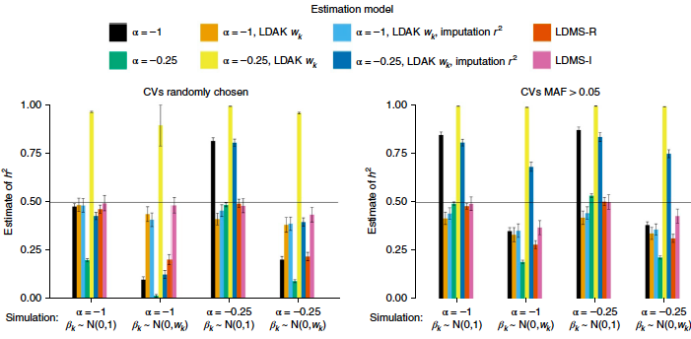
Varying model assumptions and simulation parameters – test how robust your estimates may be.

Slide 20
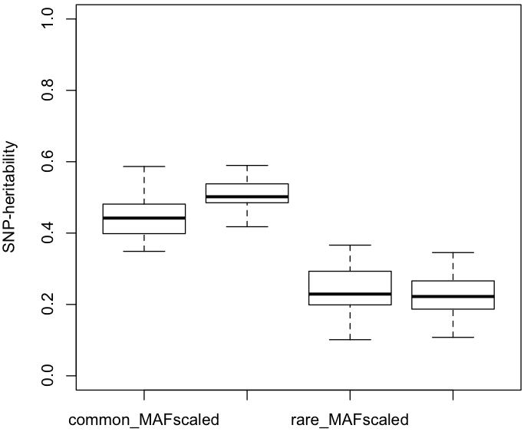
Simulation 3: Varying MAF & beta distributions
Causal Variant MAF
Common Rare
SNP-heritability
Impacts of model assumptions?
Need more replicates?
Note: The “rare” category is still pretty common. Bigger impacts of the MAF-scaling happen when variants are really rare.
N(0,1/2pq) N(0,1) N(0,1/2pq) N(0,1)
Allelic Effect Size Distribution

