Slide 1
GWAS and PLINK PRACTICAL
Lucia Colodro-Conde and Katrina Grasby

Slide 2
Contents
Basic association tests
Logistic regression
Linear regression
Plotting results

Slide 3
Data are freely available from:
http://labs.med.miami.edu/myers/LFuN/LFUN/DATA.html
Note these are genotyped data of 358 unrelated participants and we have limited the analyses to the autosomal chromosomes.

Slide 4
0. Set up
We will use the text editor, the terminal, R Studio, and the browser.
Exercises: Monday_pract2_Exercises.txt
Related documentation:
PLINK 1.9: https://www.cog-genomics.org/plink/1.9/assoc
PLINK 1: http://zzz.bwh.harvard.edu/plink/anal.shtml

Slide 5
Basic Association Test

Slide 6
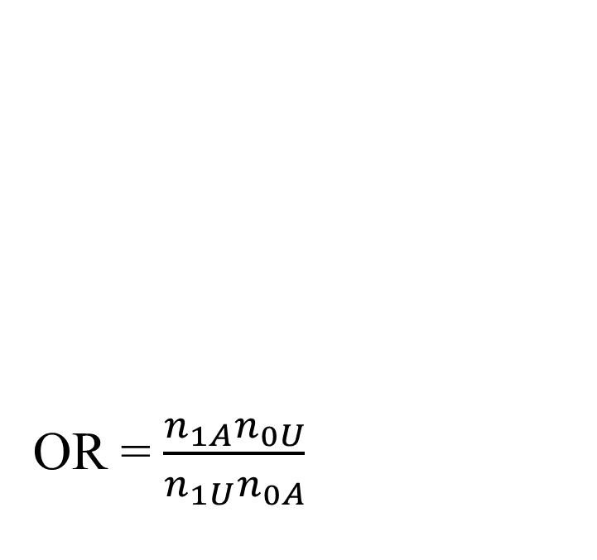
Case-control
Each individual contributes two counts to 2x2 table.
Test of association
where
X² has χ² distribution with 1 degrees of freedom under null hypothesis.
 | Cases | Controls | Total
G | n_{1A} | n_{1U} | n_{1·}
T | n_{0A} | n_{0U} | n_{0·}
Total | n_{·A} | n_{·U} | n··

Slide 7
-- assoc
It works with case/control and continuous phenotypes.
Case-control (1df chi-square test, outputs assoc)
PLINK will recognise this is a case/control analysis because the phenotype just has:
1 (for controls),
2 (for cases),
and 0/-9/non-numeric (for missing).
Continuous (regression, outputs qassoc)
If the file had more values than 0/-9/non-numeric, 1, and 2, PLINK will recognise the phenotype as continuous.
Note the code for cases, controls, and missing data can be changed using different flags.

Slide 8
This is an Alzheimer's disease case-control sample
Go to the case-control folder
How many cases and controls do you have?
Is there any missing data?

Slide 9
This is an Alzheimer's disease case-control sample
Go to the case-control folder
How many cases and controls do you have?
Is there any missing data?
awk '{print $6}' adclean.cc.fam | sort | uniq -c
170 cases and 182 controls, no missing data

Slide 10
Exercise 1. Association test for a binary trait
plink
--bfile adclean.cc
--assoc
--out 1_adclean.cc

Slide 11
Exercise 1. Association test for a binary trait
1_adclean.cc.log
Options in effect:
--assoc
--bfile adclean.cc
--out 1_adclean.cc
64148 MB RAM detected; reserving 32074 MB for main workspace.
297237 variants loaded from .bim file.
352 people (188 males, 164 females) loaded from .fam.
352 phenotype values loaded from .fam.
Using 1 thread (no multithreaded calculations invoked.
Before main variant filters, 352 founders and 0 nonfounders present.
Calculating allele frequencies... done.
Total genotyping rate is 0.985941.
297237 variants and 352 people pass filters and QC.
Among remaining phenotypes, 170 are cases and 182 are controls.

Slide 12
1_adclean.cc.assoc
CHR SNP BP A1 F_A F_U A2 CHISQ P OR
1 rs3094315 752566 C 0.1824 0.1425 T 2.046 0.1526 1.343
1 rs4040617 779322 G 0.1235 0.09669 A 1.294 0.2554 1.317
1 rs4075116 1003629 G 0.3029 0.2956 A 0.04531 0.8314 1.036
1 rs9442385 1097335 T 0.05952 0.09341 G 2.818 0.09324 0.6143
1 rs10907175 1130727 C 0.08434 0.0678 A 0.6691 0.4134 1.266
1 rs6603781 1158631 T 0.1596 0.1096 C 3.721 0.05375 1.544
1 rs11260562 1165310 T 0.04412 0.04945 C 0.1119 0.738 0.8872
1 rs6685064 1211292 T 0.05422 0.06319 C 0.252 0.6157 0.8499
1 rs307378 1268847 T 0.02679 0.0221 G 0.1611 0.6882 1.218

Slide 13
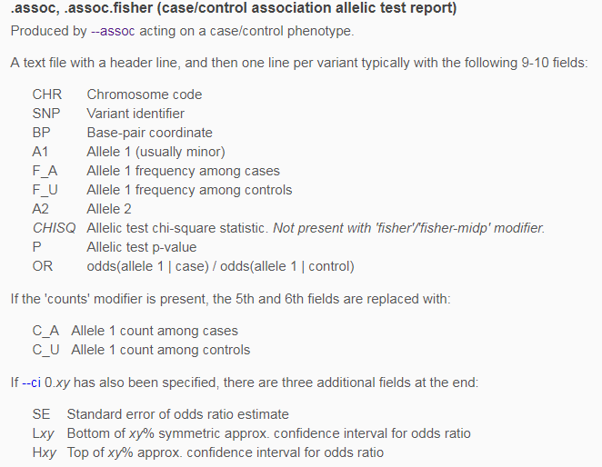
Always check which allele is the effect allele!
https://www.cog-genomics.org/plink/1.9/formats#assoc

Slide 14
(you will rarely use an association test)

Slide 15
Logistic and linear regression
Allowing the inclusion of covariates

Slide 16
How many covariates does the file adpc.txt have?
What are they?

Slide 17
How many covariates does the file adpc.txt have?
What are they?
FID IID PC1 PC2 PC3 PC4
WGAAD 10 0.0550949 0.0507711 0.00845787 -0.00116914
WGAAD 15 0.0470604 0.0474843 0.00315769 0.00810905
WGAAD 18 0.0564277 0.0471303 0.00803162 -0.00242266
WGAAD 20 0.0564051 0.0436962 0.00419304 -0.007482
WGAAD 24 0.0540288 0.0477145 0.00711973 -0.00223988
WGAAD 25 0.0475798 0.0504094 0.00207224 0.00637812
WGAAD 28 0.0570727 0.0493075 0.00609508 -0.00164
WGAAD 29 0.054579 0.0496459 0.00995307 -0.00327564
WGAAD 31 0.0552207 0.0516809 0.00705046 -0.00485599
They are principal components of genetic ancestry – more on this on Tuesday

Slide 18
Exercise 2.1. Logistic regression with PC1-PC4 as covariates
plink
--bfile adclean.cc
--logistic
--covar adpc.txt
--out 2.1_adclean.cc
--freq can be added to create a separate file with the MAF (only founders) and this can be merged with the results
--beta can be added to obtain regression coefficients instead of odds ratios

Slide 19
Exercise 2.1. Logistic regression with PC1-PC4 as covariates
2.1_adclean.cc.log
Options in effect:
--bfile adclean.cc
--covar adpc.txt
--logistic
--out 2.1_adclean.cc
Random number seed: 1551416198
64148 MB RAM detected; reserving 32074 MB for main workspace.
297237 variants loaded from .bim file.
352 people (188 males, 164 females) loaded from .fam.
352 phenotype values loaded from .fam.
Using 1 thread (no multithreaded calculations invoked.
--covar: 4 covariates loaded.
Before main variant filters, 352 founders and 0 nonfounders present.
Calculating allele frequencies... done.
Total genotyping rate is 0.985941.
297237 variants and 352 people pass filters and QC.
Among remaining phenotypes, 170 are cases and 182 are controls.
Writing logistic model association results to 2.1_adclean.cc.assoc.logistic ..

Slide 20
Exercise 2.1. Logistic regression with PC1-PC4 as covariates
2.1_adclean.cc.assoc.logistic
CHR SNP BP A1 TEST NMISS OR STAT P
1 rs3094315 752566 C ADD 349 1.352 1.437 0.1508
1 rs3094315 752566 C PC1 349 4.426e-50 -1.866 0.06207
1 rs3094315 752566 C PC2 349 8.759e+17 0.7017 0.4828
1 rs3094315 752566 C PC3 349 2.97e+21 0.8452 0.398
1 rs3094315 752566 C PC4 349 9.61e-25 -1.017 0.3094
1 rs4040617 779322 G ADD 351 1.276 1.047 0.2953
1 rs4040617 779322 G PC1 351 8.682e-51 -1.892 0.05843
1 rs4040617 779322 G PC2 351 2.841e+21 0.8415 0.4001
1 rs4040617 779322 G PC3 351 2.764e+17 0.687 0.4921

Slide 21
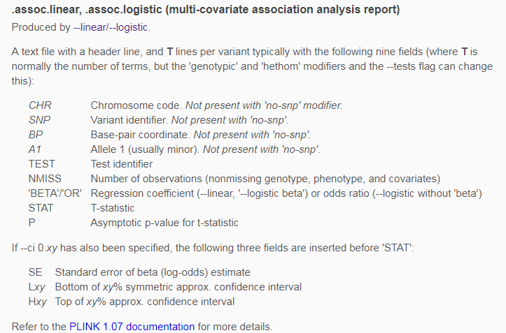
Exercise 2.1. Logistic regression with PC1-PC4 as covariates
https://www.cog-genomics.org/plink/1.9/formats#assoc_linear

Slide 22
Exercise 2.2. Logistic regression with PC1-PC4 as covariates hiding the covariates)

Slide 23
Exercise 2.2. Logistic regression with PC1-PC4 as covariates hiding the covariates)
https://www.cog-genomics.org/plink/1.9/assoc#linear

Slide 24
Exercise 2.2. Logistic regression with PC1-PC4 as covariates hiding the covariates)
plink
--bfile adclean.cc
--logistic hide-covar
--covar adpc.txt
--out 2.2_adclean.cc

Slide 25
Exercise 2.2. Logistic regression with PC1-PC4 as covariates hiding the covariates)
2.2_adclean.cc.log
Options in effect:
--bfile adclean.cc
--covar adpc.txt
--logistic hide-covar
--out 2.2_adclean.cc
Random number seed: 1551713462
64148 MB RAM detected; reserving 32074 MB for main workspace.
297237 variants loaded from .bim file.
352 people (188 males, 164 females) loaded from .fam.
352 phenotype values loaded from .fam.
Using 1 thread (no multithreaded calculations invoked.
--covar: 4 covariates loaded.
Before main variant filters, 352 founders and 0 nonfounders present.
Calculating allele frequencies... done.
Total genotyping rate is 0.985941.
297237 variants and 352 people pass filters and QC.
Among remaining phenotypes, 170 are cases and 182 are controls.
Writing logistic model association results to 2.2_adclean.cc.assoc.logistic ...

Slide 26
Exercise 2.2. Logistic regression with PC1-PC4 as covariates
hiding the covariates)
2.2_adclean.cc.assoc.logistic
CHR SNP BP A1 TEST NMISS OR STAT P
1 rs3094315 752566 C ADD 349 1.352 1.437 0.1508
1 rs4040617 779322 G ADD 351 1.276 1.047 0.2953
1 rs4075116 1003629 G ADD 351 1.013 0.08192 0.9347
1 rs9442385 1097335 T ADD 350 0.6388 -1.587 0.1125
1 rs10907175 1130727 C ADD 343 1.353 1.063 0.2879
1 rs6603781 1158631 T ADD 344 1.496 1.817 0.06918
1 rs11260562 1165310 T ADD 352 0.8613 -0.4002 0.689
1 rs6685064 1211292 T ADD 348 0.8395 -0.529 0.5968
1 rs307378 1268847 T ADD 349 1.212 0.4058 0.6849

Slide 27
Let’s plot the results
QQ plots, Manhattan plots, and regional plots

Slide 28
QQ plot
Checks the overall distribution of test statistics or –log10 p-values with the expectation under the null hypothesis of no association (the diagonal line shows where the points should fall under the null).
Evaluates systematic bias and inflation (undetected sample duplications, unknown familial relationships, gross population stratification, problems in QC…).
Lambda
It is the ratio of the median of the empirically observed distribution of the test statistic to the expected median.
It quantifies the extent of the bulk inflation and the excess false positive rate.
  The expected median of the chi-square distribution with one degree of freedom is 0.455.
  lambda=median(chi^2)/0.455
It should be close to 1.

Slide 29
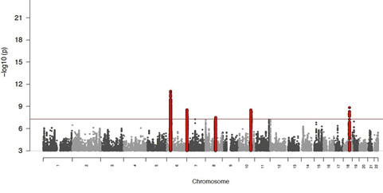
Manhattan plot
Plots the -log10 of the association p-value for each SNP against the genomic coordinates.
The strongest associations will have the smallest p-values and the –log10 of these p-values will have the highest height in the plot.
Notes:
Deviations from the identity line suggest either that the assumed distribution is incorrect or that the sample contains values arising in some other manner, as by a true association.
Since the underlying assumption in GWA studies is that the vast majority of assayed SNPs are not associated with the trait, strong deviations from the null suggest either a very highly associated and heavily genotyped locus or significant differences in population structure

Slide 30
Some examples of problematic QQ and Manhattan plots

Slide 31
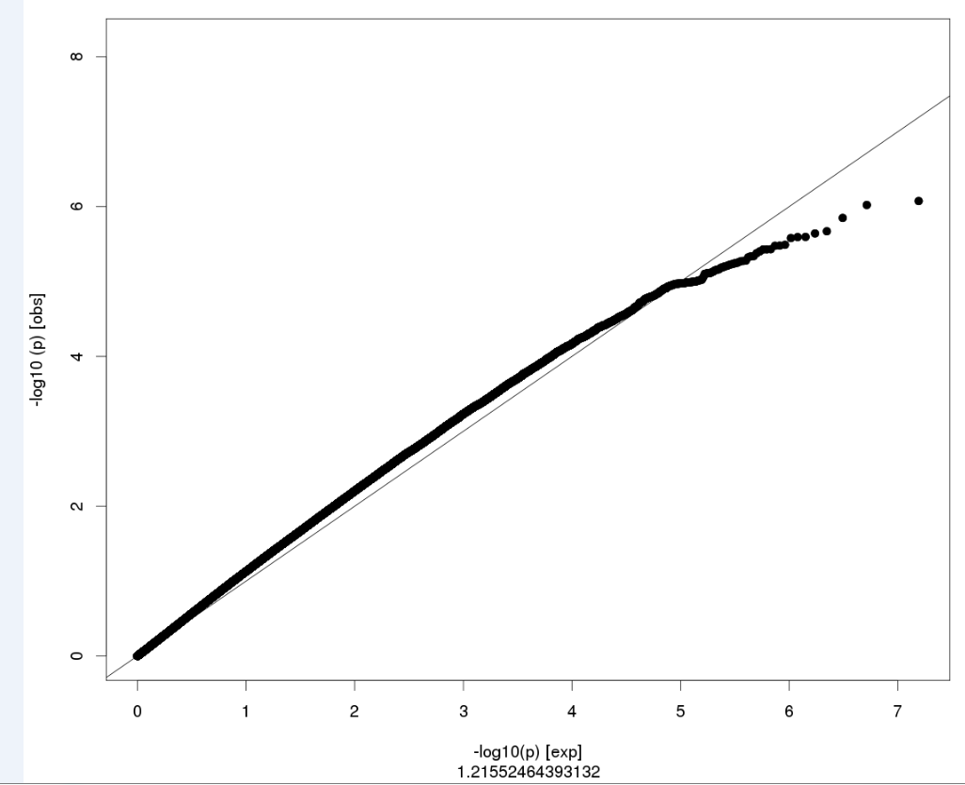

Slide 32
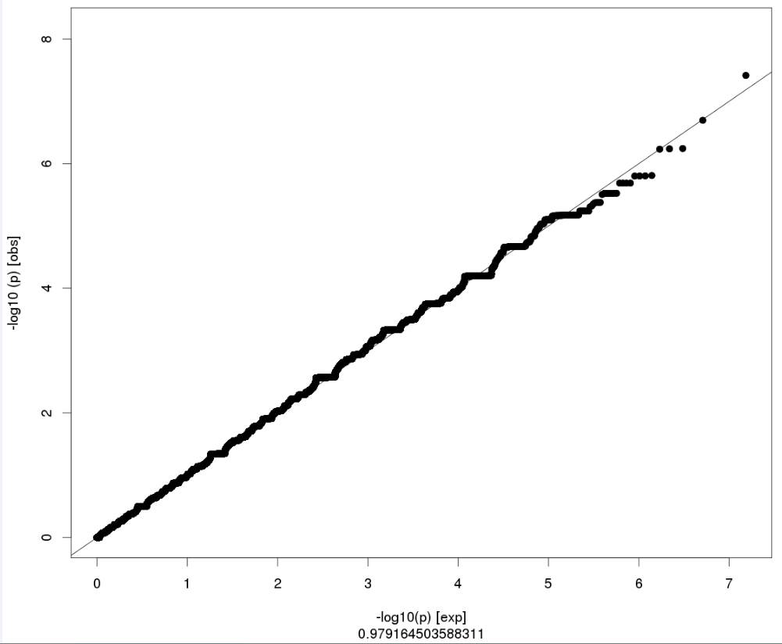

Slide 33
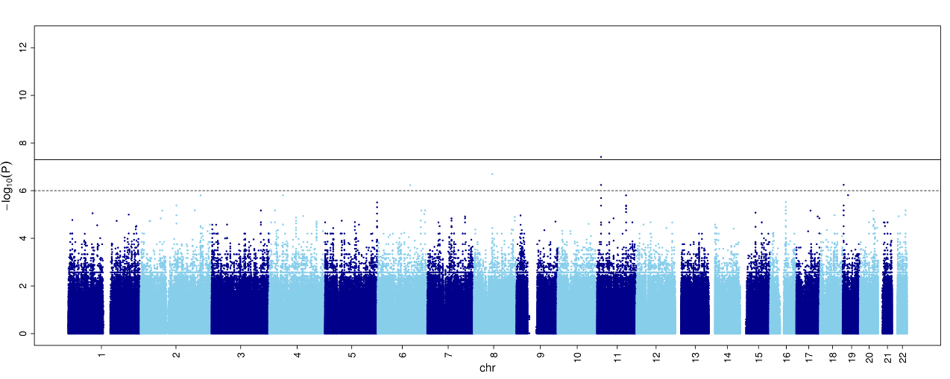

Slide 34
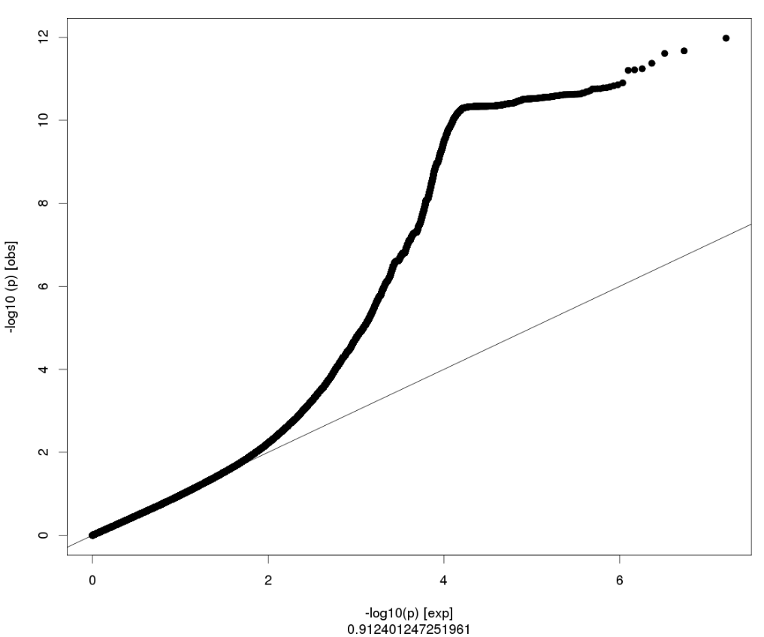

Slide 35
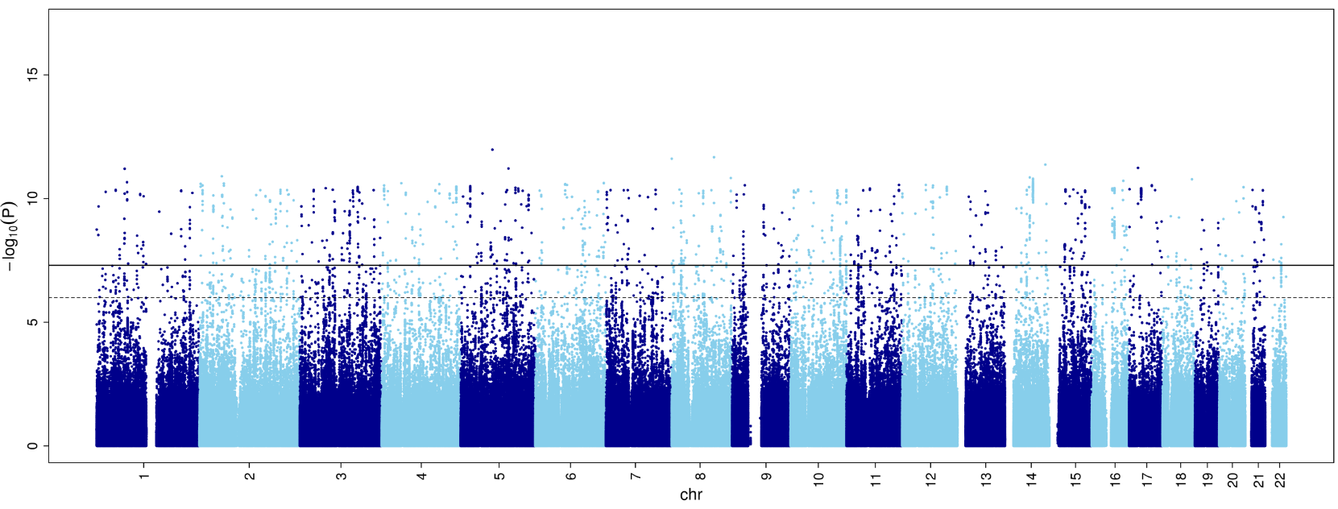

Slide 36
qqman package in R to build Manhattan and QQ plots

Slide 37
Exercise 2.3. Logistic regression with PC1-PC4 as covariates – plot the results
Use the script Rscript_qqMan.R
The script provided is ready to work with a file with no headers that will contain the chromosome, base-pair, and p-value of each SNP.
To prepare the file, do:
awk '{if (NR>1) print $1,$3,$9}’ 2.2_adclean.cc.assoc.logistic | grep –v NA
> plot_adclean.logistic.txt
plot_adclean.logistic
1 752566 0.1508
1 779322 0.2953
1 1003629 0.9347
1 1097335 0.1125
1 1130727 0.2879

Slide 38
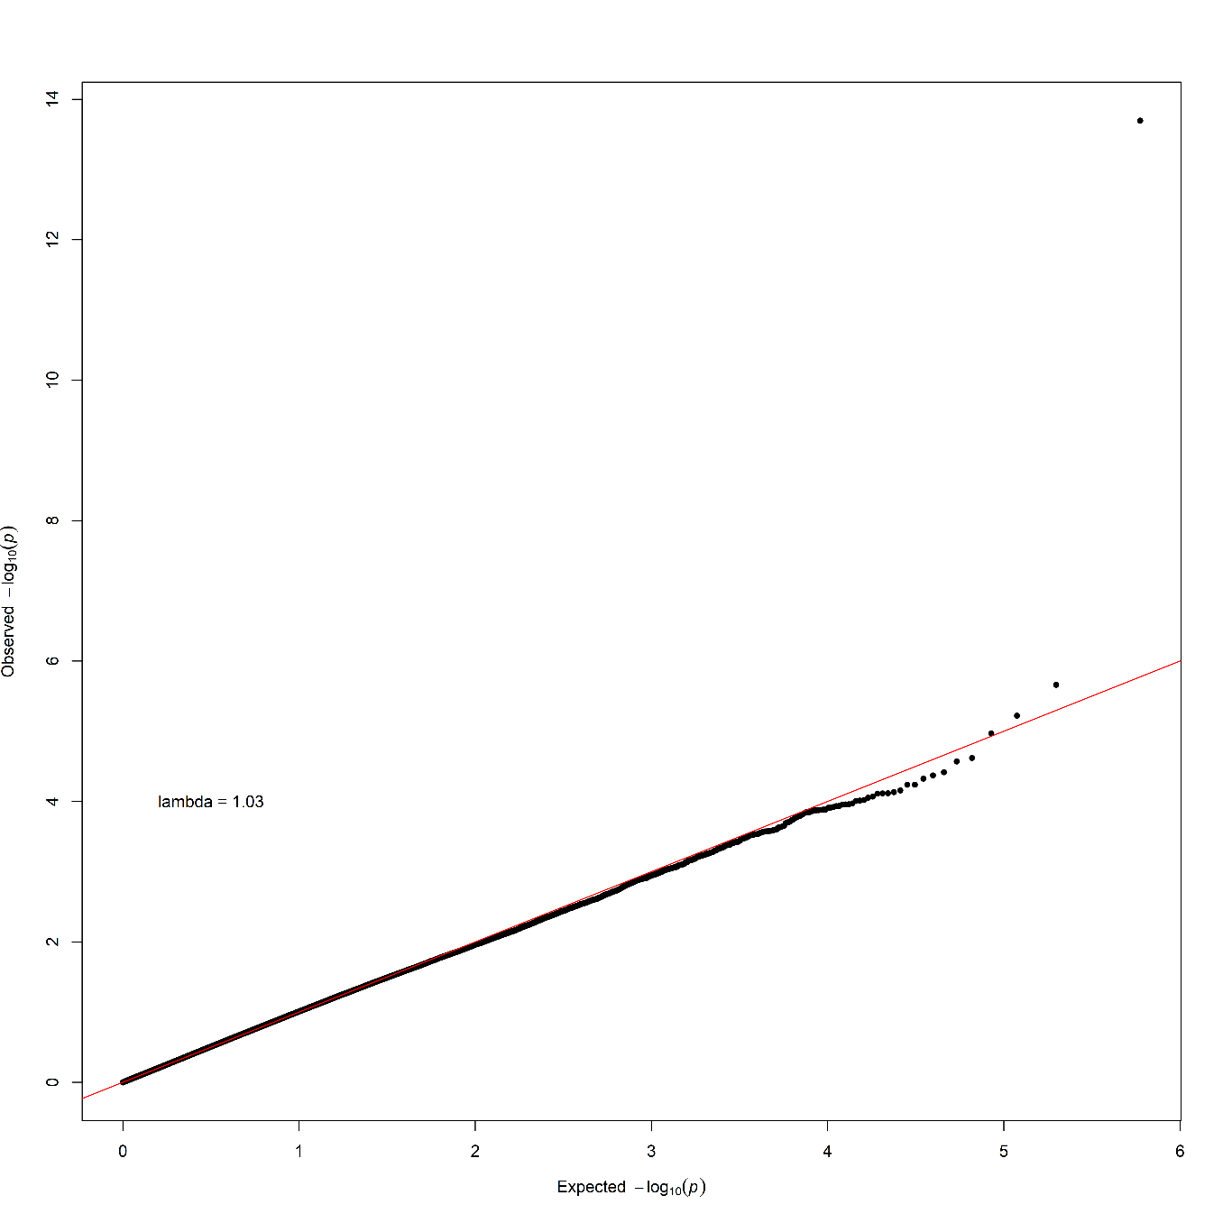
QQ plot
Logistic regression with PC1-PC4 as covariates

Slide 39
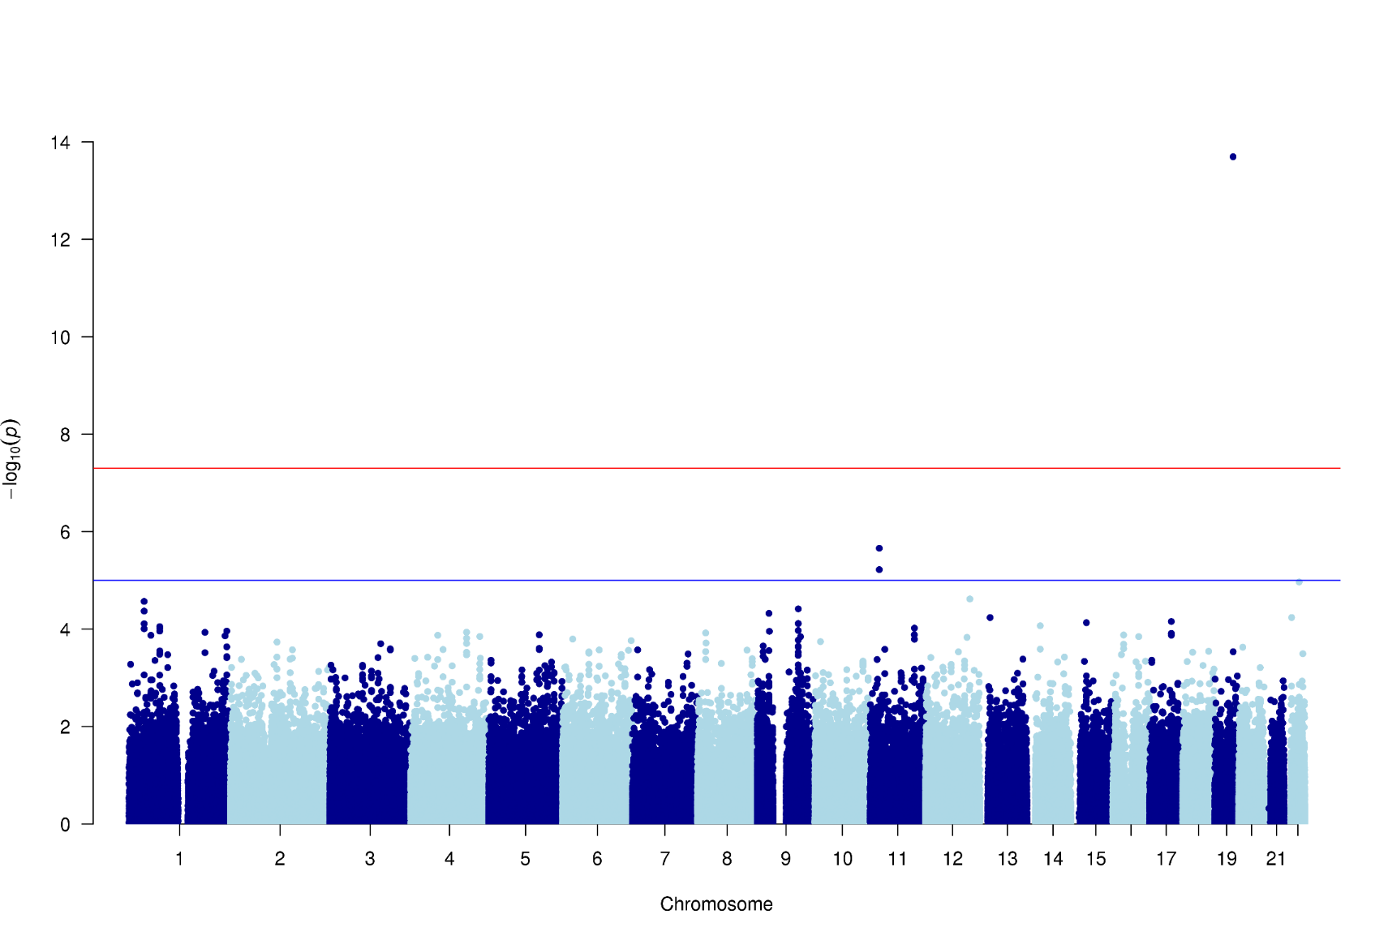
Manhattan plot
We usually expect that some of its neighbouring SNPs in LD were also associated with the phenotype
Logistic regression with PC1-PC4 as covariates

Slide 40
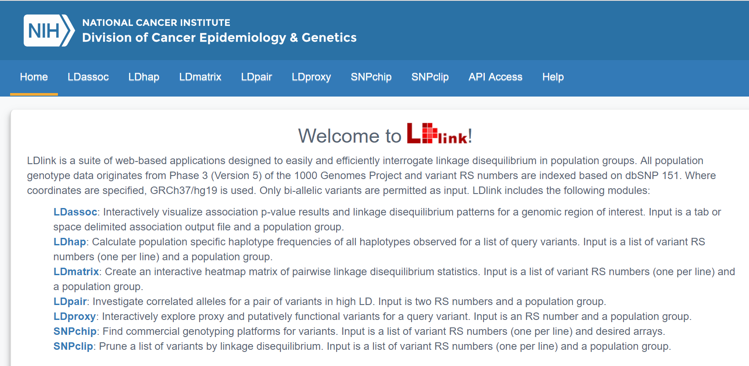
Regional plot
https://ldlink.nci.nih.gov/

Slide 41
Exercise 2.3. Logistic regression with PC1-PC4 as covariates – plot the results
To prepare the file, do:
awk '{if (NR==1 || $1==19) print $1,$3,$2,$9}' 2.2_adclean.cc.assoc.logistic | grep -v NA > ld19.adclean.cc.logistic.txt
To find the name of the SNP, do:
sort -k4 -r ld19.adclean.cc.logistic.txt | head
CHR BP SNP P
19 261033 rs8105536 0.6398
19 277776 rs11084928 0.1609
19 293934 rs1106581 0.8085
19 301639 rs4897940 0.7669
rs4420638

Slide 42
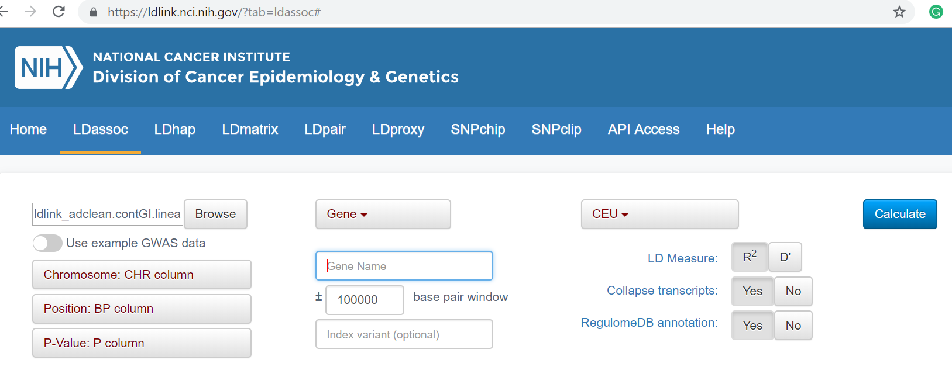

Slide 44
Exercise 3.1. Linear regression with PC1-PC4 as covariates, (hiding the covariates and using the --pheno command)
Go to the continuous folder: cd ../continuous
Have a look to the file adclean.cont.txt

Slide 45
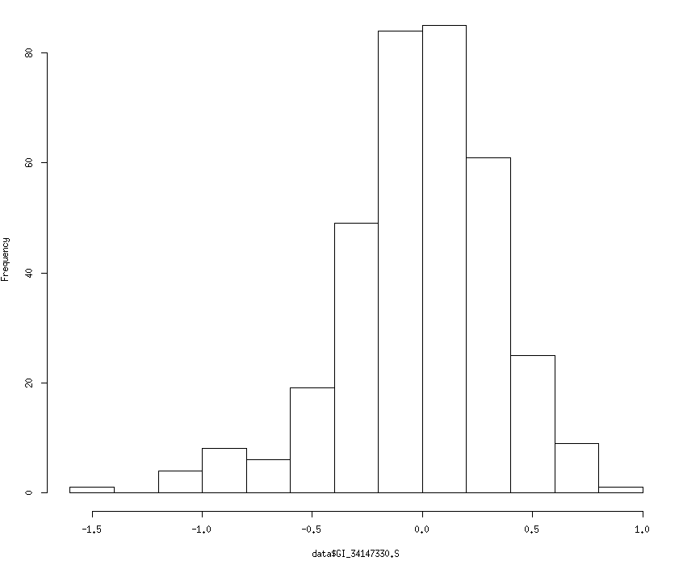
Exercise 3.1. Linear regression with PC1-PC4 as covariates, (hiding the covariates and using the --pheno command)
Go to the continuous folder: cd ../continuous
Have a look to the file adclean.cont.txt
GI_34147330-S is a transcript probe (gene expression)
n mean sd median trimmed mad min max range skew kurtosis se
352 0 0.35 0.01 0.01 0.31 -1.43 0.8 2.24 -0.62 1.11 0.02

Slide 46
Exercise 3.1. Linear regression with PC1-PC4 as covariates, (hiding the covariates and using the --pheno command)
plink
--bfile adclean.cont
-–linear hide-covar
--pheno adclean.cont.txt
--covar adpc.txt
--out 3.1_adclean.cont
The --pheno option allows for the specification of alternative (one or more) phenotypes.
When using the --pheno option, the original PED or FAM file must still contain a phenotype Column 6.
When using --linear, adding the option --standard-beta will first standard the phenotype (mean 0, unit variance), so the resulting coefficients will be standardized.

Slide 47
Exercise 3.1. Linear regression with PC1-PC4 as covariates, (hiding the covariates and using the --pheno command)
3.1_adclean.cont.log
Options in effect:
--bfile adclean.cont
--covar adpc.txt
--linear hide-covar
--out 3.1_adclean.cont
--pheno adclean.cont.txt
297237 variants loaded from .bim file.
352 people (188 males, 164 females) loaded from .fam.
352 phenotype values present after --pheno.
Using 1 thread.
Warning: This run includes BLAS/LAPACK linear algebra operations which
currently disregard the --threads limit. If this is problematic, you may want
to recompile against single-threaded BLAS/LAPACK.
--covar: 4 covariates loaded.
Before main variant filters, 352 founders and 0 nonfounders present.
Calculating allele frequencies... done.
Total genotyping rate is 0.985941.
297237 variants and 352 people pass filters and QC.
Phenotype data is quantitative.
Writing linear model association results to 3.1_adclean.cont.assoc.linear

Slide 48
Exercise 3.1. Linear regression with PC1-PC4 as covariates, (hiding the covariates and using the --pheno command)
3.1_adclean.cont.assoc.linear
CHR SNP BP A1 TEST NMISS BETA STAT P
1 rs3094315 752566 C ADD 349 -0.007604 -0.1616 0.8717
1 rs4040617 779322 G ADD 351 0.01192 0.228 0.8198
1 rs4075116 1003629 G ADD 351 0.01296 0.3529 0.7244
1 rs9442385 1097335 T ADD 350 0.0141 0.231 0.8174
1 rs10907175 1130727 C ADD 343 -0.05706 -0.8978 0.3699
1 rs6603781 1158631 T ADD 344 -0.04046 -0.8216 0.4119
1 rs11260562 1165310 T ADD 352 -0.05212 -0.6232 0.5336
1 rs6685064 1211292 T ADD 348 -0.07093 -0.9571 0.3392
1 rs307378 1268847 T ADD 349 0.07568 0.7111 0.4775

Slide 49
Exercise 3.2. Linear regression with PC1-PC4 as covariates – plot the results

Slide 50
Exercise 3.2. Linear regression with PC1-PC4 as covariates – plot the results
Use the script Rscript_qqMan.R
The script provided is ready to work with a file with no headers that will contain the chromosome, base-pair, and p-value of each SNP.
plot.adclean.cont.linear.txt
1 752566 0.1176
1 779322 0.1008
1 1003629 0.5088
1 1097335 0.7746
1 1130727 0.885
To prepare the file, do:
awk '{if (NR>1) print $1,$3,$9}’ 3.1_adclean.cont.assoc.linear | grep –v NA
> plot.adclean.cont.linear.txt

Slide 51
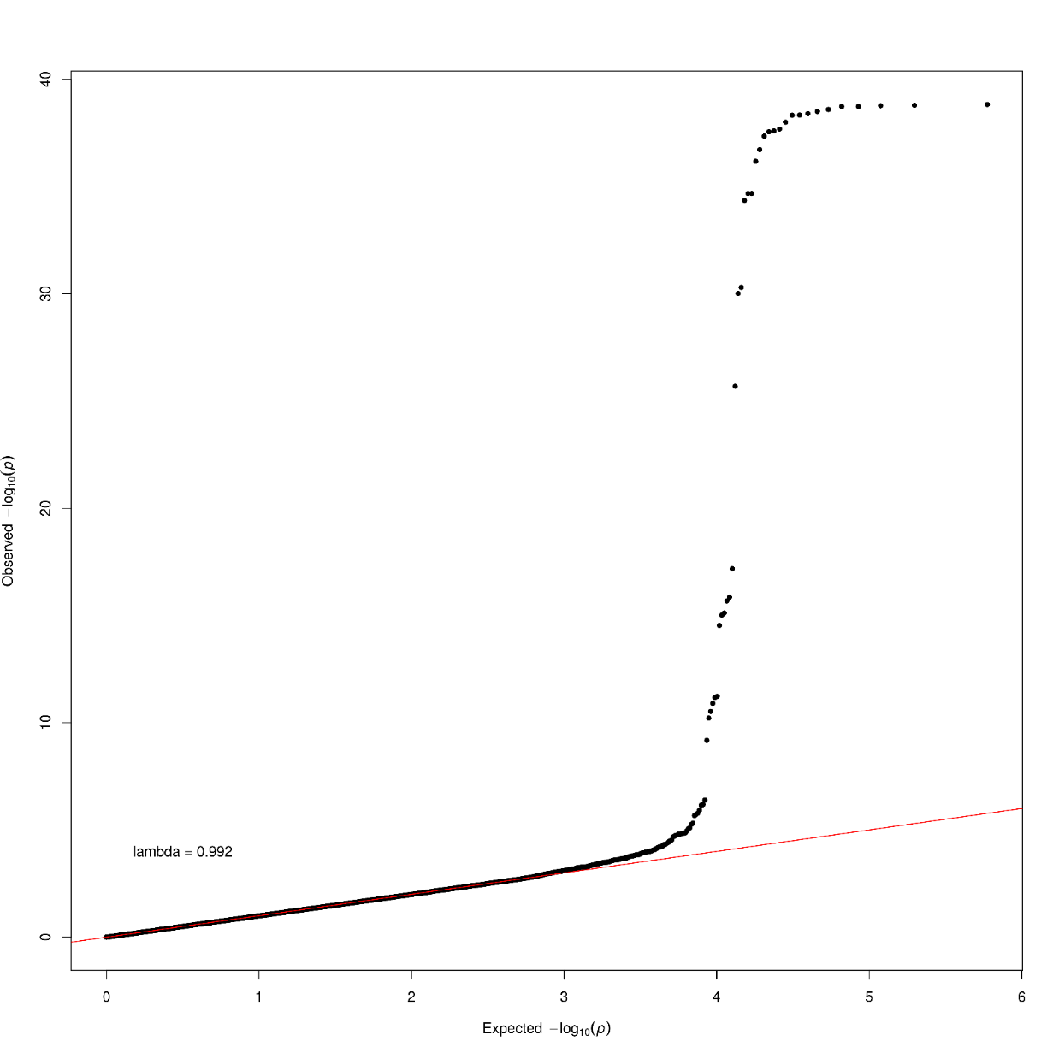
Linear regression with PC1-PC4 as covariates

Slide 52
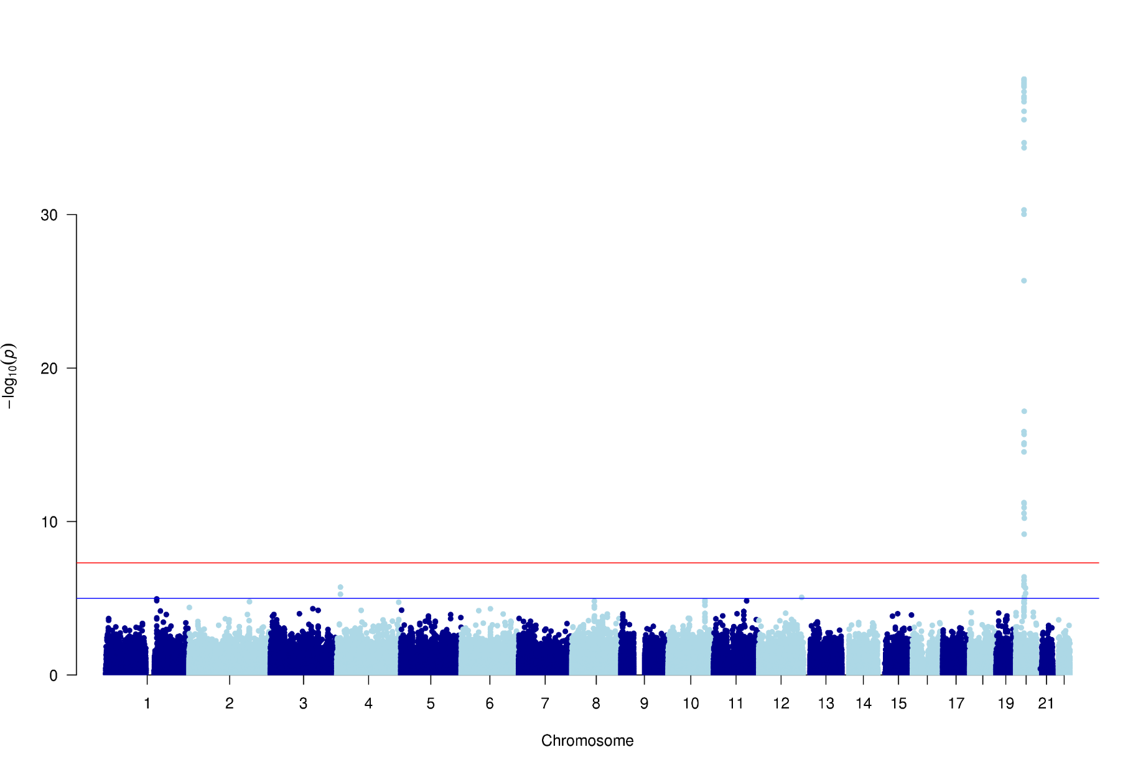
Linear regression with PC1-PC4 as covariates

Slide 53
Exercise 2.3. Logistic regression with PC1-PC4 as covariates – plot the results
To prepare the file, do:
awk '{if (NR==1 || $1==19) print $1,$3,$2,$9}' 2.2_adclean.cont.assoc.linear | grep -v NA > ld20.adclean.cont.linear.txt
To find the name of the SNP, do:
sort -k4 -r ld20.adclean.cont.linear.txt | head
CHR BP SNP P
20 69408 rs17685809 0.05855
20 109272 rs6038037 0.006237
20 134476 rs6055084 0.1093
20 138125 rs2298108 0.3534
20 138148 rs2298109 0.3534
20 138460 rs6077288 0.3176
rs6132819

Slide 54
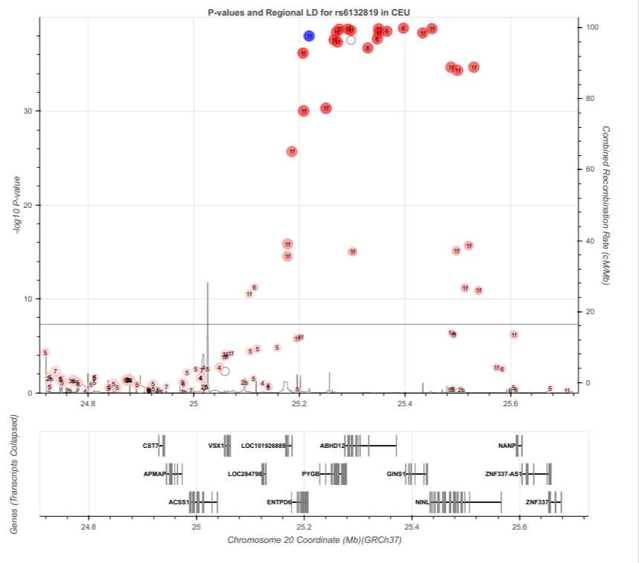

Slide 55
Exercise 3.3. Linear regression with PC1 as covariate, (hiding the covariates and using the --pheno command)
plink
--bfile adclean.cont
--linear hide-covar
--pheno adclean.cont.txt
--covar adpc.txt
--covar-name PC1
--out 3.3_adclean.cont

Slide 56
Exercise 3.3. Linear regression with PC1 as covariate, (hiding the covariates and using the --pheno command)
3.3_adclean.cont.log
Options in effect:
--bfile adclean.cont
--covar adpc.txt
--covar-name PC1
--linear hide-covar
--out 3.3_adclean.cont
--pheno adclean.cont.txt
64148 MB RAM detected; reserving 32074 MB for main workspace.
297237 variants loaded from .bim file.
352 people (188 males, 164 females) loaded from .fam.
352 phenotype values present after --pheno.
Using 1 thread.
Warning: This run includes BLAS/LAPACK linear algebra operations which
currently disregard the --threads limit. If this is problematic, you may want
to recompile against single-threaded BLAS/LAPACK.
--covar: 1 out of 4 covariates loaded.
Before main variant filters, 352 founders and 0 nonfounders present.
Calculating allele frequencies... done.
Total genotyping rate is 0.985941.
297237 variants and 352 people pass filters and QC.
Phenotype data is quantitative.
Writing linear model association results to 3.3_adclean.cont.assoc.linear ...

Slide 57
Exercise 3.3. Linear regression with PC1 as covariate, (hiding the covariates and using the --pheno command)
3.3_adclean.cont.assoc.linear
CHR SNP BP A1 TEST NMISS BETA STAT P
1 rs3094315 752566 C ADD 349 -0.0549 -1.517 0.1303
1 rs4040617 779322 G ADD 351 -0.06181 -1.538 0.1249
1 rs4075116 1003629 G ADD 351 -0.01604 -0.5652 0.5723
1 rs9442385 1097335 T ADD 350 -0.0161 -0.3403 0.7338
1 rs10907175 1130727 C ADD 343 0.001747 0.03535 0.9718
1 rs6603781 1158631 T ADD 344 -0.03843 -1.028 0.3046
1 rs11260562 1165310 T ADD 352 -0.07412 -1.155 0.2488
1 rs6685064 1211292 T ADD 348 0.0268 0.473 0.6365
1 rs307378 1268847 T ADD 349 0.07615 0.9301 0.353

