Slide 1
Introduction to common variation, quality control, GWAS, and PLINK (Part II)
Katrina Grasby and Lucia Colodro Conde

Slide 2
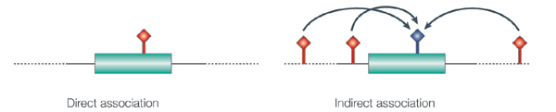
What is it?
A hypothesis free study of genetic variation across the entire human genome
Tests for genetic associations with continuous traits (e.g. height) or with the presence / absence of disease (e.g. cancer)
With a focus on low penetrance & high frequency loci
Tests indirect association
Hirschhorn & Daly. Nat Rev Genet (2014)

Slide 3
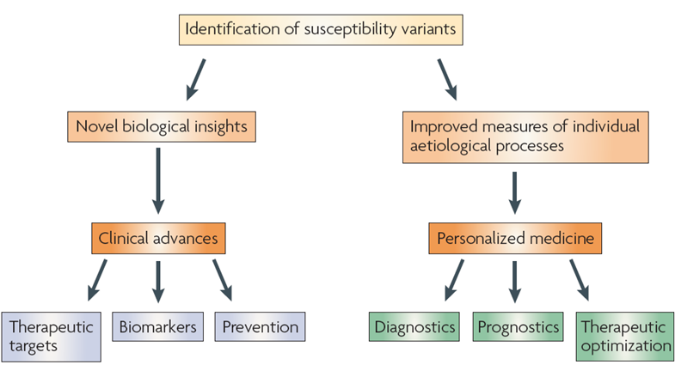
Why do it?
McCarthy et al. Nat Rev Genet (2008)

Slide 4
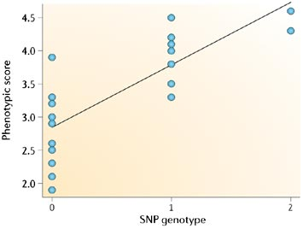
Quantitative Trait
Linear Regression
Ŷ = α + βX
Ŷ = score on phenotype
X = 0, 1 or 2 copies of allele (“G”)
β = 0 no association
β > 0 G allele increases trait
β < 0 G allele decreases trait
Balding. Nat Rev Genet (2006)
Notes:
α = intercept

Slide 5
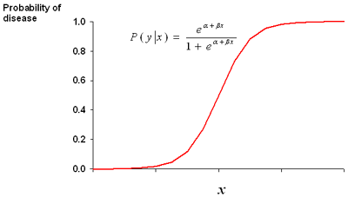
Case-Control
Logistic Regression
Controls
Cases
A/A
A/A
G/A
G/G
G/A
A/A
Allelic effect is an
Odds Ratio (OR)
OR > 1 increases risk
OR < 1 decreases risk
G/G
G/A
G/A
A/A
A/A
A/A
G/A
G/G
A/A
A/A
G/A
G/G
G/G
A/A
The G allele is associated with disease
Notes:
Controls = circles = 0; Cases = squares = 1; divide cases & controls with a logistic function
Odds of being a case given that a person has the ‘G’ allele
Taking the logarithm of the logistic function (logit) gives terms that resemble a linear regression model; ln(P/1-P) = α + βx
α = log odds for control; α + β = log odds for cases; β = difference in log odds for cases compared to controls
Taking the exponent of the log odds gives the odds; difference in odds = odds ratio; exponent of the logistic β gives the odds ratio.

Slide 6
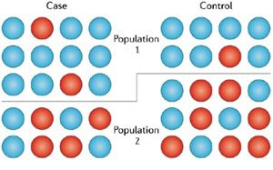
Confounders
Population Stratification
Mean trait or case frequency
differences between populations
Alleles with frequency differences
between populations
False positive / negative associations
Balding. Nat Rev Genet (2006)
Notes:
Disproportionate representation of cases in one population group, i.e. more cases in Population 1, also more blue, blue might be disease associated might be something else in population 1.

Slide 7
Multiple Testing Burden
p < 5 x 10⁻⁸
Consider ancestry
~ 1 million independent tests in Caucasians (CEU)
~ 2 million in African (YRI)
Notes:
Estimated 1 million independent tests, common SNPs in HapMap
P < 5 x10-8 for 5% alpha, based on genome-wide testing burden of common sequence variation
Higher LD (European) less independence, higher p value: Lower LD (African) more independent tests, lower p-value
CEU & YRI: 1 million testing burden in CEU & twice that in YRI
Caucasian, WTCCC

Slide 8
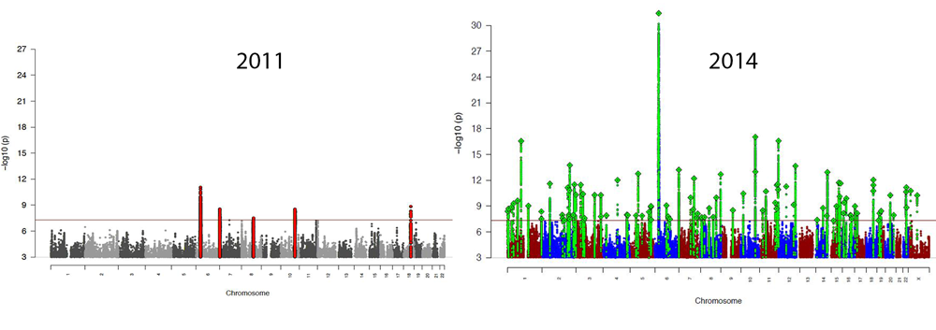
Sample Size & Power
Schizophrenia Working Group of the Psychiatric Genomics Consortium.
9,394 cases
12,462 controls
36,989 cases
113,075 controls
Notes:
Small effects = need large sample for power to detect

Slide 9
Power Calculation Tools
Consider: Effect size, Sample size, Prevalence, MAF
(more on Power later in the week)
Purcell, Cherny, & Sham. Bioinformatics, 2003
http://zzz.bwh.harvard.edu/gpc/
Johnson & Abecasis. bioRxiv, 2017
https://csg.sph.umich.edu/abecasis/gas_power_calculator/index.html

Slide 10
Replication
Run GWAS in multiple samples & meta-analyze
Replicate the just the “top hits” (i.e. p < 1e-5)
Manolio. N Engl J Med, 2010
Notes:
Replication through magnitude and direction.
Indirect association, all SNPs in high LD are potential replicates, but need to check direction of the allele effects (LD link very useful)

Slide 11
Key GWAS Findings (so far)
Thousands of genetic variants
Each has a very small effect
Large samples required
Can look at the cumulative effect…
Khera et al. Nat Gen, 2018

Slide 12
GWAS check list
Quality Control
Genotyping Call Rate, HWE, MAF, Sample Call Rate
Confounders
Population stratification, any systematic difference between cases & controls
Appropriate methods for individuals are related
mixed models (e.g. SAIGE later in the week)
Sample size large
Replication
Indirect association
be wary of over-interpreting biology, follow-up work is essential!

