Slide 1
Quality control
practical

Slide 2
Why Do Quality Control?
To remove genotyping errors
Low quality or quantity of DNA
Contaminated DNA
Chemical or machinery failure
Human error
To ensure data suitable for the analyses
Relatedness
Poor quality data false positives / negatives
Notes:
Sources of genotyping errors are many and varied:
The DNA itself, low quality DNA, low quantity DNA, artefacts, contamination, chemical processing failure, machinery failure, human errors…
Prevention steps, or at least steps to ensure errors can be identified:
Plating of cases, controls, blanks (batch effects), males & females (plate rotation), duplicates

Slide 3
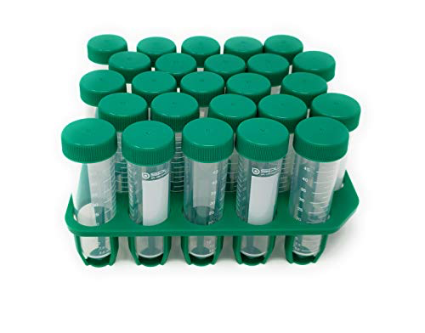
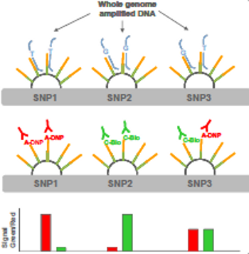
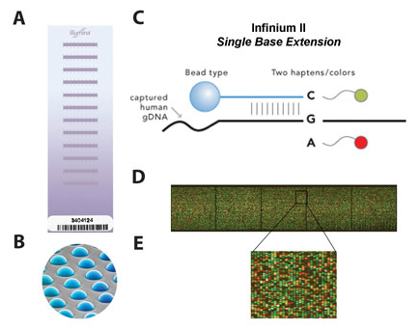
From DNA to data
Notes:
Barcoded spit kit; Manifest with ID details; Rack of tubes; Extract DNA; Aliquot some for archive, some for use; Plate some for SNP array.
SNP array beads have probes to locate genomic position; designed to fluoresce if next nucleotide is a specific base;

Slide 4
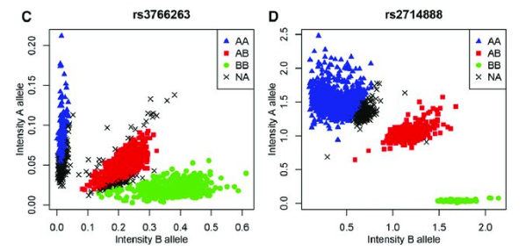
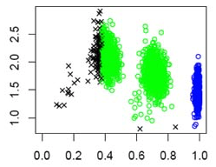
Genotyping Intensities
Notes:
Colour intensity read into genotyping code (a, c, t, g).
Top row: Ideally 3 clusters, e.g. AA AG GG; Overlap between clusters leads to missing genotype calls; If failed genotypes are biased to one allele it will biased estimates of frequencies.
Bottom row: Rare alleles; Monomorphic; Error in allele calling.
While image files are provided by genotyping company, the first genotyping quality steps are done by the genotyping company and a report returned with the genotyped data.

Slide 5
Key Steps in QC
Sex-check (chr X heterozygosity)
Genotyping Call Rate (SNPs missing individuals)
Hardy-Weinberg Equilibrium
Minor Allele Frequency
Sample Call Rate (individuals missing genotypes)
Proportion of Heterozygosity
Relatedness
Population Stratification
Notes:
Sex check compares sex of ped file with sex from genotype
Heterozygosity: excessive ~ DNA contamination, reduced ~ inbreeding
Order of QC will affect how many people or SNPs are kept/dropped

Slide 6
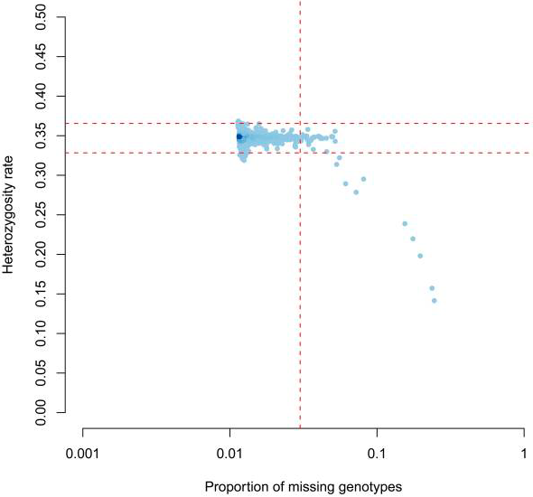
Heterozygosity vs. Missing
Anderson et al. Nat Proc. 2010
Notes:
Inappropriate inferences can be concluded about a sample based on QC,another reason why order of QC might matter.
This example shows that high rates of homozygosity can correlate with poor sample call rate.

Slide 7
Today’s Practical
http://labs.med.miami.edu/myers/LFuN/LFUN/DATA.html
193 individuals
genotypes from this published data set, but we have made up the phenotype for the purpose of this QC practical.

Slide 8
Files for practical
Data files to clean
cc.ped
cc.map
Rscript to plot data
plink-qc.R
Text file with unix & plink command
part1_practical_commands.txt

Slide 9
Check the data
The ped file contains both phenotype and genotype information.
Columns: FID IID PID MID SEX Trait SNPs…
Check coding of sex, missing data, case-control status
less -S cc.ped
awk 'NR==1{min=max=$6};$6<min{min=$6};$6>max{max=$6}END{print min,max}' cc.ped

Slide 10
Plink resources
https://www.cog-genomics.org/plink/1.9
http://zzz.bwh.harvard.edu/plink/
Default Plink coding
Male = 1, Female = 2;
Case = 1, Control = 2, Missing = -9 or 0

Slide 11
Check the data
Map file contains location/position information in the genetic variants
Columns: CHR SNP centimorgan BP
less -S cc.map

Slide 12
Check the build
https://genome.ucsc.edu

Slide 13
Remap build (if required)
https://genome.ucsc.edu/cgi-bin/hgLiftOver

Slide 14
Plink file format --bfile
Plink has a binary file format for genotyped data that reduces the size of the ped file.
Converting to bfile format holds the phenotypic and genetic data in 3 files.
The phenotype information is contained in the .fam file
The genotype data is converted into a binary form and saved in the .bed file
The map file is converted to a .bim file, which in addition to the position information it includes the alleles.

Slide 15
Convert file format to bfile
plink --ped cc.ped --map cc.map --make-bed --out cc.begin
Errors in Plink will stop progress, warnings are for you to make decisions about
Warning: 2177 het. haploid genotypes present (see cc.begin.hh )
Heterozygous haploid errors may be pseudo-autosomal region of chr X, if they are can use the split-x fcommand
First we will check for sex errors in the data.

Slide 16
Check sex
plink --bfile cc.begin --check-sex --out sex
less sex.sexcheck
Checking sex early in QC can be a useful to see if there has been a plate rotation in the genotyping.
check-sex is a heterozygosity check of chr X
Males have one chr X, females have 2
The F statistic is the probability an individual inherited two identical alleles from a single ancestor.
In the case of males this should be close to 1, for females it should be close to 0.
Notes:
F < 0.2 = female calls, F > 0.8 = male calls

Slide 17
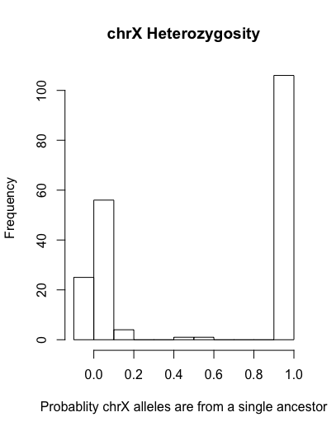
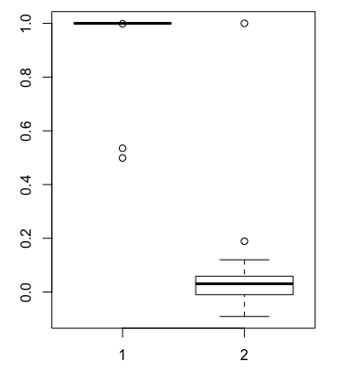
Plot Sex (plink-qc.R)

Slide 18
Remove IDs mismatched on sex
Select the 3 individuals flagged as not a match between reported and genotyped sex
Remove those individuals
plink --bfile cc.begin --remove sex.drop --make-bed --out cc.qc1
grep PROBLEM sex.sexcheck > sex.drop
plink --bfile cc.begin --remove sex.drop --make-bed --out cc.qc1

Slide 19
het haploid
Use split-x to see if the remaining issues are due to the pseudo-autosomal regions
To check chromosome, this awk code will match on the chromosome from the bim file to the remaining het.haploid variants
plink --bfile cc.qc1 --split-x b37 no-fail --make-bed --out cc.qc2
awk 'NR==FNR{a[$2]=$1; next} $3 in a{print $0,a[$3]}' cc.begin.bim cc.qc2.hh > check.hh

Slide 20
het haploid
Set the remaining het haploid issues to missing
These will be excluded from analysis anyway.
plink --bfile cc.qc2 --set-hh-missing --make-bed --out cc.qc3

Slide 21
Create files for plotting
Obtain heterozygosity information (this is across chr 1-22)
Create file with the proportion of heterozygosity for each person.
plink --bfile cc.qc3 --het --out het
echo "FID IID obs_HOM N_SNPs prop_HET" > het.txt
awk 'NR>1{print $1,$2,$3,$5,($5-$3)/$5}' het.het >> het.txt

Slide 22
Call Rate / Missingness
Sample = Individuals missing genotypes
Genotyping = variants missing data from individuals
Obtain missingness on individuals and on SNPs
Create a file that holds both proportion of heterozygosity and individual missingness (for plotting)
plink --bfile cc.qc3 --missing --out miss
awk 'NR==FNR{a[$1,$2]=$5;next}($1,$2) in a{print $1,$2,$6,a[$1,$2]}' het.txt miss.imiss > het.imiss.txt

Slide 23
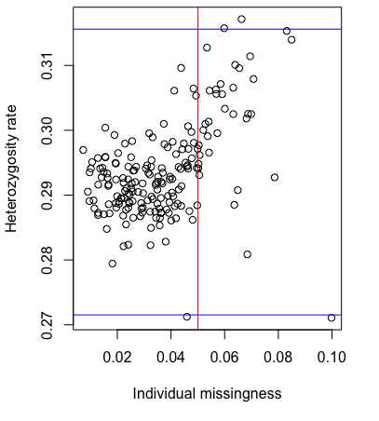
Plot Heterozygosity by Sample Call Rate

Slide 24
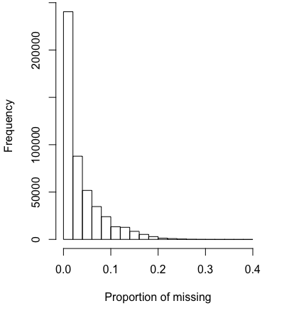
Genotyping Call Rate
Plot SNP call rate, variants with proportion of data missing

Slide 25
Genotyping Call Rate
Remove variants that are missing too much data from individuals
plink --bfile cc.qc3 --geno 0.05 --make-bed --out cc.qc4

Slide 26
Genotyping Call Rate by Case-Control
With Case-Control data check that SNP call rate is not significantly different between cases and controls
This awk code will copy any variants that differ in missingness with a p value < .00001 into a file that can be used to exclude them
plink --bfile cc.qc4 --test-missing --out case-control
awk '$5<=0.00001' case-control.missing > case-control.missing.drop

Slide 27
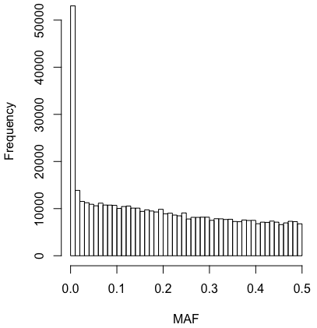
MAF
Obtain MAF information
plink --bfile cc.qc3 --freq --out maf

Slide 28
Hardy-Weinberg Equilibrium
The default HWE check on case-control data is to only conduct the check on the controls.
We have overwritten that here with the [include-nonctrl] flag.
MAF of .01 in a sample of 190 = MAC of 3.8
….(a bit liberal)
plink --bfile cc.qc4 --maf 0.01 --hwe 1e-6 include-nonctrl --make-bed --out cc.qc5

Slide 29
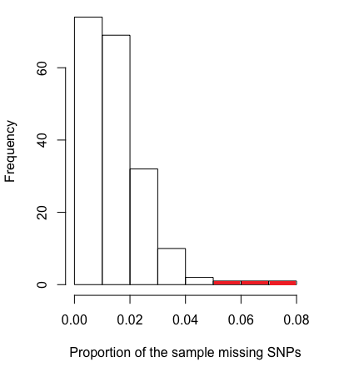
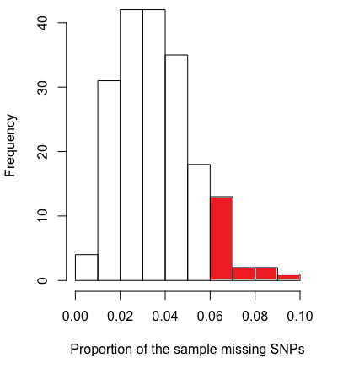
Sample Call Rate
Before QC on genotypes
After QC on genotypes
Notes:
Do before and after QC on geno, maf, hwe

Slide 30
Sample Call Rate
Remove individuals that are still missing information on more than 5% of the variants
Obtain the heterozygosity scores now that the data variant have been cleaned.
plink --bfile cc.qc5 --mind 0.05 --make-bed --out cc.qc6
plink --bfile cc.qc6 --het --out het2

Slide 31
Heterozygosity
Obtain +/- 3SD cut off for heterozygosity
First obtain the proportion of heterozygosity per person
This awk code will give +3SD and -3SD for a file with a header
echo "FID IID obs_HOM N_SNPs prop_HET" > het2.txt
awk 'NR>1{print $1,$2,$3,$5,($5-$3)/$5}' het2.het >> het2.txt)}' het2.txt
awk 'NR>1{sum+=$5;sq+=$5^2}END{avg=sum/(NR-1);print avg-3*(sqrt(sq/(NR-2)-2*avg*(sum/(NR-2))+(((NR-1)*(avg^2))/(NR-2)))),avg+3*(sqrt(sq/(NR-2)-2*avg*(sum/(NR-2))+(((NR-1)*(avg^2))/(NR-2))))}' het2.txt

Slide 32
Heterozygosity
Copy the individuals outside 3SD from the mean heterozygosity score into a file
Drop those participants
awk '$5<=0.29957 || $5>= 0.326526' het2.txt > het.drop
plink --bfile cc.qc6 --remove het.drop --make-bed --out cc.clean

Slide 33
Relatedness
Prune the SNPs and select chr 1-22
Calculate identity by descent (IBD) on those pruned SNPs
plink --bfile cc.clean --chr 1-22 --indep-pairwise 1000 5 0.2 --out indep
plink --bfile cc.clean --extract indep.prune.in --genome --out ibd

Slide 34
Relatedness
Have a look at the Identity by descent results
Z0 Z1 Z2 = the pair of IDs share 0, 1 or 2 alleles by descent
1,0,0 = unrelated (ideallistic)
0,1,0 = parent-child
.25,.5,.25 = siblings etc
pihat = proportion IBD = P(IBD=2)+0.5*P(IBD=1)
0 = unrelated
.5 = parent-child or siblings
.125 = cousins
less ibd.genome

Slide 35
Relatedness
Obtain a list of individuals related more than a pihat of .2
Check them in the file pihat.genome
plink --bfile cc.clean --extract indep.prune.in --genome --min 0.2 --out pihat
less pihat.genome

Slide 36
Population Stratification
Systematic differences in allele frequency across populations
Principal components (PC) is one method to decompose the variation in allele frequency into components that describe the population structure
PCs can be included as covariates in GWAS as a way to control for population structure as a confounder.
(more on this Tuesday morning)

